Slide 1
August 2026
Research Seminar
A gated MLIP-to-DFT screening cascade for LPSCl modification
From curated substitutions to auditable decisions
Yonghoon An
Division of Materials Science & Engineering, Hanyang University
(E-mail : yonghoon71@hanyang.ac.kr)
MLIP screening · physical gates · targeted validation
HANYANG UNIVERSITY
Notes:
오늘 발표는 특정 첨가제를 하나 골랐다는 이야기가 아니에요. LPSCl 치환 후보를 빠르게 줄이면서도 어떤 문장까지 허용되는지 계산 단계마다 제한하는 cascade를 보여드릴게요. 핵심 결과는 후보 하나보다, 버전이 고정된 47종 스냅샷과 11종 비교 집합, 그리고 다음 계산을 고르는 규칙이에요.
[Sources]
- docs/cascade_pipeline_guide.md
- kb/seminars/cascade_seminar_2026_08_spec.md
[/Sources]

Slide 2
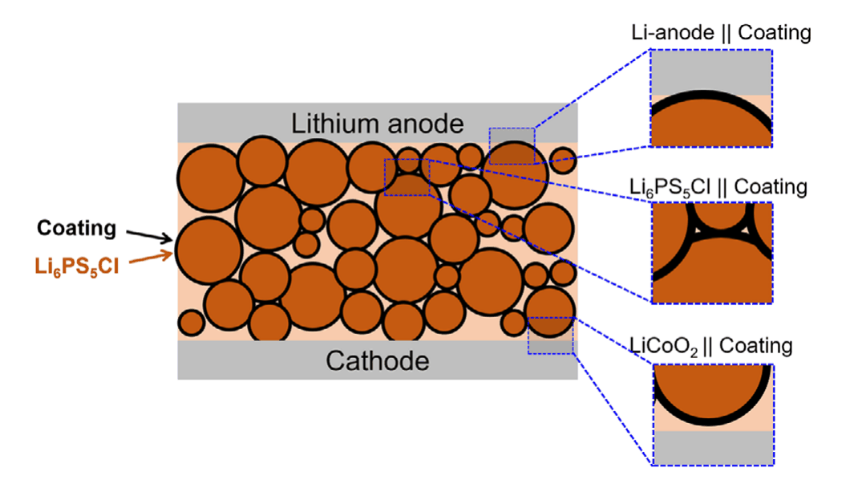
Context
LPSCl modification problem
One repair must survive several sulfide interfaces
Oxidation
S-derived states limit the cathode side.
Interface
One coating meets Li, LPSCl, and cathode chemistries.
Contact & mechanics
Pressure and particle contact change the response.
Literature schematic; coating ≠ lattice substitution (Sundar et al., Adv. Sci. 2025, Fig. 1)
There is no single repair knob — and no single screening metric.
Coating Substitution Composite Processing
HANYANG UNIVERSITY
Battery Materials Lab.
2
Notes:
LPSCl은 전도도만 좋으면 끝나는 재료가 아니에요. 산화 안정성, Li·전해질·양극 계면, 접촉과 공정성이 동시에 걸려 있어요. 그래서 coating, 치환, 복합화, 공정 제어 중 어느 하나만으로 모든 문제를 해결하기 어렵고, 후보를 여러 축으로 동시에 보는 구조가 필요해요.
[Sources]
- litdb/papers/sundar2025_oxide_coating_screening_lpscl.md
- litdb/figures/sundar2025_oxide_coating_screening_lpscl/figures.json
- docs/cascade_pipeline_guide.md
[/Sources]

Slide 3
Motivation
Campaign design record
Substitution turns one material into hundreds of decisions
Dopant chemistry
Which element or compound?
Campaign label
x002 / x005 / x010; actual x unresolved
Configuration
Where are defects placed?
Target properties
Stability · transport · mechanics
×
×
×
91
curated compounds
3
campaign labels
273
campaign run slots
×
=
Element labels alone do not predict the effect.
Source: cascade_seminar_pool_attrition_273_to_47.csv · nominal campaign labels
HANYANG UNIVERSITY
Battery Materials Lab.
3
Notes:
여기서 273은 후보 물질 수가 아니에요. 수동으로 고른 91종에 x002, x005, x010이라는 세 campaign label을 붙인 273개 실행 슬롯이에요. 실제 조성 x는 아직 provenance가 닫히지 않았기 때문에, 이 라벨을 2·5·10%로 번역하지 않아요.
[Sources]
- db/properties/cascade_seminar_pool_attrition_273_to_47.csv
- docs/reviews/cascade_db_ml_readiness_audit_2026_08_10.md
[/Sources]

Slide 4
Cascade
Decision architecture
A cascade spends precision only where it matters
1 CURATE
Chemical priors
Literature and database
Candidate count ↓
2 SCREEN
Same-protocol MLIP
and low-cost proxies
3 GATE
Reject physically
unsafe candidates
Cost and precision ↑
4 VALIDATE
Targeted DFT
and experiment
Computation narrows experiments; it does not replace them.
HANYANG UNIVERSITY
Battery Materials Lab.
4
Notes:
Cascade는 계산을 많이 하는 방법이라기보다 비용을 배치하는 방법이에요. 문헌과 DB에서 후보를 만들고, UMA와 정적 proxy로 넓게 훑고, 물리 gate로 위험한 해석을 막은 뒤, 선택된 후보에만 DFT와 실험을 써요. 각 단계의 값에는 method, source, status가 같이 따라가야 해요.
[Sources]
- docs/cascade_pipeline_guide.md
[/Sources]

Slide 5
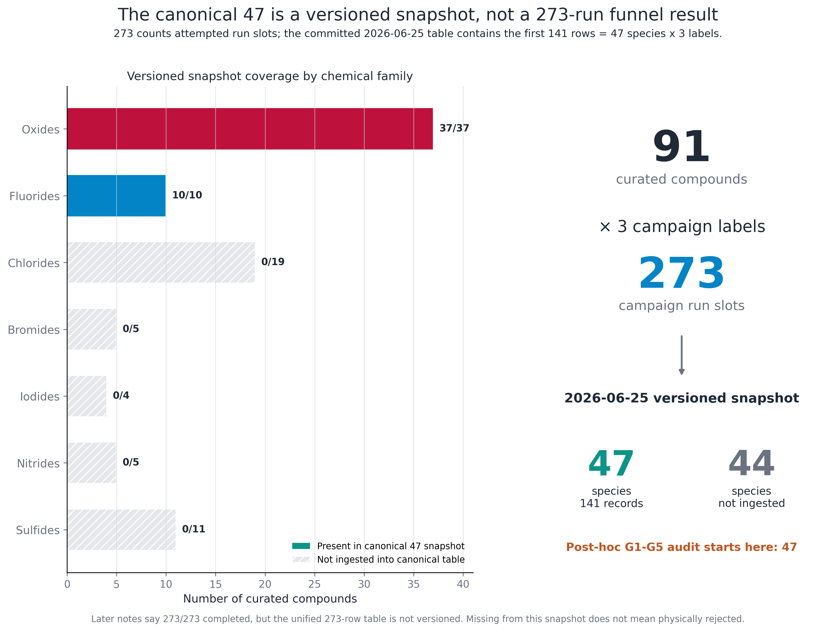
Cascade
Pool provenance · versioned lineage
Roster: 91 species × 3 nominal labels = 273 attempted slots | Snapshot: 47 species × 3 = 141 ingested records
Source: cascade_seminar_pool_attrition_273_to_47.csv · DB readiness audit
HANYANG UNIVERSITY
Battery Materials Lab.
5
Notes:
273에서 물리 gate를 거쳐 47이 된 게 아니에요. 2026년 6월 25일에 versioned table로 들어온 건 oxide 37종과 fluoride 10종, 모두 141개 기록이에요. 나머지 44종은 canonical table에 들어오지 않았고, 전종별 실패 manifest가 없으므로 탈락이나 실패로 부르지 않아요. Post-hoc gate audit는 오른쪽의 47종에서 시작해요.
[Sources]
- db/properties/cascade_seminar_pool_attrition_273_to_47.csv
- docs/reviews/cascade_db_ml_readiness_audit_2026_08_10.md
[/Sources]

Slide 6
Cascade
The 47-species snapshot, by chemical family
What we actually explored — a cast list, not a ranking
Transition metal (23)
Ag₂O · CoO · Cr₂O₃ · CrO₃ · Cu₂O · Fe₂O₃ · HfO₂ · MnO · MoO₃ · Nb₂O₅ · NiO · Sc₂O₃ · ScF₃ · Ta₂O₅ · TiF₄ · TiO₂ · V₂O₅ · WO₃ · Y₂O₃ · YF₃ · ZnO · ZrF₄ · ZrO₂
Main group (9)
Alkaline earth (6)
Al₂O₃ · AlF₃ · B₂O₃† · Ga₂O₃ · GeO₂ · In₂O₃ · Sb₂O₅ · SiO₂ · SnO₂
BaO · CaF₂ · CaO · MgF₂ · MgO · SrO
Lanthanide (6)
Alkali (3)
bold = retained through the post-hoc G4 audit (11) † = targeted deep-DFT case study (2) 37 oxides + 10 fluorides, versioned 2026-06-25
Gd₂O₃ · La₂O₃ · LaF₃ · Nd₂O₃† · NdF₃ · Sm₂O₃
Li₂O · LiF · Na₂O
A curated snapshot to explore — membership here is not a gate result.
Source: cascade_seminar_scorecard_47.csv · cascade_v23_ranked.csv
HANYANG UNIVERSITY
Battery Materials Lab.
6
Notes:
이 장은 순위표가 아니라 실제로 canonical snapshot에 들어온 47종 전체 명단이에요. 굵은 글씨는 post-hoc G1–G4 endpoint에 남은 11종이고, 십자가 표시는 targeted deep-DFT case 두 종이에요. 명단에 있다는 사실과 gate를 통과했다는 사실을 분리해서 보시면 돼요.
[Sources]
- db/properties/cascade_seminar_scorecard_47.csv
- db/properties/cascade_v23_ranked.csv
[/Sources]

Slide 7
Pipeline
Same protocol within each tier
Search, validation, and interpretation are different jobs
L0 CURATED INPUT
Composition · concentration
configuration · provenance
L1 LOW-COST SCREEN
UMA relaxation
BVSE and derived axes
L2 MATCHED DFT
Selected candidates only
energy · force · electronics
L3 EXPERIMENT
Phase purity · sigma(T)
stability · processing
Protocol tag + source file + status travel with every value
Current scope: 47 relative screens; targeted DFT validation covers 2 candidates.
HANYANG UNIVERSITY
Battery Materials Lab.
7
Notes:
같은 숫자라도 계산 층위가 다르면 주장 강도가 달라져요. UMA는 같은 프로토콜 안의 상대적인 구조·에너지 탐색, BVSE는 정적 경로 geometry, DFT는 선택 후보의 matched validation, 실험은 최종 거동 확인에 써요. 위층의 결과를 아래층의 절대 물성처럼 말하지 않는 게 첫 번째 방어선이에요.
[Sources]
- docs/cascade_pipeline_guide.md
- kb/methodology/terminology_register.md
[/Sources]

Slide 8
Evidence
Canonical registry · same-protocol values
LPSCl taught us which descriptors to watch
Electronic guard
Eg = 2.066 vs 2.099 eV
Δ = 0.033 eV
Fixed-occupation eigenvalues
Structural contrast
Li vacancies
4d-Cl anti-sites
Disorder, not a new chemistry
Transport evidence
Cl-rich modelc: Ea = 0.197 ± 0.032 eV
3-seed, 600/800/1000 K
No citable comp1 Ea
Structural descriptors first; electronics remain a guardrail.
Gap values are canonical; lineage-specific fixed-occ run files remain provenance-open.
Source: electronic.json · canonical_registry.json
HANYANG UNIVERSITY
Battery Materials Lab.
8
Notes:
Webapp에는 산화, 환원, 전자 절연, 경로, 기계, 공기 안정성, 비용과 질량 등 14개 관점이 있어요. 하지만 이 축들은 계산·문헌·큐레이션이 섞여 있으므로 한 점수로 합쳐 winner를 만들지 않아요. 각 질문 안에서만 같은 축을 묶고, missing은 0점이 아니라 제외와 표시로 다뤄요.
[Sources]
- db/properties/cascade_v23_themes.json
- webapp/templates/cascade.html
- docs/cascade_pipeline_guide.md
[/Sources]

Slide 9
Cascade
G1-G4 physical · G5 ranking-only
Five gates ask five different questions
G1
Structure
Lower UMA-relative score than host?
mean ΔE < 0
G2
Window
Does the ESW collapse?
window ≥ 0.05 V
G3
Oxidation
Worse than host onset?
Vox ≥ 2.14 V
G4
Li pathway
Is the static pathway retained?
transport_norm > 0.30
AND blocking < 0.60
G5*
Mechanics
How do survivors rank?
roster medians
G4 is also heuristic: blocking < 0.6 has no host/literature anchor. G5 is roster-relative ranking.
Source: cascade_screening_funnel.json (gates)
HANYANG UNIVERSITY
Battery Materials Lab.
9
Notes:
G1은 host 대비 상대 안정성, G2는 window collapse, G3는 host oxidation onset, G4는 정적 Li-path proxy를 봐요. G4는 transport_norm과 blocking 두 조건을 함께 쓰지만 둘 다 heuristic이고, 특히 blocking 0.60에는 host나 문헌 anchor가 없어요. G5는 11종 안의 roster-relative mechanics ranking일 뿐 hard gate가 아니에요.
[Sources]
- db/properties/cascade_screening_funnel.json
- docs/cascade_pipeline_guide.md
[/Sources]

Slide 10
Cascade
Post-hoc literature-mapped gate view
The auditable hard-gate view stops at 11
DATA-COMPLETE
47
G1 STRUCTURE
47
G2 WINDOW
43
G3 OXIDATION
25
G4 LI TRANSPORT
11
G5 mechanical ranking → 1*
* This funnel is a post-hoc analysis view. G4 is heuristic; G5 is ranking-only.
Source: cascade_screening_funnel.json (waterfall)
HANYANG UNIVERSITY
Battery Materials Lab.
10
Notes:
47종에서 G1은 아무도 제거하지 않고, G2와 G3를 거치면 25종, G4까지 적용하면 11종이 남아요. 이 11종을 비교용 endpoint로 보고하고, G5의 1종은 별표가 붙은 선호 정렬로만 남겨요. 이 funnel 자체가 문헌 기준을 뒤에서 매핑한 post-hoc audit라는 점도 같이 표시해요.
[Sources]
- db/properties/cascade_screening_funnel.json
[/Sources]

Slide 11
Audit
Standalone kill · unique kill
Two gates reveal more about the pool than the candidates
G1: 47 / 47 pass
VACUOUS
No selection pressure in the curated pool.
This does not prove universal stability.
G2: unique kill = 0
REDUNDANT
Four window-collapse failures (CoO, Fe₂O₃, MnO, NiO) also fail G3.
The same four late-TM oxides fail both gates.
Keep the records. Change the interpretation. Gate auditing is itself a scientific result.
Source: cascade_screening_funnel.json (gate_power) · pipeline guide
HANYANG UNIVERSITY
Battery Materials Lab.
11
Notes:
G1은 47종 모두 통과해서 이 pool에서는 선택 압력이 없어요. G2가 단독으로 잡는 네 종은 전부 G3에서도 탈락하므로 unique kill은 0이에요. 이걸 숨기지 않고 gate가 vacuous 또는 redundant였다고 보고하면, 다음 버전에서 threshold와 데이터 수집을 어디서 바꿔야 하는지 알 수 있어요.
[Sources]
- db/properties/cascade_screening_funnel.json
- docs/cascade_pipeline_guide.md
[/Sources]

Slide 12
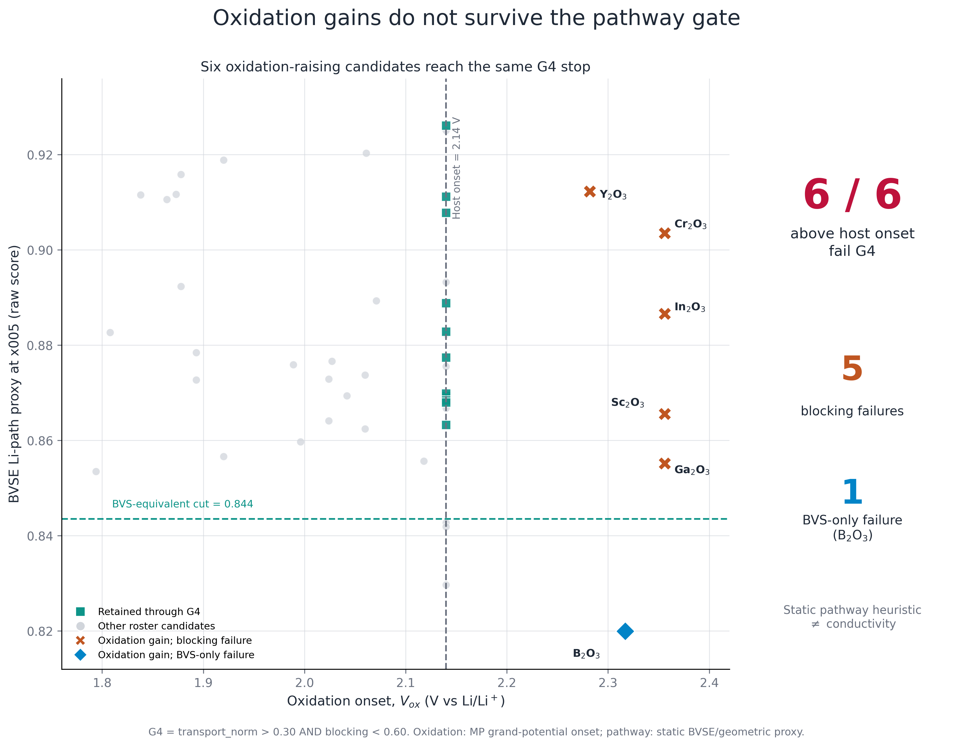
Result
47-species snapshot · static pathway audit
All six oxidation-raising candidates stop at the same static pathway heuristic — a dataset-level trade-off, not causal proof of M–O blocking
Source: cascade_seminar_oxidation_transport_47.csv (6/6 verified)
HANYANG UNIVERSITY
Battery Materials Lab.
12
Notes:
Oxidation onset을 올리는 여섯 후보가 이 스냅샷에서는 모두 G4의 정적 pathway heuristic에서 멈춰요. 이건 dataset-level trade-off이지, M–O 결합이 Li blocking을 원인적으로 만든다는 증명은 아니에요. 따라서 보완성이 있는 후보를 co-doping 가설로 넘길 수는 있지만 자동으로 좋은 조합이라고 부르지는 않아요.
[Sources]
- db/properties/cascade_seminar_oxidation_transport_47.csv
- db/properties/cascade_screening_funnel.json
[/Sources]

Slide 13
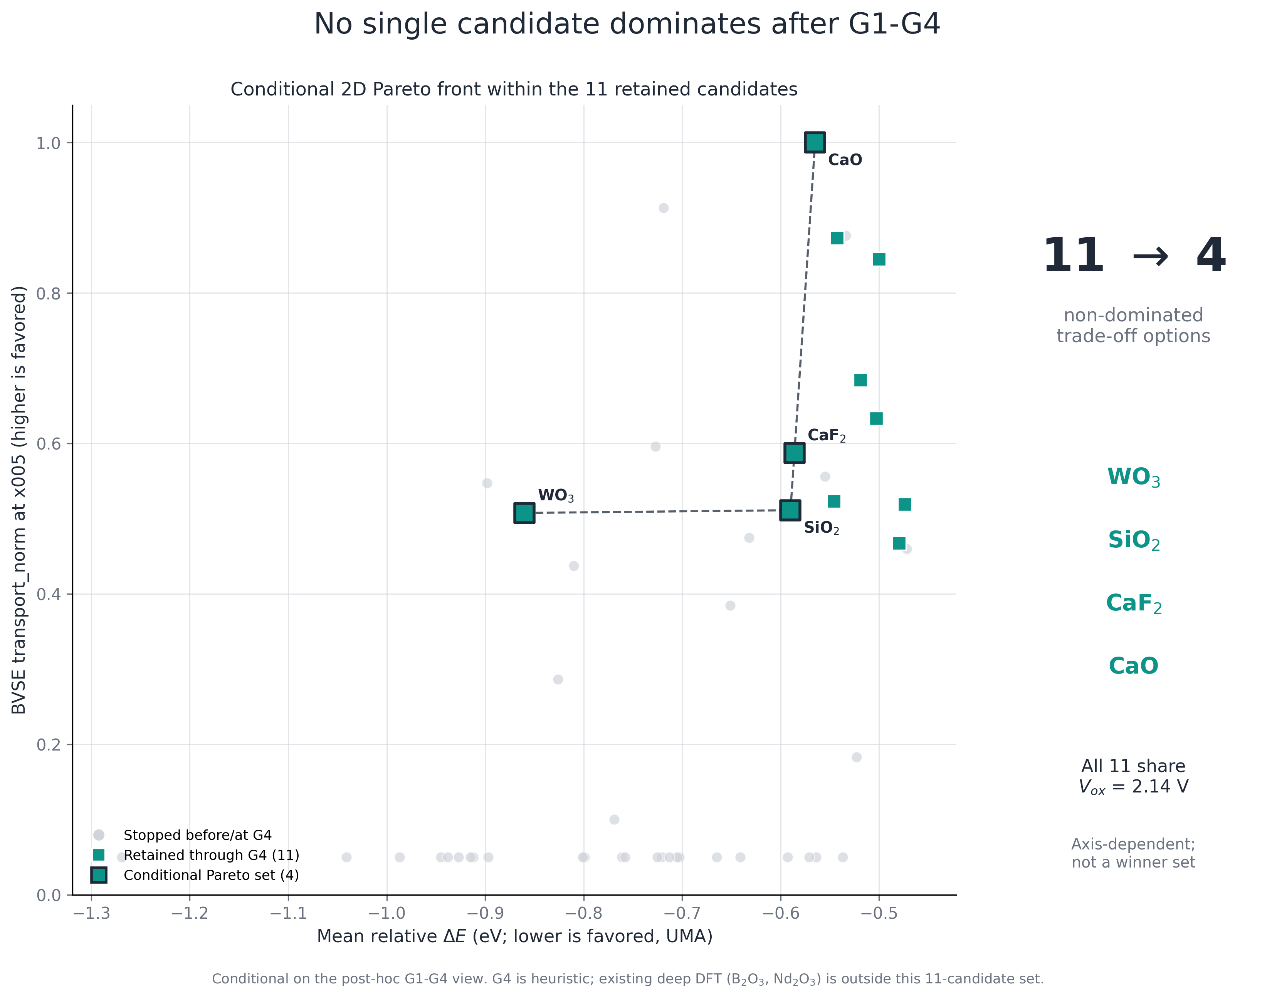
Decision model
Conditional Pareto view within post-hoc G1–G4
Non-dominated set within the 11-member shortlist — axis-dependent, not a winner list
Source: cascade_seminar_pareto_47.csv
HANYANG UNIVERSITY
Battery Materials Lab.
13
Notes:
AND gate 하나만 따라가면 한 축이 강하고 다른 축이 약한 후보를 일찍 버릴 수 있어요. 그래서 11종 안에서도 축별로 non-dominated 후보를 따로 보여줘요. 이 Pareto 집합은 질문에 따라 달라지는 후보군이고, winner list가 아니에요.
[Sources]
- db/properties/cascade_seminar_pareto_47.csv
- db/properties/cascade_seminar_scorecard_47.csv
[/Sources]

Slide 14
Decision model
One snapshot, different deployment questions
Each question inherits a different evidence level
Deployment question | Axes consulted | Examples to follow up | Evidence / caveat
High-voltage cathode? | Vox · ESW window | B₂O₃ · Cr₂O₃ · Ga₂O₃ · In₂O₃ · Sc₂O₃ · Y₂O₃ | MP-derived grand-potential; dataset trade-off, not causality
Moisture response? | T11 ΔE_H2S · Zhu ΔG_hyd · raw HSAB | Cu₂O · ZnO · Ag₂O · In₂O₃ · SnO₂ | 35/47 literature proxy; not doped-LPSCl air stability
Cheap + light? | cost tier · mass/cation | Al₂O₃ · CaO · SiO₂ · MgO · MgF₂ | Qualitative tier; never market price or Wh kg⁻¹
Stable across labels? | BVS drift across x002/x005/x010 | CaF₂ · ScF₃ · AlF₃ · HfO₂ · Nd₂O₃ | Nominal labels; actual stoichiometry unresolved
Air, cost, mass, and campaign-label axes are descriptive; none is an additional rejection gate.
Source: themes.json · scorecard_47.csv · air_axis_lit_vs_tier.csv
HANYANG UNIVERSITY
Battery Materials Lab.
14
Notes:
어떤 후보가 좋은지는 어디에 쓰려는지에 따라 달라져요. 고전압 양극 쪽은 산화 onset과 window, 수분 대응은 T11 정적 반응축과 Zhu 문헌 proxy·HSAB, 대량 적용은 qualitative cost tier와 질량을 봐요. 이 축들은 추가 gate가 아니라 후속 실험과 계산 우선순위를 정하는 descriptive evidence예요.
[Sources]
- db/properties/cascade_v23_themes.json
- db/properties/cascade_air_axis_lit_vs_tier.csv
- db/properties/cascade_seminar_scorecard_47.csv
- litdb/papers/zhu2020_air_stable_se_design_principles.md
[/Sources]

Slide 15
Decision model
Four concrete deployment trade-offs
The G4 endpoint changes when handling and scale-up axes enter
Candidate | What looks favorable | What changes the decision | Evidence
LiF | G4 retained · ΔE_H2S = 0 | No kinetics or coating-lifetime validation | STATIC / MP-THERMO
MgO | G4 retained · cost tier 1 · light | ΔE_H2S = −19.2; ΔE_LPSCl = −74.3 meV atom⁻¹ | CURATED / STATIC
CaO | G4 retained · cost tier 1 · light | ΔE_H2S = −74.3; ΔE_LPSCl = −253.3 meV atom⁻¹ | CURATED / STATIC
Cu₂O | ΔG_hyd,lit = +1.267 eV H₂O⁻¹ | Stops at G3; ΔE_LPSCl = −340.9 meV atom⁻¹ | LITERATURE / MP-THERMO
Triage flags only — not validated coating lifetimes, kinetics, or universal winners.
Source: stability_axes.csv · themes.json · scorecard_47.csv
HANYANG UNIVERSITY
Battery Materials Lab.
15
Notes:
LiF는 정적 interface 축에서 안정적으로 보이지만 kinetics나 coating lifetime까지 말할 수는 없어요. MgO와 CaO는 비용·질량 측면이 좋지만 H2S나 LPSCl 반응축에서 서로 다른 부담이 보여요. Cu2O는 문헌 수분 proxy는 좋아도 G3와 interface 축이 불리해요. 결국 한 후보의 장점은 적용 조건과 함께 읽어야 해요.
[Sources]
- db/properties/cascade_stability_axes.csv
- db/properties/cascade_v23_themes.json
- db/properties/cascade_seminar_scorecard_47.csv
[/Sources]

Slide 16
Robustness
All 5! = 120 gate orders enumerated
Gate order changes the story, not the terminal intersection
G1 → G2 → G3 → G4 → G5 47 → 47 → 43 → 25 → 11 → 1
G1 → G3 → G2 → G5 → G4 47 → 47 → 25 → 25 → 7 → 1
120 / 120 gate permutations tested — terminal set invariant; intermediate attribution order-dependent
Order invariance does not validate the thresholds; the reported comparison endpoint remains the 11-member G1–G4 set (G4 heuristic).
Source: cascade_pipeline_guide.md (permutation audit)
HANYANG UNIVERSITY
Battery Materials Lab.
16
Notes:
5개 gate의 120개 순서를 전부 바꿔도 최종 Boolean intersection은 같았어요. 하지만 중간 숫자와 어떤 gate가 누구를 죽였는지는 달라져요. 그리고 순서 불변성이 threshold 자체를 물리적으로 검증해 주는 건 아니므로, 보고 endpoint는 여전히 heuristic G4까지의 11종으로 제한해요.
[Sources]
- db/properties/cascade_screening_funnel.json
- docs/cascade_pipeline_guide.md
[/Sources]

Slide 17
Trust boundary
Method-matched claims only
Claim strength must match the method
SUPPORTED
✓ Gate pass / fail
✓ Same-protocol relative ranking
✓ Oxidation–transport trade-off
✓ Gate-order invariance
NOT SUPPORTED
× UMA absolute energies / moduli
× BVSE-derived conductivity
× Ranking inside degenerate groups
× A unique G5 winner
Still missing as full gates: interface reaction · electronic insulation · doped-LPSCl moisture response
HANYANG UNIVERSITY
Battery Materials Lab.
17
Notes:
현재 지지되는 건 gate pass·fail, 같은 프로토콜 안의 상대 비교, trade-off, gate-order audit예요. 반대로 UMA 절대 열역학, BVSE conductivity, degenerate group 내부 순위, G5 winner는 지지하지 않아요. Full gate로 아직 비어 있는 건 interface reaction, electronic insulation, 그리고 실제 doped-LPSCl moisture response예요.
[Sources]
- docs/cascade_pipeline_guide.md
- docs/reviews/cascade_db_ml_readiness_audit_2026_08_10.md
[/Sources]

Slide 18
Validation
Retraction ledger
Failures made the cascade more credible
Single-seed 1.33× conductivity → Multi-seed verdict only
MSD fit outside diffusion → β ∈ [0.8, 1.2] gate
DOS-threshold band gap → Fixed-occ eigenvalues
raw HSAB grade → [Zhu20] cross-check: 9/35 under-rated, one direction → retained only as CURATED, non-gating
Failed claims became explicit validation rules or exclusions — audit is part of the pipeline.
Source: canonical_registry.json · cascade_air_axis_lit_vs_tier.csv (26/9/12)
HANYANG UNIVERSITY
Battery Materials Lab.
18
Notes:
단일시드 1.33배 전도도는 멀티시드 판정으로, 비확산 MSD fit은 beta gate로, DOS threshold gap은 fixed-occupation eigenvalue로 바꿨어요. 공기 안정성의 raw HSAB grade는 Zhu 문헌축과 비교해 한 방향 bias가 보여 non-gating curated 축으로만 남겼어요. 실패한 주장을 숨긴 게 아니라 rule과 exclusion으로 바꾼 게 이 pipeline의 신뢰성 부분이에요.
[Sources]
- db/properties/canonical_registry.json
- db/properties/b2o3_vs_lpscl16_conductivity.csv
- db/properties/cascade_air_axis_lit_vs_tier.csv
[/Sources]

Slide 19
Validation
Current deep-DFT coverage: 2 / 47
Three coverage counts — not a linear funnel
47
data-complete relative screens
11
post-hoc G1–G4 survivors
2
selected deep-DFT cases
PARALLEL COVERAGE RECORDS · Neither DFT case is a G1–G4 survivor: B₂O₃ stops at G4; Nd₂O₃ at G3
Promote when
• Near a gate boundary
• Model heads disagree
• Pareto value is high
• Chemistry is under-sampled
Required contract for any direct comparison
Same structure, cell, constraint, k-mesh, reference, and magnetic protocol.
Compare only inside one protocol lineage.
The 47-candidate result is a relative screen — not 47 DFT confirmations.
HANYANG UNIVERSITY
Battery Materials Lab.
19
Notes:
47은 relative screen 수, 11은 post-hoc G1–G4 endpoint, 2는 targeted deep-DFT case 수예요. 이 세 숫자는 순차 funnel이 아니고, DFT 두 건도 11종에서 뽑힌 validation set이 아니에요. B2O3는 G4, Nd2O3는 G3에서 멈추므로 direct comparison을 하려면 앞으로 동일 구조·셀·k-mesh·reference·자기 프로토콜을 맞춰야 해요.
[Sources]
- db/properties/cascade_seminar_scorecard_47.csv
- db/properties/electronic.json
- webapp/data.py
[/Sources]

Slide 20
ML roadmap
UMA screen + co-doping hypothesis model
ML is already here — but it is not yet a discovery model
Cr₂O₃ ↔ HfO₂ end-member proxy
UMA MLIP
Energy and force surrogate
Fast configuration search
Same-protocol relative screen
Cr₂O₃
Vox = 2.356 V
Oxidation-side end member
Single-dopant champion site: Li_24g
Physics cascade
Gate pass / fail
Trade-off structure
Shortlist for expensive validation
HfO₂
Vred = 1.242 V
Reduction-side / lower-blocking complement
Single-dopant champion site: Li_24g
Co-doping ML v2
47 scores → 1,081 pair hypotheses
0 explicit co-doped structures
0 DFT/experimental pair labels
LODO / L2DO R² < 0
v1 heuristic #1 → v2 ML rank #8
+0.360 V = constructed endpoint proxy, not a pair calculation
Uncomputed pair: site competition and joint properties remain open.
Current role: cost reduction + hypothesis ordering, not discovery certification.
Source: synergy_pairs.csv · codoping_ml_v2.csv · codoping_ml_v2_meta.json
HANYANG UNIVERSITY
Battery Materials Lab.
20
Notes:
Cr2O3–HfO2는 v1 heuristic에서는 1위였지만 v2 ML에서는 8위예요. +0.360 V도 explicit pair 계산값이 아니라 두 single-dopant endpoint로 만든 proxy gain이에요. 두 single-dopant champion이 모두 Li_24g라 site competition도 열려 있고, pair structure·DFT·실험 label은 아직 0개예요. 그래서 현재 역할은 hypothesis ordering이에요.
[Sources]
- db/properties/cascade_v23_synergy_pairs.csv
- db/properties/codoping_ml_v2.csv
- db/properties/codoping_ml_v2_meta.json
- docs/cascade_ml_integration_guide.md
[/Sources]

Slide 21
Outlook
Pattern: Sendek 2017 · Kim 2025 · our acquisition loop
The next cascade learns where to calculate next
CANDIDATE SPACE
dopant × x × configuration
L1 FAST SCREEN
UMA + BVSE + gate risk
L2 DFT
matched validation
L3 EXPERIMENT
phase · sigma(T) · stability
VERSIONED DATABASE
provenance-tagged records
ACQUISITION
Pareto gain + uncertainty + diversity
EXPLOIT: predicted Pareto gain EXPLORE: uncertainty / new chemistry VALIDATE: gate boundary
ML chooses what to calculate next; physics and experiments decide what is true.
Source: cascade_ml_integration_guide.md · local Sendek and Kim digests
HANYANG UNIVERSITY
Battery Materials Lab.
21
Notes:
다음 단계의 ML은 47개 평균값만으로 winner를 예측하는 모델이 아니에요. 불확실성, Pareto gain, chemistry diversity, gate boundary를 합쳐 다음 explicit configuration을 고르는 acquisition model이에요. 계산과 실험이 새 label을 만들고, versioned DB가 다시 proposal로 돌아오는 closed loop를 목표로 해요.
[Sources]
- docs/cascade_ml_integration_guide.md
- litdb/papers/sendek2017_ml_screening_12k_conductors.md
- litdb/papers/kim2025_conductive_agent_se_coating_cathode.md
[/Sources]

Slide 22
Appendix A1
Terminology and symbol conventions
Symbol / term | Meaning | Usage rule
ΔE | Doped − host relative energy | Same engine, cell, composition convention
Vox / window | Grand-potential onset / Vox − Vred | Tie at 2.14 V remains unresolved; not kinetic stability
transport_norm | Min–max static BVSE/path proxy | Never call it D or conductivity
β / Ea | MSD log-slope / Arrhenius slope | β-gated, 600/800/1000 K, multiseed verdict
ΔG_hyd,MS,lit | [Zhu20] same-cation binary-sulfide proxy | 35/47; not doped-LPSCl air stability
x002/x005/x010 · cost tier | Nominal labels · qualitative cation tier (+0.5 fluoride) | Not verified x; not market price
missing | Not calculated / incomplete | Not zero and not a failure
HANYANG UNIVERSITY
Battery Materials Lab.
22
Notes:
질문이 나오면 우선 단위를 맞춰야 해요. transport_norm은 conductivity가 아니고, DeltaG_hyd 문헌축은 same-cation binary sulfide proxy예요. x002·x005·x010은 실제 농도가 아니라 campaign label이고, cost tier는 시세가 아닌 qualitative cation tier에 fluoride surcharge가 붙은 값이에요.
[Sources]
- kb/methodology/terminology_register.md
- db/properties/cascade_v23_themes.json
[/Sources]

Slide 23
Appendix A2
Protocol matrix and allowed claims
Tier / method | Primary output | Allowed claim | Do not claim
UMA MLIP | Relative E, forces, relaxation | Same-protocol candidate ordering | Absolute thermodynamics / charge-state reaction
BVSE | Static pathway geometry | Pathway-retention risk | D or conductivity
MLIP-MD | MSD, D(T), Ea | β-gated multiseed comparison at 600/800/1000 K | Absolute σ; ungated or single-seed ratios
DFT | Matched energy / electronic response | Selected candidate validation | 47/47 coverage or cross-protocol ranking
Literature / curated | External proxy / qualitative prior | Directional follow-up | Mix with internal absolutes or use as hard gate
HANYANG UNIVERSITY
Battery Materials Lab.
23
Notes:
이 표는 방법별로 무엇을 말해도 되는지 방어하는 장이에요. MLIP-MD는 canonical temperature와 MSD window에서 beta-gated multiseed Ea까지만, DFT는 matched protocol의 선택 후보 검증까지만 말해요. 외부 문헌값은 방향성 cross-check이고 내부 절대값과 섞지 않아요.
[Sources]
- docs/cascade_pipeline_guide.md
- AGENTS.md
- db/properties/electronic.json
[/Sources]

Slide 24
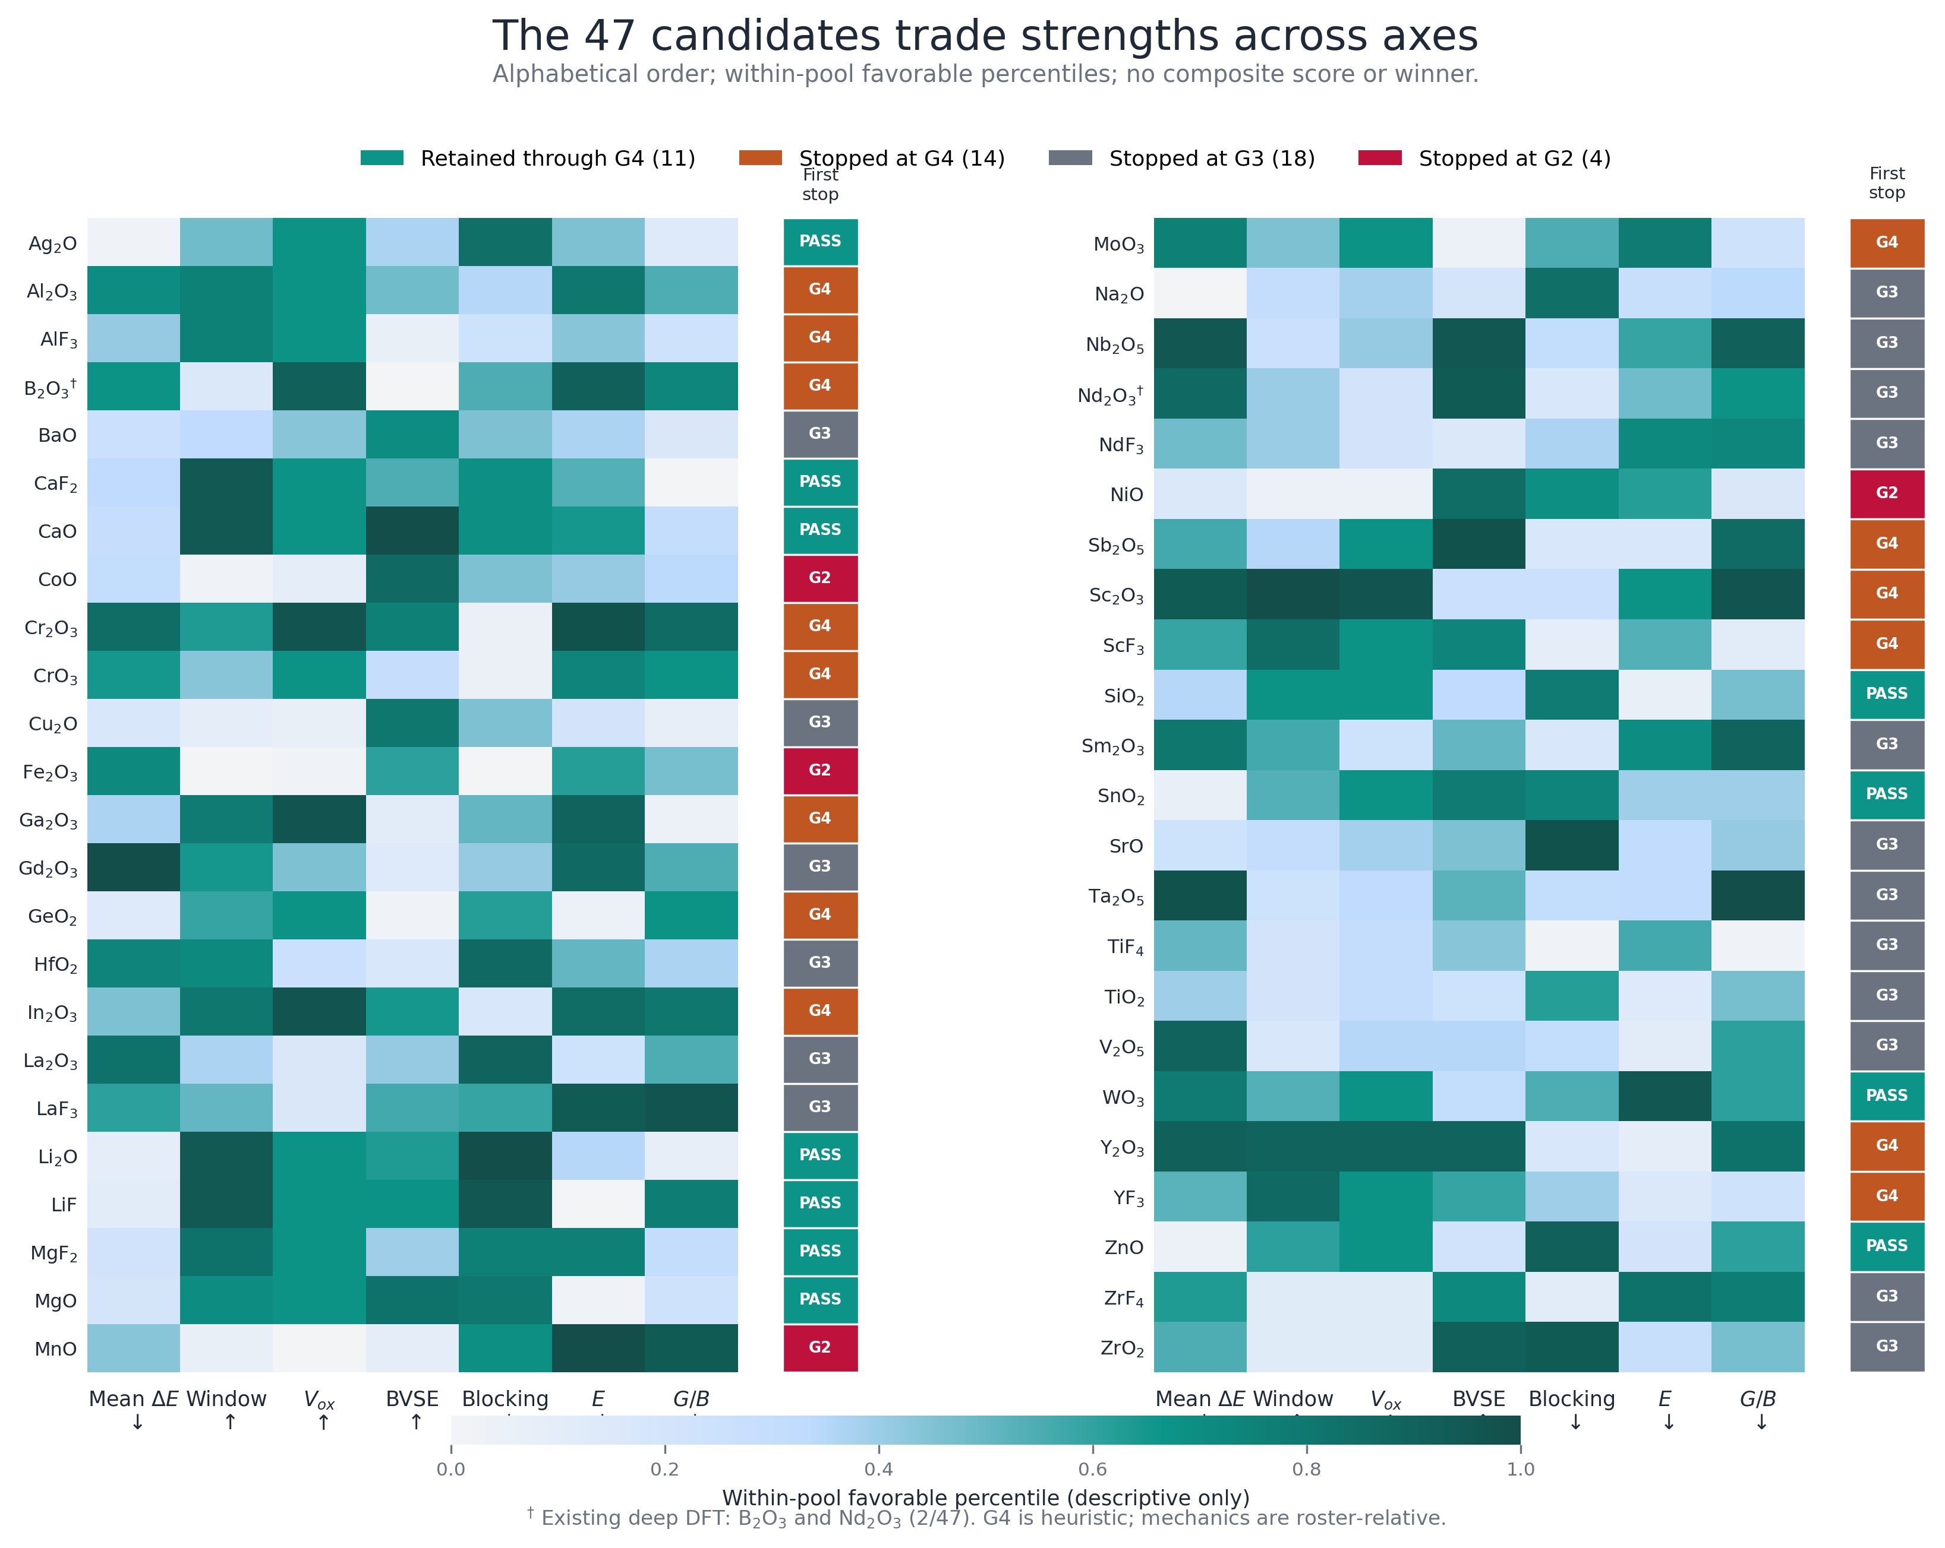
Appendix A3
47-species scorecard heatmap
Within-pool favorable percentiles + first-stop gate — no universal composite score, no winner
Source: cascade_seminar_scorecard_47.csv
HANYANG UNIVERSITY
Battery Materials Lab.
24
Notes:
전체 후보를 한 번에 물어보면 이 heatmap을 보여주면 돼요. 색은 pool 내부의 favorable percentile이고, 오른쪽은 first-stop gate예요. 절대 물성이나 하나의 composite score가 아니므로 색이 진하다고 winner라고 부르지 않아요.
[Sources]
- db/properties/cascade_seminar_scorecard_47.csv
- docs/figures/cascade/cascade_seminar_scorecard_47.png
[/Sources]

Slide 25
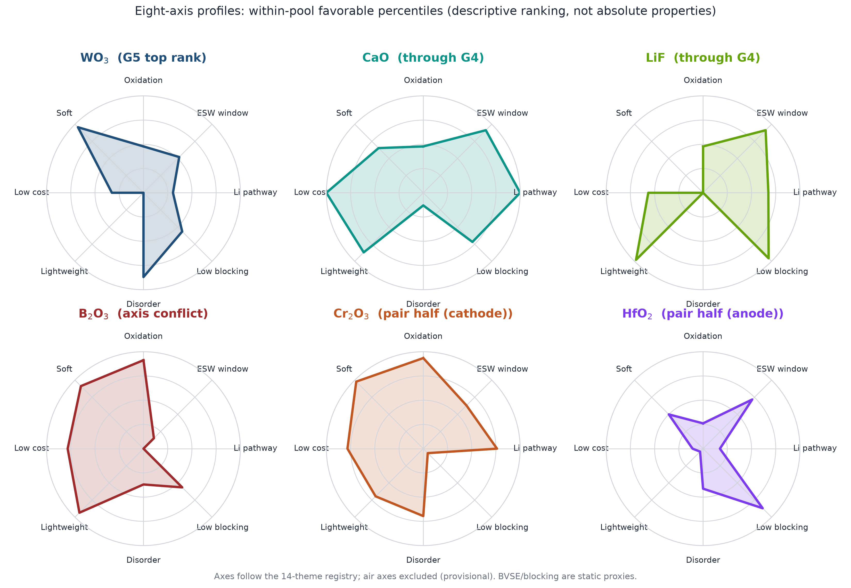
Appendix A3b
Candidate profiles across eight axes (radar)
Within-pool favorable percentiles + first-stop gate — no universal composite score, no winner
Source: cascade_radar_axes_origin.csv (within-pool favorable percentiles; air axes excluded)
HANYANG UNIVERSITY
Battery Materials Lab.
25

Slide 26
Appendix A4
Defense Q&A — cascade and evidence
Question | Defense answer
Is 47 a high-throughput discovery funnel? | No. It is a human-curated, host-specific O/F snapshot; 273 is a separate run-slot count.
What happened to the other 44 of 91? | They are absent from the versioned table. Without per-species manifests, absence is not physical rejection.
Why keep vacuous or redundant gates? | Auditability. We report selection pressure and unique kills; both may change in a new pool.
Why report 11 instead of one? | We compare at the G1–G4 endpoint while marking G4 heuristic. G5 is ranking-only.
Does BVSE failure prove low conductivity? | No. It flags static pathway risk; multiseed MD or experiment is required.
Why is air stability not a gate? | The literature proxy covers 35/47 and raw HSAB is biased; actual doped-LPSCl moisture response is missing.
HANYANG UNIVERSITY
Battery Materials Lab.
26
Notes:
이 장은 provenance와 gate 해석에 대한 짧은 답을 모아둔 backup이에요. 가장 중요한 답은 47이 273의 물리적 survivor가 아니라는 것, G4가 heuristic이라는 것, BVSE failure가 낮은 conductivity를 증명하지 않는다는 것이에요. 질문이 길어지면 관련 본문 장으로 돌아가면 돼요.
[Sources]
- docs/reviews/cascade_db_ml_readiness_audit_2026_08_10.md
- db/properties/cascade_screening_funnel.json
[/Sources]

Slide 27
Appendix A5
Defense Q&A — validation and ML
Question | Defense answer
Are all 47 candidates DFT-validated? | No. There are two targeted DFT case studies; the rest are relative screens.
Can 47 rows train a discovery model? | They define priors and axes. Predictive learning needs configuration-level, protocol-tagged labels.
Why not trust LOOCV R² = 0.9998? | Stage 1 reconstructs a score built from the same inputs. Separately, pair LODO = −0.1805 and L2DO = −0.2548.
Why not choose only the predicted top pair? | Winner's curse. Acquire uncertainty, chemical diversity, and gate-boundary cases.
When can the model be called predictive? | After explicit pair structures, real pair labels, grouped CV, and a frozen prospective holdout.
HANYANG UNIVERSITY
Battery Materials Lab.
27
Notes:
DFT coverage는 2/47이고, 47개 dopant 평균값은 일반적인 discovery model을 학습시키기에는 부족해요. Stage 1의 높은 LOOCV는 구성한 score를 복원한 결과이고, 별도의 pair model은 LODO와 L2DO에서 음수예요. 실제 co-doped 구조와 prospective holdout이 생긴 뒤에야 predictive라고 부를 수 있어요.
[Sources]
- db/properties/codoping_ml_v2_meta.json
- docs/cascade_ml_integration_guide.md
[/Sources]

Slide 28
Appendix A6
Canonical data sources held in the repository
Source | Role
cascade_seminar_pool_attrition_273_to_47.csv | 91 × 3 run-slot lineage and 47-species snapshot
cascade_screening_funnel.json | G1–G5 definitions, waterfall, gate-power, permutations
cascade_seminar_scorecard_47.csv | 47 candidates, first-stop, G1–G4 and deep-DFT flags
cascade_seminar_oxidation_transport_47.csv | Oxidation–static-pathway trade-off
cascade_seminar_pareto_47.csv | Conditional non-dominated set
cascade_stability_axes.csv / verdict.json | H2S, LPSCl, Li, cathode interface axes
cascade_v23_themes.json / air_axis_lit_vs_tier.csv | Cost, mass, air proxies and missingness
cascade_v23_synergy_pairs.csv | v1 end-member pair heuristic
codoping_ml_v2.csv / codoping_ml_v2_meta.json | v2 ranks, CV, AD, limitations
HANYANG UNIVERSITY
Battery Materials Lab.
28
Notes:
이 장에는 발표 숫자를 다시 만들 때 직접 여는 정본 데이터 파일만 모았어요. 특히 attrition, gate funnel, scorecard, stability axes, co-doping v1·v2를 분리해 두었어요. Radar source는 origin commit 9ee411a3에서 재현 가능하지만, 최종본은 수치를 직접 감사하기 쉬운 canonical 표·카드를 선택했어요.
[Sources]
- db/properties/
- docs/cascade_pipeline_guide.md
- origin/claude/friendly-meitner-lldvar@9ee411a3:db/properties/cascade_radar_axes_origin.csv
- origin/claude/friendly-meitner-lldvar@9ee411a3:tools/figures/fig_cascade_radar.py
[/Sources]

Slide 29
Appendix A7
Methods, audits, and literature sources
Source | Role
docs/cascade_pipeline_guide.md | Canonical pipeline, gates, and trust limits
docs/cascade_ml_integration_guide.md | Configuration labels and acquisition loop
docs/reviews/cascade_db_ml_readiness_audit_2026_08_10.md | 273/47 lineage, duplication, ML readiness
docs/reviews/cascade_ai_screening_literature_comparison_2026_08_10.md | External screening-pipeline comparison
kb/methodology/terminology_register.md | Terms, status, and claim discipline
db/properties/canonical_registry.json / electronic.json | Canonical values and provenance flags
litdb: Sundar 2025 / Zhu 2020 | LPSCl coating context and hydrolysis proxy
litdb: Sendek 2017 / Xiao 2019 | ML and physics-funnel precedents
litdb: Kim 2025 / Kim 2026 | Active-learning and MLIP-screening precedents
HANYANG UNIVERSITY
Battery Materials Lab.
29
Notes:
마지막 장은 수치보다 해석 규칙과 문헌 역할을 추적하는 파일들이에요. Pipeline guide, ML guide, DB readiness audit, terminology register, 그리고 local litdb digest를 기준으로 문장을 방어해요. 발표 후 수정이 생기면 이 원장과 speaker notes의 Sources 블록을 같이 갱신하면 돼요.
[Sources]
- docs/
- kb/methodology/terminology_register.md
- litdb/papers/
[/Sources]

