Slide 1


October 13, 2026
Research Seminar
Progress Report on DFT/MLIP Screening:
Dopants in Li₆PS₅Cl
Yonghoon An
Division of Materials Science & Engineering, Hanyang University
(E-mail : yonghoon71@hanyang.ac.kr)

Slide 2
Background
DFT simulations so far — the experience behind this screening
Li₆PS₅Cl baseline
Nd/O co-doping (Nd₂O₃)
B₂O₃ and O doping
h-BN on carbon fiber
Figure
Figure
Figure
Figure
Band gap (fixed-occupation NSCF), EOS, elastic constants — reference for every doped model
Band edges (Nd 5d vs 4f), −ICOHP bonding, cathode-interface (CEI) models — with the experimental team
Equation of state, bond-valence Li pathways, MLIP-MD Li transport (multi-seed, relative)
Li adsorption and migration (NEB) on h-BN-coated VGCF; layer-number (confinement) effect
Li₃N (SEI component)
Li₂S (SEI component)
Interfacial adhesion
Binder adsorption (SDCP)
Figure
Figure
Figure
Figure
Li migration barriers (NEB); universal MLIP found biased for Li₃N → DFT only
Li-vacancy migration barrier (NEB, charged cell) and supercell-size convergence
Work of adhesion of SE|SE and SE|graphite interfaces (slab DFT, MLIP cross-check) → contact input for DEM
Spin-state-resolved adsorption of a binder molecule on LiNiO₂ surfaces
Carried into this work: DFT EOS/elastic · band-edge analysis · bond-valence maps · MLIP-MD protocol (multi-seed, relative) · NEB · grand-potential stability · interface energetics

Slide 3
Overview
This work: purpose, what has run, what comes next
Purpose
Select dopant precursors for Li₆PS₅Cl that raise electrochemical and mechanical stability without slowing Li-ion transport.
Let the computation make the selection, with the selection rule stated in advance.
Completed
Stage 1: all 91 precursors enumerated and relaxed (3,675 configurations)
DFT equation of state; stability windows recomputed
September audit → Stage 2 with one primary readout
Running
Stage 2 pilot: MLIP-MD Li diffusivity, Al₂O₃- vs Al₂S₃-derived doping (12 of 40 runs)
DFT elastic constants of the reference compositions
Next
Scope over the 237-design roster and the ranking margin, fixed in advance
Check whether Stage-1 descriptors predict the measured transport
Shortlist → DFT validation → experiments
Stage-1 descriptors are used for exploration; no dopant ranking is claimed.

Slide 4
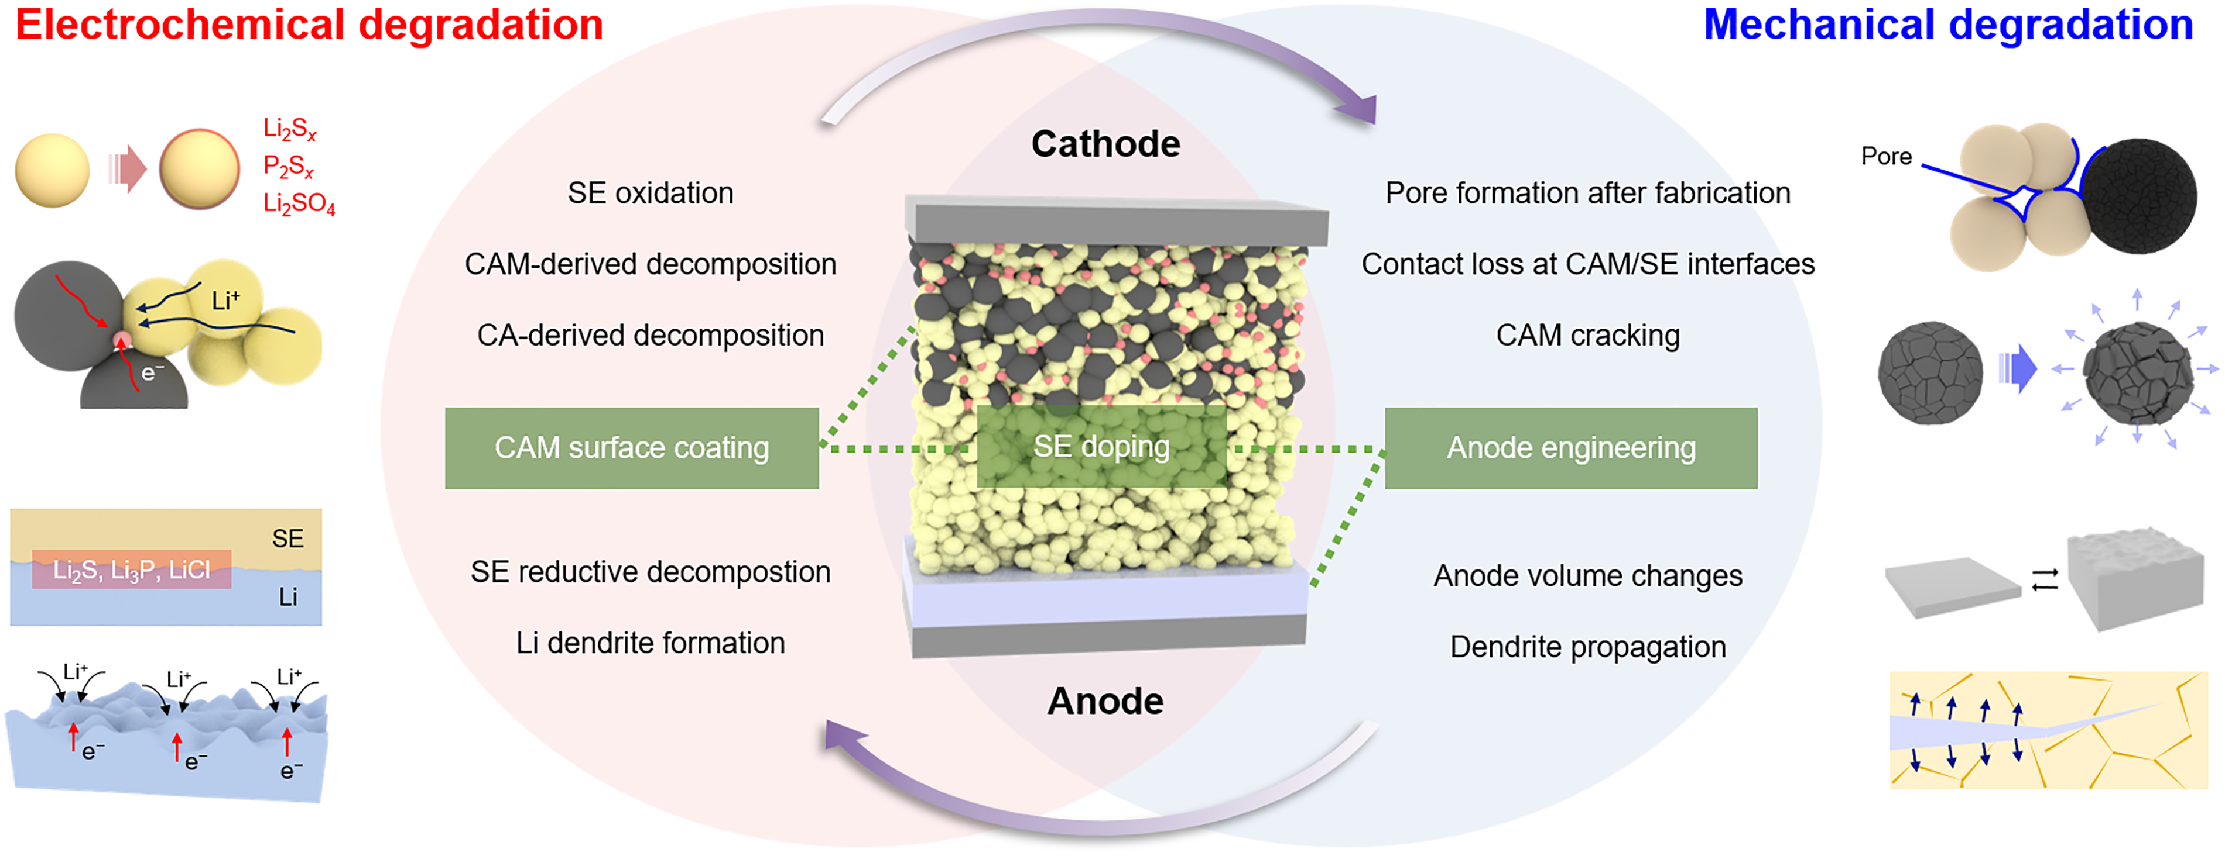
Introduction
Chem. Commun., 62, 10277 (2026).
Failure modes in sulfide solid electrolytes
Electrochemical and mechanical degradation are coupled.
Because these failure modes are coupled, improving one of them can degrade another, and the loss is not detected unless each mode is evaluated separately.

Slide 5
Introduction
Chem. Mater. 27, 4040 (2015) · Adv. Energy Mater. 14, 2304025 (2024)
J. Mater. Chem. A 12, 7272 (2024) · Joule 3, 1252 (2019)
Prior work: what dopant screens vary
Earlier screens place one element on a site, or screen hostless compounds.
Here a precursor compound fills one cation and one anion site at once.
study | host | what is varied | n | mechanical axis
Miara 2015 (via Anderson) | garnet oxide | one cation, 3 sites | 45 | none
Lee 2024 | argyrodite | elements already in the formula | 84 | none
Xiao 2019 | no host — free coating | the compound itself | 104,082 | none
this work | argyrodite sulfide | an added precursor compound | 91 | DFT reference + MLIP descriptor (not a gate)
Related screens
Holistic screening of Li-ion conductors (Sendek 2017) and high-throughput MD (Kahle 2020)
Dual-dopant screening of LGPS-type conductors (Jung 2026) · ML interface-stability screening (Park 2026)
Site-resolved dopant defect thermodynamics in argyrodites (Muy 2025)
Energy Environ. Sci. 10, 306 (2017) · Energy Environ. Sci. 13, 928 (2020) · eTransportation 28, 100570 (2026) · Adv. Sci. 2026, e76305 · Chem. Mater. 37, 2395 (2025)

Slide 6
Approach
Candidate set: 91 precursor compounds in seven anion families
Cations +1 to +6, anions O²⁻ to I⁻; only existing compounds are used.
All 91 relaxed — As₂S₃ and AlI₃ were completed in an August re-run.
family | n | role in the design | examples
oxides | 37 | strong M–O bonds | Ag₂O, Al₂O₃, B₂O₃, BaO …
chlorides | 19 | the host already has Cl | AlCl₃, BaCl₂, CaCl₂, CrCl₃ …
sulfides | 11 | control — same anion as the host | Al₂S₃, CaS, Ga₂S₃, GeS₂ …
fluorides | 10 | strongest bonds, mobility risk | AlF₃, CaF₂, LaF₃, LiF …
bromides | 5 | control — larger halide | AlBr₃, CaBr₂, LiBr, MgBr₂ …
nitrides | 5 | control — higher anion charge | AlN, Ca₃N₂, GaN, Li₃N …
iodides | 4 | control — largest halide | AlI₃, LiI, MgI₂, NaI
Precursor-derived co-doping of argyrodites: CuCl — Taklu, Nano Energy 90, 106542 (2021) · MgF₂ — Liu, Angew. Chem. Int. Ed. 62, e202302655 (2023) · ZnO — Jang, J. Alloys Compd. 957, 170273 (2023) · La₂O₃ — Yang, Electrochim. Acta 535, 146619 (2025) · Nd₂O₃ — Xu, Nano Energy 157, 112246 (2026)

Slide 7
Approach
Stage 1 — exploration screen (Jun–Aug): workflow and status
# | Step | Method | Scale | Status
1 | Site enumeration | Charge-balanced placement of precursor cation and anion on Li, P, S, Cl sites | 91 precursors | Done
2 | Relaxation | Universal MLIP (UMA), FIRE optimizer | 3,675 configurations | Done
3 | Short anneal | MLIP-MD at 500 K for 50 ps, then re-relaxation | 693 configurations | Done
4 | Li-site landscape | Bond-valence site energy (softBV) | per precursor | Done (structural proxy)
5 | EOS / elastic constants | DFT (Quantum ESPRESSO): Birch–Murnaghan fit; finite strains with ionic relaxation | reference compositions | EOS done · C_{ij} running
6 | Stability window | Grand-potential phase diagram from Materials Project phases (0 K) | 90 precursors | Recomputed (Oct)
7 | Interface reactivity | Reaction energy of each doped composition vs cathodes, Li metal, carbon | 90 precursors | Done · products redo
As₂S₃ and AlI₃ were completed in an August re-run; As₂S₃ is not yet in the stability and interface tables (rows 6–7). Since the September audit these outputs are exploratory data — Li transport is measured in Stage 2.
MLIP: machine-learning interatomic potential (UMA, a universal model) · EOS: equation of state · all Stage-1 configurations use one dopant level (one precursor unit per four formula units)

Slide 8
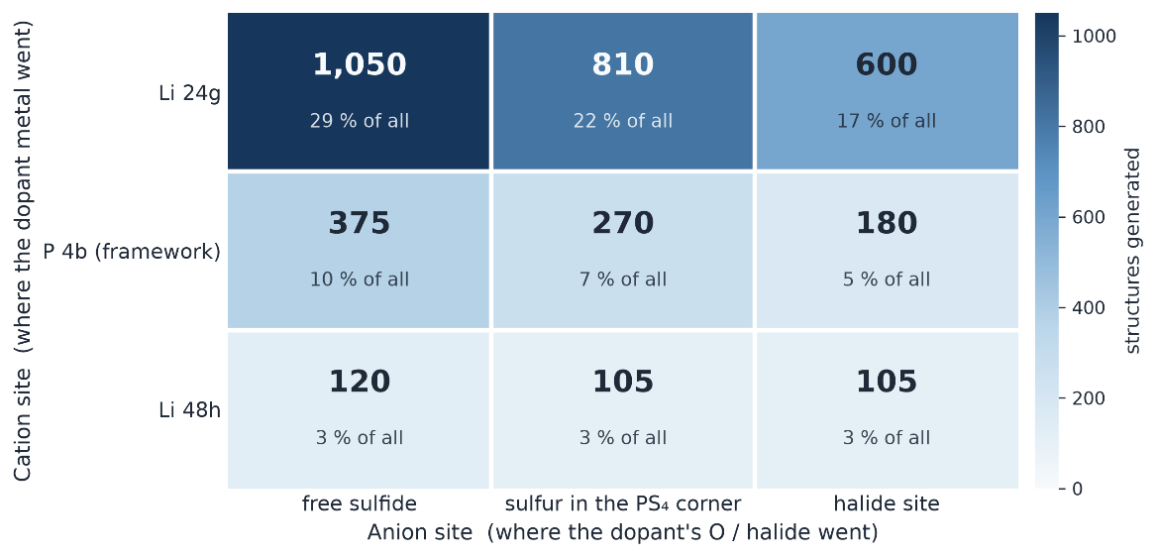
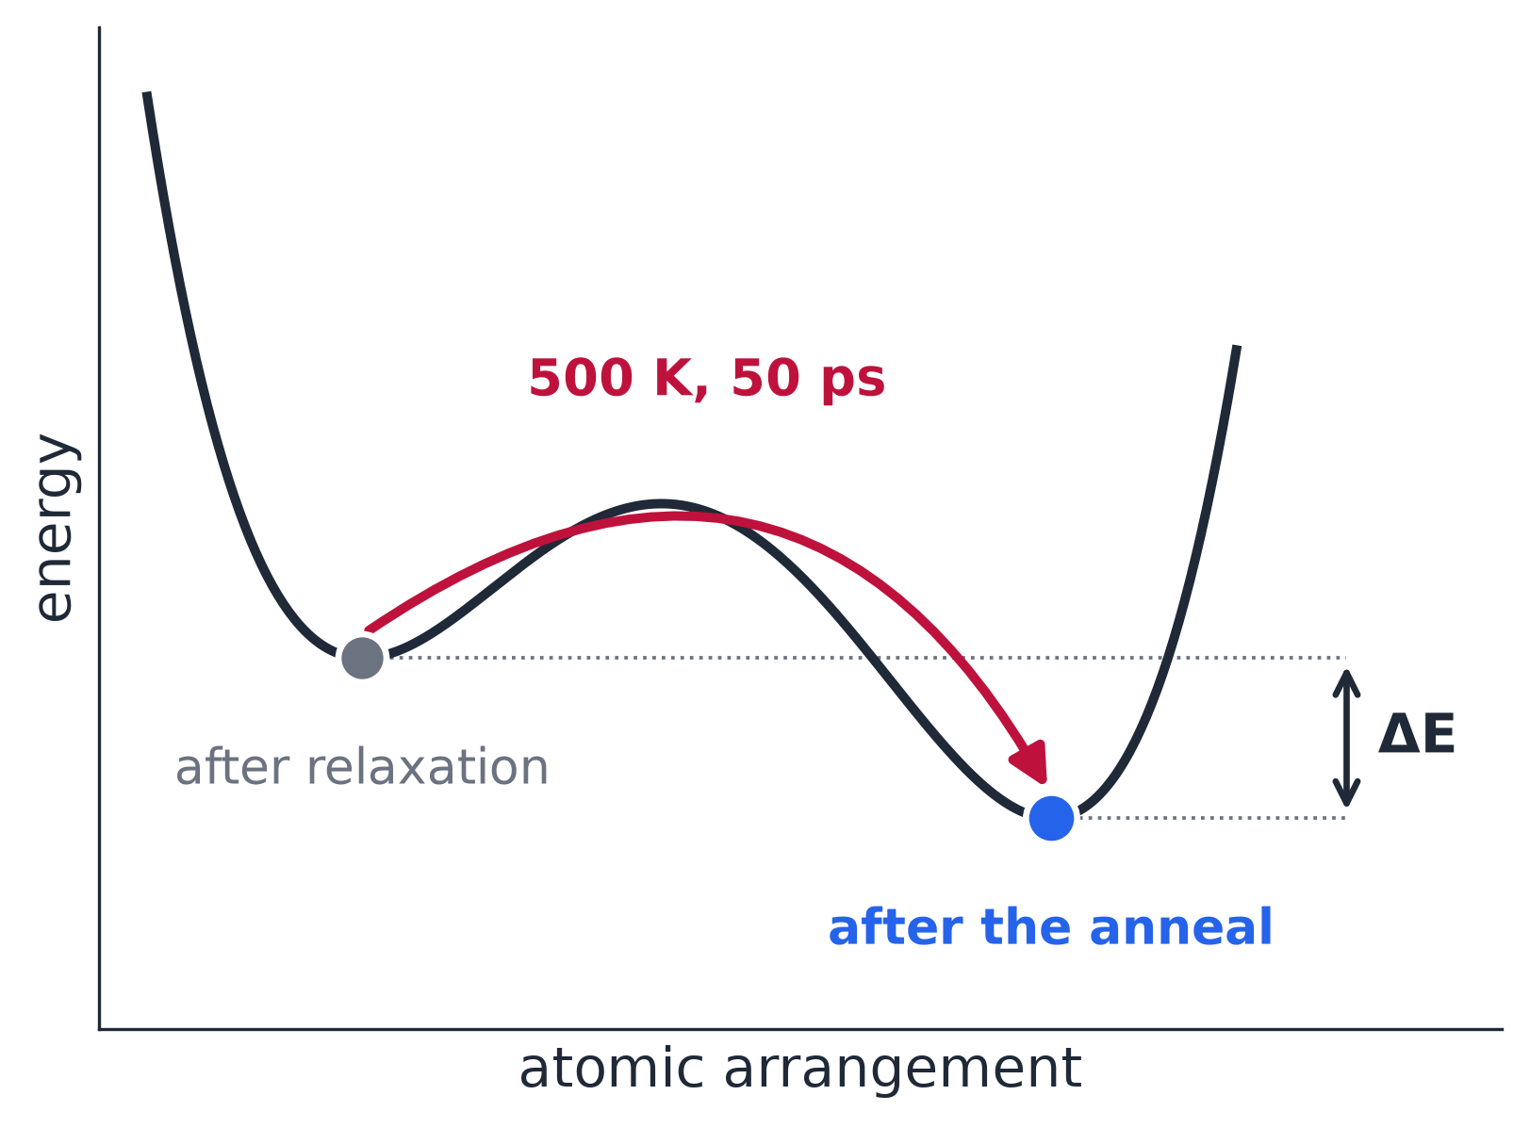
Approach
Configuration sampling and MLIP relaxation
No site was assumed: every charge-balanced placement was built and relaxed.
A short anneal (500 K, 50 ps) moves each structure out of its local minimum.
< configurations per cation–anion site pair: main batch 3,615 (+60 in the August re-run) >
< what the short anneal does >
Configurations of the same precursor can differ as much as different precursors for some descriptors → descriptors are used for exploration, not for ranking.

Slide 9
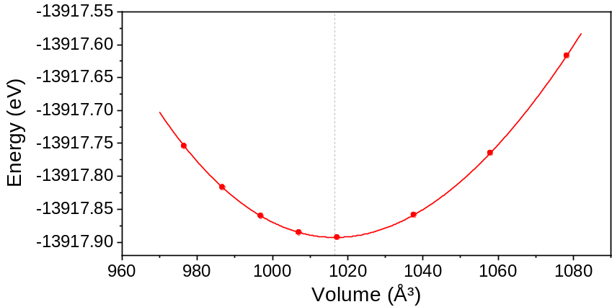
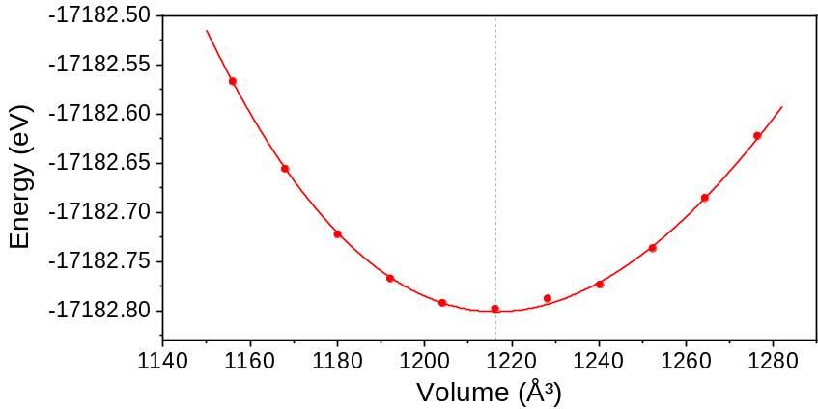
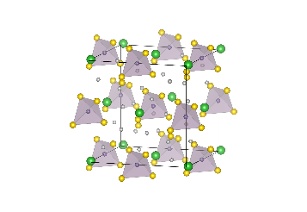
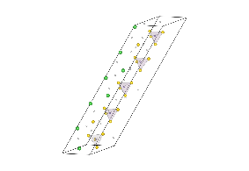
Approach
DFT reference calculations: equation of state and elastic constants
B₀ and equilibrium volume from a Birch–Murnaghan equation-of-state fit.
Elastic constants (C_{ij}) from finite strains are running on GPU.
Li₆PS₅Cl
Li_{5.4}PS_{4.4}Cl_{1.6}
B₀ = 26.2 GPa
V / f.u. = 254.16 Å³
B₀ = 21.7 GPa
V / f.u. = 243.29 Å³ (-4.3%)
< equation of state, undoped Li₆PS₅Cl vs Cl-rich LPSCl_{1.6} >
Deng, J. Electrochem. Soc. 163, A67 (2016) · Torii, J. Phys. Chem. C 129, 17882 (2025)
※ DFT (Quantum ESPRESSO); the screening itself used the MLIP

Slide 10
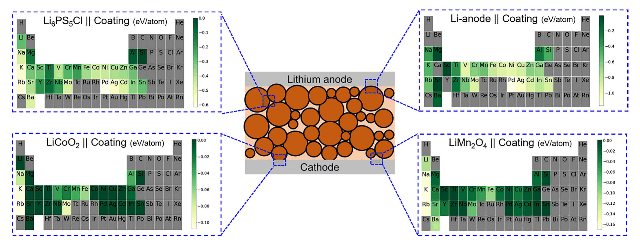
Approach
Electrochemical stability window and interfacial reactivity
Grand-potential phase diagram: the Li chemical potential is scanned as a voltage (0 K, bulk thermodynamics).
Stable window = voltage range where the composition decomposes without Li exchange; if no such range exists, no stable window.
Recomputed for the 90 precursors in the stability table with this definition (Oct); the earlier definition overestimated window widths.
< coating reaction energy at four interfaces >
Reproduced from Sundar et al., Adv. Sci. 12, e13191 (2025)
Same phase data: reaction energy of each doped composition against LiCoO₂, LiNiO₂, LiMn₂O₄, Li metal and carbon.
A separate table treats the precursor itself as a second phase (coating view, as in the figure); its product band gaps are being re-derived with ground-state phases (E_{hull} = 0).
Example: Li₆PS₅Cl host (MP phases, 0 K)
stable window 0.423 V
Li uptake
no Li exchange
Li release
1.717 V
2.140 V
voltage vs Li/Li⁺ →
Inside the window: Li₆PS₅Cl → Li₃PS₄ + Li₂S + LiCl (no Li exchange); above 2.140 V: oxidation with Li release
Zhu, ACS Appl. Mater. Interfaces 7, 23685 (2015) · Richards, Chem. Mater. 28, 266 (2016) · Xiao, Nat. Rev. Mater. 5, 105 (2020) · Schwietert, Nat. Mater. 19, 428 (2020)

Slide 11
Progress
September audit → Stage 2: rules fixed before new results
What the audit of Stage 1 found
Concentration labels did not change the dopant level: every configuration has one precursor unit per four formula units.
The volume filter used a host reference ~40 % above the DFT equilibrium volume of the same composition → Stage 2 builds from the DFT-equilibrium host.
Young's modulus: scatter among configurations of one precursor ≈ spread between precursors (ratio 1.1; substitution energy 0.2).
Several descriptors were merged into one score without a stated primary objective.
Fixed before any new result (Sep 12–19)
Primary readout
D_{rel} = D*(design) / D*(host): Li tracer diffusivity relative to the host, compared across designs
Ratified
Design roster
237 designs; one design = one composition (file names are not identifiers)
Ratified
Build rules
Parent sites fixed before substitution · full charge balance incl. vacancies · refusals counted separately
Ratified
Representative
The configuration with the median substitution energy stands for its design
Ratified
Ranking margin
How large a difference must be before one design is called better (δ)
→ Stage-1 outputs are kept as exploratory data; approved dopant ranking: none.
Proposed · δ open
237 designs ≠ 237 runs: the execution scope is decided after the pilot — the pilot tests the protocol on two Al precursors (next slides).

Slide 12
Progress
Stage 2 pilot — Li transport by MLIP molecular dynamics: setup
Pilot question: does the precursor anion (Al₂O₃ vs Al₂S₃) change Li diffusivity in Al-doped Li₆PS₅Cl — and can the protocol resolve it?
Reported quantity: ratio of Li tracer diffusivities from MSD slopes — relative, not an absolute conductivity.
Analysis plan fixed before the runs: diffusive-regime checks, then an equivalence test (margin ±ln 1.5) on the log-ratio.
Setting | Value
Potential | UMA (universal MLIP)
Ensemble | NVT, Langevin thermostat
Temperature | 1000 K (selected in a pilot)
Run length | 400 ps production; MSD fit 2–50 ps
Cell | 204 atoms, common volume (edge ≈ 1.6 nm)
Sampling | 10 start configurations × 2 precursors × 2 seeds = 40 runs
Diffusive-regime checks | sub-window MSD slope ratio 0.8–1.2 · D spread ≤ 10 % · ≥ 50 Li hops · framework intact
Al₂O₃-derived
2 Al + 3 O + 4 Li vacancies
Al₂S₃-derived
2 Al + 4 Li vacancies (S unchanged)
Same host configuration and cell volume — only the precursor anion differs
→ D(Al₂O₃) / D(Al₂S₃)
Kahle, Energy Environ. Sci. 13, 928 (2020) · He, npj Comput. Mater. 4, 18 (2018) · Wood et al. (UMA), arXiv:2506.23971 (2026)

Slide 13
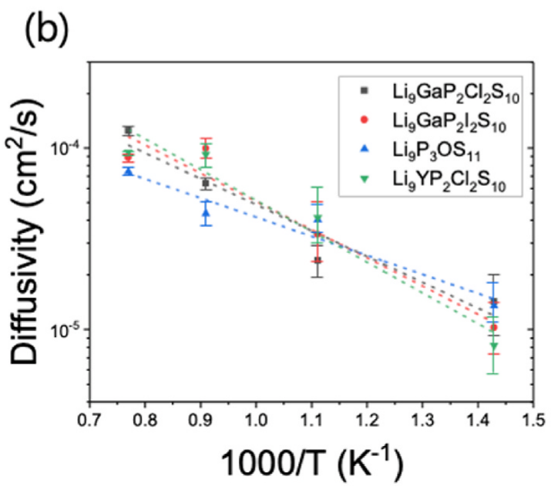
Progress
Stage 2 pilot — temperature choice, status and limits
600 K pilot (40 runs, 200 ps): Li hopped (~4,000 hops per run) but the MSD never became linear over 2–100 ps → no diffusivity reported (UMA, this cell and volume).
Temperature then chosen by a predefined pilot: 800 K failed and 1000 K passed the diffusive-regime checks.
Limits: the ~1.6-nm cell is below the ~2-nm bulk minimum suggested for MLIP transport, and rankings at high T need not hold at room temperature → relative, condition-specific result.
Status (Oct 12)
Runs
12 / 40
< Li diffusivity vs 1000/T in four LGPS-type compounds: the ordering changes between 700 and 1300 K >
GPU-hours
101 / 461
Reproduced from Jung et al., eTransportation 28, 100570 (2026), Fig. 5b
Completion expected around Oct 21; the ratio is analysed once, after all 40 runs.
Phuthi et al., Chem. Mater. (2026), Perspective · Jung et al., eTransportation 28, 100570 (2026)

Slide 14
Plan
Next steps and purpose
Now → late Oct
Finish the 40 MD runs and analyse once with the predefined criteria. The follow-up for each outcome (difference · equivalent · inconclusive · criteria not met) is written down before the analysis.
Next 1–2 months
Execution scope over the 237-design roster and the ranking margin δ — fixed before any result
Do Stage-1 descriptors predict the measured transport? (rank correlation with a confidence interval)
Stability windows and interface products with ground-state phases (As₂S₃ added) · DFT elastic constants
Then
Rank designs on the primary readout with its uncertainty → shortlist → DFT validation → synthesis and testing with the experimental team.
Method upgrades
Larger cells (≥ 2 nm) and longer runs (≥ 0.3 ns) · fine-tuned MLIP · ensemble uncertainty · dopant concentration from charge-neutral defect thermodynamics
Goal: a screen that selects the precursor, with the selection rule stated in advance.
Phuthi, Chem. Mater. (2026) · Muy, Chem. Mater. 37, 2395 (2025) · Alghamdi, J. Phys. Energy 8, 025013 (2026) · Grasselli, Digital Discovery 4, 2654 (2025)

Slide 15
Summary
Done
Stage 1: all 91 precursors enumerated and relaxed (3,675 configurations)
DFT equation of state; stability windows recomputed
September audit → Stage-2 rules fixed before new results
Running
Stage-2 pilot: Li diffusivity ratio, Al₂O₃ vs Al₂S₃ (40 runs; ~Oct 21)
DFT elastic constants
Next
Execution scope and ranking margin, fixed in advance
Check Stage-1 descriptors against the measured transport
Shortlist → DFT → experiment
No dopant ranking is claimed yet — the screen proposes, predefined tests decide.

Slide 16

Thank you
For more information or any questions, please e-mail at yonghoon71@hanyang.ac.kr

Slide 17
References
Motivation and screening
[1] Kang et al., Chem. Commun. 62, 10277 (2026)
[2] Xiao et al., Joule 3, 1252 (2019)
[3] Kahle et al., Energy Environ. Sci. 13, 928 (2020)
[4] Sendek et al., Energy Environ. Sci. 10, 306 (2017)
[5] Miara et al., Chem. Mater. 27, 4040 (2015)
[6] Anderson et al., Adv. Energy Mater. 14, 2304025 (2024)
[7] Lee et al., J. Mater. Chem. A 12, 7272 (2024)
[8] Jung et al., eTransportation 28, 100570 (2026)
[9] Park et al., Adv. Sci. 2026, e76305
[10] Muy et al., Chem. Mater. 37, 2395 (2025)
Precursor-derived co-doping
[11] Taklu et al., Nano Energy 90, 106542 (2021)
[12] Liu et al., Angew. Chem. Int. Ed. 62, e202302655 (2023)
[13] Jang et al., J. Alloys Compd. 957, 170273 (2023)
[14] Yang et al., Electrochim. Acta 535, 146619 (2025)
[15] Xu et al., Nano Energy 157, 112246 (2026)
[16] Jung et al., Adv. Funct. Mater. (2026), doi:10.1002/adfm.78249
Methods
[17] Wood et al. (UMA), arXiv:2506.23971 (2026)
[18] Rao et al., Phys. Status Solidi A 208, 1804 (2011)
[19] Deng et al., J. Electrochem. Soc. 163, A67 (2016)
[20] Torii et al., J. Phys. Chem. C 129, 17882 (2025)
[21] Zhu et al., ACS Appl. Mater. Interfaces 7, 23685 (2015)
[22] Richards et al., Chem. Mater. 28, 266 (2016)
[23] Xiao et al., Nat. Rev. Mater. 5, 105 (2020)
[24] Schwietert et al., Nat. Mater. 19, 428 (2020)
[25] Schwietert et al., JACS Au 1, 1488 (2021)
[26] Sundar et al., Adv. Sci. 12, e13191 (2025)
Transport statistics and limits
[27] He et al., npj Comput. Mater. 4, 18 (2018)
[28] Phuthi et al., Chem. Mater. (2026), Perspective
[29] Marcolongo et al., Phys. Rev. Materials 1, 025402 (2017)
[30] Alghamdi et al., J. Phys. Energy 8, 025013 (2026)
[31] Grasselli et al., Digital Discovery 4, 2654 (2025)

Slide 18
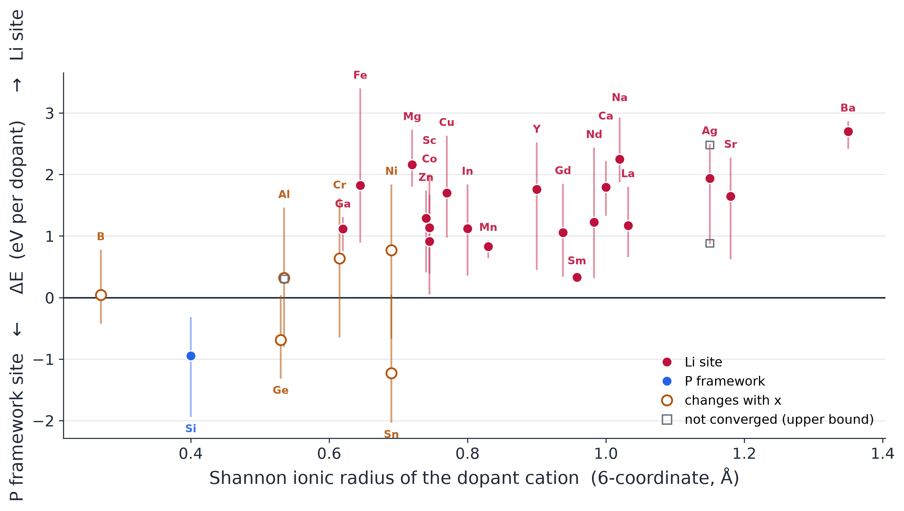
Backup
Site preference vs ionic radius (MLIP relative energies)
A precursor fills one cation and one anion site; every charge-balancing placement is a new structure.
< site preference vs ionic radius >
only Si always takes the P framework; 19 of 26 always take Li; 6 switch with the doping level.

Slide 19
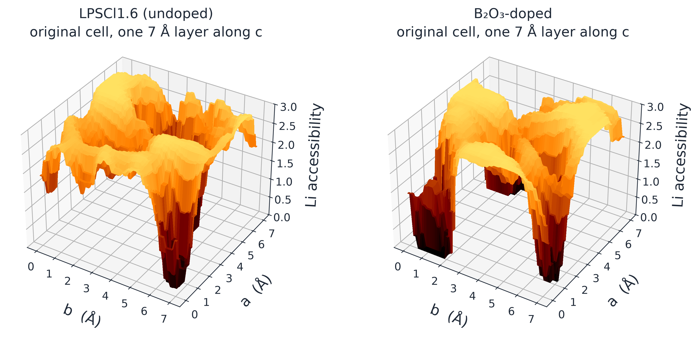
Backup
Bond-valence Li landscape (method illustration)
Low bond-valence site energy marks Li-accessible regions; it is a structural proxy for Li pathways.
< Li landscape on the annealed geometry, undoped versus B₂O₃-doped >
※ a worked example from our other DFT study, not a screened candidate; valleys are low-energy regions, not channels

