Slide 1
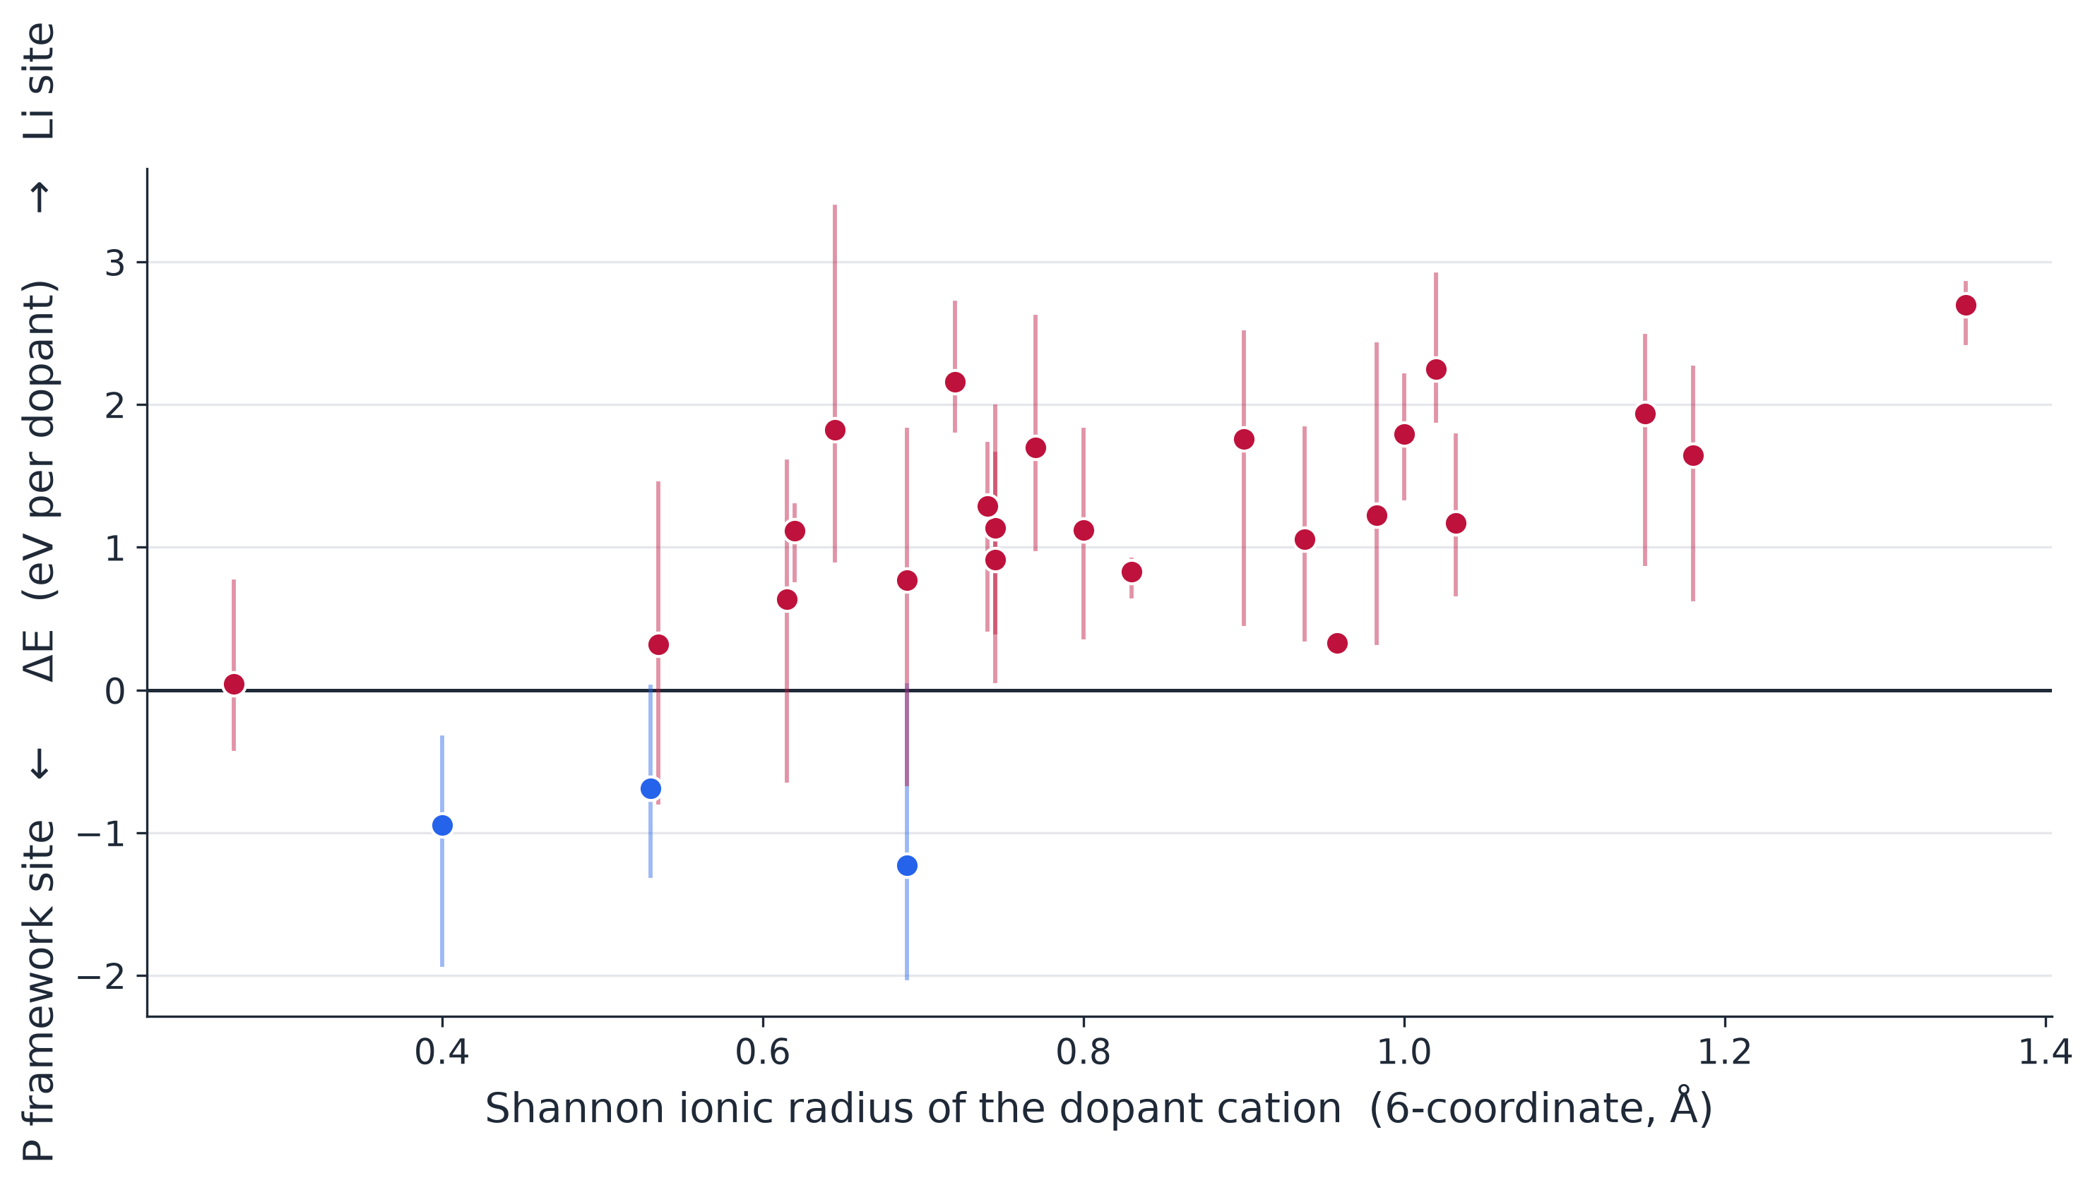
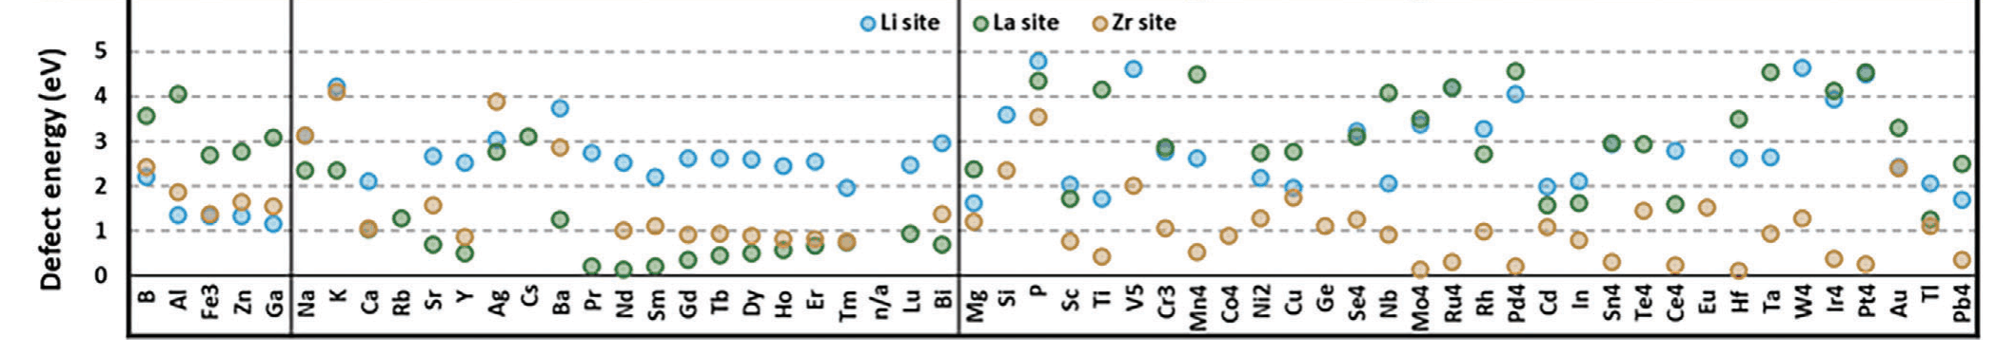
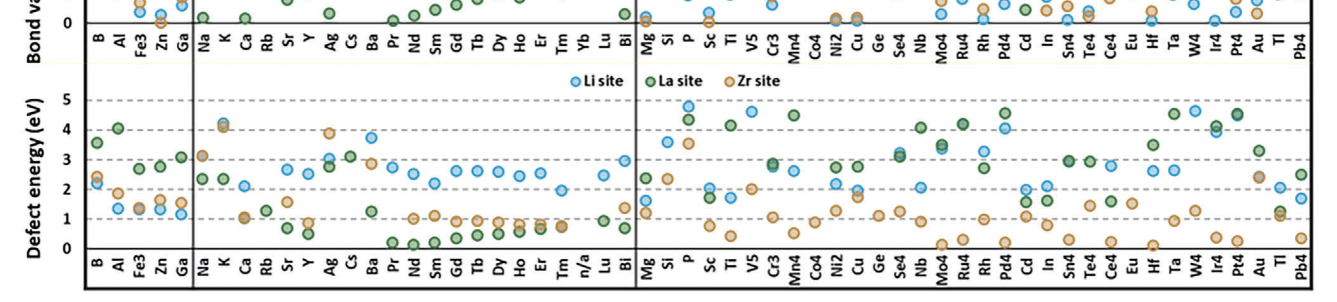
Where prior screening stops
Adv. Energy Mater., 14, 2304025 (2024).
Chem. Mater., 27, 4040 (2015).
Prior work (3): Site-resolved screening already exists
•
One cation is placed on three candidate sites, and the site is chosen by energy.
•
A dopant enters as a precursor, not an element, so a cation and an anion are placed at once.
< 45 dopants × 3 sites in a garnet >
< 91 compounds in our sulfide host >
one cation at a time
one precursor at a time
study | host | what is varied | n | mechanical axis
Miara 2015 (via Anderson) | garnet oxide | one cation, 3 sites | 45 | none
Lee 2024 | argyrodite | elements already in the formula | 84 | none
Xiao 2019 | no host — free coating | the compound itself | 104,082 | none
this work | argyrodite sulfide | an added precursor compound | 91 | included
Lee 2024: J. Mater. Chem. A, 12, 7272. Xiao 2019: Joule, 3, 1252. Left: Anderson et al. (2024) Fig. 3d — defect energies taken from Miara et al. (2015), as stated in that caption.
HANYANG UNIVERSITY
Battery Materials Lab.
6

