Slide 1
August 2026
Research Seminar
Self-Auditing Computational Screening of
Sulfide Solid Electrolytes
— from DFT gates to dopant combinations
An audited cascade: from 47-species screening to prospective co-doping labels
Yonghoon An
Division of Materials Science & Engineering, Hanyang University
(E-mail : yonghoon71@hanyang.ac.kr)
HANYANG UNIVERSITY
Notes:
오늘 발표의 핵심은 후보 하나를 골랐다는 이야기가 아니에요. 황화물 고체전해질의 치환 후보를 계산으로 줄이는 동안, 어떤 주장까지 허용되는지 gate로 제한하고 틀린 결론을 다시 철회한 과정을 보여드리려 해요. 그래서 결과보다도 ‘어떤 근거가 어떤 문장을 허용하는가’를 중심으로 보시면 돼요.
[Sources]
- kb/seminars/cascade_seminar_2026_08_spec.md

Slide 2
Motivation
Sendek et al., EES 2017 · EIS = impedance spectroscopy
The screening problem
halogen species
One experiment = synthesis + XRD + EIS + cell ≈ weeks
One calculation = hours–days
Computation does not replace experiments — it narrows where they go
Post-hoc gate audit begins from the versioned 47-species snapshot:
halogen ratio
Li₆PS₅Cl
host
dopant (47)
campaign labels (3)
pool 47
G2 43
× campaign expansion
G3 25
Three physical design knobs plus one campaign-label axis — labels are not verified concentrations
G4 11
G5 1
HANYANG UNIVERSITY Battery Materials Lab.
2
Notes:
LPSCl 같은 host에서도 할로겐 종류, 비율, 치환종, campaign label이 곱으로 늘어나요. 실험은 합성부터 구조·임피던스·셀 평가까지 시간이 오래 걸리니까, 계산의 역할은 실험을 대체하는 게 아니라 우선순위를 줄이는 거예요. 다만 오른쪽 waterfall은 273에서 47이 물리적으로 걸러졌다는 뜻이 아니고, 47종 snapshot에서 한 사후 gate audit이에요.
[Sources]
- db/properties/cascade_v23_ranked.csv
- db/properties/cascade_screening_funnel.json

Slide 3
Motivation
Screening is only as good as its gates
Screening talks end with “we found X out of N” — the pass side
The harder question: did the wrong ones actually fail? That is rarely reported
This talk puts 11 of our own verdicts under audit — 9 retracted — with the gate that caught each
One of the 11 was presented as a conclusion in our previous seminar deck
usual funnel
ours
×
×
×
×
pass counts only
false rejects invisible
every rejection carries its reason
9 retractions + 2 flags published
HANYANG UNIVERSITY Battery Materials Lab.
3
Notes:
좋은 screening은 rank가 예쁜지가 아니라, 실패했을 때 왜 실패했는지 남기는지가 중요해요. 이 발표에서는 잘못된 gap 판독, 단일 seed 수송 결론, MLIP 반응 해석 같은 사례를 gate로 바꿨어요. 즉 self-auditing은 사후 변명이 아니라 다음 계산에서 자동으로 작동하는 규칙이에요.
[Sources]
- kb/seminars/cascade_seminar_2026_08_spec.md
- db/properties/canonical_registry.json

Slide 4
Roadmap
One loop, six stops
ASK → TOOLS → ORIGIN → SCREEN → COMBINE → VERIFY → (back)
The last stop feeds the first ones — that returning arrow IS the method
Each part opens by lighting its stop on this map
tool limits exposed
(1) ASK
too many candidates
(2) TOOLS
DFT + MLIP limits
(3) ORIGIN
LPSCl: disorder
(4) SCREEN
273 run slots, 5 gates
(5) COMBINE
co-doping ML
(6) VERIFY
11 audited verdicts
ask
measure
learn
gate
combine
doubt
new labels, new sims
ask · measure · learn · gate · combine · doubt
HANYANG UNIVERSITY Battery Materials Lab.
4
Notes:
전체 흐름은 curate, compute, verify, screen의 반복이에요. compute에서 숫자가 나와도 바로 screening에 넣지 않고, verify에서 방법·source·status가 맞는지 확인해요. screen 뒤에는 다시 어떤 라벨이 부족한지 계산해 다음 구조를 고릅니다. 뒤의 co-doping은 바로 이 마지막 feedback 단계예요.
[Sources]
- kb/seminars/cascade_seminar_2026_08_spec.md

Slide 5
Screen · ours
Campaign lineage: 91 × 3 attempted slots → versioned 47-species O/F snapshot
Curated roster
91 species
Attempted campaign
273 run slots (3 labels)
Versioned snapshot
141 records = 47 × 3
The 2026-06-25 canonical table contains 37 oxides + 10 fluorides; the remaining 44 species are absent from the versioned table.
⚠ x002/x005/x010 are campaign labels; conflicting concentration metadata means nominal x remains unresolved.
Absence is not physical rejection: a per-species failure manifest for the missing 44 is not versioned.
“The post-hoc gate audit starts from the 47-species table; it does not explain the 91→47 provenance gap.”
PROVENANCE BOUNDARY
No per-species failure manifest for the missing 44
Only As₂S₃ ×3 is individually documented with n_structures = 0
Missing records remain unclassified until raw run manifests are recovered.
HANYANG UNIVERSITY Battery Materials Lab.
5
Notes:
여기는 반드시 단위를 분리해서 말씀드릴게요. 273은 91종에 세 개 nominal label을 곱한 실행 슬롯이에요. 현재 versioned canonical table은 2026년 6월 25일 snapshot으로, oxide 37종과 fluoride 10종, 총 47종의 141개 record만 들어 있어요. 나머지 44종이 물리적으로 탈락한 건 아니고, 개별 실패 manifest가 없어서 현재는 미분류예요. 따라서 273에서 47로 떨어졌다는 discovery funnel 해석은 하지 않습니다.
[Sources]
- db/properties/cascade_v23_champions.csv
- db/properties/cascade_v23_ranked.csv
- kb/seminars/cascade_seminar_2026_08_spec.md

Slide 6
Tools · DFT
EOS · VRH · ESW · BVSE defined in Appendix A1–A2
From total energy to observables — and into which gate
Quantity | Judges | Used in gate
E(V) → BM3 EOS | B₀ (stiffness) | G5 mechanical
C_ij → VRH | E, G, Pugh ratio | G5 mechanical
grand-potential hull | ESW window · oxidation onset | G2 window + G3 oxidation
BVSE (bond valence) | channels, bottlenecks (cheap) | G4 transport — the gate engine
MLIP-MD → MSD → Arrhenius | Ea, D | champion validation (after the gates)
fixed-occupation nscf eigenvalues | band gap = e⁻ insulation | diagnostic axis, not a gate
ICOHP / ELF / Bader | bonding character | not a gate; explanation only
Gap rule: fixed-occupation eigenvalues ONLY — DOS-threshold reading under-estimates by ~0.3 eV (we did it once; see the retraction table)
ICOHP sign convention: negative = bonding — always printed on the table
Nothing on this ladder reaches particle/electrode scale
HANYANG UNIVERSITY Battery Materials Lab.
6
Notes:
계산마다 말할 수 있는 문장이 달라요. UMA는 많은 구조와 상대 경향을 빠르게 보고, BVSE는 빈 격자에서 정적 경로를 보며, MLIP-MD는 확산 구간을 통과한 동역학을 보고, DFT는 전자상태와 최종 후보를 확인해요. 이 경계를 섞으면 빠른 계산의 숫자가 곧바로 열역학이나 실험 물성처럼 보이는 문제가 생깁니다.
[Sources]
- kb/seminars/cascade_seminar_2026_08_spec.md
- kb/results/mlip_md_diffusive_gate_2026_08_01.md

Slide 7
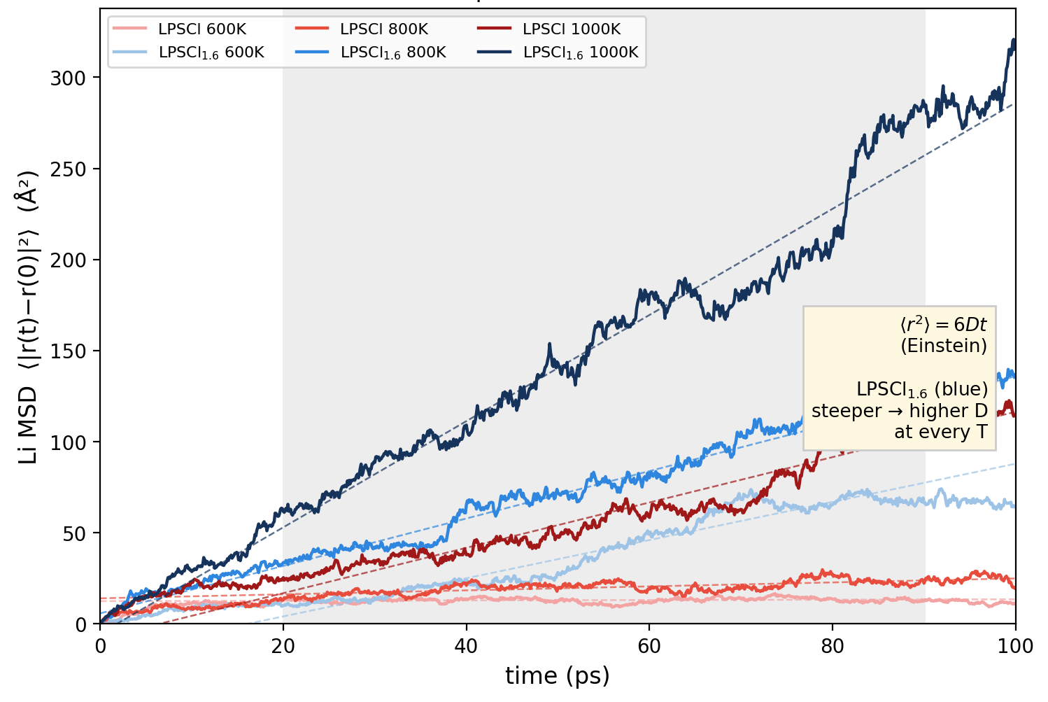
Tools · MLIP
kb/results/mlip_md_diffusive_gate · UMA = universal MLIP (Meta)
Machine-learned potentials: what they buy, what they cannot
UMA (omat head): 200 ps MD, hundreds of atoms — impossible with DFT-MD
Three failures measured in OUR systems:
① no explicit charge states — bit us in SDCP (Part 6)
② cannot select magnetic states — Ni oxides AFM/FM
③ no dispersion in training — fatal for physisorption
Banned on Li₃N (deterministic bias, 2026-06); validated standard on LPSCl family
⇒ MLIP = screening-stage surrogate; champions go back to DFT
MLIP-MD Li MSD, LPSCl vs LPSCl₁.₆ (multi-T; 100 ps window shown)
HANYANG UNIVERSITY Battery Materials Lab.
7
Notes:
MLIP의 장점은 DFT보다 훨씬 많은 configuration을 탐색할 수 있다는 점이에요. 하지만 charge state를 직접 선택할 수 없고, 결합이 끊기거나 Li가 추출되는 사건의 에너지 의미를 자동으로 보장하지 않아요. 그래서 여기서는 구조 탐색과 상대 screening에 쓰고, 반응이나 최종 adsorption 해석은 DFT 단계로 넘깁니다.
[Sources]
- kb/results/mlip_md_diffusive_gate_2026_08_01.md
- kb/projects/sdcp_phaseB_direction_2026_08_06.md

Slide 8
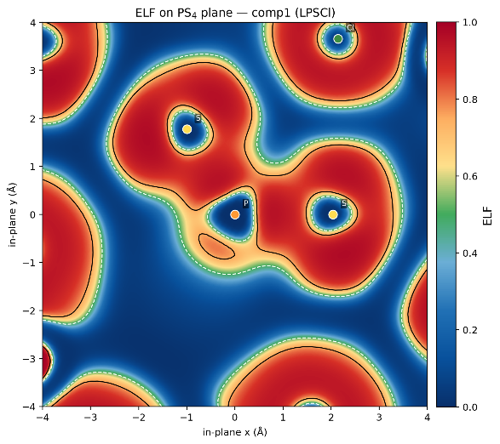
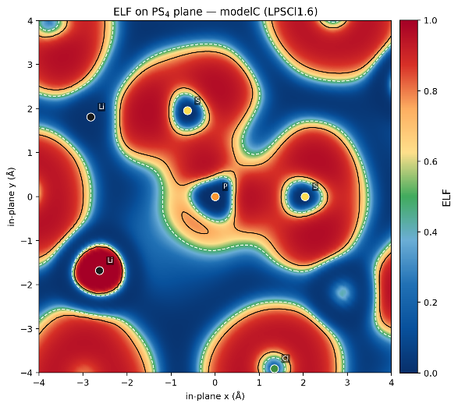
Origin
gap = fixed-occ eigenvalues · ICOHP: negative = bonding
The electronic structure barely moves
ELF, Li₆PS₅Cl
ELF, Li₅.₄PS₄.₄Cl₁.₆ — near-identical topology
 | Li₆PS₅Cl | Li₅.₄PS₄.₄Cl₁.₆ | Δ
gap (eV) | 2.066 | 2.099 | 0.033
ICOHP PS₄ (eV/bond) | −5.938 | −6.000 | ≈0
PBE values are shown for traceability; only same-protocol differences are interpreted — and the smallness is the result
HANYANG UNIVERSITY Battery Materials Lab.
8
Notes:
comp1과 Cl-rich modelc의 fixed-occupation gap은 각각 2.066과 2.099 eV로 차이가 0.033 eV예요. PBE 절대값을 실험 gap처럼 주장하려는 게 아니라, 같은 protocol에서 변화가 작다는 걸 보는 겁니다. 따라서 electronic axis가 주된 설계 신호라기보다, 구조·결함 쪽으로 시선을 옮기는 guardrail 역할을 해요.
[Sources]
- db/properties/electronic.json
- db/properties/canonical_registry.json

Slide 9
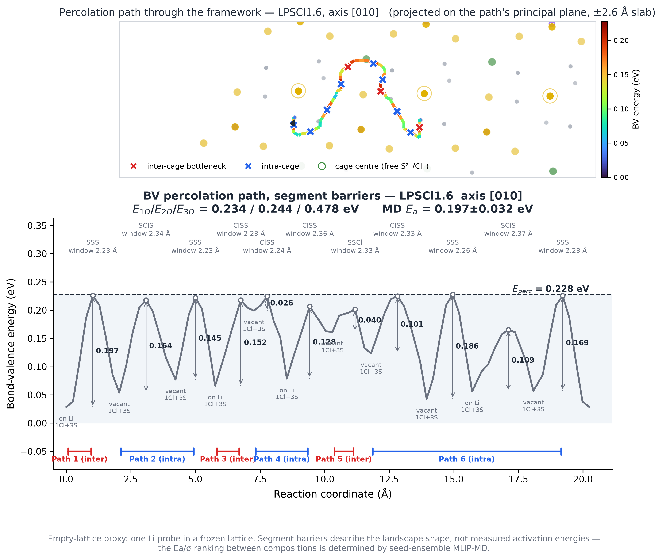
Origin
Structural contrast motivates the screening axes
More Cl is accompanied by Li vacancies and 4d-Cl antisites
The static BVSE channel shrinks (~15%), while MLIP-MD shows higher Li motion
This contrast suggests disorder-sensitive descriptors; it does not isolate causality because composition and defect populations change together
⇒ screen transport retention · disorder response · label robustness · structural stability
Electronic quantities remain guardrails, not the ranking target
Empty-lattice BVSE geometry only — not Eₐ, D, or conductivity
HANYANG UNIVERSITY Battery Materials Lab.
9
Notes:
Cl-rich 조성에는 Li vacancy와 4d-Cl antisite가 같이 들어가요. 정적 BVSE 채널은 오히려 줄고, MLIP-MD에서는 더 큰 Li motion이 보입니다. 이 차이는 disorder-sensitive descriptor를 선택할 이유는 되지만, composition과 defect population이 함께 바뀌었기 때문에 인과를 분리한 증거는 아니에요. 또 comp1에는 인용 가능한 multi-seed Ea가 없어서 비교 수송 향상을 확정하지 않습니다.
[Sources]
- db/properties/canonical_registry.json
- kb/results/mlip_md_diffusive_gate_2026_08_01.md

Slide 10
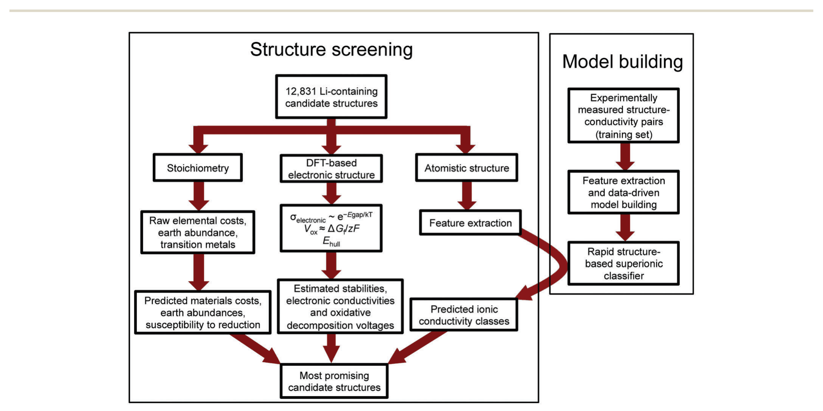
Screen · the field
Sendek et al., EES 2017, 10, 306
How the field screens ①: 12,831 → 21
Two tracks: structure screening (12,831 candidates) + model building on 40 measured conductors (Sendek 2017)
4 prerequisite gates (Eₕᵤₗₗ = 0 · gap ≥ 1 eV · Vₒₓ ≥ 4 V · no TM) → 317; classifier trained on 40 measured σ → 21 (0.16%)
Their lesson: cheap validity gates cut harder than the conductivity model (model alone leaves 1,408)
Small-sample lesson, not dataset equivalence: our 47 in-host candidates require grouped CV and prospective labels
HANYANG UNIVERSITY Battery Materials Lab.
10
Notes:
Sendek 연구에서는 1만 종이 넘는 후보에 먼저 안정성·gap·전압 같은 싼 prerequisite gate를 적용하고, 40개의 측정 전도도로 학습한 classifier를 뒤에 썼어요. 중요한 점은 classifier보다 앞의 physics gate가 더 크게 후보를 줄였다는 거예요. 우리 47종과 데이터 크기가 같다는 뜻은 아니고, 작은 라벨에서는 grouped validation과 prospective test가 필요하다는 교훈만 가져옵니다.
[Sources]
- litdb/papers/sendek2017_ml_screening_12k_conductors.md
- litdb/papers/xiao2019_cathode_coating_screening.md

Slide 11
Screen · ours
G4 lineage: Kahle et al. 2020 (HT-AIMD)
Five gates: metric, threshold, and why
Gate | Metric | Threshold | Physical basis | Lit. analog
G1 structural | mean ΔE over 3 campaign-label champions, UMA | mean ΔE < 0 | relative favorability vs host; 47/47 pass → vacuous here | Xiao F2 · Sendek P1
G2 window | grand-potential ESW width | window ≥ 0.05 V | a window must exist at all | Zhu 2015 · Xiao F3
G3 oxidation | oxidation onset (V vs Li) | V_ox ≥ 2.14 V (= undoped host onset) | must not be worse than the host | Richards windows
G4 transport | static BVSE proxy (x005 label) | norm > 0.3 AND blocking < 0.6* | heuristic pathway screen; not conductivity | Kahle HT-AIMD
G5 mechanical | E (UMA) and G/B | E ≤ 46.9 GPa AND G/B ≤ 0.78 (roster medians) | roster-relative ranking only | —
G1 and G3 are host-referenced, but G1 is vacuous in this snapshot
G2's four kills all also fail G3 → unique kill = 0
* Both G4 cuts are heuristic; blocking < 0.6 has no host/literature anchor
G5 uses roster medians and ranks the G4 set — it is not a hard physical gate
HANYANG UNIVERSITY Battery Materials Lab.
11
Notes:
G1은 세 campaign-label champion의 평균 상대에너지, G2는 window 존재, G3는 host 이상의 oxidation onset, G4는 정적 BVSE proxy, G5는 softness와 ductility 순위예요. 여기서 G1은 47종 모두 통과해서 현재 pool에서는 gate power가 없고, G2의 네 탈락은 전부 G3에도 걸립니다. G4 두 cutoff는 heuristic이고, G5는 roster median이라 ranking-only예요.
[Sources]
- db/properties/cascade_screening_funnel.json
- db/properties/cascade_v23_ranked.csv

Slide 12
Screen · ours
The defensible hard-gate view stops at the 11-member G4 shortlist
G1 47/47 = curated snapshot, not gate power
G2 unique kill = 0: all four are already removed by G3
All 5! = 120 gate orders give the same final Boolean intersection; only attribution and intermediate counts move
47 → 43 → 25 → 11 through G4; G5 only ranks the 11
HANYANG UNIVERSITY Battery Materials Lab.
12
Notes:
47에서 43, 25, 11로 줄어드는 구간까지가 G4까지의 결과예요. 마지막 1은 G5 순위 cutoff가 만든 값이라 winner로 부르지 않습니다. 120개 gate 순서를 전부 바꿔도 최종 Boolean intersection은 같았지만, 중간 count와 어느 gate가 탈락시켰는지는 달라져요. 즉 waterfall 모양은 설명 방식이고, terminal set만 논리적으로 invariant합니다.
[Sources]
- db/properties/cascade_screening_funnel.json

Slide 13
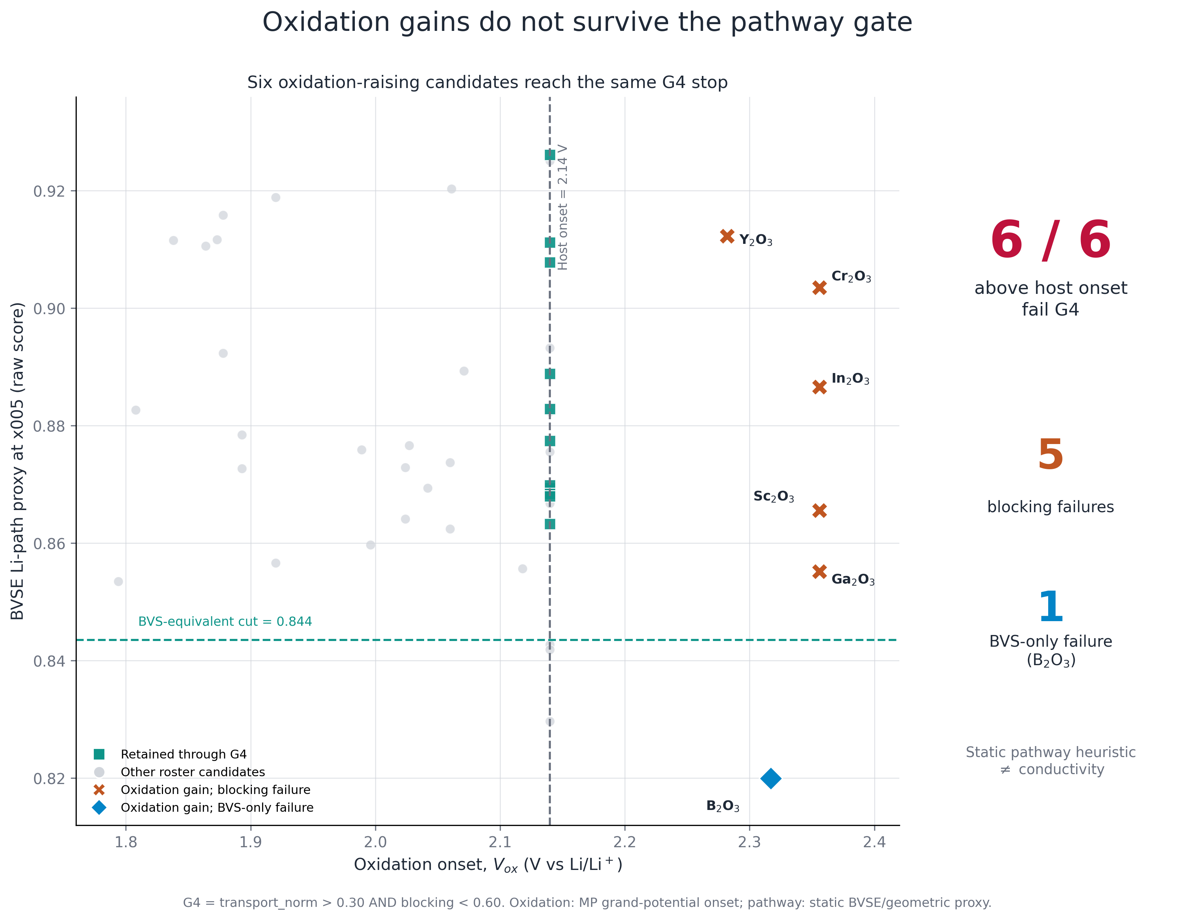
Screen · ours
source: cascade_seminar_oxidation_transport_47.csv
Oxidation improvement and the static pathway proxy trade off in this snapshot
All six oxidation-raising candidates (Cr₂O₃, Ga₂O₃, In₂O₃, Sc₂O₃, B₂O₃, Y₂O₃) fail G4
This is a dataset-level trade-off, not proof that M–O bonding causes Li blocking
Their complementary strengths motivate explicit pair hypotheses — not automatic pair validity
All six oxidation-raising candidates stop at the same static pathway heuristic — not measured or MD conductivity
HANYANG UNIVERSITY Battery Materials Lab.
13
Notes:
47종 snapshot에서 oxidation onset을 높인 여섯 후보가 모두 같은 G4 정적 경로 heuristic에서 멈췄어요. 이건 데이터셋 수준의 trade-off이고, M–O 결합이 Li blocking을 일으킨다는 인과 증명은 아닙니다. 그리고 BVSE는 conductivity가 아니에요. 다만 한 후보의 약점과 다른 후보의 강점을 조합해 볼 이유는 충분히 줍니다.
[Sources]
- db/properties/cascade_seminar_oxidation_transport_47.csv
- docs/figures/cascade/cascade_seminar_oxidation_transport_47.png

Slide 14
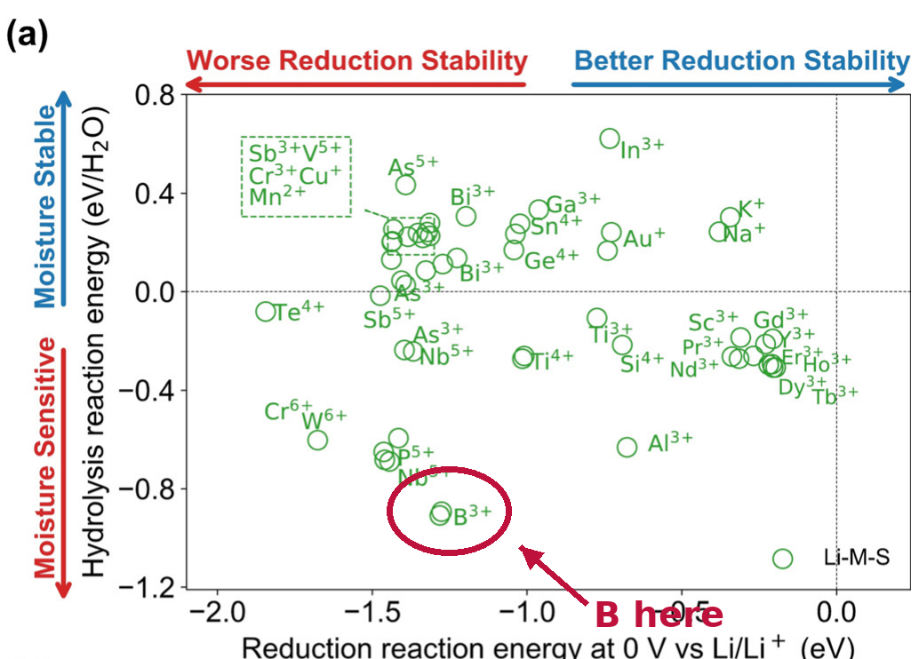
Screen · ours
Zhu et al., Angew. 2020 (hydrolysis map)
Why the funnel is the wrong endpoint for our question
① “1 survivor” is a property of thresholds, not a unique chemical truth
② Sequential AND can discard complementarity: an oxidation-strong / pathway-weak dopant dies before pairing
③ B₂O₃ illustrates conflicting axes: favorable in one transport landscape, rejected by the static pathway proxy, and provisional on air-related axes
No single universal score is defensible
⇒ retain multi-objective structure and acquire targeted combination labels
Literature hydrolysis map, used as context only; our air-related axes remain descriptive until ΔGₕᵧd is closed
HANYANG UNIVERSITY Battery Materials Lab.
14
Notes:
AND funnel은 한 축의 약점을 이유로 후보를 완전히 버려요. 그런데 oxidation은 좋고 pathway proxy는 약한 후보가 co-doping에서는 필요한 cathode-side half일 수 있어요. B2O3처럼 지표마다 방향이 다른 후보도 하나의 score로 좋다·나쁘다를 말하기 어렵습니다. 그래서 14축 구조를 유지하고, combination을 실제 계산하는 쪽으로 넘어갑니다.
[Sources]
- db/properties/cascade_seminar_scorecard_47.csv
- litdb/papers/zhu2020_air_stable_se_design_principles.md

Slide 15
Combine
synergy = max(joint-window gain, 0) × radius-match × stability
Co-doping: complementarity as the design variable
Pair | proxy joint window (V) | proxy gain vs best single | radius match | tag
Cr₂O₃ + HfO₂ | 1.114 | +0.360 | 0.87 | anode↔cathode
Al₂O₃ + Cr₂O₃ | 0.984 | +0.216 | 0.90 | anode↔cathode
HfO₂ + In₂O₃ | 1.114 | +0.323 | 0.88 | anode↔cathode
Ga₂O₃ + HfO₂ | 1.114 | +0.336 | 0.88 | anode↔cathode
Rows 1/3/4 share 1.114 V because HfO₂ supplies the lower reduction edge, while Cr/Ga/In oxides supply the upper oxidation edge.
All rows are end-member combinations, not explicit co-doped calculations
Cr₂O₃ and HfO₂ single-dopant champions both occupy Li_24g → site competition is a first-order risk
Before believing a pair: build explicit structures · resolve site/stoichiometry/charge · compute formation energy · label with UMA/DFT
The formula rewards complementarity by construction; it does not validate pair chemistry
HANYANG UNIVERSITY Battery Materials Lab.
15
Notes:
표의 +0.360 V는 실제 Cr2O3–HfO2 co-doped 구조 계산값이 아니에요. single-dopant의 reduction edge와 oxidation edge를 조합한 end-member proxy입니다. Cr oxide가 높은 oxidation edge를, HfO2가 낮은 reduction edge를 주는 조합이에요. 더구나 두 single-dopant champion이 모두 Li_24g라 site competition 위험이 있습니다. 구조를 만들기 전에는 chemistry가 검증된 게 아닙니다.
[Sources]
- db/properties/codoping_ml_v2.csv
- db/properties/codoping_ml_v2_meta.json
- tools/cascade/codoping_ml.py

Slide 16
Combine
ridge · λ by 1-SE rule · LOOCV
What the model actually knows
Stage | Target | n | LOOCV R² | Reading
1 ridge | our cascade score (composite) | 47 | 0.9998 | not success: it dissected our own formula
2 pair features | feature construction (min/max/avg + quadratic) | — | — | construction stage — no CV target
3 interaction | pair synergy | 1,081 pairs | 0.089 | honest number — interactions essentially unlearned
Stage 1 LOOCV R² = 0.9998: recovery of the constructed single-dopant score formula.
Stage 3 pair-LOOCV R² = 0.0892; LODO = −0.1805; L2DO = −0.2548; optimism gap = +0.344.
1,081 H0 pair hypotheses; 0 explicit pair structures and 0 pair UMA/DFT/experimental targets.
Therefore this is a hypothesis generator, not a property predictor.
HANYANG UNIVERSITY Battery Materials Lab.
16
Notes:
single-dopant score 공식을 다시 맞추는 stage 1은 R²가 0.9998로 높아요. 하지만 pair hypothesis에 들어가면 pair-LOOCV가 0.0892, dopant를 통째로 빼는 LODO와 L2DO는 음수가 됩니다. 지금은 1,081개 H0 가설이 있지만 실제 pair structure와 pair target은 0개예요. 따라서 predictor가 아니라 다음 계산을 정하는 hypothesis generator로만 씁니다.
[Sources]
- db/properties/codoping_ml_v2_meta.json
- tools/cascade/codoping_ml.py

Slide 17
Combine
Making the labels the model is missing
Prospective pair-label matrix: 3 × 3 nominal slots (resolve actual stoichiometry before interpreting dose)
Build explicit co-substituted structures for prioritized pairs: site assignment · charge/Li-count closure · formation energy
Success = frozen prospective co-dopant holdouts beat a mean/heuristic baseline under L2DO-style splits
Failure = complementarity hypothesis is falsified — still useful
Loop: propose → calculate → validate → retrain → select the next structure
x002
x005
x010
x002
x005
x010
= 9 nominal pair-label slots — composition is a new label axis, not an inherited physical x
HANYANG UNIVERSITY Battery Materials Lab.
17
Notes:
다음 단계는 숫자 농도를 가정하는 게 아니라, explicit co-substituted structure를 만드는 거예요. x002, x005, x010은 nominal campaign label이므로 실제 stoichiometry를 먼저 닫아야 합니다. 각 pair에서 site, charge/Li-count, formation energy를 정하고 prospective holdout으로 검사해요. 모델이 맞으면 다음 구조 선택 효율이 좋아지고, 틀리면 complementarity 가설을 버리면 됩니다.
[Sources]
- db/properties/codoping_ml_v2_meta.json
- kb/seminars/cascade_seminar_2026_08_spec.md

Slide 18
Verify
Retracted verdicts, and the gates that caught them
# | Retracted claim | What was wrong | Caught by
1 | σ ratio 1.33× | single seed | multi-seed rule
2 | comp1 Ea 0.253 eV | MSD not in diffusive regime | β-gate (0/6 pass)
3 | LPSOCl Ea 0.287 eV | 600 K β = 0.61 (caged) | β-gate → on hold
4 | gaps read from DOS threshold | ~0.3 eV under | fixed-occ eigenvalue rule
5 | air_hsab grades | wrong driver (softness ≠ oxophilicity) | [Zhu20] SI check — 9/35 off
6 | SDCP frozen UMA score −0.258 eV | frozen slab blocked relaxation | constraint variation → Li-transfer pose; not Eads
7 | Li-transfer pose −1.27 to −1.465 eV | MLIP lacks charge-state energetics | old DFT endpoint +0.336/+0.340 eV; v2 recheck open
8 | SDCP site / adsorption differences | 9 meV, −32/−26 meV, +0.34 eV were conflated | matched-endpoint rule; site preference unresolved
9 | Nd gaps (3 phases) | quantity undefined (metallic SCF) | fixed-occ validity condition
10 | Nd₂S₃ gap 1.79 eV | metastable theoretical polymorph (mp-32586) picked | material-id pinning → 0.760 (obs. Pnma)
11 | 4 canonical gaps | values fine — run files missing | provenance audit (Part 6 close)
Ledger: 9 retracted · 1 on hold (#3) · 1 provenance-flagged (#11) — and 5 of 11 landed within the last four days
HANYANG UNIVERSITY Battery Materials Lab.
18
Notes:
이 표는 실패를 숨기지 않고 claim과 gate를 연결한 ledger예요. SDCP는 세 숫자를 분리해야 합니다. 9 meV는 site-pose 비교, −32/−26 meV는 old doped–neutral adsorption 비교, +0.336/+0.340 eV는 Li-transfer endpoint 비교예요. 마지막 값도 old protocol의 provisional endpoint라 v2 재검 전에는 반응 자유에너지나 barrier로 부르지 않습니다.
[Sources]
- kb/projects/sdcp_phaseB_direction_2026_08_06.md
- kb/results/sdcp_master_summary_2026_07_16.md
- db/properties/canonical_registry.json

Slide 19
Conclusions
What we deliver, then the one sentence
Deliverable | State
LPSCl descriptor lesson | gap Δ = 0.033 eV; structural axes motivated; transport causality open
Screening evidence | 47-species O/F snapshot (141 rows); 273 is a separate run-slot count
Gate result | 47 → 43 → 25 → 11 through heuristic G4; G5 ranks only
Co-doping | 1,081 H0 proxies; pair-CV 0.0892; no explicit pair labels
Provenance infrastructure | live drift checks; flags ship with values
Audit ledger | 9 retracted · 1 on hold · 1 provenance flag
The defensible output is a versioned snapshot, an audited heuristic shortlist, and a label-acquisition plan — not a discovered winner.
Supported: relative screening · trade-offs · prospective hypotheses
Not supported: a unique winner · 47/47 DFT validation · absolute conductivity · experimental proof
HANYANG UNIVERSITY Battery Materials Lab.
19
Notes:
결론은 winner가 아니라 세 가지 산출물이에요. 첫째, provenance가 분리된 47종 versioned snapshot. 둘째, heuristic임을 공개한 11종 G4 shortlist와 G5 ranking. 셋째, real pair label을 얻기 위한 acquisition plan입니다. 그리고 11개 감사 판정 중 9개는 철회했고, 하나는 hold, 하나는 provenance-open 상태로 값과 함께 표시합니다.
[Sources]
- db/properties/cascade_screening_funnel.json
- db/properties/codoping_ml_v2_meta.json
- db/properties/canonical_registry.json

Slide 20
Closing
One ladder, our two rungs, and the loop
Å–nm
DFT · MLIP
(this talk)
µm
DEM: contacts,
tortuosity, eff. σ
mm
electrode
(continuum)
we hand over E · G · γ · ΔV — DEM takes it from there (a different talk)
tool limits exposed
(1) ASK
too many candidates
(2) TOOLS
DFT + MLIP limits
(3) ORIGIN
LPSCl: disorder
(4) SCREEN
273 run slots, 5 gates
(5) COMBINE
co-doping ML
(6) VERIFY
11 audited verdicts
ask
measure
learn
gate
combine
doubt
new labels, new sims
Today was one lap of this loop. Thank you.
HANYANG UNIVERSITY Battery Materials Lab.
20
Notes:
처음의 loop로 돌아오면, 지금 위치는 screen에서 verify와 label acquisition으로 넘어가는 지점이에요. explicit pair structure를 만들고 UMA로 configuration space를 줄인 뒤, 필요한 후보만 DFT와 실험으로 확인합니다. 이후 새 라벨이 쌓이면 모델을 다시 학습해 다음 계산을 고르는 active-learning loop로 확장할 수 있어요.
[Sources]
- kb/seminars/cascade_seminar_2026_08_spec.md
- tools/cascade/codoping_ml.py

Slide 21
Appendix A1
DFT terms
Term | One-line definition (and our setting)
SCF | self-consistent field — iterate density↔potential to a fixed point
pseudopotential | replace core electrons by an effective potential; valence-only problem
k-mesh | Brillouin-zone sampling grid; denser = more accurate band integrals
XC functional | the one approximated term E_xc[n]; ours: PBE (GGA)
Hubbard U | on-site repulsion for localized d/f; ours: Ni 3d, U = 6.2 eV (empirical)
smearing | fractional occupations to stabilize metallic SCF; NEVER for our gap readings (fixed-occ rule)
HANYANG UNIVERSITY Battery Materials Lab.
21
Notes:
질문이 나오면 DFT, exchange-correlation, U, k-point, fixed occupations를 이 표로 짧게 정의하면 돼요. 핵심은 모든 숫자에 method tag를 붙이고, 서로 다른 protocol의 절대값을 한 축에 섞지 않는다는 겁니다.
[Sources]
- db/properties/electronic.json
- kb/seminars/cascade_seminar_2026_08_spec.md

Slide 22
Appendix A2
Property terms
Term | One-line definition (and our setting)
BM3 EOS | 3rd-order Birch–Murnaghan fit of E(V) → B₀
C_ij / VRH | elastic tensor / Voigt–Reuss–Hill average → E, G
ICOHP | bond-resolved band-energy integral; SIGN: negative = bonding
ELF | electron localization function, 0–1
Bader charge | charge partitioned by zero-flux surfaces of n(r)
ESW | electrochemical stability window from grand-potential hull
E_hull | height above convex hull = decomposition driving force
HANYANG UNIVERSITY Battery Materials Lab.
22
Notes:
window, oxidation onset, BVSE, elastic 지표가 무엇을 뜻하는지 묻는 질문용이에요. 각 항목은 서로 다른 물성을 보므로, 하나의 universal score로 합치는 순간 해석이 바뀐다는 점을 강조하면 됩니다.
[Sources]
- db/properties/cascade_screening_funnel.json
- db/properties/cascade_seminar_scorecard_47.csv

Slide 23
Appendix A3
Protocol matrix: the method tag sets the strongest allowed claim
Tier / method | Primary output | Allowed claim | Do not claim
UMA MLIP | relative E, forces, relaxation | same-protocol candidate ordering | absolute thermodynamics
BVSE | static pathway geometry | pathway-retention risk | D or conductivity
MLIP-MD | MSD, D(T), Ea | multi-seed verdict at 600/800/1000 K (β-gated) | single-seed ratios
DFT (+U) | matched energies, electronic response | selected-candidate validation | 47/47 DFT coverage
Literature / experiment | external values | directional cross-check | mixing with internal absolutes
One symbol = one method-qualified quantity. Never reuse a label across protocol lineages.
HANYANG UNIVERSITY Battery Materials Lab.
23
Notes:
이 표는 method-to-claim 계약의 세부 버전이에요. 입력, 기준 구조, 허용 claim, 금지 claim을 함께 보고 답하면 됩니다. 특히 screen 값과 DFT case study를 같은 validation coverage처럼 말하지 않는 게 중요해요.
[Sources]
- kb/seminars/cascade_seminar_2026_08_spec.md
- db/properties/canonical_registry.json

Slide 24
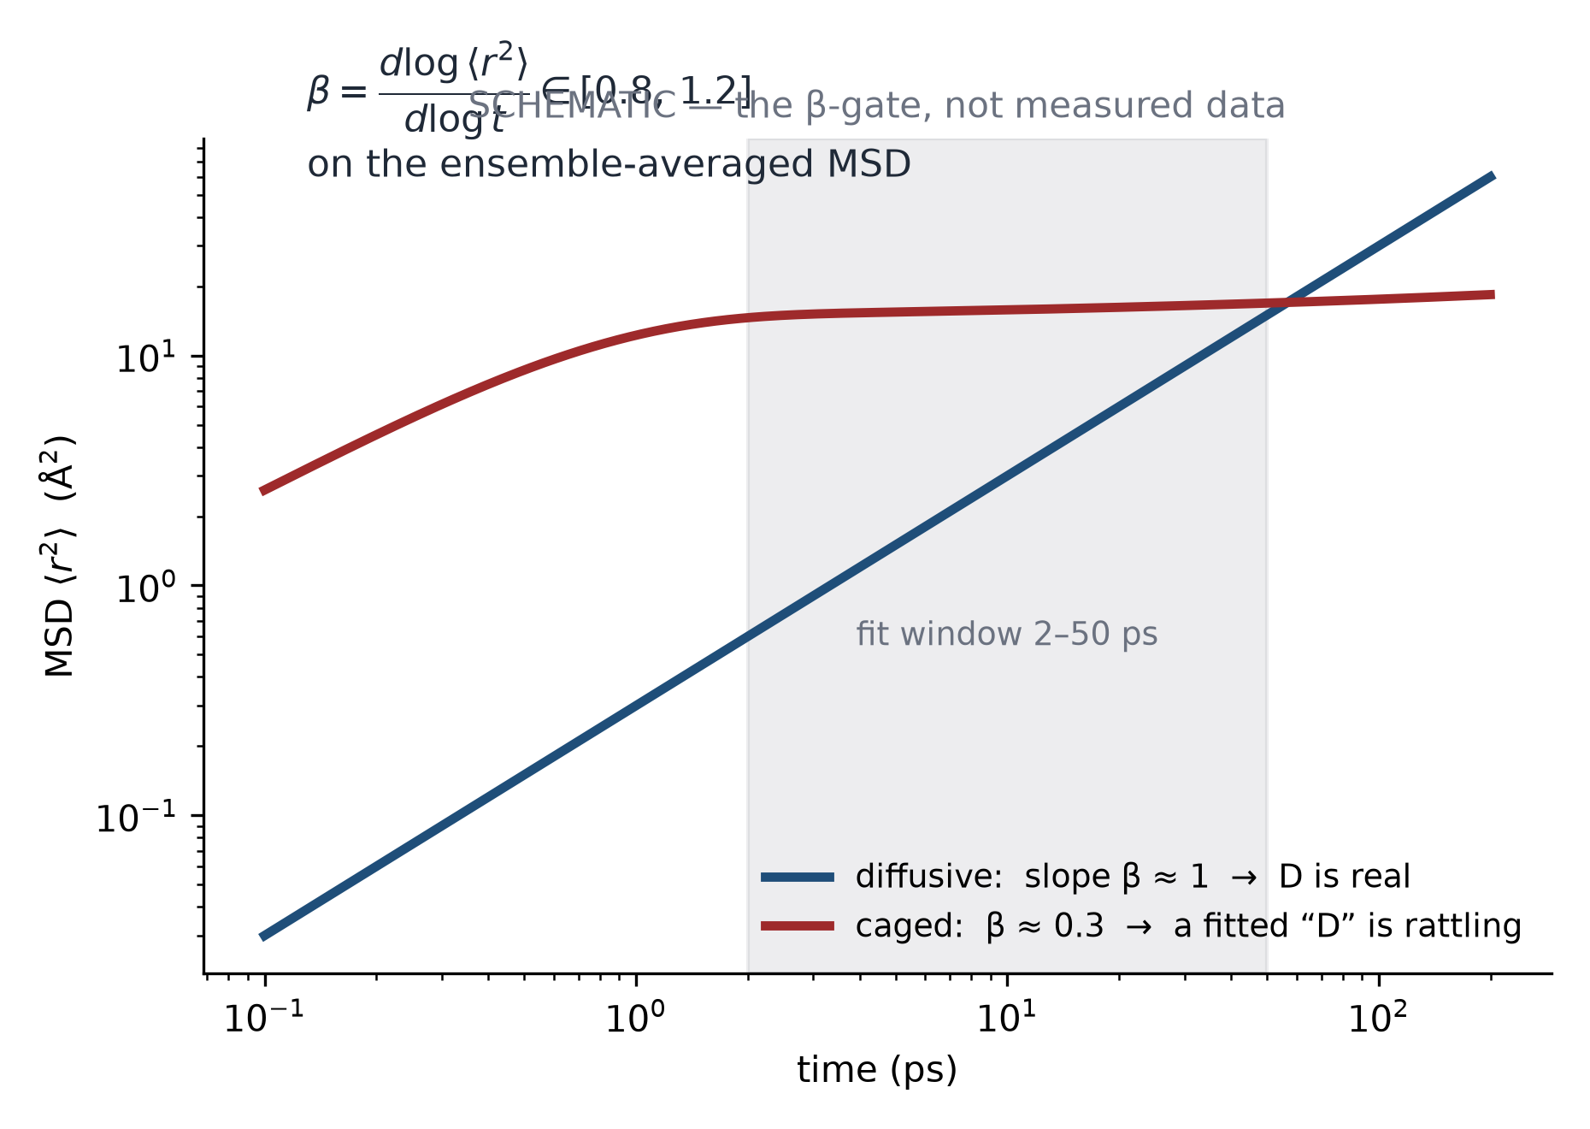
Appendix A4
Transport terms, and the β-gate
MSD: ⟨r²(t)⟩; diffusive regime ⇔ log–log slope near 1
β-gate: β ∈ [0.8, 1.2] on ensemble-averaged MSD; otherwise D can be cage rattling
Arrhenius verdict: 600/800/1000 K; canonical MSD fit window: 2–50 ps
Nernst–Einstein (Haven = 1): no absolute σ; even ratios require a multi-seed verdict
β validates the diffusive regime — it does not identify a microscopic saddle
Schematic only — no measured data. The gate separates rattling from transport
HANYANG UNIVERSITY Battery Materials Lab.
24
Notes:
β는 MSD가 확산 구간인지 확인하는 지표예요. 0.8에서 1.2 사이가 아니면 cage rattling을 D로 잘못 맞출 수 있습니다. 판정은 600, 800, 1000 K와 2–50 ps 창을 사용하고, 절대 conductivity는 인용하지 않으며 비율도 multi-seed 판정일 때만 씁니다. β 자체가 특정 saddle을 알려주는 건 아니에요.
[Sources]
- kb/results/mlip_md_diffusive_gate_2026_08_01.md
- db/properties/canonical_registry.json

Slide 25
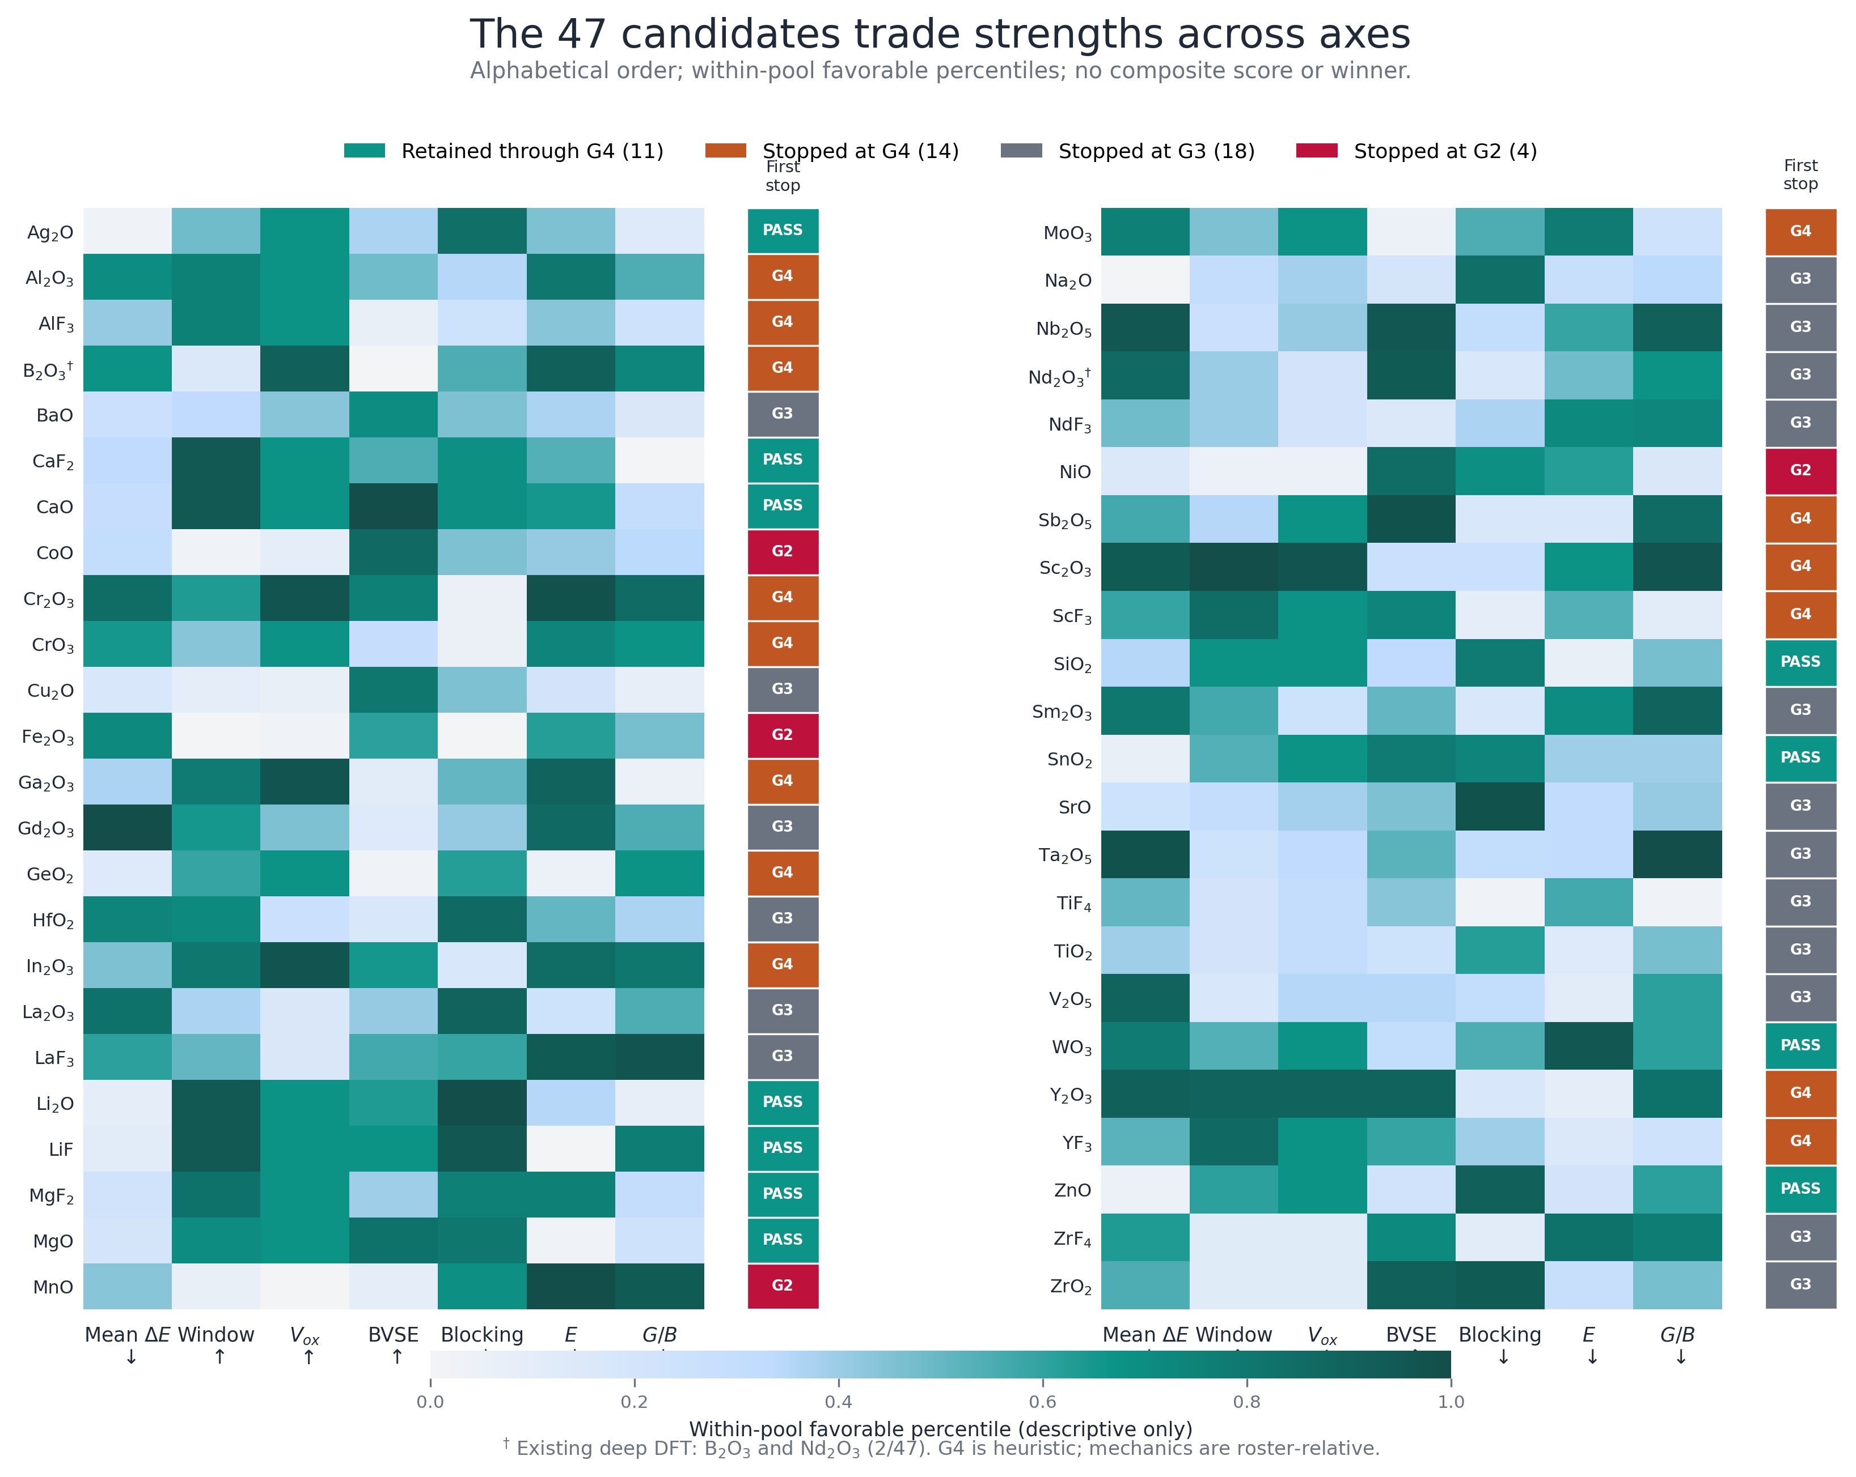
Appendix A5
source: cascade_seminar_scorecard_47.csv
Ranking without a funnel: strengths trade across axes
Per-axis percentiles + first-stop gate — no universal composite score and no winner (live 14-theme view: web app /cascade)
14 themes: oxidative · reduction · e⁻-insulation · transport · disorder · label-robustness · lightweight · low-cost · soft · ductile · air ×2 · structural · balanced
Within-theme geometric means are AND-like; there is no cross-theme universal score
Missing ≠ bad — excluded and flagged, never zero-filled · air/HSAB axes remain descriptive/provisional
HANYANG UNIVERSITY Battery Materials Lab.
25
Notes:
후보별 전체 축을 묻는 질문에 쓰는 backup이에요. percentile과 theme 내부 geometric mean은 표시용 비교이고, theme를 가로지르는 universal score는 없습니다. missing은 0으로 채우지 않고 제외·flag 처리했고, air와 HSAB 관련 축은 아직 descriptive 또는 provisional입니다.
[Sources]
- db/properties/cascade_seminar_scorecard_47.csv
- docs/figures/cascade/cascade_seminar_scorecard_47.png

Slide 26
Appendix A6
Twelve defense questions: concise first answers
Q | First sentence of the answer
Do you trust a PBE gap? | Not the absolute value — only same-method differences.
Why no absolute σ? ★ | No absolute σ; even relative ratios require a multi-seed verdict under the canonical MSD/temperature protocol.
Does MLIP replace DFT? | No — screening surrogate; champions return to DFT. Charge states failed us, measurably.
Experimentally validated? | Not yet — two targeted DFT case studies do not validate all 47 candidates or all screening axes.
Is WO₃ the answer? | It is the G5 top rank within an 11-member heuristic shortlist, not a discovered winner.
Why U = 6.2? | Established lineage value, empirical; we fix it and quote same-U differences.
R² = 0.089 — useless? | As a predictor yes; pair-LOOCV is 0.0892 and L2DO is −0.2548, so it is only a hypothesis generator.
11 audited verdicts — can we trust you? | Trust the executable gates and versioned evidence: 9 claims were retracted, 1 is on hold, and 1 carries an open provenance flag.
Canonical values without run files? | Values pass live drift checks; the missing-provenance flag ships WITH them.
Why show the funnel at all? | Drawing it the field's way is what reveals where we diverge.
Is co-doping even makeable? | Not yet — explicit pair structures must resolve site, stoichiometry, charge closure, and formation energy.
Can you predict the ratio? | Not yet — the ratio axis requires structure-defined prospective labels; x002/x005/x010 are nominal campaign labels only.
HANYANG UNIVERSITY Battery Materials Lab.
26
Notes:
질문에는 먼저 한 문장으로 범위를 닫고, 필요할 때 숫자를 추가하세요. 특히 WO3는 winner가 아니라 G5 top rank, 2/47은 targeted DFT case study, co-doping은 explicit structure가 없는 hypothesis라는 세 문장을 먼저 기억하면 대부분의 과장을 막을 수 있어요.
[Sources]
- kb/seminars/cascade_seminar_2026_08_spec.md
- db/properties/codoping_ml_v2_meta.json

Slide 27
Appendix A7
Five harder questions from our own review
Q (who asks) | First sentence of the answer
Why must an electrolyte be an electronic insulator? (basics, on purpose) | If electrons leak, Li⁺ keeps reducing inside/at interfaces — SEI never self-limits and dendrite paths grow; ion-only transport is the defining condition.
What IS Ea physically — where is the hill in the structure? (basics) | Eₐ is the slope of ln D versus 1/T after a diffusive-MSD gate; β does not locate a specific 4d-site saddle.
“UMA is a validated standard” — validated on what, by how much? | UMA supports relative geometry/ranking in the LPSCl family; it does not validate charge states, reactions, or absolute adsorption energies.
Will HfO₂ really enter the lattice in a 550 °C H₂S synthesis? Cost of Hf? | We do not know — Hf-containing pairs remain end-member hypotheses until explicit structures, phase stability, cost, and synthesis are checked.
Why are 44 roster species absent from the canonical table? | The 47 is a versioned O/F snapshot; the missing 44 lack a per-species manifest, so bias propagation is currently unquantified.
Honest answer: this provenance gap blocks any discovery-rate claim from the 273-slot campaign.
HANYANG UNIVERSITY Battery Materials Lab.
27
Notes:
어려운 질문에서는 모르는 걸 분명히 말하는 게 답이에요. Ea는 Arrhenius slope이지 자동으로 특정 saddle이 아니고, UMA의 상대 geometry 활용과 charge-state 한계를 분리해야 합니다. 그리고 44종 provenance gap 때문에 273-slot campaign의 discovery rate를 계산할 수 없다고 명확히 답하면 됩니다.
[Sources]
- kb/results/mlip_md_diffusive_gate_2026_08_01.md
- kb/seminars/cascade_seminar_2026_08_spec.md

Slide 28
Appendix A8
ML backup: the numbers behind Part 5
Item | Value | Note
stage-1 λ (1-SE) | 0.0794 | LOOCV residual σ = 0.0018 score units
stage-1 leakage audit | +3.4% σ_loo | fold-wise re-standardization only; not a pair-chemistry leakage audit
stage-3 λ | 39.8 | pair-LOOCV R² = 0.0892; optimism gap +0.344
stage-3 dopant-level CV | LODO −0.1805 · L2DO −0.2548 | independent folds: R² < 0 (bias +0.34)
stage-3 residual | 2.33 z-units | interactions unlearned
v1 top-40 Spearman | 0.672 | top-10 overlap 2/10
v1-unlisted pairs | synergy ≈ 0 (weight 0.1) | 1,041 of 1,081 — weak approximation
assumptions | aggregate single-dopant features + quadratic terms | 0 explicit pair structures or pair-property targets
verdict | hypothesis generator — NOT a property predictor | structure-defined prospective labels required
HANYANG UNIVERSITY Battery Materials Lab.
28
Notes:
모델 수치를 요구하면 stage 1과 stage 3을 분리하세요. 0.9998은 만든 공식을 다시 찾은 결과이고, pair prediction 성능은 0.0892입니다. 새로운 dopant를 통째로 빼면 R²가 음수라 일반화에 실패해요. 그래서 real pair structure와 prospective label이 다음 병목입니다.
[Sources]
- db/properties/codoping_ml_v2_meta.json
- tools/cascade/codoping_ml.py

Slide 29
Appendix A9
References: only what we physically hold (litdb)
Sendek et al., Energy Environ. Sci. 2017, 10, 306 — 12,831-candidate ML screening
Xiao et al., Joule 2019 — cathode-coating funnel (104,082 → 184)
Richards et al., Chem. Mater. 2016 — pseudo-binary interface stability
Zhu et al., Angew. Chem. 2020 — air-stability design principles (ΔGₕᵧd)
Kahle et al. 2020 — high-throughput AIMD screening
He et al., Energy Environ. Mater. 2019 — DFT for battery materials (review)
Famprikis et al., Nat. Mater. 2019 — fundamentals of inorganic SSEs
InF₃/GaF₃ co-substitution lineage — argyrodite two-dopant precedent (local litdb)
HANYANG UNIVERSITY Battery Materials Lab.
29
Notes:
참고문헌은 로컬 litdb에 실제로 보유한 논문만 넣었어요. 발표에서는 숫자를 기억으로 옮기지 않고, digest와 figure crop이 있는 자료만 method와 함께 인용합니다.
[Sources]
- litdb/papers/sendek2017_ml_screening_12k_conductors.md
- litdb/papers/xiao2019_cathode_coating_screening.md
- litdb/papers/zhu2020_air_stable_se_design_principles.md
- litdb/papers/kahle2020_ht_aimd_screening.md
- litdb/papers/liyaru_gaf3_codoping_argyrodite.md

