Slide 1
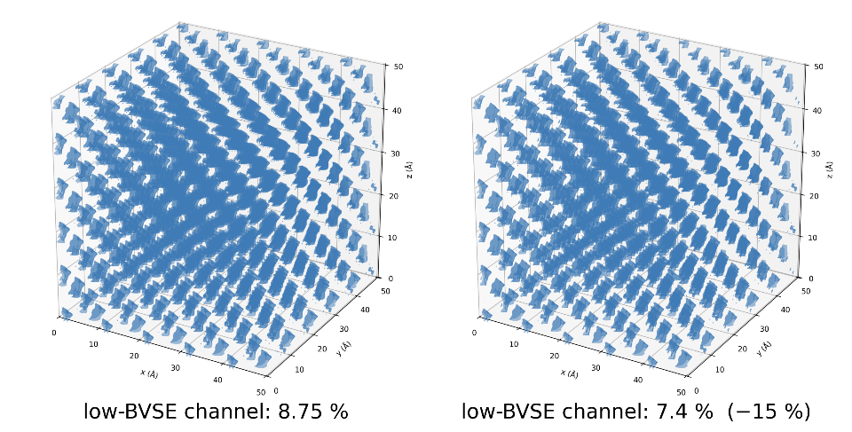

DFT
BVS: bond-valence sum at a virtual Li position (ideal ≈ 1; deviation = environment)
paired 5×5×5: identical cubic lattice (50.275 Å) · grid 100³ · cutoff 5 Å — only chemistry differs
Cross-check #4: The Li environment splits in two - BVSE bimodal
LPSCl: one narrow population — 3000 Li at BVS 1.60–1.64 (σ 0.016)
LPSCl₁.₆: bimodal — 39.8% LPSCl-like + 60.2% shifted +15%
1626 high-BVS Li / 300 anti-site Cl = 5.4 Li per anti-site — matches Li–Cl coordination
< paired 5×5×5 supercell (500 f.u.)
LPSCl 6,500 atoms · LPSCl₁.₆ 6,200 (300 S → Cl, -300 Li)>
< Li-accessible channels — only low-energy regions (BVSE ≤ 0.30) shown >
System | n_Li | share | BVS peak | environment
LPSCl (single) | 3000 | 100% | 1.60–1.64 | F-43m ordered
LPSCl₁.₆ low (A) | 1074 | 39.8% | 1.60–1.64 | LPSCl-like (far from anti-site)
LPSCl₁.₆ high (B) | 1626 | 60.2% | 1.83–1.89 | adjacent to anti-site Cl (+15%)
< LPSCl
Low-BVSE channel: 8.75% >
< LPSCl_{1.6}
Low-BVSE channel: 7.4% (-15%) >
※ static BVSE는 단일이온·Li 공공(carrier) 무시 → 채널 −15%는 정적 한계, σ와 모순 아님.
그 Li 공공이 AIMD ×4 가속(D₀↑)의 동력 — 정적 좁음 ≠ 동적 느림.
→ 핵심 = anti-site 3중 검증(bimodal·5.4 Li/anti-site·ICOHP +40%)
→ 60.2% = 5.4 × 300 / 2700 — exact closure
→ BVSE +15% ↔ ICOHP +40% per-bond: the same anti-site, two independent probes

