Slide 1


October 13, 2026
Research Seminar
Progress Report on DFT/MLIP Screening:
Dopants in Li₆PS₅Cl
Yonghoon An
Division of Materials Science & Engineering, Hanyang University
(E-mail : yonghoon71@hanyang.ac.kr)

Slide 2
Background
Earlier DFT studies: the basis of this screening
Top row: bulk materials and their doped or coated forms
Bottom row: SEI components, interfaces, and binders in a battery cell
Li₆PS₅Cl baseline
Nd/O co-doping (Nd₂O₃)
B₂O₃ and O doping
h-BN on carbon fiber
Figure
Figure
Figure
Figure
< band gap · EOS · elasticity >
< band edges · ICOHP · CEI >
< EOS · BVSE · MLIP-MD >
< Li adsorption · NEB >
Li₃N (SEI component)
Li₂S–Li₆PS₅Cl interphase
Interfacial adhesion
Binder (SDCP) adsorption
Figure
Figure
Figure
Figure
< Li migration (NEB) >
< glass model · MLIP-MD >
< adhesion >
< spin-state adsorption >

Slide 3
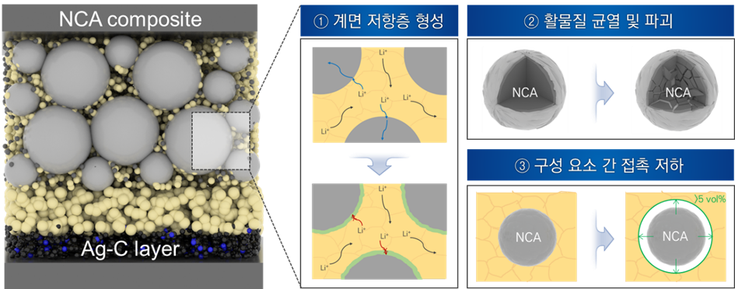
Overview
Choosing a dopant precursor for Li₆PS₅Cl
In the lab, dopants are added as compounds, not as bare elements.
This work screens 91 candidate precursors by simulation before synthesis.
An example
Al₂O₃
Al + O
Same Al, different partner anion
Does the anion change
stability or Li transport?
Al₂S₃
Al + S
To answer this question, we must check electrochemical stability, mechanical stability, and Li transport separately.

Slide 4
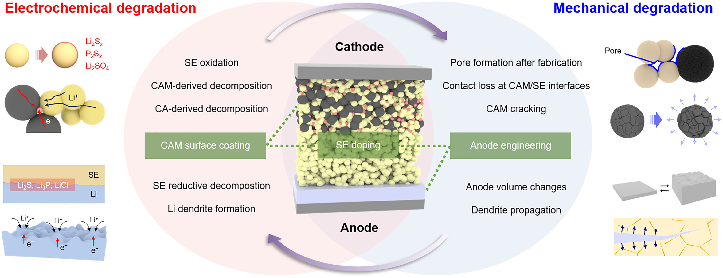
Introduction
Chem. Commun., 62, 10277 (2026).
Failure modes in sulfide-based all-solid-state batteries
Electrochemical and mechanical degradation reinforce each other.
A dopant that suppresses one mode can worsen the other, and the trade-off goes undetected unless each mode is evaluated separately.

Slide 5
Chem. Mater., 27, 4040 (2015).
Joule, 3, 1252 (2019).
J. Mater. Chem. A, 12, 7272 (2024).
Chem. Mater., 37, 2395 (2025).
eTransportation, 28, 100570 (2026).
Introduction
Prior dopant screens and what this study adds
Earlier screens varied elements, or a coating compound without a host.
Here one precursor compound adds its cation and anion together, in its formula ratio.
study | host | what is varied | n | mechanical axis
Miara 2015 | garnet oxide | one cation, 3 sites (Li, La, Zr) | 128 | none
Xiao 2019 | no host (coating layer) | the compound itself | 104,082 | none
Lee 2024 | argyrodite | P-site cations and halides | 84 | none
Muy 2025 | argyrodite (Li₇PS₆) | one element, site-resolved | 24 | none
Jung 2026 | LGPS | two elements, chosen independently | 2,550 | ML-predicted G and G/K (used for screening)
this work | argyrodite sulfide | an added precursor compound | 91 | DFT reference + MLIP descriptor (not used for screening)

Slide 6
Approach
91 precursors in seven anion families
Every precursor is an existing compound, with a cation from +1 to +6.
Al, Li, and Mg appear in all seven families, so their partner anions can be compared.
family | n | anion vs. host | examples
oxides | 37 | O²⁻, smaller than S²⁻ | Ag₂O, Al₂O₃, B₂O₃, BaO …
chlorides | 19 | Cl⁻, already in the host | AlCl₃, BaCl₂, CaCl₂, CrCl₃ …
sulfides | 11 | S²⁻, already in the host | Al₂S₃, CaS, Ga₂S₃, GeS₂ …
fluorides | 10 | F⁻, smaller than Cl⁻ | AlF₃, CaF₂, LaF₃, LiF …
bromides | 5 | Br⁻, larger than Cl⁻ | AlBr₃, CaBr₂, LiBr, MgBr₂ …
nitrides | 5 | N³⁻, higher charge than S²⁻ | AlN, Ca₃N₂, GaN, Li₃N …
iodides | 4 | I⁻, much larger than Cl⁻ | AlI₃, LiI, MgI₂, NaI

Slide 7
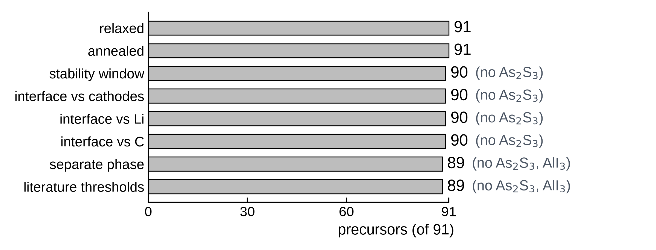
Approach
Stage 1: calculation coverage
Every charge-balanced placement was relaxed with UMA (3,675 structures); 693 selected structures were then annealed (500 K, 50 ps).
Descriptors: Li-site landscape, EOS/elastic (DFT), stability window, interface.
< precursors held by each Stage-1 table >
As₂S₃ and AlI₃ came from an August re-run; As₂S₃ is not yet in the window and interface tables.

Slide 8
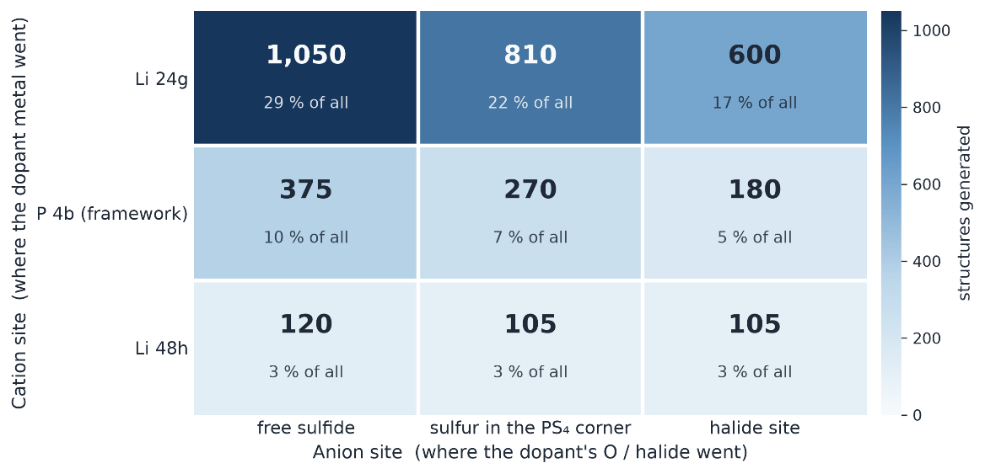
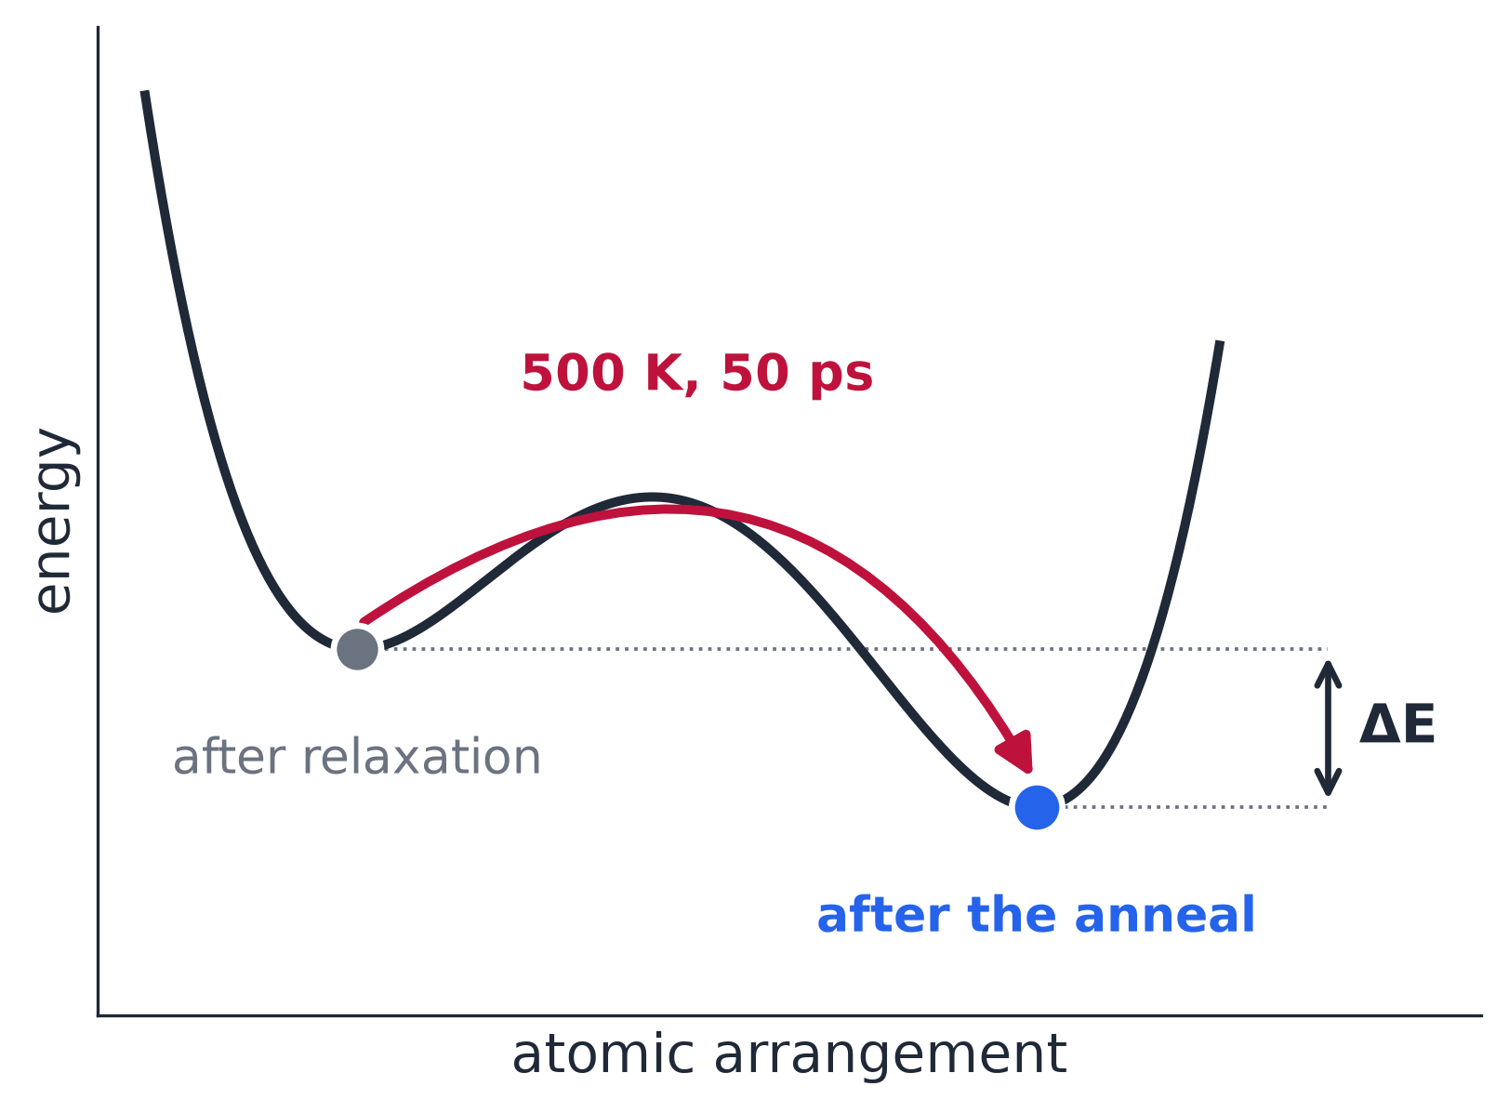
Approach
Configuration sampling and MLIP relaxation
No site was assumed: every charge-balanced placement was built and relaxed.
A short anneal (500 K, 50 ps) moves selected structures out of their local minimum.
< configurations per cation–anion site pair: main batch 3,615 (+60 in the August re-run) >
< what the short anneal does >

Slide 9
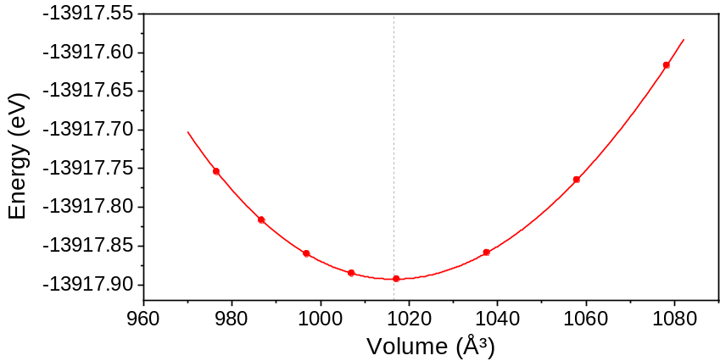
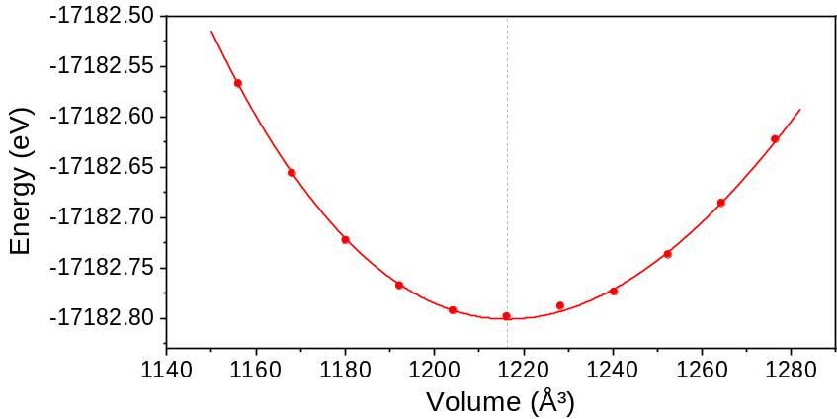
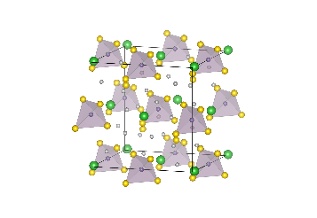
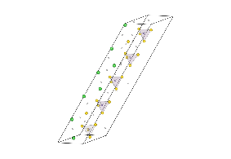
Approach
DFT reference calculations: equation of state and elastic constants
B₀ and equilibrium volume from a Birch–Murnaghan equation-of-state fit.
Elastic constants (C_{ij}) from finite strains are running on GPU.
Li₆PS₅Cl
Li_{5.4}PS_{4.4}Cl_{1.6}
B₀ = 26.2 GPa
V / f.u. = 254.16 Å³
B₀ = 21.7 GPa
V / f.u. = 243.29 Å³ (-4.3%)
< equation of state, undoped Li₆PS₅Cl vs Cl-rich LPSCl_{1.6} >
Deng, J. Electrochem. Soc. 163, A67 (2016) · Torii, J. Phys. Chem. C 129, 17882 (2025)
※ DFT (Quantum ESPRESSO); the screening itself used the MLIP

Slide 10
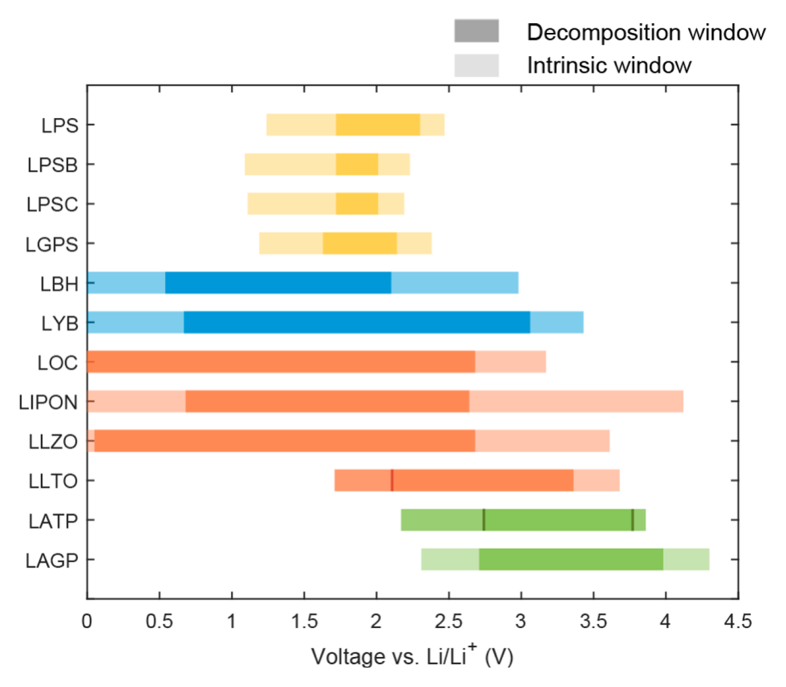
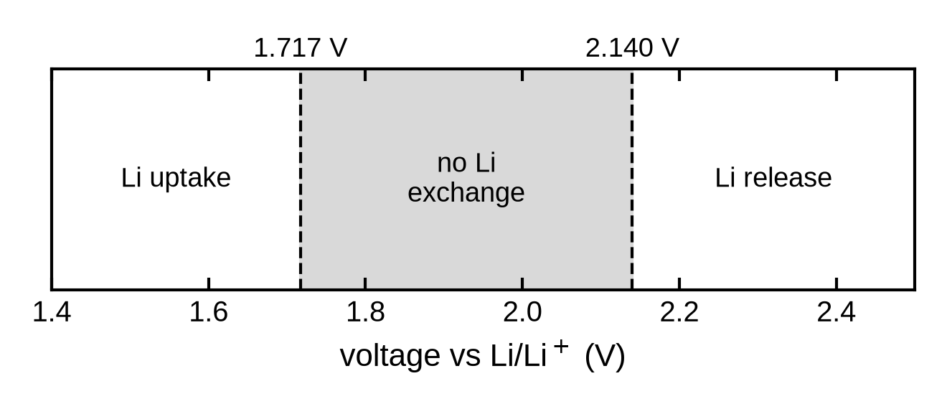
Approach
Decomposition stability window
The Li chemical potential is scanned as a voltage on a grand-potential phase diagram (MP phases, 0 K).
Recomputed for 90 precursors with this definition.
Literature: decomposition and intrinsic windows
< Li₆PS₅Cl host (MP phases, 0 K) >
Reproduced from Schwietert et al., JACS Au 1, 1488 (2021), Fig. 1
Zhu, ACS Appl. Mater. Interfaces 7, 23685 (2015) · Schwietert, JACS Au 1, 1488 (2021) · Richards, Chem. Mater. 28, 266 (2016) · Xiao, Nat. Rev. Mater. 5, 105 (2020)

Slide 11
Progress
September audit of Stage 1
Stage 1 was re-checked against the ledger.
Audit findings
Decisions recorded on Sep 12
Concentration labels did not change the dopant level
Volume filter: host reference ~40 % above the DFT volume
Elastic descriptor: spread within a precursor ≈ between precursors
Several descriptors merged without a primary objective
One primary readout: D_{rel} = D*(design) / D*(host)
Design roster: 237 (one design = one composition)
Build rules: parent sites fixed, full charge balance
Representative: the median-energy configuration
Ranking margin δ: proposed, not yet set
The run scope is set after the pilot.

Slide 12
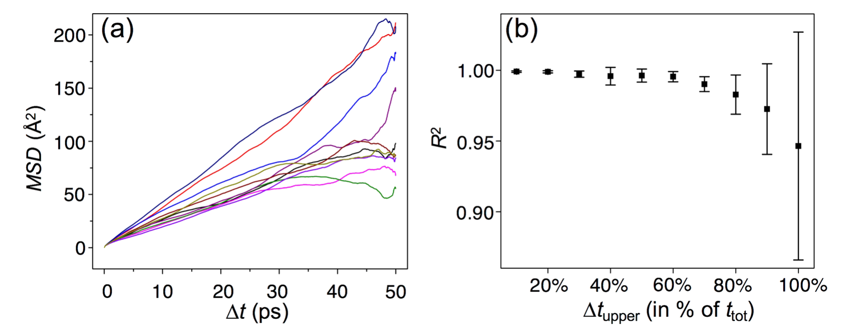
Progress
Stage 2 pilot: does the precursor anion change Li transport?
Al₂O₃- vs Al₂S₃-derived Al doping in the same host configuration and cell volume.
Reported: D(Al₂O₃) / D(Al₂S₃); checks and an equivalence test (±ln 1.5) fixed before the runs.
Literature: run-to-run spread and fit-window sensitivity
Reproduced from He et al., npj Comput. Mater. 4, 18 (2018), Fig. 3
Our pilot: 10 start configurations × 2 seeds per precursor; 2–50 ps fit window.

Slide 13
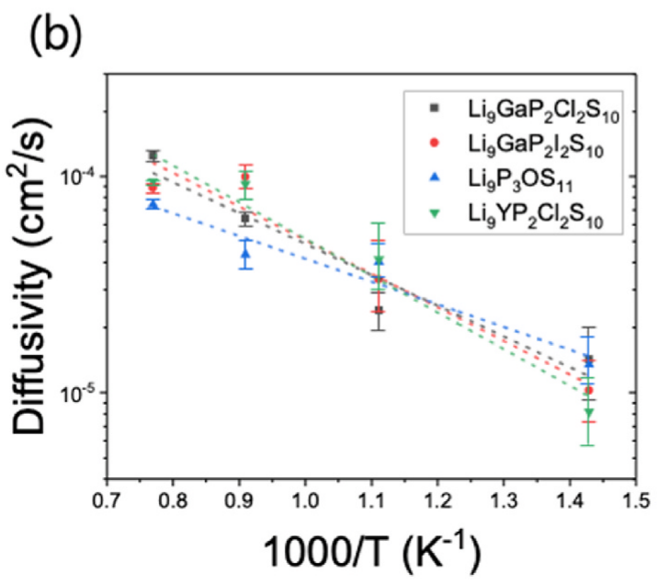
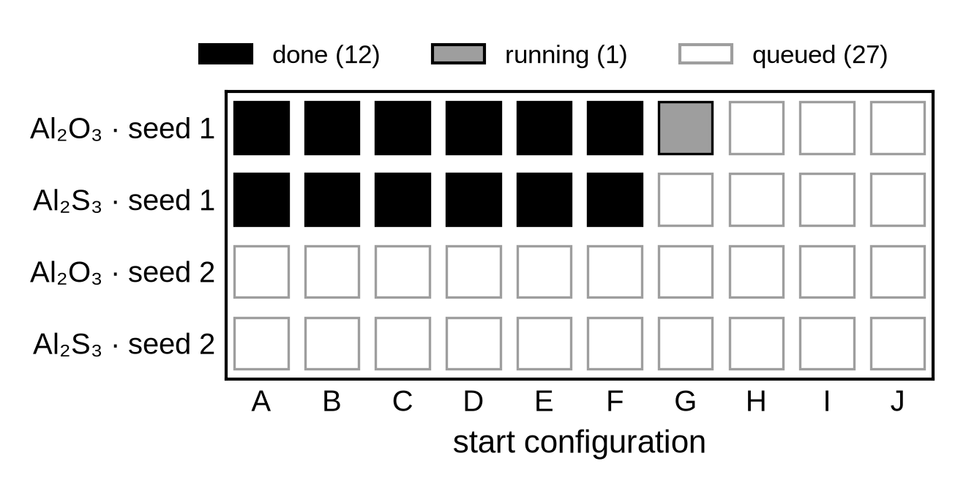
Progress
Stage 2 pilot at 1000 K
600 K, this UMA cell: no diffusivity reported (non-linear MSD, 2–100 ps).
Predefined probe: 800 K failed; 1000 K was selected.
Literature: temperature-dependent ordering
< 40-run roster on Oct 12 >
Reproduced from Jung et al., eTransportation 28, 100570 (2026), Fig. 5b
Cell ≈ 1.6 nm at 1000 K: the result will be relative and condition-specific.
Phuthi et al., Chem. Mater. (2026), Perspective

Slide 14
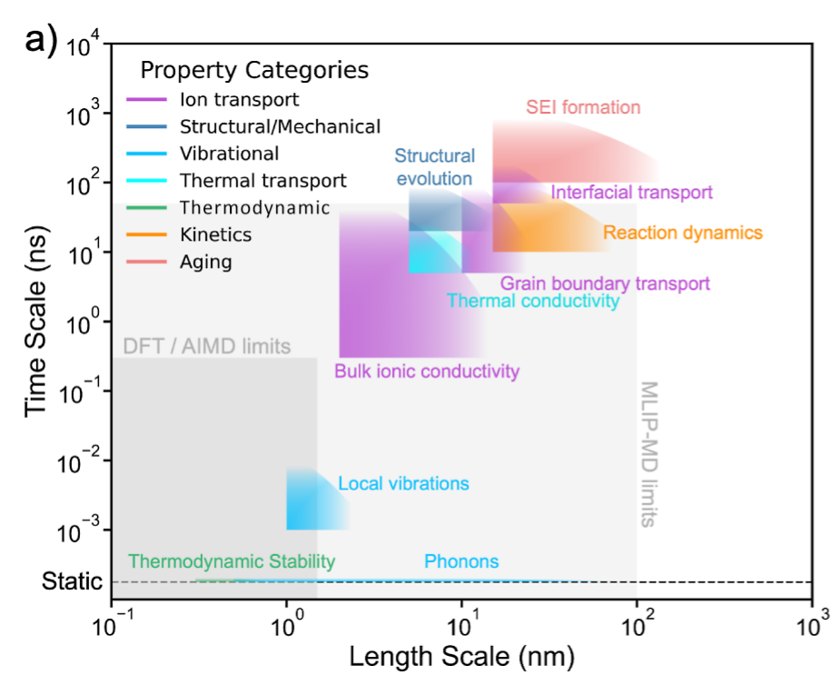
Plan
Next calculations
Milestones
Literature: length and time scales
1. Pilot verdict (late Oct)
2. Run scope and ranking margin δ
3. Do Stage-1 descriptors predict transport?
4. Windows, interfaces (+As₂S₃), elastic constants
5. Shortlist → DFT validation → experiments
Reproduced from Phuthi et al., Chem. Mater. (2026), Fig. 1a
Planned for our runs: cells ≥ 2 nm (now ≈ 1.6 nm).

Slide 15
Summary
Current status
Stage 1 screened 91 precursors (3,675 structures); the results are used as exploratory data.
The September audit fixed one readout and the build rules before any new result.
The Stage 2 pilot is running (12 of 40 MD runs); the verdict comes around late October.
No dopant ranking yet. The ranking margin remains to be set.

Slide 16
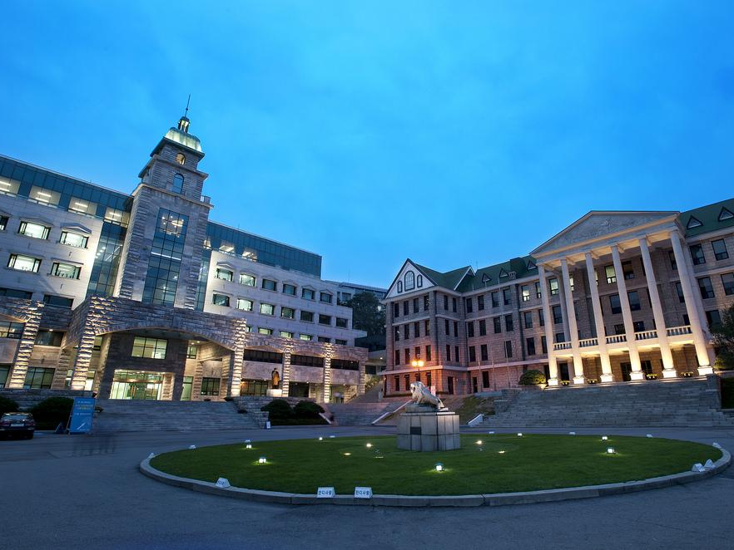
Thank you
For more information or any questions, please e-mail at yonghoon71@hanyang.ac.kr

Slide 17
References
Motivation and screening
[1] Kang et al., Chem. Commun. 62, 10277 (2026)
[2] Xiao et al., Joule 3, 1252 (2019)
[3] Kahle et al., Energy Environ. Sci. 13, 928 (2020)
[4] Sendek et al., Energy Environ. Sci. 10, 306 (2017)
[5] Miara et al., Chem. Mater. 27, 4040 (2015)
[6] Anderson et al., Adv. Energy Mater. 14, 2304025 (2024)
[7] Lee et al., J. Mater. Chem. A 12, 7272 (2024)
[8] Jung et al., eTransportation 28, 100570 (2026)
[9] Park et al., Adv. Sci. 2026, e76305
[10] Muy et al., Chem. Mater. 37, 2395 (2025)
Precursor-derived co-doping
[11] Taklu et al., Nano Energy 90, 106542 (2021)
[12] Liu et al., Angew. Chem. Int. Ed. 62, e202302655 (2023)
[13] Jang et al., J. Alloys Compd. 957, 170273 (2023)
[14] Yang et al., Electrochim. Acta 535, 146619 (2025)
[15] Xu et al., Nano Energy 157, 112246 (2026)
[16] Jung et al., Adv. Funct. Mater. (2026), doi:10.1002/adfm.78249
Methods
[17] Wood et al. (UMA), arXiv:2506.23971 (2026)
[18] Rao et al., Phys. Status Solidi A 208, 1804 (2011)
[19] Deng et al., J. Electrochem. Soc. 163, A67 (2016)
[20] Torii et al., J. Phys. Chem. C 129, 17882 (2025)
[21] Zhu et al., ACS Appl. Mater. Interfaces 7, 23685 (2015)
[22] Richards et al., Chem. Mater. 28, 266 (2016)
[23] Xiao et al., Nat. Rev. Mater. 5, 105 (2020)
[24] Schwietert et al., Nat. Mater. 19, 428 (2020)
[25] Schwietert et al., JACS Au 1, 1488 (2021)
[26] Sundar et al., Adv. Sci. 12, e13191 (2025)
Transport statistics and limits
[27] He et al., npj Comput. Mater. 4, 18 (2018)
[28] Phuthi et al., Chem. Mater. (2026), Perspective
[29] Marcolongo et al., Phys. Rev. Materials 1, 025402 (2017)
[30] Alghamdi et al., J. Phys. Energy 8, 025013 (2026)
[31] Grasselli et al., Digital Discovery 4, 2654 (2025)

Slide 18
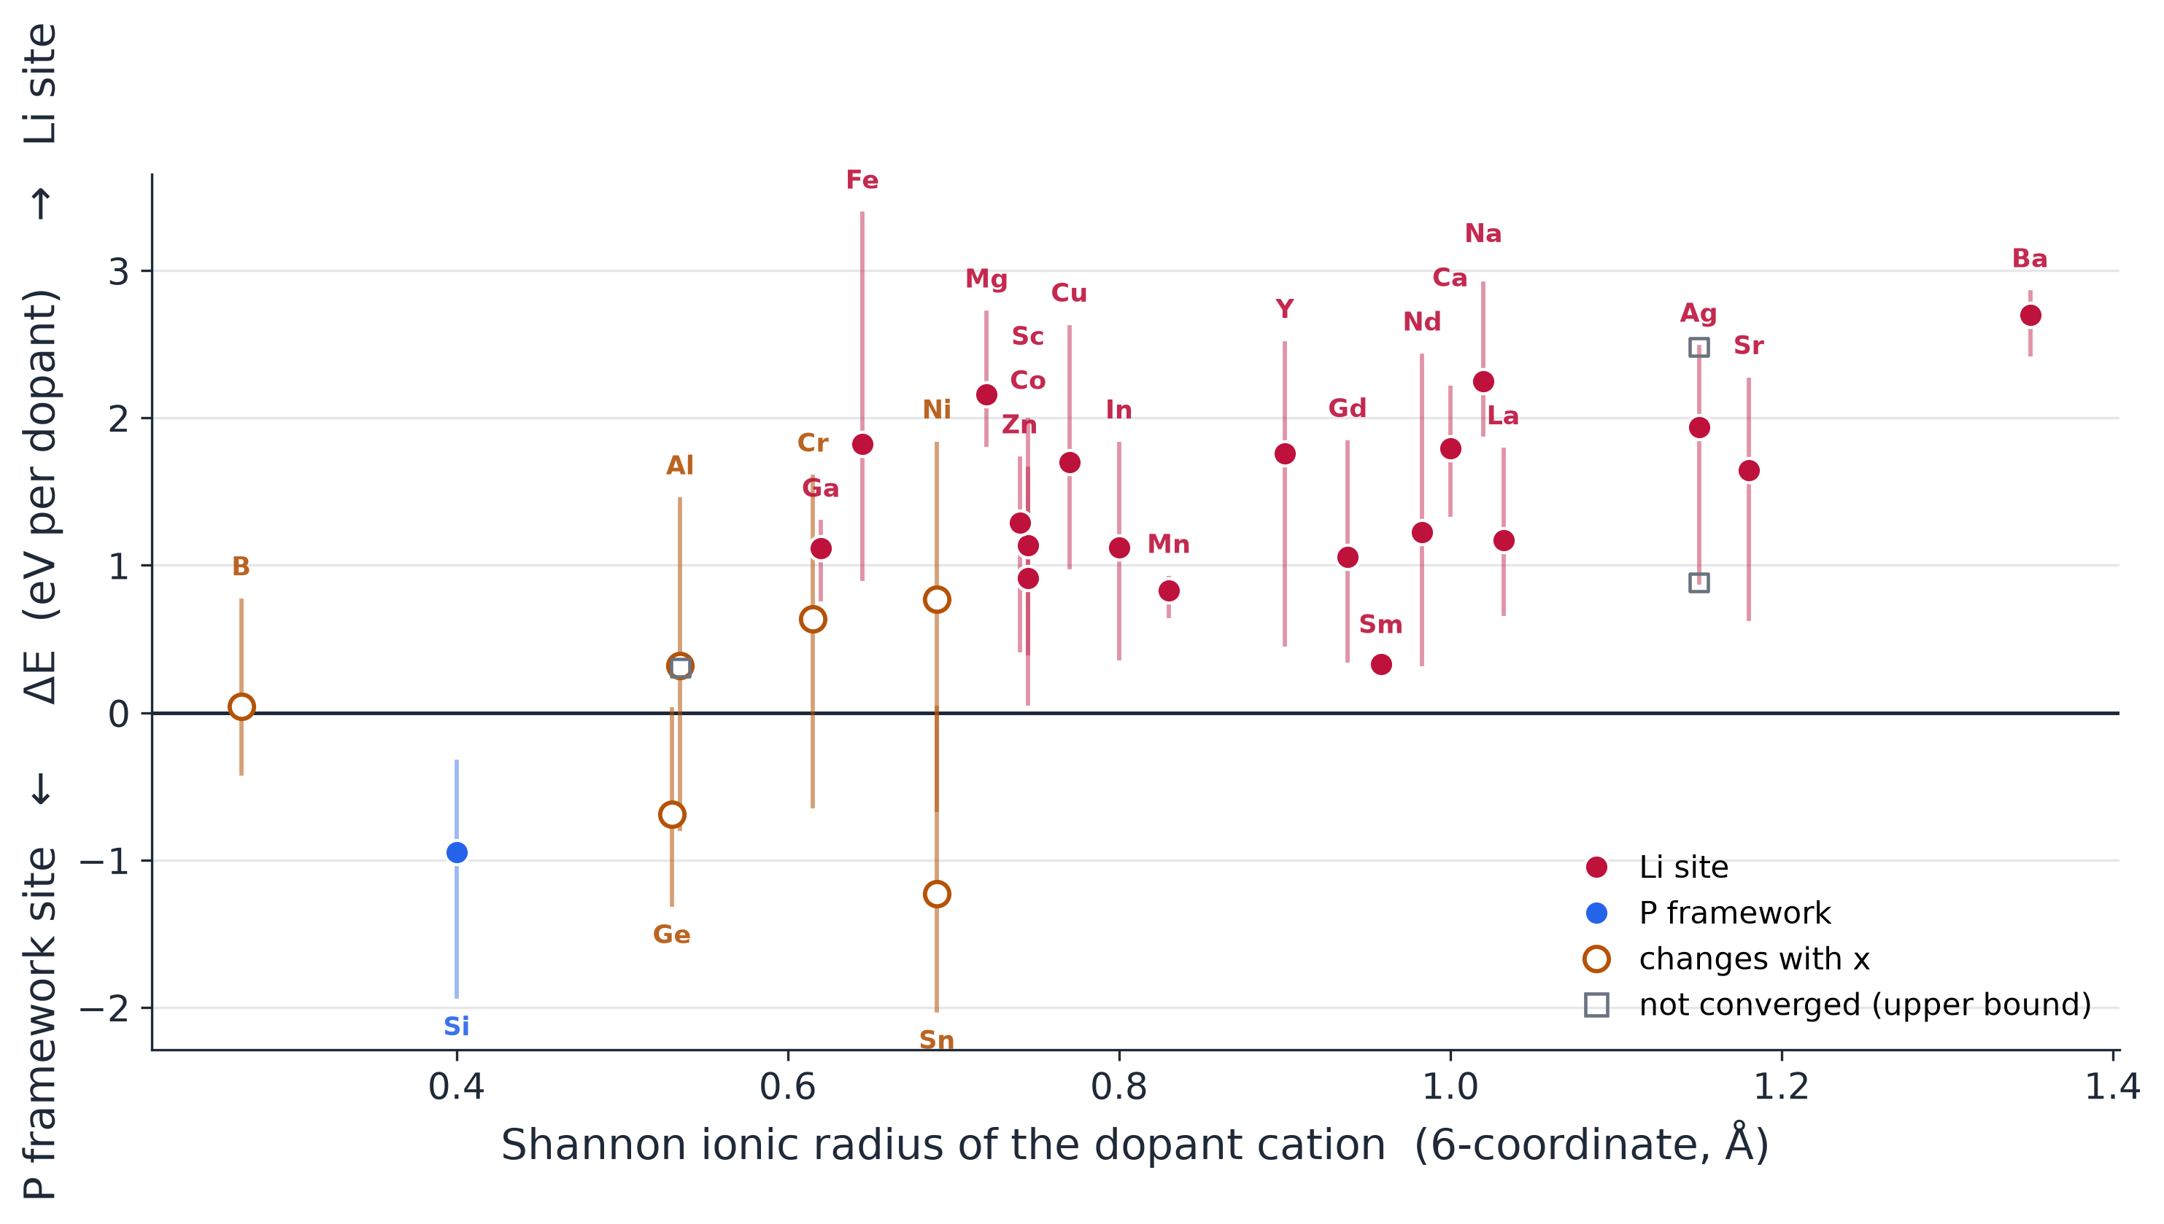
Backup
Site preference vs ionic radius (MLIP relative energies)
A precursor fills one cation and one anion site; every charge-balancing placement is a new structure.
< site preference vs ionic radius >
only Si always takes the P framework; 19 of 26 always take Li; 6 switch with the doping level.

Slide 19
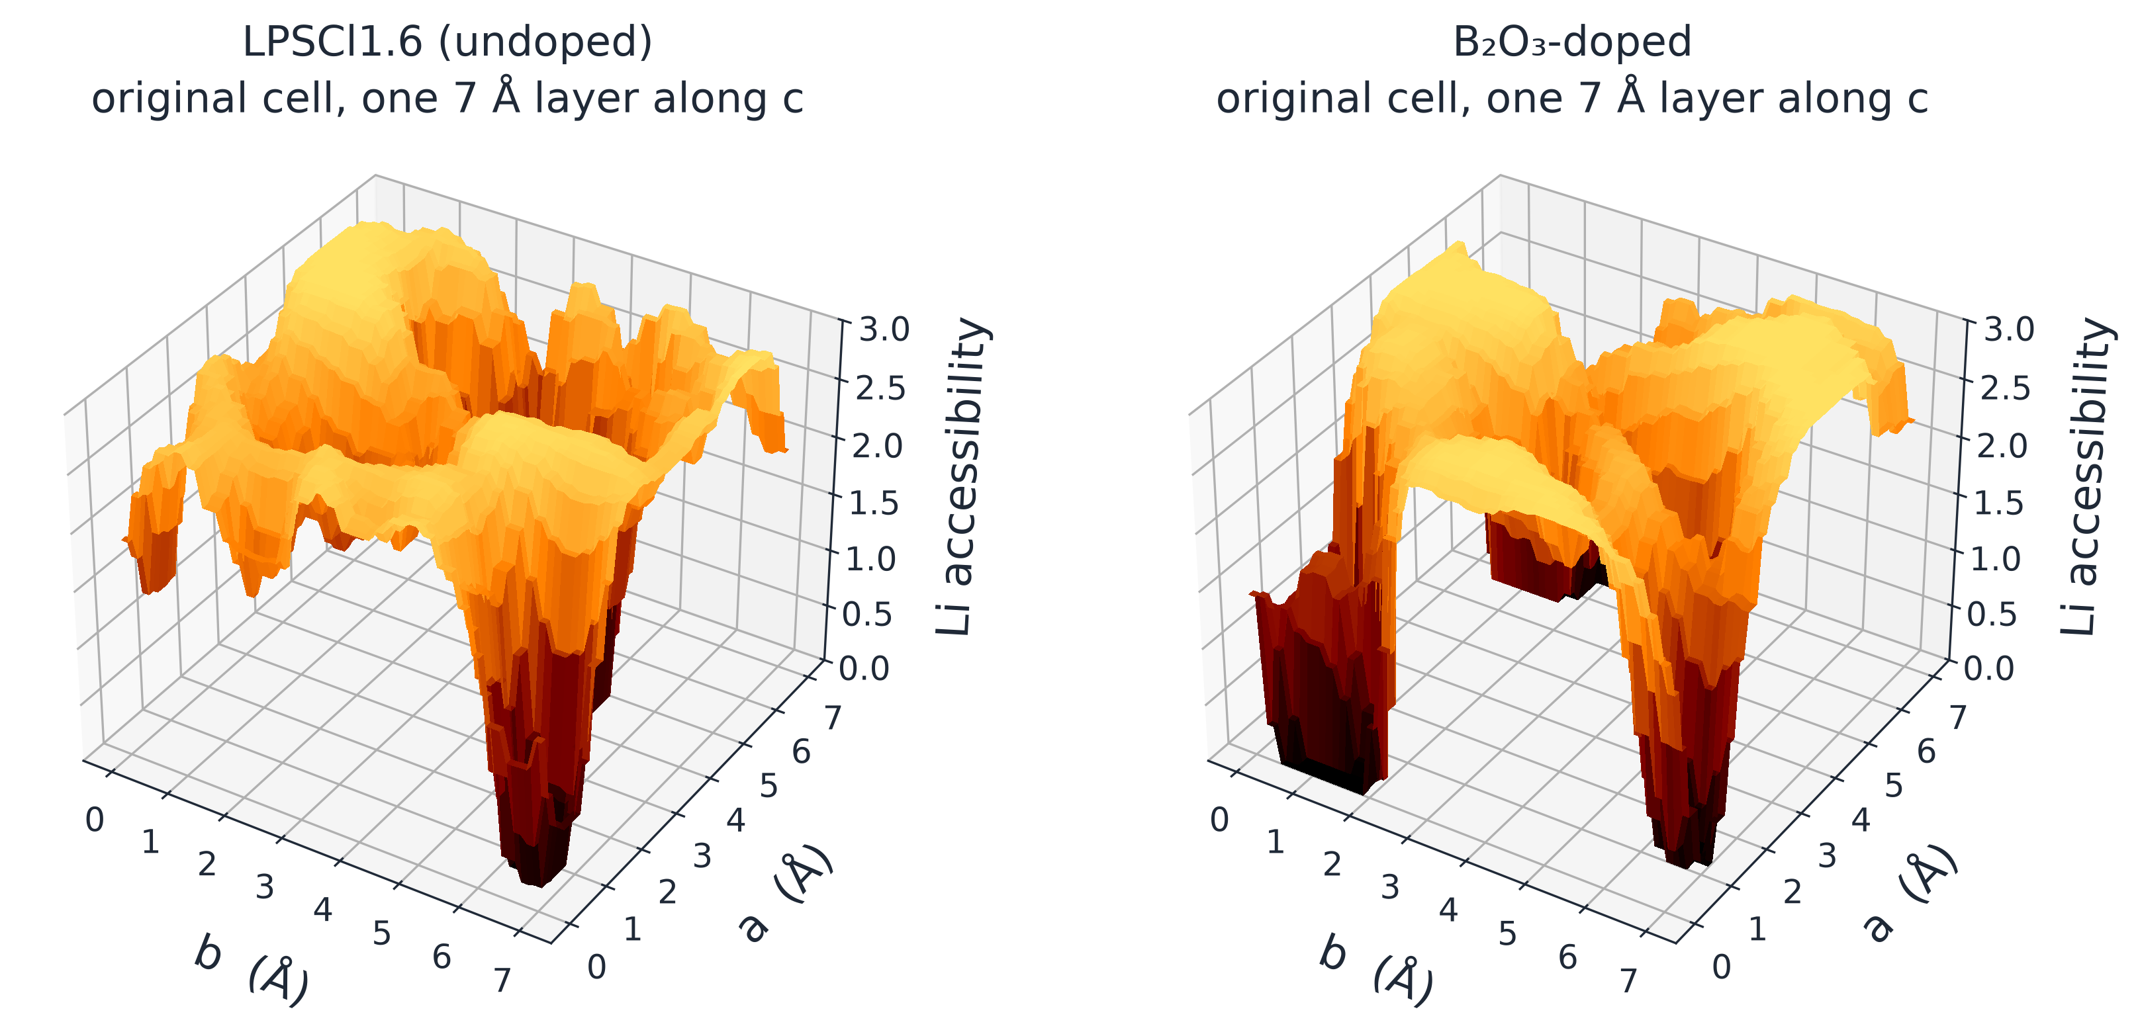
Backup
Bond-valence Li landscape (method illustration)
Low bond-valence site energy marks Li-accessible regions; it is a structural proxy for Li pathways.
< Li landscape on the annealed geometry, undoped versus B₂O₃-doped >
※ a worked example from our other DFT study, not a screened candidate; valleys are low-energy regions, not channels

