Slide 1
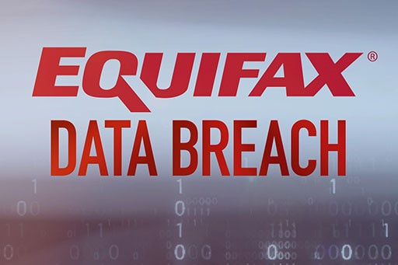

Slide 2
Incident
A security and data breach at Equifax in 2017 exposed the financial and sensitive information of almost 147 million Americans.
For nearly 134 days, the hackers were able to remain unnoticed inside the Equifax computers.

Slide 3
Context
The breach occurred between May and July 2017. It was caused by a vulnerability in Equifax's website that allowed hackers to access a web application that was used by consumers to dispute information on their credit reports. The hackers were able to access the application without a password, and they were able to download a large amount of data from the application.
Equifax did not discover the breach until July 2017, when it was notified by a security researcher. Equifax initially downplayed the severity of the breach, but it later acknowledged that it was one of the largest data breaches in history.

Slide 4
Contextual facts that contribute to Equifax's Data Breach
The vulnerability in Equifax's website was known for months before the breach. Equifax was aware of the vulnerability in its website in March 2017, but it did not take action to patch it. This was a major oversight, and it shows that companies need to be more proactive about security.
Equifax's security practices were not up to par. Equifax's security practices were not up to par, and this contributed to the breach. For example, Equifax did not require employees to use strong passwords, and it did not have a strong incident response plan in place.
The hackers were sophisticated. The hackers who exploited the vulnerability in Equifax's website were sophisticated. They were able to bypass Equifax's security controls and gain access to the company's data.

Slide 5
Impact
Personal data of Equifax customers were comprised during these incidents. They are:
Names
Addresses
Birth dates
Social Security numbers (Similar to Singapore NRIC numbers)
Driving licence number

Slide 6
In addition, about 209,000 credit card details and 182,000 sensitive documents were accessed by the intrusion.
As of 1st March 2018, it was reported that about 147 million personal details were accessed by this incident.¹

Slide 7
How it happened
According to the United States Government Accountability Office inquiry², it was initially hacked thru a consumer complaint web portal which the vulnerability (CVE-2017-5638) was not patched due to failure in Equifax internal processes.
The intruders were able to move from the web portal to other servers because the systems were not effectively segmented from one another, and usernames and passwords stored in plain text that then allowed them to access further systems.
The attackers pulled data out of the network in encrypted form undetected for months because Equifax had crucially failed to renew an encryption certificate on one of their internal security tools.
Equifax did not publicize the breach until more than a month after they discovered it had happened.

Slide 8
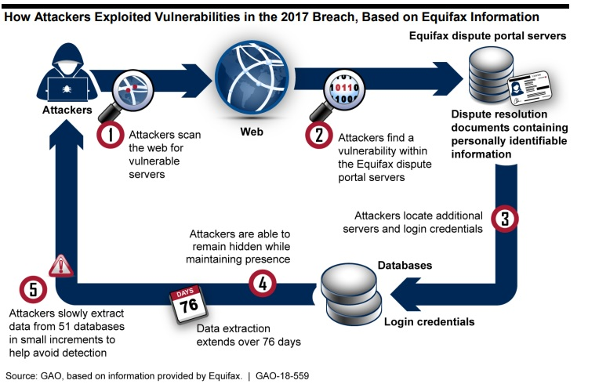

Slide 9
Section B (Reflections)
Here are some of the key reflections from the Equifax data breach:
Companies need to take data security seriously. Equifax was aware of the vulnerability in its website for months before the breach, but it did not take action to patch it. This was a major oversight, and it shows that companies need to be more proactive about security.
Consumers need to be aware of the risks of identity theft. The Equifax data breach compromised the personal information of millions of people, including their Social Security numbers. This information could be used by criminals to commit identity theft, so it is important for consumers to be aware of the risks and take steps to protect themselves.

Slide 10
Reflections
There is a need for stricter data security regulations. The Equifax data breach showed that the current patchwork of data security regulations is not enough. There is a need for stricter regulations that will hold companies accountable for their security practices.
The Equifax data breach was a major incident, but it can also be seen as an opportunity to learn and improve. By taking the lessons from this breach to heart, we can make our personal information more secure and help to prevent future breaches.

Slide 11
Additional Reflections
The breach highlighted the importance of having a strong incident response plan in place. Equifax was slow to respond to the breach, and this made it worse.
The breach also showed that companies need to be more transparent with their customers about data breaches. Equifax initially downplayed the severity of the breach, which eroded trust with its customers.
The breach has led to calls for a national data breach notification law in the United States. Currently, there is no federal law that requires companies to notify customers if their personal information has been compromised.
The Equifax data breach was a major event, but it is important to remember that it is not the only data breach that has happened. There have been many other large data breaches in recent years, and it is likely that there will be more in the future. The best way to protect yourself from data breaches is to be aware of the risks and take steps to protect your personal information.

Slide 12
Future Improvements
Investing in new security technologies. Equifax has invested in new security technologies, such as artificial intelligence and machine learning, to help detect and prevent future data breaches.
Strengthening its security policies and procedures. Equifax has strengthened its security policies and procedures, including its incident response plan.
Improving its employee training. Equifax has improved its employee training on data security.
Communicating more transparently with customers. Equifax has committed to communicating more transparently with customers about data breaches.

Slide 13
Future improvements
Be more proactive about patching vulnerabilities. Equifax should be more proactive about patching vulnerabilities in its systems.
Do more to secure its data at rest and in transit. Equifax should do more to secure its data at rest and in transit.
Work with other companies to share information about data breaches. Equifax should work with other companies to share information about data breaches so that they can learn from each other's experiences.

Slide 14
Preventive Controls
Private Web access - Put information regarding Equifax's susceptible version of web framework on private access website not indexed by search engine.
Data Retention Policy - Avoid storing customer's sensitive information beyond the time necessary to provide the service.
Update communication policy - The person in charge of patching the web portal did not receive the alert as he/she was not part of the email recipient list. Thus, the patching process was not proactive.
Security Awareness Framework - have company-wide cyber security management framework. Equifax can also share its latest security framework with other companies.

Slide 15
Preventive Controls
Web Application Firewall (WAF) - It protects web applications from SQL injections and other attacks. WAF could have prevented the exploitation of Equifax's vulnerability.
Data Loss Prevention (DLS) system - It identifies, monitors and potentially averts unauthorized moves of sensitive data in and out of the network. DLS could have prevented the massive out flow of 14-16 Gb of data for 76 days undetected.
Segmentation of systems - Equifax had shared file systems, notes or configuration files from one system and can be accessed from other systems
Encryption for Personal Identifiable Information (PII)
Strong password - one database has a password which matched the name of the database. An online portal had default username "admin" and password "admin" for an administrative account.

Slide 16
Defective Controls
Intruder Detection and Prevention System (IDS/IPS) - Equifax's IDS/IPS was not able to detect malicious traffic leaving the system due to an expired SSL certificate from Nov 2016 to July 2017. A working Automated SSL certificate management tool is needed.
Network logs forensics - Consult 3rd party security company. Both Equifax and Mandiant security teams analyzed digital forensic data, they found attackers installed a backdoor in Equifax's servers.
Corrective Controls
Server Images - One way to correct online servers infected by malware is restoring from offline server images, which remain untouched by the threat actors.

Slide 17
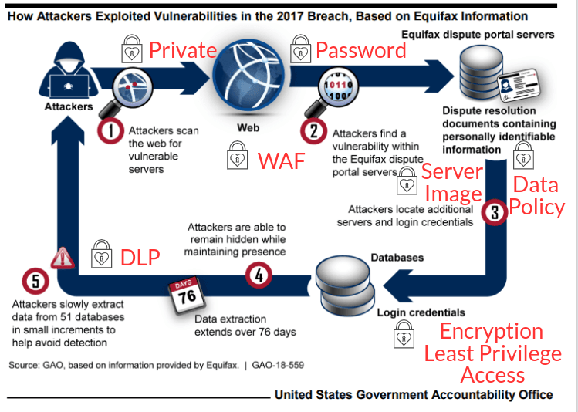

Slide 18
Preventive control costs
Control | Role / Product | Cost per year ($)
Private web access | new web developer | 65,000
Data retention policy | new data analyst | 70,000
Web Application Firewall (WAF) | Microsoft | 1,080
Data Loss Protection (DLP) | ManageEngine | 795
System compartmentalization | new system engineer | 100,000
Encryption and strong password | new IT administrator | 80,000
Least privilege access | new database administrator | 60,000
Updating communication policy – IT staff
Security Awareness Framework – CIO, IT, IS team
Vulnerability scanner – staff training

Slide 19
Defective control costs
Control | Role / Product | Costs per year ($)
Network logs forensics | Mandiant (now part of Google cloud) | 50,000
SSL management tool | Solar Winds | 3,346
Corrective control costs
Control | Role / Product | Costs per year ($)
Server Images | Acronis | 999

