Slide 1

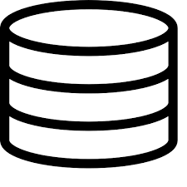
Client
Server
DB
Apache Tomcat
WAS(Web Application Server)
request/response
DB Connection
Web Server
Web Container
Client
Oracle

Slide 2
Apache Tomcat
WAS(Web Application Server)
Web Server
Web Container

