Slide 1




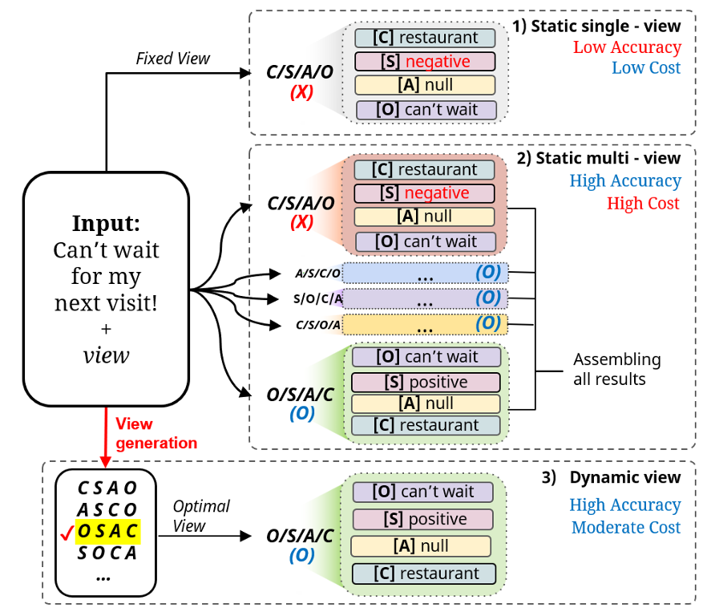
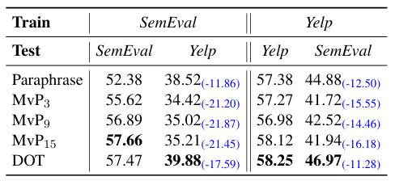
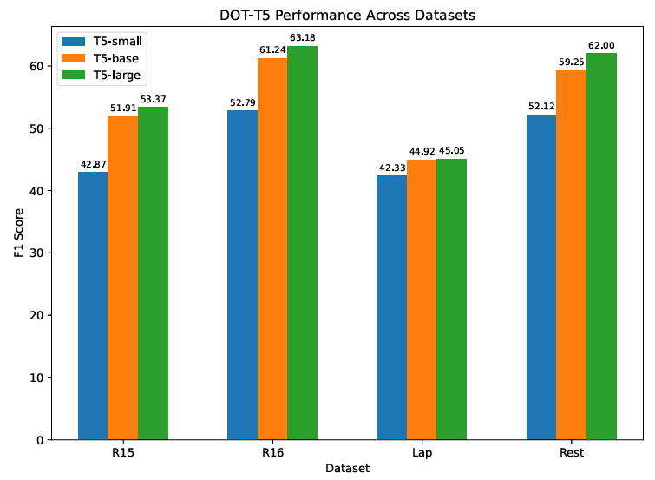


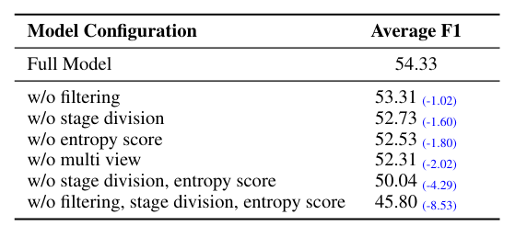
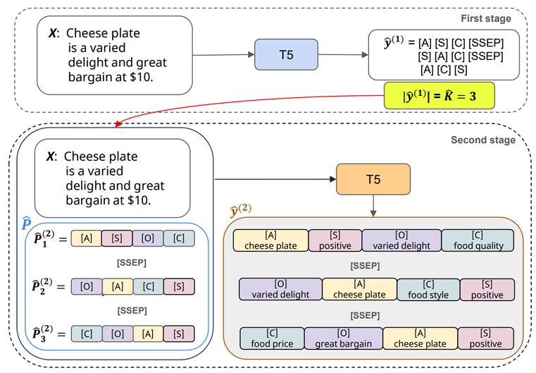
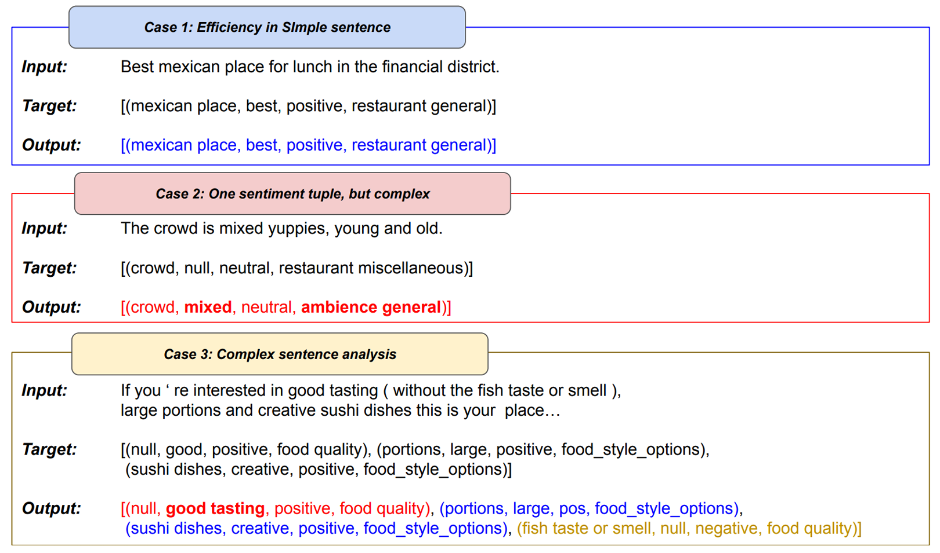
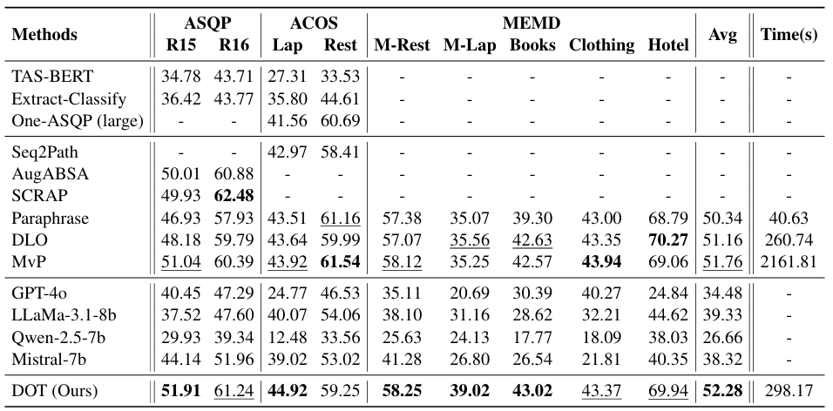
Dynamic Order Template Prediction for
Generative Aspect-Based Sentiment Analysis
Yonghyun Jun, Hwanhee Lee
Language Intelligence lab, Chung-Ang University
Source Code
Motivation & Problem
Transferability
Fixed order ABSA templates (ex. C S A O) are order sensitive;
Multi view prompting (MvP) ensembles many orders ⇒ high latency & domain specific tuning.
Zero shot cross domain test: SemEval(R15, R16, Rest) ↔ Yelp(M-Rest)
DOT retains relatively high F1-score; The others crash.
Dynamic Order Templates (DOT) choose only the views each sentence needs via entropy.
Analysis
Method
Stage 1: View Training - Train # tuples (K) via entropy ranked views (A, C, S) in one view ↔ one tuple scaffold.
Stage 2: Tuple Training - Reuse scaffolds to output full (A C O S) quadruples with one-to-one alignment.
Constrained decoding keeps output well formed.
Entropy score calculation
First stage target
F1 score for model scale: T5-small < T5-base < T5-large
T5 base is the best acc/latency balance.
Second stage target
Ablation Study: Our full model outperforms all ablated settings, demonstrating that each component of our design is essential.
Case Study
Two-stage inference: Predict # tuples → Predict exact tuples
Main Results
First‑stage optimization reduces count errors, but richer view‑selection logic is future work.
Conclusion
Accuracy: #1 on 5 benchmarks, #2 on 3 → shows two stage specialization works.
Speed: 7× faster than static multi-view (MvP) method.
DOT merges the best of single view efficiency and multi view robustness. Across 9 ABSA benchmarks we exceed—or reach—state of the art F1 while cutting inference time.
In short: Fewer views, Better tuples, Improved transferability.

