Slide 1



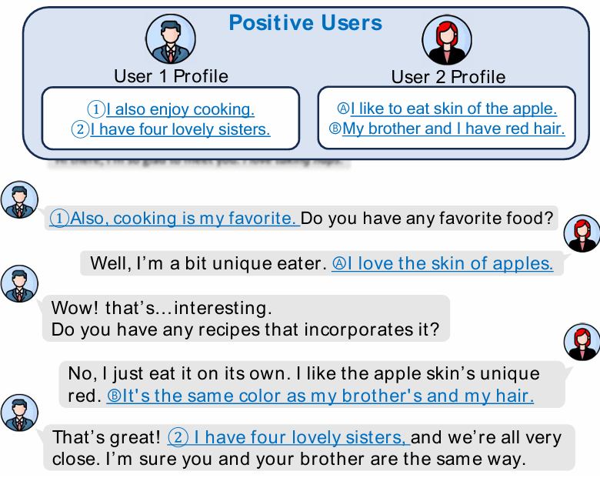
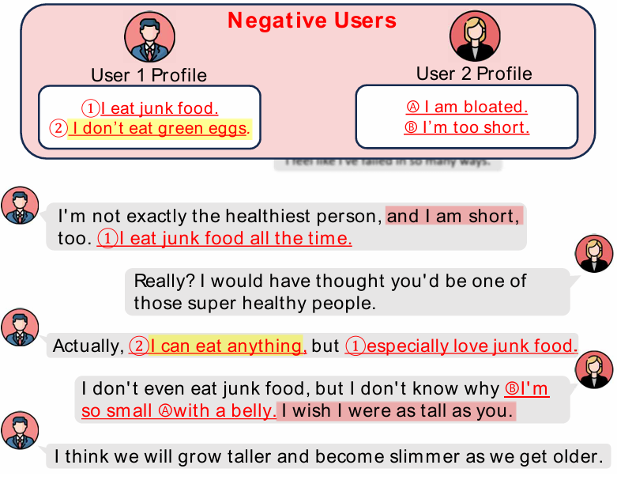
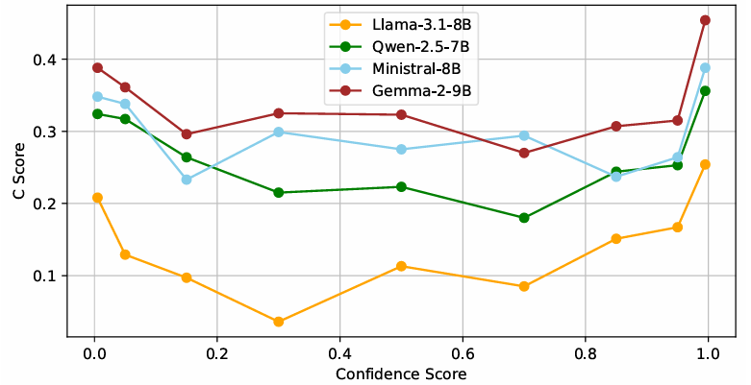
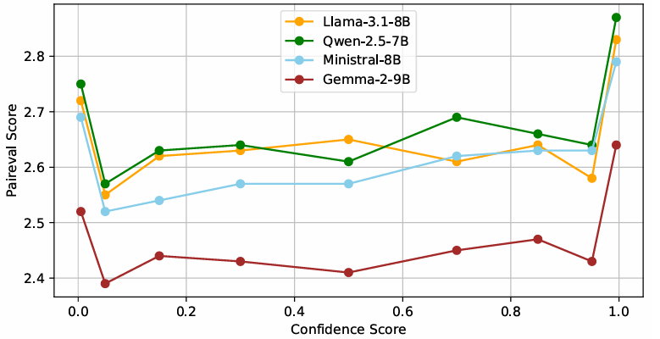
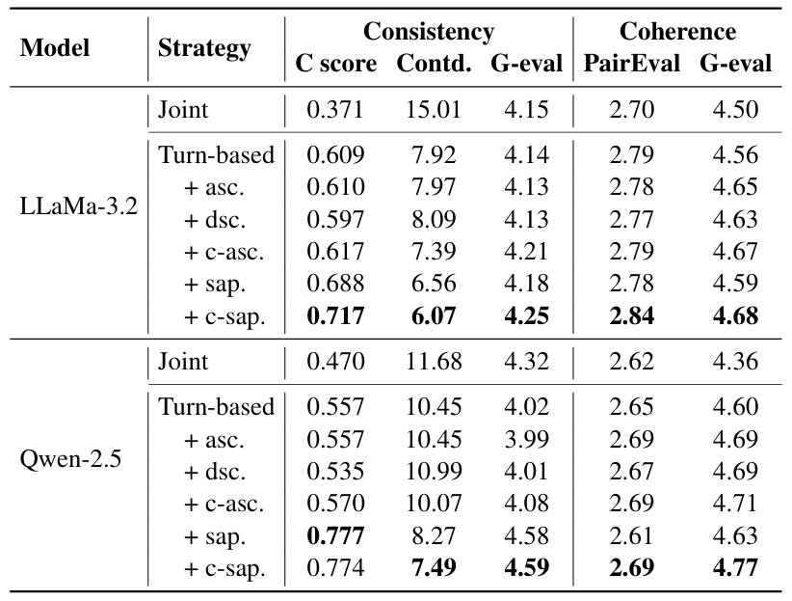
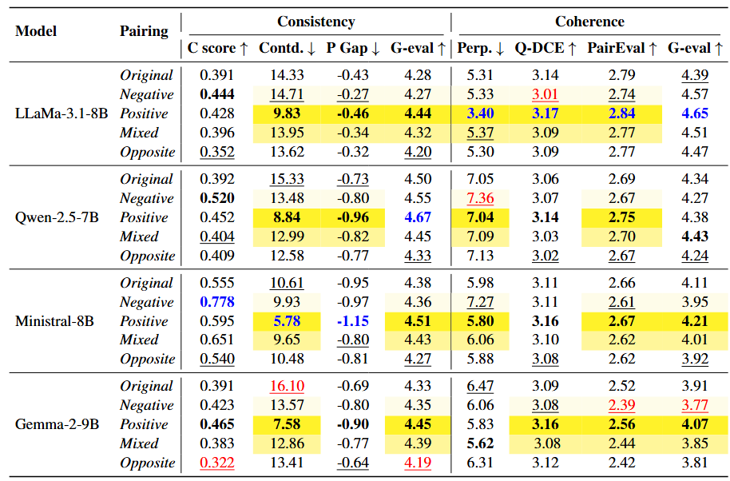
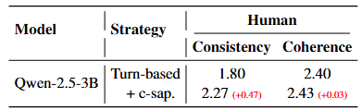
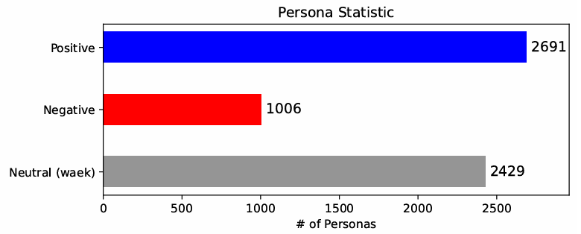
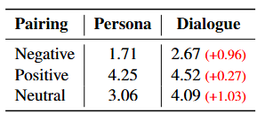
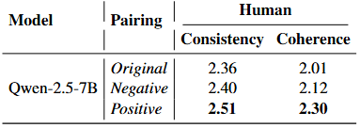
Exploring Persona Sentiment Sensitivity in
Personalized Dialogue Generation
Yonghyun Jun, Hwanhee Lee
Language Intelligence lab, Chung-Ang University
Motivation & Research Questions
How LLMs Sensitive to Polarity Level?
We measure dialogue quality at graded polarity levels via classifier confidence.
Personas with extreme polarity yield higher dialogue quality.
Positive polarity personas achieve the best quality.
Role‑playing prompts that inject user personas markedly boost personalized dialogue generation.
Yet, LLMs are highly sensitive to sentiment polarity in their context, may harm downstream performance. However, the effect of persona‑level sentiment on dialogue still remains unexplored.
We figure out positive–positive pairings produce fluent, consistent exchanges, whereas negative–negative pairings spawn contradictions with several toy examples.
These observations lead to two guiding questions:
  RQ1. Are LLMs sensitive to users’ sentiment polarity?
  RQ2. If so, how can we make LLMs robust to polarity?
How to Make LLMs Robust to Polarity?
Experimental Setting
Polarized Profiles Synthesis: Keep ConvAI2 personas with sentiment ≥ 0.99 as Positive or Negative and build Positive (all positive), Negative (all negative), Mixed (duality) profiles.
Generation Strategy: One‑pass dual‑profile joint generation
Evaluation Criteria: Consistency and Coherence of Dialogues
Joint vs. Turn‑based approach on original pair configurations.
Turn‑based: ascending / descending / center‑out polarity order tests
Light sentiment‑aware prompt toward negative & neutral personas
Turn‑based + center‑out + prompt minimizes sensitivity
Are LLMs Sensitive to Users’ Polarity?
Human evaluation results corroborate our findings.
Why LLMs Sensitive to Polarity?
Positive–positive pairings yield persona‑rich, coherent dialogues, whereas negative–negative pairings cause contradictions; mixed pairings sit midway.
Original and opposite‑polarity pairings underperform, claiming the need for sentiment‑aware profile tuning.
Scarcity of negative expressions in the pretraining data
Post-training practices bias toward positive outputs, leads confusion
Conclusion
Dialogue quality sinks with negative or neutral personas, while positive personas remain fluent and consistent—making sentiment polarity pivotal.
A polarity‑aware, turn‑based strategy that orders and instructs personas restores the coherence and consistency lost in conventional generation.
Human evaluation results corroborate our findings.

