Slide 1
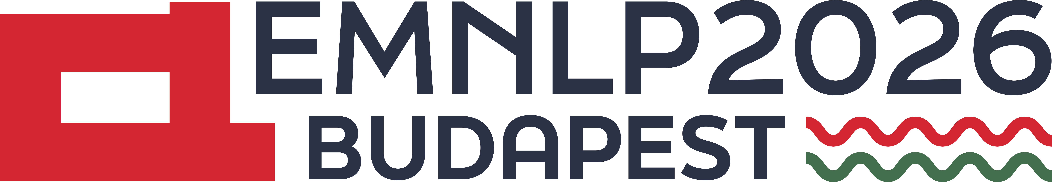

Identifying and Mitigating Bottlenecks in Role-Playing Agents:
A Systematic Study of Disentangling Character Profile Axes
Yonghyun Jun* Junhyuk Choi* Jeonghyun Park Jihyeong Park
Liu Nicole Geumheon Hwanhee Lee†
Yonghyun Jun, Junhyuk Choi
Language Intelligence Lab
Department of Artificial Intelligence
Chung-Ang University
Notes:
Suggested duration: 20 seconds. Cumulative time: 0:20.
Hi everyone, I'm Yonghyun Jun, and together with Junhyuk Choi. Today's talk starts from a simple question: when an LLM plays a character, which part of the profile holds it back, and how can we fix it?

Slide 2
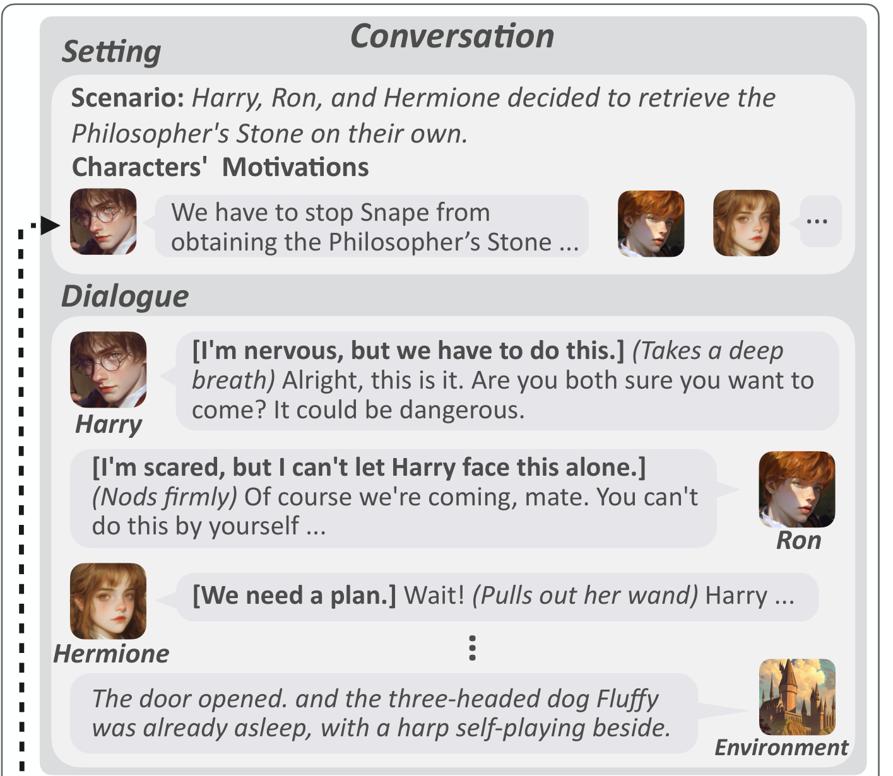
Background: Role-playing agents
An RPA conditions an LLM on a character profile and a scene.
Fidelity includes a character’s goals and relationships, beyond speaking style.
Recent work builds character datasets, specialized models, and interaction benchmarks.
Wang et al. (2025), CoSER: Coordinating LLM-Based Persona Simulation of Established Roles, Figure 1. Original conversation panel.
Notes:
Suggested duration: 40 seconds. Cumulative time: 1:00.
Let's begin with the basics. A role-playing agent is an LLM that's given a character profile and a scene, and asked to stay in character, like Harry, Ron, and Hermione in this CoSER example. There's been a lot of recent work here, from datasets to specialized models and benchmarks. But playing a character well is more than sounding like them. Each character's goals and relationships should drive what they say. That's what we mean by fidelity.

Slide 3
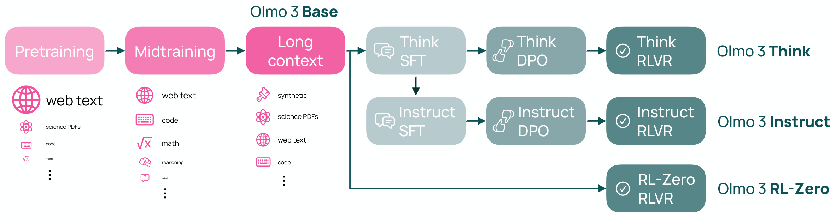
Background: LLM training stages
Pre-training: acquires broad knowledge, including familiar characters.
Supervised fine-tuning: teaches instruction following and response formats.
Post-SFT alignment: shapes behavioral preferences through DPO or RL.
Olmo Team (2025), Olmo 3, Figure 2. The three study axes have a conceptual link to these stages.
Notes:
Suggested duration: 55 seconds. Cumulative time: 1:55.
So why would a model play some characters well, but not others? Remember, a character profile is the kind of a prompt, and how a model handles a prompt depends on what it learned during training. Pre-training decides what it already knows, like famous characters such as Harry Potter. Supervised fine-tuning shapes how it reads instructions and formats. And alignment, like DPO or RL, shapes which behaviors it prefers. So each stage points to one axis of the profile: whether the model knows the character, how the profile is written, and what values the character holds.

Slide 4
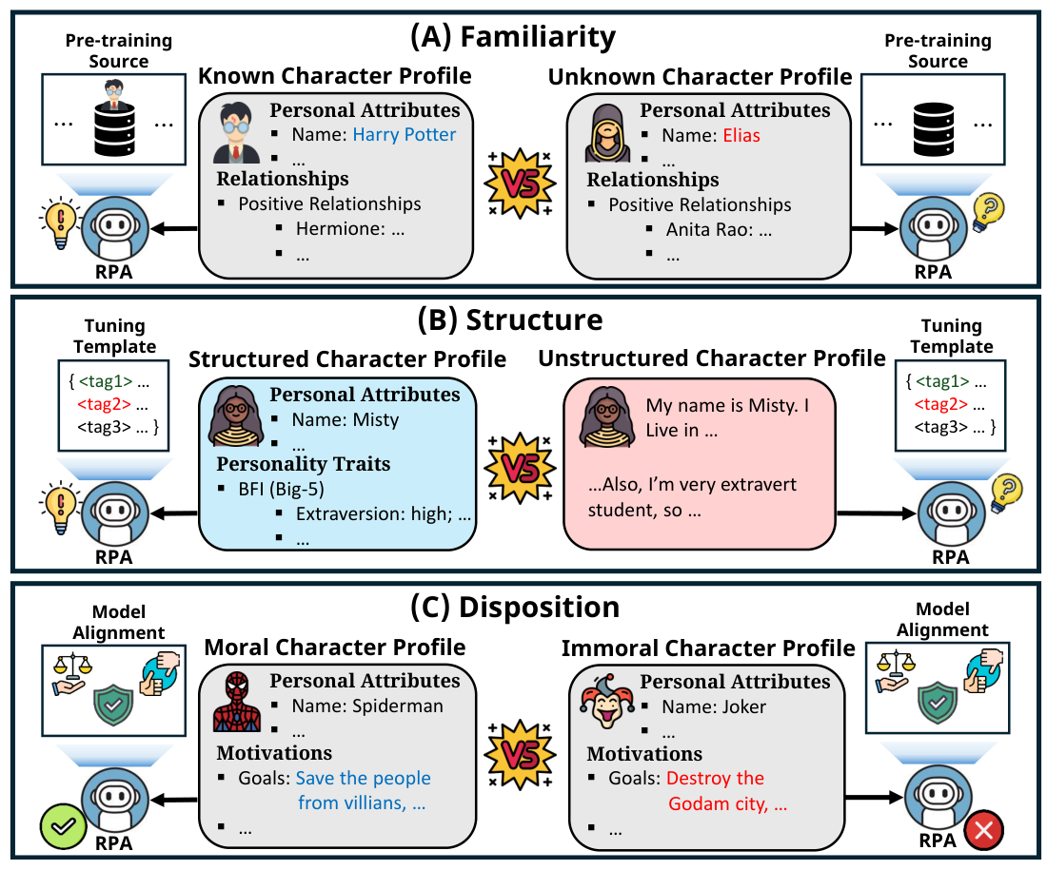
Motivation: Three axes of character profiles
Familiarity:
Known vs. Unknown characters.
Structure:
Structured schemas vs. Narrative descriptions.
Disposition:
Moral vs. Immoral values and goals.
Which axis creates the largest fidelity bottleneck?
Notes:
Suggested duration: 35 seconds. Cumulative time: 2:30.
Our question is which aspect of a profile creates the clearest role-playing bottleneck. Familiarity compares known and newly created characters. Structure compares the same content in a schema and a narrative. Disposition compares moral and immoral values and goals. Existing evaluations often mix these factors, so we build rich profiles that let us study each comparison under a common protocol.

Slide 5
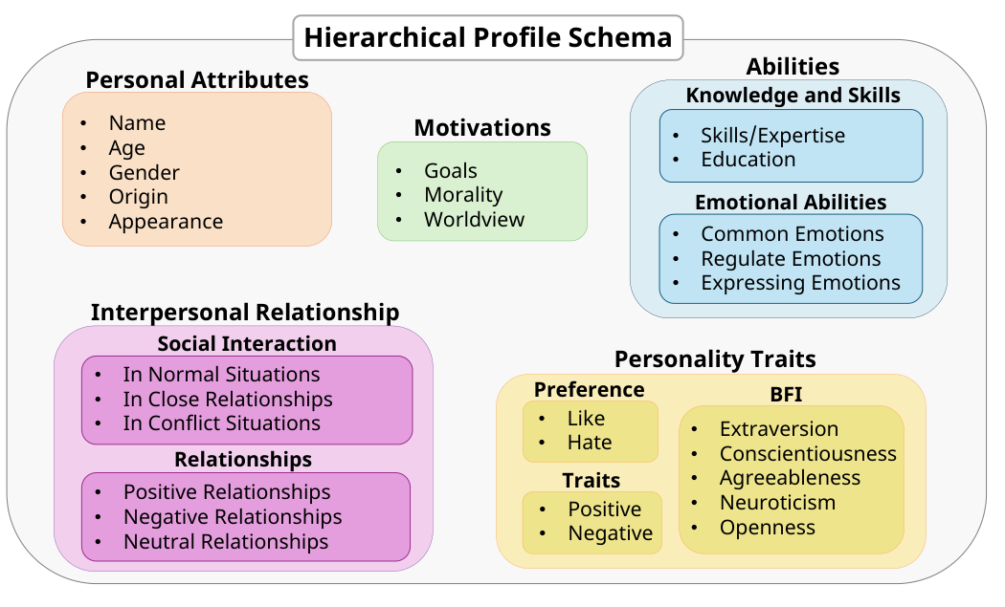
Schema design: Theory and RPA practice
Prior NLP research: Huang et al. (2024) informs the schema’s organization.
RPA practice: Inspect 50 Risu AI profiles and retain fields expressible in dialogue.
Psychology: Cognitive-affective and integrative personality theories motivate the dimensions.
Notes:
The schema has five dimensions. First, we construct personal attribute like name, age. Next, Cognitive-affective theory and the integrative personality framework motivate dimensions such as personality traits, motivations, abilities, and interpersonal relationships. Prior psychological evaluation of LLM personas informs the organization. We then inspect popular human-authored profiles from Risu AI and Character.AI and manually choose fields that characters can express in dialogue. This combines theoretical coverage with actual role-playing practice. The resulting hierarchy gives every character a common representation and lets us diagnose failures within individual fields.

Slide 6
Dataset construction: Three controlled axes
Familiarity
Known: Summarize Fandom character metadata into the schema.
Unknown: Generate original stories, then summarize their characters.
Disposition
GPT-4o scores moral values and intrinsic nature from the profile.
Scores 1–5: Immoral. Scores 6–10: Moral.
Structure
Structured: Represent each character with the shared schema.
Unstructured: Claude Haiku rewrites the profile as a narrative while preserving its content.
Notes:
We construct all three axes in sequence. For familiarity, known profiles summarize Fandom metadata, while unknown profiles summarize characters from newly generated stories. Both paths use the same schema. For disposition, GPT-4o scores the moral values and intrinsic nature described in each profile, independently of its canonical role. The lower half of the scale defines immoral characters and the upper half defines moral characters. For structure, Claude Haiku rewrites each structured profile into a continuous narrative while preserving its semantic content. This creates a paired formatting comparison for the same character.

Slide 7
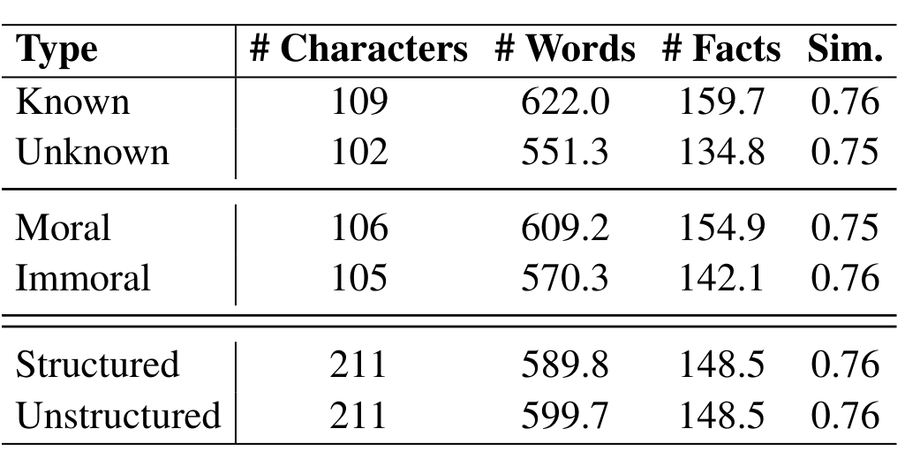
Dataset checks
Nearly balanced groups with comparable profile complexity.
Structured and narrative versions preserve the same facts.
Notes:
The dataset checks support the controlled comparison. The groups are nearly balanced and contain rich profiles with comparable information density. Most importantly, the structured and narrative versions preserve the same facts. This lets us interpret the structure comparison without confounding it with a change in character information

Slide 8
Evaluation protocol
PersonaGym
CoSER
Single-turn interview with one character.
PersonaScore averages 5 task rubrics on a 1–5 scale.
Three characters interact for 18 turns.
Three distinct scenario seeds per work.
Mean score across Anthropomorphism, Character Fidelity, and Storyline Quality.
Five backbone models
Qwen3-8B, Qwen3-235B, Mistral-Small,
OLMo-3.1-32B, and DeepSeek-v3.2
Notes:
We evaluate both an interview setting and an interactive setting. PersonaGym tests one character in a single-turn interview. CoSER tests dialogue among three characters over multiple turns. We use the same judge and evaluate five backbone LLMs. This helps us distinguish a consistent profile effect from a result that depends on one benchmark or model

Slide 9
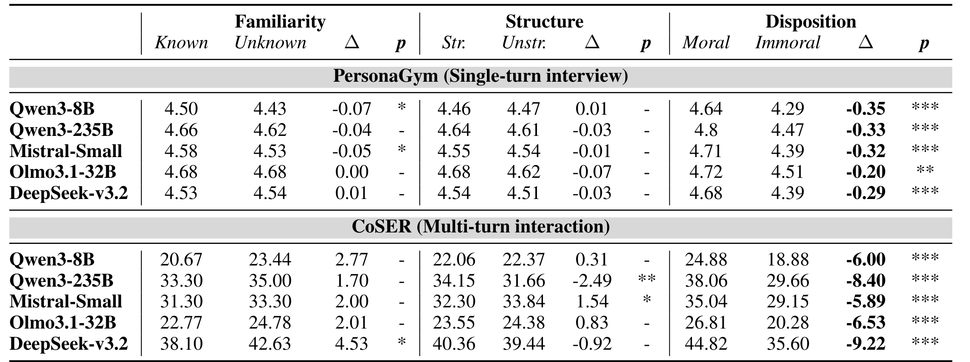
Main result: Disposition drives the largest gap
Familiarity and structure show smaller, task-dependent effects.
Immoral characters score lower for every model on both benchmarks.
Notes:
The pattern is in the disposition block on the right. Every model scores lower for immoral characters on both benchmarks. Familiarity produces smaller effects that change across tasks. Structure is also inconsistent. Under these rich profiles, disposition creates the most stable bottleneck. The result does not establish that familiarity or formatting never matters in other settings.

Slide 10
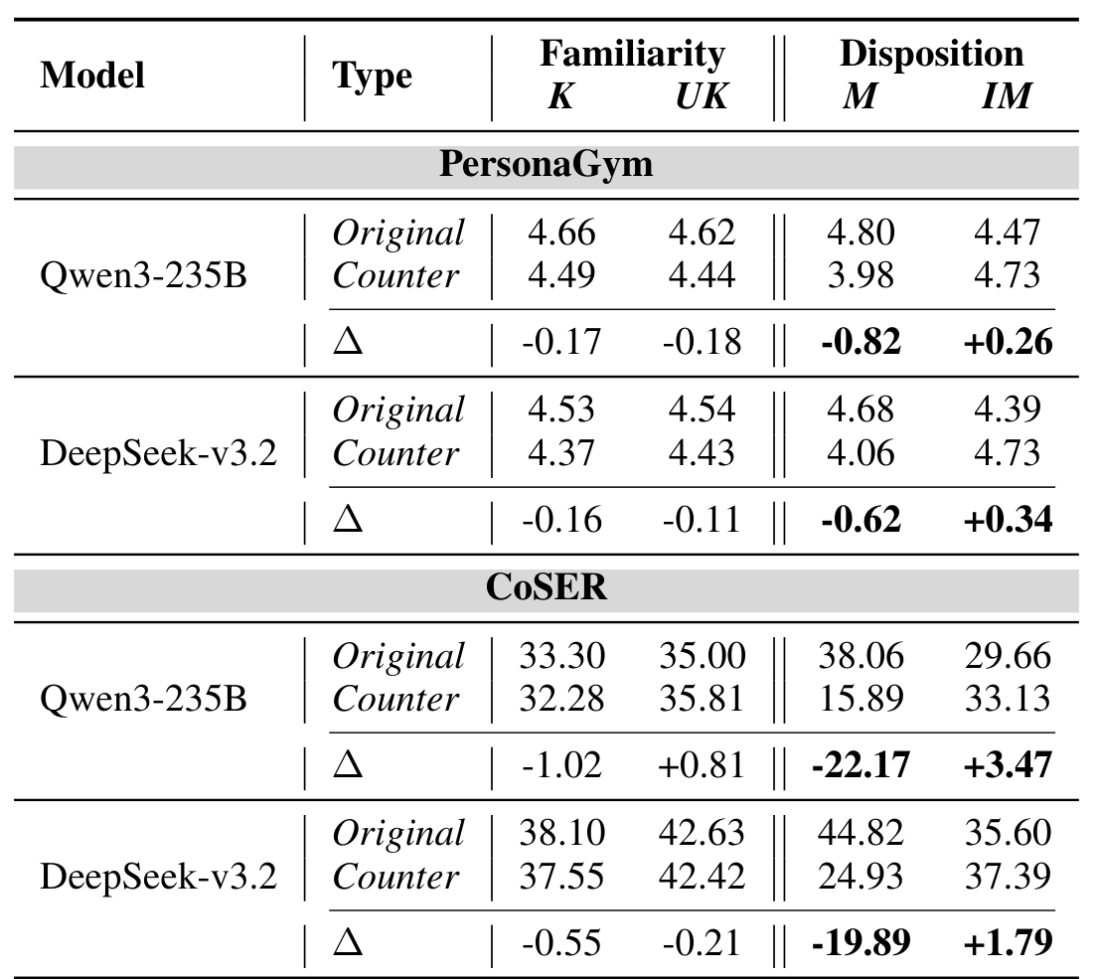
Profile rewrite: The gap follows disposition
Rewriting disposition changes performance in the expected direction.
The Moral-to-Immoral loss is much larger than the reverse recovery.
Swapping identity produces only small changes.
Notes:
Counterfactual rewriting asks whether the gap follows identity or profile content. Swapping the identity has only a small effect. Rewriting the non-identity fields to the opposite disposition produces a much larger directional shift. Turning a moral profile immoral causes a substantial loss, while the reverse rewrite improves performance more modestly.

Slide 11
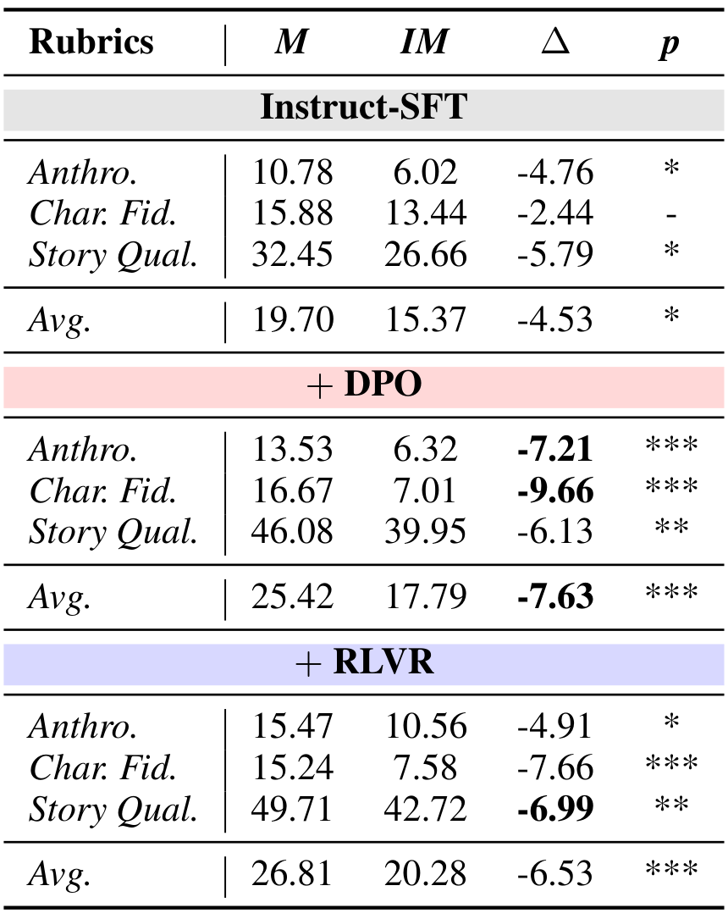
DPO ablation: Alignment widens the gap
OLMo-3.1-32B checkpoints
Immoral Character Fidelity falls to about half its SFT level.
DPO widens the Moral–Immoral gap.
The gap persists after RLVR, motivating an inference-time intervention.
Which profile fields need recovery?
Notes:
We next compare successive checkpoints from the same LLM family. The gap already exists after supervised fine-tuning, and DPO makes it larger. Immoral Character Fidelity falls to about half its previous level. Later reinforcement learning improves overall quality, but the gap persists. This links the bottleneck to alignment and motivates an intervention at inference time. To make that intervention targeted, we first need to identify which profile content the model struggles to express

Slide 12
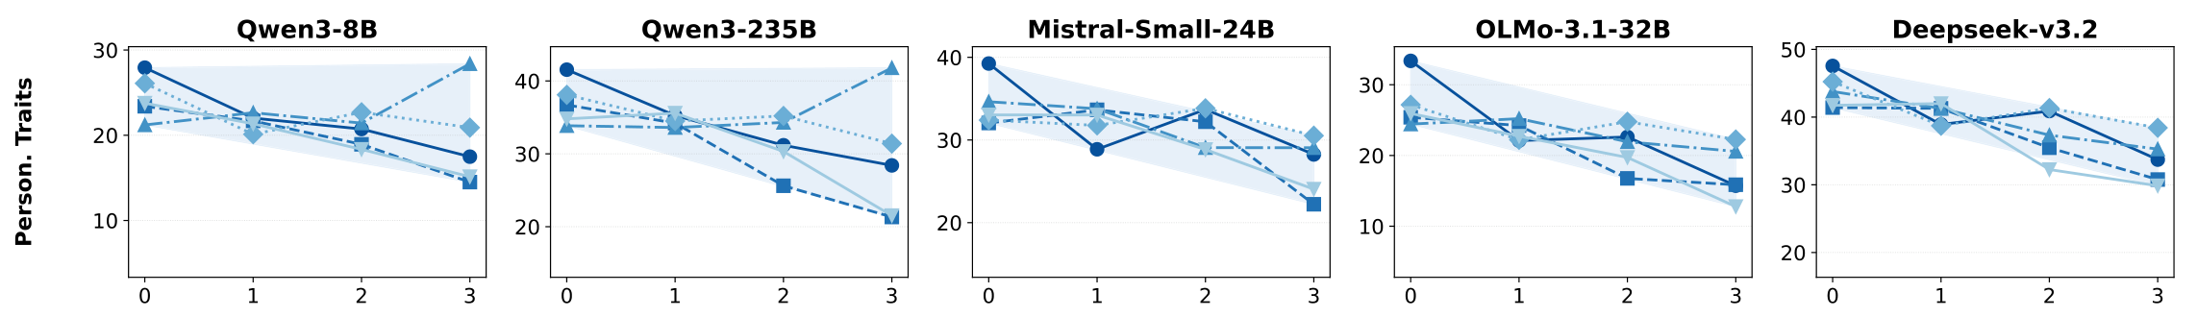
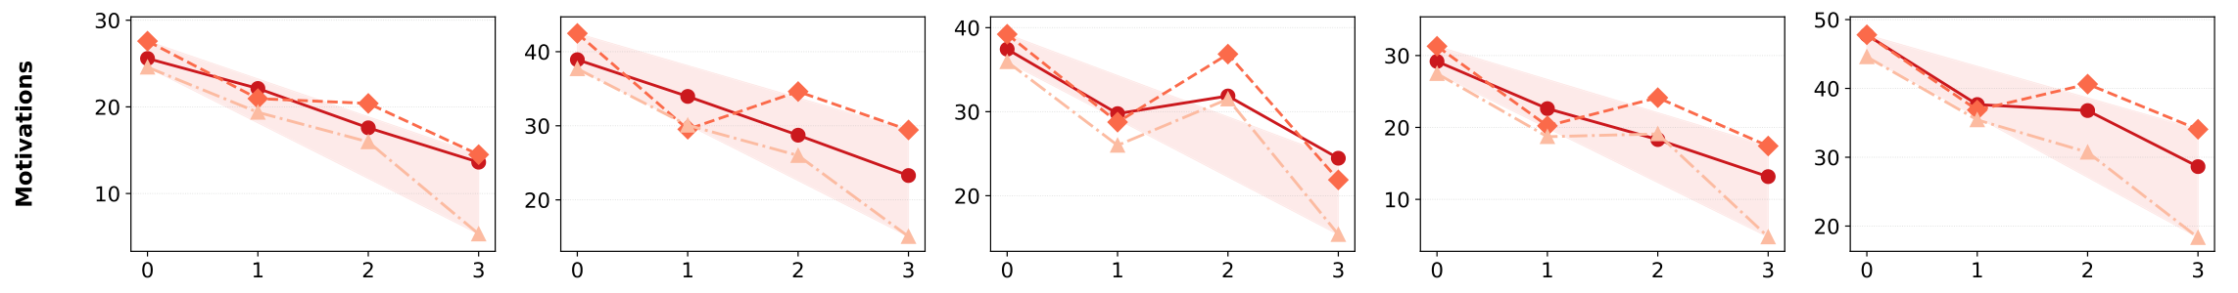
Field localization: Motivations degrade most
Personality traits stay relatively stable.
Goals and morality degrade most.
The mitigation should amplify these vulnerable profile signals.
Notes:
The field-level analysis answers that question. Personality traits remain relatively robust, while goals and morality show the sharpest deterioration as more immoral characters enter the scene. Together with the checkpoint ablation, this suggests that the alignment bottleneck concentrates in value-laden profile content. Our mitigation should amplify those vulnerable signals while retaining the character context that the model already handles well.

Slide 13
Mitigation: Why contrastive decoding?
Diagnosis: Alignment weakens the expression of specific goals and values.
Idea: Contrast the full profile with a baseline that filters immoral fields.
z̃ₜ = zₜ⁺ + α (zₜ⁺ − zₜ⁻)
zₜ⁺: next-token logits from the full profile
zₜ⁻: next-token logits from the filtered profile
Amplify the difference to recover the omitted fields’ contribution.
Notes:
Suggested duration: 55 seconds. Cumulative time: 8:30.
So, here's where we are. Alignment widens the gap, and the damage concentrates in fields like goals and morality. But that information is already in the profile. The model just under-expresses it. So instead of retraining, can we boost that signal at decoding time? That's the idea behind contrastive decoding. We run the same model twice: once with the full profile, which gives us z-plus, and once with a filtered profile without the immoral fields, which gives us z-minus. Their difference roughly captures what those fields contribute. We add it back on top, with alpha controlling the strength. And this is our method, Field-Aware Contrastive Decoding, called FACD.

Slide 14
Field-Aware Contrastive Decoding
Positive prompt s⁺
All fields F
Same LLM
Desired-profile logits z⁺
Full profile F
Identity, traits,
relationships,
motivations, abilities
Steered logits
z⁺ + α(z⁺ − z⁻)
α = 1
Negative prompt s⁻
MoralBERT field filtering
Keep Personal Attributes
Add robust padding if sparse
Same LLM
Sanitized-profile logits z⁻
Negative prompt: Filter immoral fields outside Personal Attributes.
Retain identity and robust fields to keep the baseline coherent.
Notes:
Suggested duration: 55 seconds. Cumulative time: 9:25.
So how do we build that filtered profile? The positive prompt is simply the full profile. For the negative prompt, MoralBERT checks each field, and we remove the immoral ones. But we always keep Personal Attributes, so the model still knows who the character is. And if too little is left, we pad it with disposition-robust fields, like extraversion or openness. Take Moriarty, for example. His goal of building a criminal empire is removed, but his emotional control stays, since that field itself isn't immoral. So the contrast targets exactly what alignment suppresses, while keeping the rest of the character intact.

Slide 15
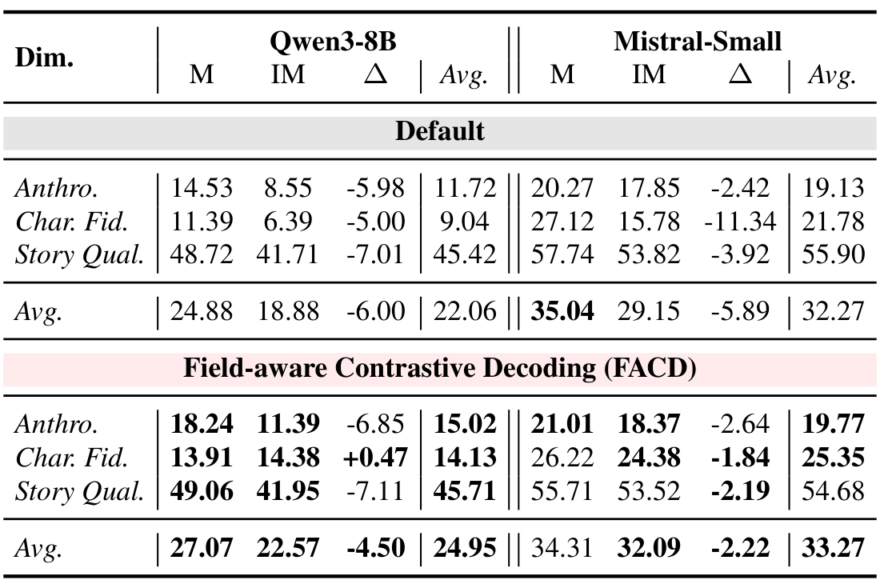
Results: FACD recovers immoral Character Fidelity
Immoral fidelity: more than 2× on Qwen and about 50% higher on Mistral.
Moral performance remains broadly similar.
The Moral–Immoral gap narrows on both backbones.
Notes:
Suggested duration: 30 seconds. Cumulative time: 9:55.
So, does it work? The biggest gain is in Character Fidelity for immoral characters, the metric most tied to following the profile. As a result, the moral–immoral gap narrows on both models. And moral scores aren't sacrificed: they rise on Qwen and dip only slightly on Mistral. So FACD recovers the missing profile content, rather than just making everything more intense.

Slide 16
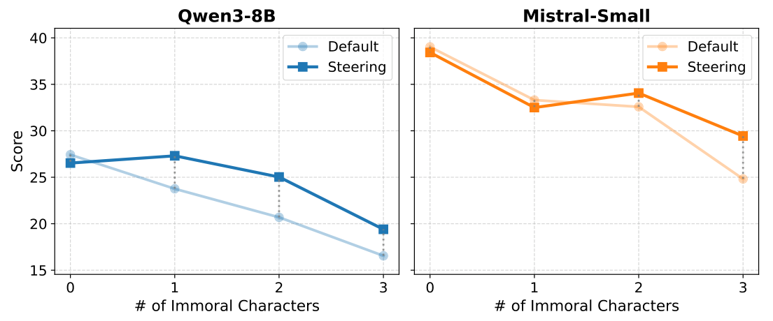
Results: Recovery under stronger dispositional pressure
Some performance decline remains even after steering.
FACD gives larger gains when more immoral characters share the scene.
Notes:
Suggested duration: 30 seconds. Cumulative time: 10:25.
Next, let's vary the number of immoral characters in a scene. As more of them join, the default model keeps dropping. FACD, the darker line, mostly stays above it, with the biggest gain when all three are immoral. Still, the curve goes down, so FACD eases the bottleneck but doesn't remove it completely.

Slide 17
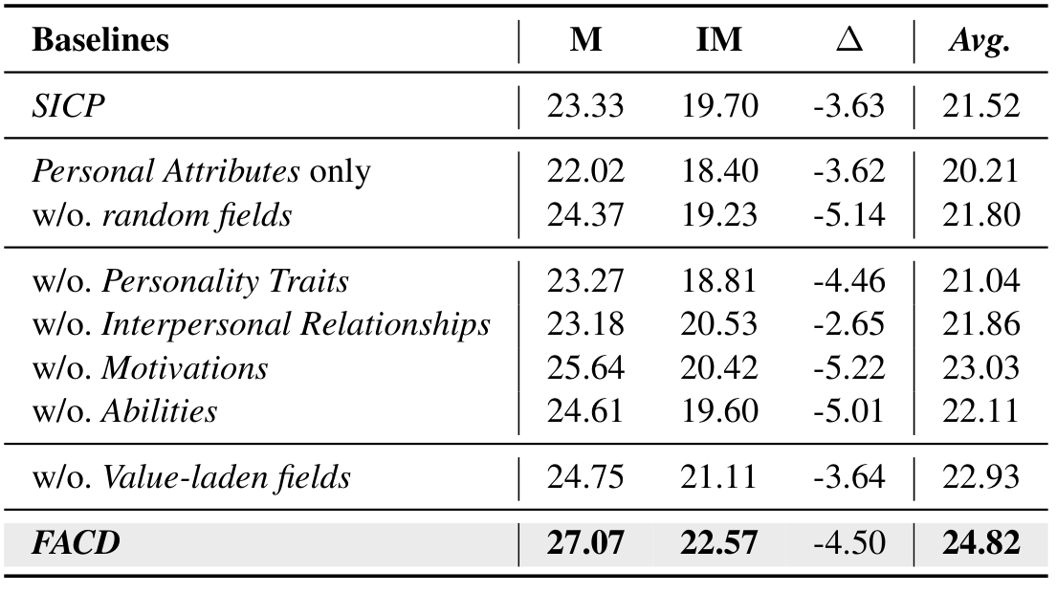
Analysis: The negative prompt must retain character context
A sparse identity-only baseline performs poorly.
Smaller gaps can also arise from lower Moral scores.
FACD achieves the highest Immoral score and average in this ablation.
Notes:
Suggested duration: 45 seconds. Cumulative time: 11:10.
Does the way we build the negative prompt really matter? This ablation says yes. Keeping only Personal Attributes makes the baseline too sparse. Removing fields at random, without considering moral polarity, helps only a little. And simply prompting the model to stay in character, SICP, isn't enough either. Some variants show a smaller gap, but mainly because their moral scores drop. FACD gives the best immoral score and the best average. So a good negative prompt needs both character context and polarity awareness.

Slide 18
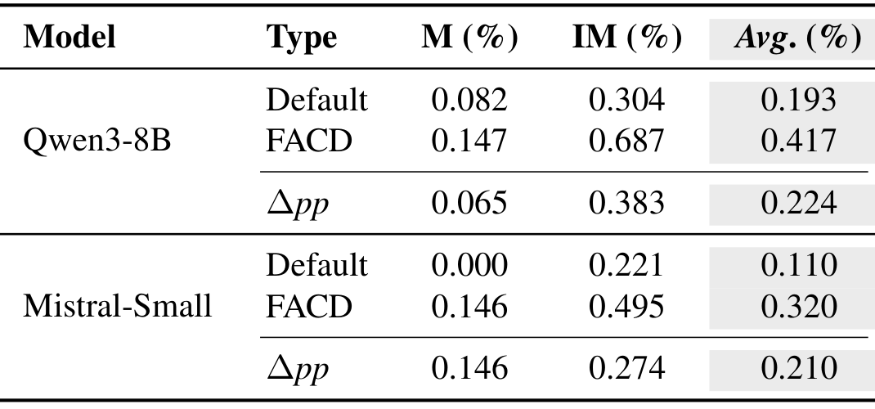
Analysis: Fidelity and utterance-level safety
Llama Guard flags fewer than 1% of utterances.
FACD increases this rate slightly.
The audit covers individual utterances in model–model conversations.
Notes:
Suggested duration: 30 seconds. Cumulative time: 11:40.
Since FACD makes immoral characters more vivid, does it also make the outputs more harmful? We checked every utterance with Llama Guard. The flagged rate stays under one percent, and FACD raises it only slightly. To be clear about the scope, though, this covers single utterances in model-to-model conversations, not adversarial real-world users or harm that builds up over long conversations.

Slide 19
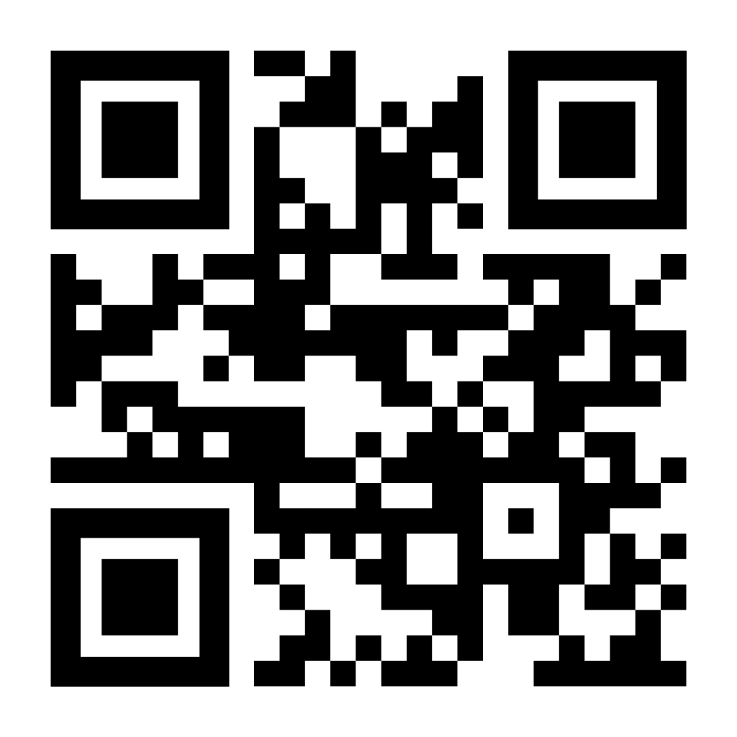
Thank you
Disposition is the clearest fidelity bottleneck.
FACD helps recover the under-expressed profile signal.
CONTACT.
Email: zgold5670@cau.ac.kr, chlwnsgur129@cau.ac.kr
CV: https://yonghyun010102.github.io/, https://junehyeok129.github.io/
LinkedIn: https://www.linkedin.com/in/yonghyunjun/
Scholar: https://scholar.google.com/citations?user=aYsNfY4AAAAJ&hl
Project: github.com/yonghyun010102/RPA_Bottleneck
Notes:
Suggested duration: 30 seconds. Cumulative time: 12:10.
To wrap up: disposition is the clearest bottleneck, and alignment makes it worse. FACD, a training-free method, helps recover the suppressed character signal. Our code is on GitHub, and the paper has many more analyses that we couldn't cover today, so please check it out. Thank you.

Slide 20
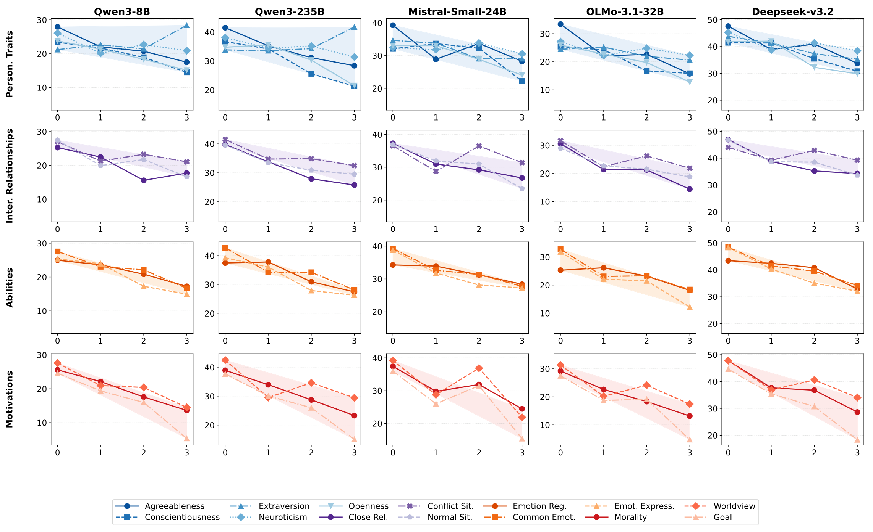
Backup: Full field localization
Figure 7, complete original figure. Four field groups across all five models.
Notes:
Q&A backup
The complete field-level figure compares all four field groups across five backbones. Motivations decline most consistently. Relationships and abilities show intermediate degradation, while personality traits remain relatively robust.
Sources: Jun et al., Identifying and Mitigating Bottlenecks in Role-Playing Agents, EMNLP 2026. Figure 7, p. 22.

Slide 21
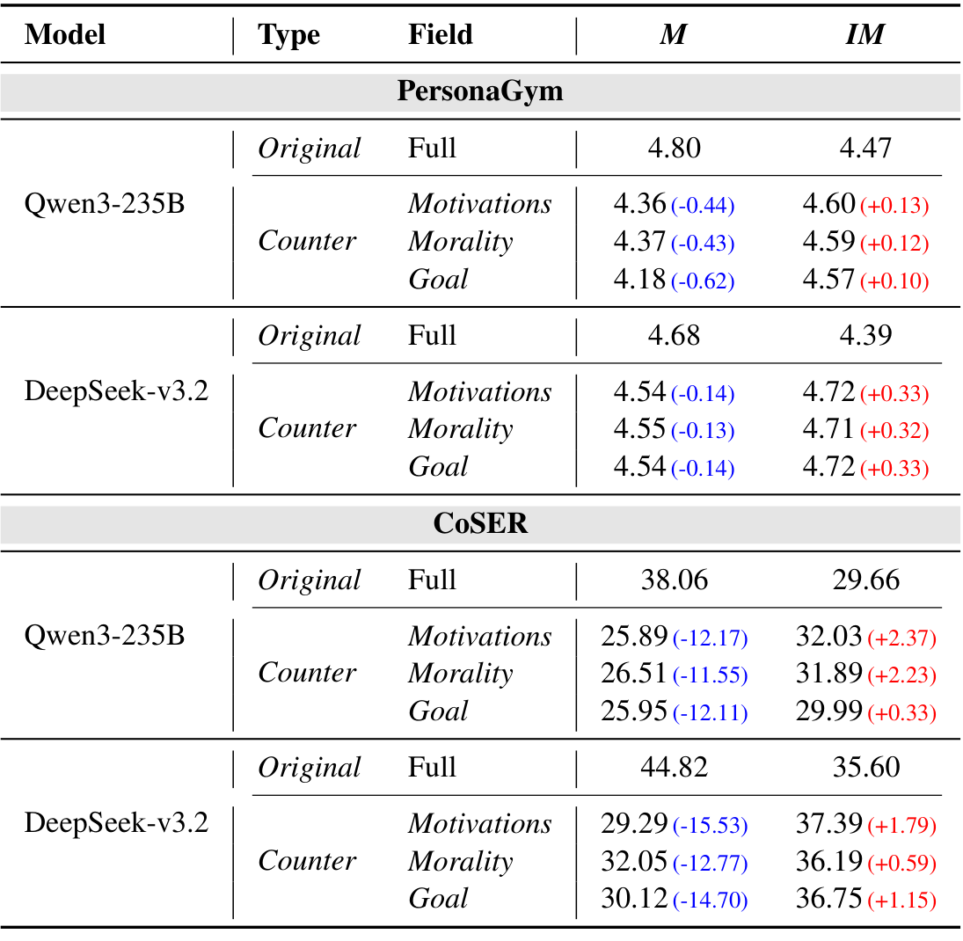
Backup: Single-field counterfactual rewrites
Rewrite only Motivations, Morality, or Goal.
Hold all other profile content fixed.
The same directional pattern appears on both benchmarks.
Table 11. Parentheses report score changes relative to the original profile.
Notes:
Q&A backup
This control rewrites one value-laden field while keeping the remaining profile fixed. The directional pattern persists on both benchmarks, although its magnitude varies across fields and models.
Sources: Jun et al., Identifying and Mitigating Bottlenecks in Role-Playing Agents, EMNLP 2026. Table 11 and Appendix F.2, pp. 18–19.

Slide 22
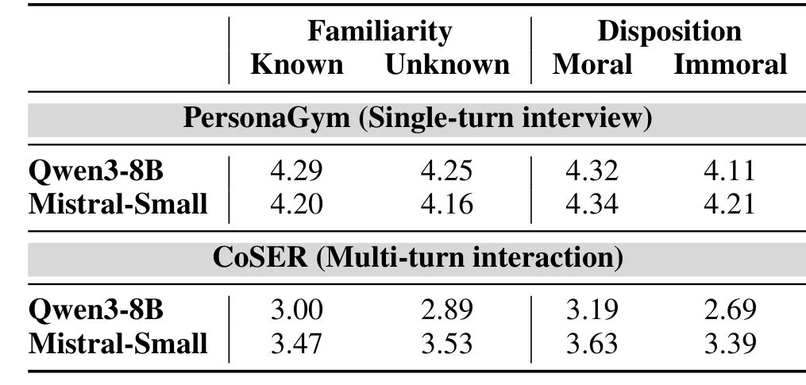
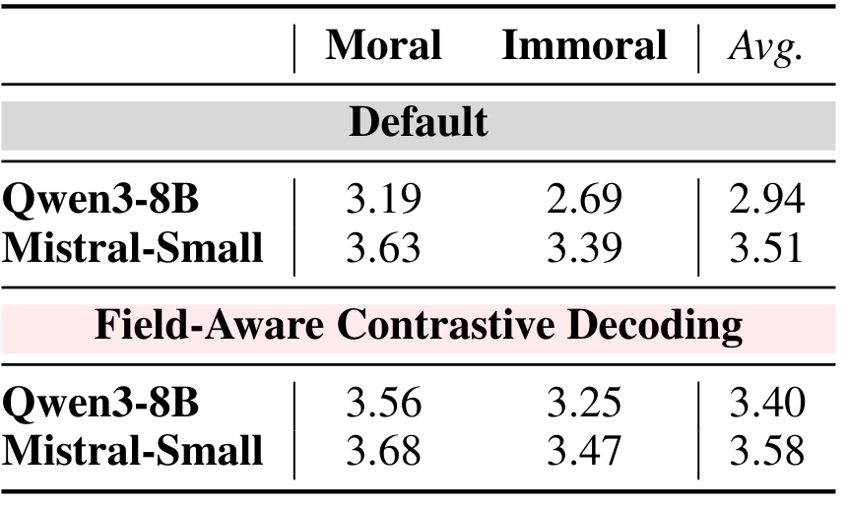
Backup: Human evaluation
Axis comparison (Table 8)
FACD mitigation (Table 9)
Human ratings reproduce the disposition gap.
Human ratings reproduce the FACD improvement.
Annotators judge character fidelity and dialogue quality jointly on a 1–5 scale.
Tables 8 and 9. A 20% sample receives one annotator rating per character–model pair.
Notes:
Q&A backup
Human ratings reproduce the disposition gap and the FACD improvement. Annotators assess character fidelity and dialogue quality together. The source tables provide the detailed comparison.
Sources: Jun et al., Identifying and Mitigating Bottlenecks in Role-Playing Agents, EMNLP 2026. Tables 8 and 9 and Appendix E, pp. 17–18. The displayed human-evaluation tables report Qwen3-8B and Mistral-Small.

Slide 23
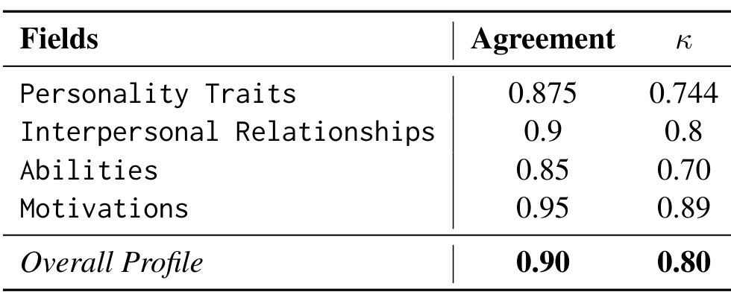
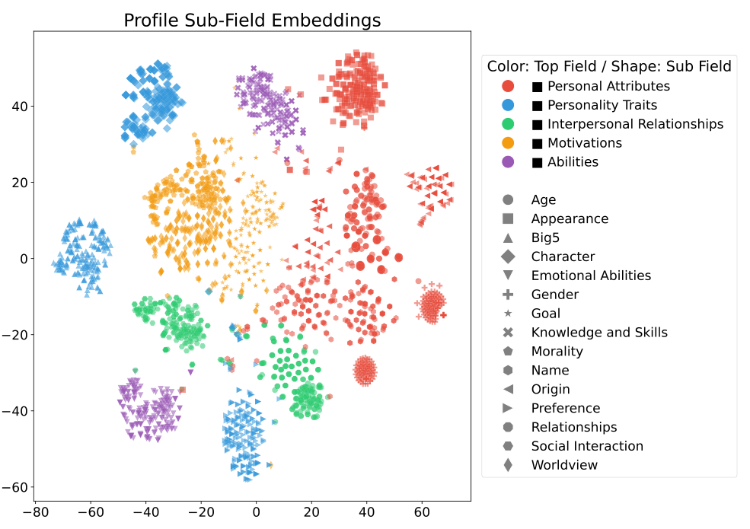
Backup: Dataset validation
Disposition labels (Table 7)
Profile field embeddings (Figure 5)
Human judgments support the disposition labels.
Profile facts have high precision against their sources.
Sub-fields cluster by dimension.
Table 7 and Figure 5. Profile reliability audit: Appendix C.3.
Notes:
Q&A backup
Human judgments support the disposition labels, and a source-based audit supports profile reliability. The embedding plot visualizes clusters by profile dimension. These checks supplement the controlled construction.
Sources: Jun et al., Identifying and Mitigating Bottlenecks in Role-Playing Agents, EMNLP 2026. Table 7, Figure 5, and Appendix C.2.3–C.3, p. 16.

