Slide 1
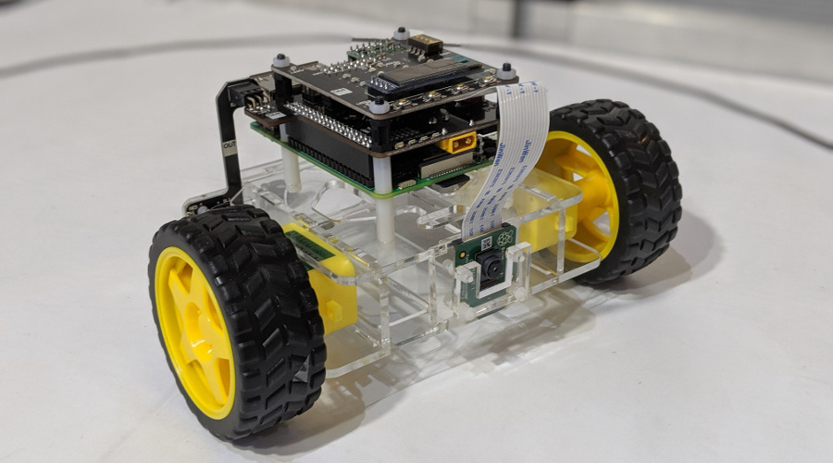
ECE4078 Intelligent robotics
Lab 4-2: Kal Backman & Shujie Zhou

Slide 2
ECE4078 Intelligent robotics
Week | Objectives | Milestones
2: M1-1 | Introduction and setup
3: M2-1 | Calibration, ARUCO markers | M1 due
4: M2-2 | SLAM
5: M2-3 | SLAM
6: M3-1 | Object recognition & localisation | M2 due
7: M3-2 | Object recognition & localisation
8: M4-1 | Navigation & Planning | M3 due
9: M4-2 | Navigation & Planning
10: M5-1 | Integration | M4 due
11: Final | Improvement | M5 due
12: Final | Final demo & competition | Final demo
*

Slide 3
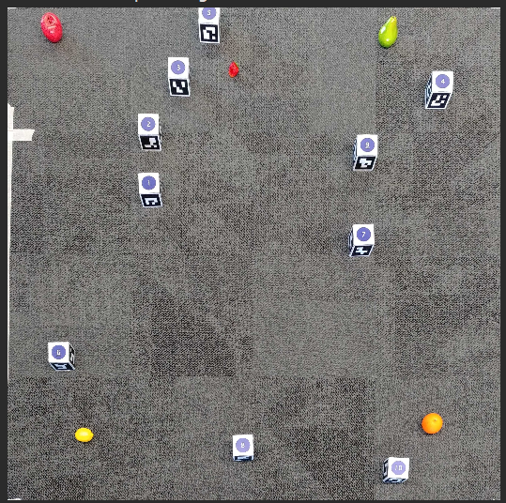

Milestone 4
Milestone is focused on navigation and planning
Your task will be to semi OR fully autonomously navigate and path plan around the arena to “pick up” various fruit in a specified order
In order for our robot to autonomously plan a path it first needs to build an occupancy map
To do this we can voxelise the true map given to us where a 0 represents a free space and 1 an obstacle
Using the OpenCV cv2.circle() function we can draw obstacles with a given safety radius
Apple is the goal therefore not counted as an obstacle
Arena
Occupancy map

Slide 4
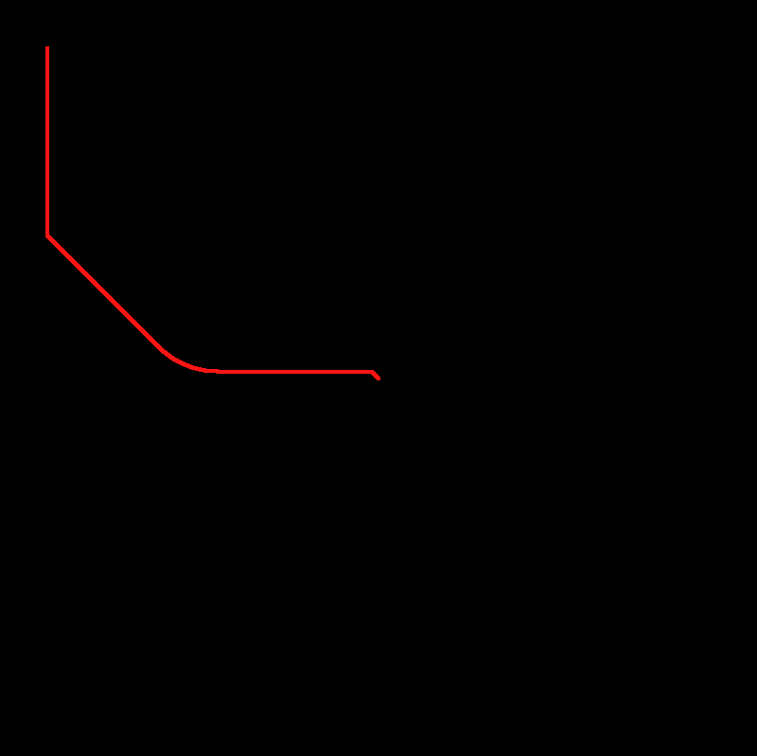
Milestone 4
Once an occupancy map is created you can then implement your path planning algorithm of your choice
If you want to generate the shortest path possible then you can use Dijkstra algorithm
Step 1: Generate a distance map from the goal point
Starting from the goal location, propagate the distance from the goal until
the whole map is filled
Selecting any point in this image will tell you the shortest distance to the
goal point
Step 2: Generate the shortest path
Select a starting point on the image, look at the point’s nearest neighbors
and then select the neighbor with the smallest distance value.
Continue selecting the nearest neighbors with the smallest distance value
until you reach the goal point

