Slide 1
ASE 2018
L-CMP
An Automatic Learning-based Parameterized Verification Tool
Jialun Cao, Youngjian Li, Jun Pang
Notes:
Good morning everyone. It is my pleasure to introduce our tool, L-CMP to you all. L-CMP is an automatic parameterized verification tool which is based on association rule learning. So now, let’s start from its background.

Slide 2
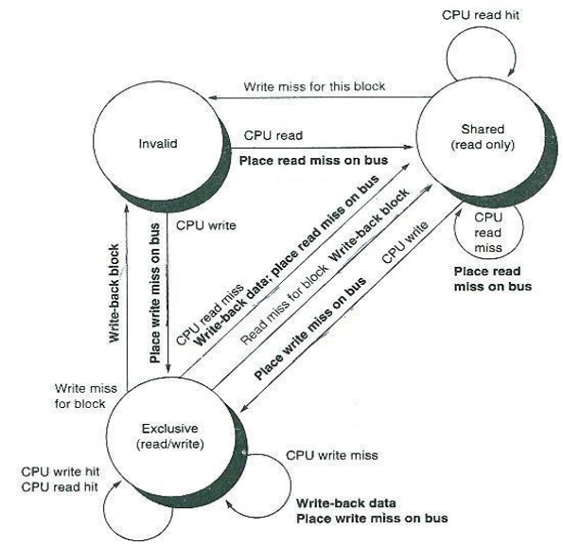
Background
BACKGROUND:
Parameterized systems exist in many practical areas, such as mutual exclusion protocols, bus protocols, networking communication, cache coherence protocols.
Notes:
Parameterized system exists in many areas. For example, as we all know the mutual exclusion protocol is one of them. These parameterized systems work together, keeping the computer running as usual.

Slide 3





Background
DEFINITION
P(N) : a parameterized system that consists of N nodes. The verification of such protocol is to verify some properties hold for arbitrary sizes.
$$𝒩_{1}$$
...
$$𝒩_{M}$$
......
$$𝒩_{M+1}$$
$$𝒩_{M+2}$$
......
$$𝒩_{N}$$
Notes:
Now, let’s give a formal definition of what a parameterized system or protocol is.
In general, a parameterized system P(N) is defined as a system that consists of N instances, where the term parameterized refers to the fact that the size of the system is a parameter.

Slide 4
Background
CHALLENGE
need to check the correctness with arbitrary sizes of instances, which has been proved to be undecidable
P1
P2
P3
……
Pn
Mem
Notes:
While the verification is to ensure the correctness with arbitrary sizes of instances. This problem has been proved to be NP hard and undecidable.

Slide 5
limitations OF EXISTING WORKS
Manual works are dependent on researchers’ insights and guidance --- not automatic
The theoretical basis of the existing automatic tools are unsolid --- not solid proved
The auxiliary invariants they derived are difficult to read --- not understandable
Notes:
To address this problem, many works have been proposed. They fall in two main categories: manual and automatic.
However, the manual works are error-prone, especially when the protocol description is long and complicated. While for the automatic methods such as Cubicle, the invariants they found are hard to read and understand.

Slide 6
What is l-cmp
An automatic learning-based parameterized verification tool
Originalities:
Combine with machine learning
Auxiliary invariants it provides are straightforward and easy-to-understand
Notes:
Therefore, we propose L-CMP, an automatic learning-based parameterized verification tool.
It can learn directly from instances of protocols, and derive understandable auxiliary invariants. The verification process is carried out automatically in the aid of machine learning.

Slide 7
Capabilities
Derive a set of auxiliary invariants of protocols
Verify parameterized protocols
Auxiliary
invariants
Protocol
Deeper understanding of protocol’s mechanism
Designer
L-CMP
Verified
protocol
Protocol
Y / N
Researcher
Business Analyst
Notes:
Because of its natural traits, it can benefit protocols designers and researchers by providing them deeper understanding of how protocols are functioning.
It also gives direct result to business analysts who only need to know whether the protocol is correct or not.

Slide 8
An overview of L-CMP
Atomic
predicates
phase 1
Protocol
Dataset
Association Rules
Auxiliary Invariants
Reachable Set
1. Preprocessor
2. Learner
3. Selector
N
Tune parameters
phase 2
Y
5. Abstractor
4. Strengthener
Verified Protocol
6. Model checker
Notes:
Now, let’s give an overview of the L-CMP.
We can see that there are two phases in L-CMP.
The first phase is learning phase. It learns a set of auxiliary invariants from the input protocol.
The second phase generally follows the idea of parameterized abstraction and guard strengthening technique, but it strengthens the protocol before, not after the abstraction process. Because of this changed order, L-CMP can therefore avoid the guidance from humans, making it possible to automatize.

Slide 9
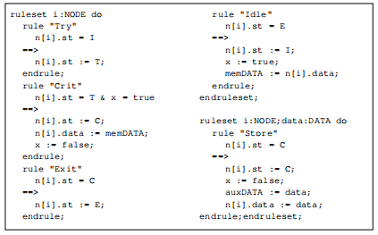
Implementation details – phase 1
Preprocessor
Given a parameterized protocol in Murphi language
Notes:
Given a parameterized protocol in Murphi, the first step is to generate a reachable set of its instance.

Slide 10
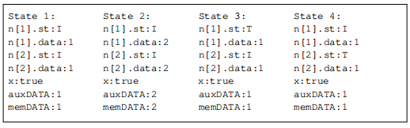


Implementation details – phase 1
Preprocessor
Generate reachable set by Murphi
Extract atomic predicates from protocol
Transform the reachable set according to atomic predicates
Notes:
Given a parameterized protocol in Murphi, the first step is to generate a reachable set of its instance.

Slide 11
Implementation details – phase 1
Association rule learning
Association rule learning is to mine interesting correlations among items.
Example: Beer – Diaper
Notes:
The second step, association rule learning.
Then what is association rule learning?
It is designed to mine interesting correlations among items from large database.
A classical example of association rule learning is “Beer and Diapers”. Researchers found that diapers are often bought with beer, which means these two items have strong correlations.

Slide 12
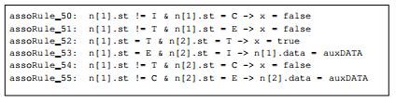
Implementation details – phase 1
Association rule learning
Size of frequent item set = 3
Minimum support = 0.0
Minimum confidence = 1.0
Notes:
The second step, association rule learning.
Then what is association rule learning?
It is designed to mine interesting correlations among items from large database.
A classical example of association rule learning is “Beer and Diapers”. Researchers found that diapers are often bought with beer, which means these two items have strong correlations.

Slide 13
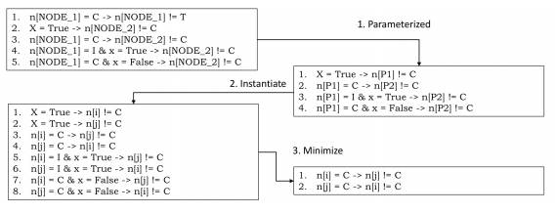
Implementation details – phase 1
The number of derived association rules is generally large, so we need a step to minimize it
Notes:
Selector, as its name implied, selects truly auxiliary invariants from the association rules. This step needs the help of Murphi.

Slide 14
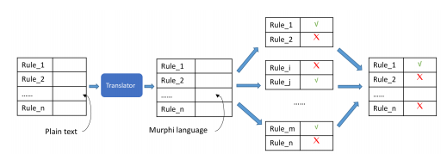
Implementation details – phase 1
Selection
Murphi
Notes:
Selector, as its name implied, selects truly auxiliary invariants from the association rules. This step needs the help of Murphi.

Slide 15
Implementation details – phase 1
Selection
Murphi
Notes:
Selector, as its name implied, selects truly auxiliary invariants from the association rules. This step needs the help of Murphi.

Slide 16
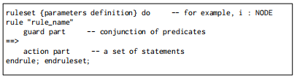
Implementation details – phase 2
Strengthening
The structure of rules
Notes:
Before introducing the detailed implementation, we need to explain the structure of rules in parameterized protocols. A protocol rule is consist of two main parts: guard
and action. If the predicates in guard are satisfied, then the
statements in action can be executed.
Meanwhile, the auxiliary invariants are associations of predicates.
Thus, it is straight-forward to add the conclusion (i.e., ψ) of auxiliary invariants to the guard of rules if its antecedent (i.e., ϕ) is a subset of the guard.

Slide 17
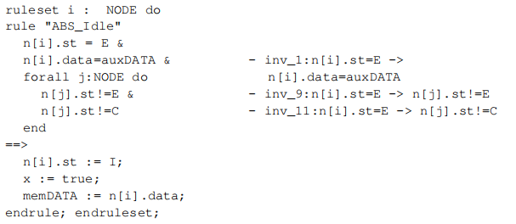
Implementation details – phase 2
Strengthening
Notes:
Before introducing the detailed implementation, we need to explain the structure of rules in parameterized protocols. A protocol rule is consist of two main parts: guard
and action. If the predicates in guard are satisfied, then the
statements in action can be executed.
Meanwhile, the auxiliary invariants are associations of predicates.
Thus, it is straight-forward to add the conclusion (i.e., ψ) of auxiliary invariants to the guard of rules if its antecedent (i.e., ϕ) is a subset of the guard.

Slide 18
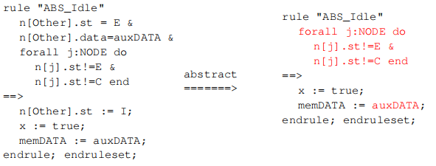
Implementation details – phase 2
Abstraction
Notes:
Finally, the abstraction step is realized by removing the predicates and statements that are related to a parameter in definition part under three circumstances.

Slide 19
Experiment result
Protocol name | # assoRules | # auxInvs | # usedInvs | Runtime (s) | result
Moesi | 736 | 20 | 5 | 24.744 | √
Mesi | 144 | 16 | 5 | 24.412 | √
MutualEx | 656 | 12 | 3 | 890869 | √
Mutdata | 540 | 12 | 6 | 19.703 | √
German | 21202 | 448 | 8 | 85.418 | √
Flash | 358710 | 1636 | 327 | 41371.023 | √
Notes:
We have tested several typical protocols in L-CMP.
We can see that for smaller protocols, L-CMP can verify them in seconds. While for larger protocols especially the Flash protocol, it takes L-CMP several hours. Note that some experiment records are omit in this table due to space limitation.

Slide 20
ASE 2018
Thank you
L-CMP: An Automatic Learning-based Parameterized Verification Tool

Slide 21
USING Decision tree to Derive INVARIANTS FOR parameterized verification
ASE 2018
This paper proposes a robust decision tree-based learning paradigim for synthesizing inductive invariants for parameterized verification of protocols. We use explicit-state based model checking to get the reachable state set of a protocol instance usually with the help of symmetry reduction; then we can obtain a data sheet from the reachable states. We propose a new decision-tree based learning technique to transform a data sheet into symbolic formulas. These formulas are classification rules from the root to a leaf node. They can be regarded as knowledge to summarize behaviours of the system. From the knowledge, we can construct a teacher to judge candidates of invariants of the protocol, which is conjectured by an finder of invariants. After proper generalization and proof generation, a formal proof for the correctness of the protocol can be derived. The effectiveness of our method is demonstrated by case studies on typical benchmarks including Flash protocols.
Thank you

Slide 22
Using Recurrent Neural Network for Cloud Masquerade Attack Detection
ASE 2018
ABSTRACT
There is an increasing trend to use cloud for data storage and applications. However, the security and privacy issues in the cloud environment become the major concerns for cloud users and organizations. Masquerade attack is one of the most critical attacks in the cloud. To exploit the sequential feature of the masquerade attack dataset, we propose to use Recurrent Neural Network (RNN) with Long Short-Term Memory (LSTM) to detect masquerade attacks. We also applied word vector to preprocess the dataset to provide more exploitable information for prediction. Experimental results showed that the proposed RNN methods obtained better performance than the traditional multilayer perceptron methods. Moreover, the RNN with word vector method showed promising performance in identifying both the normal and masquerade records.
Thank you

