Slide 1
HackGlobal 2024
How can we enhance the utilization of shared spaces and amenities
Lyf Space
Team ByteForce

Slide 2
WHAT

Slide 3
Tracking and Analyzing Usage Patterns of Shared Spaces

Slide 4
WHO

Slide 5
The Customers Lyf Management Team

Slide 6
WHY

Slide 7
Enable the customer, improve engagement and create a wow experience

Slide 8
Insights to improve utilization and engagement Prioritize and allocate square footage based on usage Optimize and maximize revenue stream from shared spaces A/B test different initiatives across all the properties

Slide 9
HOW

Slide 10
Track IoT for gated spaces (counting people), Camera feed for open spaces (motion sensing for Occupancy)

Slide 11
Value Add Live Occupancy Rates of Different Spaces Usage patterns for planning where to go Average time spent by people Pattern changes due to initiatives Insights on peak/non-peak times

Slide 12
Tech Stack

Slide 13
Arduino
Supabase
Python

Slide 14
Demo

Slide 15
Github: https://github.com/yongjip/byteforce2024-grand-finals
Demo: https://youtu.be/kDnj2R_PkIw

Slide 16
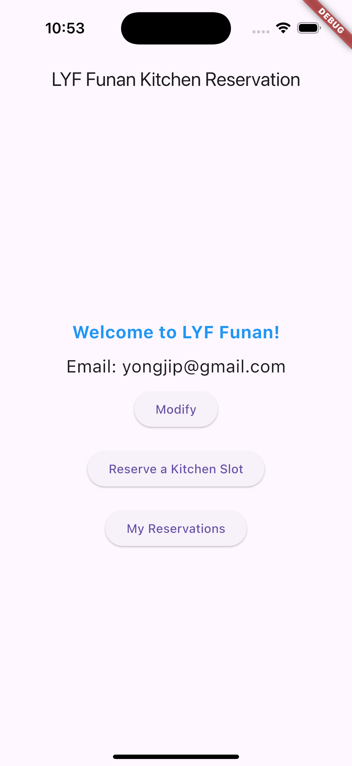
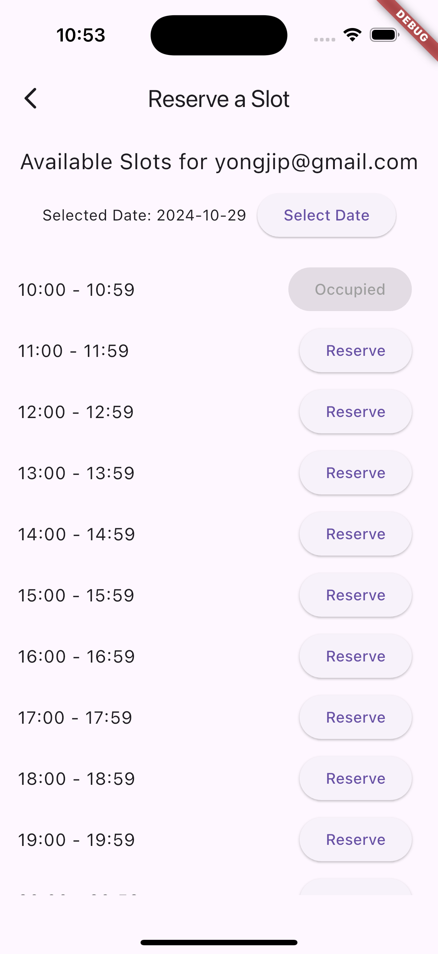
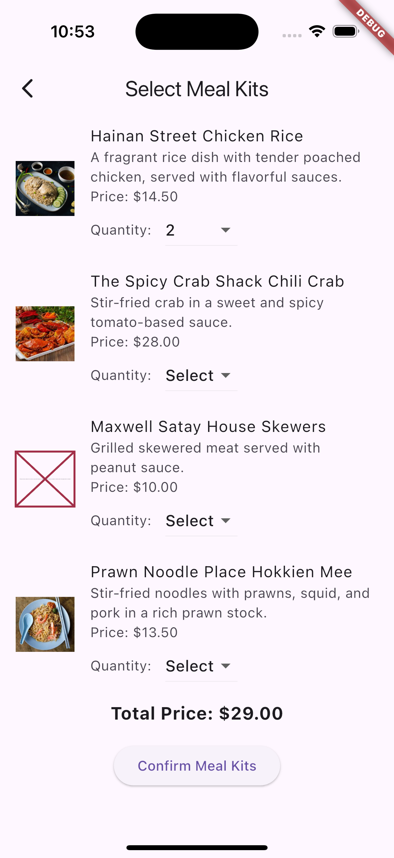
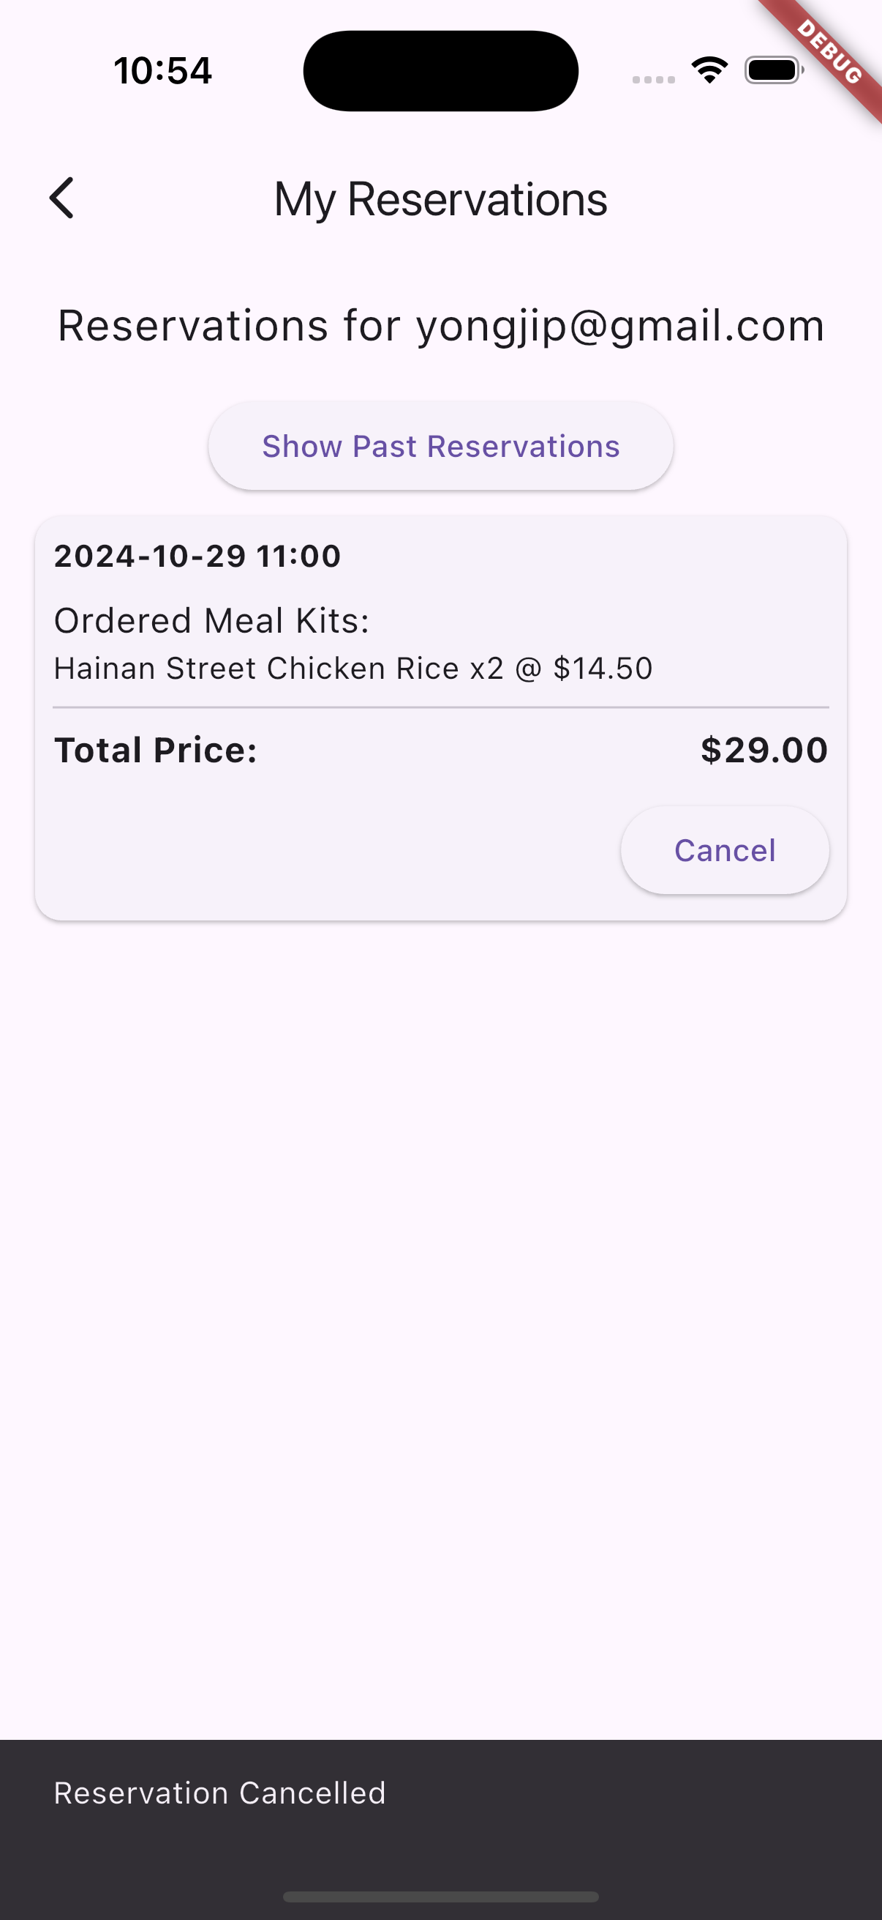
Appendix – Meal kit purchase from app

