Slide 1
Pattern Template Manifest
for live DASH streaming
Proposal from Amazon Prime Video & AWS Elemental
DASH-IF F2F Meeting #20
Yongjun Wu yongjuw@amazon.com
Nicolas Weil nicoweil@elemental.com

Slide 2
Outlines
What is the problem?
Why does the problem exist?
Where does the problem come from, through case studies?
The proposed solution of Pattern Template Manifest
Pre-DASHIF F2F updates

Slide 3
What is the problem?
Manifest size grows linearly as time duration increases
A generic problem across DASH, HLS and Smooth Streaming
A common behavior exists in all DASH packagers.
More significant in live streaming than VOD due to live manifest refresh every N seconds

Slide 4
What is the problem?
Scenarios impacted by big manifests
Just After Broadcast (JAB) video assets in long duration
StartOver/scrub/seekback in live streaming >1 hours
Live manifest with M minutes live window
…
On the aspects of,
Manifest generation on service
Manifest parsing on service and more importantly device
Manifest storage on service and more importantly device
Manifest download through (limited) internet bandwidth

Slide 5
What is the problem?
Manifest size will be N times larger with N audio tracks in live events, such as 4 tracks in Thursday Night Football and 3 tracks in English Premier League.
If there are multiple (M) audio codecs in each language, manifest size will be MxN times larger
Notes:
…

Slide 6
Outlines
What is the problem?
Why does the problem exist?
Where does the problem come from, through case studies?
The proposed solution of Pattern Template Manifest
Pre-DASHIF F2F updates

Slide 7
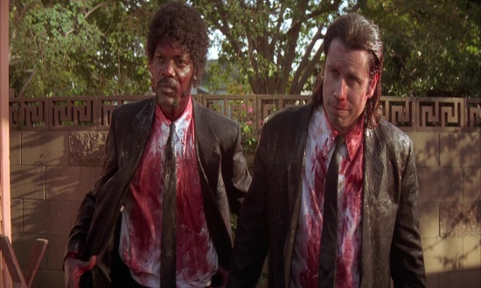
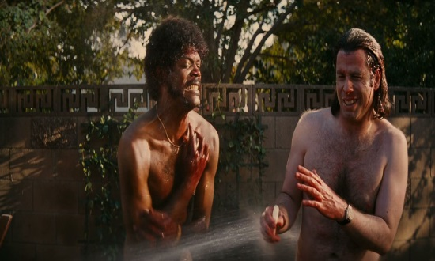
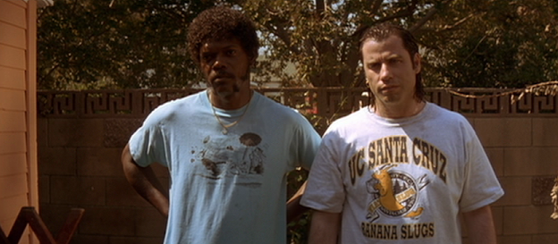

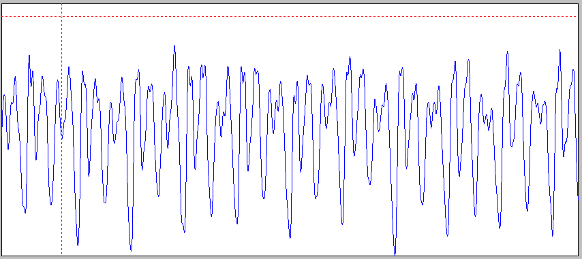
Why does the problem exist?
Fragmentation aligns audio and video fragments in the best efforts
2 seconds
2 seconds
2 seconds
2 seconds
H.264
at 30fps
…
AAC-LC at 48 KHz
…
2.0053 seconds
2.0053 seconds
2.0053 seconds
1.984 seconds
A pattern of 8 seconds for perfect audio and video alignment
Minimum misalignment in the middle, 0, 5.3 ms, 10.6 ms and 16 ms
Notes:
In general, fragmentation …

Slide 8
Why does the problem exist?
Why the alignment between audio and video fragments are necessary?
Trimming a certain portion from the whole content will be easy
Some (MSE/EME) players can only play the full audio and video fragments, without dropping any audio or video frames, which requires misalignment of audio and video fragments under the A/V sync threshold [-45, 125] ms
Playback seek will be easy to implement, with minimum audio and video drift and without dropping any audio or video frames

Slide 9
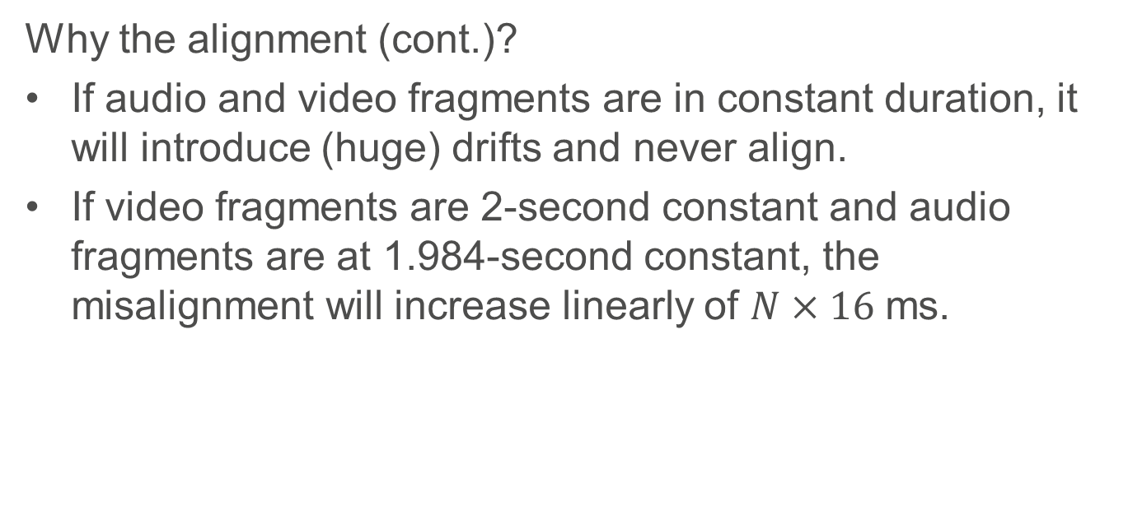
Why does the problem exist?
Why the alignment (cont.)?
If audio and video fragments are in constant duration, it will introduce (huge) drifts and never align.
If video fragments are 2-second constant and audio fragments are at 1.984-second constant, the misalignment will increase linearly of $N×16$ ms.

Slide 10
Outlines
What is the problem?
Why does the problem exist?
Where does the problem come from, through case studies?
The proposed solution of Pattern Template Manifest
Pre-DASHIF F2F updates

Slide 11
Where does the problem come from?
Where does such pattern and cycle come from?
Case study 1 with integer video frame rate 30 fps and AAC audio sampling frequency 48 KHz
Case study 2 with non-integer video frame rate 29.97 fps = 30,000/1,001 and AAC audio sampling frequency 48 KHz

Slide 12
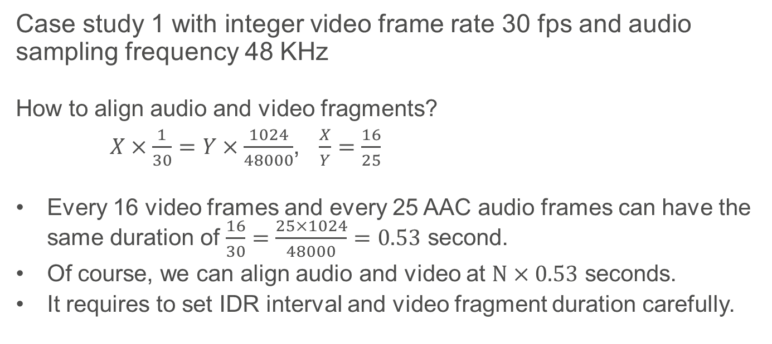
Where does the problem come from?
Case study 1 with integer video frame rate 30 fps and audio sampling frequency 48 KHz
How to align audio and video fragments?
$X×\frac{1}{30}=Y×\frac{1024}{48000}$, $\frac{X}{Y}=\frac{16}{25}$
Every 16 video frames and every 25 AAC audio frames can have the same duration of $\frac{16}{30}=\frac{25×1024}{48000}=0.53$ second.
Of course, we can align audio and video at $N×0.53$ seconds.
It requires to set IDR interval and video fragment duration carefully.

Slide 13
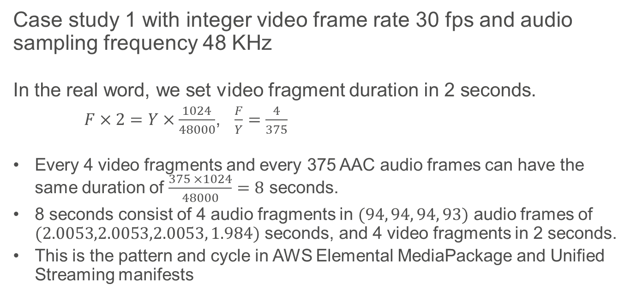
Where does the problem come from?
Case study 1 with integer video frame rate 30 fps and audio sampling frequency 48 KHz
In the real word, we set video fragment duration in 2 seconds.
$F×2=Y×\frac{1024}{48000}$, $\frac{F}{Y}=\frac{4}{375}$
Every 4 video fragments and every 375 AAC audio frames can have the same duration of $\frac{375 ×1024}{48000}=8$ seconds.
8 seconds consist of 4 audio fragments in $(94, 94, 94, 93)$ audio frames of $(2.0053,2.0053,2.0053, 1.984)$ seconds, and 4 video fragments in 2 seconds.
This is the pattern and cycle in AWS Elemental MediaPackage and Unified Streaming manifests

Slide 14
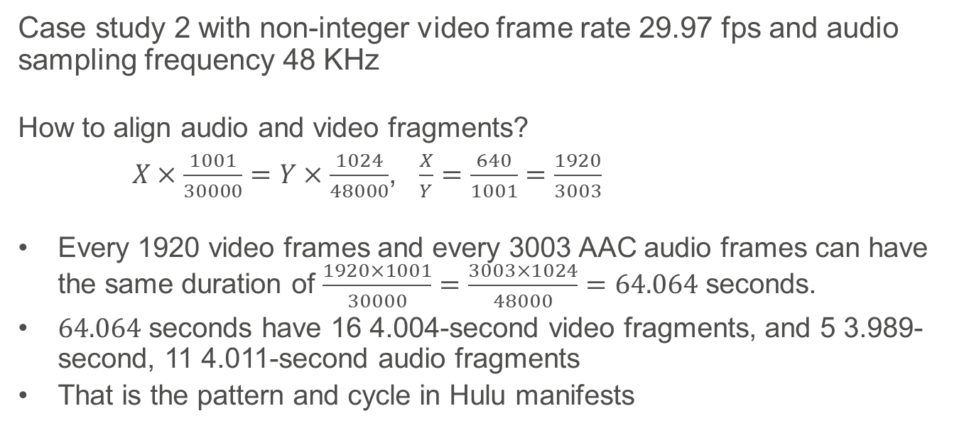
Where does the problem come from?
Case study 2 with non-integer video frame rate 29.97 fps and audio sampling frequency 48 KHz
How to align audio and video fragments?
$X×\frac{1001}{30000}=Y×\frac{1024}{48000}$, $\frac{X}{Y}=\frac{640}{1001}=\frac{1920}{3003}$
Every 1920 video frames and every 3003 AAC audio frames can have the same duration of $\frac{1920×1001}{30000}=\frac{3003×1024}{48000}=64.064$ seconds.
$64.064$ seconds have 16 4.004-second video fragments, and 5 3.989-second, 11 4.011-second audio fragments
That is the pattern and cycle in Hulu manifests

Slide 15
Where does the problem come from?
General observations and conclusions
Audio and video fragments could be perfectly aligned in integer frame rate and most popular sampling frequency of 48 KHz or 32 KHz for AAC and DD+/Atmos with careful configurations
General practice of 2-second video fragment duration will introduce a typical pattern and cycle of audio fragment duration even with integer frame rate
It’s inevitable to have a pattern and cycle of audio fragment duration with non-integer frame rate and sampling frequency of 48 KHz or 32 KHz

Slide 16
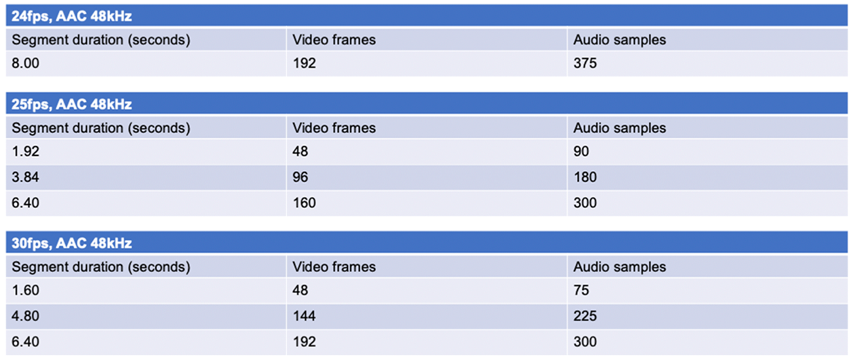
Alignment for integer framerates

Slide 17
Outlines
What is the problem?
Why does the problem exist?
Where does the problem come from, through case studies?
The proposed solution of Pattern Template Manifest
Pre-DASHIF F2F updates

Slide 18
The proposed solution
Existing run-length compression in DASH spec .
@r,
specifies the repeat count of the number of following contiguous Segments with the same duration expressed by the value of @d. This value is zero-based (e.g. a value of three means four Segments in the contiguous series). A negative value of the @r attribute of the S element indicates that the duration indicated in @d attribute repeats until the start of the next S element, the end of the Period or until the next MPD update.

Slide 19
The proposed solution
Existing run-length compression in DASH spec.
<SegmentTimeline>
<S t="111610668" d="60" r="4244"/>
</SegmentTimeline>
It’s the first-order compression of fragment duration.
It only works for repeated fragment duration, not for fragment duration in a pattern or cycle.

Slide 20
The proposed solution
Pattern Template
Element Pattern to allow for the grouping of a set of S elements into a pattern. Pattern element may exist in conjunction with S elements at the SegmentTimeline level and contains child S elements which represent a repeating pattern of multiple segments.
<SegmentTimeline> <Pattern t="178577070976" r="1"> <S d="95232"/> <S d="96256" r="2"/> </Pattern> <S t="178577838976" d="95232"/> </SegmentTimeline>

Slide 21
The proposed solution
Pattern Template
It is second-order compression of fragment duration in a pattern
It is applicable to JAB, StartOver, live manifest and more.
It makes (live) manifest size constant, not dependent on total time duration of N hours.
It optimizes manifest generation, parsing and storage on services and devices, and (refresh) download through internet pipes.

Slide 22
The proposed solution
Pattern Template
Optimization results:
~2 hours DASH manifest size reduces from 121 KB to 24 KB, in single English audio.
Original manifest:
https://s3.amazonaws.com/dv-external-share/manifests/Elemental-2.3-hours.mpd
Manifest optimized with Pattern Template:
https://s3.amazonaws.com/dv-external-share/manifests/Pattern.mpd

Slide 23
The proposed solution
Pattern Template Different Patterns can be saved at a higher level with an ID, such as MPD, and re-used at lower level through ID, such as Representation, which is useful for multiple track audio, multiple audio codecs, and discontinuity with ad insertion or failover etc.
<Patterns>
<Pattern id=”1”>
<S d="95232"/>
<S d="96256" r="2"/>
</Pattern>
<Pattern id=”2”>
<S d="95234"/>
<S d="96258" r="3"/>
</Pattern>
</Patterns>
<SegmentTimeline> <Pattern t="178577070976“ id=“1” r="1“/> <S t="178577838976" d="95232"/> </SegmentTimeline>

Slide 24
Outlines
What is the problem?
Why does the problem exist?
Where does the problem come from, through case studies?
The proposed solution of Pattern Template Manifest
Pre-DASHIF F2F updates

Slide 25
Pre-DASHIF F2F updates
Interactions with Live Ingest Interface 1 In the case of interface 1, if packagers operate relatively independently, there is also a way to figure out the patterns. Here are the algorithm steps:
Figure out the SegmentTimeline of video streams and generate something like <S d="60" r="27" t="4519322"/> with timescale="30"
Pick the video segment duration, VD=d/timescale = 2, in the above example, where the values in @r syntax are significant. In general, this step finds the constant video segment duration used in encoder.
Sliding-window scan the segment durations of audio stream. Whenever the duration of N audio segments = N x VD, there is the pattern of audio segment durations.
If there is a discontinuity with a broken pattern for some reason, fall back to basic syntaxes for those audio segments. Then go back to step 3 and repeat, for the rest audio segments.
Step 3 could be a post-processing on top of basic syntax generation as the first step. It can also be done in one pass in a sliding window.

Slide 26
Pre-DASHIF F2F updates
Avoiding syntax ambiguities
<Pattern>
<P d="95232"/>
<P d="96256" r="2"/>
</Pattern>
Instead of
<Pattern>
<S d="95232"/>
<S d="96256" r="2"/>
</Pattern>

Slide 27
Pre-DASHIF F2F updates
Keeping pattern stable over time
With dur_pattern_offset attribute which specificies the duration of the first
segment in the repetition as the first duration in the pattern:
<Pattern>
<P d="95232"/>
<P d="96256" r="2"/>
</Pattern>
<S t="178577070976" r="3183" dur_pattern_offset="0">
Next MPD update:
<Pattern>
<P d="95232"/>
<P d="96256" r="2"/>
</Pattern>
<S t="178577166208" r="3183" dur_pattern_offset="1">

Slide 28
Pre-DASHIF F2F updates
Comparison with SCTE 214-1 approach
Analysis from Yongjun Wu:
It looks like the definitions there apply to some pre-defined pattern(s) and then offsets could apply to the approximate “@duration”, correct it and make each existing segment duration precise, mainly for offline encoded VOD contents (?).
It doesn’t seem to be flexible and applicable to rolling-window live streaming, where the leading and trailing segments might not have a perfect pattern/cycle but partial. It doesn’t seem to be flexible for ad insertion and discontinuity scenarios where the leading, trailing or middle segments again will break the patterns.
Instead, our proposal is flexible and able to handle all the scenarios with self-identified patterns for video and audio segment alignment, leaving partial segments breaking the patterns aside as they are.

Slide 29
Proposal summary: with Pattern inside Representation
<AdaptationSet mimeType="audio/mp4" segmentAlignment="0" lang="eng">
<Representation id="10" bandwidth="129031" audioSamplingRate="48000" codecs="mp4a.40.2">
<SegmentTemplate timescale="48000" media="cenc_audio_17_0_$Number$.mp4" initialization="cenc_audio_17_0_init-ec9e43.mp4" startNumber="1862008" presentationTimeOffset="178577070976">
<SegmentTimeline>
<Pattern>
<P d="95232"/>
<P d="96256" r="2"/>
</pattern>
<S t="178577070976" r="3183" dur_pattern_offset="0"/>
<S t="178984494976" d=“44307"/>
</SegmentTimeline>
</SegmentTemplate>
</Representation>
</AdaptationSet>
<AdaptationSet mimeType="audio/mp4" segmentAlignment="0" lang="fr">
<Representation id="10" bandwidth="129031" audioSamplingRate="48000" codecs="mp4a.40.2">
<SegmentTemplate timescale="48000" media="cenc_audio_17_0_$Number$.mp4" initialization="cenc_audio_17_0_init-ec9e43.mp4" startNumber="1862008" presentationTimeOffset="178577070976">
<SegmentTimeline>
<Pattern>
<P d="95232"/>
<P d="96256" r="2"/>
</Pattern>
<S t="178577070976" r="3183" dur_pattern_offset="0"/>
<S t="178984494976" d="44307"/> </SegmentTimeline>
</SegmentTemplate>
</Representation>
</AdaptationSet>

Slide 30
Proposal summary: with mutualized Patterns
<MPD>
<Patterns>
<Pattern id="1">
<P d="95232"/>
<P d="96256" r="2"/>
</Pattern>
</Patterns>
<Period start="PT0.000S" id="1857601" duration="PT8490.000S">
<AdaptationSet mimeType="audio/mp4" segmentAlignment="0" lang="eng">
<Representation id="10" bandwidth="129031" audioSamplingRate="48000" codecs="mp4a.40.2">
<SegmentTemplate timescale="48000" media="cenc_audio_17_0_$Number$.mp4" initialization="cenc_audio_17_0_init-ec9e43.mp4" startNumber="1862008" presentationTimeOffset="178577070976">
<SegmentTimeline>
<S t="178577070976" r="3183" dur_pattern_offset="0" pattern_id =“1"/>
<S t="178984494976" d=“44307"/>
</SegmentTimeline>
</SegmentTemplate>
</Representation>
</AdaptationSet>
<AdaptationSet mimeType="audio/mp4" segmentAlignment="0" lang="fr">
<Representation id="10" bandwidth="129031" audioSamplingRate="48000" codecs="mp4a.40.2">
<SegmentTemplate timescale="48000" media="cenc_audio_17_0_$Number$.mp4" initialization="cenc_audio_17_0_init-ec9e43.mp4" startNumber="1862008" presentationTimeOffset="178577070976">
<SegmentTimeline>
<S t="178577070976" r="3183" dur_pattern_offset="0" pattern_id =“1"/>
<S t="178984494976" d=“44307"/>
</SegmentTimeline>
</SegmentTemplate>
</Representation>
</AdaptationSet>
</Period>
</MPD>

