Slide 1
Context Enrichment and
Style Intervention for Reducing
AI Detectability in Technical Content
Yongkyun (Daniel) Lee
Mini Research Project - March 2025

Slide 2
About Me
yongkyun.daniel.lee@gmail.com | linkedin.com/in/yongkyunlee | noninertialframe.com
2016-2018
Sergeant, Republic of Korea Army
SIGINT research
2021
B.S. Computer Science, Caltech
2021-2022
Analyst, Goldman Sachs
Portfolio management tool in Private Wealth Management Team
2022-2026
Software Engineer, Onehouse
Spark Jobs/SQL platform. Quanton Engine optimization. Lakebase.
2026-Present
Founder, Galley
AI team for technical content marketing

Slide 3
tl;dr
Problem
AI-generated technical content is easily detected by both humans and detectors.
Method
Ablation study on the effects of context enrichment, style constraints, and post-hoc humanization on detectability and factual accuracy.
Key Results
All AI conditions showed ~97% GPTZero AI probability vs. 35% for human baselines. Style constraints achieved highest factual precision (99.1%) while humanization degraded accuracy to 97.6%.

Slide 4
Motivation
9x Growth in AI-Generated Content
Explosive growth in low-quality AI content. Ninefold increase in “AI slop” mentions in 2025 vs. 2024
73% of Practitioners Say They Can Identify AI Text
Medical experts correctly identified AI-authored text in ~72% of evaluations in a blinded study.
Quality is the biggest blocker to publishing more technical content
From interviews with 10+ founders and GTM people, low quality of AI-generated blog posts is the issue.
[1] Meltwater (2025). 9x increase in “AI slop” mentions.
[2] Detecting AI-Generated Text (PMC, 2023). Medical experts: ~72% accuracy.
[3] GPTZero Benchmark (2024). 99.3% overall accuracy, 0.24% FPR.
[4] Originality.ai (2024). 99%+ accuracy, <1% FPR.

Slide 5
Literature Review - AI Text Detection
DetectGPT: Zero-Shot Machine-Generated Text Detection using Probability Curvature
Mitchell et al. (2023)
Detects AI text zero-shot by measuring log-probability curvature under perturbations. Foundational baseline method used in this study.
A Watermark for Large Language Models
Kirchenbauer et al. (2023)
Partitions vocabulary into green/red token lists during generation, enabling statistical detection. Establishes proactive watermarking approach.

Slide 6
Literature Review - Evasion & Robustness
Can AI-Generated Text be Reliably Detected?
Sadasivan et al. (2023)
Recursive paraphrasing degrades detector accuracy. Proves theoretical impossibility bounds as LLMs improve.
Paraphrasing Evades AI-Generated Text Detectors, but Retrieval is an Effective Defense
Krishna et al. (2023)
11B-param DIPPER paraphraser defeats watermarking, GPTZero, and DetectGPT. Demonstrates fragility of current detection.
HUMPA: Humanized LLM-Paraphraser for Evading AI-Generated Text Detection (ICLR 2025)
Wang et al. (2025)
Trains a proxy LLM via DPO to produce human-like text that evades detectors.

Slide 7
Literature Review - Detector Limitations
GPT Detectors Are Biased Against Non-Native English Writers
Liang et al. (2023)
Detectors show 61% false positive rate on non-native English writing. Highlights equity concerns in detector deployment and evaluation.
DetectRL: Benchmarking LLM-Generated Text Detection in Real-World Scenarios
Wu et al. (2024)
Benchmarks SOTA detectors on real-world text, showing significant performance drops vs. lab conditions. Motivates ecological validity.
Language Models Optimized to Fool Detectors Still Have a Distinct Style (And How to Change It)
Rivera Soto et al. (2025)
Models trained to evade detectors still retain measurable stylistic fingerprints. Supports using linguistic feature analysis as a complementary detection axis.

Slide 8
Literature Review - Accuracy Metrics
Enabling Large Language Models to Generate Text with Citations
Gao et al. (2023)
Proposes citation-level precision and recall metrics for evaluating factual grounding.
Evaluating Verifiability in Generative Search Engines
Liu et al. (2023)
Shows high surface fluency does not guarantee factual accuracy.

Slide 9
Literature Review - Gaps
Existing work addresses detection and evasion separately:
Detection: DetectGPT, watermarking, and trained classifiers achieve high accuracy on unmodified AI text.
Evasion: Paraphrasing (DIPPER, HUMPA) defeats detectors but does not track factual accuracy trade-offs.
Bias: Detectors show systematic biases (e.g., non-native English) and degrade in real-world conditions.
The Gap: No prior work systematically isolates which content generation pipeline decisions reduce detectability while tracking factual accuracy as a co-metric.
This study attempts to fill that gap with a controlled ablation design.

Slide 10
Experimental Design
4-Condition Ablation Study
3 Open Source Projects: CrewAI | DuckDB | LangChain
context_rich
Baseline - README, source files, GitHub issues, community threads, competitor docs
style_constrained
+ Persona prompt, anti-pattern rules, sentence structure rules, content rules
humanized
context_rich output rewritten with “sound human” prompt
human_baseline
Gold set - real engineer-written blog posts

Slide 11
Style Constraint Design
Persona: “You are a senior backend engineer writing for other engineers on your team’s blog. Sound experienced and opinionated.”
Sentence Structure
Vary sentence length aggressively: mix very short (3-7 words) with longer complex ones (25+ words)
Use contractions naturally: don’t, it’s, we’ve, wouldn’t, can’t, I’m
Start some sentences with I, We, So, But, or And. Use occasional sentence fragments for emphasis.
Anti-Pattern Rules
Never use: Moreover, Furthermore, Additionally, Subsequently, Accordingly, Indeed, Notably
Never open with: “In the world of”, “In today’s”, “Let’s dive in”, “It’s important to note”
Ban overused AI words: delve, leverage, streamline, robust, seamless, cutting-edge, pivotal, holistic
No excessive bullet lists, no em dashes, no hedging (“arguably”, “one might argue”)
Content Rules
Include at least one specific version number, date, or command from provided sources
Only mention errors/configs that appear in provided sources. Do not invent examples.
Include one grounded trade-off judgment and 1-2 mild opinions or subjective judgments

Slide 12
Methodology: Two Evaluation Axes
AI Detectability
GPTZero: gptzero_generated_prob and gptzero_human_prob per document
Each document submitted to GPTZero API (v2/predict/text)
Primary metric: generated_prob (probability text is AI-generated, 0-1)
Factual Accuracy (LLM Judge)
Two-step LLM judge pipeline using Claude Opus
Step 1 - Claim Extraction: Extract all atomic factual claims from generated text
Step 2 - Claim Verification: Judge each claim against reference docs as CORRECT, INCORRECT, or UNVERIFIABLE
Metric: Factual precision = correct_claims / total_claims per document

Slide 13
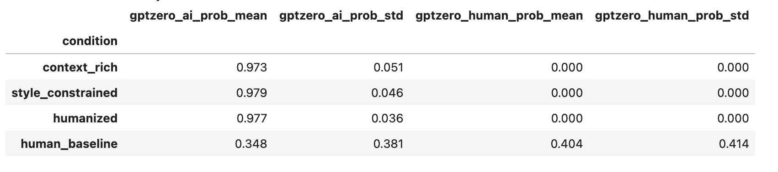
Results: AI Detectability
No significant difference between AI conditions.
Human-written blog posts are significantly different

Slide 14
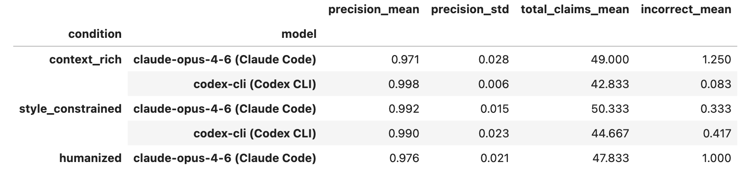
Results: Accuracy
No significant difference between models or conditions

Slide 15
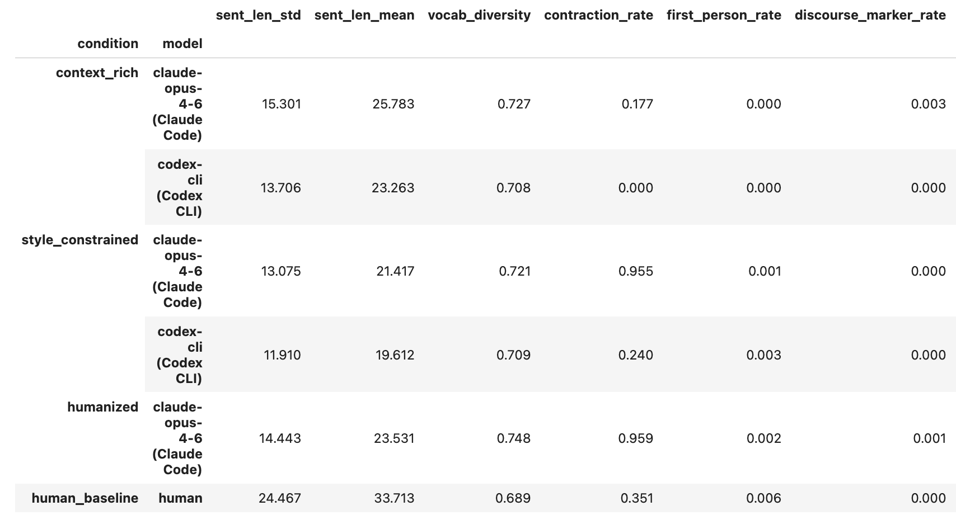
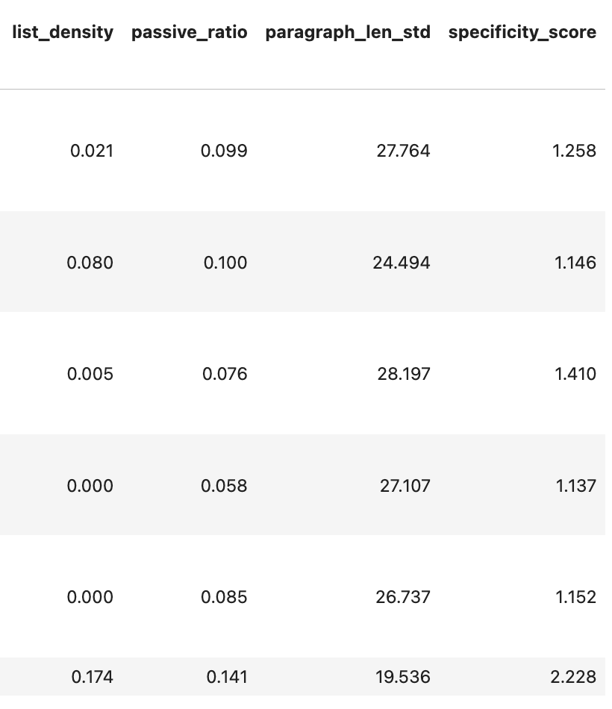
Results: Linguistic Feature Analysis
sent_len_mean: average sentence length. sent_len_std: standard deviation of sentence length. vocab_diversity: unique words / total words
contraction_rate: ratio of contracted (e.g. don't) form. first_person_rate: proportion of first-person words (e.g. we, I)
discourse_marker_rate: occurrences of filler/transition phrases per sentence (e.g., "furthermore", "it's worth noting")
list_density: List items (e.g. bullet points) per paragraph. Passive ratio: fraction of sentences containing passive voice
paragraph_len_std: standard deviation of paragraph lengths (in words). specificity_score: named entities + numeric tokens per sentence

Slide 16
Results & Future Work
Result
Simple prompt engineering is not good enough to avoid AI detection
Prompt for adjusting style does not affect factual accuracy
Future Work
Try different ways of recursive paraphrasing
Use AI detector's diagnosis in paraphrasing process

Slide 17
Links
Github Link:
github.com/yongkyunlee/ai-detectability-research
Youtube Link:
18 / 18

