Slide 1

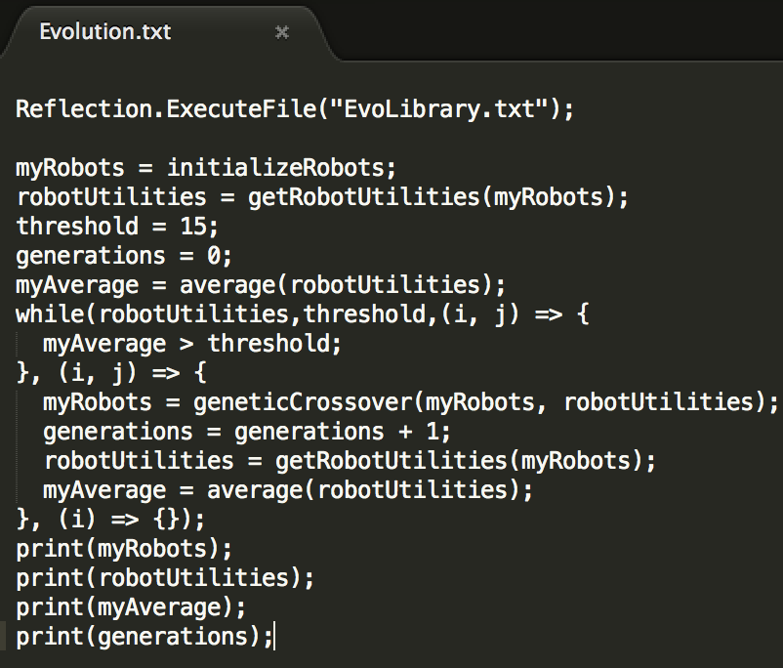
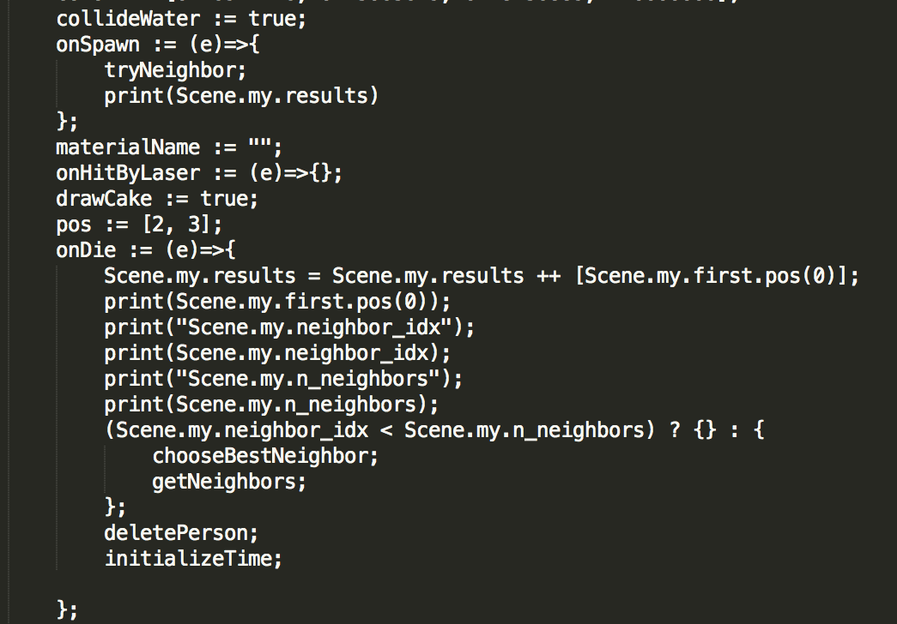
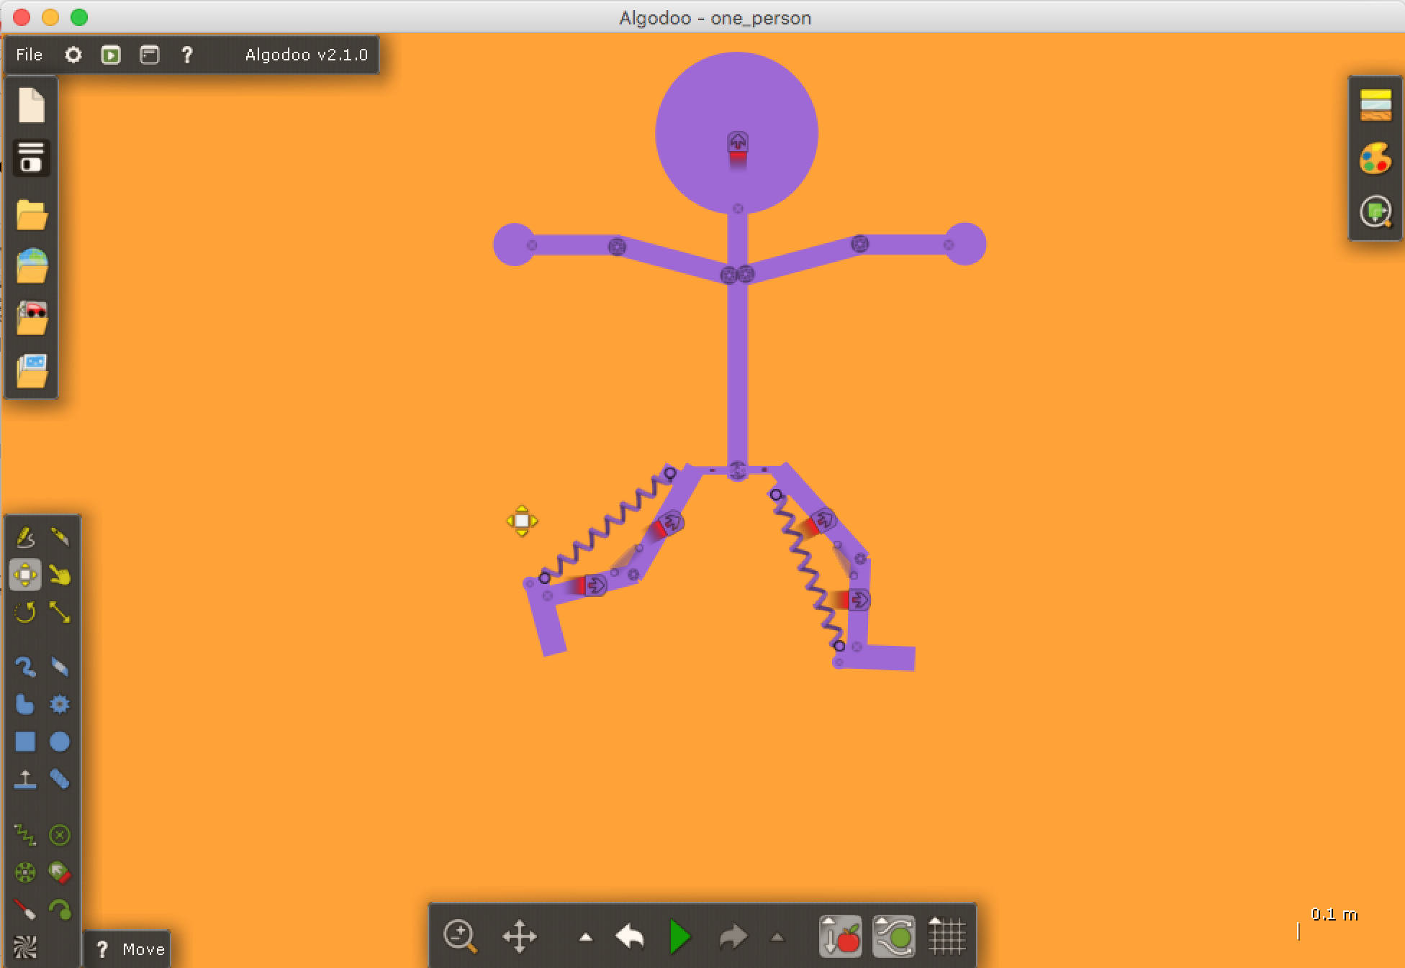
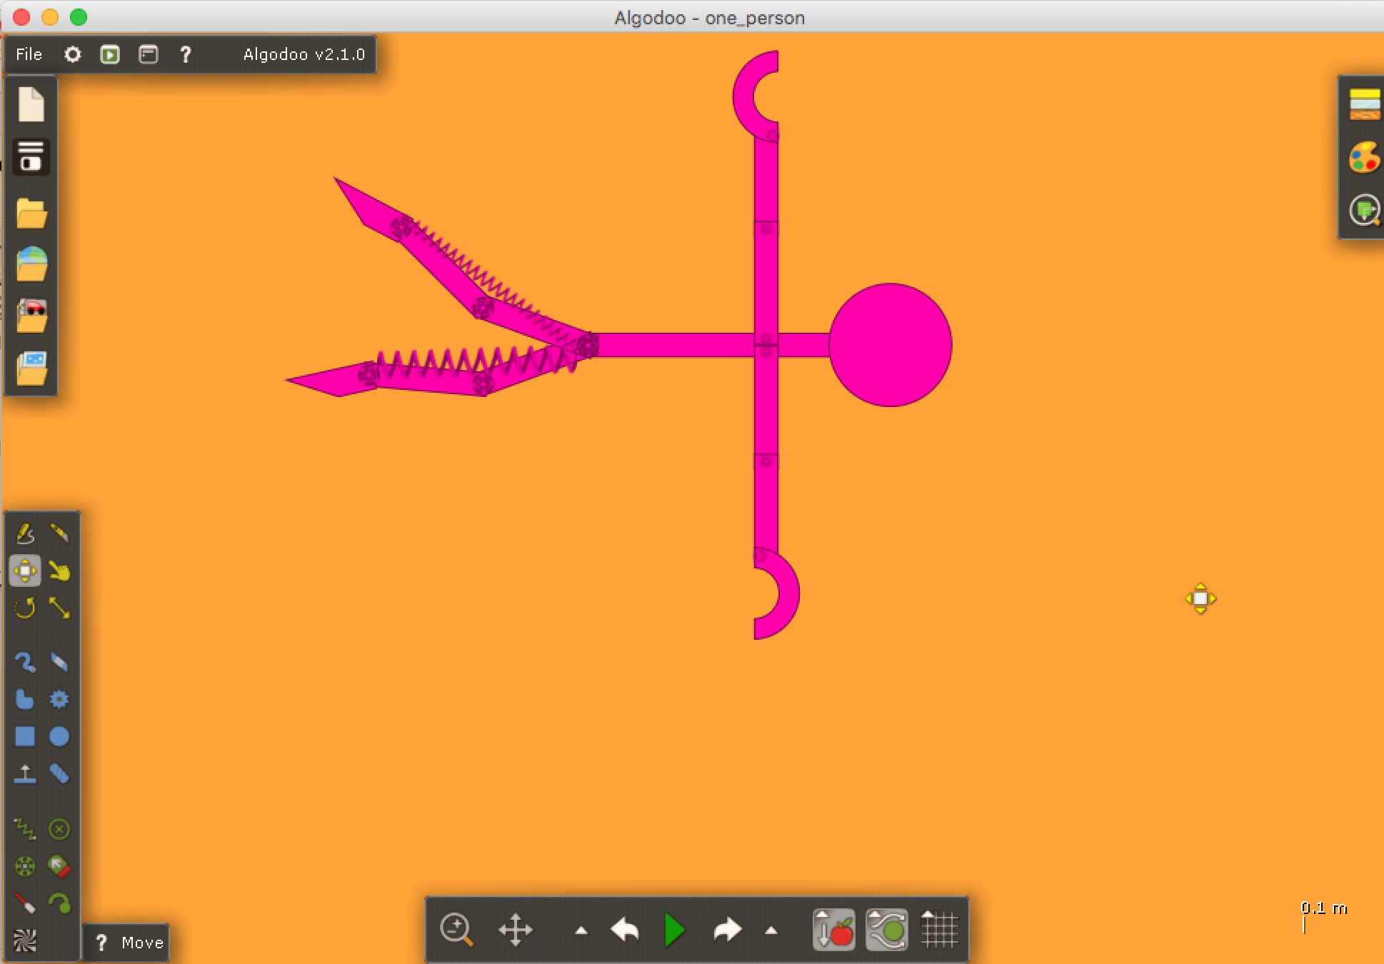
Sink or Swim: Breeding the best 2D Robot Swimmer with Genetic Algorithms, Hill Climbing, and Simulated Annealing
Joe Mooney, Laura Ungar, Yong Li Dich
joemooney@college.harvard.edu, ungar@college.harvard.edu, ydich@college.harvard.edu
CS 182: Artificial Intelligence
Fall 2017
Introduction
Using Algodoo, a virtual physics environment, the team creates a two-dimensional robot to train to swim. The goals are to maximize the swimming utility of the robot (swims farthest in given amount of time) and determine which algorithm (genetic algorithm, hill climbing, or simulated annealing) would produce the best set of parameter values for maximum utility.
From Google’s DeepMind AI learning to walk in a three-dimensional environment to Boston Dynamic’s most recent robots learning to navigate through obstacle courses while doing backflips, the team was inspired to learn the process of applying machine learning algorithms to teach an action to an agent. We decided to explore a different terrain: water.
Utilizing the Algodoo simulated physics environment, we designed a simple two dimensional robot to teach how to swim. We defined our success as the farthest distance an iteration of our robot can swim given a certain amount of time.
We tested three different algorithms: genetic algorithm, hill climbing with restarts, and simulated annealing. This is essentially solving a parameterized design optimization by fixing the components and optimizing over continuous values. give rewards or punishments based on specific behavior.
blah blah blah
Data
We optimized our design over several control parameters using a multivariate simulated annealing algorithm. We varied the spring constants in the legs and the speed of the motors in the knees and thighs. Since the algorithm’s runtime grows exponentially with the number of parameters and Algodoo is not extremely powerful, we needed to keep the number of parameters small. For that reason, we mostly ignored the robot’s arms and used them as dead weight that needed to be managed when balancing the swimming motion.
Approach
Figure 3. Genetic Algorithm Structure
Conclusions
To standardize each iteration, we chose to restrict time and look at farthest distance instead of calculating speed.
Our first robot was one that focused on walking. We initialized the robot for testing, first with hill climbing.
For Hill Climbing, we used pointers to access attributes for each object of our robot and set global variables to alter specific parameters for best values to maximize our utility. This will be transitioned into simulated annealing by applying a temperature function. The functions coded allowed for deletion of a person, generating parametric values to try, trying the values and evaluating maximum utility, creating a timer to restrict amount of time a robot can swim, and then trying the parametric values when the robot is spawned but evaluating the utility from the values when the robot “dies” or is deleted for the restart (another robot iteration). For our first test, we adjusted motor speed of a hinge by looking at how far the robot can get.
For genetic algorithm, we wanted to apply it to find the “fittest” robot, as utilized in “Automatic design and manufacture of robotic lifeforms” (Lipson 2000). For the first test, values were randomly generated and then sorted with a merge sort before pairing the top values (minimized utility in the first test) before recombination and generating the next best values to try based on the newest robot parametric value sets.
We moved on to create a swimming robot that was “mirrored”, as in when you’re looking at the 2D robot, it’s best to imagine that you’re looking at the side of the robot. We gave it cupped hands and trapezoid feet that are both fixed to the body. Everything else is connected with a joint and/or spring. We drop it into a pool of water to test. The next step is initializing this robot and controlling parameter values to maximize the distance over a given amount of time as well as code the opposite direction kicking of the feet based on alternating times.
Results
Throughout this entire process, most of our time was trying to understand the strengths and weaknesses of Algodoo in order to carry out our goal of implementing algorithms to teach the robot to swim. Algodoo was not very well documented. While it’s not impossible to train an AI using Algodoo, one should be aware that the team created a separate library to add functionality and there’s a learning curve in separating the code from the environment. There are also significant limitations of the scripting console.
Replicating the human world such as creating a realistic 2D robot has proven difficult as we adjust to accommodate for limitations in design, simplicity for testing like decreasing variable parts or changing density of 2D robot parts to agree with density of water, and learning to manipulate the Algodoo environment and work with its limitations.
We also learned to implement and test quickly and letting our robot design guide our choice of parameters and utility definition. For future implementation, we can combine genetic algorithm and simulated annealing by optimizing the results of genetic algorithm by giving it the values from the simulated annealing before recombination step in GA.
We have a good library of functions for use of Algodoo’s Thyme language.
For hill climb, we were able to successfully generate a script that can initialize and iterate through different walking robot versions with different parametric value inputs. The algorithm maximizes a specified metric: distance traveled in 5 seconds. We used the motor speed parameter as our value and maximized the utility.
This allowed us to understand how we wanted to structure the code. We knew we needed to use global variables to control parametric values and pointers to access the most recent state (such as position) of the robot to evaluate effectiveness of parameter values inputted.This means we can do multidimensional parameter optimizations for a robot. The next step is to just transition into simulated annealing.
For genetic algorithm, we have a running code that needs to be mapped to an initialized robot. A merge sort was created and detecting array types was added to the library. It takes in values, generates top pairs, mutates, recombines and generates next robots to test.
We’re transitioning from testing on a walking robot to a swimming robot.
blah blah blah
Citations and Links
Ijspeert, Auke and Kodjabachian, Jerome. “Evolution and Development
of a Central Pattern Generator for the Swimming of a Lamprey.” 2006.
Kuindersma, Scott. “Lecture 7: Local Search.” 2017
Lipson, Hod. “Automatic Design and Manufacture of Robotic Lifeforms.” Nature, Nature, 2000.
Terzopoulos, Demetri, et al. “Artificial Fishes: Autonomous Locomotion, Perception, Behavior, and Learning in a Simulated Physical World.” MIT Press Journals, 30 Apr. 2010,
“Thyme.” Algodoo Wiki, algodoo.wikia.com/wiki/Thyme.
Figure 1. Walking and swim robots
Figure 2. Hill climb structure
John A. Paulson School of Engineering and Applied Sciences

