Slide 1
Lecture 4: Markov Chain Monte Carlo

Slide 2
Overview
Markov Chain Monte Carlo
- Markov Chains
- Metropolis-Hastings Algorithm
- Gibbs sampling
Advanced MCMC
- Adaptive MCMC
- Variable dimension techniques

Slide 3
Introduction
Markov Chain Monte Carlo
A combination between Monte Carlo sampling and time homogeneous Markov chains.
The Monte Carlo approaches up to now have typically generated identically independently distributed (i.i.d) variables directly from the density of interest or indirectly in the case of importance sampling.
The Markov property of a Markov chain introduces dependency, but only with a “one-step memory” between time points.

Slide 4
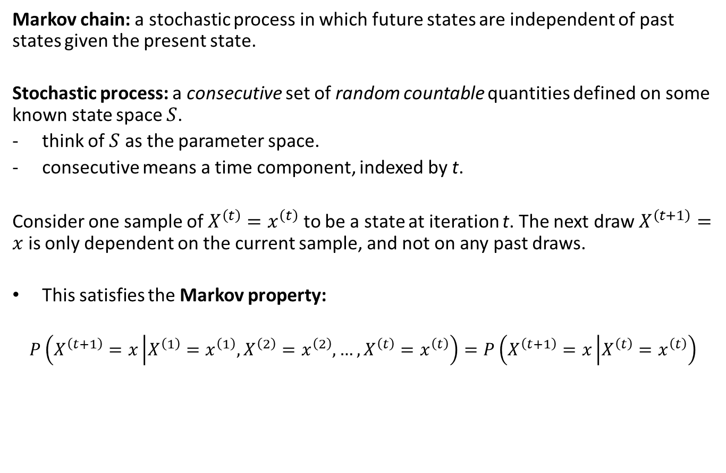
Markov Chains
Markov chain: a stochastic process in which future states are independent of past states given the present state.
Stochastic process: a consecutive set of random countable quantities defined on some known state space $S$.
think of $S$ as the parameter space.
consecutive means a time component, indexed by t.
Consider one sample of $X^{\left(t\right)}=x^{\left(t\right)}$ to be a state at iteration t. The next draw $X^{\left(t+1\right)}=x$ is only dependent on the current sample, and not on any past draws.
This satisfies the Markov property:
$$P\left(X^{\left(t+1\right)}=x\left|X^{\left(1\right)}=x^{\left(1\right)},X^{\left(2\right)}=x^{\left(2\right)},…,X^{\left(t\right)}=x^{\left(t\right)}\right.\right)=P\left(X^{\left(t+1\right)}=x\left|X^{\left(t\right)}=x^{\left(t\right)}\right.\right)$$

Slide 5
Markov Chains
So, the chain moves around in the parameter space, remembering only where it has been in the last state.
What are the rules that determine how the chain jumps from one state to another at each period?
The jumping rules are governed by a transition probability matrix (kernel), which is a mechanism that describes the probability of moving to some other state based on the current state.

Slide 6
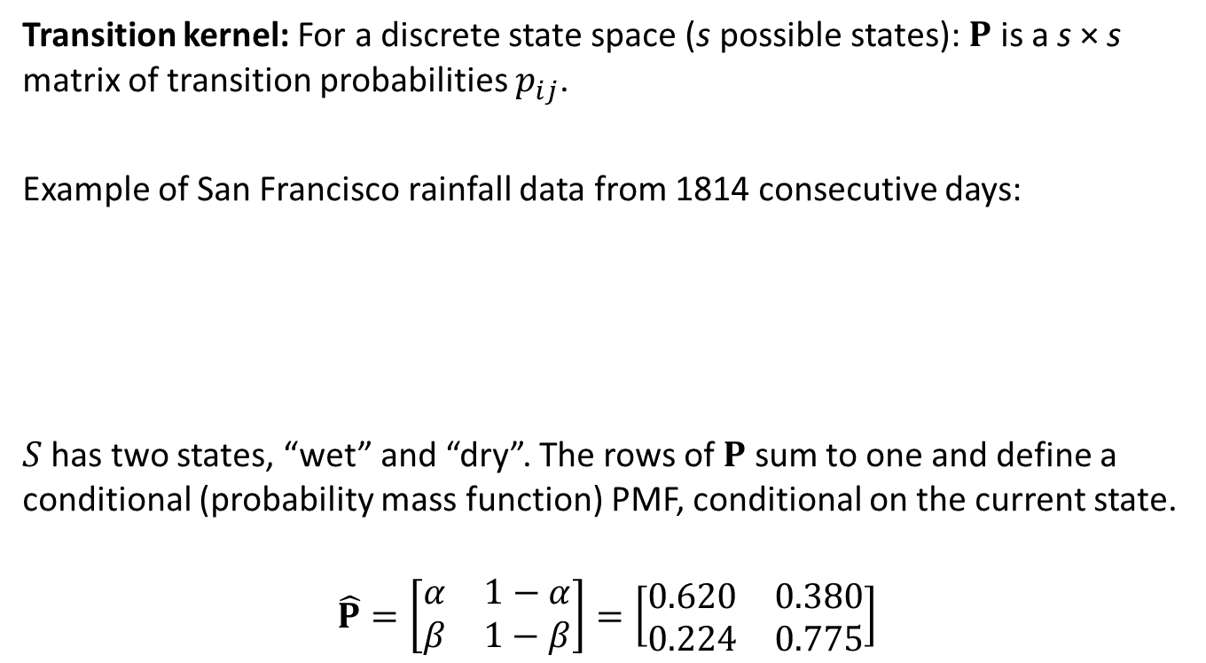
Markov Chains
Transition kernel: For a discrete state space (s possible states): $P$ is a s × s matrix of transition probabilities $p_{ij}$.
Example of San Francisco rainfall data from 1814 consecutive days:
$S$has two states, “wet” and “dry”. The rows of $P$ sum to one and define a conditional (probability mass function) PMF, conditional on the current state.
$$\hat{P}=\left[\begin{matrix}α & 1−α \\ β & 1−β\end{matrix}\right]=\left[\begin{matrix}0.620 & 0.380 \\ 0.224 & 0.775\end{matrix}\right]$$
 | Wet today | Dry today
Wet yesterday | 418 | 256
Dry yesterday | 256 | 884

Slide 7
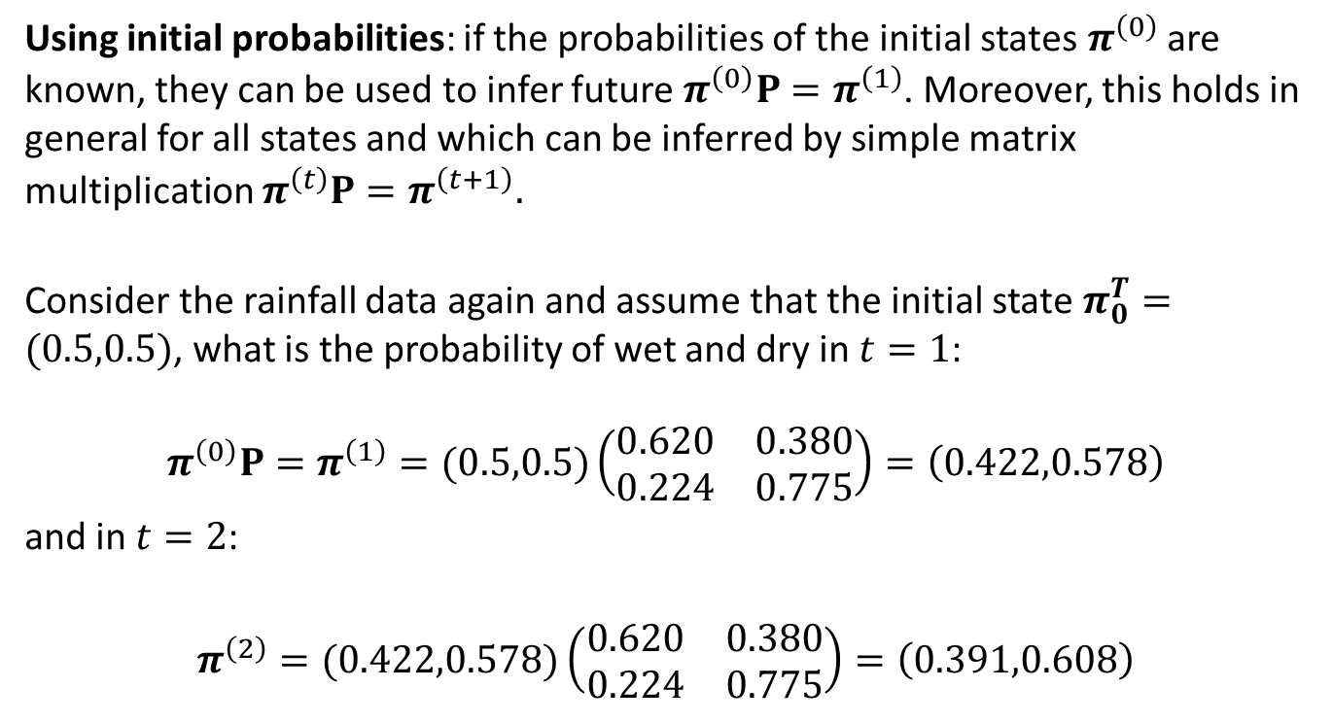
Markov Chains
Using initial probabilities: if the probabilities of the initial states $π^{\left(0\right)}$ are known, they can be used to infer future $π^{\left(0\right)}P=π^{\left(1\right)}$. Moreover, this holds in general for all states and which can be inferred by simple matrix multiplication $π^{\left(t\right)}P=π^{\left(t+1\right)}.$
Consider the rainfall data again and assume that the initial state $π_{0}^{T}=(0.5,0.5)$, what is the probability of wet and dry in $t=1$:
$$π^{\left(0\right)}P=π^{\left(1\right)}=(0.5,0.5)\left(\begin{matrix}0.620 & 0.380 \\ 0.224 & 0.775\end{matrix}\right)=\left(0.422,0.578\right)$$
and in $t=2$:
$$π^{\left(2\right)}=(0.422,0.578)\left(\begin{matrix}0.620 & 0.380 \\ 0.224 & 0.775\end{matrix}\right)=\left(0.391,0.608\right)$$

Slide 8
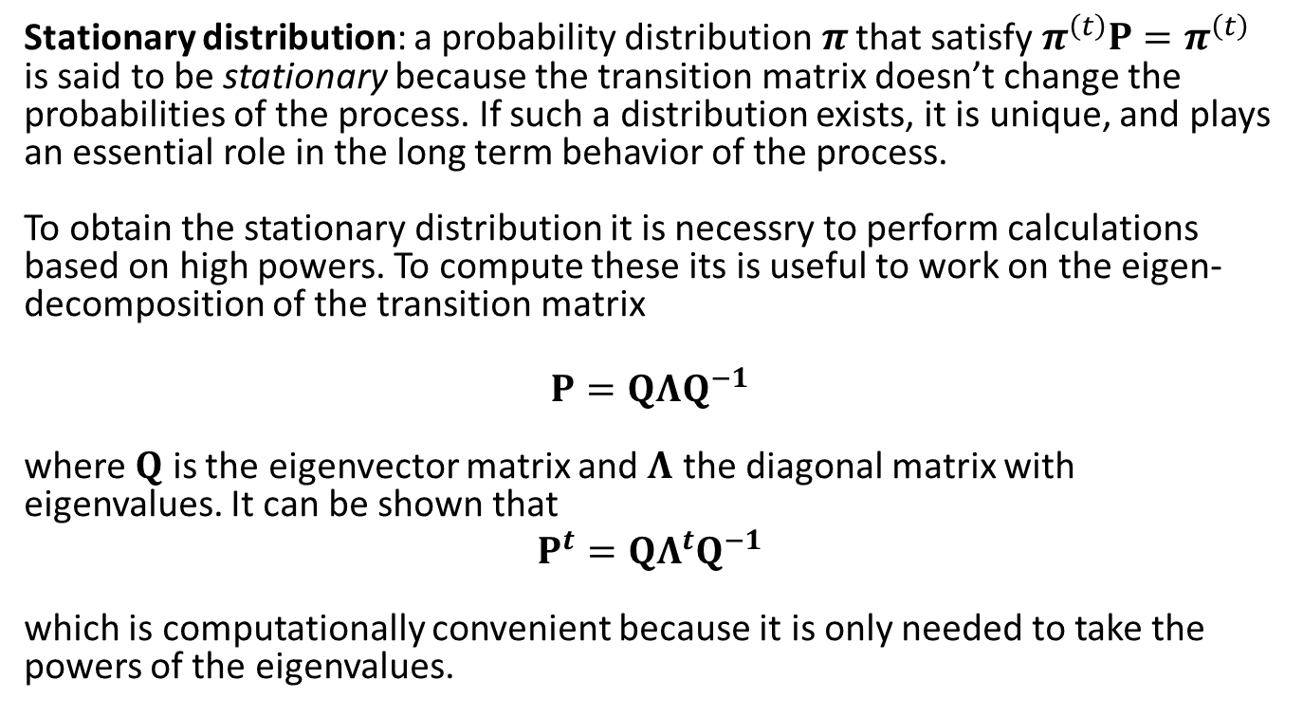
Markov Chains
Stationary distribution: a probability distribution$π$ that satisfy $π^{\left(t\right)}P=π^{\left(t\right)}$ is said to be stationary because the transition matrix doesn’t change the probabilities of the process. If such a distribution exists, it is unique, and plays an essential role in the long term behavior of the process.
To obtain the stationary distribution it is necessry to perform calculations based on high powers. To compute these its is useful to work on the eigen-decomposition of the transition matrix
$$P=QΛQ^{−1}$$
where $Q$ is the eigenvector matrix and $Λ$ the diagonal matrix with eigenvalues. It can be shown that
$$P^{t}={QΛ^{t}Q}^{−1}$$
which is computationally convenient because it is only needed to take the powers of the eigenvalues.

Slide 9
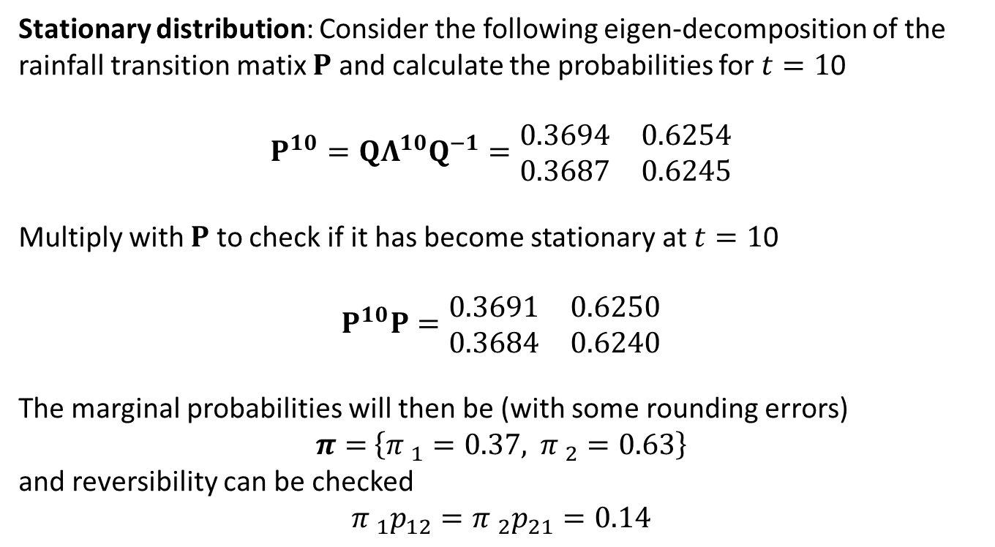
Markov Chains
Stationary distribution: Consider the following eigen-decomposition of the rainfall transition matix $P$ and calculate the probabilities for $t=1$0
$$P^{10}={QΛ^{10}Q}^{−1}=\begin{matrix}0.3694 & 0.6254 \\ 0.3687 & 0.6245\end{matrix}$$
Multiply with $P$ to check if it has become stationary at $t=1$0
$$P^{10}P=\begin{matrix}0.3691 & 0.6250 \\ 0.3684 & 0.6240\end{matrix}$$
The marginal probabilities will then be (with some rounding errors)
$π=$ $\left\{{π }_{1}=0.37, {π }_{2}=0.63\right\}$
and reversibility can be checked
$${π }_{1}p_{12}={π }_{2}p_{21}=0.14$$

Slide 10
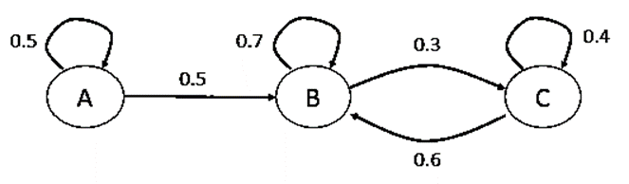
Markov Chains
Reducibility: A Markov chain is irreducible if it is possible go from any state to any other state (not necessarily in one step).
The chain is reducible because we cannot get (the probability of transitioning is zero) to A from B or C regardless of the number of steps we take.

Slide 11
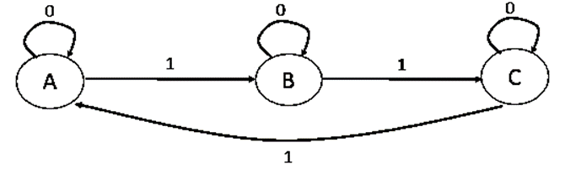
Markov Chains
Periodicity: A state in a Markov chain is periodic if the chain can return to the state only at multiples of some integer larger than 1.
Let A, B and C denote the states in a 3-state Markov chain. The following chain is periodic with period 3, where the period is the number of steps that it takes to return to a certain state.
A Markov chain is ergodic if it is irreducible, aperiodic, and all its states are nonnull and recurrent.

Slide 12
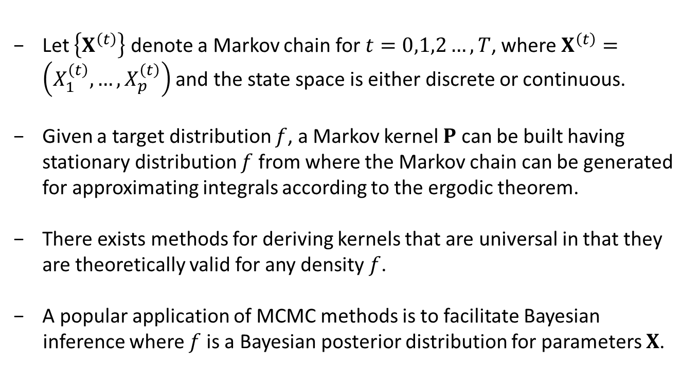
Markov Chain Monte Carlo
Let $\left\{X^{\left(t\right)}\right\}$ denote a Markov chain for $t=0,1,2…, T$, where $X^{\left(t\right)}=\left(X_{1}^{\left(t\right)},…,X_{p}^{\left(t\right)}\right)$ and the state space is either discrete or continuous.
Given a target distribution $f$, a Markov kernel $P$ can be built having stationary distribution $f$ from where the Markov chain can be generated for approximating integrals according to the ergodic theorem.
There exists methods for deriving kernels that are universal in that they are theoretically valid for any density $f$.
A popular application of MCMC methods is to facilitate Bayesian
inference where $f$ is a Bayesian posterior distribution for parameters $X$.

Slide 13
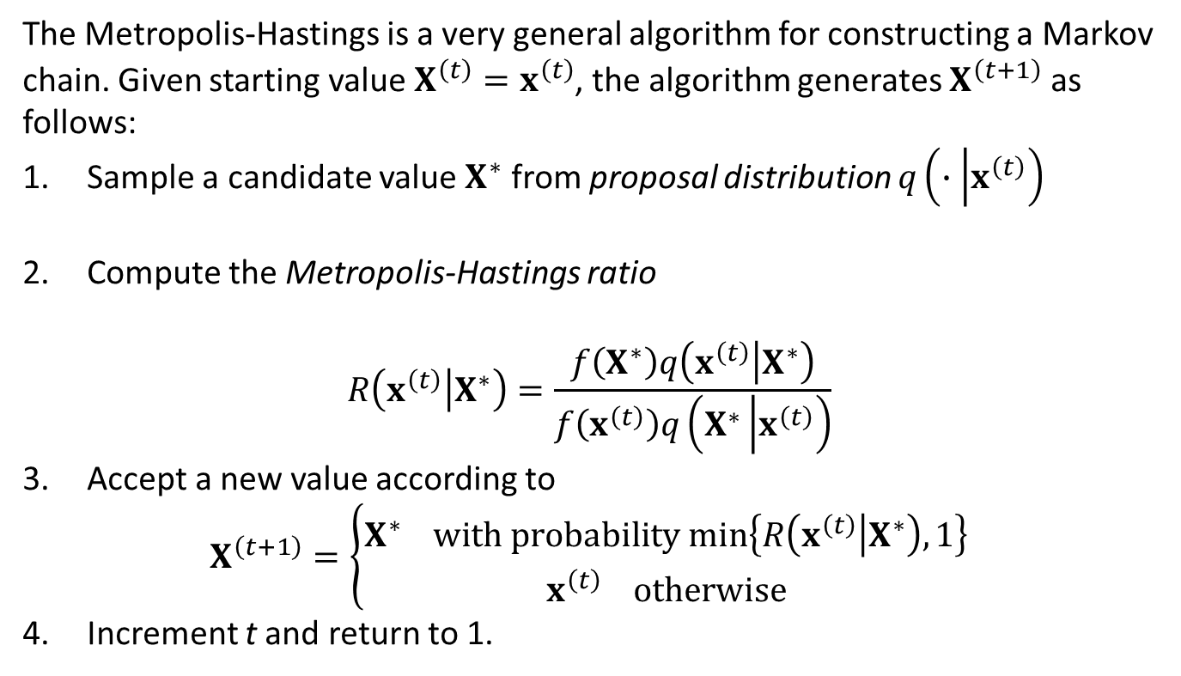
Metropolis-Hastings
The Metropolis-Hastings is a very general algorithm for constructing a Markov chain. Given starting value $X^{\left(t\right)}=x^{\left(t\right)}$, the algorithm generates $X^{\left(t+1\right)}$ as follows:
Sample a candidate value $X^{∗}$ from proposal distribution $q\left(∙\left|x^{\left(t\right)}\right.\right)$
Compute the Metropolis-Hastings ratio
$$R\left(x^{\left(t\right)}\left|X^{∗}\right.\right)=\frac{f\left(X^{∗}\right)q\left(x^{\left(t\right)}\left|X^{∗}\right.\right)}{f\left(x^{\left(t\right)}\right)q\left(X^{∗}\left|x^{\left(t\right)}\right.\right)}$$
Accept a new value according to
$$X^{\left(t+1\right)}=\left\{\begin{matrix}X^{∗} with probability min\left\{R\left(x^{\left(t\right)}\left|X^{∗}\right.\right),1\right\} \\ x^{\left(t\right)} otherwise\end{matrix}\right.$$
Increment t and return to 1.

Slide 14
R: Metropolis-Hastings
Simple example: Metropolis-Hastings sampling for simulating a sample from a Beta target with uniform candidate
Nsim <- 2500
a <- 2.7; b <- 6.3
X <- rep(runif(1),Nsim)
for (i in 2:Nsim){
Xstar <- runif(1)
R <- dbeta(Xstar,a,b)/dbeta(X[i-1],a,b)
X[i] <- X[i-1] + (Xstar-X[i-1])*(runif(1)<R)
}
plot(X,type="l")

Slide 15
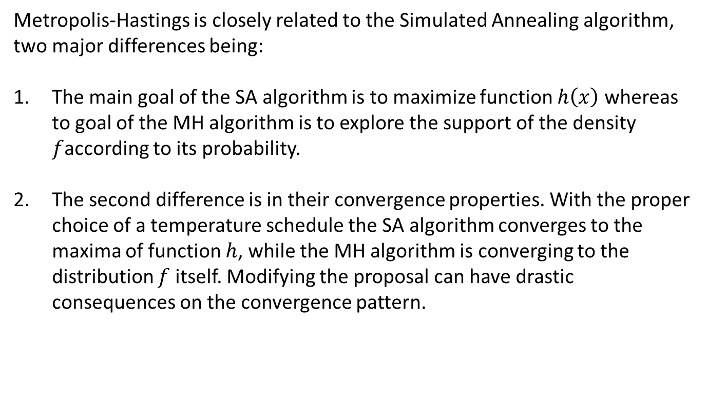
Metropolis-Hastings
Metropolis-Hastings is closely related to the Simulated Annealing algorithm, two major differences being:
The main goal of the SA algorithm is to maximize function $h\left(x\right)$ whereas to goal of the MH algorithm is to explore the support of the density $f$according to its probability.
The second difference is in their convergence properties. With the proper choice of a temperature schedule the SA algorithm converges to the maxima of function $h$, while the MH algorithm is converging to the distribution $f$ itself. Modifying the proposal can have drastic consequences on the convergence pattern.

Slide 16
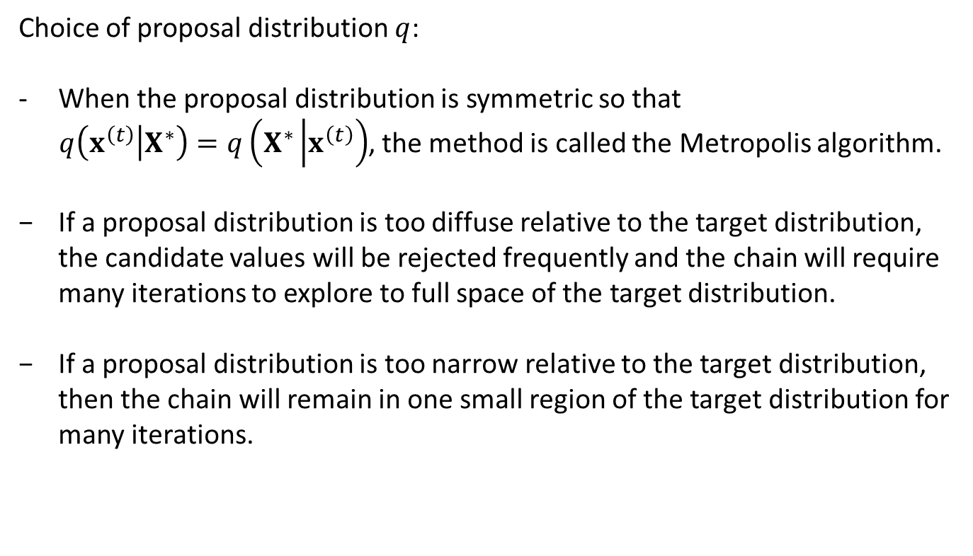
Metropolis-Hastings
Choice of proposal distribution $q$:
When the proposal distribution is symmetric so that
$q\left(x^{\left(t\right)}\left|X^{∗}\right.\right)=q\left(X^{∗}\left|x^{\left(t\right)}\right.\right)$, the method is called the Metropolis algorithm.
If a proposal distribution is too diffuse relative to the target distribution, the candidate values will be rejected frequently and the chain will require many iterations to explore to full space of the target distribution.
If a proposal distribution is too narrow relative to the target distribution, then the chain will remain in one small region of the target distribution for many iterations.

Slide 17
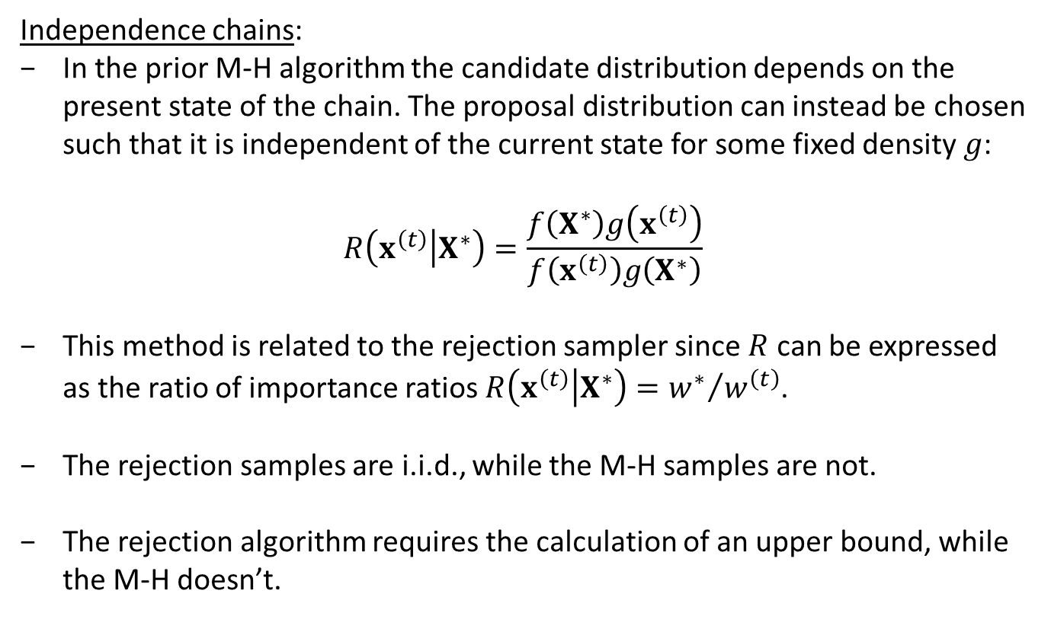
Metropolis-Hastings
Independence chains:
In the prior M-H algorithm the candidate distribution depends on the present state of the chain. The proposal distribution can instead be chosen such that it is independent of the current state for some fixed density $g$:
$$R\left(x^{\left(t\right)}\left|X^{∗}\right.\right)=\frac{f\left(X^{∗}\right)g\left(x^{\left(t\right)}\right)}{f\left(x^{\left(t\right)}\right)g\left(X^{∗}\right)}$$
This method is related to the rejection sampler since $R$ can be expressed as the ratio of importance ratios $R\left(x^{\left(t\right)}\left|X^{∗}\right.\right)={w^{∗}}/{w^{\left(t\right)}}$.
The rejection samples are i.i.d., while the M-H samples are not.
The rejection algorithm requires the calculation of an upper bound, while the M-H doesn’t.

Slide 18

R: Metropolis-Hastings
Independence chains, Example 7.2 (Givens and Hoeting):
100 data points sampled from the mixture distribution:
$$y \sim δN\left(7,{0.5}^{2}\right)+\left(1−δ\right)N\left(10,{0.5}^{2}\right)$$
where the mixture proportion is $δ=0.7$.

Slide 19
R: Metropolis-Hastings
Independence chains, Example 7.2 (Givens and Hoeting):
Evaluate the effect of two different Beta proposal densities on delta:
## INITIAL VALUES
Nsim <- 2500
x.val1 <- NULL
x.val2 <- NULL
set.seed(0)
## FUNCTIONS
f <- function(x){prod(x*dnorm(y,7,0.5) +
(1-x)*dnorm(y,10,0.5))}
R <- function(xt,x){f(x)*g(xt)/(f(xt)*g(x))}

Slide 20
R: Metropolis-Hastings
Independence chains, Example 7.2 (Givens and Hoeting):
## M-H IND SAMP WITH BETA(1,1) PROPOSAL DENSITY
g <- function(x){dbeta(x,1,1)}
x.val1[1] <- rbeta(1,1,1)
for(i in 1:Nsim){
xt <- x.val1[i]
x <- rbeta(1,1,1)
p <- min(R(xt,x),1)
d <- rbinom(1,1,p)
x.val1[i+1] <- x*d + xt*(1-d)
}

Slide 21
R: Metropolis-Hastings
Independence chains, Example 7.2 (Givens and Hoeting):
## M-H IND SAMP WITH BETA(2,10) PROPOSAL DENSITY
g <- function(x){dbeta(x,2,10)}
x.val2[1] <- rbeta(1,2,10)
for(i in 1:Nsim){
xt <- x.val2[i]
x <- rbeta(1,2,10)
p <- min(R(xt,x),1)
d <- rbinom(1,1,p)
x.val2[i+1] <- x*d + xt*(1-d)
}

Slide 22
R: Metropolis-Hastings
Independence chains, Example 7.2 (Givens and Hoeting):

Slide 23
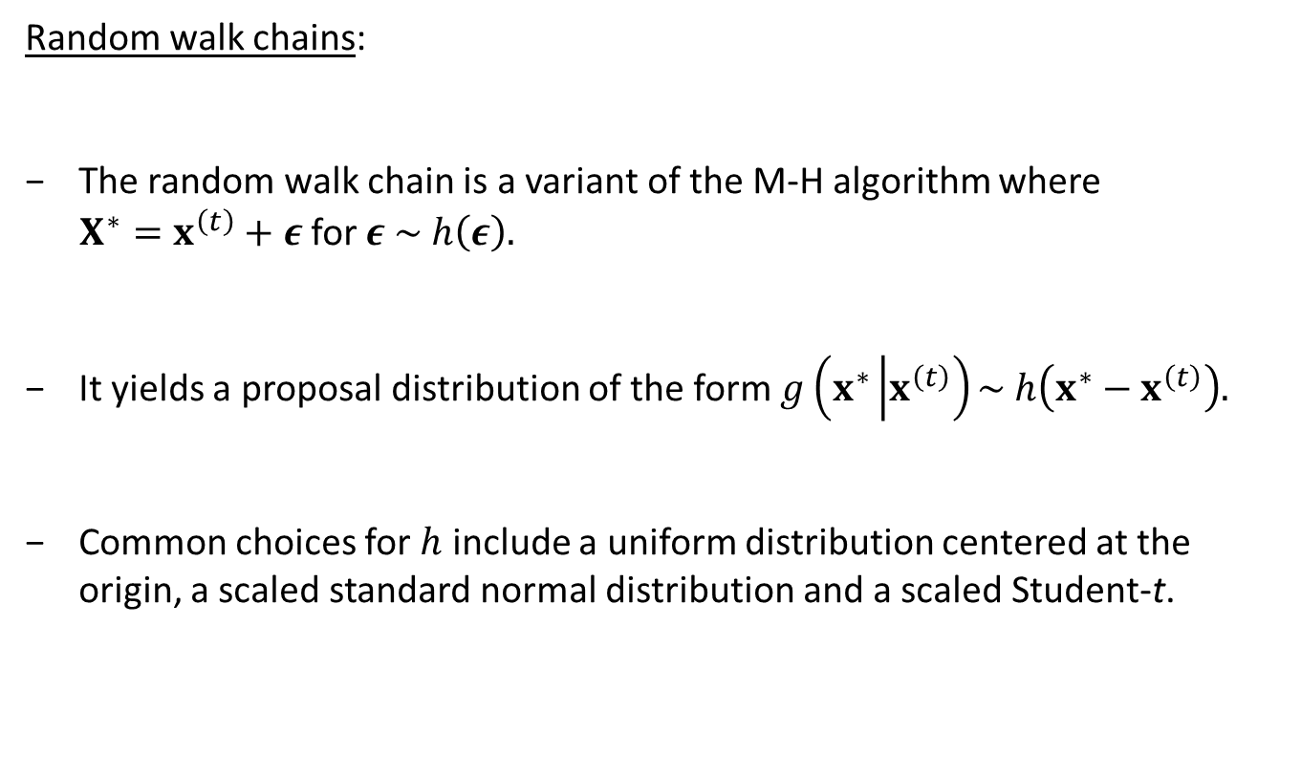
Metropolis-Hastings
Random walk chains:
The random walk chain is a variant of the M-H algorithm where
$X^{∗}=x^{\left(t\right)}+ε$ for $ε \sim h\left(ε\right).$
It yields a proposal distribution of the form $g\left(x^{∗}\left|x^{\left(t\right)}\right.\right)\sim h\left(x^{∗}−x^{\left(t\right)}\right).$
Common choices for $h$ include a uniform distribution centered at the origin, a scaled standard normal distribution and a scaled Student-t.

Slide 24
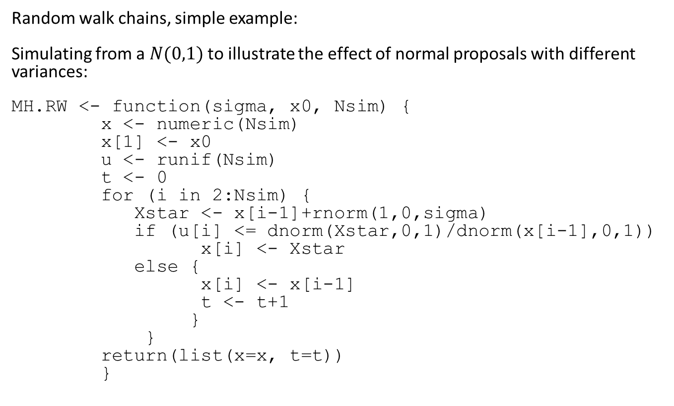
R: Metropolis-Hastings
Random walk chains, simple example:
Simulating from a $N(0,1)$ to illustrate the effect of normal proposals with different variances:
MH.RW <- function(sigma, x0, Nsim) {
x <- numeric(Nsim)
x[1] <- x0
u <- runif(Nsim)
t <- 0
for (i in 2:Nsim) {
Xstar <- x[i-1]+rnorm(1,0,sigma)
if (u[i] <= dnorm(Xstar,0,1)/dnorm(x[i-1],0,1))
x[i] <- Xstar
else {
x[i] <- x[i-1]
t <- t+1
}
}
return(list(x=x, t=t))
}

Slide 25
R: Metropolis-Hastings
Random walk chains, simple example:
Nsim <- 20000 # number of iterations
sigma <- c(.05, .5, 2, 16) # sd proposal distribution
x0 <- 10 # initial mean value
rw1 <- MH.RW(sigma[1],
x0, Nsim)
rw2 <- MH.RW(sigma[2],
x0, Nsim)
rw3 <- MH.RW(sigma[3],
x0, Nsim)
rw4 <- MH.RW(sigma[4],
x0, Nsim)

Slide 26
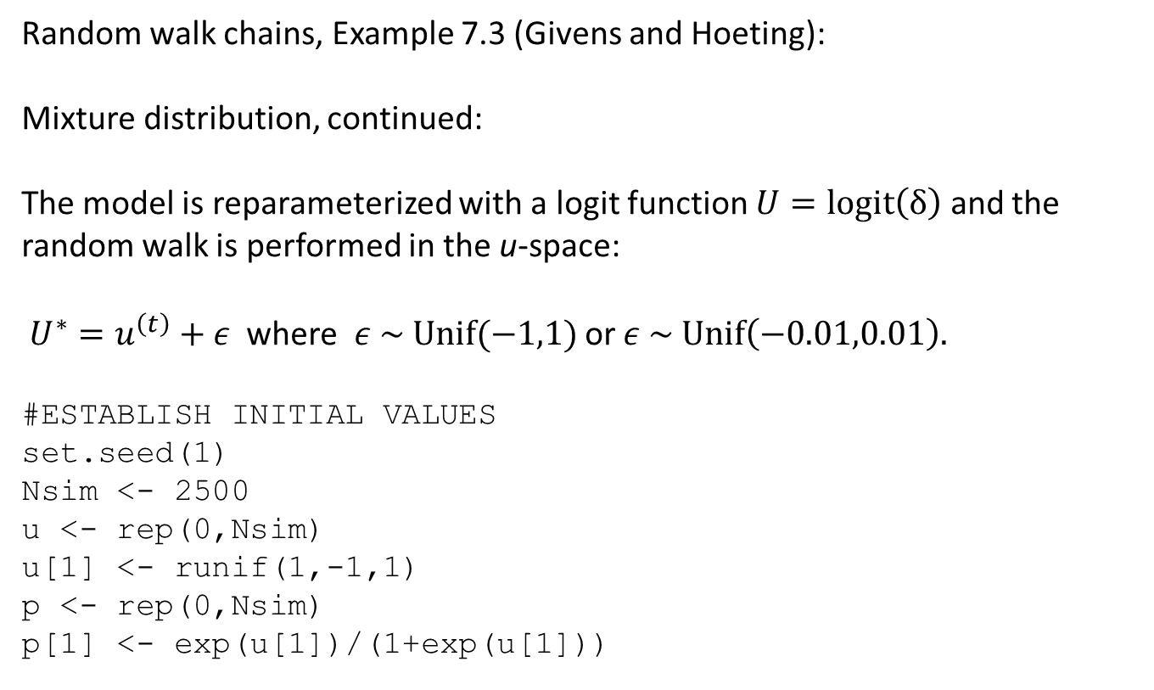
R: Metropolis-Hastings
Random walk chains, Example 7.3 (Givens and Hoeting):
Mixture distribution, continued:
The model is reparameterized with a logit function $U=logit\left(δ\right)$ and the random walk is performed in the u-space:
$U^{∗}=u^{\left(t\right)}+ε$ where $ε \sim Unif(−1,1)$ or $ε \sim Unif\left(−0.01,0.01\right).$
#ESTABLISH INITIAL VALUES
set.seed(1)
Nsim <- 2500
u <- rep(0,Nsim)
u[1] <- runif(1,-1,1)
p <- rep(0,Nsim)
p[1] <- exp(u[1])/(1+exp(u[1]))

Slide 27
R: Metropolis-Hastings
Random walk chains, Example 7.3 (Givens and Hoeting):
## FUNCTION LOG SCALE
log.like<-function(p,x) {
sum(log(p*dnorm(y,7,.5)+(1-p)*dnorm(y,10,.5)))
}
## M-H RAND WALK SAMP WITH UNIF(-1,1) PROPOSAL DENSITY
for (i in 1:(Nsim-1)) {
u[i+1] <- u[i]+runif(1,-1,1)
p[i+1] <- exp(u[i+1])/(1+exp(u[i+1]))
R <- exp(log.like(p[i+1],x)-log.like(p[i],x))*exp(u[i])/exp(u[i+1])
if (R<1)
if(rbinom(1,1,R)==0) {p[i+1] <- p[i]; u[i+1] <- u[i]}
}

Slide 28
R: Metropolis-Hastings
Random walk chains, Example 7.3 (Givens and Hoeting):

Slide 29
Gibbs sampling
It is difficult to construct M-H samplers for high dimensional target functions.
The appeal of the Gibbs sampler algorithm is that it first gather most of the calibration from the target density and then provides a consistent procedure for breaking up complex problems into a series of easier problems.
The goal is still to construct a Markov chain whose stationary
distribution—or some marginalization thereof—equals the target density.
Sequentially samples from univariate conditional distributions, which needs to be available in closed form.

Slide 30
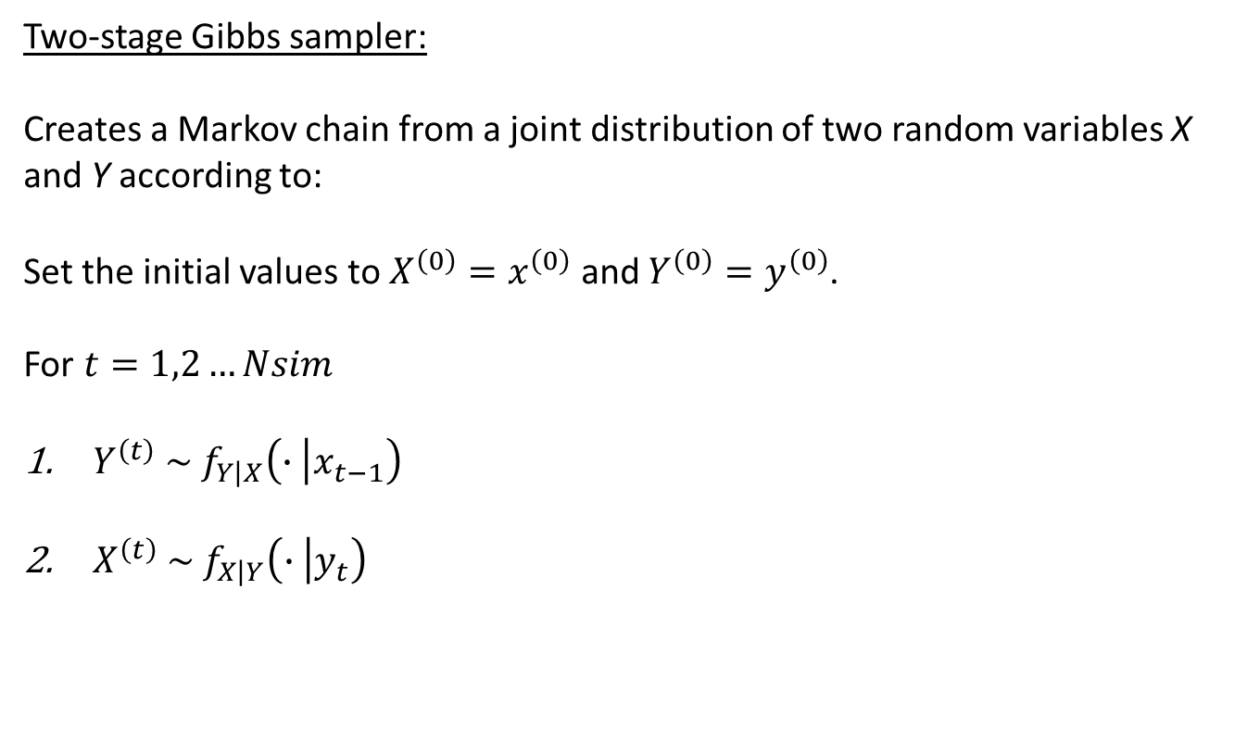
Gibbs sampling
Two-stage Gibbs sampler:
Creates a Markov chain from a joint distribution of two random variables X and Y according to:
Set the initial values to $X^{\left(0\right)}=x^{\left(0\right)}$ and $Y^{\left(0\right)}=y^{\left(0\right)}$.
For $t=1,2…Nsim$
$Y^{\left(t\right)} \sim f_{Y\left|X\right.}\left(∙\left|x_{t−1}\right.\right)$
$X^{\left(t\right)} \sim f_{X\left|Y\right.}\left(∙\left|y_{t}\right.\right)$

Slide 31

R: Gibbs sampling
Two-stage Gibbs sampler:
Simple example sampling from a joint bivariate normal density $f\left(x,y\right)$.
## Initial values
NSim <- 50
rho <- 0.5
x0 <- 1
y0 <- 1
x <- rep(0, NSim)
y <- rep(0, NSim)
x[1] <- x0
y[1] <- y0

Slide 32
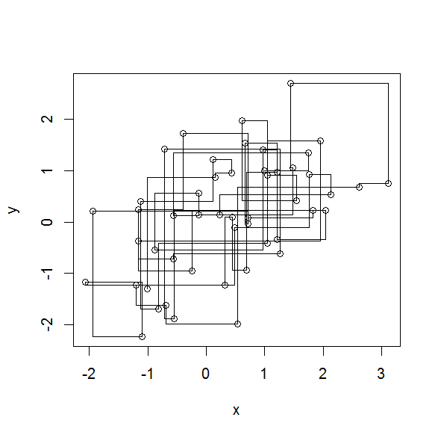
R: Gibbs sampling
## Bivariate Gibbs sampler
for(i in 2:NSim) {
## sample the x direction conditional on (prior) y
x[i] <- rnorm(1, rho*y[i-1], sqrt(1-rho^2))
## sample the y direction conditional on x
y[i] <- rnorm(1, rho*x[i], sqrt(1-rho^2))
}
plot(x,y)
for(i in 2:NSim) {
lines(c(x[i-1], x[i]),
c(y[i-1], y[i-1]))
lines(c(x[i], x[i]),
c(y[i-1], y[i]))
}

Slide 33
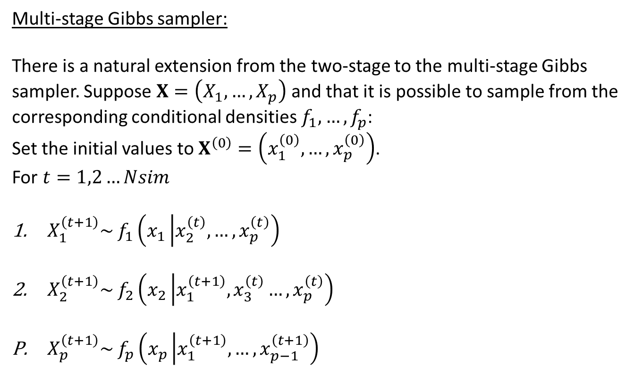
Gibbs sampling
Multi-stage Gibbs sampler:
There is a natural extension from the two-stage to the multi-stage Gibbs sampler. Suppose $X=\left(X_{1},…,X_{p}\right)$ and that it is possible to sample from the corresponding conditional densities $f_{1},…,f_{p}$:
Set the initial values to $X^{\left(0\right)}=\left(x_{1}^{\left(0\right)},…,x_{p}^{\left(0\right)}\right)$.
For $t=1,2…Nsim$
$X_{1}^{\left(t+1\right)}\sim f_{1}\left(x_{1}\left|x_{2}^{\left(t\right)},…,\right.x_{p}^{\left(t\right)}\right)$
$X_{2}^{\left(t+1\right)}\sim f_{2}\left(x_{2}\left|x_{1}^{\left(t+1\right)},x_{3}^{\left(t\right)}…,\right.x_{p}^{\left(t\right)}\right)$
$X_{p}^{\left(t+1\right)}\sim f_{p}\left(x_{p}\left|x_{1}^{\left(t+1\right)}, …,\right.x_{p−1}^{\left(t+1\right)}\right)$

Slide 34
R: Gibbs sampling
Many options to do Gibbs sampling in R:
CRAN Task View Bayesian provides a good overview.
Packages that link R to other sampling engines include:
R2WinBUGS which links to WinBUGS and OpenBUGS
R2jags which links to JAGS
RStan (not on CRAN)
There are also some less flexible general packages:
MCMCpack
MCMCglmm

Slide 35
R: Gibbs sampling
Example logistic fixed regression using MCMCpack:
library(MCMCpack)
data(birthwt)
posterior <- MCMClogit(low~age+as.factor(race)+smoke,
data=birthwt)
summary(posterior)

Slide 36
R: Gibbs sampling
Example logistic fixed regression using MCMCpack:
Iterations = 1001:11000
Thinning interval = 1
Number of chains = 1
Sample size per chain = 10000
1. Empirical mean and standard deviation for each variable,
plus standard error of the mean:
Mean SD Naive SE Time-series SE
(Intercept) -0.98190 0.9109 0.009109 0.038909
age -0.03812 0.0341 0.000341 0.001403
as.factor(race)2 1.03851 0.5002 0.005002 0.020253
as.factor(race)3 1.08242 0.4185 0.004185 0.017995
smoke 1.12993 0.3922 0.003922 0.016334
2. Quantiles for each variable:
2.5% 25% 50% 75% 97.5%
(Intercept) -2.72363 -1.60072 -1.00723 -0.31925 0.87166
age -0.11025 -0.06131 -0.03675 -0.01468 0.02623
as.factor(race)2 0.06971 0.69756 1.03927 1.38325 2.01703
as.factor(race)3 0.30514 0.79286 1.06132 1.36351 1.94954
smoke 0.38584 0.85418 1.14129 1.39460 1.88826

Slide 37
Advanced MCMC
Many recent advancements in different areas of MCMC modelling:
Two particular notable innovations:
Adaptive MCMC where proposal distributions are adapted while the algorithm is running.
Variable dimension algorithms, particularly the Reversible Jump MCMC

Slide 38
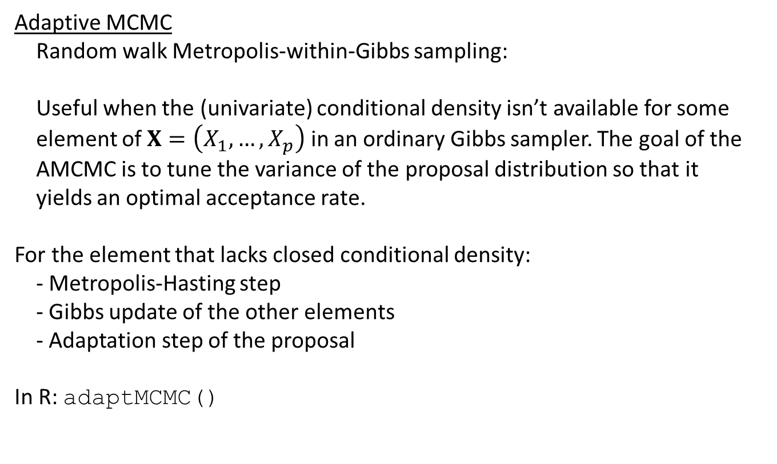
Advanced MCMC
Adaptive MCMC
Random walk Metropolis-within-Gibbs sampling:
Useful when the (univariate) conditional density isn’t available for some
element of $X=\left(X_{1},…,X_{p}\right)$ in an ordinary Gibbs sampler. The goal of the
AMCMC is to tune the variance of the proposal distribution so that it
yields an optimal acceptance rate.
For the element that lacks closed conditional density:
- Metropolis-Hasting step
- Gibbs update of the other elements
- Adaptation step of the proposal
In R: adaptMCMC()

Slide 39
Advanced MCMC
Reversible Jump MCMC
Standard MCMC algorithms require that the dimensionality of X^{(t)} and
the interpretation of the elements of X^{(t)} do not change with t.
In many applications, it may be of interest to develop a chain that allows
for changes in the dimension m of the parameter space from one iteration
to the next.
Examples where RJMCMC methods are useful:
– model selection
– selection of the number of components in a mixture distribution
– knot selection in nonparametric regression

Slide 40
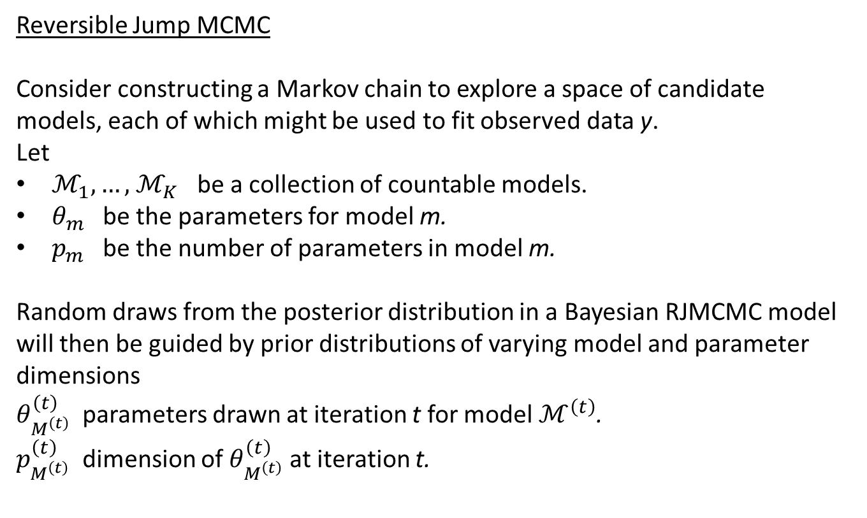
Advanced MCMC
Reversible Jump MCMC
Consider constructing a Markov chain to explore a space of candidate
models, each of which might be used to fit observed data y.
Let
$ℳ_{1},…,$ $ℳ_{K}$ be a collection of countable models.
$θ_{m}$ be the parameters for model m.
$p_{m}$ be the number of parameters in model m.
Random draws from the posterior distribution in a Bayesian RJMCMC model will then be guided by prior distributions of varying model and parameter dimensions
$θ_{M^{\left(t\right)}}^{\left(t\right)}$ parameters drawn at iteration t for model$ℳ^{\left(t\right)}$.
$p_{M^{\left(t\right)}}^{\left(t\right)}$ dimension of $θ_{M^{\left(t\right)}}^{\left(t\right)}$ at iteration t.

Slide 41
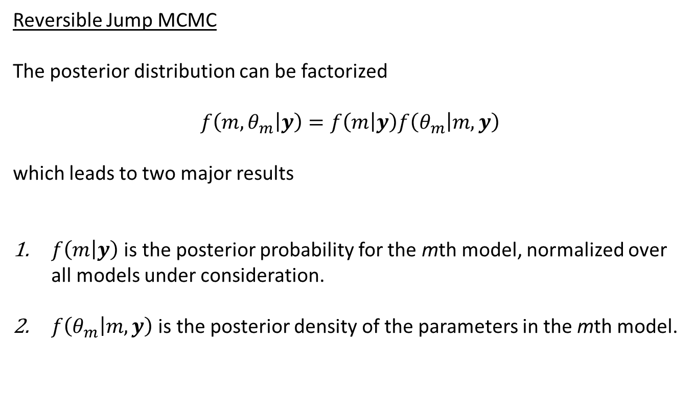
Advanced MCMC
Reversible Jump MCMC
The posterior distribution can be factorized
$$f\left(m,θ_{m}\left|y\right.\right)=f\left(m\left|y\right.\right)f\left(θ_{m}\left|m,y\right.\right)$$
which leads to two major results
$f\left(m\left|y\right.\right)$ is the posterior probability for the mth model, normalized over all models under consideration.
$f\left(θ_{m}\left|m,y\right.\right)$ is the posterior density of the parameters in the mth model.

Slide 42
R: Advanced MCMC
Example of Reversible Jump MCMC in R
Package BMA includes several options for Bayesian model selection. The function MC3.REG() is a version of RJMCMC called Markov Chain Monte Carlo Model Composition (MC3).
This function can be applied to the baseball.dat data that was analysed with simulated annealing and genetic algorithms for variable selection.
library(BMA)
data <- read.table("baseball.dat",header=TRUE)
pred <- data[,-1]
salary.log <- log(data$salary)
Mc3 <- MC3.REG(salary.log, pred,
num.its=100000,rep(TRUE,27), outliers = FALSE)

Slide 43
R: Advanced MCMC
Example of Reversible Jump MCMC in R
24058 models were selected
Best 5 models (cumulative posterior probability = 0.2055 ):
prob model 1 model 2 model 3 model 4 model 5
variables
average 0.03032 . . . . .
obp 0.02760 . . . . .
runs 0.65245 . x x x x
hits 0.39126 x . . . .
doubles 0.03751 . . . . .
triples 0.03794 . . . . .
homeruns 0.06455 . . . . .
rbis 0.96889 x x x x x
walks 0.07319 . . . . .
sos 0.59122 . x x x x
sbs 0.07823 . . . . .
errors 0.07189 . . . . .
freeagent 1.00000 x x x x x
arbitration 1.00000 x x x x x
runsperso 0.27751 . x . . x
hitsperso 0.14713 . . . . x
hrsperso 0.03212 . . . . .
rbisperso 0.05997 . . . . .
walksperso 0.02966 . . . . .
obppererror 0.11122 . . . . .
runspererror 0.15005 . . . x .
hitspererror 0.19789 . . . x .
hrspererror 0.02800 . . . . .
soserrors 0.40525 x . . . .
sbsobp 0.10225 . . . . .
sbsruns 0.05768 . . . . .
sbshits 0.05630 . . . . .
post prob 0.05902 0.04953 0.04858 0.02576 0.02261

Slide 44
Reading
Book (Givens and Hoeting)
Chapter: (1), 7, 8
CRAN Task View: Bayesian Statistics

