Slide 1

Project Release Plan
10/15/14
HomePage Website
  Hai Vo (product owner)
  Luis Nunez
  Steven Yeng
  Doo Kyung Lee
  Craig Hu
  Andy Ly

Slide 2
Project Release Plan
HomePage Website
The goal of this project is to make a fully customizable website that user would use as their homepage for their browser. Ultimately the goal is to introduce an open api to allow website owners to display useful information about their website.

Slide 3
Project Release Plan – User Stories
HomePage Website
Sprint 1 Users should be able to add their favorite websites onto their homepage.
  High Level goals: once a site is added a static image should be displayed on them profile
Sprint 2 Users should be able to change the size and location of their favorite website.
  High Level goals: allow the boxes to be customizable
Sprint 3 Emails urls should display actually messages and not a static image.
  High Level goals: email boxes display some of the users messages.

Slide 4
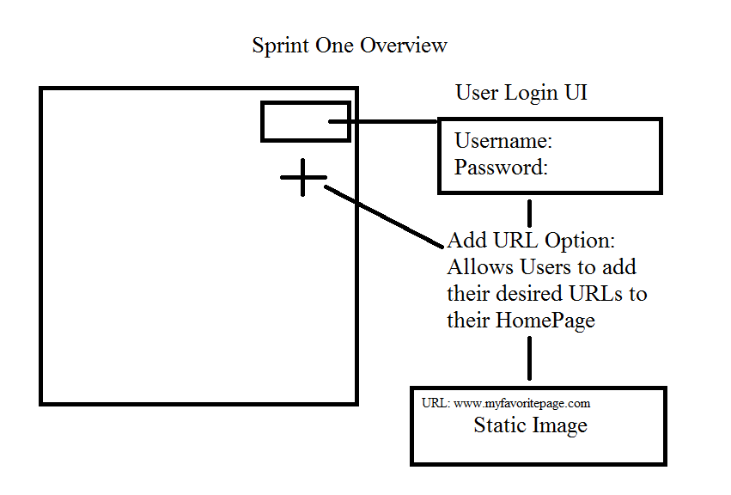

Slide 5
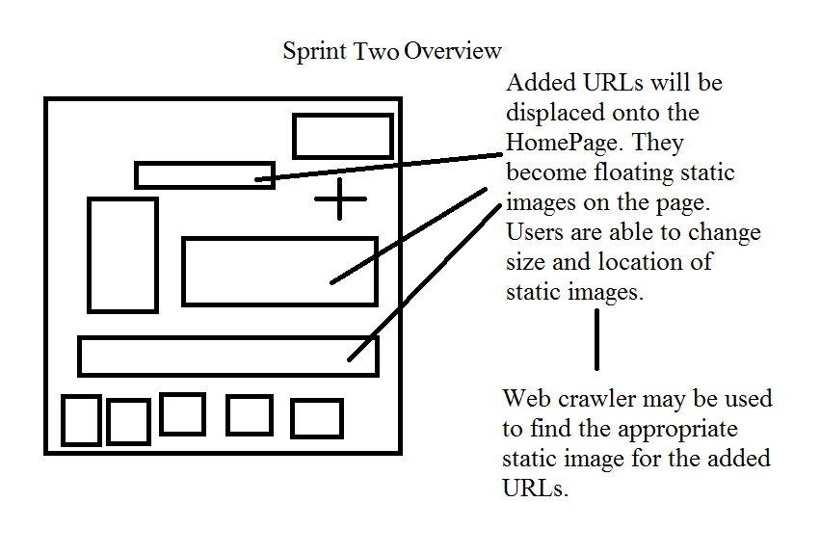

Slide 6
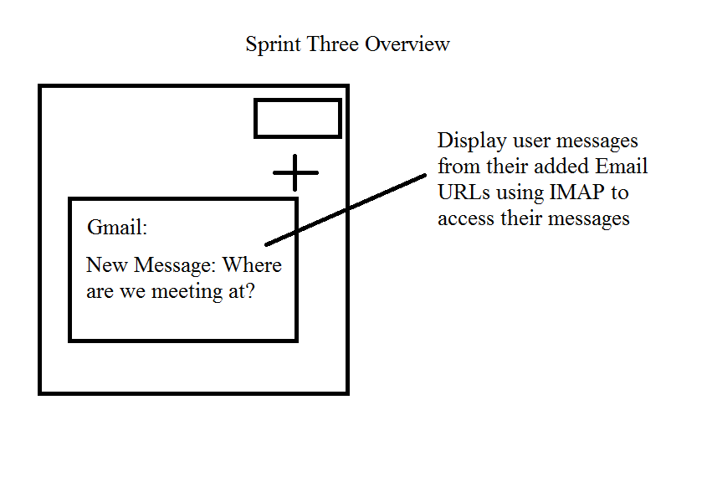

Slide 7
