Slide 1
Fileshare screenshots

Slide 2
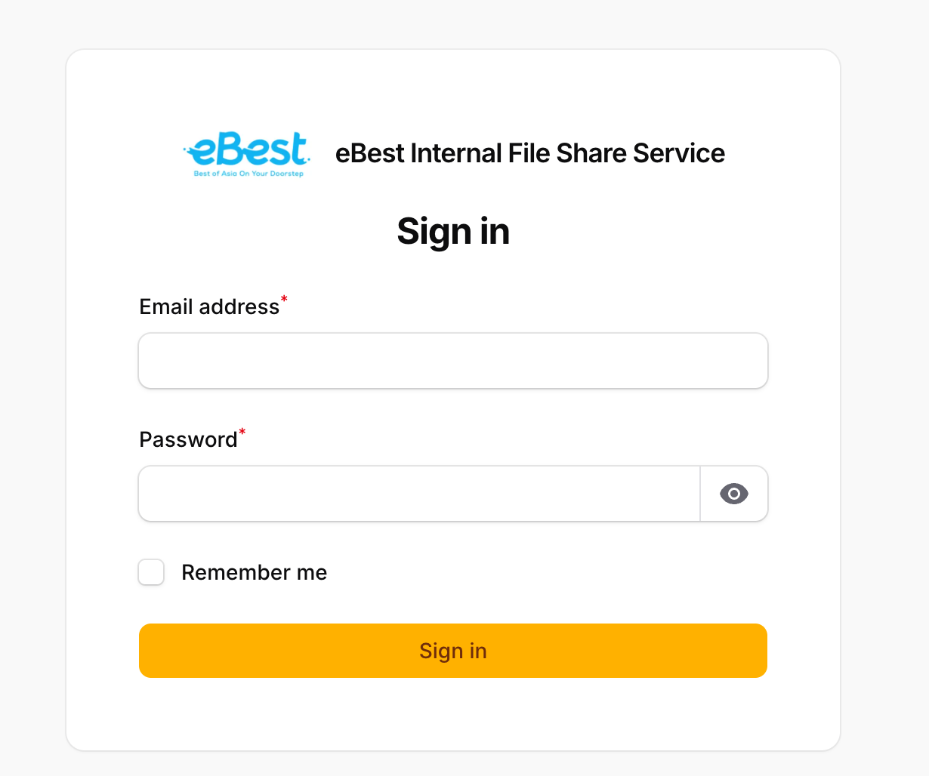
Login page

Slide 3
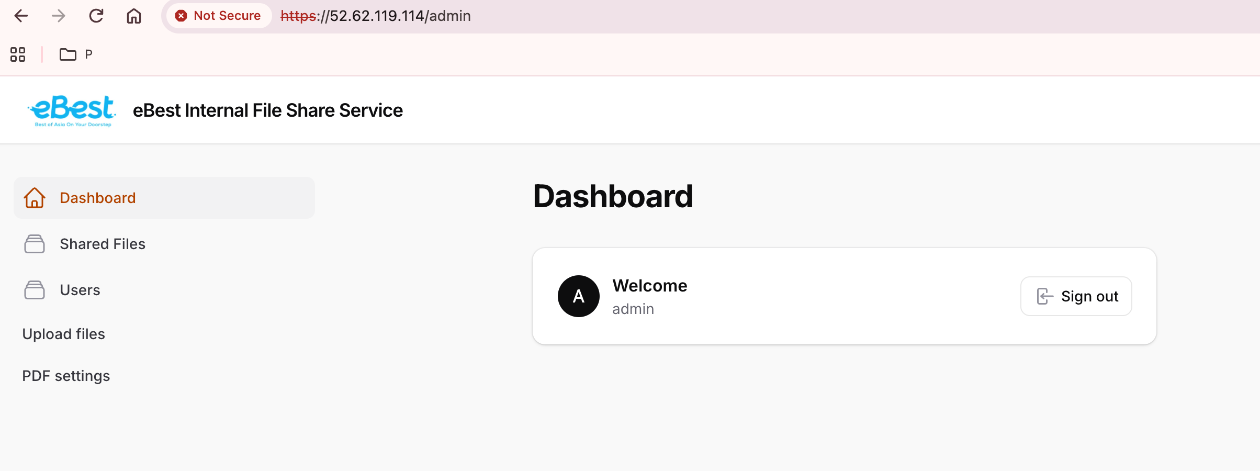
Admin landing page

Slide 4
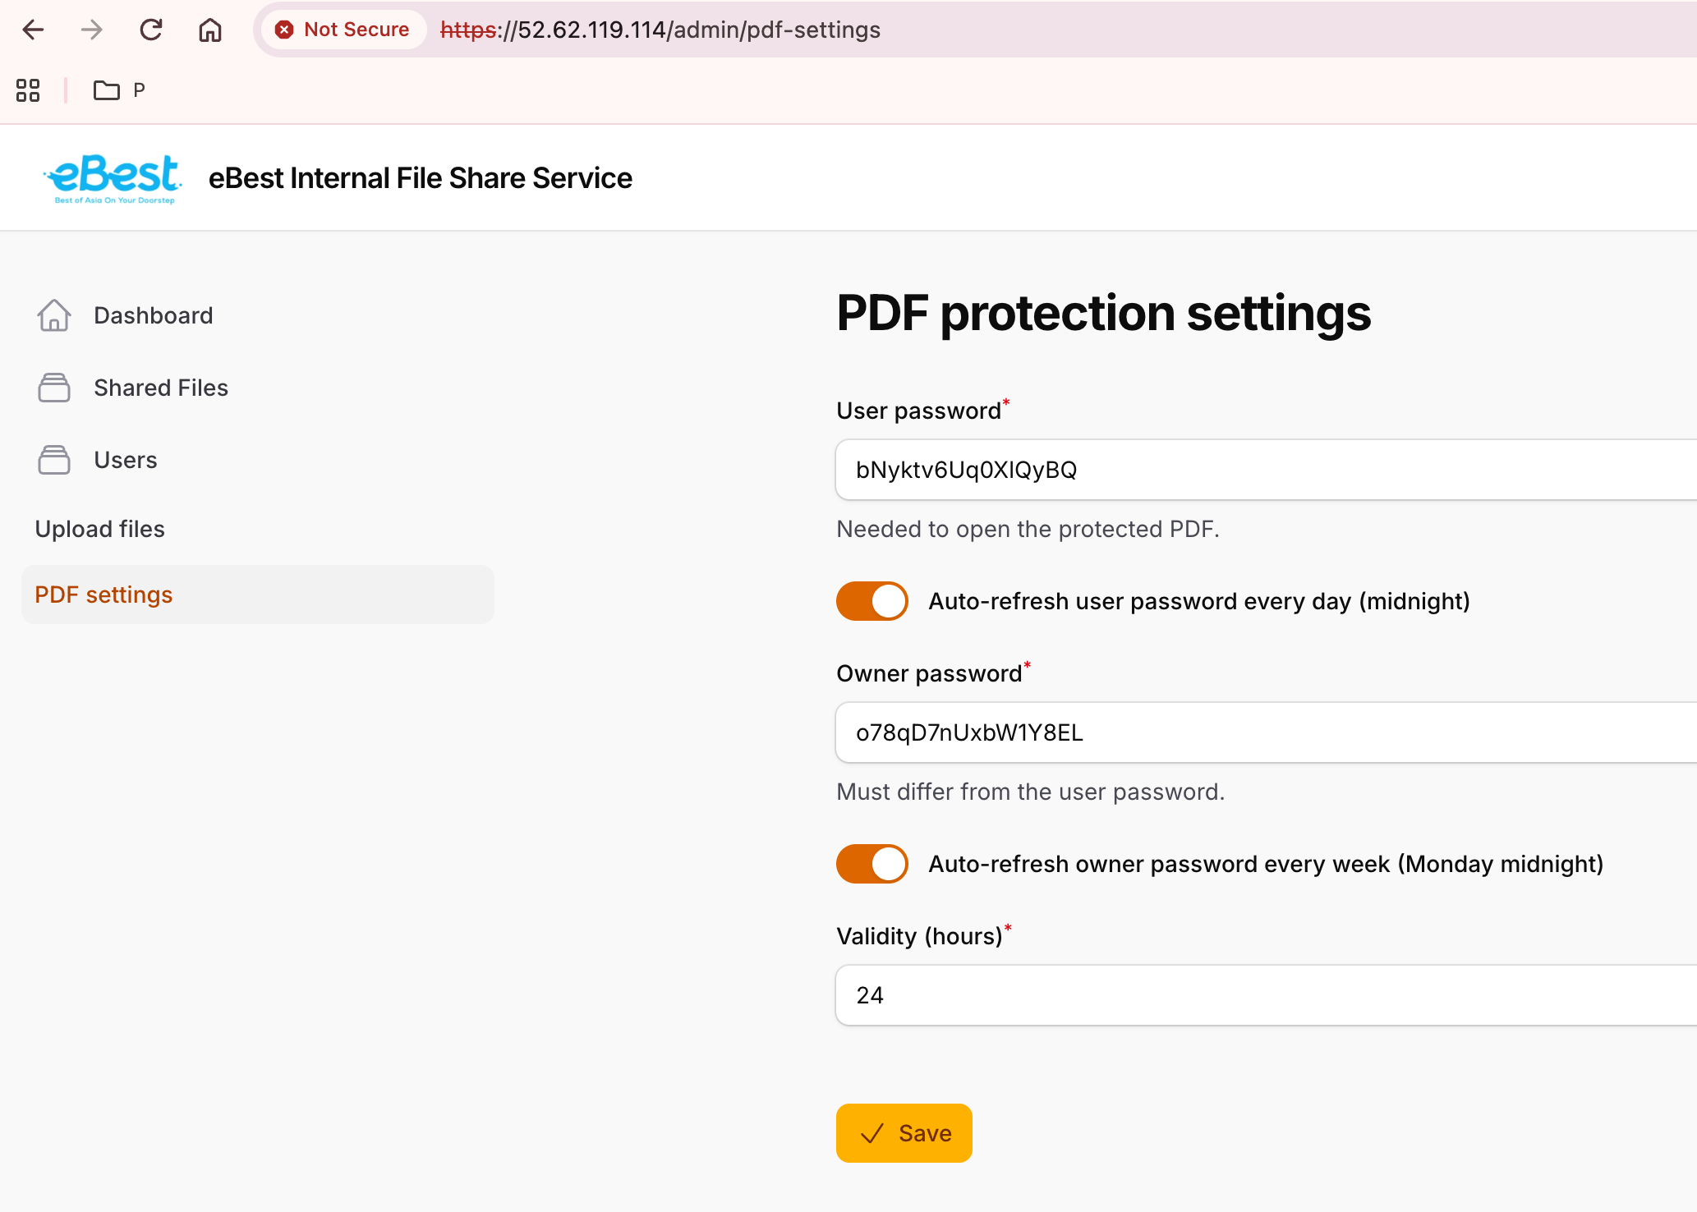
PDF setting

Slide 5

User management

Slide 6
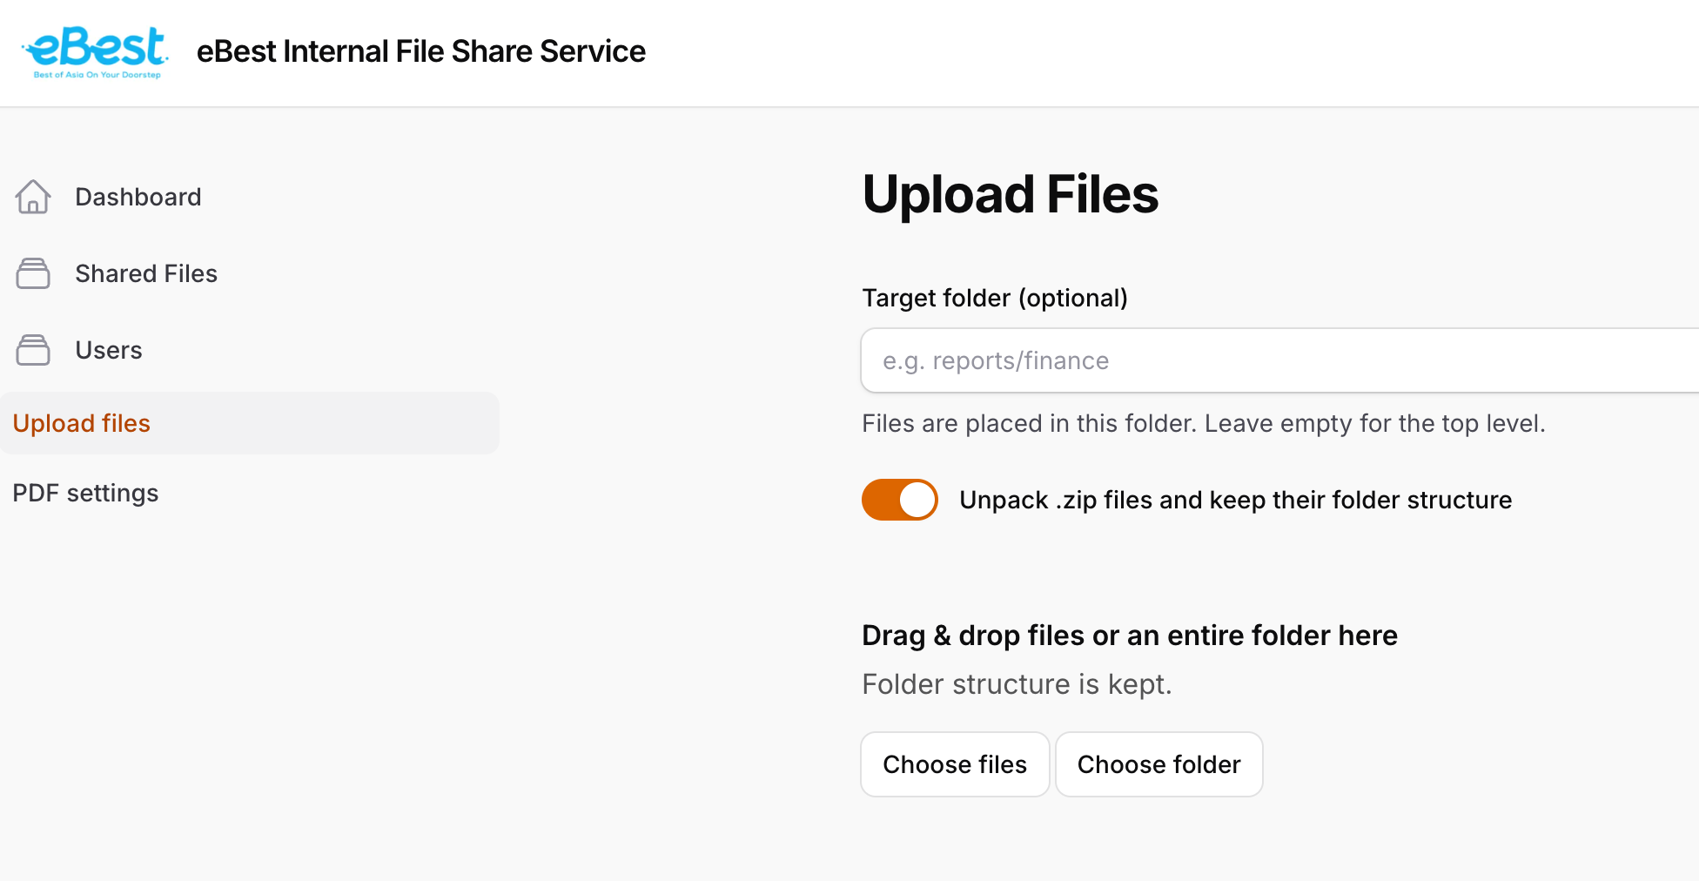
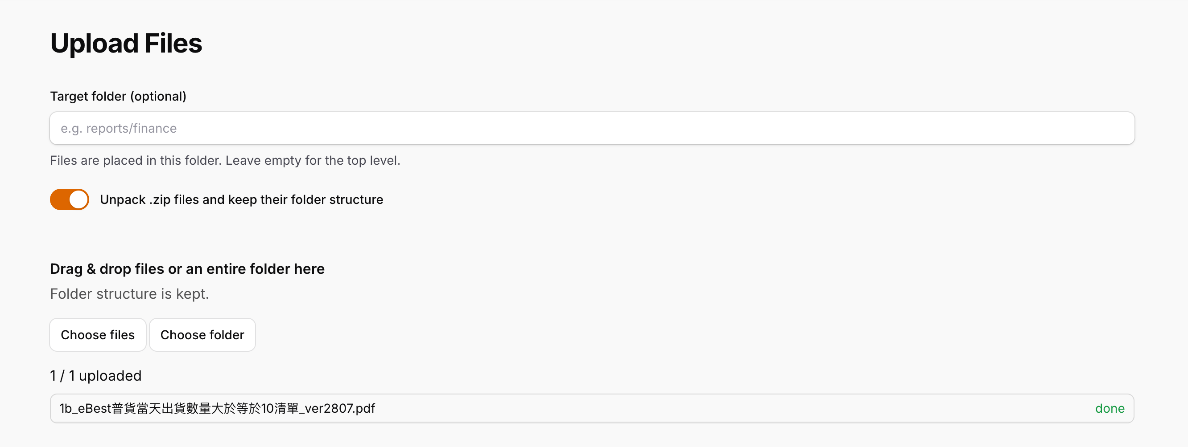
Upload Files

Slide 7
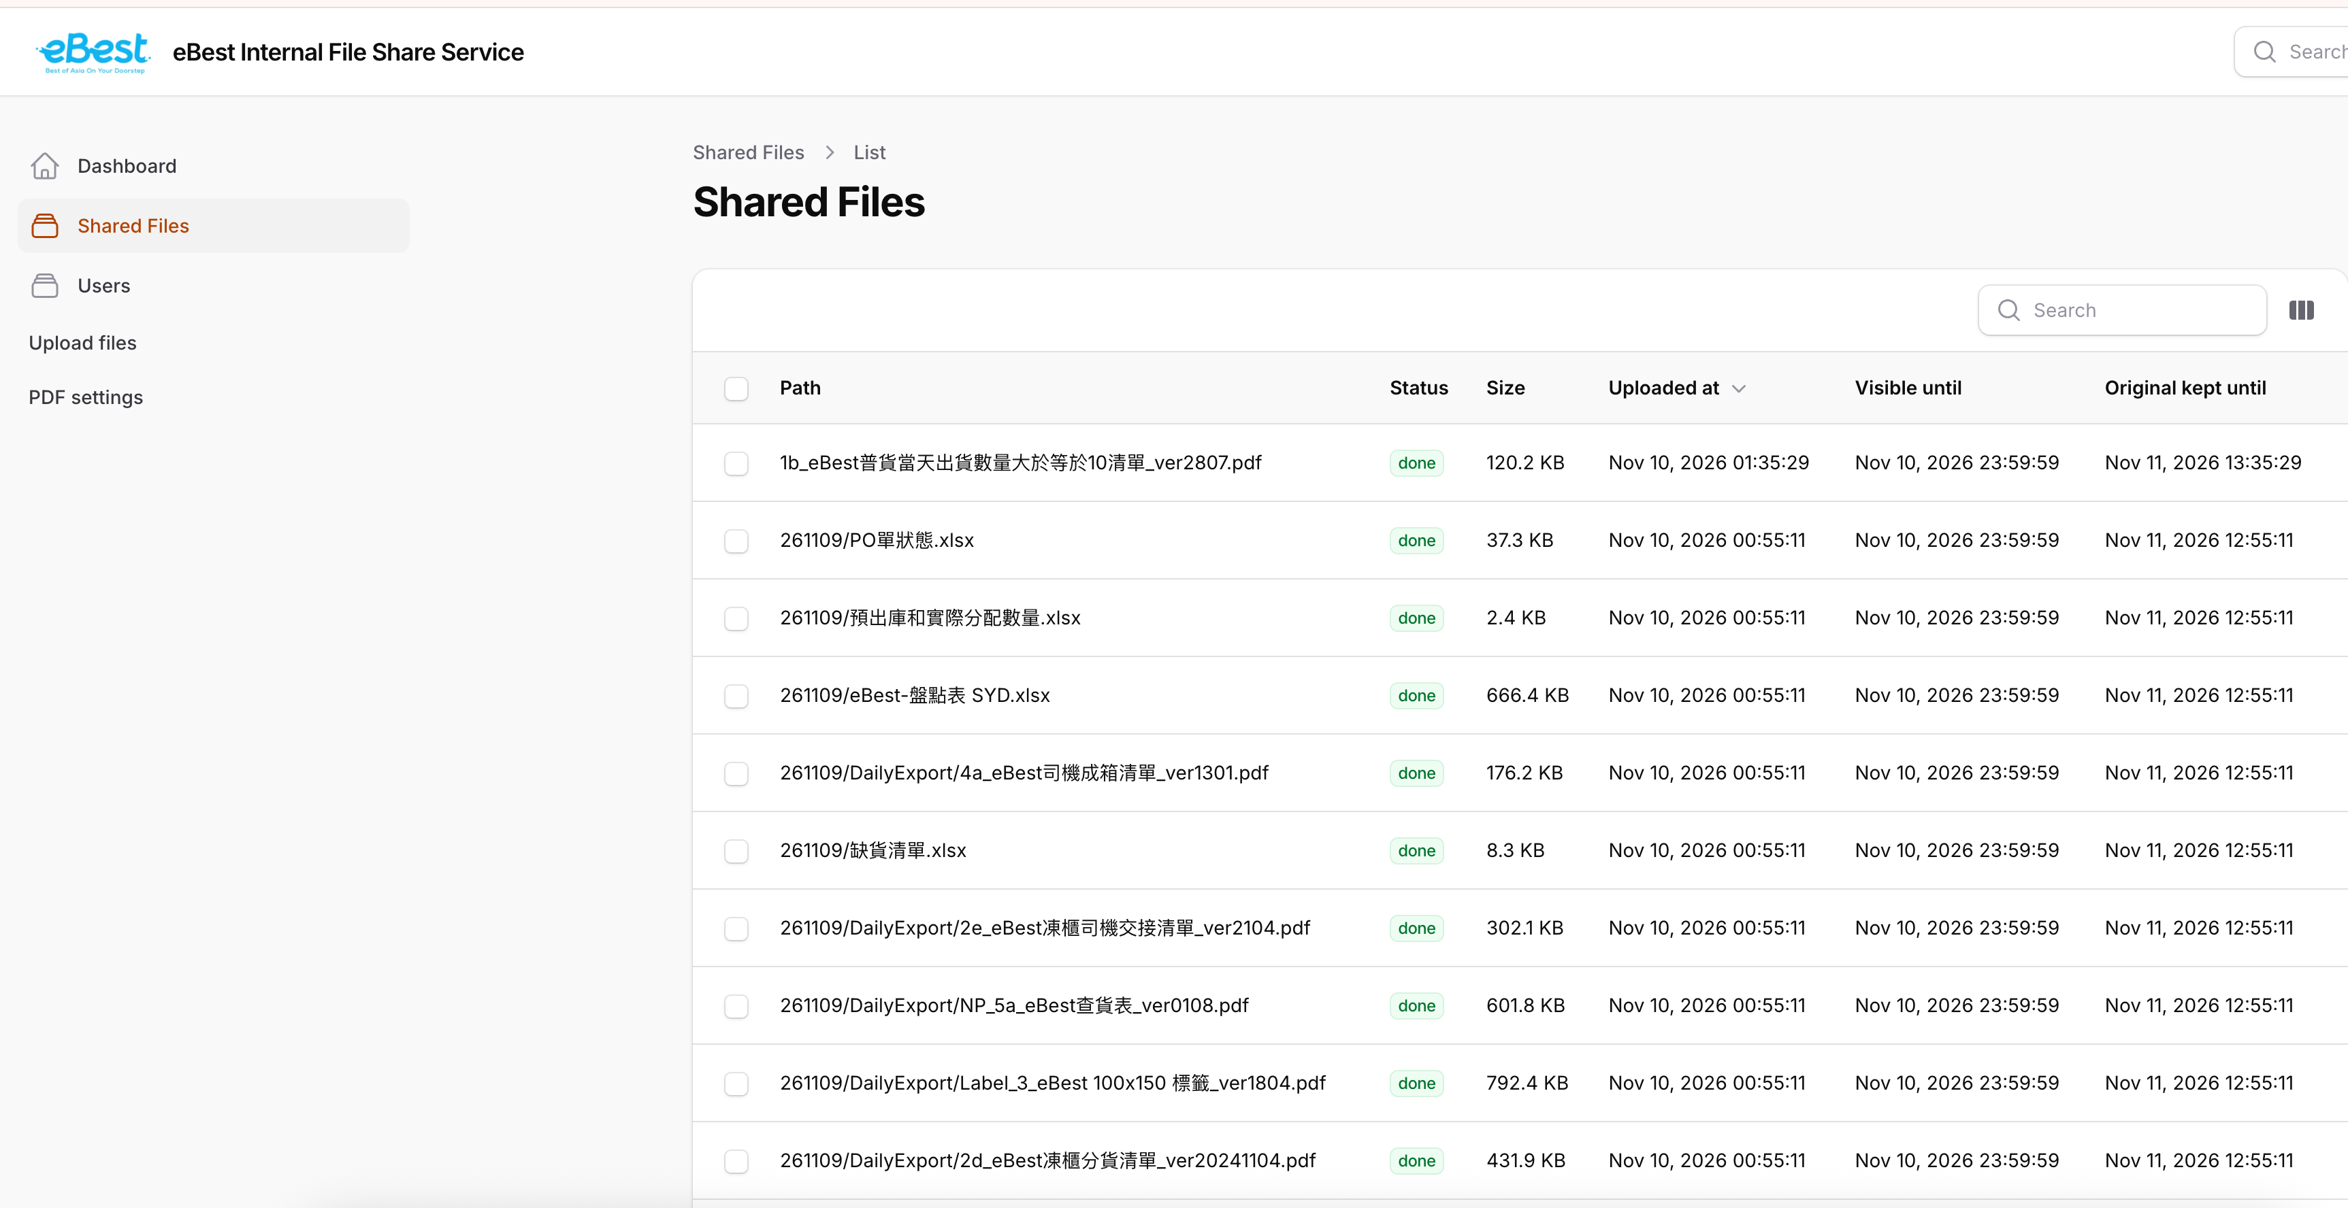
Admin – list of shared file and status

Slide 8

File list for user

Slide 9
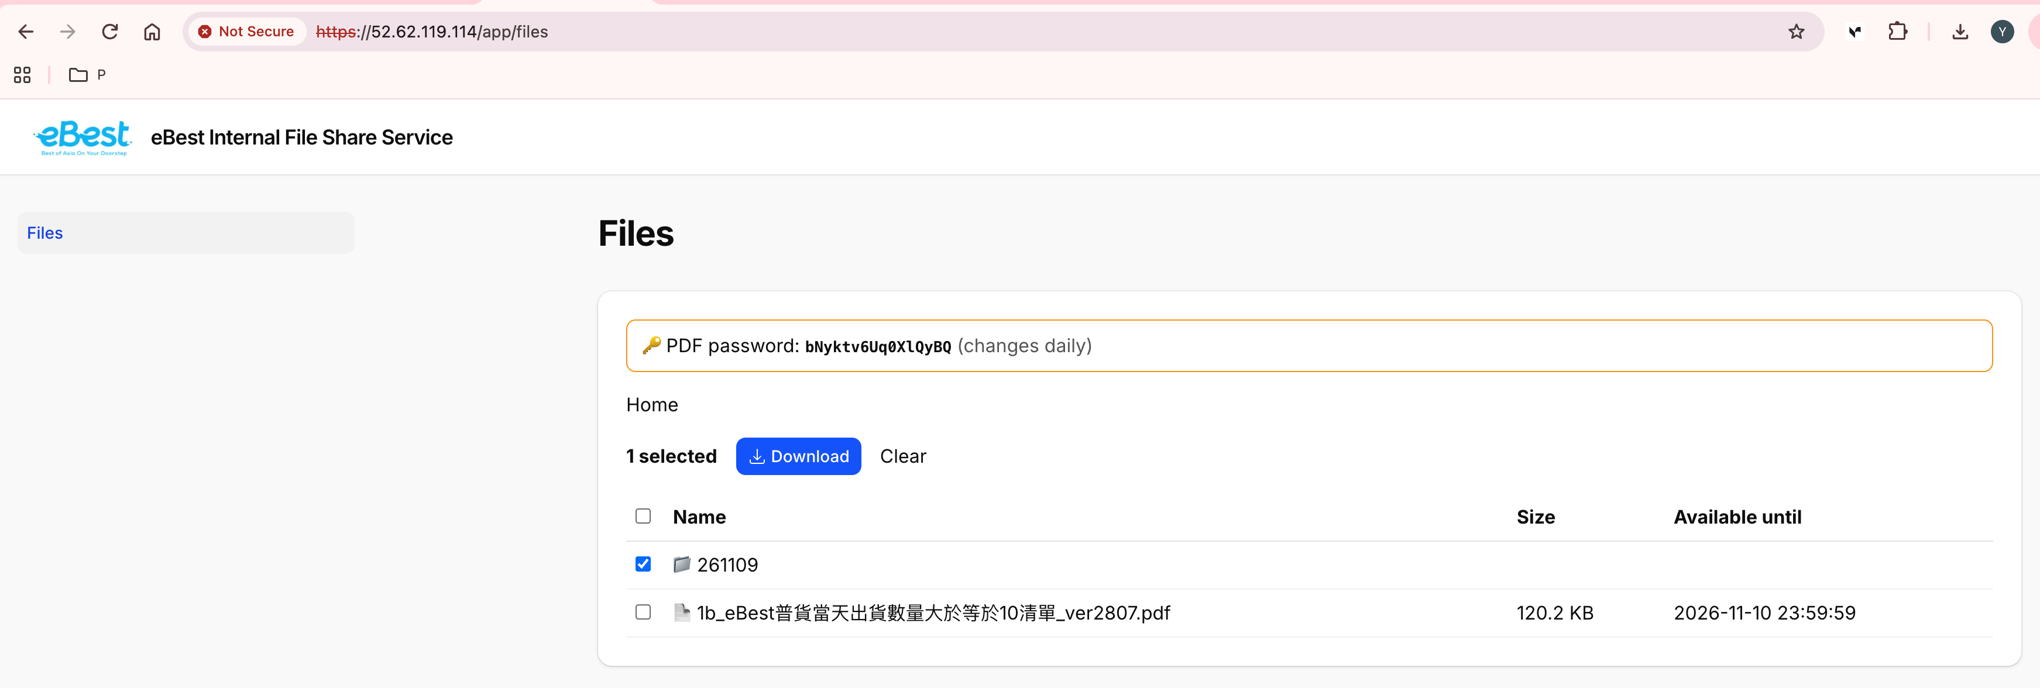
Download button

Slide 10

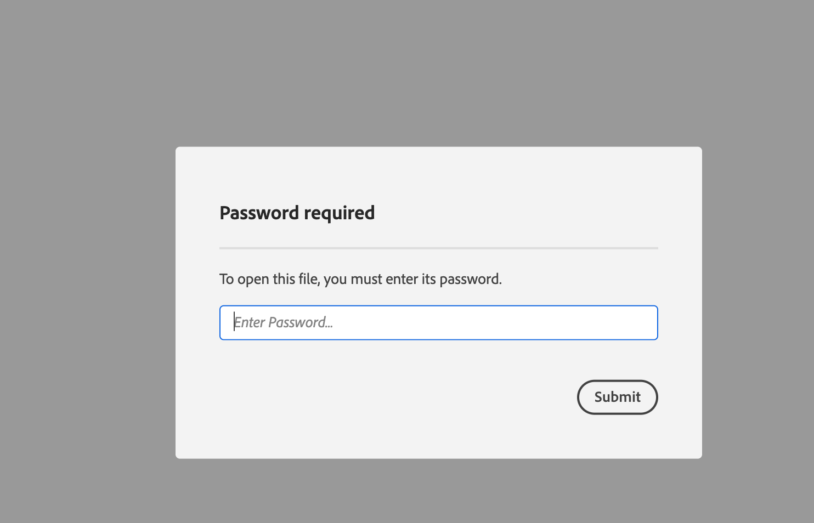
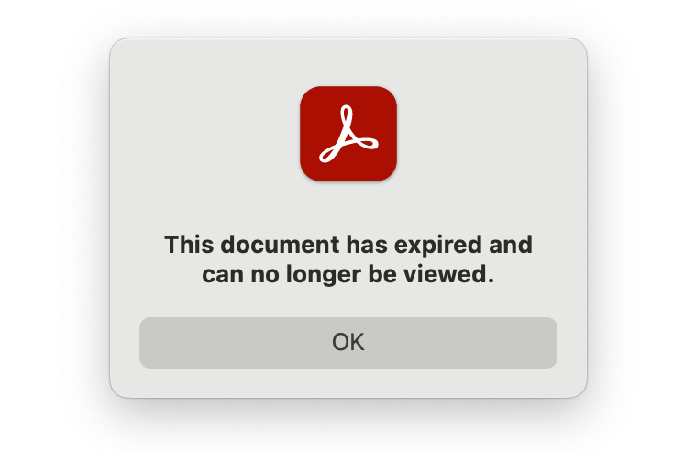
Password for file or expired after 24 hours

