Slide 1
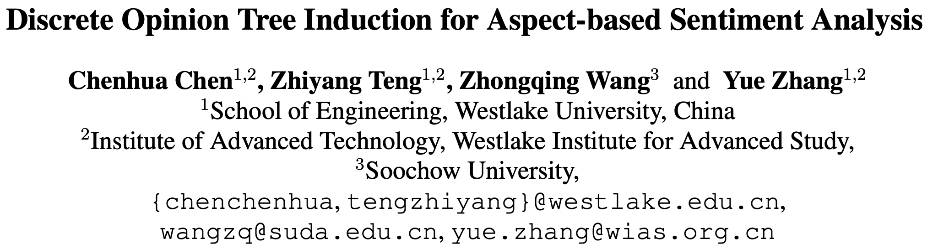
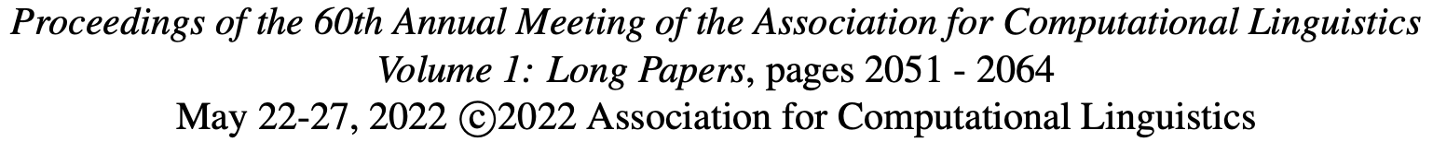

Slide 2
Motivation
How to locate the corresponding opinion contexts for each aspect term is a key challenge for ABSA.
Syntactic dependencies have been shown to better capture the interaction between the aspect and the opinion contexts
unavailable for low-resource languages or perform worse in low-resource domains
dependency trees are also not optimized for aspect-based sentiment classification
hand-crafted rules —— R-GAT

Slide 3
Method
our algorithm induces a tree structure recursively according to a set of attention scores, calculated using a neural layer on top of BERT representation of the sentence
Starting with the root node, the algorithm builds a tree by selecting one child node on each side of a current node and recursively continue the partition process to obtain a binarized and lexicalized tree structure
policy-based reinforcement learning + a set of regularizers

Slide 4
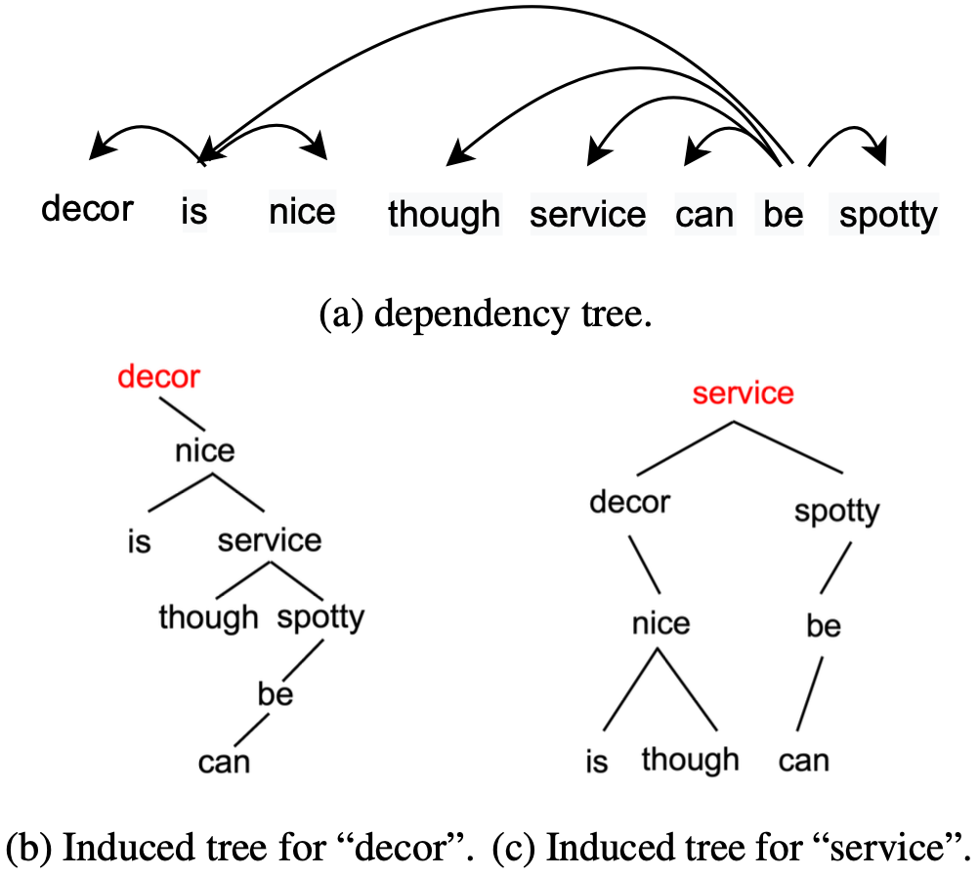

Slide 5
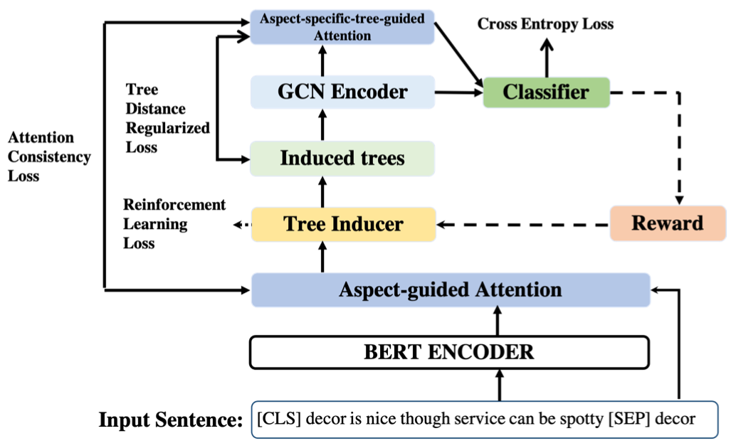
Model

Slide 6
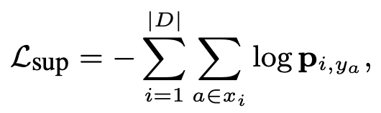
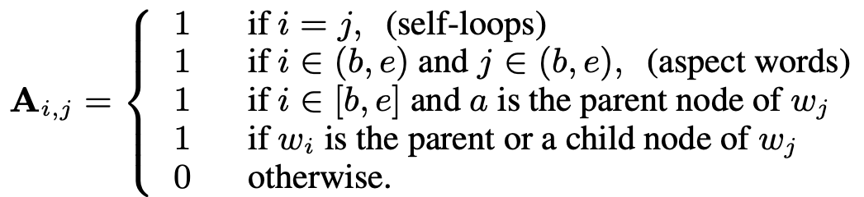


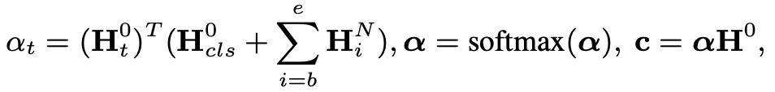

Model

Slide 7
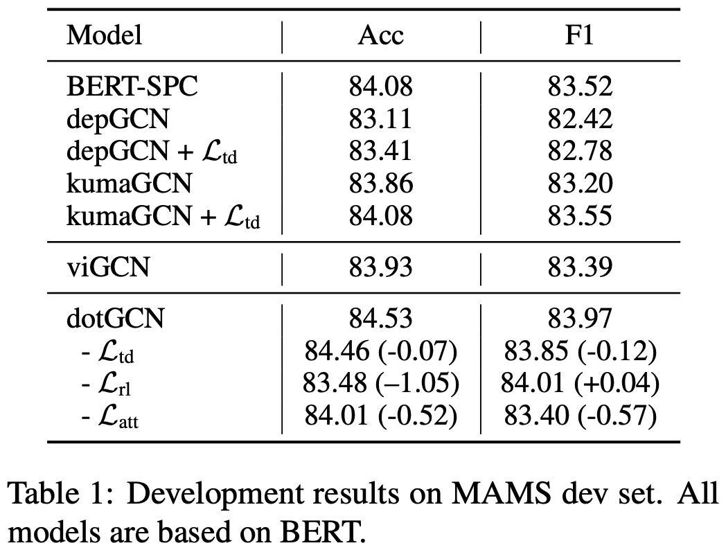
Experiments

Slide 8
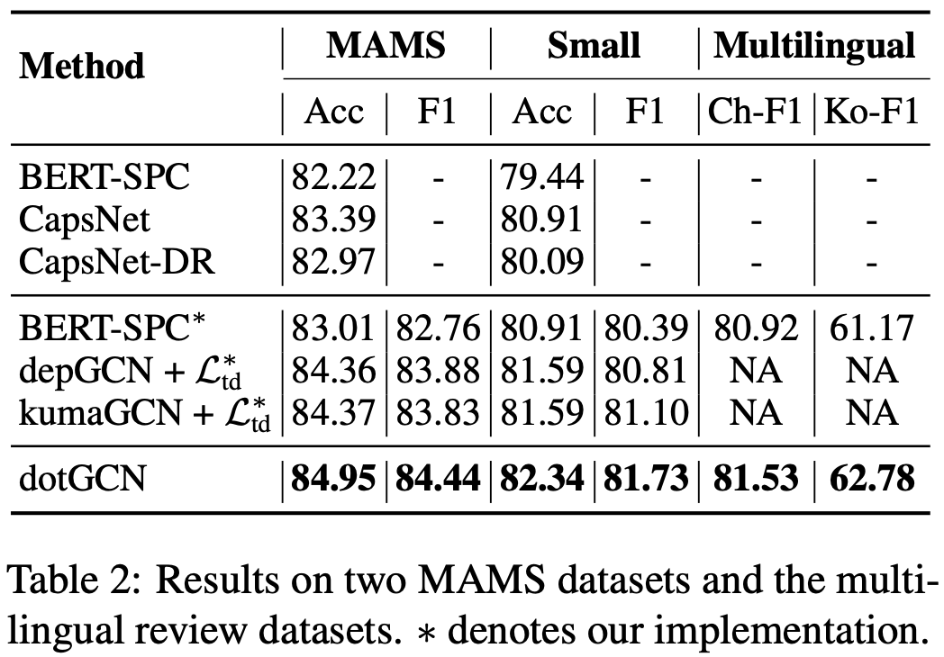
Experiments

Slide 9
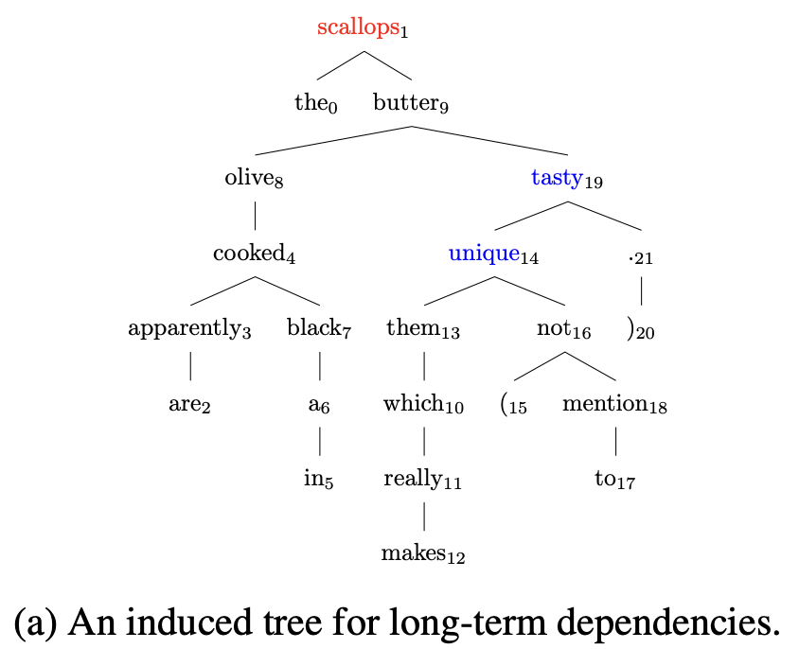
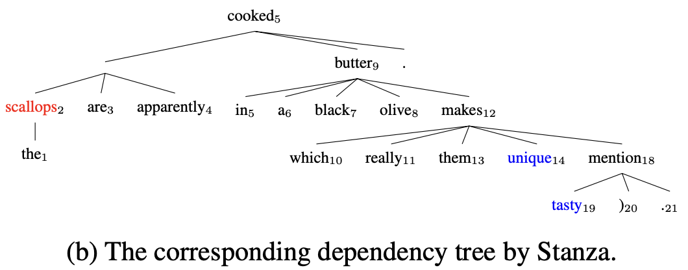
Case Study
the scallops are apparently cooked in a black olive butter which really makes them unique ( not to mention tasty ) .

Slide 10
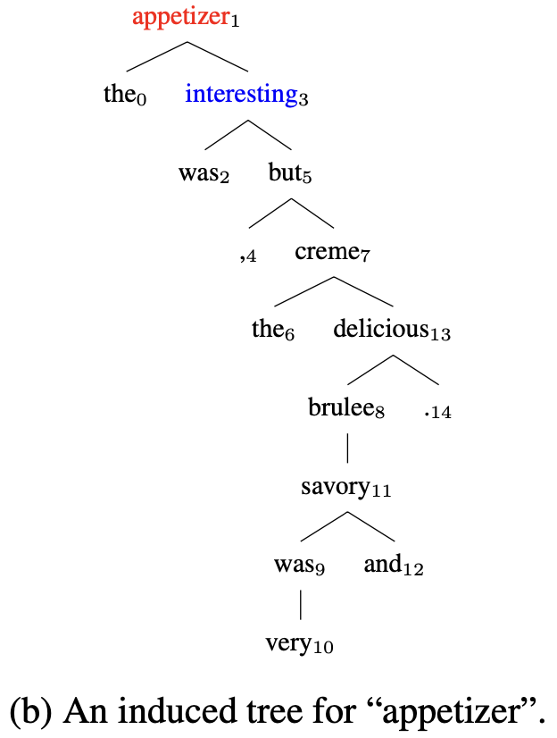
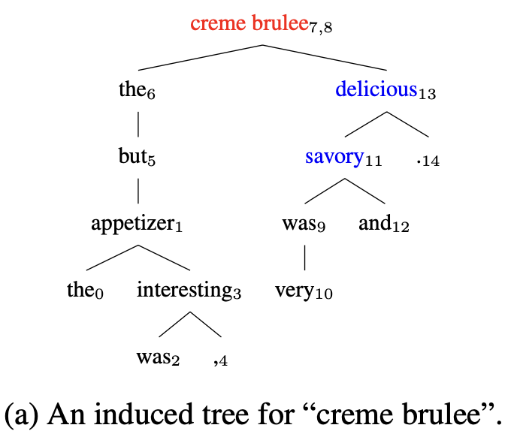
Case Study
the appetizer was interesting , but the creme
brulee was very savory and delicious .

Slide 11
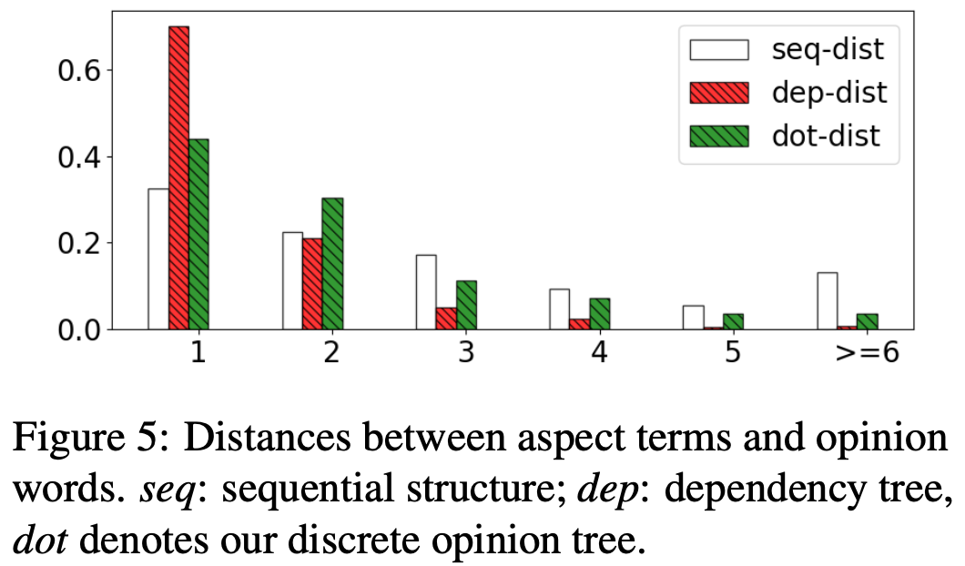
Analysis

Slide 12
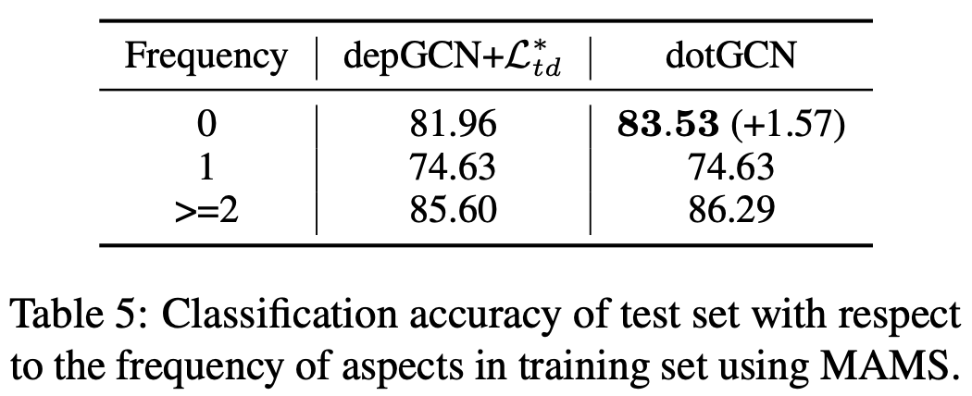
Analysis

