Slide 1
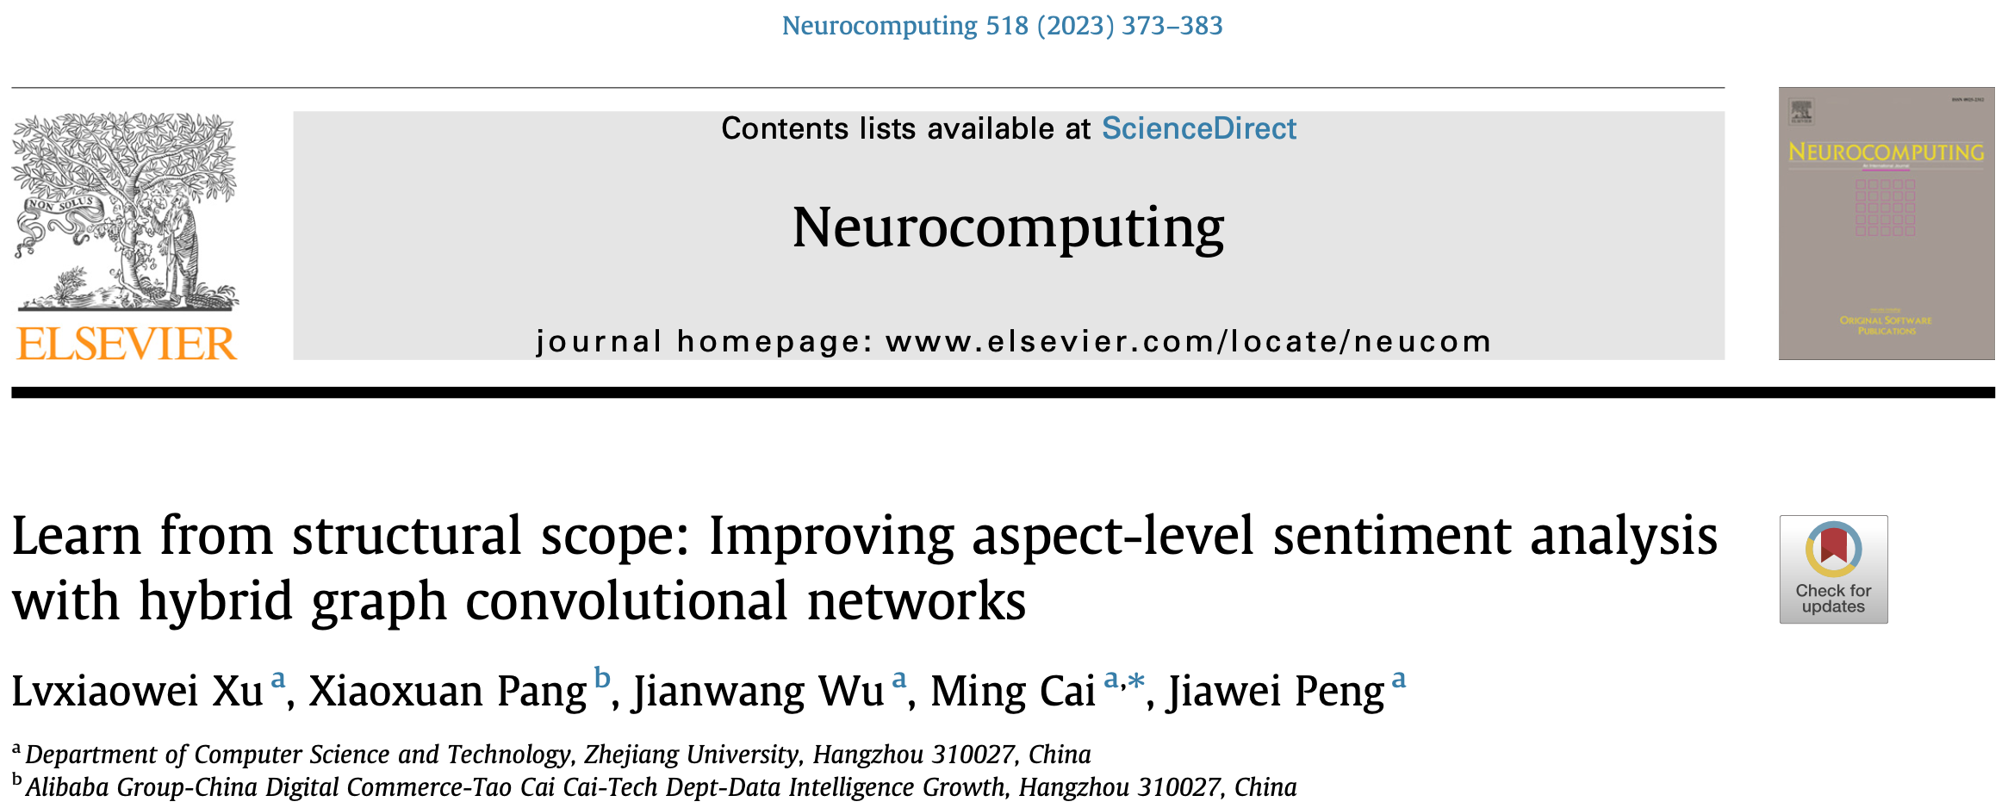

Slide 2
Motivation
Span-based models
divide-and-conquer strategy
extracts an opinion span towards each target based on a soft or hard selection approach
focuses on the phrase-level features
difficult to generate structurally complete spans for complicated sentences due to lack of syntactic information

Slide 3
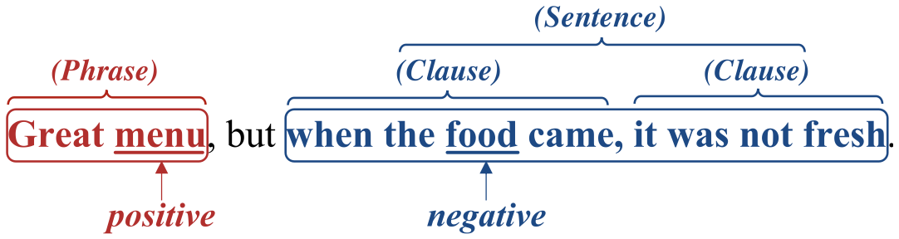
Motivation
Scope: a well-structured and continuous text region expressing target-specific opinion
alleviate the distraction problem caused by opinion words from other targets.
well-defined structure
learn various syntactic features (e.g., phrase, clause and sentence)
ensure structural and semantic completeness.

Slide 4
Motivation
First, constituency parsing decomposes a sentence into phrases and combines them hierarchically into clauses and sentences, which naturally follows the phrase-clause-sentence structure of Scope and can serve as the foundation to encode structural information.

Slide 5
Motivation
Second, dependency parsing is capable of capturing long-range dependencies such as coreference relation, which can help the model obtain the sentence-level connection. As for constituency parsing, it displays the entire sentence structure and relations, while dependency parsing explores relations between words.

Slide 6
Motivation
Third, dependency tree can actually not only parse the dependency relations, but also derive constituent boundaries, which is critical for modeling Scope. However, this requires unbounded number of hops over dependency tree to determine the boundaries that entail more layers of networks (e.g., GCN) for obtaining syntactic representations. It would be resource consuming and impractical.

Slide 7
Motivation
In this perspective, constituency tree and dependency tree present two complementary sides of syntactic relations in sentences. Therefore, it would be beneficial to incorporate constituency tree and dependency tree into the model to learn more comprehensive syntactic relations.

Slide 8
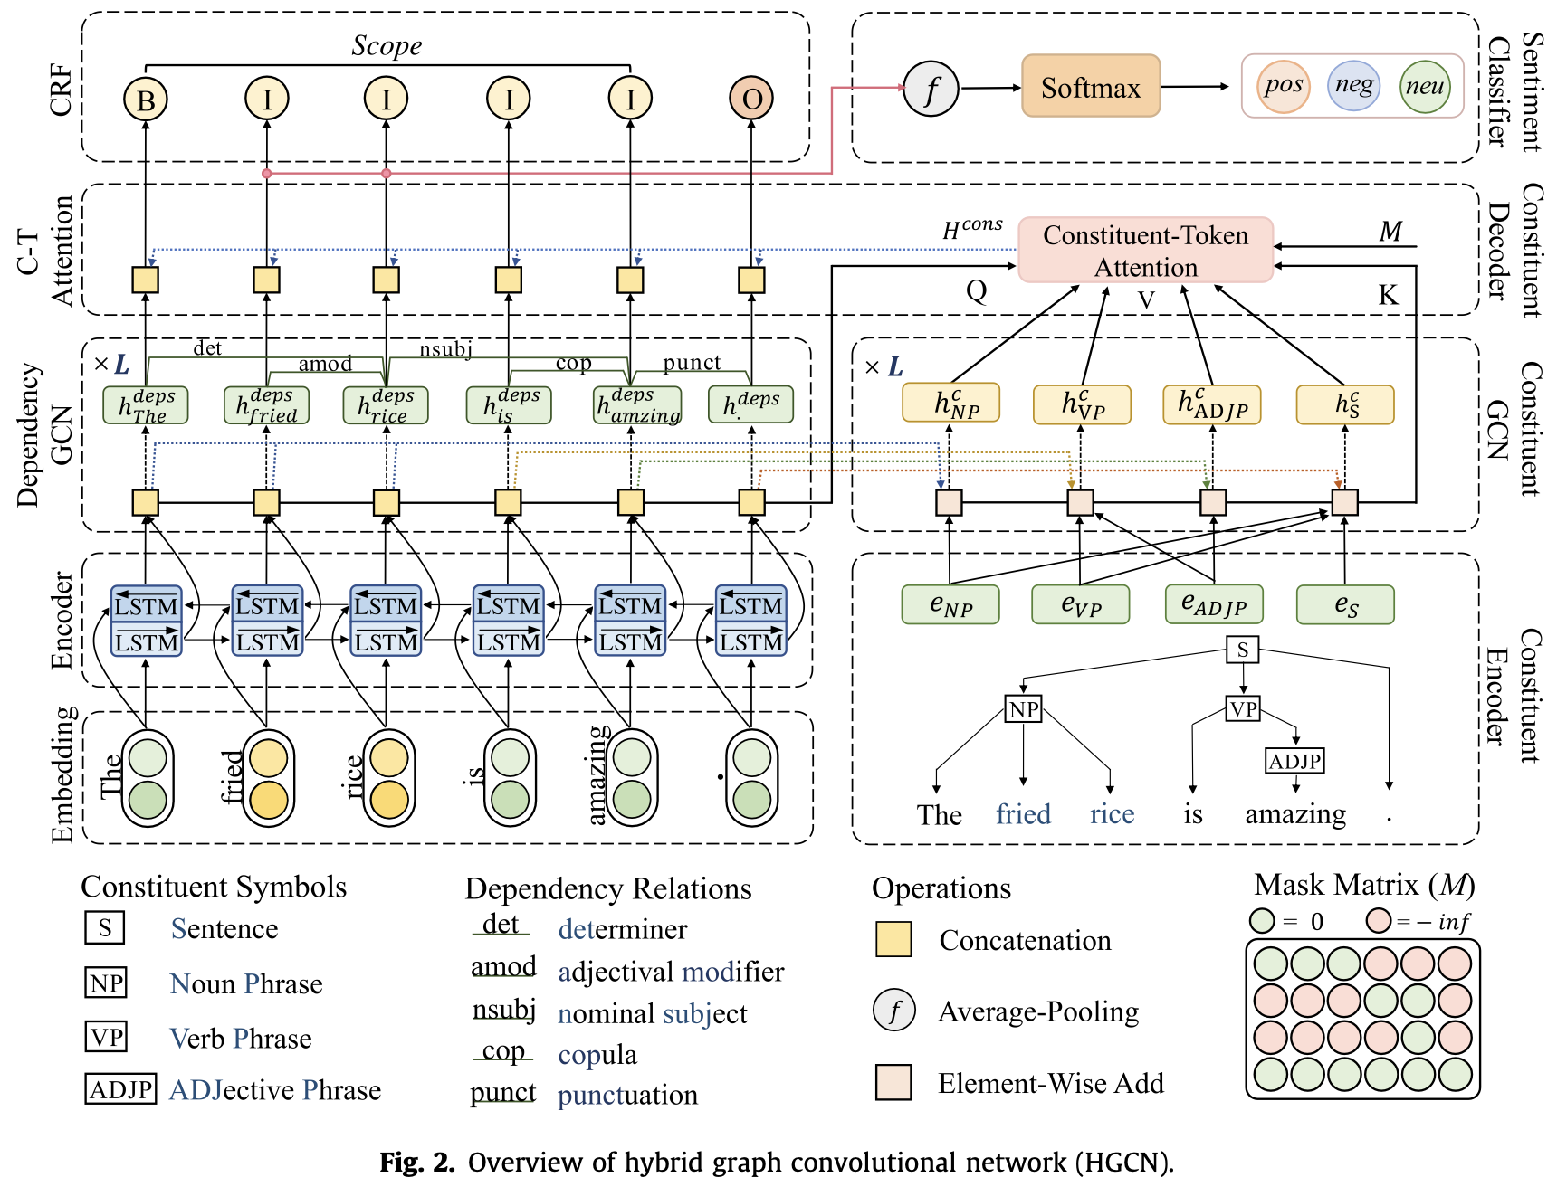
Model

Slide 9
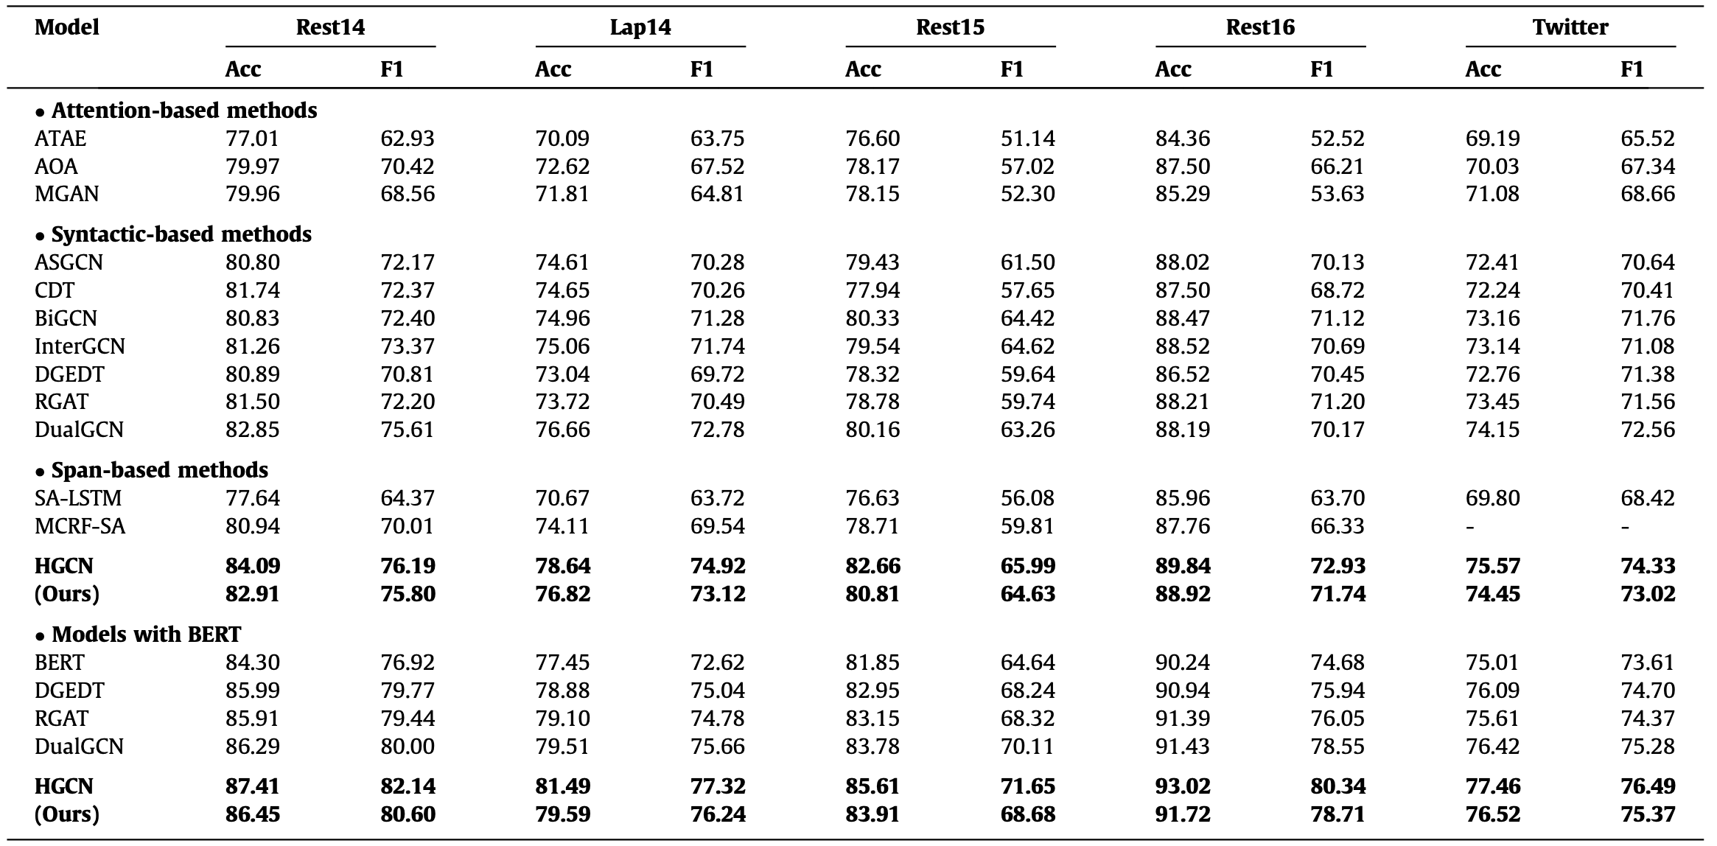
Experiments

Slide 10
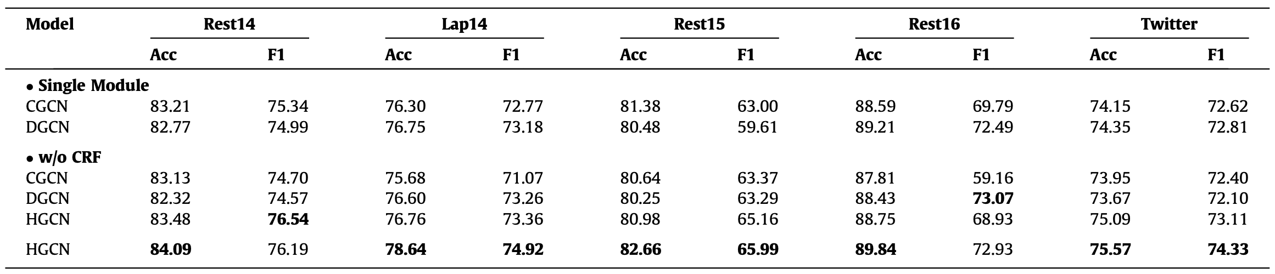
Ablation

Slide 11
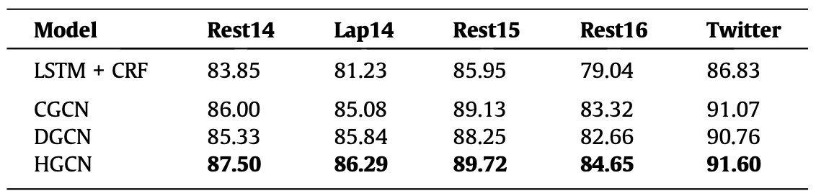
Ablation

Slide 12
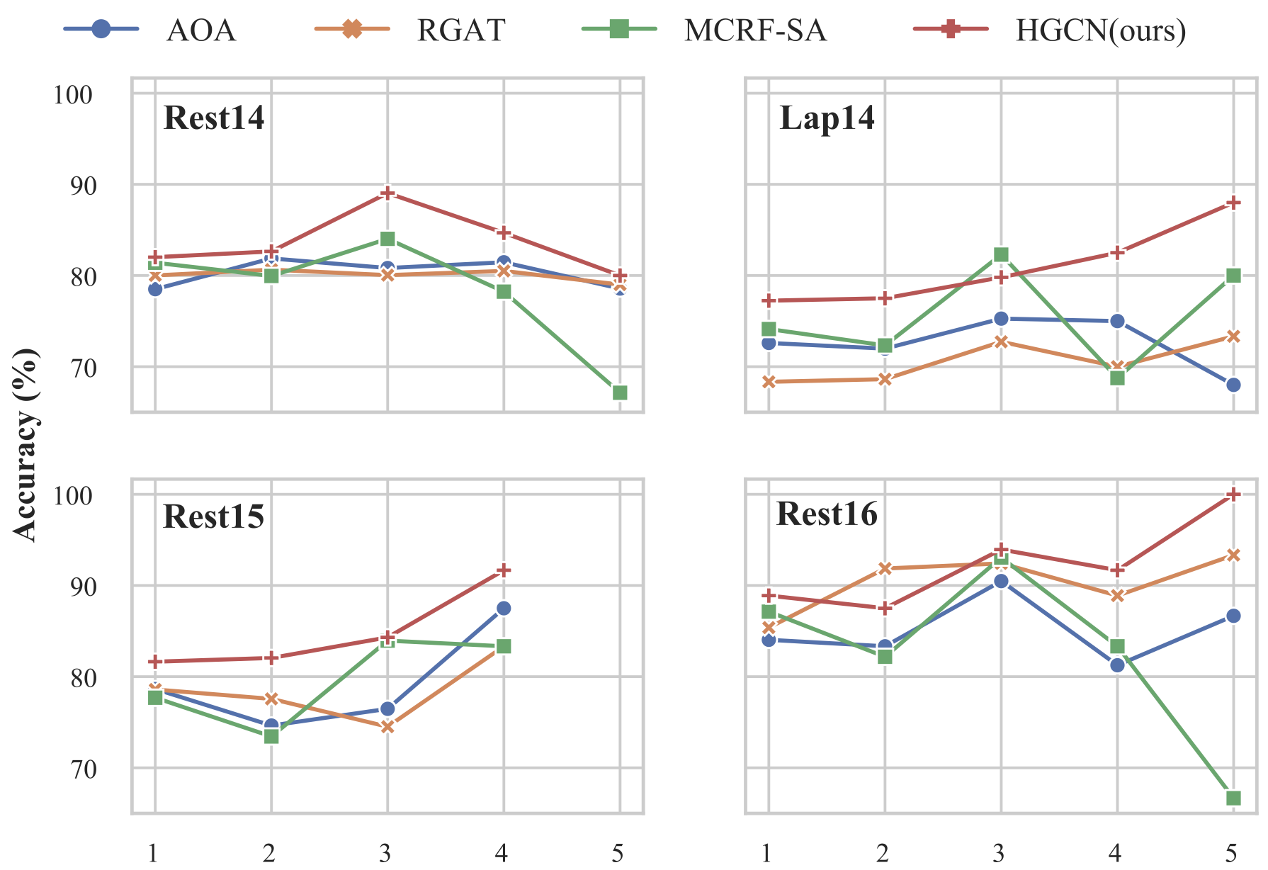
Analysis

Slide 13
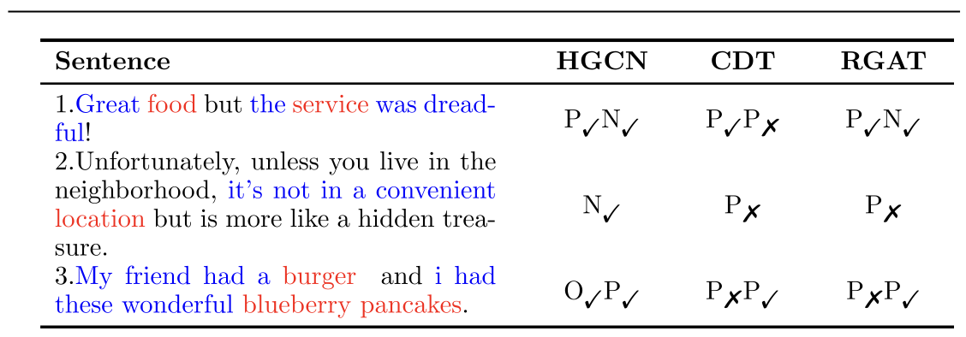
Case Study

