Slide 1
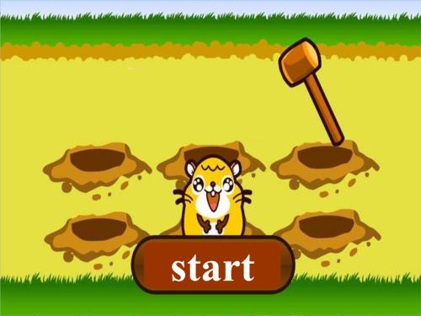
打地鼠游戏
Poke A Mole
.
——GROUP 1

Slide 2
NUMBER
Lu Xing 陆兴
Yong Tai Liang 雍太亮
Tian Yuan 田源
Shi Hao 石豪

Slide 3
.
Content
1-Introduction 介绍
2-The flow chart 流程图
3-Four Program modules 程序四大模块
4-The question and improvement 问题和改进

Slide 4
.
Introduction
How to join us(The rules)
1- four different kind of colors mean different button.
2-Press the button when the corresponding indicator light is on.
3-at the beginning of the game ,LCD displays “HAVE FUN “
When you make a mistake ,LCD displays “Good Game” and LedOn(WHITE)
4-The game begins with the bell.
Join us and join the challenge !

Slide 5
The improvement
To make the game more difficult,
We added a program ,the game will get faster and faster ,
try to keep up with you reactions.
Our game is endless,
Come and bring it!
I’II take you on anytime anyplace.

Slide 6
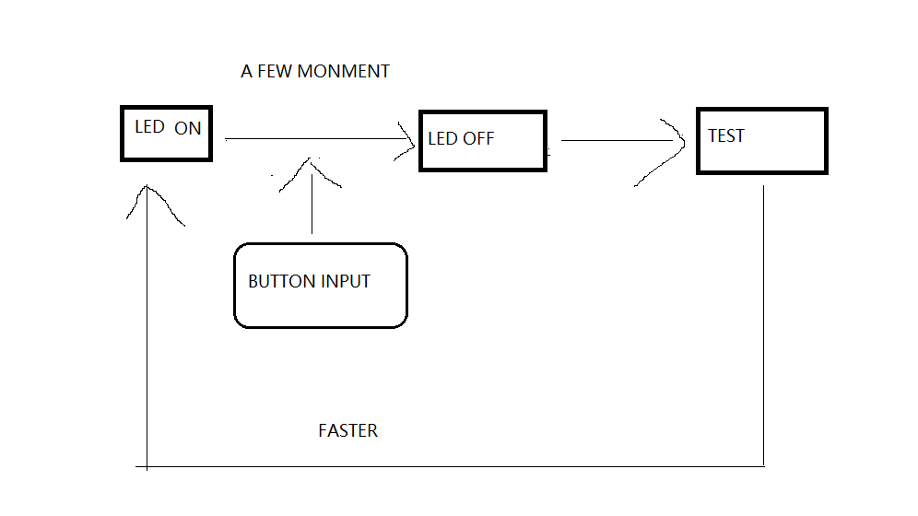
.
The flow chart
LedOn WHITE

Slide 7
.
Program modules
LED PART
for(i=0;i<100;i++) }
else
LedOff(RED);
if(u8Counter==2) //每个LED对
应不同的值
{
LedOn(ORANGE);
LedOff(RED);
LedOff(GREEN);
LedOff(YELLOW);
}
else
}
else
LedOff(ORANGE);
if(u8Counter==3)
{
LedOn(YELLOW);
LedOff(ORANGE);
LedOff(GREEN);
LedOff(RED);
}
else
LedOff(YELLOW);
if(u8Counter==4)
{
LedOn(GREEN);
LedOff(YELLOW);
LedOff(ORANGE);
LedOff(RED);
}
else
LedOff(GREEN);
}
{
if(u8Counter==1)
{
LedOn(RED);
LedOff(GREEN);
LedOff(YELLOW);
LedOff(ORANGE);

Slide 8
.
Program modules
if(WasButtonPressed(BUTTON1))
{
u8Return=3;
ButtonAcknowledge(BUTTON1);
}
if(WasButtonPressed(BUTTON0))
{
u8Return=4;
ButtonAcknowledge(BUTTON0);
}
}
BUTTON PART
if(WasButtonPressed(BUTTON3))
{
u8Return=1; //每个按键返回不
同值
ButtonAcknowledge(BUTTON3);
}
if(WasButtonPressed(BUTTON2))
{
u8Return=2;
ButtonAcknowledge(BUTTON2);
}

Slide 9
.
Program modules
LCD PART
LCDCommand(LCD_CLEAR_CMD);
u8 au8Message[] = " GOODGAME!";
LCDMessage(LINE1_START_ADDR+4, au8Message);
LCDCommand(LCD_CLEAR_CMD);
u8 au8Message[] = " Have fun!";
LCDMessage(LINE1_START_ADDR+2, au8Message);//游戏
开始显示以及游戏失
败显示

Slide 10
.
Program modules
TEST PART
if(u16BlinkCount==velocity) //判断按键和LED是否对应
{u16BlinkCount=0;
if (u8Return==u8Counter)
{
i=u8Counter;
u8Counter=rand()%4+1;
while(i==u8Counter)
{u8Counter=rand()%4+1;}

