Slide 1
Git Basics
Software Engineer
YongWan Jo(Jo)
Notes:
http://git-scm.com/book/en/Git-Basics

Slide 2
Getting a Git Repository
Initializing a Repository in an Existing Directory
git init
Creates a new subdirectory named .git
Cloning an Existing Repository
git clone [url]
Creates a directory named specified [url]
Initializes a .git directory inside it
Pulls down all the data for that repository
Checks out a working copy of the latest version

Slide 3
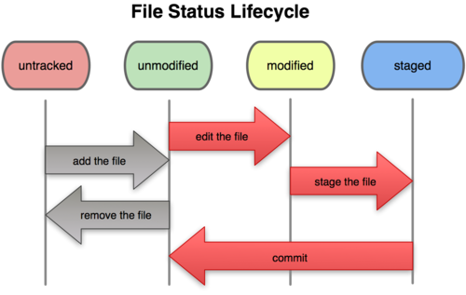
Recording Changes to the Repository
git status
git add
.gitignore
git diff
git commit
git rm
git mv
git add
git add
git commit
Notes:
git diff : Compares what is in your working directory with what is in your staging area.
git diff --cached : Compares your staged changes to your last commit.
git add -a :Providing the –a option to the git commit command makes Git automatically stage every file that is already tracked before doing the commit
git rm --cached : Keeps the file in your working tree but remove it from your staging area.
git mv readme.txt readme : same as ‘mv readme.txt readme’ + ‘git rm readme.txt’ + ‘git add readme’

Slide 4
Viewing the Commit History
git log
Option | Description
-p | Show the patch introduced with each commit
--stat | Show statistics for files modified in each commit.
--shortstat | Display only the changed/insertions/deletions line from the --stat command.
--name-only | Show the list of files modified after the commit information.
--name-status | Show the list of files affected with added/modified/deleted information as well.
--abbrev-commit | Show only the first few characters of the SHA-1 checksum instead of all 40.
--relative-date | Display the date in a relative format (for example, “2 weeks ago”) instead of using the full date format.
--graph | Display an ASCII graph of the branch and merge history beside the log output.
--pretty | Show commits in an alternate format. Options include oneline, short, full, fuller, and format (where you specify your own format).

Slide 5
Options that format takes
git log --pretty=format:”%h - %an, %ar : %s”
Option | Description of Output
%H | Commit hash
%h | Abbreviated commit hash
%T | Tree hash
%t | Abbreviated tree hash
%P | Parent hashes
%p | Abbreviated parent hashes
%an | Author name
%ae | Author e-mail
%ad | Author date (format respects the –date= option)
%ar | Author date, relative
%cn | Committer name
%ce | Committer email
%cd | Committer date
%cr | Committer date, relative
%s | Subject

Slide 6
Limiting Log Output
git log
Option | Description
-(n) | Show only the last n commits
--since, --after | Limit the commits to those made after the specified date.
--until, --before | Limit the commits to those made before the specified date.
--author | Only show commits in which the author entry matches the specified string.
--committer | Only show commits in which the committer entry matches the specified string.

Slide 7
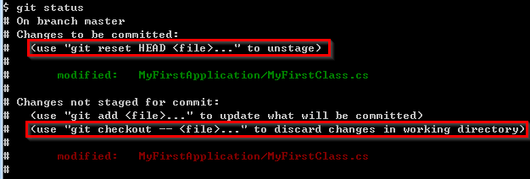
Undoing Things
Change Your Last Commit
git commit --amend
Unstaging a Staged File
git reset HEAD <file>
Unmodifying a Modified File
git checkout -- <file>
Notes:
Be careful, because you can’t always revert some of these undos.
Anything that is committed in Git can almost always be recovered. However, anything you lose that was never committed is likely never to be seen again.

Slide 8
Working with Remotes
Showing Your Remotes
git clone
git remote
git remote –v : shows you the URL that Git has stored
Adding Remote Repositories
git remote add [short-name] [url]
Fetching and Pulling from Your Remotes
git fetch [remote-name(= short-name)]
git pull : git fetch followed by git merge
Notes:
If you’ve cloned your repository, you should at least see origin – this is the default name Git gives to the server you cloned from

Slide 9
Working with Remotes
Pushing to Your Remotes
git push [remote-name] [branch-name]
Inspecting a Remote
git remote show [remote-name]
Removing and Renaming Remotes
git remote rename [remote-name] [new-remote-name]
git remote rm [remote-name]

Slide 10
Tagging
Listing Your Tags
git tag
git tag -l ‘v1.4.1.*’
Annotated Tags
git tag -a v1.4 -m ‘my version 1.4’
git show v1.4
Lightweight Tags
git tag v1.4.1
Tagging Later
git tag -a v1.2 [checksum(or part of it)]
Sharing Tags
git push origin [tagname]
git push origin --tags
Notes:
Generally, people use tagging to mark release points.
By default, the git push command doesn’t transfer tags to remote servers.
64bit versions of Windows are not supported for the Signed and Verifying Tags.
http://www.gnupg.org/download/supported_systems.en.html

Slide 11
Tips and Tricks
Auto-Completion
Pressing the Tab key returns a set of suggestions
Git Aliases
git config --global alias.unstage ‘reset HEAD --’
‘git unstage fileA’ equals to ‘git reset HEAD fileA’
git config --global alias.last ‘log -1 HEAD’
git config --global alias.visual “!gitk”
Notes:
Starting the command with ‘!’ makes run an external command.

Slide 12

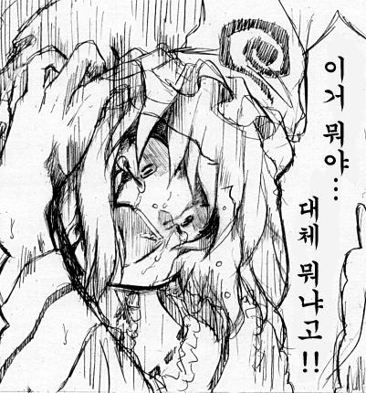


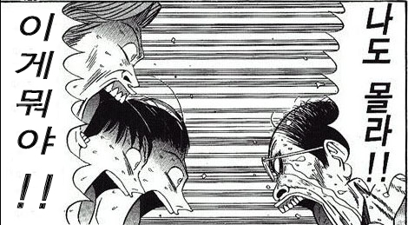



Q & A

