Slide 1
Git – Getting Started
Software Engineer
YongWan Jo(Jo)
Notes:
http://git-scm.com/book/en/Git-Basics

Slide 2
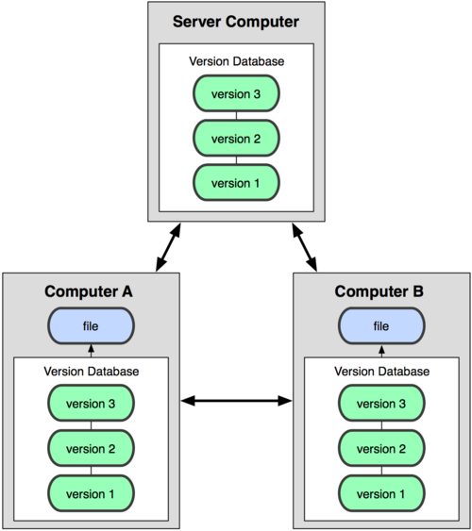

About Version Control
Centralized VCS
Distributed VCS
Notes:
CVCS(Centralized Version Control Systems) : TFS, The most obvious downside is the single point of failure that the centralized server represents.
DVCS(Distributed Version Control Systems) : Git, Every checkout is really a full backup of all the data.

Slide 3
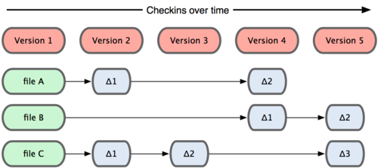
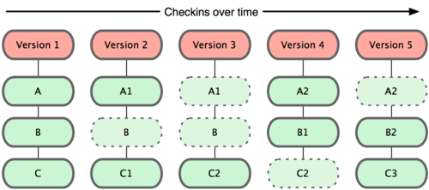

Git Basics
Snapshots, Not Differences
Nearly Every Operation Is Local
Git Has Integrity
Git Generally Only Adds Data
There Three States
Other Systems
Git
Notes:
The most other systems store information as a list of file-based changes. Git thinks of its data more like a set of snapshots of a mini file system.

Slide 4
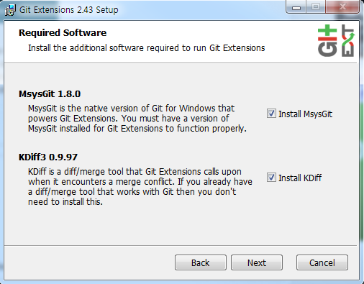
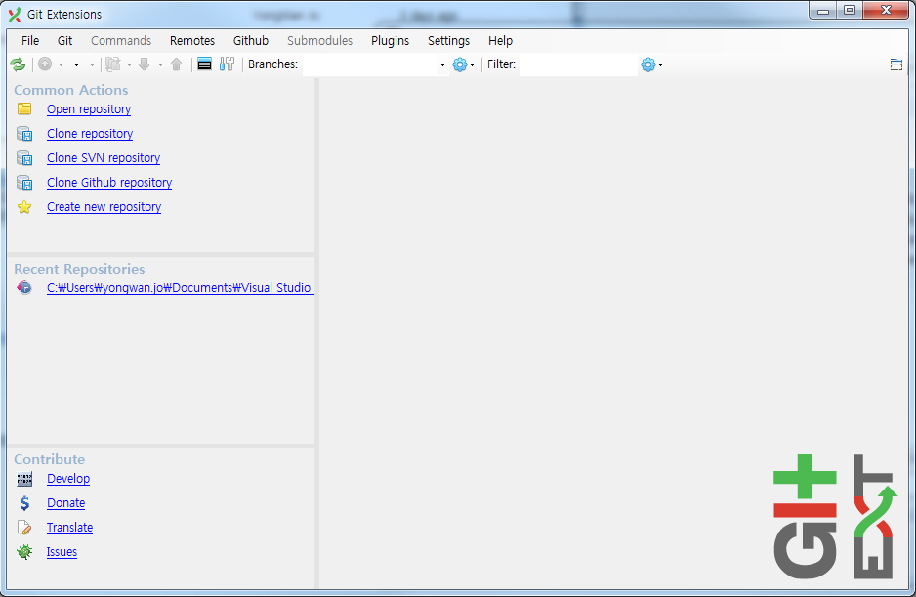
Installing Git
Installing on Windows : msysGit
Git Extensions

Slide 5
First-Time Git Setup
Configuration Places
Every User on the system and all Repositories
--system option
{$GitInstalledDirectory}/etc/gitconfig
Specific to your user
--global option
{$HOME}/.gitconfig
$HOME == C:\Documents and Settings\$USER
Specific to that single repository
.git/config
Each level overrides values in the previous level

Slide 6
First-Time Git Setup
Your Identity
git config --global user.name “YongWan Jo”
git config --global user.email “yongwan.jo@aveva.com”
Your Editor
git config --global core.editor emacs
Your Diff Tool
git config --global merge.tool vimdiff
Checking Your Settings
git config --list
git config user.name

Slide 7
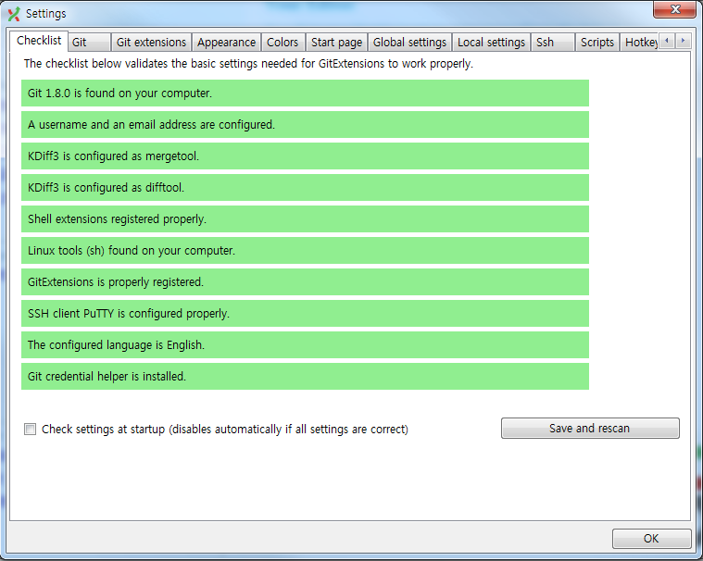
First-Time Git Setup

