Slide 1
AI Border Crowd & Weather Intelligence for Woodlands–JB Travel Proposal
Innovative AI solutions enhancing travel and safety management
Notes:
AI-generated content may be incorrect. ---

Slide 2
Project Context and Business Need
Notes:
--- This slide references information from the following file: https://microncorp-my.sharepoint.com/personal/ypoha_micron_com/Documents/Microsoft%20Copilot%20Chat%20Files/python_jalanow_api_collector.py,https://microncorp-my.sharepoint.com/personal/ypoha_micron_com/Documents/Microsoft%20Copilot%20Chat%20Files/jalannow_classifier.py,https://www.enterprisesg.gov.sg/resources/media-centre/news/2024/june/bridging-borders-100-years-on,https://data.gov.sg/datasets/d_6cdb6b405b25aaaacbaf7689bcc6fae0/view Border Monitoring Problem, Use Cases, and Business Rationale

Slide 3
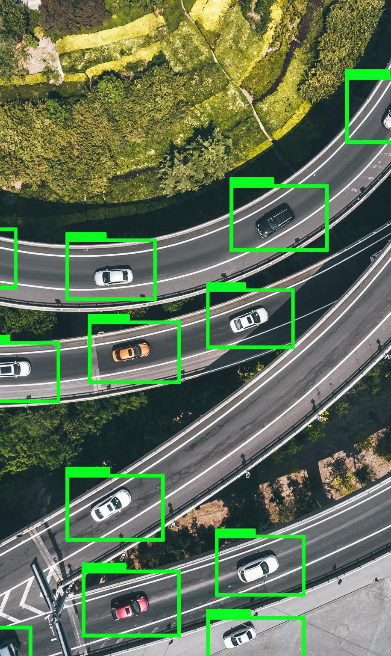
Border Monitoring Problem, Use Cases, and Business Rationale
AI-Driven Border Monitoring
The system uses image classification to monitor crowding, pedestrian flow, and weather conditions at key border points.
Operational Use Cases
Detects heavy crowds, pedestrian movements, and adverse weather affecting traveler experience and traffic flow.
Business Rationale and Impact
Addresses congestion and safety at one of the world’s busiest land crossings, improving situational awareness and reducing manual monitoring.
Prototype and Solutions
Prototype integrates real-time image capture and machine learning to support travel planning and operational decision-making.
Notes:
--- This slide references information from the following file: https://microncorp-my.sharepoint.com/personal/ypoha_micron_com/Documents/Microsoft%20Copilot%20Chat%20Files/python_jalanow_api_collector.py,https://microncorp-my.sharepoint.com/personal/ypoha_micron_com/Documents/Microsoft%20Copilot%20Chat%20Files/jalannow_classifier.py,https://www.enterprisesg.gov.sg/resources/media-centre/news/2024/june/bridging-borders-100-years-on,https://data.gov.sg/datasets/d_6cdb6b405b25aaaacbaf7689bcc6fae0/view This presentation begins by framing the project as an AI-driven border monitoring and travel-advisory system focused on two high-interest Singapore–Johor camera views: Woodlands Causeway toward Johor and Woodlands Checkpoint. The system addresses three operational questions using image classification: first, whether there is heavy crowding inside the custom or checkpoint space before passengers board or after they alight from public transport; second, whether pedestrians are walking on the Causeway toward or back from Johor Bahru, a strong visual sign of severe congestion or route substitution; and third, whether weather conditions such as rain, haze, wet roads, or nighttime conditions are likely to worsen traveler experience and traffic flow. The business rationale is compelling because the Causeway is widely cited as one of the world’s busiest land crossings, with roughly 350,000 daily travelers on average and more than 400,000 on peak days, making delays, crowd surges, and safety concerns highly visible problems for commuters and operators. The uploaded project files already show a practical foundation for this idea: a Python collector script acquires real-time camera images from Singapore’s traffic image API, while a classifier script is structured to predict crowd density, crowd activity, and weather from those images. This makes the proposed solution much more than a concept; it is a prototype that can demonstrate end-to-end data capture, machine learning, and decision support. From a business perspective, the project can be positioned as a smart monitoring tool that reduces manual observation, improves situational awareness, and supports traveler communication or internal operational response. Example outcomes include alerting users to avoid peak periods, warning them when walking on the Causeway under rain is likely, or identifying recurring congestion windows by analyzing historical image patterns. For a course or capstone evaluation, this opening slide should clearly connect the AI outputs to measurable value: lower monitoring effort, more consistent interpretation of crowded scenes, and the potential for improved travel planning and communication. That positioning also strengthens the later discussion of decision automation, business resource optimization, knowledge discovery, and cognitive design.

Slide 4
System Design and Technical Architecture
Notes:
--- This slide references information from the following file: https://microncorp-my.sharepoint.com/personal/ypoha_micron_com/Documents/Microsoft%20Copilot%20Chat%20Files/python_jalanow_api_collector.py,https://microncorp-my.sharepoint.com/personal/ypoha_micron_com/Documents/Microsoft%20Copilot%20Chat%20Files/annotation_tool.py,https://microncorp-my.sharepoint.com/personal/ypoha_micron_com/Documents/Microsoft%20Copilot%20Chat%20Files/quick%20image%20validation.py,https://microncorp-my.sharepoint.com/personal/ypoha_micron_com/Documents/Microsoft%20Copilot%20Chat%20Files/jalannow_classifier.py,https://data.gov.sg/datasets/d_6cdb6b405b25aaaacbaf7689bcc6fae0/view Data Pipeline, Labeling Workflow, and Multi-Output Model Design

Slide 5
Data Pipeline, Labeling Workflow, and Multi-Output Model Design
Data Capture and Ingestion
Automated image collection uses API calls, duplicate checks, and timestamp logging for reliable data ingestion.
Labeling with Human-in-Loop
A graphical annotation tool enables assigning crowd and weather labels, supporting supervised learning and relabeling.
Data Validation Process
Validation scripts check for missing files, label accuracy, and class balance to maintain clean training data.
Multi-Output Model Training
Model uses MobileNetV2 backbone (Convolutional Neural Network) with transfer learning to predict crowd density, activity, and weather simultaneously.
Prediction and Advisory Reporting
The system generates real-time risk scores and detailed reports, enabling decision-support beyond classification.
Notes:
--- This slide references information from the following file: https://microncorp-my.sharepoint.com/personal/ypoha_micron_com/Documents/Microsoft%20Copilot%20Chat%20Files/python_jalanow_api_collector.py,https://microncorp-my.sharepoint.com/personal/ypoha_micron_com/Documents/Microsoft%20Copilot%20Chat%20Files/annotation_tool.py,https://microncorp-my.sharepoint.com/personal/ypoha_micron_com/Documents/Microsoft%20Copilot%20Chat%20Files/quick%20image%20validation.py,https://microncorp-my.sharepoint.com/personal/ypoha_micron_com/Documents/Microsoft%20Copilot%20Chat%20Files/jalannow_classifier.py,https://data.gov.sg/datasets/d_6cdb6b405b25aaaacbaf7689bcc6fae0/view The technical design of the project can be explained as a five-stage pipeline that moves from live image collection to advisory generation. The first stage is data capture. The uploaded collector script shows a Python process that calls the official Singapore traffic image API, retrieves images for camera 2701 and 2702, saves both original and Keras-ready resized versions, skips duplicates using hash checks, and logs timestamps for traceability. This is important because it demonstrates a repeatable and auditable ingestion process rather than ad hoc screenshot collection. The second stage is data labeling. The uploaded annotation tool provides a Tkinter-based graphical interface that lets the user assign one crowd level, one crowd activity type, and multiple weather tags to each image, then save those assignments into a structured labels.json file. That human-in-the-loop annotation step is a strong system-design feature because it supports supervised learning and allows relabeling and note taking. The third stage is data validation. A dedicated validation script checks for missing files, invalid labels, empty weather tags, and category distribution, helping ensure the training data remains clean and class definitions are consistent. The fourth stage is model training. The classifier script uses TensorFlow and Keras with a MobileNetV2 backbone configured as a multi-output model. It predicts crowd density as a five-class softmax problem, crowd activity as a four-class softmax problem, and weather as a six-label sigmoid problem. The architecture includes transfer learning, shared dense layers, and later fine-tuning, which is an appropriate modern deep learning design for a moderately sized image dataset. The fifth stage is prediction and reporting. The same script fetches the latest image, runs inference, decodes class probabilities, computes a travel-risk score, and generates a text or JSON report with crowd status, activity type, weather detections, and advisory text. That final stage is where the system becomes more than a classifier: it becomes a decision-support prototype. In a presentation, this architecture slide should emphasize smart functions such as real-time ingestion, structured annotation, validation, transfer learning, multi-task prediction, and explainable output generation. These elements collectively support the project’s claims about system implementation quality, technological advancement, and readiness for demonstration.

Slide 6
How the Project Demonstrates Intelligent System Capabilities
Notes:
--- This slide references information from the following file: https://microncorp-my.sharepoint.com/personal/ypoha_micron_com/Documents/Microsoft%20Copilot%20Chat%20Files/jalannow_classifier.py,https://microncorp-my.sharepoint.com/personal/ypoha_micron_com/Documents/Microsoft%20Copilot%20Chat%20Files/annotation_tool.py Decision Automation, Optimization, Data Mining, and Cognitive Features

Slide 7

Decision Automation, Optimization, Data Mining, and Cognitive Features
Decision Automation
Combines machine learning predictions with business rules for automated risk assessment and actionable advice.
Resource Optimization
Uses predictions to prioritize operational resources and manage congestion effectively during high-risk periods.
Data Mining and Knowledge Discovery
Transforms raw data into structured labels to uncover patterns for improving recommendations and diagnostics.
Cognitive Features
Incorporates human-centered annotation and natural language summaries for better user understanding and interaction.
Notes:
--- This slide references information from the following file: https://microncorp-my.sharepoint.com/personal/ypoha_micron_com/Documents/Microsoft%20Copilot%20Chat%20Files/jalannow_classifier.py,https://microncorp-my.sharepoint.com/personal/ypoha_micron_com/Documents/Microsoft%20Copilot%20Chat%20Files/annotation_tool.py A major strength of this project is that it can be explicitly mapped to the intelligent-system aspects requested in the assignment. First, decision automation is demonstrated by combining machine learning outputs with business rules. The classifier predicts crowd level, movement type, and weather, after which the advisory logic converts those predictions into risk categories and human-readable actions. For example, if the model detects a high or congested crowd level together with pedestrians walking on the Causeway and rainy conditions, the rules can escalate the travel-risk score and recommend postponement or extra caution. That is a clear example of business rules layered on top of perception models. Second, business resource optimization can be framed as informed search or operational prioritization. The system helps identify when and where congestion is likely, enabling smarter allocation of attention, alerts, transport communications, or even support personnel during high-risk periods. Historical prediction logs could also be used to discover the least congested crossing windows for different traveler segments. Third, the system demonstrates knowledge discovery and data mining because raw images are transformed into structured labels and prediction histories that can be mined for patterns. Examples include finding hourly congestion trends, weather-linked delays, or directional asymmetry between travel toward JB and travel back to Singapore. This is especially relevant for recommendation and diagnosis tasks, such as recommending the best crossing time or diagnosing whether weather or crowd activity is the dominant cause of slowdown. Fourth, the project already contains cognitive elements through its annotation interface and advisory generation. The annotation tool is a human-centered interaction component, while the prediction engine turns machine output into natural-language summaries that users can understand. The system could be extended with a dashboard, chatbot, or rule repository that functions like a lightweight knowledge base. Finally, the project can be characterized overall as a hybrid AI system that combines computer vision, rule-based reasoning, and analytics. This positioning is powerful in a report because it shows the work is not limited to image classification accuracy alone; it also demonstrates applied business reasoning, intelligent interpretation, and support for human decision making. That broader framing will make the presentation more aligned with the requested assessment language and help justify stronger scores for smart functions and system sophistication.

Slide 8
Evaluation Framework and Evidence
Notes:
--- This slide references information from the following file: https://www.enterprisesg.gov.sg/resources/media-centre/news/2024/june/bridging-borders-100-years-on,https://outlook.office365.com/owa/?ItemID=AAMkAGJjMjI0NjlhLWJkNGItNGNlMy05ZjE1LWZiMmY1NTQzMmRhNQBGAAAAAACmpHQHoCvMQJy%2fm%2fQqYMnLBwBZaJ54S76BQKebZvSQEZ8iAAAAAAEMAABZaJ54S76BQKebZvSQEZ8iAAFTKj9ZAAA%3d&exvsurl=1&viewmodel=ReadMessageItem,https://microncorp.sharepoint.com/sites/PLMMD/_layouts/15/Doc.aspx?sourcedoc=%7B98BAAAC0-17B7-4658-9474-6D210B138526%7D&file=SIG%20BOM%20Project%20Overview.pptx&action=edit&mobileredirect=true&DefaultItemOpen=1,https://microncorp.sharepoint.com/sites/NextGenOQRM/_layouts/15/Doc.aspx?sourcedoc=%7BAEADB71F-4603-4ED2-B2FC-270C9E079F38%7D&file=Next%20Gen%20OQRM%20OSIR%20-%20Jan%202026.pptx&action=edit&mobileredirect=true&DefaultItemOpen=1,https://microncorp-my.sharepoint.com/personal/ypoha_micron_com/Documents/Microsoft%20Copilot%20Chat%20Files/jalannow_classifier.py,https://microncorp-my.sharepoint.com/personal/ypoha_micron_com/Documents/Microsoft%20Copilot%20Chat%20Files/python_jalanow_api_collector.py,https://microncorp-my.sharepoint.com/personal/ypoha_micron_com/Documents/Microsoft%20Copilot%20Chat%20Files/annotation_tool.py How to Evaluate Business Value, Design, Implementation, and Contribution, Evaluation Checklist and Evidence Matrix

Slide 9

How to Evaluate Business Value, Design, Implementation, and Contribution
Business Value Assessment
Demonstrate business value through clear problem statements and user needs backed by market research. Connect goals to traveler demand and improved monitoring.
System Design Overview
Show architecture diagrams, data flow, model design, and technology choices emphasizing smart systems with AI and advisory logic.
Implementation Evidence
Provide software pipeline demos, screenshots, logs, and quantitative metrics including accuracy, precision, recall, and inference time.
Project Contribution & Value Adds
Clarify team roles, peer review, and additional features like dashboards, alerts, or chatbots to demonstrate project maturity and completeness.
Notes:
--- This slide references information from the following file: https://www.enterprisesg.gov.sg/resources/media-centre/news/2024/june/bridging-borders-100-years-on,https://outlook.office365.com/owa/?ItemID=AAMkAGJjMjI0NjlhLWJkNGItNGNlMy05ZjE1LWZiMmY1NTQzMmRhNQBGAAAAAACmpHQHoCvMQJy%2fm%2fQqYMnLBwBZaJ54S76BQKebZvSQEZ8iAAAAAAEMAABZaJ54S76BQKebZvSQEZ8iAAFTKj9ZAAA%3d&exvsurl=1&viewmodel=ReadMessageItem,https://microncorp.sharepoint.com/sites/PLMMD/_layouts/15/Doc.aspx?sourcedoc=%7B98BAAAC0-17B7-4658-9474-6D210B138526%7D&file=SIG%20BOM%20Project%20Overview.pptx&action=edit&mobileredirect=true&DefaultItemOpen=1,https://microncorp.sharepoint.com/sites/NextGenOQRM/_layouts/15/Doc.aspx?sourcedoc=%7BAEADB71F-4603-4ED2-B2FC-270C9E079F38%7D&file=Next%20Gen%20OQRM%20OSIR%20-%20Jan%202026.pptx&action=edit&mobileredirect=true&DefaultItemOpen=1,https://microncorp-my.sharepoint.com/personal/ypoha_micron_com/Documents/Microsoft%20Copilot%20Chat%20Files/jalannow_classifier.py,https://microncorp-my.sharepoint.com/personal/ypoha_micron_com/Documents/Microsoft%20Copilot%20Chat%20Files/python_jalanow_api_collector.py,https://microncorp-my.sharepoint.com/personal/ypoha_micron_com/Documents/Microsoft%20Copilot%20Chat%20Files/annotation_tool.py For evaluation, the deliverable should be organized so that each assessment area is backed by concrete evidence rather than general claims. The first category is business value, which should be demonstrated through a problem statement, user need, and lightweight market or context research. A strong report would explain that the Woodlands–Johor corridor experiences intense demand, often exceeding 350,000 daily travelers on average and higher during peak periods, creating delays, uncertainty, and weather exposure for commuters. The business value argument should connect the project to reduced manual monitoring, faster traveler awareness, and more consistent interpretation of congestion conditions. The second category is system design. Here, the presentation and report should show a clear architecture diagram, camera data flow, label schema, model design, reasoning rules, and technology choices such as using MobileNetV2 transfer learning with multi-output heads. The system should be described as smart because it combines computer vision with advisory logic and could be extended into dashboards or conversational interfaces. The third category is system implementation, where the team should run the actual software pipeline or show credible screenshots and logs. Demonstrating camera ingestion, data labeling, validation, model training outputs, and prediction reports will be important. Quantitative metrics should include crowd classification accuracy, weather precision and recall, and inference time, while qualitative implementation evidence should include a user guide and screenshots of the annotation UI or generated reports. The fourth category is presentation video. The best structure is a short narrative arc: introduce the border problem, show one latest camera image, run the model, display crowd and weather outputs, then explain the travel advisory generated. The fifth category is project contribution, where peer review, team size, and role allocation should be transparent. For example, one member might handle data collection, one annotation and QA, one model training and tuning, and one report and presentation production. The sixth category is value adds. Strong examples include a dashboard for historical trend analysis, confidence visualization, automated alerting, or a chatbot that answers questions such as whether it is a good time to cross. Presenting evaluation this way shows maturity, completeness, and alignment with how many project overview templates assess initiative, implementation, and measurable outcomes.

Slide 10
Demonstration Strategy and Future Roadmap
Notes:
--- This slide references information from the following file: https://microncorp-my.sharepoint.com/personal/ypoha_micron_com/Documents/Microsoft%20Copilot%20Chat%20Files/python_jalanow_api_collector.py,https://microncorp-my.sharepoint.com/personal/ypoha_micron_com/Documents/Microsoft%20Copilot%20Chat%20Files/annotation_tool.py,https://microncorp-my.sharepoint.com/personal/ypoha_micron_com/Documents/Microsoft%20Copilot%20Chat%20Files/quick%20image%20validation.py,https://microncorp-my.sharepoint.com/personal/ypoha_micron_com/Documents/Microsoft%20Copilot%20Chat%20Files/jalannow_classifier.py,https://data.gov.sg/datasets/d_6cdb6b405b25aaaacbaf7689bcc6fae0/view Recommended Demo Flow, KPIs, and Value-Add Roadmap

Slide 11
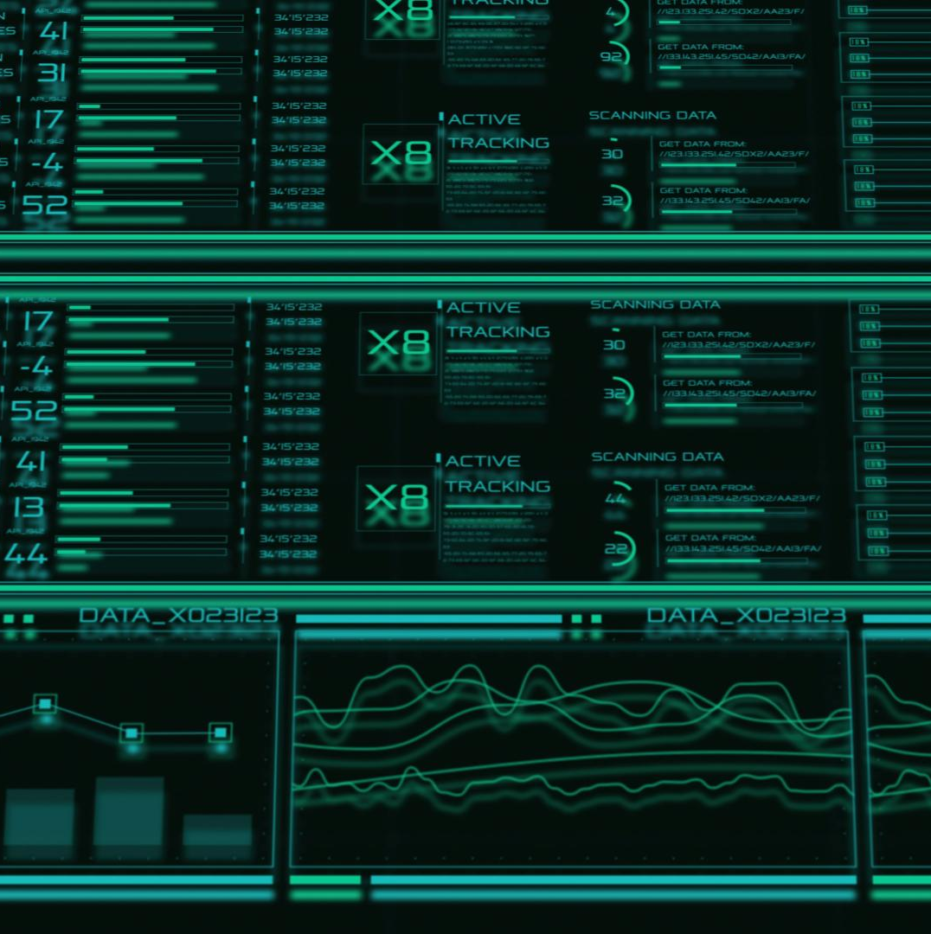
Recommended Demo Flow, KPIs, and Value-Add Roadmap
Effective Demo Structure
Start with live camera views showing crowding and movement issues, then explain system objectives clearly.
Data Collection and Annotation
Showcase automated image collection and structured annotation to ensure reliable model training.
Prediction Outputs and Interpretation
Present real-time predictions with crowd levels, activities, weather labels, and risk advisories linked to real conditions.
KPIs and Future Roadmap
Track technical and business KPIs while outlining roadmap with dashboards, alerts, chatbots, and advanced AI features.
Notes:
--- This slide references information from the following file: https://microncorp-my.sharepoint.com/personal/ypoha_micron_com/Documents/Microsoft%20Copilot%20Chat%20Files/python_jalanow_api_collector.py,https://microncorp-my.sharepoint.com/personal/ypoha_micron_com/Documents/Microsoft%20Copilot%20Chat%20Files/annotation_tool.py,https://microncorp-my.sharepoint.com/personal/ypoha_micron_com/Documents/Microsoft%20Copilot%20Chat%20Files/quick%20image%20validation.py,https://microncorp-my.sharepoint.com/personal/ypoha_micron_com/Documents/Microsoft%20Copilot%20Chat%20Files/jalannow_classifier.py,https://data.gov.sg/datasets/d_6cdb6b405b25aaaacbaf7689bcc6fae0/view The final slide should focus on how to present the project convincingly in a live demo and how to position future enhancements. A strong demonstration can be completed in about five minutes. Start by showing the problem visually: two live or recently captured border camera views, one focused on the Causeway and one on the checkpoint. Briefly explain that the system is designed to judge crowding inside the checkpoint, detect when travelers are forced to walk on the Causeway, and evaluate weather factors that make such movement more difficult. Then show the data collection process, using the collector script or screenshots to prove that the system obtains near-real-time images automatically from the official API. Next, present the annotation and validation workflow to establish that the model is trained on structured crowd, activity, and weather labels rather than random image folders. After that, run or simulate a prediction on a current image and display the outputs: a crowd level such as moderate or congested, an activity class such as causeway_walking_to_jb, one or more weather labels such as rainy or wet_road, and the generated travel-risk advisory. The most persuasive part of the demo is not the raw classification itself but the operational interpretation. For instance, if the system identifies heavy pedestrian movement on the Causeway during rain, the presenter should explicitly connect this to traveler discomfort, increased danger, and likely traffic disruption. In terms of KPIs, the project should track model accuracy for the crowd and activity heads, precision and recall for weather detection, inference latency, and camera capture freshness. Business-facing KPIs can include reduction in manual monitoring effort, time-to-awareness, and user-perceived usefulness. To strengthen the value-add story, the roadmap should include a dashboard that aggregates prediction history over time, a chatbot or natural-language interface for traveler questions, and threshold-based alerts for severe congestion. More advanced extensions could involve adding more cameras, moving from image classification to object detection or segmentation, or introducing temporal forecasting to predict congestion in the next hour. Ending the presentation with this roadmap helps frame the project as a scalable intelligent monitoring platform rather than a single-purpose classifier, which is ideal for scoring well on business value, system design, implementation quality, and innovation.

