Slide 1
FuzzCert
fuzzcert --bench verapak --function falsify --input experiments/VERAPAK/corpus --max_len 60000:
main.py
--bench verapak
adapters.py
VERAPAK
Benchmark2
Benchmark level
fuzzer.py
bench_adapter.py
abstract base class
falsify()
main()
function()
function_1()
function_2()
function_3()
verapak_adapter.py
Function level
--function falsify
falsify_adapter.py
concrete implementation

Slide 2
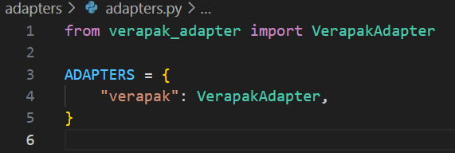
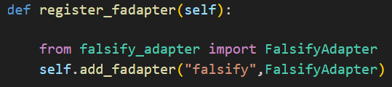
Add a benchmark
Add a function
update benchmark-level adapter
(adapters/adapters.py)
update function-level adapter
(adapters/verapak_adapter.py)
2. implement function_adapter class
follow the template falsify_adapter.py
2. implement benchmark_adapter class
follow the template verapak_adapter.py

