Slide 1
The 3rd UCL OpenFOAM Workshop
24 – 26 February 2021
Tutorial Session
Simulation of multiphase gas-liquid bubbly and boiling flows with reactingEulerFOAM
Marco Colombo School of Chemical and Process Engineering University of Leeds, Leeds LS2 9JT, United Kingdom M.Colombo@leeds.ac.uk

Slide 2
reactingEulerFOAM
Eulerian multifluid solver of OpenFOAM
For each phase, a set of volume fraction, momentum and energy transport equations are solved, and a single pressure equation that is shared between all the phases
Many additional features, such as multiple species and frameworks to model mass and energy transfer due to chemical reactions or boiling at the wall.
Two solvers:
- reactingMultiphaseEulerFoam, for a n number of phases
- reactingTwoPhaseEulerFoam, a simplified solver when only two phases are present (e.g., it is sufficient to solve only a single volume fraction transport equation).
The two solvers have been joined in the latest OpenFOAM 8. Here OpenFOAM 7 used as the reference solver

Slide 3
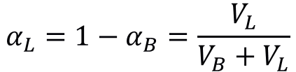
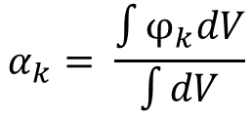

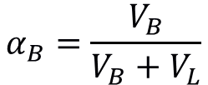
Multifluid Model
Multifluid Eulerian-Eulerian model
Phase marker φ_{k}
1 = Gas – 0 = Liquid
Gas bubbles dispersed in liquid
U_{B}
U_{L}
Averaging procedure
α_{k} = phase-fraction of phase k
α_{B}
α_{L}
For the two-phase bubbly flow
$$α_{k}= \frac{\int{φ_{k}dV}}{\int{dV}}$$
$$α_{B}=\frac{V_{B}}{V_{B}+V_{L}}$$
$$α_{L}=1−α_{B}=\frac{V_{L}}{V_{B}+V_{L}}$$
$$α_{B}+α_{L}=1$$
Different types of averaging possible (and different phase fractions defined): temporal, ensemble, etc.

Slide 4
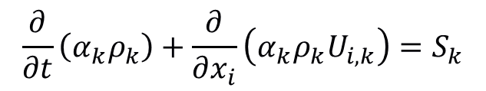

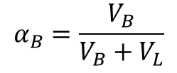
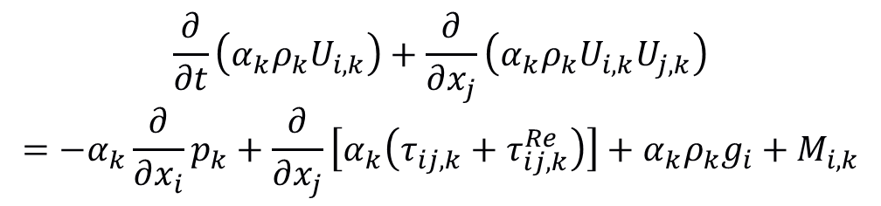
Multifluid Model
Multifluid Eulerian-Eulerian model
U_{B}
U_{L}
Averaged conservation equations for each phase
$$\frac{∂}{∂t}\left(α_{k}ρ_{k}\right)+\frac{∂}{∂x_{i}}\left(α_{k}ρ_{k}U_{i,k}\right)=S_{k}$$
α_{B}
α_{L}
$$α_{B}=\frac{V_{B}}{V_{B}+V_{L}}$$
$$\frac{∂}{∂t}\left(α_{k}ρ_{k}U_{i,k}\right)+\frac{∂}{∂x_{j}}\left(α_{k}ρ_{k}U_{i,k}U_{j,k}\right)=−α_{k}\frac{∂}{∂x_{i}}p_{k}+\frac{∂}{∂x_{j}}\left[α_{k}\left(τ_{ij,k}+τ_{ij,k}^{Re}\right)\right]+α_{k}ρ_{k}g_{i}+M_{i,k}$$
$$α_{B}+α_{L}=1$$
Interpenetrating continua
Each phase and its properties (velocity, density, etc.) defined in each cell
Equations not coupled, need additional terms to see presence of the other phase. Exchanges of mass, momentum and energy at the interface depends on the interface shape and density, so the flow regime
Robust and generally applicable
Interfacial structure lost in averaging, coupling with closure models

Slide 5
Interfacial Interaction
Multifluid Eulerian-Eulerian model
Mass and momentum balance equations
Adiabatic, no mass and energy transfer
$$\frac{∂}{∂t}\left(α_{k}ρ_{k}U_{i,k}\right)+\frac{∂}{∂x_{j}}\left(α_{k}ρ_{k}U_{i,k}U_{j,k}\right)−α_{k}\frac{∂}{∂x_{i}}p_{k}+\frac{∂}{∂x_{j}}\left[α_{k}\left(τ_{ij,k}+τ_{ij,k}^{Re}\right)\right]+α_{k}ρ_{k}g_{i}+M_{i,k}$$
$$M_{k}=F_{D}+F_{L}+F_{W}+F_{VM}+F_{TD}$$
Momentum source contains a sum of forces that model the exchange of momentum between the phases

Slide 6
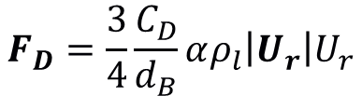
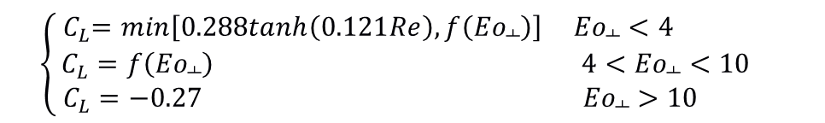


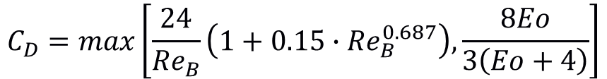
Interfacial Forces
Drag Force F_{D}
Resistance of the fluid to the movement of bubbles
Drag coefficient often from correlation of experimental measurements
Eötvös number
U_{r} = U_{g} - U_{l}
$$Eo= \frac{∆ρgd_{B}}{σ}$$
U_{g}
$$F_{D}=\frac{3}{4}\frac{C_{D}}{d_{B}}αρ_{l}\left|U_{r}\right|U_{r}$$
$$C_{D}=max\left[\frac{24}{{Re}_{B}}\left(1+0.15∙{Re}_{B}^{0.687}\right),\frac{8Eo}{3\left(Eo+4\right)}\right]$$
F_{D}
F_{L}
Lift Force F_{L}
Tomiyama et al. (1998)
Force perpendicular to bubble motion in a shear liquid flow
Tomiyama et al. (2002) correlation for C_{L}
$$\left\{\begin{matrix}{ C}_{L}=min\left[0.288tanh\left(0.121Re\right), f\left({Eo}_{┴}\right)\right] {Eo}_{┴}<4 \\ C_{L}=f\left({Eo}_{┴}\right) 4<{Eo}_{┴}<10 \\ C_{L}=−0.27 { Eo}_{┴}>10 \end{matrix} \right.$$
$$F_{L}=C_{L}αρ_{l}U_{r}×\left(∇∙U_{l}\right)$$
U_{l}

Slide 7
Bubbly Pipe Flow
Bubbly flow in a vertical pipe
Bubbles injected from the bottom in a liquid flow
Predict the void distribution and the velocity profiles along the pipe
Pipe flow experiment of Liu (1998)*
Air bubbles in water at ambient conditions
Pipe diameter D = 0.0572 m
Measurements at L / D = 60
j_{w} = 1.0 m/s; j_{a} = 0.14 m/s; α = 0.106 (L21B)
d_{B} = 3.03 mm
Bubbles have monodispersed distribution, with values in a small range around the mean. Can be characterized by a single constant diameter
*Liu, T.J., 1998. The role of bubble size on liquid phase turbulence structure in two phase bubbly flow. ICMF 1998, Lyon, France
α_{B}, U_{B}, U_{L}

Slide 8
Geometry & Mesh
blockMeshDict file
Boundaries
Inlet and outlet as patches
Wall boundary
Symmetry boundary on lateral surfaces
A quarter section of the pipe subdivided in three blocks
Equally spaced mesh elements in each block
blocks
(
hex (0 1 2 3 7 8 9 10) (10 10 750) simpleGrading (1 1 1)
hex (1 4 5 2 8 11 12 9) (15 10 750) simpleGrading (1 1 1)
hex (2 5 6 3 9 12 13 10) (15 10 750) simpleGrading (1 1 1)
);
inlet
{
type patch;
faces
(
(0 3 2 1)
(1 2 5 4)
(2 3 6 5)
);
}
outlet
{
type patch;
faces
(
(7 8 9 10)
(8 11 12 9)
(9 12 13 10)
);
}
pipeWall
{
type wall;
faces
(
(4 5 12 11)
(5 6 13 12)
);
}
symPlane
{
type symmetry;
faces
(
(0 1 8 7)
(1 4 11 8)
(3 0 7 10)
(6 3 10 13)
);
}

Slide 9
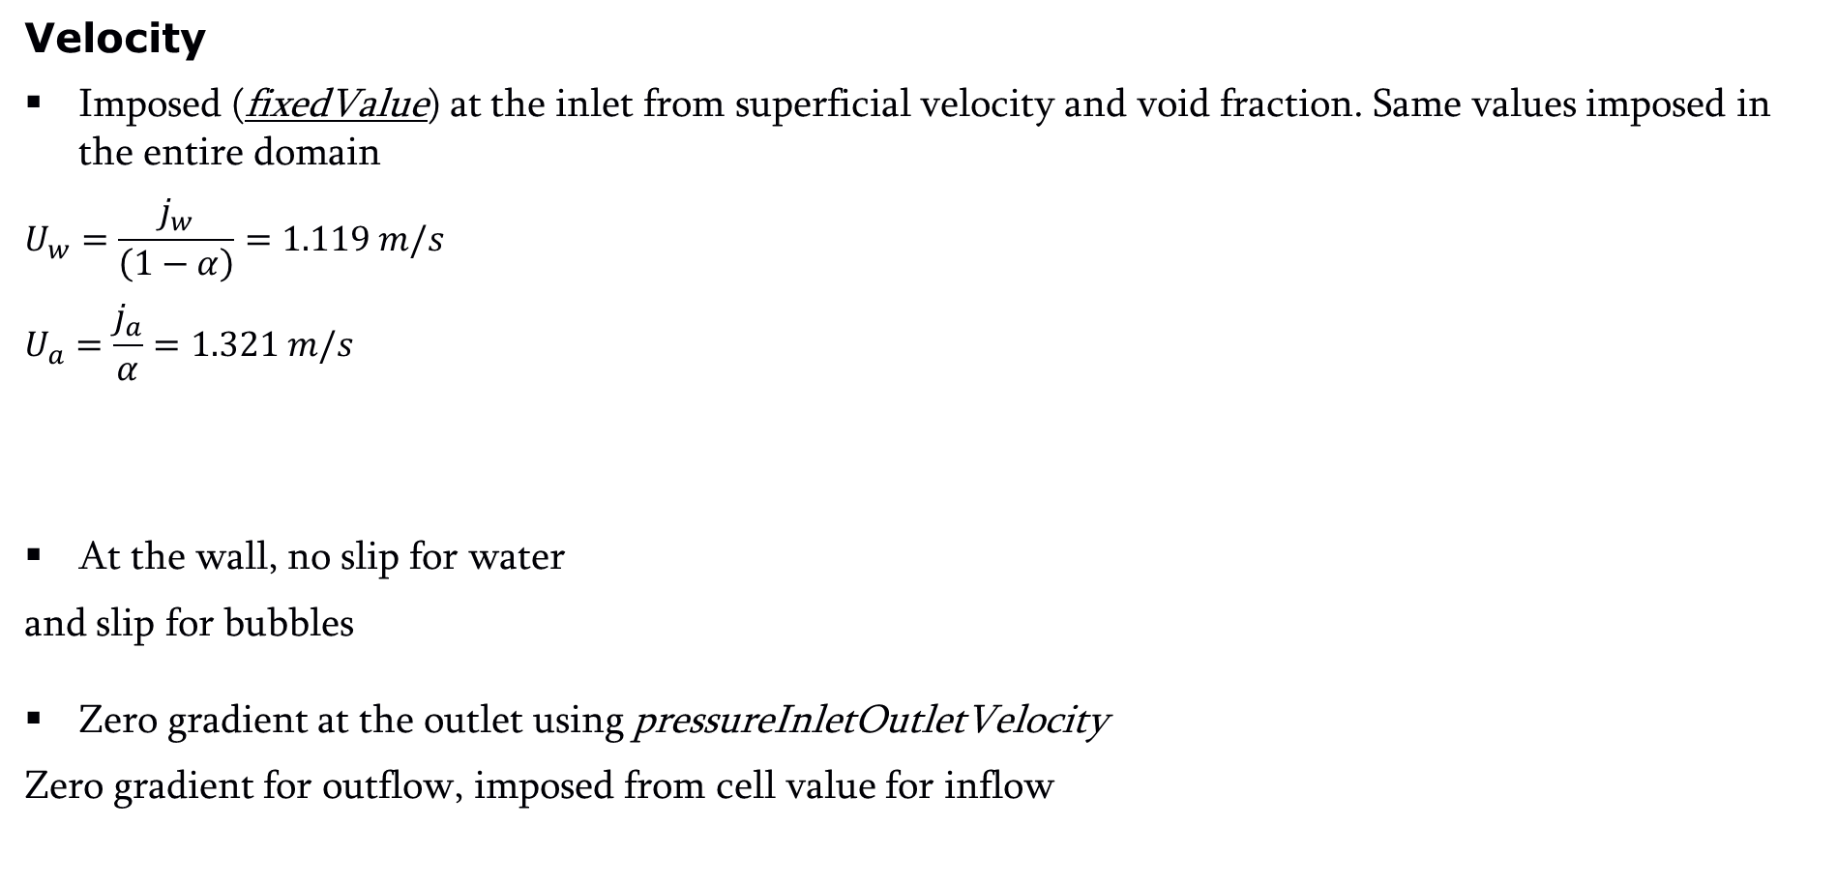
Boundary and Initial Conditions
Velocity
Imposed (fixedValue) at the inlet from superficial velocity and void fraction. Same values imposed in the entire domain
$$U_{w}=\frac{j_{w}}{\left(1−α\right)}=1.119 m/s$$
$$U_{a}=\frac{j_{a}}{α}=1.321 m/s$$
At the wall, no slip for water
and slip for bubbles
Zero gradient at the outlet using pressureInletOutletVelocity
Zero gradient for outflow, imposed from cell value for inflow
internalField uniform (0 0 1.119);
boundaryField
{
inlet
{
type fixedValue;
value $internalField;
}
internalField uniform (0 0 1.321);
boundaryField
{
inlet
{
type fixedValue;
value uniform (0 0 1.321);
}
pipeWall
{
type noSplip;
}
pipeWall
{
type slip;
}
outlet
{
type pressureInletOutletVelocity;
phi phi.air;
value $internalField;
}

Slide 10
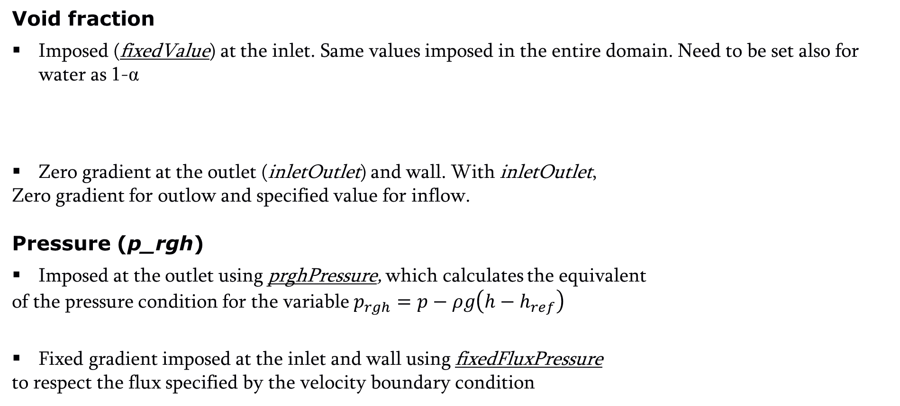
Boundary and Initial Conditions
Void fraction
Imposed (fixedValue) at the inlet. Same values imposed in the entire domain. Need to be set also for water as 1-α
Zero gradient at the outlet (inletOutlet) and wall. With inletOutlet,
Zero gradient for outlow and specified value for inflow.
Pressure (p_rgh)
Imposed at the outlet using prghPressure, which calculates the equivalent
of the pressure condition for the variable $p_{rgh}=p−ρg\left(h−h_{ref}\right)$
Fixed gradient imposed at the inlet and wall using fixedFluxPressure
to respect the flux specified by the velocity boundary condition
inlet
{
type fixedValue;
value uniform 0.106;
}
inlet
{
type fixedValue;
value uniform 0.894;
}
outlet
{
type inletOutlet;
phi phi.air;
inletValue $internalField;
value $internalField;
}
outlet
{
type prghPressure;
p $internalField;
value $internalField;
}
inlet
{
type fixedFluxPressure;
value $internalField;
}

Slide 11
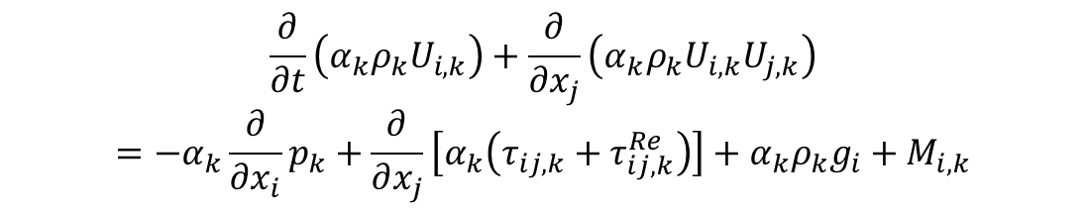


Turbulence
Turbulence Model
Turbulence models set through the constant/turbulenceProperties.* files, one for each phase
Standard k-ε RANS model used in the liquid phase
Laminar model for air, frequently used in bubbly flows due to very low density of the gas phase
simulationType RAS;
RAS
{
RASModel kEpsilon;
turbulence on;
printCoeffs on;
}
Eddy-viscosity assumption, balance equations for k and ε
$$τ_{ij,k}^{Re}=−ρ\overline{u_{i}^{′}u_{j}^{i}}=μ_{t}\left(\frac{∂U_{i}}{∂x_{j}}+\frac{∂U_{j}}{∂x_{i}}−\frac{2}{3}\frac{∂U_{k}}{∂x_{k}}δ_{ij}\right)−\frac{2}{3}ρkδ_{ij}$$
$$\frac{∂}{∂t}\left(α_{k}ρ_{k}U_{i,k}\right)+\frac{∂}{∂x_{j}}\left(α_{k}ρ_{k}U_{i,k}U_{j,k}\right)=−α_{k}\frac{∂}{∂x_{i}}p_{k}+\frac{∂}{∂x_{j}}\left[α_{k}\left(τ_{ij,k}+τ_{ij,k}^{Re}\right)\right]+α_{k}ρ_{k}g_{i}+M_{i,k}$$
$$\frac{∂}{∂t}\left(α_{k}ρ_{k}k_{k}\right)+\frac{∂}{∂x_{i}}\left(α_{k}ρ_{k}U_{i,k}k_{k}\right)=+\frac{∂}{∂x_{i}}\left[α_{k}\left(μ_{k}+\frac{μ_{t,k}}{σ_{k}}\right)\frac{∂k_{k}}{∂x_{i}}\right]+α_{k}\left(P_{k}−ρ_{k}ε_{k}\right)$$
$$\frac{∂}{∂t}\left(α_{k}ρ_{k}ε_{k}\right)+\frac{∂}{∂x_{i}}\left(α_{k}ρ_{k}U_{i,k}ε_{k}\right)=+\frac{∂}{∂x_{i}}\left[α_{k}\left(μ_{k}+\frac{μ_{t,k}}{σ_{ε}}\right)\frac{∂ε_{k}}{∂x_{i}}\right]+α_{k}\frac{ε_{k}}{k_{k}}\left({C_{ε,1}P}_{k}−C_{ε,2}ρ_{k}ε_{k}\right)$$
$$μ_{t,k}=C_{μ}ρ_{k}\frac{k_{k}^{2}}{ε_{k}}$$
simulationType laminar;

Slide 12

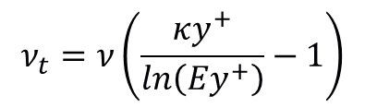


Wall Treatment
Wall function
Single-phase wall law imposed through the boundary condition on the turbulent viscosity in 0/nut.water
Wall condition on k (zero gradient) and ε (imposed value) in their respective files k.water and epsilon.water
Inlet and initial value of k and ε imposed (fixedValue) from single-phase estimations. Zero gradient (inletOutlet) at outlet
pipeWall
{
type nutkWallFunction;
value uniform 0.0;
}
$$ν_{t}=ν\left(\frac{κy^{+}}{ln\left(Ey^{+}\right)}−1\right)$$
pipeWall
{
type kqRWallFunction;
value uniform 0.0047;
}
pipeWall
{
type epsilonWallFunction;
value uniform 0.0051;
}
$$ε=\frac{C_{μ}^{3/4}}{κy}k^{3/2}$$
$$k={\frac{3}{2}\left(I∗U\right)}^{2}$$
$$ε=\frac{C_{μ}k^{3/2}}{l}$$

Slide 13
Thermophysical Properties
Specified in constant/thermophysicalProperties.* for each phase
Given the adiabatic conditions, we use constant properties for both water and air, with typical values for ambient conditions
Water
Air
thermoType
{
type heRhoThermo;
mixture pureMixture;
transport const;
thermo hConst;
equationOfState rhoConst;
specie specie;
energy sensibleInternalEnergy;
}
thermoType
{
type heRhoThermo;
mixture pureMixture;
transport const;
thermo hConst;
equationOfState rhoConst;
specie specie;
energy sensibleInternalEnergy;
}
equationOfState
{
rho 1000;
}
equationOfState
{
rho 1;
}
transport
{
mu 0.001;
}
transport
{
mu 1.84e-05;
}

Slide 14
Phase Properties
phaseProperties file
Interfacial interaction and the modelling of interfacial exchanges is setup in the constant/phaseProperties file.
In the solver, calculation of interfacial exchange terms needed by the conservation equations is done through the phaseSystem class, which also initializes and handles the phaseModel objects of each phase. Multiple phase systems are available, implemented as template classes, and each implements different capabilities (e.g. MomentumTransferPhaseSystem, PhaseTransferPhaseSystem)
At the beginning of the file, the type of phase system is selected. At construction, phase model object for all the phases listed will be also created.
typedef
PhaseTransferPhaseSystem
<
OneResistanceHeatTransferPhaseSystem
<
MomentumTransferPhaseSystem<phaseSystem>
>
>
basicMultiphaseSystem;
Defined in multiphaseSystems.C
type basicMultiphaseSystem;
phases (air water);

Slide 15
Phase Properties
Phase Models
A phase model for each phase is then defined. In this case with constant diameter.
OpenFOAM can simultaneously handle air dispersed in water, water dispersed in air, so a diameter is input also for water, although it is not used for this case. Different models can be specified for each situation, and blended together based on the value of the volume fraction.
air
{
type purePhaseModel;
diameterModel constant;
constantCoeffs
{
d 3.03e-3;
}
residualAlpha 1e-6;
}
water
{
type purePhaseModel;
diameterModel constant;
constantCoeffs
{
d 1e-4;
}
residualAlpha 1e-6;
}
blending
{ default
{
type linear;
minFullyContinuousAlpha.air 0.7;
minPartlyContinuousAlpha.air 0.3;
minFullyContinuousAlpha.water 0.7;
minPartlyContinuousAlpha.water 0.3;
}
}
(air in water) air dispersed in water
(water in air) water dispersed in air
(air and water) continuous air and water

Slide 16
Phase Properties
Drag Model
drag
(
(air in water)
{
type IshiiZuber;
swarmCorrection
{
type none;
}
}
(water in air)
{
type SchillerNaumann;
residualRe 1e-3;
swarmCorrection
{
type none;
}
}
(air and water)
{
type segregated;
m 0.5;
n 8;
swarmCorrection
{
type none;
}
}
);
Interfacial models are implemented between numerous classes in the interfacial models folder.
Every interfacial model is specified with a dictionary in the phaseProperties file. To model momentum transfer, we define drag, lift, wall lubrication and turbulent dispersion
Drag models are implemented in the dragModel class. In the dictionary, all three possibilities are specified, although only the air in water is active in this case:
When air bubbles are dispersed in liquid, the model of Ishii and Zuber for bubbles is used.
For water droplets dispersed in gas, the model of Schiller and Naumann is used.
In between, when air and water are both continuous, the model for segregated interfaces is used

Slide 17
Phase Properties
Lift Model
Wall Lubrication
Turbulent Dispersion
lift
(
(air in water)
{
type constantCoefficient;
Cl 0.05;
}
);
For lift, a constant coefficient is used, although other models such as Tomiyama et al. (1998) are available.
wallLubrication
(
(air in water)
{
type Hosokawa;
}
);
Wall lubrication models a force that, once bubble are close to a wall, prevent them to move closer.
Model of Hosokawa et al. (2002) is used. This is not available, and is implemented as a separate library as an example of how to implement new interfacial models
turbulentDispersion
(
(air in water)
{
type Burns;
sigma 1.0;
}
);
Turbulent dispersion model models the dispersion of bubbles from random turbulent motion. Model of Burns et al. (2005) is used.

Slide 18
controlDict and fvSolution
controlDict
fvSolution
application reactingMultiphaseEulerFoam;
deltaT 0.001;
reactingMultiphaseEulerFoam solver
Variable time step, adjusted to maintain a maximum Courant number of 0.5
Additional library myEulerianInterfacialModels that contains Hosokawa wall lubrication model
adjustTimeStep yes;
maxCo 0.5;
maxAlphaCo 0.5;
maxDeltaT 1;
libs ("libmyEulerianInterfacialModels.so");
PIMPLE
{
momentumPredictor no;
nOuterCorrectors 3;
nCorrectors 1;
nNonOrthogonalCorrectors 0;
pRefCell 0;
pRefValue 0;
faceMomentum yes;
Multiphase extension of the PIMPLE algorithm, with three PIMPLE iterations at each time step
faceMomentum option active, provides consistent treatment of forces at the cell-faces

Slide 19
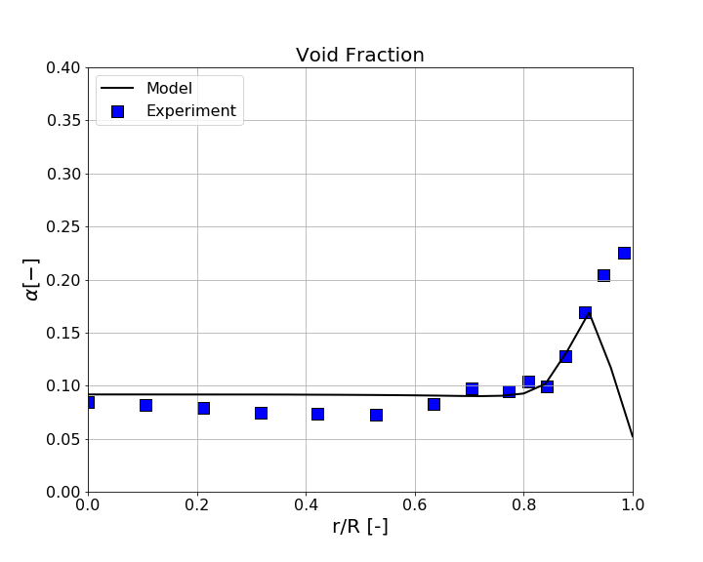
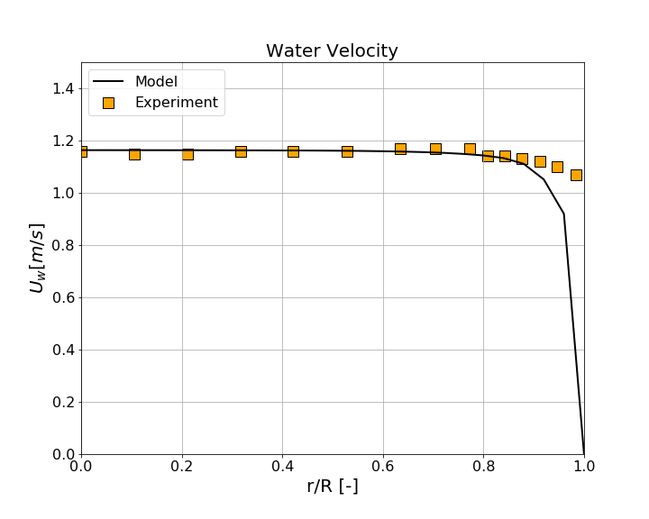
Results
Wall-peaked profile driven by lift and wall lubrication forces. Typical of bubbly flows where bubbles have an almost spherical shape
Flat velocity profiles driven by bubbles in the near wall region
Pipe Wall
Lift pushes spherical bubbles towards the wall
Near the wall, wall force prevents bubble to further reach
At 5 < d_{B} < 6 mm lift changes sign and large bubbles towards centre

Slide 20
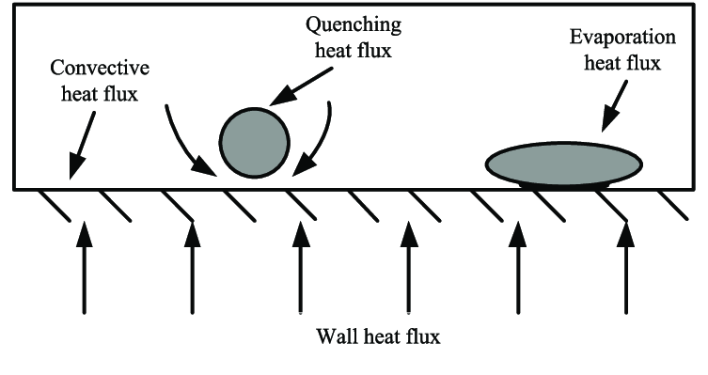



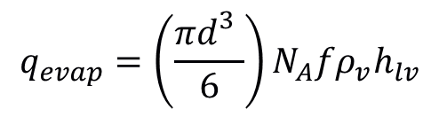
Boiling Modelling
Rensselaer Polytechnic Institute (RPI) heat flux partitioning approach
Heat flux from the wall partitioned between convective heat transfer, evaporation and quenching
Boundary condition in the multifluid model, solutions iterated until temperature that provide the imposed heat flux found
$q_{tot}=q_{conv}$+$q_{evap}$+$q_{quench}$
$$q_{conv}=h_{conv}\left(1−A_{b}\right)\left(T_{w}−T_{l}\right)$$
$$q_{quench}=h_{q}A_{b}\left(T_{w}−T_{l}\right)$$
$$q_{evap}=\left(\frac{πd_{}^{3}}{6}\right)N_{A}fρ_{v}h_{lv}$$

Slide 21

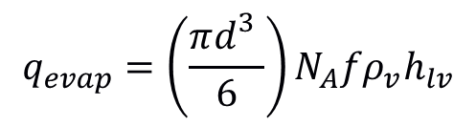

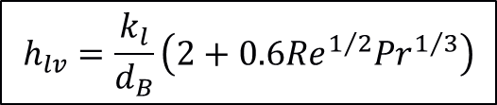

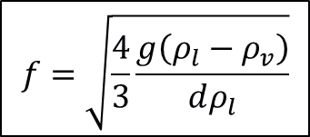
Evaporation heat flux
$$q_{evap}=\left(\frac{πd_{}^{3}}{6}\right)N_{A}fρ_{v}h_{lv}$$
From nucleation site density N_{A}, bubble departure diameter d and bubble departure frequency f
Heat flux due to evaporation from mass flow rate of vapour and enthalpy
Mass transfer in the first near-wall cell
Requires model N_{A}, d and f, empirical correlations most often used
$$d=d_{0}exp\left[{−\left(T_{sat}−T_{l}\right)}/{∆T_{0}}\right]$$
Tolubinsky and Kostanchuk (1970)
$$N_{A}=N_{0}{\left(T_{w}−T_{sat}\right)}^{1.805}$$
Lemmert and Chawla (1977)
$$f=\sqrt{\frac{4}{3}\frac{g\left(ρ_{l}−ρ_{v}\right)}{dρ_{l}}}$$
Cole (1960)
Closure for interfacial heat transfer
$$h_{lv}=\frac{k_{l}}{d_{B}}\left(2+0.6{Re}^{1/2}{Pr}^{1/3}\right)$$
$$q=h_{lv}\left(T_{v}−T_{l}\right)$$
Ranz and Marshall (1952)

Slide 22
Population balance
Most bubbly flows includes bubbles of different sizes
Size and shape determines the interfacial area density available to interfacial transfer processes
Bubble interaction
Multiple mechanisms can lead to changes in bubble size and number
Coalescence
Breakup
Population balance class model
Diameter range divided in discrete classes
Balance equation for each class with sources for coalescence and breakup
Tyagi et al., 2017. Chem Eng J 308

Slide 23
Boiling Flow
Boiling flow in a vertical pipe
Heat flux applied to the pipe wall where boiling occurs
Predict the void distribution and the wall temperature
DEBORA experiment (Garnier et al., 2001)*
Subcooled boiling of Freon R-12 at moderate pressures
Pipe diameter D = 0.0192 m
Heated length of 3.5 m
G = 1996 kg m⁻²s⁻¹; p = 2.62 MPa
T_{in} = 341.67 K; T_{sat} = 359.98 K q = 73.9 kW m⁻²
Bubbles experience significant change in size from departure from the heated wall, driven by coalescence in the flow. Population balance is therefore included
q_{w}
U_{L}, T_{L}
*Garnier, G. et al., 2001. Local measurements on flow boiling of refrigerant 12 in a vertical tube. Multiphase Science and Technology 13, 1-111.

Slide 24
Boundary and Initial Conditions
Temperature
Imposed (fixedValue) at the inlet and zero gradient at the outlet (inletOutlet).
At the wall, fixedMultiPhaseHeatFlux condition is used, that calculates the wall temperature that produces the imposed heat flux in a multiphase flow. On the other phase, copiedFixedValue ensures the temperatures are consistent.
Void fraction
Imposed (fixedValue) at the inlet with zero value, given that single-phase flow of liquid is injected at the inlet of the pipe.
wall
{
type fixedMultiPhaseHeatFlux;
relax 0.5;
q uniform 73890;
phase "liquid";
value uniform 341.67;
}
wall
{
type copiedFixedValue;
sourceFieldName T.liquid;
value uniform 341.67;
}

Slide 25
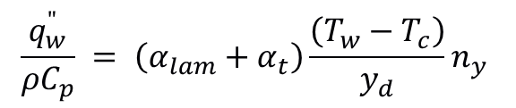
Wall Treatment
Wall boiling
Heat flux partitioning model is essentially a boundary condition that links the heat flux with the wall temperature.
It is used as the wall boundary condition for the turbulent thermal diffusivity, returning the value at the wall necessary to achieve the wall temperature prescribed by the boiling model given the imposed heat flux
It is selected in 0/alphat.liquid
$$\frac{q_{w}^{"}}{ρC_{p}} = \left(α_{lam}+α_{t}\right)\frac{\left(T_{w}−T_{c}\right)}{y_{d}}n_{y}$$
partitioningModel
{
type phaseFraction;
}
nucleationSiteModel
{
type LemmertChawla;
}
departureDiamModel
{
type TolubinskiKostanchuk;
}
departureFreqModel
{
type Cole;
}
value uniform 0.01;
}
wall
{
type compressible::alphatWallBoilingWallFunction;
otherPhase gas;
phaseType liquid;
Prt 0.85;
Cmu 0.09;
kappa 0.41;
E 9.8;
relax 0.01;
dmdt uniform 0;
Necessary sub-models (e.g. bubble departure diameter) are also selected in the same file

Slide 26
Thermophysical Properties
Specified in constant/thermophysicalProperties.* for each phase
Still constant properties, calculated as an average between inlet and saturation value. Additional thermal properties required.
Liquid
Gas
thermoType
{
type heRhoThermo;
mixture pureMixture;
transport const;
thermo eRefConst;
equationOfState rhoConst;
specie specie;
energy sensibleInternalEnergy;
}
thermoType
{
type heRhoThermo;
mixture pureMixture;
transport const;
thermo eRefConst;
equationOfState rhoConst;
specie specie;
energy sensibleInternalEnergy;
}
thermodynamics
{
Hf 0;
Cv 1284.4;
Tref 359.98;
Eref 292670;
}
thermodynamics
{
Hf 0;
Cv 1294.0;
Tref 359.98;
Eref 378590;
}

Slide 27
Phase Properties
phaseProperties file
Different phaseSystem that also handle thermal phase change and population balance modelling
Phases gas and liquid are set
Phase change is activated
A population balance model named bubbles is also set
typedef
ThermalPhaseChangePhaseSystem
<
PopulationBalancePhaseSystem
<
PhaseTransferPhaseSystem
<
TwoResistanceHeatTransferPhaseSystem
<
MomentumTransferPhaseSystem<multiphaseSystem>
>
>
>
>
thermalPhaseChangePopulationBalanceMultiphaseSystem;
type thermalPhaseChangePopulationBalanceMultiphaseSystem;
phases (gas liquid);
phaseChange on;
populationBalances (bubbles);
multiphaseSystems.C

Slide 28
Phase Properties
Saturation temperature. This can be modelled in different ways, such as function of the pressure. In this example a constant value is used
Heat transfer. Specifies a model for the heat transfer at the interface. The heat transfer coefficient correlation from Ranz and Marshall (1952) is selected
saturationModel
{
type constant;
pSat 2620000;
Tsat 359.98;
};
heatTransfer.liquid
(
(gas in liquid)
{
type RanzMarshall;
residualAlpha 1e-3;
}
);

Slide 29
Phase Properties
Population balance
Assigned to the phase in the phase model dictionary. Initial bubble distribution specified.
Sub-models for coalescence, breakup, etc. selected in the populationBalanceCoeffs dictionary
gas
{
type purePhaseModel;
diameterModel velocityGroup;
velocityGroupCoeffs
{
populationBalance bubbles;
formFactor 0.5235987756;
sizeGroups
(
f0 {d 1.0e-4; value 0 ;}
f1 {d 2.0e-4; value 0 ;}
f2 {d 3.0e-4; value 0 ;}
f3 {d 4.0e-4; value 0 ;}
f4 {d 5.0e-4; value 0 ;}
f5 {d 6.0e-4; value 0 ;}
f6 {d 7.0e-4; value 0 ;}
f7 {d 8.0e-4; value 1.0 ;}
f8 {d 9.0e-4; value 0 ;}
f9 {d 1.0e-3; value 0 ;}
f10 {d 1.1e-3; value 0 ;}
f11 {d 1.2e-3; value 0 ;}
f12 {d 1.3e-3; value 0 ;}
f13 {d 1.4e-3; value 0 ;}
);
}
residualAlpha 1e-4;
}
populationBalanceCoeffs
{
bubbles
{
continuousPhase liquid;
coalescenceModels
(
PrinceBlanch
{
turbulence true;
buoyancy true;
laminarShear false;
}
);
binaryBreakupModels
(
LuoSvendsen
{
}
);
…

Slide 30
controlDict and fvSolution
controlDict
fvSolution
application reactingMultiphaseEulerFoam;
deltaT 0.0001;
reactingMultiphaseEulerFoam solver
Variable time step, adjusted to maintain a much lower Courant number of 0.05. With boiling, all mass transfer in the first cell at the wall, computationally challenging
adjustTimeStep yes;
maxCo 0.05;
maxDeltaT 0.001;
relaxationFactors
{
fields
{
iDmdt 0.2;
}
equations
{
".*" 1;
"e\..*" 0.2;
}
}
PIMPLE
{
nOuterCorrectors 3;
nCorrectors 1;
nNonOrthogonalCorrectors 0;
nEnergyCorrectors 2;
faceMomentum yes;
}
Multiphase extension of the PIMPLE algorithm, with three PIMPLE iterations at each time step.
Significant relaxation on energy and mass transfer

Slide 31
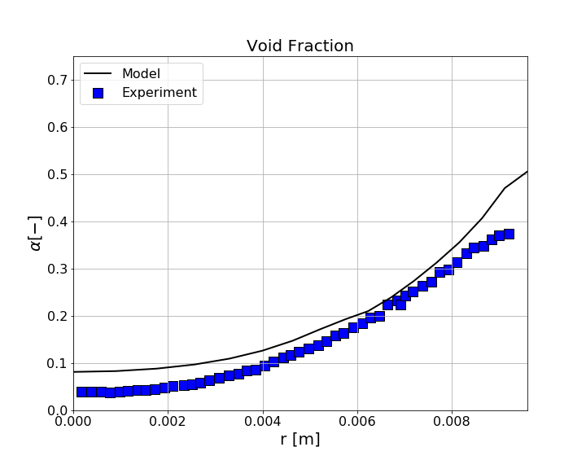
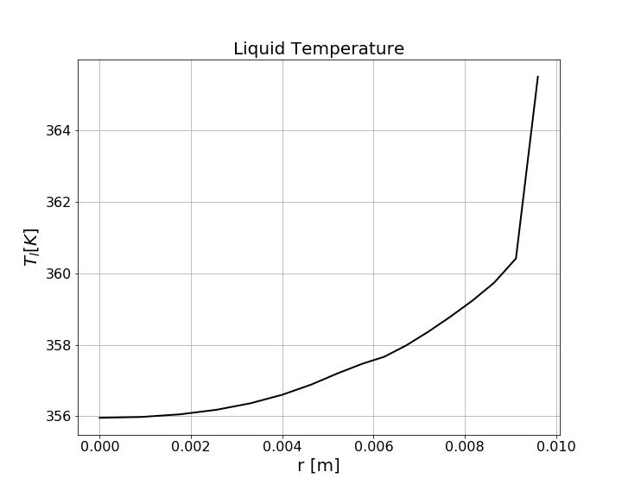
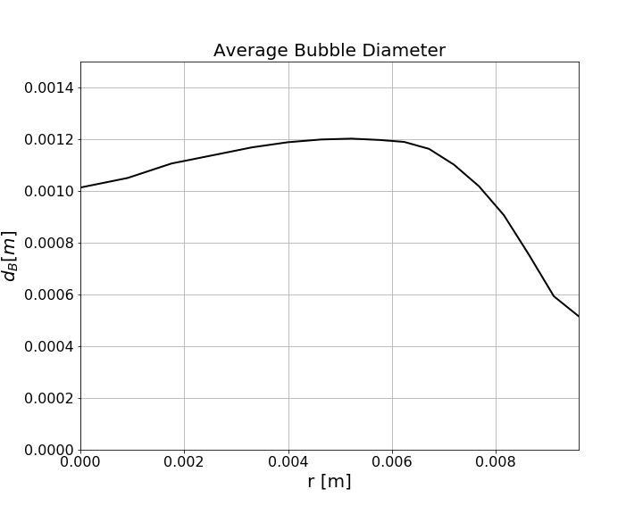
Results
Void fraction peaks at the wall due to boiling
Temperature profiles shows superheating at the wall, but water that remains subcooled in the centre of the pipe
Bubble diameter increases in the flow due to coalescence
Pipe Wall

