Slide 1

Hybrid MPI Programming in High-Performance Computing
Yongyu Chen
Advisor: Alexey Paznikov
yuchen@stud.etu.ru
Saint Petersburg Electrotechnical University “LETI”
December 10th 2020

Slide 2
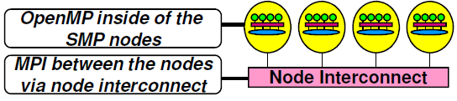
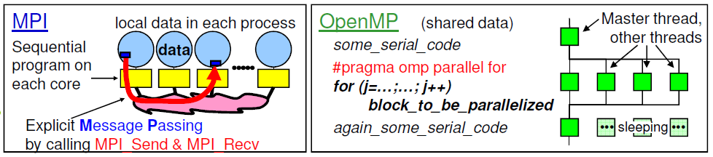
Hybrid MPI Programming in High-Performance Computing
Major Hybrid Programming Models
Motivation:
• Reduction in memory footprint
• Improved performance
Pure MPI (one MPI process on each core)
• Hybrid: MPI + OpenMP
• Hybrid: MPI + Pthread
• Hybrid: MPI message passing + MPI-3.0 shared memory programming(new, SC13)
• etc.
• Often hybrid programming (MPI+OpenMP) slower than pure MPI – why?
Yongyu Chen, ETU, yuchen@stud.etu.ru

Slide 3
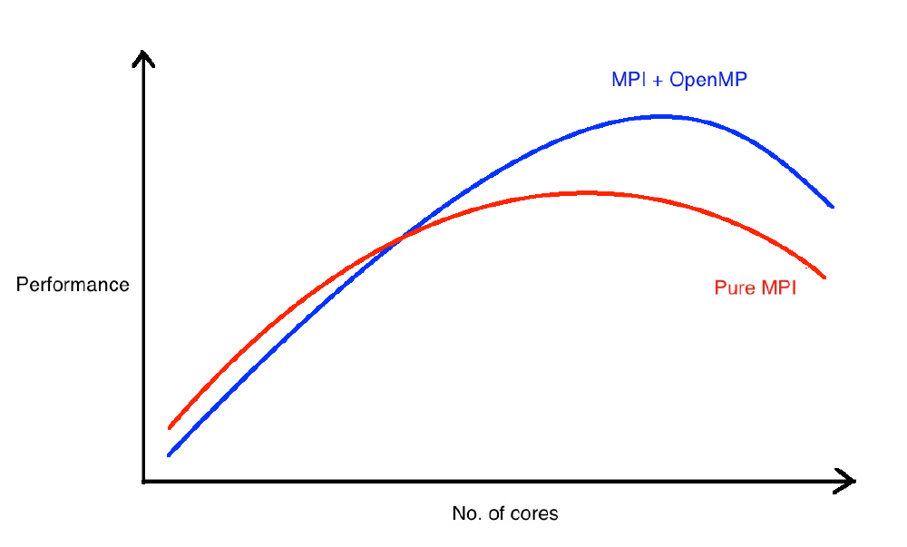
Hybrid MPI Programming in High-Performance Computing
Summary and Conclusion of MPI + OpenMP
– Usability on higher number of cores
• Advantages
– Reducing memory requirements
– Improving performance(Figure)
– Exploiting additional layers of parallelism
-- Reducing communication overheads
-- Reducing load imbalance
-- Reducing memory access costs
• Disadvantages
-- Development and maintenance costs
-- Portability
-- Libraries
• Huge amount of pitfalls
• Pitfalls of MPI & OpenMP & combination of them
– Idle threads
-- Synchronization
-- MPI derived datatypes
-- Memory effects and placement
•Applications:(e.g., Parallel machine learning)
Woodsend K, Gondzio J. Hybrid MPI/OPENMP parallel linear support vector machine training[J]. Journal of Machine Learning Research, 2009, 10 : 1937-1953.
Waghmare V N, Kulkarni D B. Convex hull using k-means clustering in hybrid(MPI/OpenMP) environment[C]// Proceedings of the International Conference on Computational Intelligence and Communication Networks, Piscataway, 2010: 150-153.
Yongyu Chen, ETU, yuchen@stud.etu.ru

