Slide 1
SPI UVM
Programme : PCDA – DV Miniproject
Instructors : CY, Sean
Date : 19 August 2025
Group : 2
Members : Faaez; Kevin; YY

Slide 2
Outline
UVM Microarchitecture
Test Sequence
Testplan
Test Case
Results and Discussions
Conclusion and Future

Slide 3
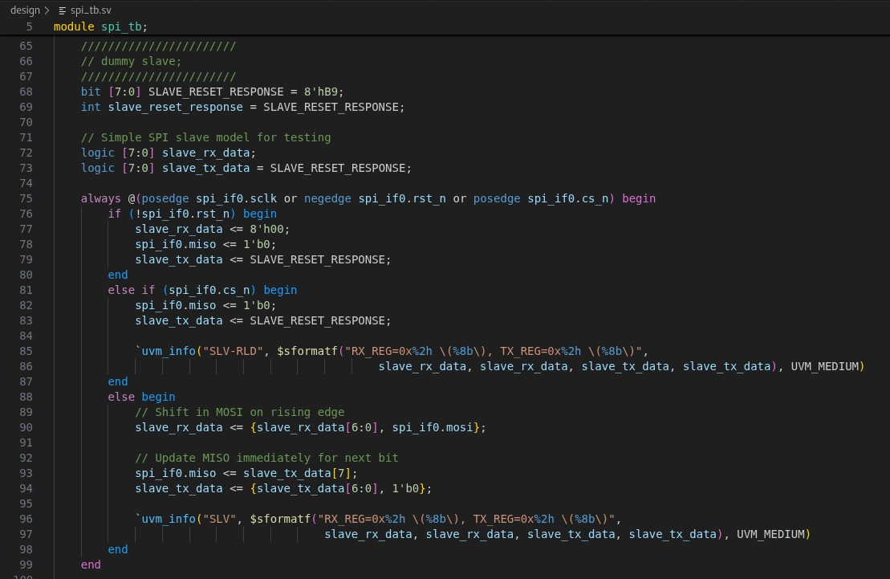
DISCLAIMER
TB Dummy slave is based on old version as follows. But RTL is based on the latest one. See Appendix - RTL for more information.

Slide 4
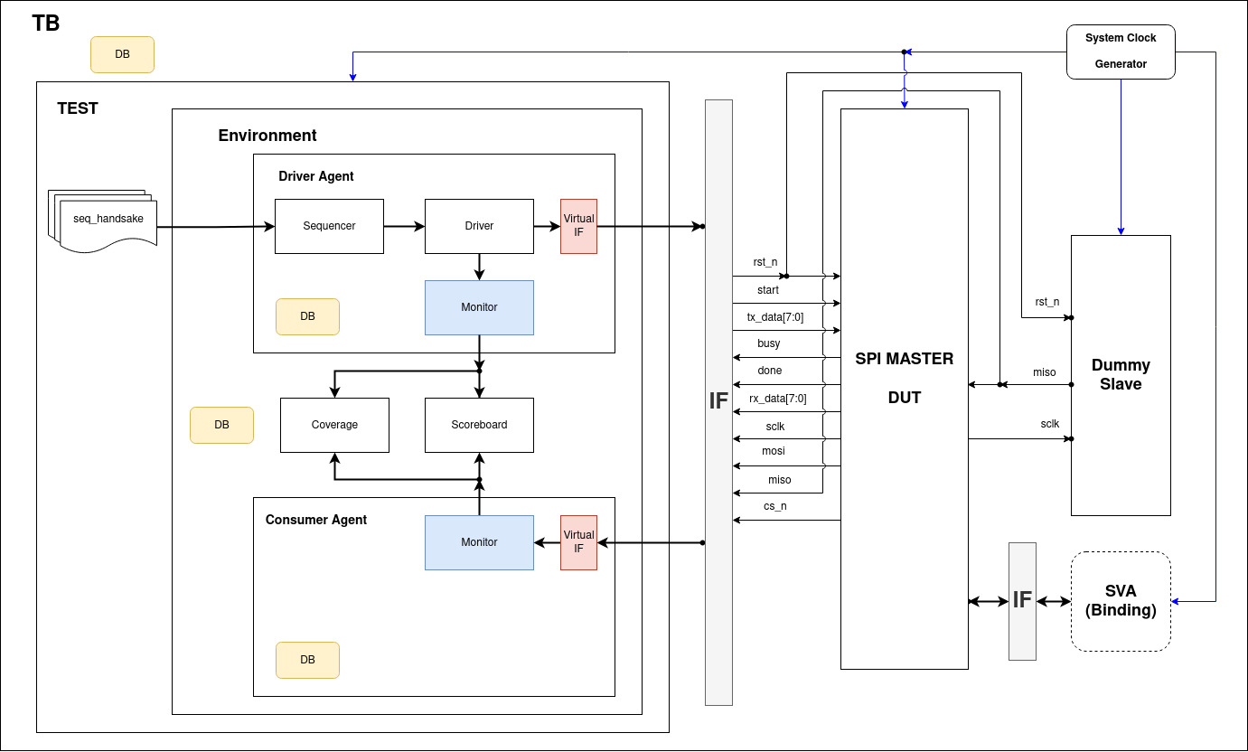
UVM Microarchitecture

Slide 5
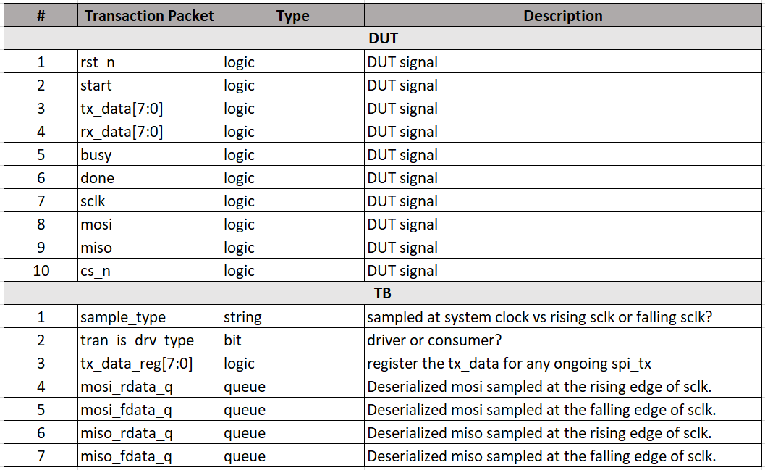
UVM uarch: Transaction Packet

Slide 6
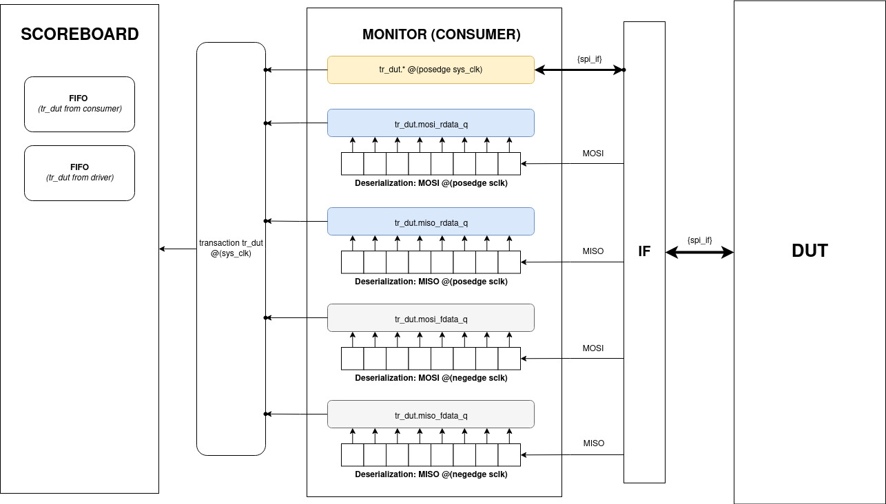

Slide 7
Test Sequence
Handshake
Start randomization only
Reset randomization only
Back-to-back TX data randomization only
All randomization: {start, rst_n, tx_data}

Slide 8
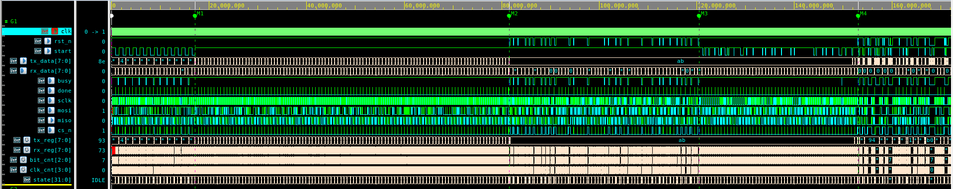
Test Sequence (continued)
T1: Handshake
T2: Back-to-back tx_data
T3:
Randomized rst_n
T4:
Randomized start
T5:
Randomized all

Slide 9
Test Plan
Assumption
Fixed topology: SPI master only
Fixed SCLK clock division value.
Fixed SPI mode: {CPOL: 0, CPHA: 1}

Slide 10
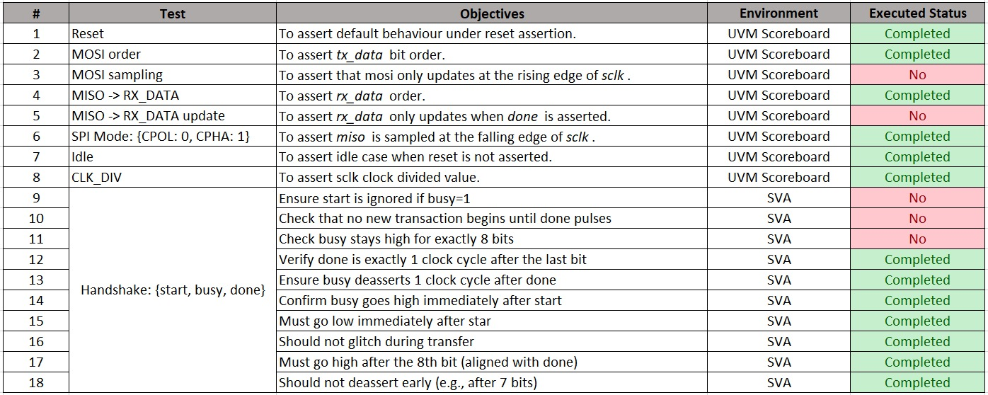
Test Plan (Continued)
Planned: 18; Executed: 15

Slide 11
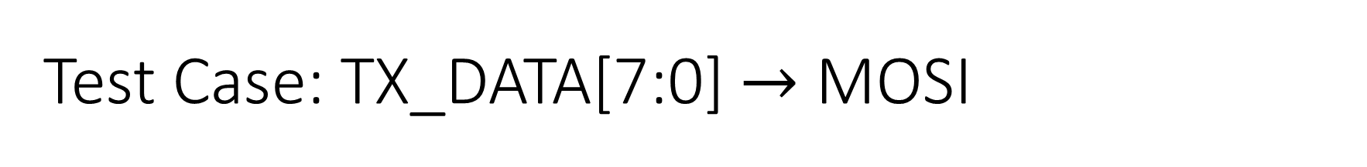
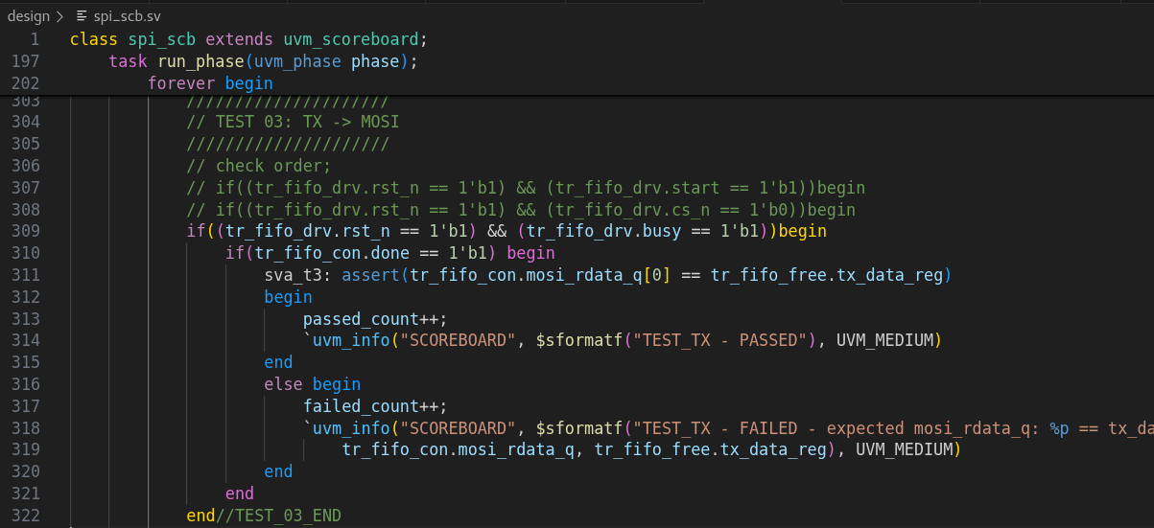
How? deserialized mosi and compared it against the tx_data.
Method: queued from the monitor.

Slide 12
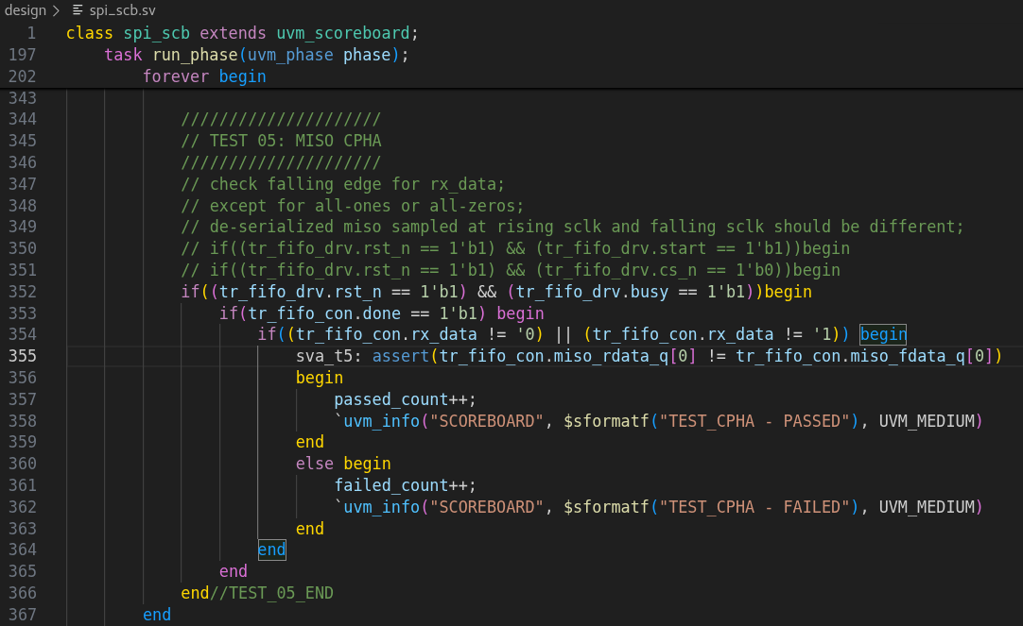
Test Case: {CPOL: 0, CPHA: 1}
Problem: not sufficient to check at the falling edge of sclk!
So, need to sample the miso at both rising and falling edge of sclk. These samples must not be the same except when the data is all-zeros or all-ones.

Slide 13
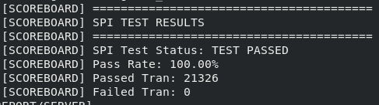
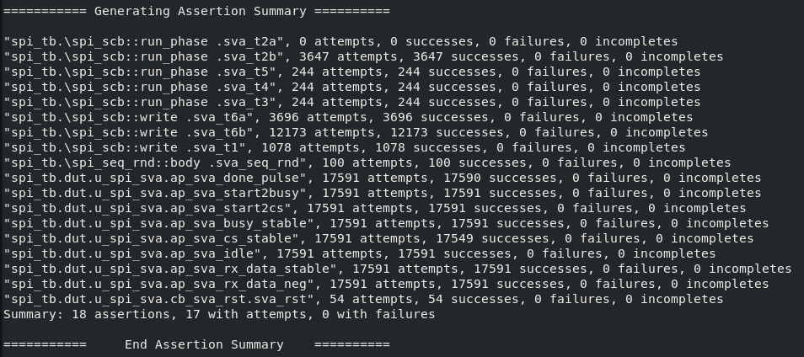
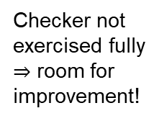
Results
Checker not exercised fully
$⇒$ room for improvement!

Slide 14
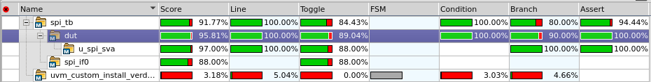
Results: Code Coverage (95.81%)

Slide 15
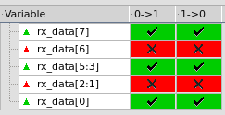

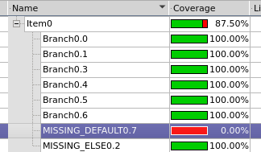
Results: Code Coverage (Continued)
What’s not hit?
Toggle: rx_data
Toggle: clk_cnt
Branch: RTL missing branch
Analysis:
TB hardcoded to 8’hB9 for MISO
Fixed SCLK divider parameter
RTL bad practice
Can waive. 100% code coverage achieved!

Slide 16
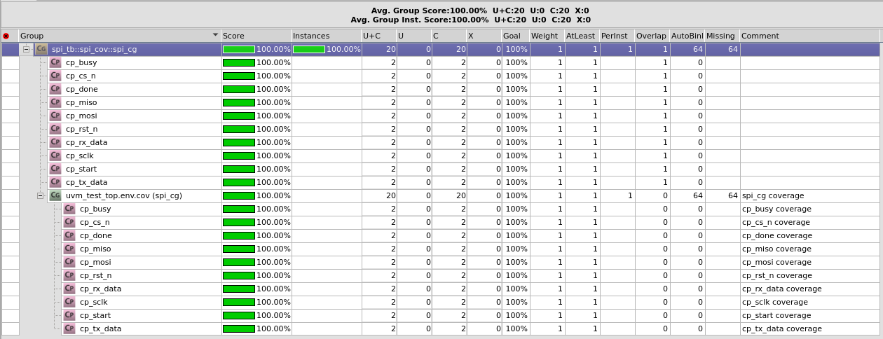
Results: Functional Coverage (100%)
Capture all DUT’s signals.

Slide 17
Conclusions
Developed a UVM framework to verify SPI master only.
Planned 18 test cases but executed only 15.
No RTL bug found.
~95% code coverage; those un-hit could be waived.
100% functional coverage.
It was fun!

Slide 18
Limitations and Future
Not able to have full control over different sequence to the driver during runtime.
Solution: create new virtual interface for TB or use sv plusargs passed from compilation.
Framework not scalable to:
Different SPI data width parameters.
Different SPI modes: {CPHA, CPHOL}.
Different SCLK divider parameter.
Only for SPI master
Need modifications to accommodate SPI slave/master.

Slide 19
THANK YOU

Slide 20
Appendix - RTL
TRANSFER: begin
if (clk_cnt == CLK_DIV-1) begin
clk_cnt <= '0;
sclk <= ~sclk;
if (sclk) begin
// Rising edge - sample MISO
rx_reg <= {rx_reg[6:0], miso};
if (bit_cnt == 0) begin
// Last bit
state <= IDLE;
rx_data <= {rx_reg[6:0], miso};
done <= 1'b1;
cs_n <= 1'b1;
end else begin
bit_cnt <= bit_cnt - 1;
end
end else begin
// Falling edge - change MOSI
mosi <= tx_reg[bit_cnt];
end
end else begin
clk_cnt <= clk_cnt + 1;
end
end
endcase
end
end
endmodule
module spi #(
parameter CLK_DIV = 4 // Clock divider (sysclk/spi_clk)
)(
input logic clk, // System clock
input logic rst_n, // Active-low reset
input logic start, // Start transmission
input logic [7:0] tx_data, // Data to transmit
output logic [7:0] rx_data, // Received data
output logic busy, // Transmission in progress
output logic done, // Transmission complete
// SPI interface
output logic sclk, // SPI clock
output logic mosi, // Master out, slave in
input logic miso, // Master in, slave out
output logic cs_n // Chip select (active low)
);
logic [7:0] tx_reg; // Transmit shift register
logic [7:0] rx_reg; // Receive shift register
logic [2:0] bit_cnt; // Bit counter (0-7)
logic [CLK_DIV-1:0] clk_cnt; // Clock divider counter
typedef enum {IDLE, TRANSFER} state_t;
state_t state;
always_ff @(posedge clk or negedge rst_n) begin
if (!rst_n) begin
state <= IDLE;
sclk <= 1'b0;
cs_n <= 1'b1;
busy <= 1'b0;
done <= 1'b0;
rx_data <= 8'h00;
clk_cnt <= '0;
bit_cnt <= 3'd7;
end else begin
done <= 1'b0;
case (state)
IDLE: begin
cs_n <= 1'b1;
sclk <= 1'b0;
busy <= 1'b0;
clk_cnt <= '0;
bit_cnt <= 3'd7;
rx_data <= 1'b0;
if (start) begin
state <= TRANSFER;
tx_reg <= tx_data;
cs_n <= 1'b0;
busy <= 1'b1;
end
End

Slide 21
QnA

Slide 22
Feedback Received

Slide 23
Feedback Received
Transaction class can be split into two different classes:
One is for the DUT.
One is for the TB and other utility signals.
For the interaction between sequence and driver, we could use event structure to signal to the sequence for a given event.

