Slide 1
SPI UVM
Programme : PCDA – DV Miniproject
Instructors : CY, Sean
Date : 19 August 2025
Group : 2
Members : Faaez; Kevin; YY

Slide 2
Outline
UVM Microarchitecture
Test Sequence
Testplan
Test Case
Results and Discussions
Conclusion and Future

Slide 3
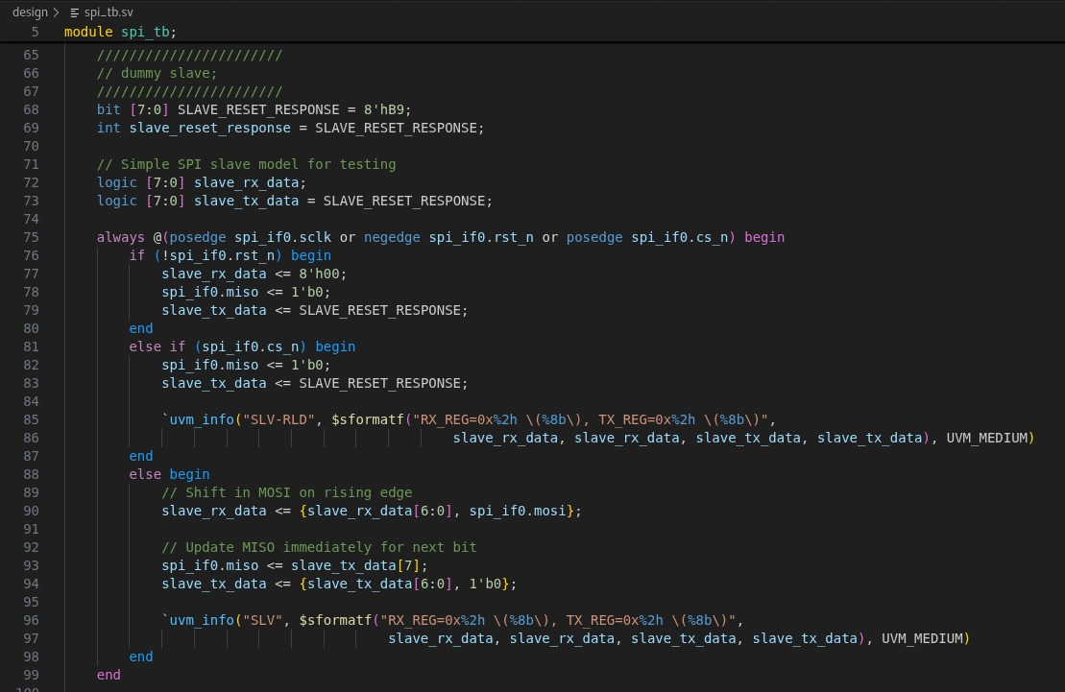
DISCLAIMER
TB Dummy slave is based on old version as follows. But RTL is based on the latest one. See Appendix - RTL for more information.

Slide 4
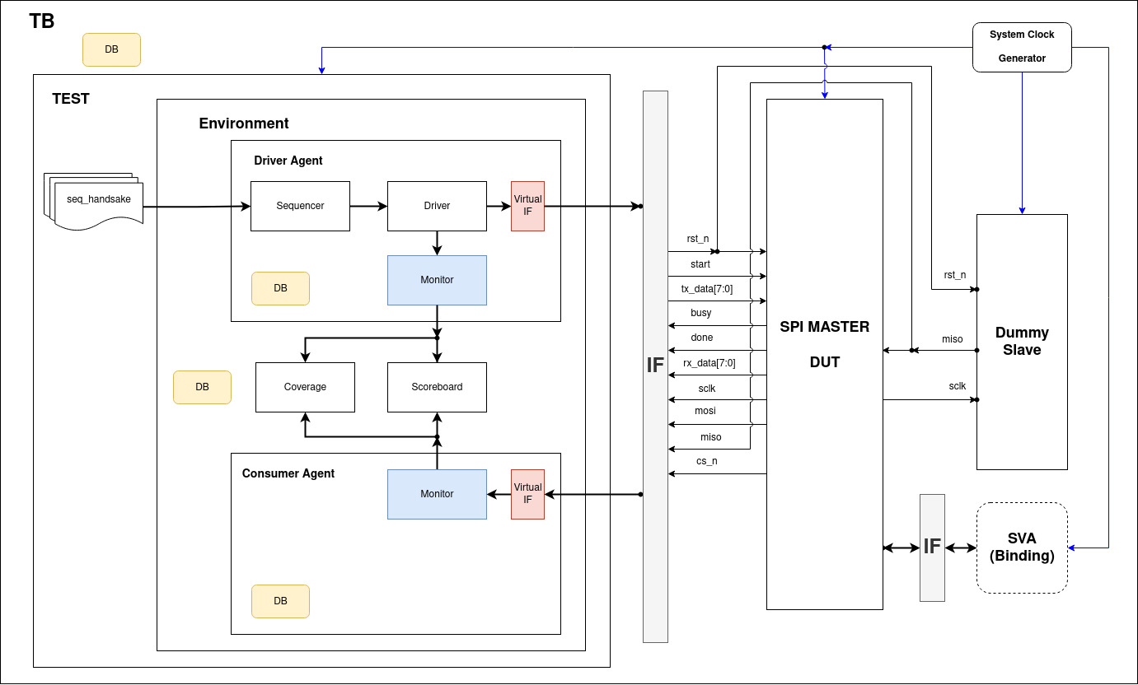
UVM Microarchitecture

Slide 5
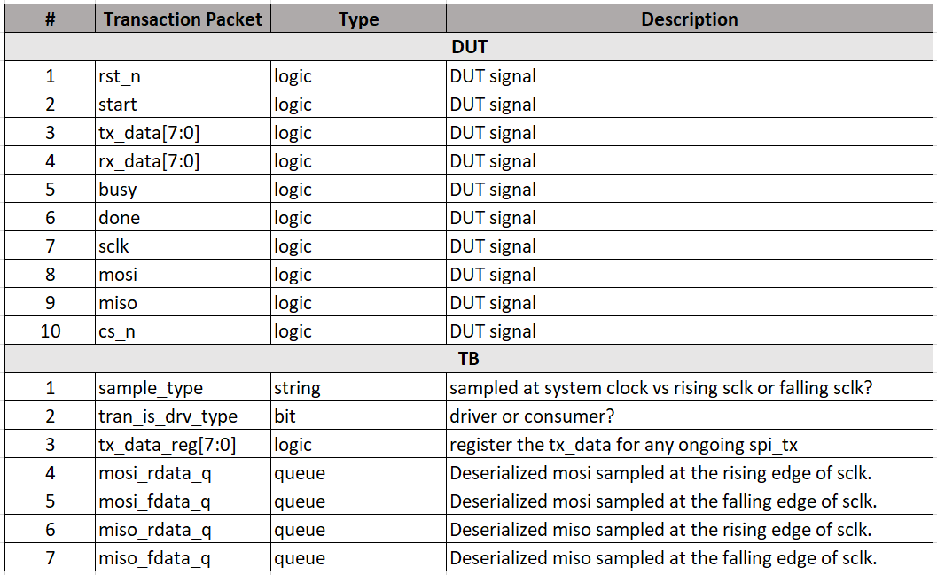
UVM uarch: Transaction Packet

Slide 6
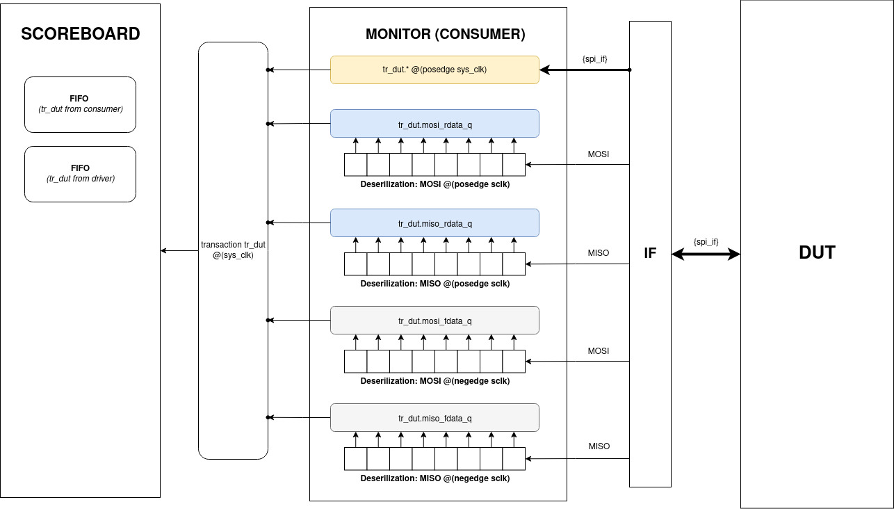

Slide 7
Test Sequence
Handshake
Start randomization only
Reset randomization only
Back-to-back TX data randomization only
All randomization: {start, rst_n, tx_data}

Slide 8
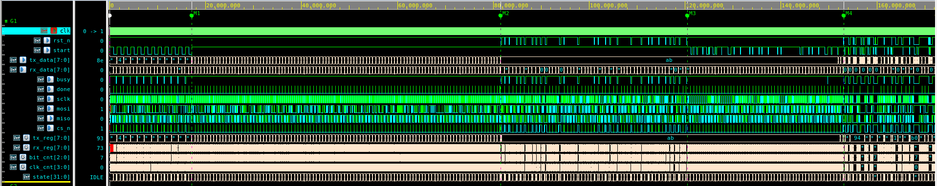
Test Sequence (continued)
T1: Handshake
T2: Back-to-back tx_data
T3:
Randomized rst_n
T4:
Randomized start
T5:
Randomized all

Slide 9
Test Plan
Assumption
Fixed topology: SPI master only
Fixed SCLK clock division value.
Fixed SPI mode: {CPOL: 0, CPHA: 1}

Slide 10
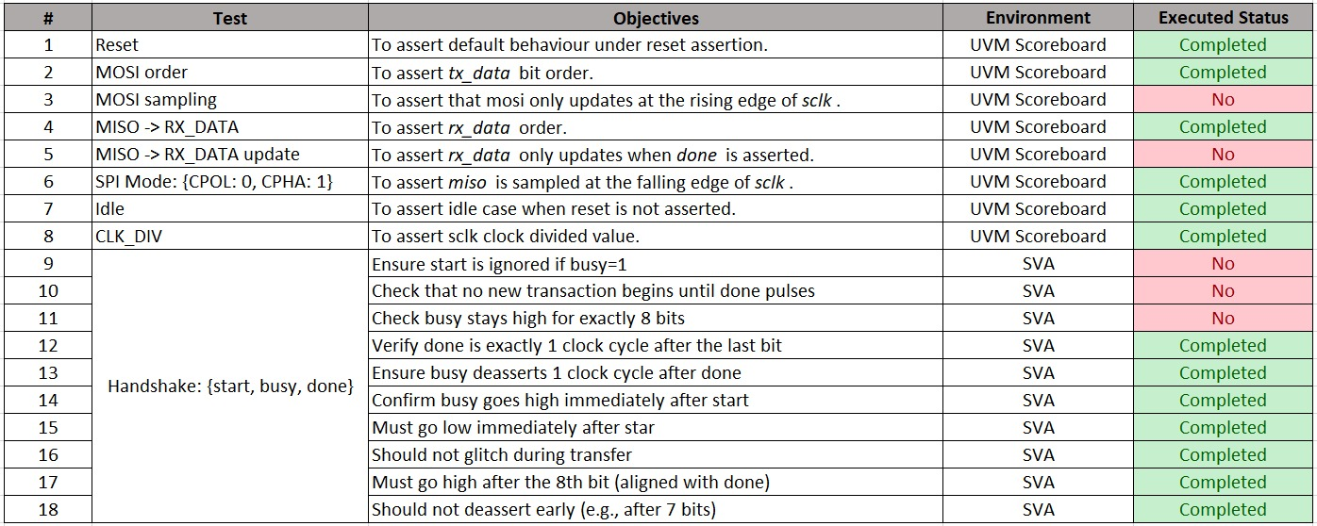
Test Plan (Continued)
Planned: 18; Executed: 15

Slide 11

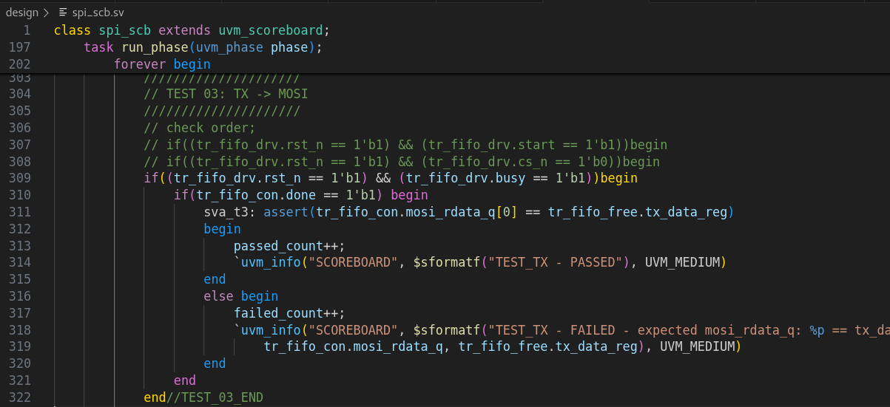
How? deserialized mosi and compared it against the tx_data.
Method: queued from the monitor.

Slide 12
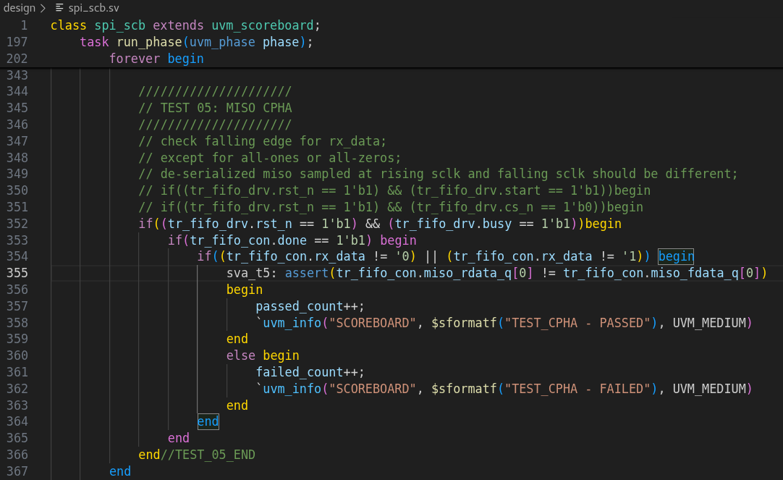
Test Case: {CPOL: 0, CPHA: 1}
Problem: not sufficient to check at the falling edge of sclk!
So: need to sample the miso at both rising and falling edge of sclk. These samples must not be the same except when the data is all-zeros or all-ones.

Slide 13
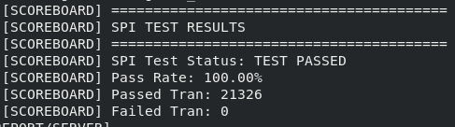
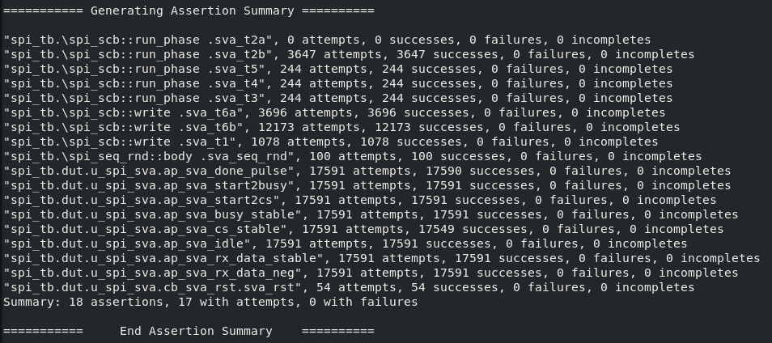
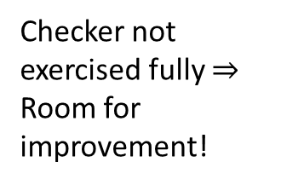
Results

Slide 14
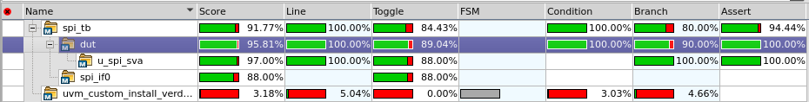

Results: Code Coverage (95.81%)
What’s not hit?
Toggle: rx_data
Toggle: clk_cnt
Branch: RTL missing branch
Analysis:
TB hardcoded to 8’hB9 for MISO
Fixed SCLK divider parameter
RTL bad practice

Slide 15
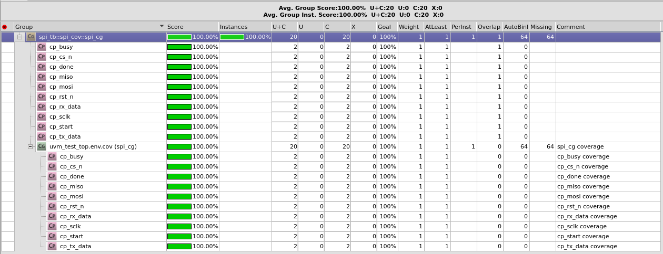
Results: Functional Coverage (100%)
Capture all DUT’s signals.

Slide 16
Conclusions
Developed a UVM framework to verify SPI master only.
Planned 18 test cases but executed only 15. 1 RTL bug found.
~95% code coverage; those un-hit could be waived.
100% functional coverage.
It was fun!

Slide 17
Limitations and Future
Not able to have full control over different sequence to the driver during runtime.
Solution: create new virtual interface for TB or use sv plusargs from compilation
Framework not scalable to:
Different SPI data width parameters.
Different SPI modes: {CPHA, CPHOL}.
Different SCLK divider parameter.
Only for SPI master
Need modifications to accommodate SPI slave/master.

Slide 18
THANK YOU

Slide 19
Appendix - RTL
TRANSFER: begin
if (clk_cnt == CLK_DIV-1) begin
clk_cnt <= '0;
sclk <= ~sclk;
if (sclk) begin
// Rising edge - sample MISO
rx_reg <= {rx_reg[6:0], miso};
if (bit_cnt == 0) begin
// Last bit
state <= IDLE;
rx_data <= {rx_reg[6:0], miso};
done <= 1'b1;
cs_n <= 1'b1;
end else begin
bit_cnt <= bit_cnt - 1;
end
end else begin
// Falling edge - change MOSI
mosi <= tx_reg[bit_cnt];
end
end else begin
clk_cnt <= clk_cnt + 1;
end
end
endcase
end
end
endmodule
module spi #(
parameter CLK_DIV = 4 // Clock divider (sysclk/spi_clk)
)(
input logic clk, // System clock
input logic rst_n, // Active-low reset
input logic start, // Start transmission
input logic [7:0] tx_data, // Data to transmit
output logic [7:0] rx_data, // Received data
output logic busy, // Transmission in progress
output logic done, // Transmission complete
// SPI interface
output logic sclk, // SPI clock
output logic mosi, // Master out, slave in
input logic miso, // Master in, slave out
output logic cs_n // Chip select (active low)
);
logic [7:0] tx_reg; // Transmit shift register
logic [7:0] rx_reg; // Receive shift register
logic [2:0] bit_cnt; // Bit counter (0-7)
logic [CLK_DIV-1:0] clk_cnt; // Clock divider counter
typedef enum {IDLE, TRANSFER} state_t;
state_t state;
always_ff @(posedge clk or negedge rst_n) begin
if (!rst_n) begin
state <= IDLE;
sclk <= 1'b0;
cs_n <= 1'b1;
busy <= 1'b0;
done <= 1'b0;
rx_data <= 8'h00;
clk_cnt <= '0;
bit_cnt <= 3'd7;
end else begin
done <= 1'b0;
case (state)
IDLE: begin
cs_n <= 1'b1;
sclk <= 1'b0;
busy <= 1'b0;
clk_cnt <= '0;
bit_cnt <= 3'd7;
rx_data <= 1'b0;
if (start) begin
state <= TRANSFER;
tx_reg <= tx_data;
cs_n <= 1'b0;
busy <= 1'b1;
end
End

