Slide 1


University of Toronto
School of Continuing Studies
3253 - Machine Learning
Can factor investing disrupt the hedge fund industry?
Mirroring “Global Macro” Hedge Funds performance through factor-based predictive modelling and ensemble learning
Presented by:
Gabriel Ignacio
Jason Zhang
Wigglesworth, R. (2018). Can factor investing kill off the hedge fund? Financial Times. Retrieved from https://www.ft.com/content/2b3e2eaa-6fe6-11e8-92d3-6c13e5c92914
Notes:
Introduce that you’re both in the financial services so it’s relevant to both of you
$1.9 trillion – blackrock
AQR → factor investing

Slide 2

Hedge Funds
Wealthy individuals or institutional investors
Significant diversification benefits
“Absolute returns” (positive risk-adjusted returns)
Has anyone invested in hedge funds before?
Sources:
Edwards, F. R., & Gaon, S. (2003). Hedge Funds: What Do We Know? Journal of Applied Corporate Finance, 15(4), 58-71.
Fung, W., & Hsieh, D. A. (1999). A primer on hedge funds. Journal of Empirical Finance, 6(1999), 309-331.
Notes:
At least $100,000 to $1million (minimum) to invest in hedge funds with at least 1 year lock in period, and the risk appetite to sleep at night when the markets aren’t doing well
- Accredited investor (AI): financial capacity and financial sophistication

Slide 3



US Global Macro Hedge Funds
3 trillion USD CAGR 8%-10%
5-10 years
14,000 US firms
Top fund uses global macro strat
George Soros - $1billion overnight
Each of the top 35 US hedge funds > entire Canadian hedge funds industry (200 hedge funds, 200 billion in AUM)
Sources:
Banquier, S. (2019). Overview of Prime Brokerage. Presented at Smith School of Business, Queen's University.
Fung, W., & Hsieh, D. A. (2011). The risk in hedge fund strategies: Theory and evidence from long/short equity hedge funds. Journal of Empirical Finance, 18(2011), 547-569.
.
Notes:
3 trillion- almost 500x the bail out money in 2009

Slide 4
Research Question
Are “Global Macro” Hedge Funds replicable using the factor-based frameworks for non-accredited investors (like you and me)?
Notes:
Avoid the fees
Do it yourself

Slide 5

Objectives
Algorithm
Dynamic linkages: can market variables predict GMHF performance?
Neutrality: or do dynamic investment strategies (i.e. manager skill) play a factor?
Implication: systematically replicate results without Hedge Fund fees
$
Hedge Fund
$
$
$
$
$
Notes:
From financial times:
By in theory replicating what a lot of professional money managers do at a fraction of the cost, factor investing puts more pressure on fees. Many of the anomalies that factor investing exploit are deeply rooted in human psychology, which is why they are not weeded out over time. And as long as even quants can fall prey to these foibles, then factors will have a bright future
“But if we can’t keep emotion out of our own brains, it’s pretty good news for the factors, for the idea that investors aren’t perfectly rational is the reason these factors work

Slide 6
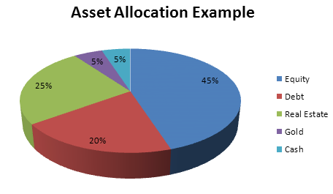
Methodology
Gather and prepare the data – target variables and feature variables
Predict the target using feature variables using machine learning
Identify the best factor-based framework to replicate GMHF Performance
Use feature selection to determine portfolio weightage per feature
Inform non-accredited investors of index trackers to mirror GMHF returns
?
How much $ do you allocate per index or asset class to mirror the performance of a GMHF?
Notes:
From financial times:
By in theory replicating what a lot of professional money managers do at a fraction of the cost, factor investing puts more pressure on fees. Many of the anomalies that factor investing exploit are deeply rooted in human psychology, which is why they are not weeded out over time. And as long as even quants can fall prey to these foibles, then factors will have a bright future
“But if we can’t keep emotion out of our own brains, it’s pretty good news for the factors, for the idea that investors aren’t perfectly rational is the reason these factors work

Slide 7
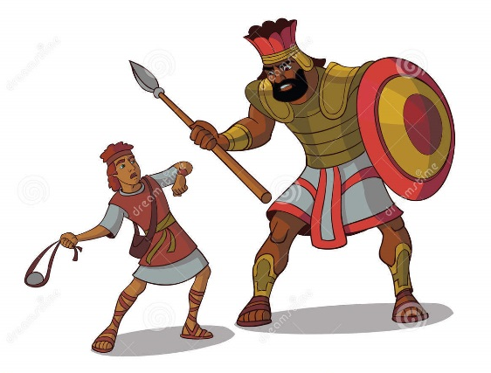



Data Exploration
Target: Global Macro Hedge Funds Mean Index Returns (GMHF)
Fama-French-Carhart 4 Factor Model
Market returns (Mkt), size factor (SMB), value factor (HML) and momentum (MOM)
Risk-based Factor Model
Bond Trending following risk factors
Equity-oriented risk factors
Bond-oriented risk factors
Macroeconomic Factor Model
GDP, inflation rate, interest rates, unemployment rates, etc
Observations: 1994-2018, 300 monthly data points
Source: Hedge Fund Research Institute, Ken French Library, David Hsieh Library, US government data

Slide 8
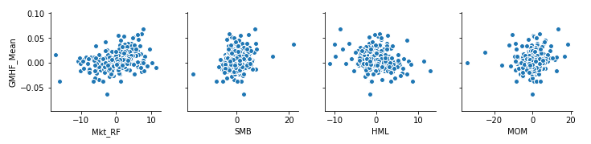
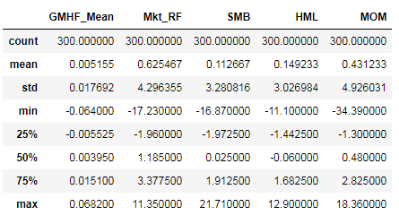
Data Exploration - 4 factor model
Target
Features
Linear correlation
Notes:
Linear relationship
As GMHF performance correlates to performance of large cap performance improvement, growth stocks and momentum

Slide 9
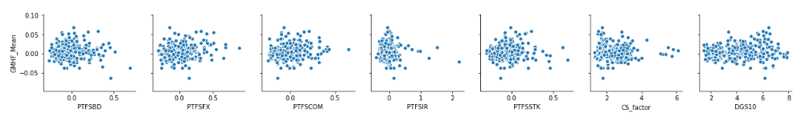
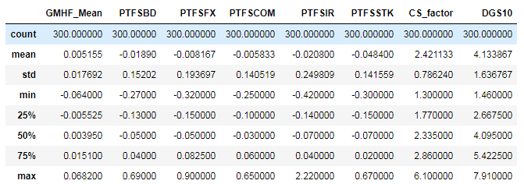
Data Exploration – Risk Based Model
Target
Features
Notes:
Lookback straddle
Biggest stock swing over the from initiation to expiration
GMHF performance positively correlates with lookback straddles for FX, commodity, credit spreads and 10 year T-bills maturity
GMHF performance negatively correlates with lookback straddles for bonds and short-term interest rates

Slide 10
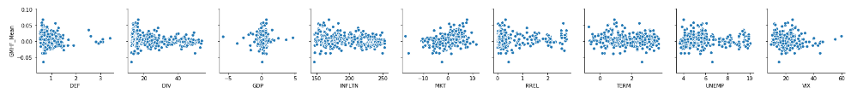
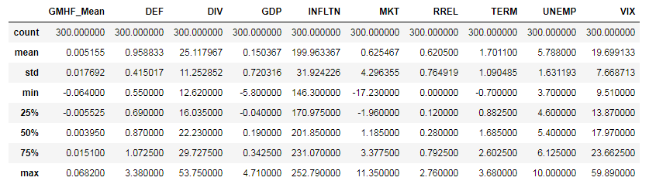
Data Exploration – Macroeconomic Model
Linear correlation

Slide 11
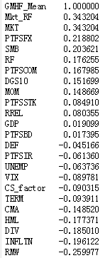
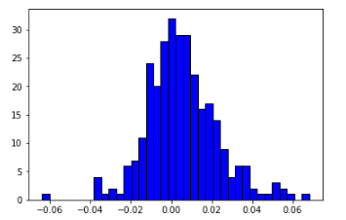
Target : Global Macro Hedge Funds Mean Index Returns (GMHF)
Applied models | Hypothesis
regression | How much could the businessmen get in terms of ROI
classification | Could they gain or lose in their GMHF investment

Slide 12
Model Building Process
Feature Selection | Numeric Variables
Fama-French-Carhart | 'Mkt_RF','SMB','HML','MOM'
Risk-based | 'PTFSBD','PTFSFX','PTFSCOM','PTFSIR','PTFSSTK','DGS10','CS_factor'
Macroeconomic | 'DEF','DIV','GDP','INF','MKT','RREL','TERM','UNEMP','VIX'
Algorithms Comparison | Regression (RMSE) | Classification (Accuracy)
Linear Algorithms | LinearRegression | LogisticRegression
Non-Linear Algorithms | KNeighborsRegressor, SVR | KNeighborsClassifier, DecisionTreeClassifier, GaussianNB, SVC
Emsemble Algorithms | GradientBoostingRegressor, RandomForestRegressor | VotingClassifier, RandomForestClassifier
Making pipeline | 1. Scaling 2. PCA 3. Parameters tuning (GridSearchCV) for the best algorithm
Feature Importance | Use Algorithm RandomForest method best_estimator.feature_importances

Slide 13
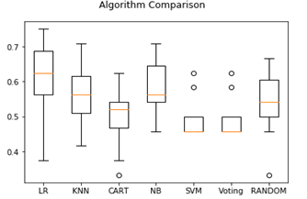
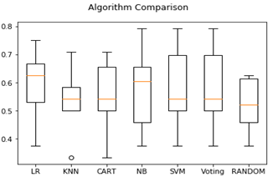
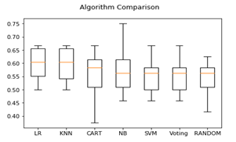



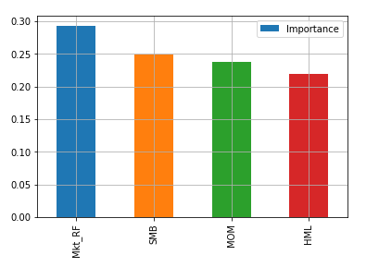
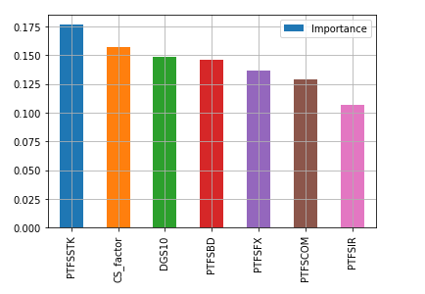
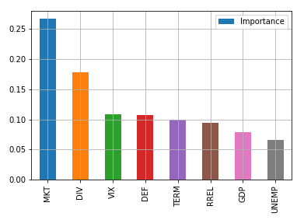
Classification
Fama-French-Carhartrt
Risk-based t
Macroeconomic rt

Slide 14
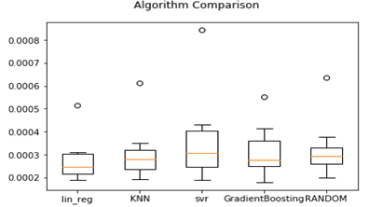
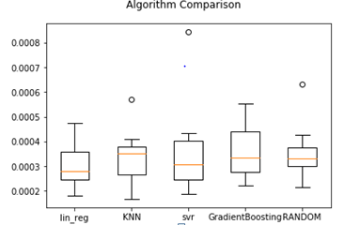
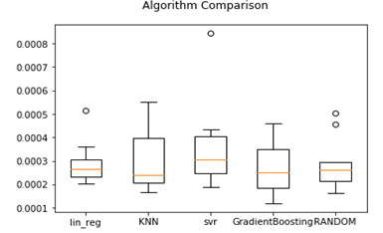


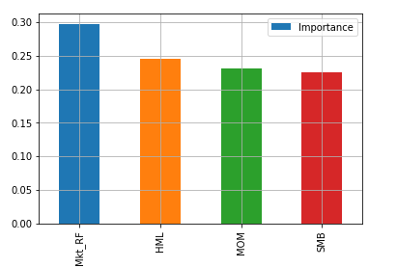
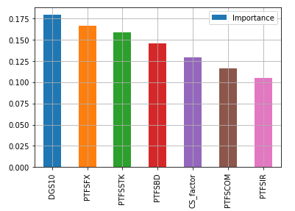
Regression
Fama-French-Carhartrt
Risk-based t
Macroeconomic rt

Slide 15
Summary Results: Best Performing Model
Evaluated each factor model using classification (accuracy) and regression (RMSE)
The best model is chosen based on accuracy and RMSE
Models | Classification Accuracy | Regression RMSE
Fama-French-Carhart 4-factor model | 77% Logistic Regression | 0.0153 Linear Regression
Risk-based factor model | 69% Logistic Regression | 0.0170 Linear Regression
Macroeconomic factor model | 63% Logistic Regression | 0.0159 Gradient Boosting
Fama-French-Carhart has the best predictive power across the 3 models using logistic regression and Linear Regression. Not surprisingly, AQR also uses the same factor model

Slide 16

Conclusion and Recommendations
Given models performance, it is possible to predict (and mirror) GMHF performance using the Fama-French-Carhart, risk-based and macroeconomic factor models
Among the three factor-models, Fama-French-Carhart best explain Global Macro Hedge Funds’ performance
Among all the features (or factors), market performance, foreign exchange look back straddle and small cap stock performance best predict GMHF returns
Exploiting these indicators might be key to drive alpha
The model performance could be improved better by doing data engineer work on the dataset. E.g. Data transformation, coefficient analysis, and outlier detection

Slide 17
Appendices
Notes:
Introduce that you’re both in the financial services so it’s relevant to both of you

Slide 18
Frameworks Used
Frameworks | Theoretical | Empirical
Fama-French-Carhart Four Factor Model | Market, size, value and momentum explain stock performance | (𝑅_{𝑖}−𝑅_{𝑓}) = 𝛼_{𝑖} + 𝛽_{MKT} (𝑅_{𝑀𝐾𝑇}−𝑅_{𝑓})+ 𝛽_{SMB}(SMB) + 𝛽_{HML} (HML) + 𝛽_{UMD} (UMD) + e_{i}
Trend Following Factors | Trend-Following Risk Factors (3): -Bond Trend-Following Factor -Currency Trend-Following Factor -Commodity Trend-Following Factor Equity-oriented Risk Factors (2): -Equity Market Factor -The Size Spread Factor Bond-oriented Risk Factors (2): -The Bond Market Factor -The Credit Spread Factor | (𝑅_{𝑖}−𝑅_{𝑓}) = 𝛼_{𝑖} + 𝛽₁ (PTFSBD)+ 𝛽₂(PTFSFX) + 𝛽₃ (PTFSCOM) + 𝛽₄ (PTFSIR) + 𝛽₅(PTFSTK) + 𝛽₆ (DGS10) + 𝛽₇ (CS_factor) + e_{i}
Macroeconomic Factors | Default spread, aggregate dividend yield, the growth rate of real Gross Domestic Product (GDP) per capita, inflation rate, equity market index, term spread, short-term interest rate changes, and unemployment rate | (𝑅_{𝑖}−𝑅_{𝑓}) = 𝛼_{𝑖} + 𝛽₁ (DEF)+ 𝛽₂(DIV) + 𝛽₃ (GDP) + 𝛽₄ (INFLTN) + 𝛽₅(MKT) + 𝛽₆ (RREL) + 𝛽₇ (TERM) +𝛽₇ (UNEMP) + e_{i}
Volatility | Volatility index | (𝑅_{𝑖}−𝑅_{𝑓}) = 𝛼_{𝑖} + 𝛽₁ (VIX) + e_{i}

Slide 19
Data Preparation
Fama-French-Carhart 4 Factor Model (combination of market risks)
Variables | Description | # of observations | Timeframe | Corrected to | Source
Mkt-RF | Rm-Rf, the excess return on the market | 1,111 monthly data points | July 1926 to Jan 2019 | Jan 1994 to Dec 2018 | Kenneth R. French - Data Library
SMB | Size factor: small stocks relative to large stocks | 1,111 monthly data points | July 1926 to Jan 2019 | Jan 1994 to Dec 2018 | Kenneth R. French - Data Library
HML | Value factor: value stocks relative to growth stocks | 1,111 monthly data points | July 1926 to Jan 2019 | Jan 1994 to Dec 2018 | Kenneth R. French - Data Library
MOM | Tendency for the stock price to continue rising if it is going up and to continue declining if it is going down | 1,105 data points Monthly | Jan 1927 to Jan 2019 | Jan 1994 to Dec 2018 | Kenneth R. French - Data Library

Slide 20
Data Preparation
Trend-Following factors under Fung and Hsieh (directional / trend risks)
Variables |  | Description | # of observations | Timeframe | Corrected to | Source
PTFSBD |  | Return of PTFS Bond lookback straddle | 301 data points | Jan 1, 1994 to Jan 1, 2019 | Jan 1994 to Dec 2018 | David A. Hsieh's Data Library: Hedge Fund Risk Factors
PTFSFX |  | Return of PTFS Currency Lookback Straddle | 301 data points | Jan 1, 1994 to Jan 1, 2019 | Jan 1994 to Dec 2018 | David A. Hsieh's Data Library:
PTFSCOM |  | Return of PTFS Commodity Lookback Straddle | 301 data points | Jan 1, 1994 to Jan 1, 2019 | Jan 1994 to Dec 2018 | Hedge Fund Risk Factors
PTFSIR |  | Return of PTFS Short Term Interest Rate Lookback Straddle | 301 data points | Jan 1, 1994 to Jan 1, 2019 | Jan 1994 to Dec 2018 | David A. Hsieh's Data Library:
PTFSSTK |  | Return of PTFS Stock Index Lookback Straddle | 301 data points | Jan 1, 1994 to Jan 1, 2019 | Jan 1994 to Dec 2018 | Hedge Fund Risk Factors
The Credit Spread Factor | DBAA | Moody's Baa yield | 398 data points 33 years Monthly obs | Jan 1, 1986 to Jan 1, 2019 | Jan 1994 to Dec 2018 | Federal Reserve Bank of St. Louis
 | DGS10 | 10-year treasury constant maturity yield | 686 data points | Jan 1, 1962 to Feb 1, 2019 | Jan 1994 to Dec 2018 | Federal Reserve Bank of St. Louis
The Bond Market Factor | DGS10 | The monthly change in the 10-year treasury constant maturity yield | 686 data points | Jan 1, 1962 to Feb 1, 2019 | Jan 1994 to Dec 2018 | Federal Reserve Bank of St. Louis

Slide 21
Data Preparation
Macroeconomic variables by Bali, Brown and Caglayan (2014)
Variables | Description | # of observations | Timeframe | Corrected to | Source
DEF | default spread measured as the difference between yields on BAA-rated and AAA-rated corporate bonds | 1,202 data points 100 years Monthly obs | Jan 1, 1919 to Feb 1, 2019 | Jan 1994 to Dec 2018 | Federal Reserve Bank of St. Louis
DIV | aggregate dividend yield on the Standard&Poor's (S&P)500Index | 1,768 data points | Jan 1871 to Dec 2018 | Jan 1994 to Dec 2018 | Robert Shiller’s online data library
GDP | U.S. monthly Growth rate of real GDP per capita | 719 data points | Feb 1, 1959 to Dec 1, 2018 | Jan 1994 to Dec 2018 | Federal Reserve Bank of St. Louis
INF | INF: monthly inflation rate based on the U.S. consumer price index | 865 data points | Jan 1, 1947 to Jan 1, 2019 | Jan 1994 to Dec 2018 | Robert Shiller’s online data library
MKT | MKT: excess return on the value-weighted NYSE/Amex/ Nasdaq (CRSP) equity market index | 666 monthly data points | July 1963 to Dec 2018 | Jan 1994 to Dec 2018 | Kenneth R. French - Data Library
RREL | RREL: relative T-bill rate, defined as the difference between the three- month T-billrateandits12-monthbackwardmoving average | 1,022 monthly data points | Jan 1, 1934 to Feb 1, 2019 | Jan 1994 to Dec 2018 | Federal Reserve Bank of St. Louis
TERM | TERM: term spread measured as the difference Between yields on ten-year and three-month Treasury securities | 446 monthly data points | Jan 1, 1982 to Feb 1, 2019 | Jan 1994 to Dec 2018 | Federal Reserve Bank of St. Louis
UNEMP | UNEMP: the U.S. monthly unemployment rate defined as the number of unemployed as a Percentage of the labor force | 854 monthly data points | Jan 1, 1948 to Feb 1, 2019 | Jan 1994 to Dec 2018 | US Bureau of Labor and Employment Statistics

Slide 22
Data Preparation
Volatility Index (market risks)
Variables | Description | # of observations | Timeframe | Corrected to | Source
VVIX Index | CBOE simple proxy for uncertainty, calculated uncertainty betas for individual stocks using the volatility of their implied option volatilities | 344 data points Monthly obs | June 30, 1986 to June 29, 2018 | Jan 1994 to Dec 2018 | Chicago Board Options Exchange (CBOE®) website
Global Macro Hedge Fund Index (Dependent Variable Y)
Variables | Description | # of observations | Timeframe | Corrected to | Source
HFRI GMHF Index | Index mean return on Global Macro Hedge Funds in the US | 300 data points | Jan 1, 1994 to Dec 1, 2018 | Jan 1994 to Dec 2018 | Hedge Fund Research Index

Slide 23
References
Bali, T. G., Brown, S. J., & Caglayan, M. O. (2014). Macroeconomic risk and hedge fund returns. Journal of Financial Economics, 114(2014), 1–19.
Banquier, S. (2019). Overview of Prime Brokerage. Presented at Smith School of Business, Queen's University.
Board of Governors of the Federal Reserve System (US) (2019). Total Consumer Credit Owned and Securitized, Outstanding [TOTALSL], retrieved from FRED, Federal Reserve Bank of St. Louis; https://fred.stlouisfed.org/series/TOTALSL.
Carhart, M. (1997). On Persistence in Mutual Fund Performance. The Journal of Finance, 52(1997), 1-26.
Chawla, R. K. , & Uppal, S. Household Debt in Canada. Retrieved from https://www150.statcan.gc.ca/n1/pub/75-001-x/2012002/article/11636-eng.htm.
Edwards, F. R., & Gaon, S. (2003). Hedge Funds: What Do We Know? Journal of Applied Corporate Finance, 15(4), 58-71.
El Kalak, I., Azevedob, A., & Hudson, R. (2016). Reviewing the hedge funds literature II: Hedge funds' returns and risk management characteristics. International Review of Financial Analysis 48(2016) 55-66.
Fama, E. F., & French, K. R. (2015). A Five-Factor Asset Pricing Model. Journal of Financial Economics, 116(2015), 1–22.
French, K. (2018). Fama-French 5 Factors (2x3). Retrieved from http://mba.tuck.dartmouth.edu/pages/faculty/ken.french/Data_Library/f-f_5_factors_2x3.html.
Fung, W., & Hsieh, D. A. (1999). A primer on hedge funds. Journal of Empirical Finance, 6(1999), 309-331.
Fung, W., & Hsieh, D. A. (2011). The risk in hedge fund strategies: Theory and evidence from long/short equity hedge funds. Journal of Empirical Finance, 18(2011), 547-569.
Grant, T. (2019). Alternative Investing. Retrieved from http://v1.theglobeandmail.com/partners/free/srinvest/art7_hedge.html.
Hedge Fund Research Index. (2019). HFRI® Indices Performance Tables. Retrieved from https://www.hedgefundresearch.com/family-indices/hfri

Slide 24
References
Hsieh, D. A. (2019). David A. Hsieh's Data Library: Hedge Fund Risk Factors. Retrieved from https://faculty.fuqua.duke.edu/~dah7/HFRFData.htm
Isenberg School of Management. (2018). CISDM Equity Long/Short Index (xlsx). Retrieved from https://www.isenberg.umass.edu/resources/downloads/download-cisdm-equity-longshort-index.
Ji, X., Martin, J., & Yao, Y. (2017). Macroeconomic risk and seasonality in momentum profits. Journal of Financial Markets 36(2017)76–90
Krause, T.A. (2019). Hedge fund returns and uncertainty. North American Journal of Economics and Finance 47 (2019) 597–601.
L’Her, J. F., Masmoudib, T., & Suret, J. M. Evidence to support the four-factor pricing model from the Canadian stock market. International Financial Markets, Institutions and Money, 14 (2004) 313–328.
Namvar, E., Phillips, B., & Pukthuanthong, K., Raghavendra, P. (2016). Do hedge funds dynamically manage systematic risk? Journal of Banking & Finance, 64 (2016) 1–15.
Panopoulou, E., & Vrontos, S. (2015).Hedge fund return predictability: To combine forecasts or combine information. Journal of Banking & Finance, 56 (2015) 103–122.
Patton, A. J. (2009). Are “Market Neutral” Hedge Funds Really Market Neutral? Review of Financial Studies, 22(7), 2495-2530.
Racicot, F.E., & Theoret, R. Multi-moment risk, hedging strategies, & the business cycle. International Review of Economics and Finance 58(2018) 637–675.
Slavutskaya, A. (2013). Short-term hedge fund performance. Journal of Banking & Finance, 37 (2013), 4404–4431.
Statisa. (2017). Assets of the Hedge Funds Worldwide. Retrieved from https://www.statista.com/statistics/271771/assets-of-the-hedge-funds-worldwide/.
Stafylas, D., Anderson, K., & Uddin, M. (2017). Recent advances in explaining hedge fund returns: Implicit factors and exposures. Global Finance Journal, 33(2017) 69–87
Wigglesworth, R. (2018). Can factor investing kill off the hedge fund? Financial Times. Retrieved from https://www.ft.com/content/2b3e2eaa-6fe6-11e8-92d3-6c13e5c92914

