Slide 1
Getting Set Up
Install Java, IntelliJ, Scala, and course materials.

Slide 2
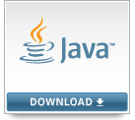

Installation Steps
Install course materials (project files and ml-100k data set)
See https://sundog-education.com/sparkscala
Install a Java Development Kit (JDK)
From oracle.com
Choose a version compatible with the current Scala IDE (8-14)
Install IntelliJ IDEA Community Edition
From jetbrains.com
Windows only: Install winutils.exe
Set up HADOOP_HOME and PATH accordingly
Set up our IntelliJ project
Detailed, written steps at https://sundog-education.com/sparkscala

Slide 3
Scala Crash Course

Slide 4
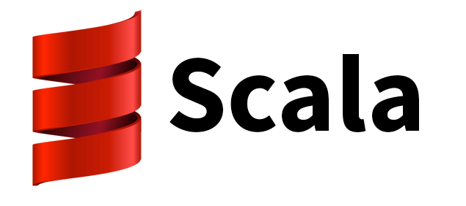
What is Scala?
Yet another programming language!
It’s what Spark is built with
New features are often Scala-first.
You can also program Spark with Python or Java
Runs on top of the Java virtual machine
Can access Java classes
Functional programming

Slide 5
Administrative note
I’ll attach sample code to each lecture on platforms that support it
But you downloaded these same files in lesson 2 – you can import them from wherever you saved them instead if you want.

Slide 6
Let’s Just Dive In.

Slide 7
Introduction to spark
Frank Kane

Slide 8

What is spark?
"A fast and general engine for large-scale data processing"

Slide 9
It's scalable
Executor
- Cache
-Tasks
Driver Program
-Spark Context
Cluster Manager
(Spark, YARN)
Executor
- Cache
-Tasks
Executor
- Cache
-Tasks
...

Slide 10
It's fast
"Run programs up to 100x faster than Hadoop MapReduce in memory, or 10x faster on disk."
DAG Engine (directed acyclic graph) optimizes workflows

Slide 11
it's hot
Amazon
Ebay: log analysis and aggregation
NASA JPL: Deep Space Network
Groupon
TripAdviser
Yahoo
Many others: https://cwiki.apache.org/confluence/display/SPARK/Powered+By+Spark

Slide 12
it's not that hard
Code in Python, Java, or Scala
If you know SQL, you’ll feel right at home with Spark DataSets and DataFrames
Lower-level API is available too: the Resilient Distributed Dataset (RDD)

Slide 13
Components of spark
Spark Streaming
Spark SQL
MLLib
GraphX
SPARK CORE

Slide 14
this course uses Scala
Why Scala?
Spark itself is written in Scala
Scala’s functional programming model is a good fit for distributed processing
Gives you fast performance (Scala compiles to Java bytecode)
Less code & boilerplate stuff than Java
Python is slower in comparison
But...
You probably don’t know Scala
So we’ll have to learn the basics first.
It’s not as hard as you think!

Slide 15
FEAR NOT
Scala code in Spark looks a LOT like Python code.
Python code to square numbers in a data set:
nums = sc.parallelize([1, 2, 3, 4])
squared = nums.map(lambda x: x * x).collect()
Scala code to square numbers in a data set:
val nums = sc.parallelize(List(1, 2, 3, 4))
val squared = nums.map(x => x * x).collect()

