Slide 1
Spark Streaming

Slide 2
Spark Streaming
Analyzes continual streams of data
Common example: processing log data from a website or server
Data is aggregated and analyzed at some given interval
Can take data fed to some port, Amazon Kinesis, HDFS, Kafka, Flume, and others
“Checkpointing” stores state to disk periodically for fault tolerance

Slide 3
Spark Streaming: The Dstream api
A “Dstream” object breaks up the stream into distinct RDD’s
Simple example: val stream = new StreamingContext(conf, Seconds(1)) val lines = stream.socketTextStream(“localhost”, 8888) val errors = lines.filter(_.contains(“error”)) errors.print() This listens to log data sent into port 8888, one second at a time, and prints out error lines. You need to kick off the job explicitly: stream.start() stream.awaitTermination()

Slide 4
Spark streaming
Remember your RDD’s only contain one little chunk of incoming data.
“Windowed operations” can combine results from multiple batches over some sliding time window
See window(), reduceByWindow(), reduceByKeyAndWindow()
updateStateByKey()
Lets you maintain a state across many batches as time goes on
For example, running counts of some event

Slide 5
Let’s stream
We’ll run a Spark Streaming script that monitors live Tweets from Twitter, and keeps track of the most popular hashtags as Tweets are received!

Slide 6

Need a Twitter developer account.
Specifically we need to get an API key and access token
This allows us to stream Twitter data in real time!
Do this at https://apps.twitter.com/

Slide 7
Create a twitter.txt file in your workspace
On each line, specify a name and your own consumer key & access token information.
For example (substitute in your own keys & tokens!) consumerKey AXXXXXXXXXXXXXXXXXXXXXXXXXXSQ consumerSecret 9EwXXXXXXXXXXXXXXXXXXXXXXXXXXXXXOG8lVKVX accessToken 384953089-3DUtu13XXXXXXXXXXXXXXXXXXXXXXXOM accessTokenSecret 7XXXXXXXXXXXXXXXXXXXXXXX4W3411l

Slide 8

Step one
Get a Twitter stream and extract just the messages themselves
val tweets = TwitterUtils.createStream(ssc, None) val statuses = tweets.map(status => status.getText()) Vote for #BoatyMcBoatFace! Vote for “I Like Big Boats and I Cannot Lie!” No! Vote for #WhatIceberg? Are you crazy? #BoatyMcBoatFace all the way. …

Slide 9
Step two
Create a new Dstream that has every individual word as its own entry.
We use flatMap() for this
val tweetwords = statuses.flatMap(tweetText => tweetText.split(" ")) Vote for #BoatyMcBoatFace Vote For I …

Slide 10
Step three
Eliminate anything that’s not a hashtag
We use the filter() function for this
val hashtags = tweetwords.filter(word => word.startsWith("#")) #BoatyMcBoatFace #WhatIceberg #BoatyMcBoatFace …

Slide 11
Step four
Convert our RDD of hashtags to key/value pairs
This is so we can count them up with a reduce operation
val hashtagKeyValues = hashtags.map(hashtag => (hashtag, 1)) (#BoatyMcBoatFace, 1) (#WhatIceberg, 1) (#BoatyMcBoatFace, 1) …

Slide 12
Step five
Count up the results over a sliding window
A reduce operation adds up all of the values for a given key
Here, a key is a unique hashtag, and each value is 1
So by adding up all the “1”’s associated with each instance of a hashtag, we get the count of that hashtag
reduceByKeyAndWindow performs this reduce operation over a given window and slide interval
val hashtagCounts = hashtagKeyValues.reduceByKeyAndWindow( (x,y) => x + y, (x,y) => x - y, Seconds(300), Seconds(1)) (#BoatyMcBoatFace, 2) (#WhatIceberg, 1)

Slide 13
Step six
Sort and output the results.
The counts are in the second value of each tuple, so we sort by the ._2 element.
val sortedResults = hashtagCounts.transform(rdd => rdd.sortBy(x => x._2, false)) sortedResults.print (#BoatyMcBoatFace, 2) (#WhatIceberg, 1)

Slide 14
Let’s see it in action
In Spark 2.0.0+, we need to import a few extra packages: dstream-twitter, twitter4j-core, and twitter4j-stream.

Slide 15
Structured streaming
Spark 2 introduced “structured streaming”
Uses DataSets as its primary API (much of Spark is going this way)
Imagine a DataSet that just keeps getting appended to forever, and you query it whenever you want.
Streaming is now real-time and not based on “micro-batches”
val inputDF = spark.readStream.json("s3://logs")
inputDF.groupBy($"action", window($"time", "1 hour")).count()
.writeStream.format("jdbc").start("jdbc:mysql//...")

Slide 16
Streaming log files
Spark.readstream.text(directory path)
Use SQL operations or mappers to parse out data from log lines
Apply real-time analysis (ie, groupBy, etc)
Stream your output to the console, a database, whatever you want

Slide 17

Let’s stream logs

Slide 18
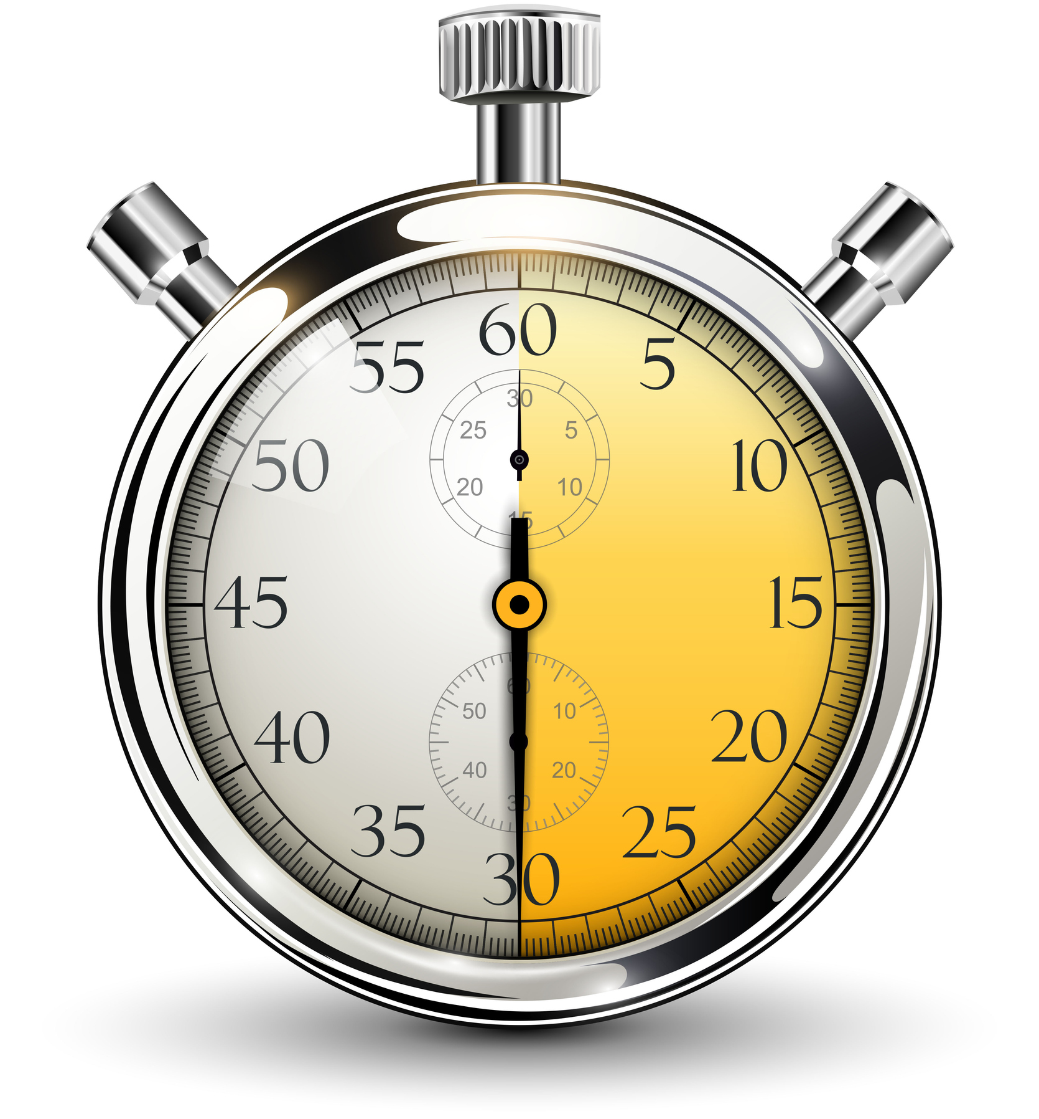
Exercise
Stream top URL’s in the past 30 seconds

Slide 19
Introducing windows
A “windowed” operation looks back over some period of time
For example, consider only events that happened in the past 10 minutes – 10 minutes would be the “window”
The “slide interval” defines how often we evaluate a window

Slide 20
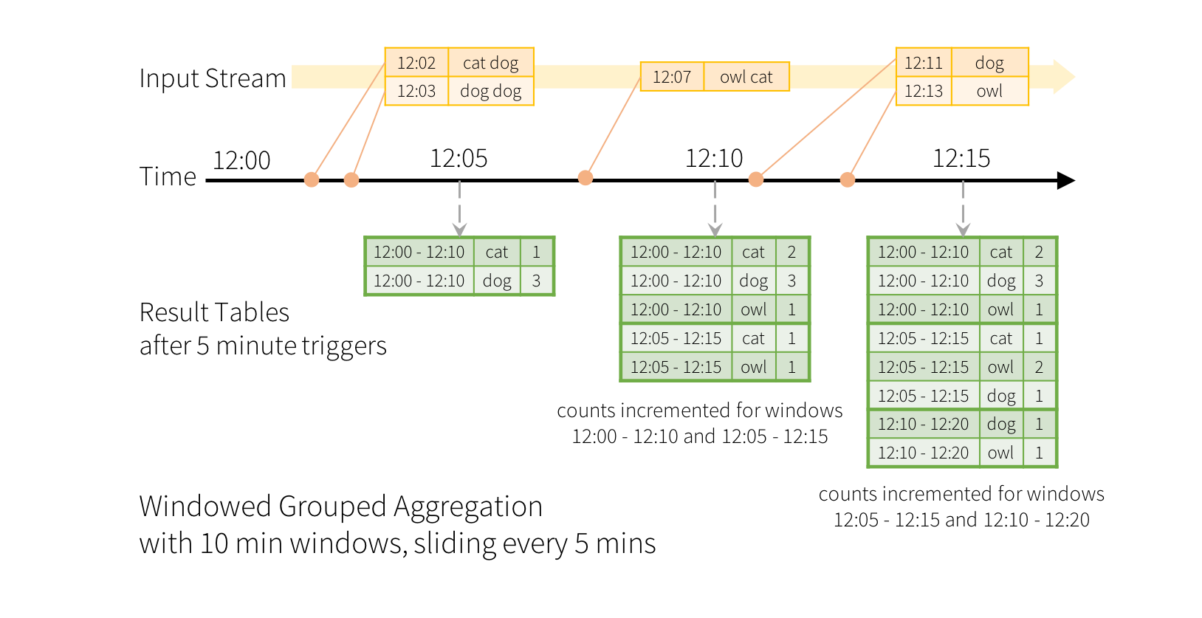
Window example
Image credit: https://spark.apache.org/docs/latest/structured-streaming-programming-guide.html#window-operations-on-event-time

Slide 21
Windowed aggregation code
dataset.groupBy(window(col(“timestampColumnName”), windowDuration = “10 minutes”, slideDuration = “5 minutes”), col(“columnWeAreGroupingBy”)

Slide 22
Your challenge
Modify the StructuredStreaming script to keep track of the most-viewed URL’s (endpoints) in our logs
Compute this with a 30 second window and 10 second slide

Slide 23
Useful snippets
logsDF.groupBy(window(col(“eventTime”), “30 seconds”, “10 seconds”), col(“endpoint”))
logsDF.withColumn(“eventTime”, current_timestamp())
endpointCounts.orderBy(col(“count”).desc)

Slide 24
Graphx

Slide 25
Graphx
Not that kind of graph…
Graphs like our social network of superheroes – graphs in the computer science / network sense.
However, it’s only useful for specific things.
It can measure things like “connectedness”, degree distribution, average path length, triangle counts – high level measures of a graph
It can count triangles in the graph, and apply the PageRank algorithm to it.
It can also join graphs together and transform graphs quickly
For things like our “degrees of separation” example, you won’t find built-in support.
But it does support the Pregel API for traversing a graph…

Slide 26
graphx
Introduces VertexRDD and EdgeRDD, and the Edge data type
Otherwise, GraphX code looks like any other Spark code for the most part

Slide 27
Creating Vertex RDD’s
// Function to extract hero ID -> hero name tuples (or None in case of failure)
def parseNames(line: String) : Option[(VertexId, String)] = {
var fields = line.split('\"')
if (fields.length > 1) {
val heroID:Long = fields(0).trim().toLong
if (heroID < 6487) { // ID's above 6486 aren't real characters
return Some( fields(0).trim().toLong, fields(1))
}
}
return None // flatmap will just discard None results, and extract data from Some results.
}

Slide 28
Creating edge RDD’s
/** Transform an input line from marvel-graph.txt into a List of Edges */
def makeEdges(line: String) : List[Edge[Int]] = {
import scala.collection.mutable.ListBuffer
var edges = new ListBuffer[Edge[Int]]()
val fields = line.split(" ")
val origin = fields(0)
for (x <- 1 to (fields.length - 1)) {
// Our attribute field is unused, but in other graphs could
// be used to deep track of physical distances etc.
edges += Edge(origin.toLong, fields(x).toLong, 0)
}
return edges.toList
}

Slide 29
Creating a graph
// Build up our vertices
val names = sc.textFile("../marvel-names.txt")
val verts = names.flatMap(parseNames)
// Build up our edges
val lines = sc.textFile("../marvel-graph.txt")
val edges = lines.flatMap(makeEdges)
// Build up our graph, and cache it as we're going to do a bunch of stuff with it.
val default = "Nobody"
val graph = Graph(verts, edges, default).cache()

Slide 30
Doing stuff
Top 10 most-connected heroes:
graph.degrees.join(verts).sortBy(_._2._1, ascending=false).take(10).foreach(println)

Slide 31
Breadth-first search with pregel
r
s
t
u
1
0
2
∞
∞
1
2
∞
v
w
x
y

Slide 32
How Pregel Works
Vertices send messages to other vertices (their neighbors)
The graph is processed in iterations called supersteps
Each superstep does the following:
Messages from the previous iteration are received by each vertex
Each vertex runs a program to transform itself
Each vertex sends messages to other vertices

Slide 33
BFS: Intialization
val initialGraph = graph.mapVertices((id, _) => if (id == root) 0.0 else Double.PositiveInfinity)
r
s
t
u
∞
0
∞
∞
∞
∞
∞
∞
v
w
x
y

Slide 34
Sending messages
triplet => {
if (triplet.srcAttr != Double.PositiveInfinity) {
Iterator((triplet.dstId, triplet.srcAttr+1))
} else {
Iterator.empty
}
},
r
s
t
u
1
0
∞
∞
∞
1
∞
∞
v
w
x
y

Slide 35
Preserving the minimum distance at each step
Pregel’s vertex program will preserve the minimum distance between the one it receives and what it has:
(id, attr, msg) => math.min(attr, msg)
Its reduce operation preserves the minimum distance if multiple messages are received for the same vertex:
(a,b) => math.min(a,b)

Slide 36
Putting it All Together
val initialGraph = graph.mapVertices((id, _) => if (id == root) 0.0 else Double.PositiveInfinity)
val bfs = initialGraph.pregel(Double.PositiveInfinity, 10)(
(id, attr, msg) => math.min(attr, msg),
triplet => {
if (triplet.srcAttr != Double.PositiveInfinity) {
Iterator((triplet.dstId, triplet.srcAttr+1))
} else {
Iterator.empty
}
},
(a,b) => math.min(a,b)
)

Slide 37
Let’s do it

