Slide 1
Automated Machine Learning

Slide 2
Introduction
Name: Zi Ping
University: NUS, School of Computing
Course: Bachelor of Science (Business Analytics)
Project: Democratizing Machine Learning with AutoML
Internship Objectives:
Test open source AutoML packages and evaluate them along different dimensions
Develop a platform to make them available to researchers to reduce their workload
Democratize Machine Learning making them available to non-data scientist

Slide 3
Agenda
Trials and Results
Limitations and Solutions
Further Work and Challenges
AutoML Frameworks Considerations
Modifications
Optimization
Introduction to Automated Machine Learning (AutoML)
Workflow
Rationale
Benefits
Challenges

Slide 4
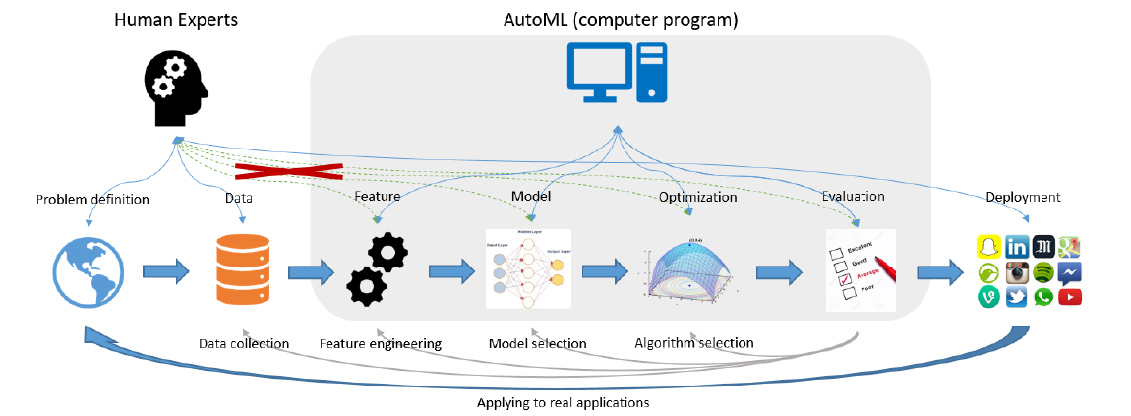

Slide 5
Benefits
State of the Art Methods
Running Strong Baselines
Advanced
Increased Productivity
Democratising Machine Learning
Novice

Slide 6
Challenges
Human Interpretability
Huge computational resources
Void of contextual knowledge
Less useful for smaller datasets
Data privacy if used on commercial platforms

Slide 7
Frameworks
Considerations
H2O
TPOT
AutoKeras
AutoGluon
Ludwig
NNI

Slide 8
Why NNI?
Extensible/ Customisable
WebUI available
Support many frameworks
Supports convolutions
Supports both pytorch and tensorflow

Slide 9
Some Issues
User Interface
NAS Workflow
Lack of pre-processing
Lacks integration of information
Unable to do search over extracted features
Requires retraining after searching
Unable to tune algorithm’s hyperparameters

Slide 10
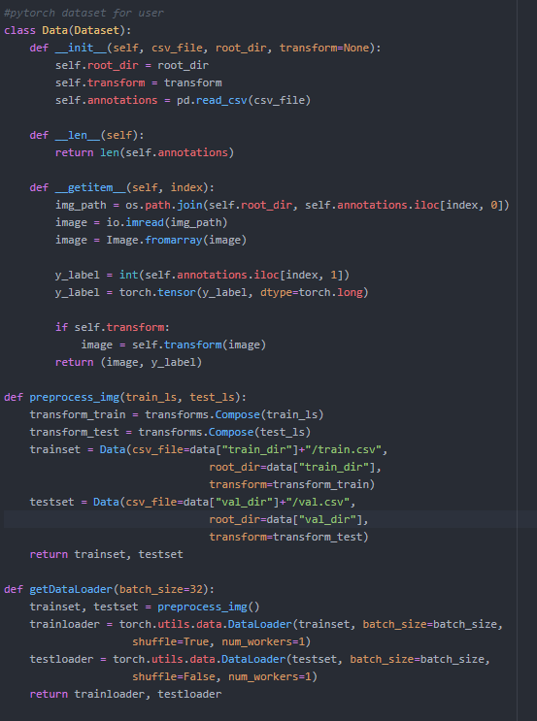

Lack of Pre-processing
Do not provide a convenient API call
Results in inability to pre-process data
Might be inconvenient for seasoned users and confusing for new users
Previous
Current

Slide 11
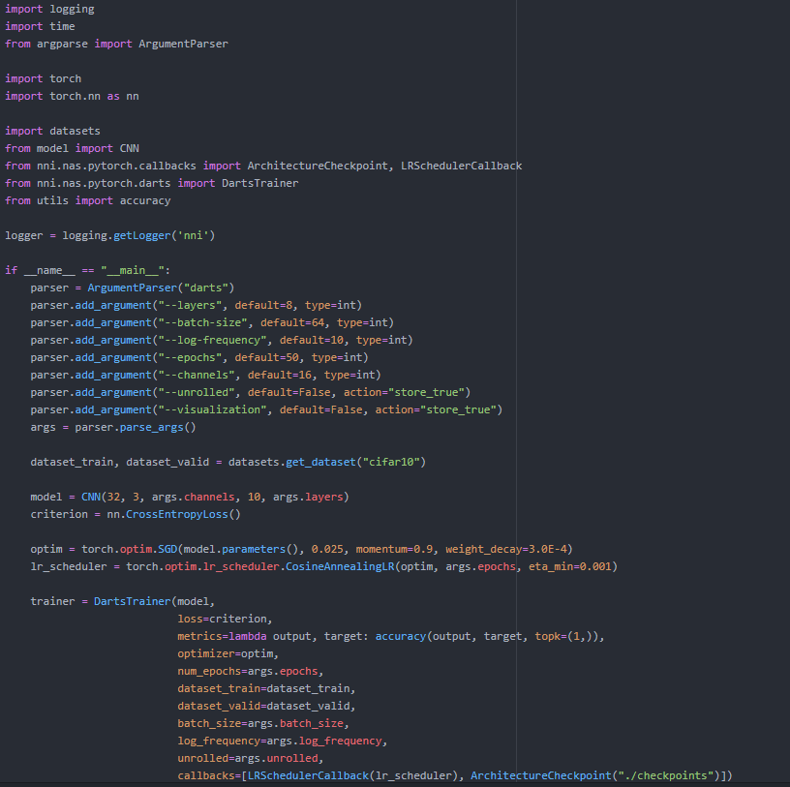
Lacks Integration
Codes were not consolidated and separated for HPO and NAS
Resulting in user exposed to many scripts for both NAS and HPO
To run neural architecture search (nas.py)

Slide 12
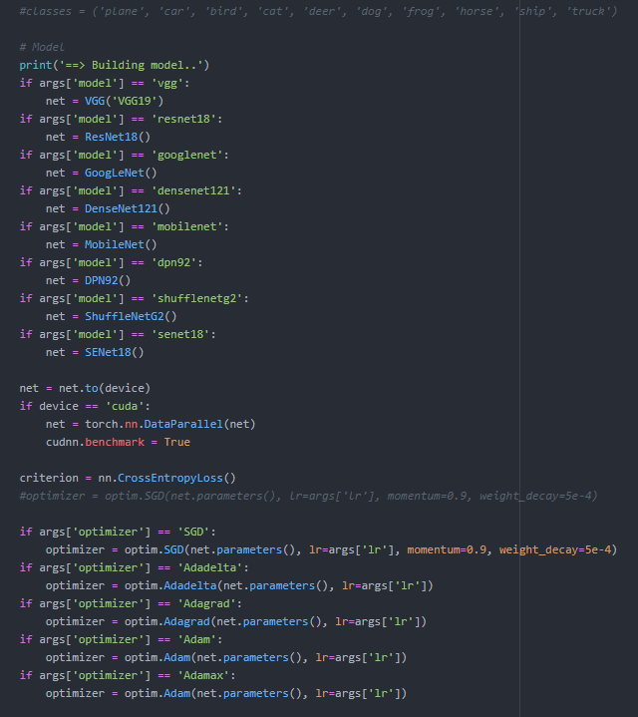
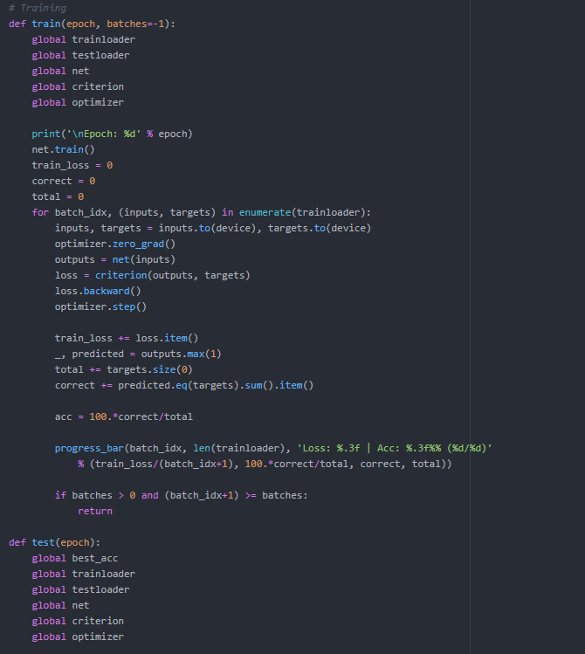
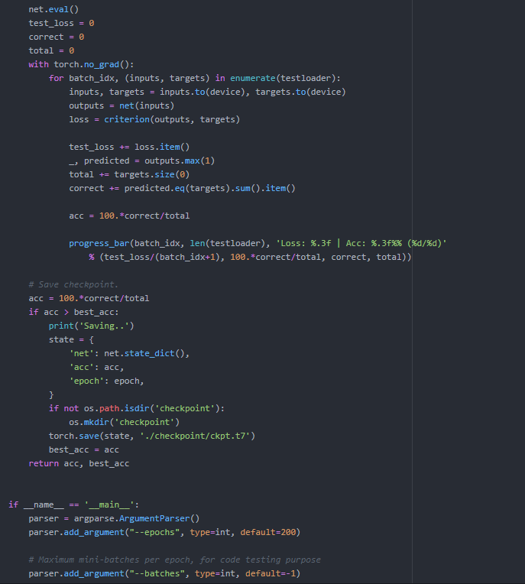
Lacks Integration
To run hyperparameter optimization (train.py)

Slide 13
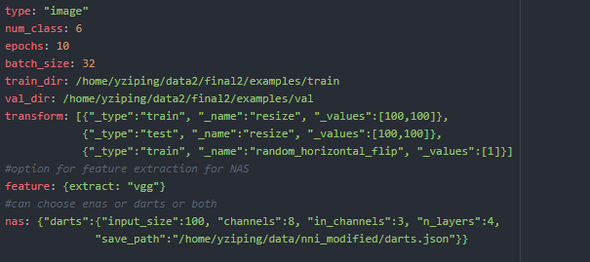
Lacks Integration
Provided a consolidation of scripts and abstracted for easy usage for users
Only require minimal declarations to run e.g. type, num_class, train/ val dir
Provided optional declarations such as NAS and feature extraction if called upon
Current codes exposed to user

Slide 14
NNI Workflow
Data
NAS
Hyperparameter Optimization
Results

Slide 15
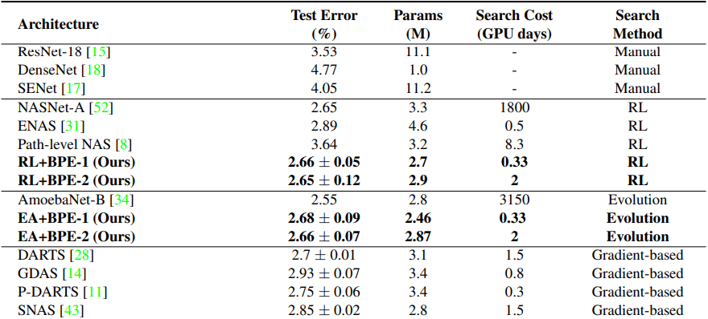
CIFAR 10 Results
Differentiable Architecture Search (DARTS) is used having reproduced on NNI
Reproduced state of the art results (2.78) on NNI as compared to the paper (3.00 +/- 0.14)

Slide 16
Custom Dataset
Military Weapons
6 Classes (Warships, Cannons, Missiles, Rifles, Bombers, Tanks)
Balanced Dataset (~800 training images per class ~200 validation images per class)
Coloured Images used

Slide 17
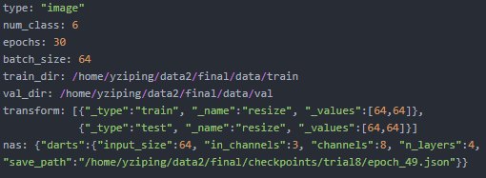
Specifications
Input resized to (64,64)
Batch Size: 64
Learning Rate: 0.025
Momentum: 0.9
Optimizer: SGD
Number of Cells: 4
Number of Channels: 8

Slide 18
Required Steps (NAS/ HPO)
Declare preferred specifications (ss.yml)
Run python nas.py
Input resized to (64,64)
Batch Size: 64
Learning Rate: 0.025
Momentum: 0.9
Optimizer: SGD
Number of Cells: 4
Number of Channels: 8

Slide 19
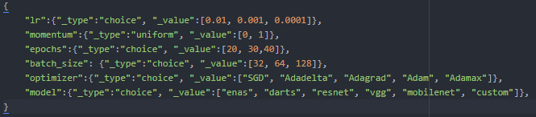
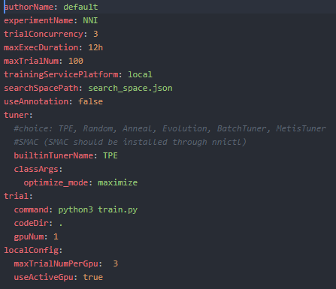
Required Steps (NAS/ HPO)
Declare preferred specifications (ss.yml)
Run python nas.py
Update ss.yml on path to prefered architecture
Update search space to conduct HPO (search_space.json)
Update config.yml (if needed)
Run nnictl create --config ./config.yml
search_space.json
config.yml

Slide 20
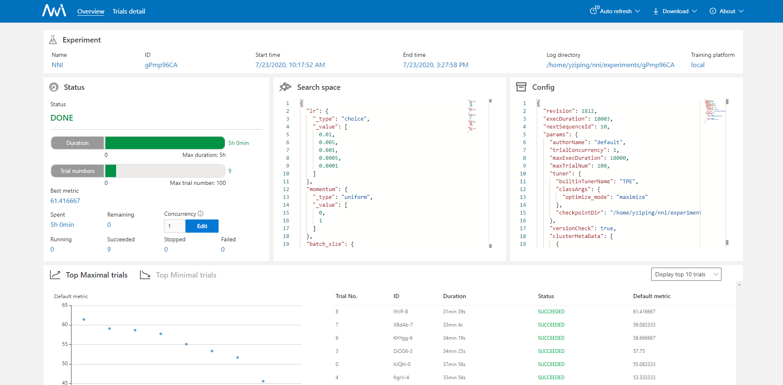
Web UI

Slide 21
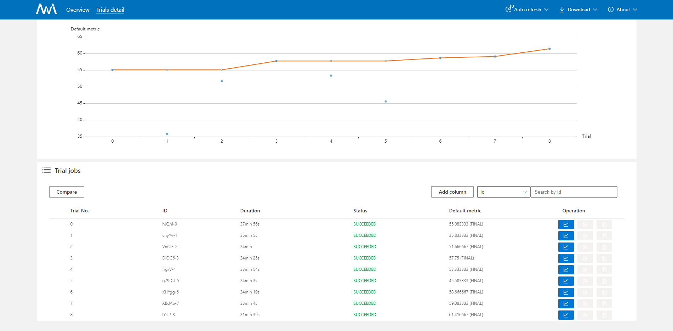
Web UI

Slide 22
Results
Both trained and fine tuned for 6 hours
VGG uses pretrained weights (freezed) and replaced last layer with fully connected layer
DARTS was trained with 1 hour on searching (50 epochs) and 5 hours on fine tuning and retraining (50 epochs each trial)
65.00
61.41
VGG
(fine-tuned/ freezed)
DARTS
(fine-tuned) from scratch

Slide 23
Web UI

Slide 24
Updated Workflow
Feature Extraction
Data
NAS
Hyperparameter Optimization
Results

Slide 25
Results
Features are extracted out using a pretrained VGG model
Features are trained using DARTS to search for the optimal architecture
Total of 150 epochs of searching in 15 mins and fine-tuned + retrained for 45 mins at 150 epochs each trial
65.00
66.08
61.41
VGG
(fine-tuned/ freezed)
DARTS
(fine-tuned) from scratch
DARTS
(fine-tuned) using extracted features

Slide 26
Results on CIFAR 10
Features are extracted out using a pretrained VGG model
Features are trained on a fully connected layer and another using DARTS to search for the optimal architecture
No transformations or augementation done to the images for both models
For DARTS, total of 100 epochs of searching in an hour and retrained
54.78
51.34
VGG
(freezed) using extracted features
DARTS
using extracted features

Slide 27
Extraction of Weights
Feature Extraction
Data
NAS
Hyperparameter Optimization
Results

Slide 28
Naive Joint Optimization
Feature Extraction
Data
HPO/ NAS
Hyperparameter Optimization
Results

Slide 29
Target Workflow
Feature Extraction
Data
HPO + NAS
Results
Hyperparameter Optimization

Slide 30
Joint Optimization
Active area of research on Neural Architecture Search
Some current approaches:
Speed up the optimization process since NAS can be seen an optimization problem
Reduce the evaluation time of the evaluation stage
Through pruning the hyperparameters by feature importance using Random Forest (https://arxiv.org/pdf/2005.09917.pdf)
Jointly optimize DARTS treating hyperparameters as part of the candidates to search for by sharing weights across all hyperparameters and architectures (Auto-HAS https://arxiv.org/pdf/2006.03656.pdf)
Might lead to a huge overload of memory
Addressed in the paper by increasing the number of cores to meet memory requirements

Slide 31
Joint Optimization
One disadvantage of DARTS is the huge memory usage due to the joint training of a super-network and searching for an optimal architecture (https://arxiv.org/pdf/1907.05737.pdf)
Pruning in DARTS has been in practice to search over large search spaces (P-DARTS https://arxiv.org/pdf/1904.12760.pdf)
Possible directions might be to reduce the huge memory required for jointly optimizing both hyperparameters and architectures by pruning
Pruning by feature importance using Random Forest (https://arxiv.org/pdf/2005.09917.pdf)
Prune bad candidate operations and replace them with more promising one (Prune and Replace NAS https://arxiv.org/pdf/1906.07528.pdf)

Slide 32
Limitations and Further Work
Microsoft released a CDARTS algorithm last month that is reproducible using NNI
Focuses on Image data and slight touch on tabular data
Standardize the usage of terms in the search space
Require further test on large datasets
Joint Optimization of Hyperparameters during NAS

Slide 33
Challenges faced:
Unfamiliarity with the servers usage which leads to inefficiency during development
Misconception of some parts of the NAS algorithms which was solved by reading the research papers
To determine which capabilities to retain and prioritized to keep usage convenient
Lack of large relevant datasets and resources due to NAS being a relatively new area of research

Slide 34
Thank You

