Slide 1
MEDALLION THEATRE
System Design & Implementation Report
Comprehensive Review of Specifications and Final Architecture

Slide 2
System Background
The Medallion Theatre is an expanding community arts organization managing a 602-seat venue.
Historically, operations have relied on manual documentation and verbal communication.
Clerks take ticket requests by phone and locate available seats via physical charts.

Slide 3
Problem Statement & Current Limitations
Data Inaccuracy: The manual process frequently leads to the double-booking of specific physical seats.
Lack of Analytics: Management cannot easily track historical ticket sales or patron loyalty.
Operational Bottlenecks: Verifying seat availability across multiple clerks causes significant delays.
Data Loss: Physical records are prone to loss or damage.

Slide 4
Proposed Solution & Objectives
Develop a centralized, relational database application to handle all box office operations.
Objective 1: Enforce strict database constraints to mathematically eliminate the possibility of double booking.
Objective 2: Provide an intuitive Graphical User Interface (GUI) to accelerate clerk workflows.
Objective 3: Centralize patron data for historical tracking and customer service.
Objective 4: Automate financial reporting and seat availability calculations.

Slide 5
Functional Requirements: Patron Management
The system must maintain a registry of all theater patrons.
Required Data Fields: First Name, Last Name, Street Address, City, State, Zip Code, Phone Number, Email.
System must allow users to search the patron database using names or unique identifiers.
System must provide forms to register new patrons or update existing contact details.

Slide 6
Functional Requirements: Scheduling & Performances
The system must differentiate between a "Production" (the show title) and a "Performance" (the specific date/time).
Required Data Fields (Production): Title, Type (Musical, Play, etc.).
Required Data Fields (Performance): Date, Time category (Matinee or Evening).
Users must be able to create, edit, and assign performances to their parent production.

Slide 7
Functional Requirements: Ticket Reservations
The system must facilitate the reservation of a specific physical seat for a specific performance.
Reservations must be explicitly linked to a registered patron.
The system must output a printable "Will Call Reservation Form" for physical distribution.
The UI must clearly display which seats are available and which are occupied.

Slide 8
Functional Requirements: Reporting & Analytics
Seat Availability Report: An output detailing the exact status of all 602 seats for a selected performance.
Patron Ticket Report: An aggregate view of a specific patron’s purchase history to resolve disputes or identify loyalty.
Ticket Sales Report: A managerial overview calculating total tickets sold and gross revenue for performance evaluation.

Slide 9
System Use Case: Box Office Manager
Actor Profile: Administrative personnel responsible for overall operations and financial tracking.
Primary Actions:
1. Setup and schedule upcoming productions and their respective dates.
2. Review ticket sales reports to assess performance profitability.
3. Manage system access and override specific ticket reservations if necessary.

Slide 10
System Use Case: Ticket Clerk
Actor Profile: Frontline staff focused on speed and accuracy during patron interactions.
Primary Actions:
1. Register incoming callers into the patron database.
2. Navigate the system to find the requested performance date.
3. Select available seats on behalf of the patron and finalize the booking.
4. Print the physical Will Call slip.

Slide 11
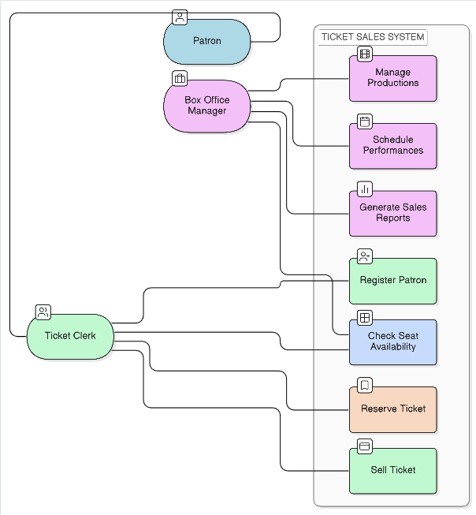
System Design: Diagram 1

Slide 12
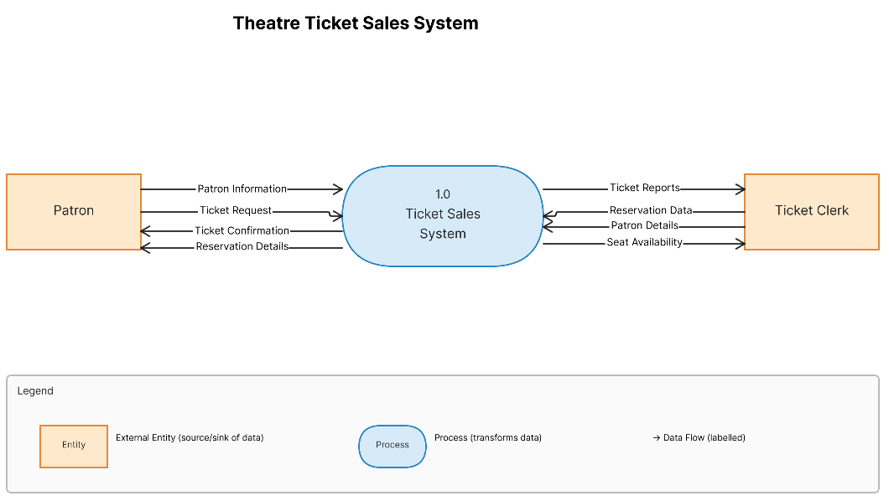
System Design: Diagram 2

Slide 13
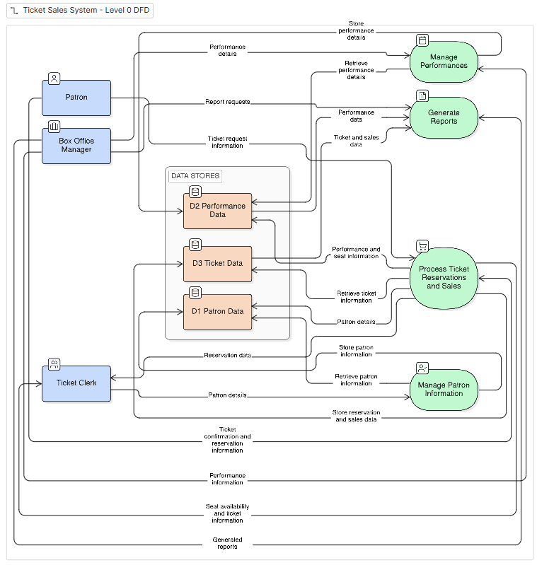
System Design: Diagram 3

Slide 14
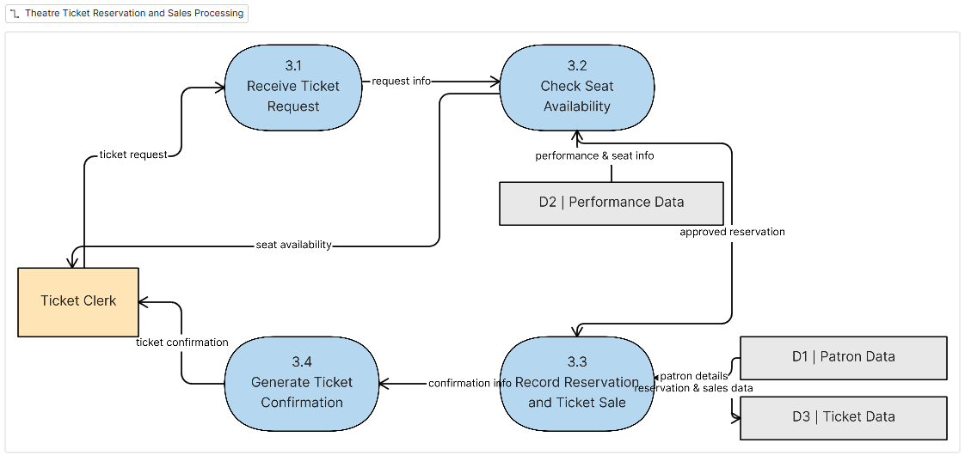
System Design: Diagram 4

Slide 15
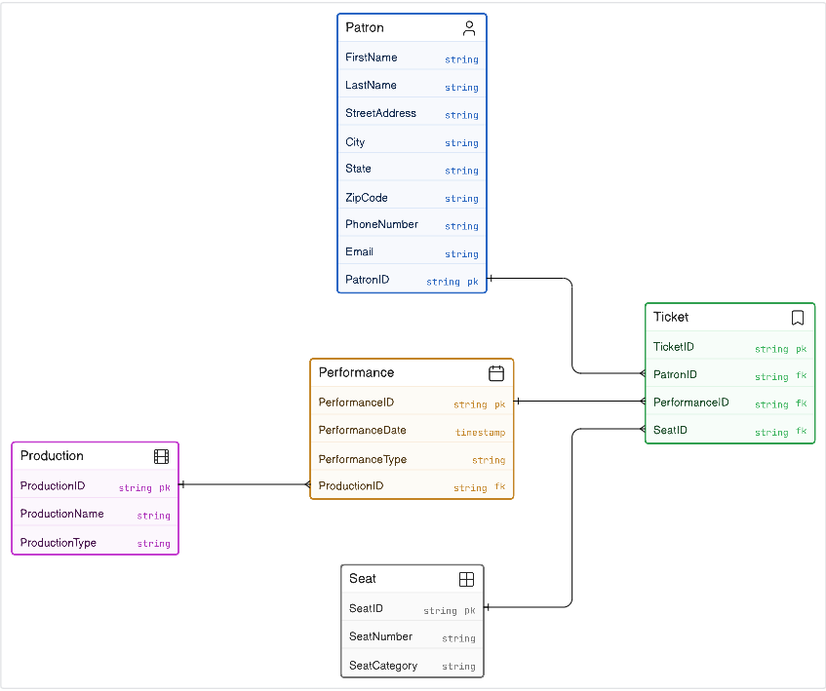
System Design: Diagram 5

Slide 16
Database Architecture Overview
The backend utilizes PostgreSQL to enforce strict relational integrity.
UUIDs (Universally Unique Identifiers) are used as primary keys to ensure global uniqueness and security.
The schema is normalized to prevent data redundancy across patrons, performances, and physical seats.

Slide 17
Entity Relationships Deep Dive
Production (1) -> (M) Performance: One show can have multiple dates.
Seat: A static table containing exactly 602 rows representing the physical layout. Fixed categories: Orchestra, Mezzanine, Balcony, Box.
Ticket Table: The core junction entity linking PatronID, PerformanceID, and SeatID.
Constraint: A UNIQUE(performanceid, seatid) index physically prevents the database from saving a double-booked seat.

Slide 18
Implementation: Technology Stack
Frontend Architecture: Next.js (App Router) combined with React. Provides Server-Side Rendering (SSR) capabilities and a robust component structure.
Styling: Tailwind CSS used for strict, utility-based styling, ensuring visual consistency without bloated stylesheets.
Backend Engine: Node.js running Express.js to construct a RESTful API layer.
Database Connector: The `pg` library manages connection pooling to the PostgreSQL instance.

Slide 19
Implementation: Security & Authentication
Authentication was implemented to restrict system access to authorized staff only.
JSON Web Tokens (JWT): Used for stateless, secure session validation across API requests.
Password Hashing: Passwords are encrypted using bcrypt before database insertion.
Middleware: Express middleware intercepts requests to verify JWT validity and enforce role-based access control (RBAC).

Slide 20
Implementation: The Seat Map Engine
Rather than a simple dropdown list, the UI implements a complex DOM-based visual grid.
The 602 seats are geometrically mapped to reflect the theatre's actual floor plan (Left, Center, Right aisles).
State Management: React dynamically parses the 602 seats and cross-references them against the Ticket table to render "Available" vs "Reserved" UI states.

Slide 21
Implementation: 3-Step Reservation Workflow
The clerk experience was consolidated into a linear state machine to prevent user error.
Phase 1: Database query interface to locate or create the Patron.
Phase 2: Selection of the Performance via a clean tabular interface.
Phase 3: The visual Seat Map takes the parameters from Phase 1 and 2 to execute the final POST request to the Ticket table.

Slide 22
Implementation: Reporting Module
A dedicated reporting interface processes complex SQL JOIN operations.
Financial Aggregation: Queries SUM() the price column from the Seat table based on active Tickets to calculate exact revenue.
Seat Availability: Queries use LEFT JOIN logic to identify Seats that lack a corresponding Ticket record for a given Performance.

Slide 23
Planned Specifications vs. Final Implementation
The initial System Design document (DOCX) successfully captured the core domain entities and required workflows.
The final code deployment accurately implements the defined relational database, the input forms, and the requested reports.
During development, several technical necessities (such as security layers and state management) were expanded upon to translate the design into functional software.

Slide 24
Enhancements Built Beyond the Original Scope
System Security: Implemented the full JWT authentication flow, which was implicitly needed but not documented in the initial specifications.
Data Correction UI: Built a manager-restricted interface to delete/cancel tickets, addressing the real-world need for refunds and mistake handling.
Modern UX: Upgraded the proposed basic interface to a high-fidelity "Dark Mode" aesthetic, optimizing contrast and reducing eye strain for clerks.

Slide 25
Conclusion
The Medallion Theatre system successfully digitizes a highly inefficient manual workflow.
By relying on strict SQL constraints, the foundational issue of double-booking is permanently resolved.
The final deployment is a robust, secure, and highly visual application that aligns with both academic requirements and modern software engineering standards.

