Slide 1
Cancer In The Fire Service
CWU SHM-102, Fall 2026

Slide 2

Introduction
Firefighter since 2013
Emergency Medical Technician 2018
Outside of work: Rock climbing, hiking, Skiing, Kayaking, and local history

Slide 3
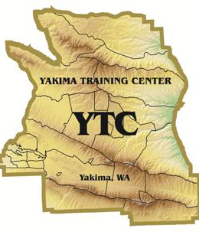
Yakima Training Center (YTC)
US Army live fire training area established in 1942
327,000 acres
Bordered by I-82, the Columbia River, I-90 & Yakima Ridge

Slide 4
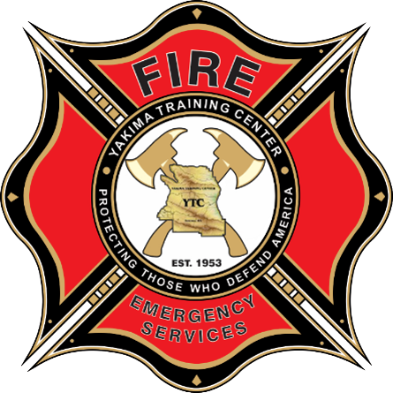
YTC Fire Department
“Protecting those who defend America”
All Hazard Fire Department
30 employees
1 station
15 Apparatus

Slide 5
Cancer In The Fire Service
Firefighters are 9% more likely to be diagnosed with cancer than the general population
Cancer is the #1 cause of line of duty deaths surpassing heart attack
Firefighters are at risk for more than 20 different cancer types
14% higher risk of dying from cancer than general public
Sources: NIOSH 2021 Firefighter Cancer Cohort Study | USFA Cancer Workgroup Report 2024 | IARC Monograph 132 (2022)

Slide 6
Firefighting, Known Human Carcinogen
World Health Organization, International Agency for Research on Cancer
Classified Firefighting as Group 1 cancer risk category in 2022
  Group 1 is the same tier as asbestos, benzene and tobacco
Source: IARC Monograph 132 (2022)

Slide 7
Where Do Carcinogens Come From In Fires?
Smoke is a toxic mixture of solids, liquid particles, and gaseous byproducts of combustion
  Partially burned fuel
  Volatile Organic Compounds (VOC)
  Formaldehyde
  Hydrogen Cyanide, Carbon monoxide
Source: IFSTA Essentials of Firefighting 6th Edition

Slide 8
PFAS, Forever Chemicals
Per- and Polyfluoralky Substances, are a Family of >9,000 distinct compounds
Carbon-Fluorine (C-F) bond is the strongest single bond in organic chemistry
PFAS does not break down in the human body or the Environment
PFAS is found in many consumer products and Firefighting Protective Clothing
Sources: NIOSH FFCCS (2023–2024) | IARC Classification Nov 2023 | WA Dept. of Ecology | Lubina et al. Am J Ind Med 2026

Slide 9
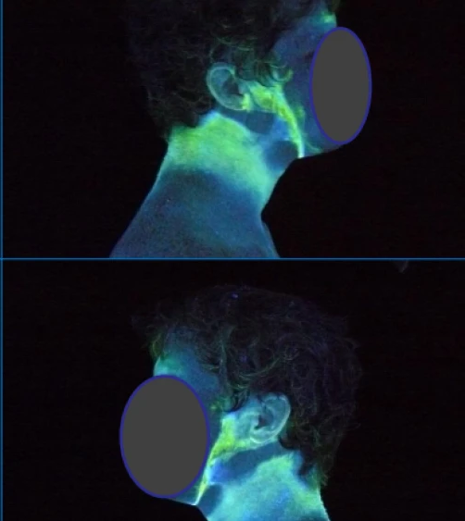
How Carcinogens Enter The Body
Dermal absorption
  Skin absorbs combustion byproducts through unprotected neck, ears, wrists, and face.
Ocular absorption
  Eyes absorb carcinogens directly through mucous membranes. Eye irrigation and face washing are critical steps in decontamination process.
Inhalation
  Combustion gases, particulate matter, and volatile organic compounds (VOCs) inhaled after SCBA is doffed and the scene appears clear.
Ingestion
  Contaminated hands touch face, food, and drinks. Eating before showering is a direct ingestion pathway.
Source: Fire-Dex via FireRescue1
Source: Fent et al. NIOSH (2017) | IARC Monograph 132 (2022)

Slide 10
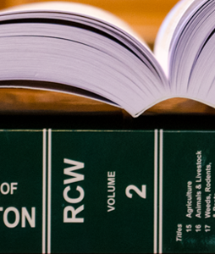
Regulatory Protections
Federal
  Federal Firefighters Fairness Act Title 5 U.S.C Section 8143b
    NDAA (FY) 2020
State
  Washington RCW 51.32.185
    Personal Internet Injury Exposer Reporting System (PIIERS)
IAFF Presumptive Health Initiative

Slide 11
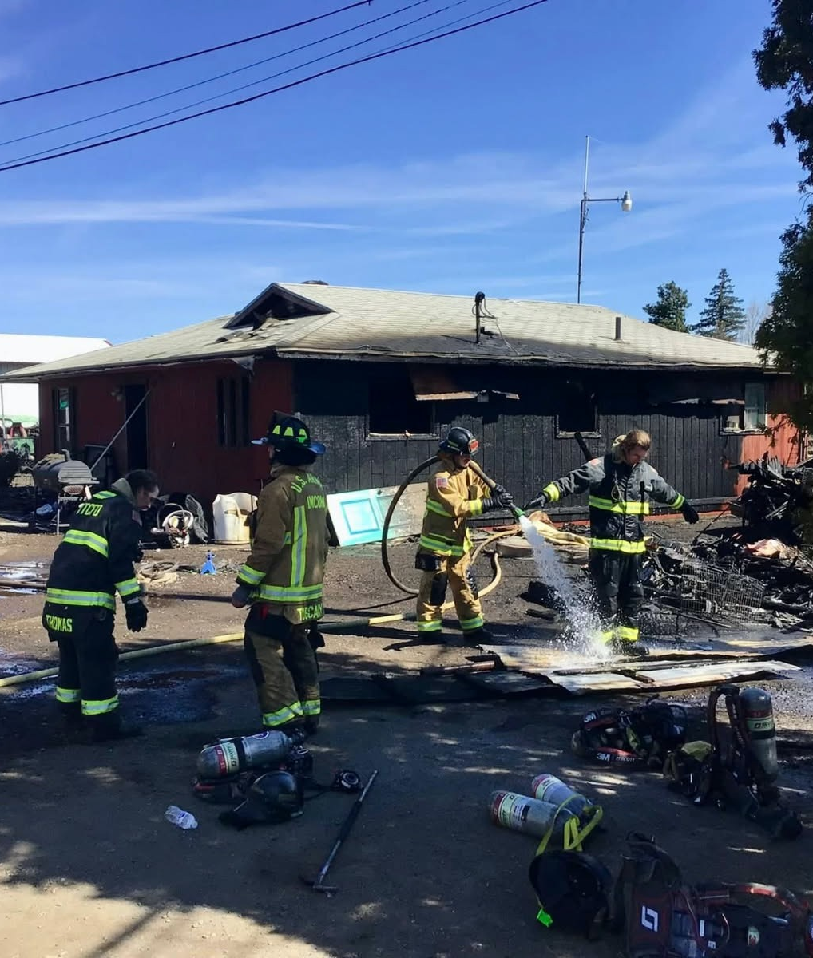
YTC FD Post Incident Decontamination
Gross Decontamination
Clean Cab Initiative
Laundering Personal Protective Clothing and uniform
Full body shower before entering living quarters

Slide 12

Sauna For Toxin Elimination
Limited number of studies
Additional health benefits
  Cardiovascular health
  Alleviate stress
  Improve sleep
  Help alleviate depression
Sources: Minnesota Public Health Laboratory

Slide 13
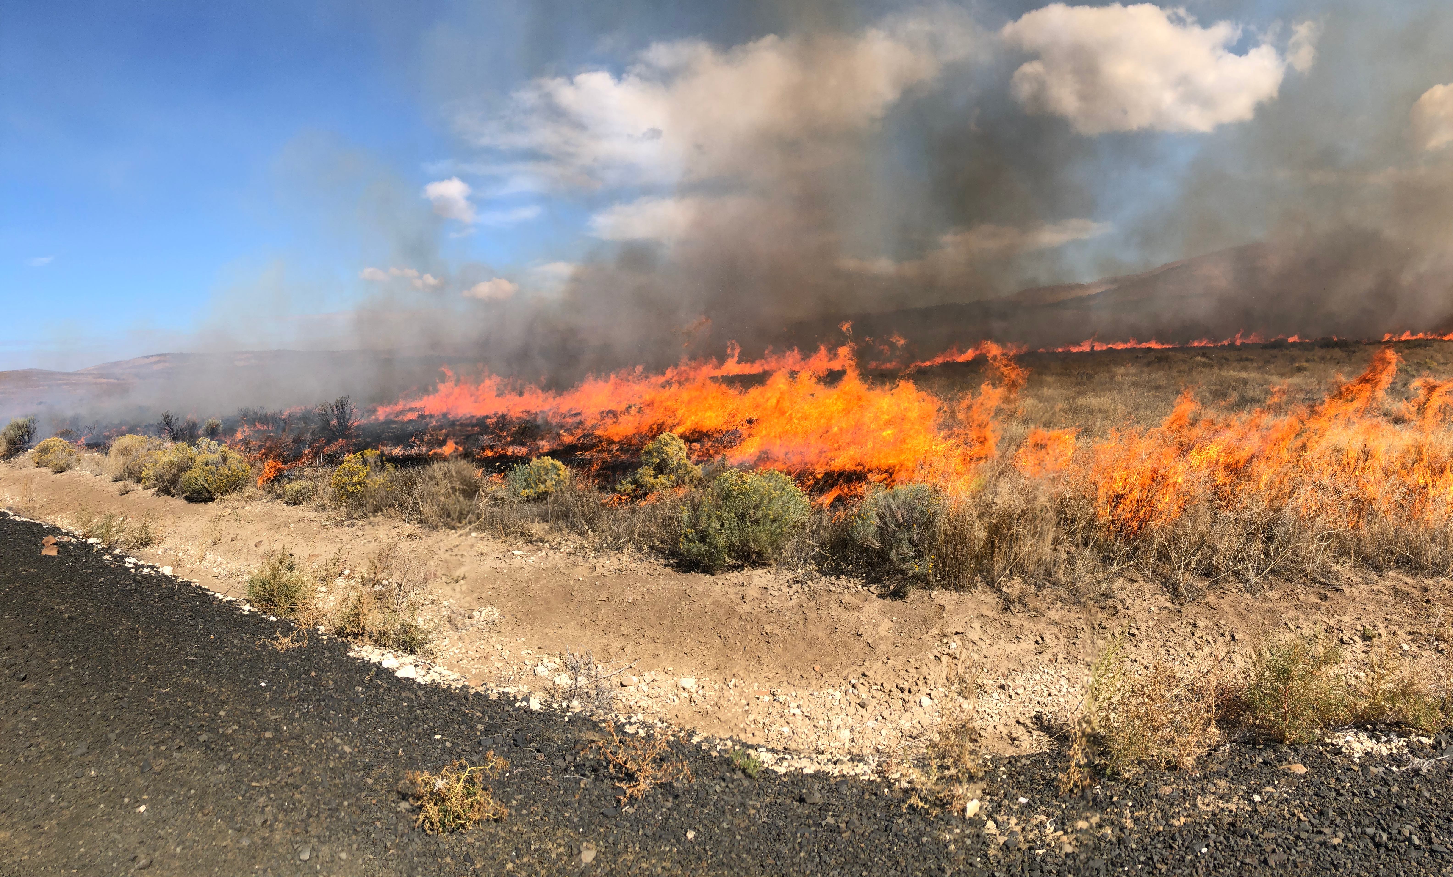
Questions?

