Slide 1

Verification of Smart Contracts in the Blockchain
Guy Gedalya
Oz Gutman

Slide 2
A survey of attacks on Ethereum smart contracts
What is the paper about – the paper is about the vulnerabilities in smart contract and possible attack on Ethereum blockchain using these vulnerabilities.
Motivation – the main motivation is to increase our knowledge about the weaknesses in the whole world of Ethereum blockchain to avoid attacks.
Main contribution – the paper give thorough information about the operation of solidity and weaknesses of the blockchain base of experience which can help us build better smart contract.

Slide 3
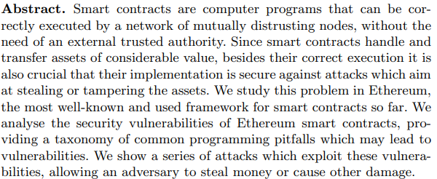
Terminology and notions

Slide 4
Terminology and notions
Decentralized cryptographic currency – a currency that doesn’t need a formal institution to inspect on him.
Blockchain – append-only data structure maintained by the nodes of peer-to-peer network. The block chain is a public ledger (פנקס) which the cryptocurrency use for record the transfers.
Turing complete language – a language that can execute any program that can be execute by a Turing machine if there is no limit of time and hardware.

Slide 5
Consensus protocol of Ethereum
Specifies how the node of the peer-to-peer network extend the blockchain. A mechanism that assure the network agreed on new blocks without the need of central authority.
Has the goal to ensure the correct execution of contacts.
Proof of work – race to add the new block to the blockchain. More power more likelihood.
Evil strong hacker – even if hacker with great power will be notice since the rest of the nodes verified him.
If most of the node are honest the system is secured.

Slide 6
Smart contract
Composed by fields and functions.
Execute correctly is necessary condition – if not an attacker can transfer money to himself.
Is it enough? No!
An attacker can use vulnerabilities in correctly execute contact.
Example – steal a 60M$ from a contact using these vulnerabilities.
To insure the correctness of the execution. Ethereum rely on a group of untrusted peers called miners.

Slide 7
Miners
Network of mutually untrusted peers.
The protocol relies on the assumption that they are reasonable – it more likely that they co operate than try to attack.
To maintain this assumption, they get reward for good behavior and fine for bad.
The fee they get (a reward) is bounded to prevent DoS attack.

Slide 8
Solidity
High level language supported by Ethereum.
Similar by look to java script.
Gap between semantics to intuition of programmers – can cause vulnerabilities.
For example – exception – the fee is lost.
Doesn't have a mechanism to deal with blockchain problem.
Doesn’t have a single source of all the security vulnerabilities that might happened.
Have exceptions machanism – it not necessarily good.

Slide 9
Exception mechanism
If an exception is thrown – it cannot be caught.
That means the execution is stop and the fee is lost.
All the side effects – including transfers of ether are reverted.
Preview: out-of-gas exception – when the computation consume all the gas.

Slide 10
Background on Ethereum smart contract
Contract written in Turing complete language – Solidity.
Contract written in a Turing complete bytecode – EVM bytecode.
Set of function defined by a sequence of bytecode instruction.
Contract can sent ether.

Slide 11
Transaction
User use transaction for:
Create new contract
Invoke functions of contract
Transfer ether
As mentioned before, all the transaction is recorded in the blockchain.
Must have the execution fee to prevent DoS.

Slide 12
Programming smart contract
This example is an illustration of a personal wallet.
It has a pay function to execute payment.
It has two fields:
The owner.
A Hashtable (called outflow) that map an address to the money sent to it.
Additionally, a wallet need to hold a field of balance – how much ether it holds and cannot be change by the programmer.

Slide 13
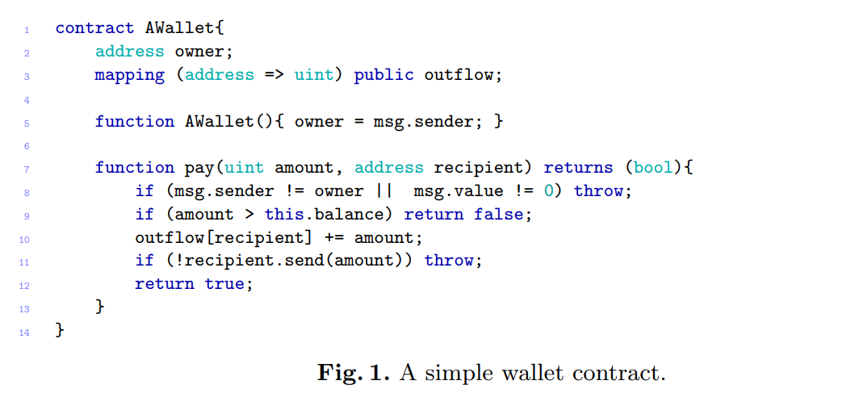
Programming smart contract

Slide 14
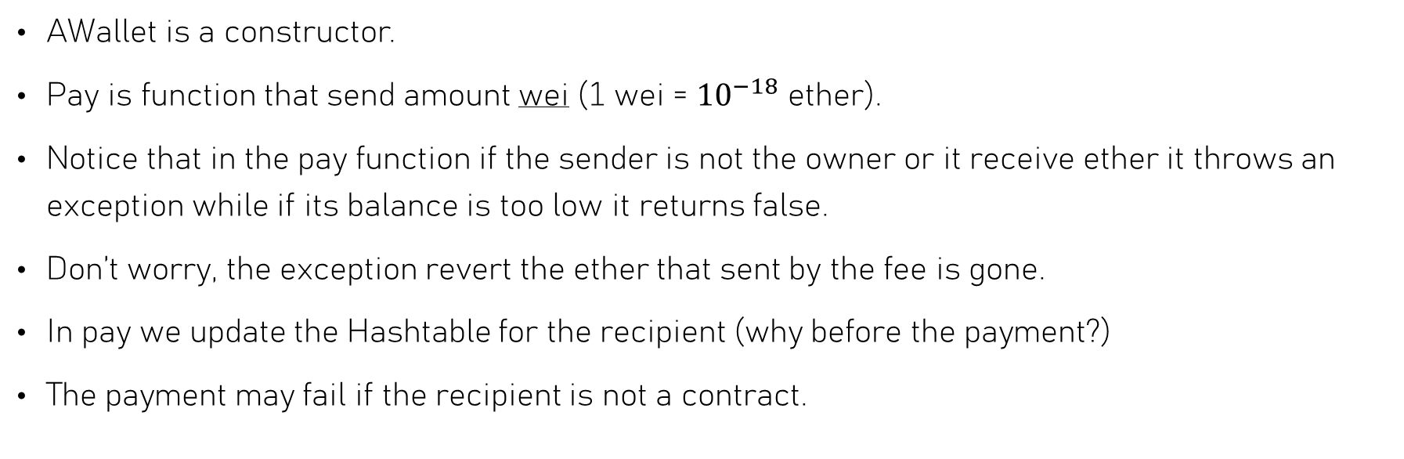
Programming smart contract
AWallet is a constructor.
Pay is function that send amount wei (1 wei = ${10}^{−18}$ ether).
Notice that in the pay function if the sender is not the owner or it receive ether it throws an exception while if its balance is too low it returns false.
Don’t worry, the exception revert the ether that sent by the fee is gone.
In pay we update the Hashtable for the recipient (why before the payment?)
The payment may fail if the recipient is not a contract.

Slide 15
Execution fee (Gas)
Represent the cost paid by the user to execute code.
The transaction specified the gas limit and the price per unit of gas.
The higher the price per gas the higher the change to pick this transaction.
The overall fee depends on the whole sequence of operation execute by the miners.
If a transaction terminates successfully the remaining gas return to the caller.
Else, all the gas is lost.

Slide 16
How execution fee prevent DoS?
If an attacker willing to preform a DoS attack, he must pay execution fee.
If he pays as he should according to the market, it will be too expensive.
If he pays too little, the miner won`t execute it.

Slide 17
The mining process
The miner group the transaction into block (remember – by the most profit one).
Each miner want to collect the fee.
Only the valid block can be appended to the blockchain.
An example of validity of block – the solve of PoW puzzle – update it difficulty to maintain mining rate of block per 12 seconds.

Slide 18
The mining process
Each miner try to solve the puzzle.
When the first one solve it he broadcast a new valid block to the network.
The other miner discard their attempt and update their local blockchain and start mining on top of it.
The fastest miner get the fee.
What happens if two miners solve the puzzle in the same time?

Slide 19
Fork
Happens when two miners solve the puzzle at the same time.
The blockchain forks into two branches – both pointing to the same parent block.
The consensus protocol prescribes miners to extend the longest branch.
Only transaction belong to the longest branch stay valid while the other discard (remember this for when we will talk about Hard Fork).
So, are the miners of the short branch spend afford for nothing?

Slide 20
GHOST Protocol
Assign the full fees to the miners of the blocks in the longest branch.
But why should I stop mine in my branch?
Each miner can donate part of its reward to the miner of the “uncle block” to increase the weight of its branch in the fork resolution process.

Slide 21
Compiling Solidity into EVM bytecode
EVM bytecode has no support for functions.
Each function is uniquely identified by a signature base on its name and type parameters.
When calling a function, its signature passes as input.
If the signature matches one of the function, it jump to the relevant code.
Else, if goes to the fallback function (important!)

Slide 22

Fallback function
Has no name and no arguments.
Can be arbitrarily code (how can an attacker use that?)
Execute also when an empty signature is passed.

Slide 23
Vulnerabilities in smart contracts

Slide 24
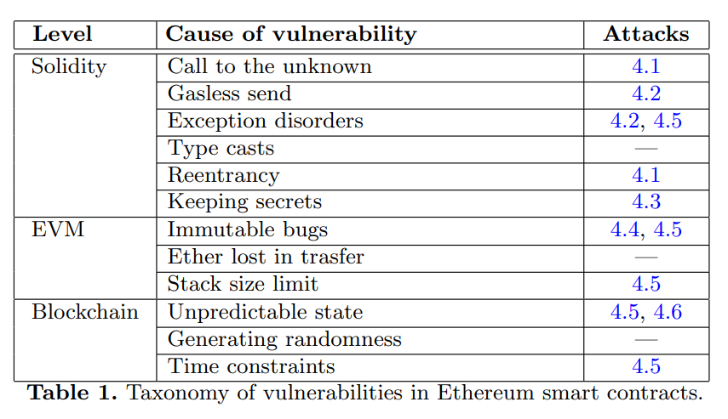
Vulnerabilities in smart contracts

Slide 25
Call to the unknown
Solidity has the following primitives: call, send, delegatecall, direct call.
Each one of them can invoke the fallback function.

Slide 26
Call to the unknown - call
Call invoke a function and transfer ether to the callee.
For example:
The function that called is identify by the first four bytes of its hashed, amount is how many wei to transfer to c and n is the actual parameter of ping.
But what happened if the requested function doesn’t exists?
FallBack!

Slide 27
Call to the unknown - send
Send function used to transfer ether from running contract to some recipient.
After the transferring, send execute the recipient
FallBack!

Slide 28
Call the unknown - delegatecall
Why we need another call function?
In this one, the invoked function run in the caller environment.
For example, if the called function use this, its refers to the caller address.
This one wont call the fallback directly, but the called function can call the send function and it will invoke the caller send.

Slide 29
Call the unknown – direct call
When one's function calling another function.
For example:
If the programmer has a tyipo, then it will call an unexisting function which lead to invoking Alice fallback.
FallBack!

Slide 30
Exception disorder
When exception raise in Solidity?
The execution run out of gas.
The call stack reach its limit
The command theow is executed.
So far so good, what wrong?
Solidity is not uniform in the wat it hands exceptions!

Slide 31

Example
Assume that Alice ping throw an exception.
What will happened if someone invoke Bob pong or if Bob will call pong?

Slide 32
Example
If someone invoke Bob`s pong, the execution is stop and the side effects of the whole transaction is reverted.
Therefore x=0.
But if Bob invoke pong, only the changes occured in Alice ping will be reverted, and the call will return false and in the end x=2.

Slide 33
Exception disorder – general case
Assume that there is a chain of nested calls.
If every element of the chain is direct calls, the execution stop and all the side effect reverted including the ether transferring. Also, the gas allocated is fully consumed.
If al least one element of the chain is call or send or delegatecall, every side effects is reverted, until we reach the call or send or delegatecall which will return false. From that point the execution is resumed. In this case all the gas allocated by the call is consumed.

Slide 34
Upper Bound of gas in call
A caller can set the upper bound of gas available.
In case of exceptions, if not mentioned upper bound of gas, all the available gas is lost, else only the amount of gas whitin the upper bound is lost.
For example:
g is the upper bound of gas.

Slide 35
Exception disorder
When there is no one handle of exceptions, it may affect the security of contract.
For example, believing that a transfer of ether was successful just because there were no exceptions may lead to attack.

Slide 36
Gasless send
We have the function send(amount) that sending ether from one contract to another.
Warning! The send function compiles as call function without signature but has ether.
So, we have ether, then the receive function need to be invoked.
But what id we don’t have one? What happened when there is no signature and the function is call?
FallBack!

Slide 37
Gasless send
In send the number of gas units available is 2300.
But this is small amount of gas for running code of fallback.
Then we get out of gas exception.

Slide 38
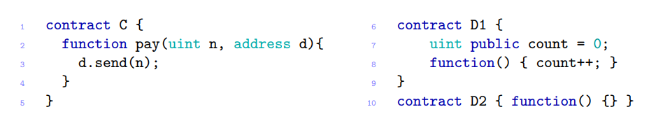
Gasless send - example
Let's consider the following code:
Now we divide into different scenarios

Slide 39
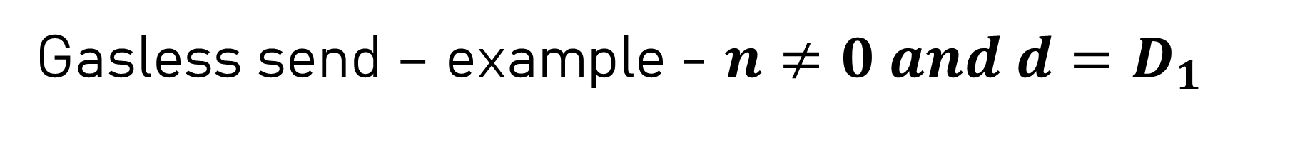
Gasless send – example - $n≠0 and d=D_{1}$
Which function will invoke?
D1.function! (remember? Fallback has no name and no argument).
But it execute state-updating (count++).
Out-of-gas exception!

Slide 40
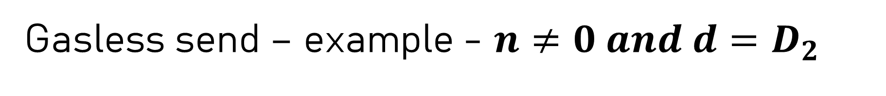
Gasless send – example - $n≠0 and d=D_{2}$
Now what?
The execution is succeeded because 2300 is enough to execute D2`s fallback.

Slide 41
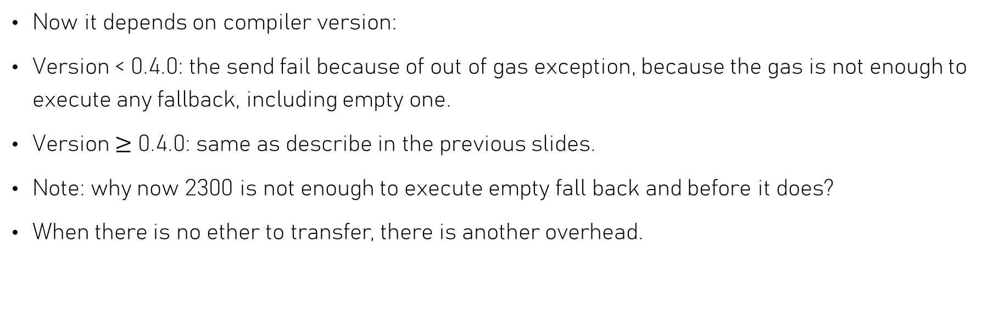
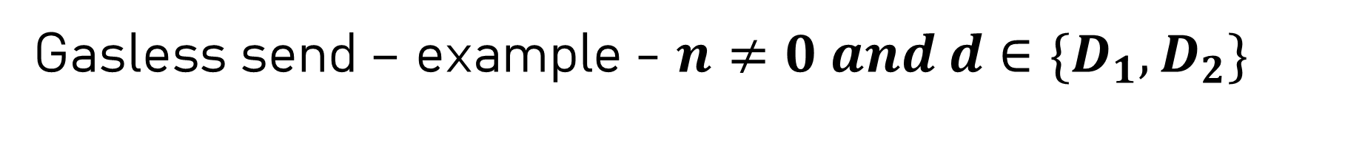
Gasless send – example - $n≠0 and d∈\{D_{1},D_{2}\}$
Now it depends on compiler version:
Version < 0.4.0: the send fail because of out of gas exception, because the gas is not enough to execute any fallback, including empty one.
Version $≥$ 0.4.0: same as describe in the previous slides.
Note: why now 2300 is not enough to execute empty fall back and before it does?
When there is no ether to transfer, there is another overhead.

Slide 42
Type casts
The compiler of solidity can detect type error of int and string.
That might confuse programmer into thinking the code is type safe.
When using a direct call, the caller must declare the requested interface and cast it.

Slide 43
Type casts
Let consider the following example:
The compiler only check if the interface in Bob`s contact has the requested signature.
What if c is not address of Alice type contract?
What if the interface declare at Bob`s contract doesn’t match Alice?

Slide 44
Type casts
The direct call is compiled as call (except the management of exception).
That leads to irregularity in different scenarios:
If c is not a contract, nothing will execute and the call return.
If c is address of contract with matching signature, this one will execute.
If c is address of contract with no matching signature, the fallback will execute.
Notice that in all cases no exception invoke and the caller unaware of the problem.

Slide 45
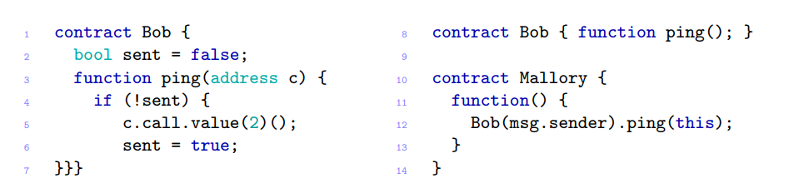
Reentrancy
The problem – a fallback function might allow an attacker to re-enter the caller function.
Why is it problematic?
Consider the following code:
What`s wrong?

Slide 46
Reentrancy
Bob try to send 2 wei to Mallory.
But Mallory has no receive.
Then we go to the fallback, that invoke Bob`s send again.
Since Bob didn’t update the send Boolean, it will preform another transaction.
And so on.

Slide 47
Reentrancy
But wouldn’t Bob be out of ether eventually and the chain will fail, or the function will be out of gas?
But remember that we know that call won't throw exception but return false.
So only the last call will fail, while the rest execute fine.
For example – DAO attack

Slide 48

Keeping secrets
Fields in contract can be either public or private.
But, declaring a field as private isn’t enough.
If user want to set the value of field he needs to send valid transaction to the miners, which in their turn publish it to the blockchain, which is public.
What will we do if we want to keep the field hide? For example, contract that implementing multiplate games?

Slide 49
Immutable bugs
Remember that when a contract is published, he can't be changed.
but what if a contact has a bug?
The bug is immutable and there is no possibility of recovery.

Slide 50
Hard Fork
When the DAO attack happened, the countermeasure was a hard fork.
The idea is to start new chain before the steal happened and continue mining on top of it.
That nullified the effects of the transactions involved in the attack.
But on the other hand, it contrasted with the “code is law” principle.
So now we have two different blockchain for two different coins: ETC and ETH.

Slide 51
Ether lost in transfer
If we sending ether to an orphan address, the ether is lost forever.
Since lost ether cannot be recovered, the programmers must manually ensure the correctness of the recipient addresses.

Slide 52
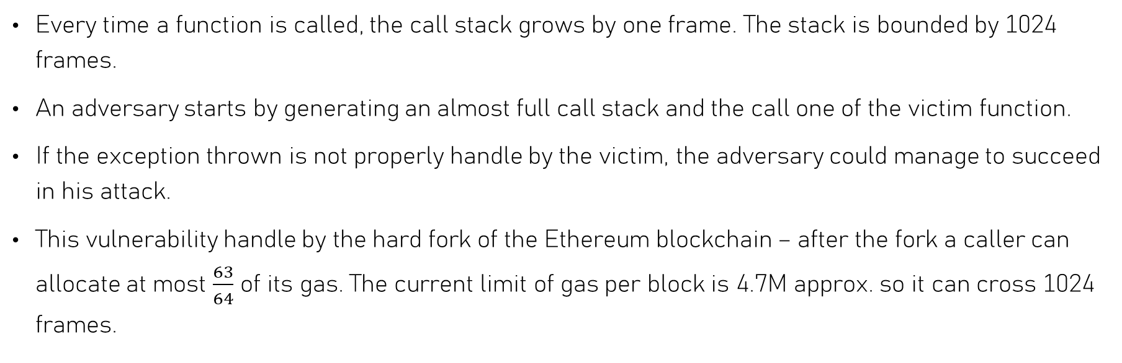
Stack size limit
Every time a function is called, the call stack grows by one frame. The stack is bounded by 1024 frames.
An adversary starts by generating an almost full call stack and the call one of the victim function.
If the exception thrown is not properly handle by the victim, the adversary could manage to succeed in his attack.
This vulnerability handle by the hard fork of the Ethereum blockchain – after the fork a caller can allocate at most $\frac{63}{64}$ of its gas. The current limit of gas per block is 4.7M approx. so it can cross 1024 frames.

Slide 53
Unpredictable state
The state of a contract is determined by the value of its fields and balance.
But the state of contract is dynamically changing, so when a transaction is sent it not necessarily the same state of the contract as when it receive.
Additionally, the state of contract can be change because of the fork that might happen – and might lead to the state to revert if the other branch is chose.
Not knowing the state where a transaction will be run could rise to vulnarabilities.

Slide 54
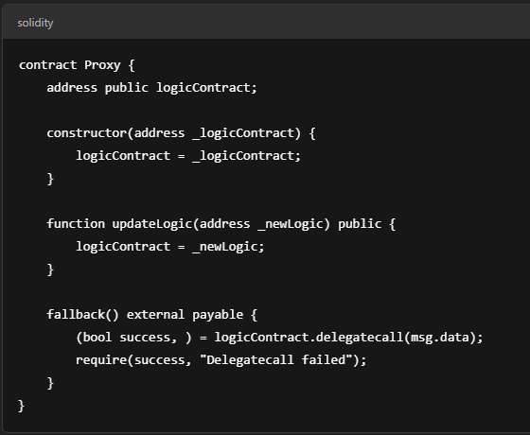
Unpredictable state
Indeed, a contract cannot be change after publish.
But we can craft a contract whose components can be updated at his owner's request.
For example, a code from ChatGPT:
we can see that the owner can change the logic of the code to malicious code.

Slide 56
Generating randomness
The problem – the execution of EVM bytecode is deterministic.
How can we generate random number then?
Many contract generate pseudo-random numbers using uniquely seed for each miner.
Pseudo random number – a number that might seem random but rely on a previous calculation.
How can we pick this seed?

Slide 57
Generating randomness
A contract can use the hash or the timestamp of some future block in the blockchain.
Since all the miners can the blockchain, they can get this value in the future.
Does it a safe way to generate number?
Apparently yes, no one can predict the blocks of the blockchain.
Not exactly.
The miner's control which transaction are put in a block and in which order.
An analysis has shown that an attacker controlling a minority of the mining power of the network of Bitcoin can significantly bias the probability distribution of the outcome.

Slide 58
Generating randomness
Another way to generate random number is based on timed commitment protocol.
Each participant choses a secret and publish a digest (תקציר) of it – like a hash of the number and pay deposit as a guarantee.
Late each participant must reveal its secret, or their deposit will be lost.
The secret can be approved by the hash.
The pseudo-random number is the computed by combining the secret of all participants.

Slide 59
Time constraints
Contract can use time constraints to determine which actions are permitted in the current state, for example – bidding, money locking.
Contract can retrieve the timestamp of its own block and all the transaction in this block share the same timestamp.
But the miner who mined the contract could gain an advantage by choosing suitable timestamp for a block he is mining.

Slide 60
Attacks
We now illustrate some attacks many of which inspired to real use cases which exploit the vulnerabilities that we discussed on them.

Slide 61
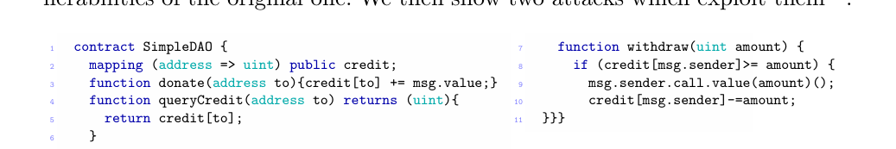
The Dao Attack
Simple DAO allows participants to donate ether to fund contracts at their choice.
Contracts can then withdraw their funds.

Slide 62
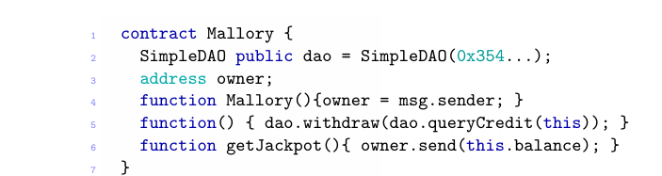
Attack #1
The first step of the attack is to publish the contract Mallory
Then, the adversary donates some ether for Mallory, and invokes Mallory s fallback
The fallback function invokes withdraw of dao, which transfers the ether to Mallory
Now, the function call used to this purpose has the side effect of invoking Mallory s fallback again which maliciously calls back withdraw and is go again and again …

Slide 63
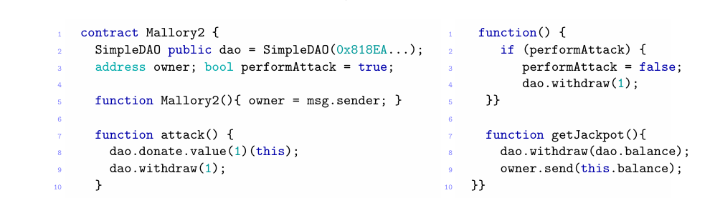
Attack #2 on Dao
The attacker need only need two calls to the fallback function.
the adversary invokes attack to donate 1wei to herself and subsequently withdraws it.
The function withdraw checks that the user credit is enough, and if so it transfers the ether to Mallory2.

Slide 64
Continue:
call invokes Mallory2 s fallback, which in turn calls back withdraw. Also in this case withdraw is interrupted before updating the credit: hence, the check at line 8 succeeds again.
Consequently, the DAO sends 1wei to Mallory2 for the second time, and invokes her fallback again
The effect is that Mallory2 s credit is updated twice: the rst time to zero, and the second one to (2^256- 1)wei, because of the underflow and the account is not negtive.
To finalise the attack, Mallory2 invokes getJackpot, which steals all the ether from SimpleDAO, and transfers it to Mallory2 s owner.

Slide 65
Solution to attack on Dao
The problem was SimpleDAO sends the specifed amount of ether before decreasing the credit.
the attacks exploit the call to the unknown , and reentrancy (the call to func again and again) vulnerabilities that we told about.
So the solution were:
Update the the credit of the contract and before outer interactive as the call.
Reentrancy Guard that avoid call the func before he end her action.

Slide 66
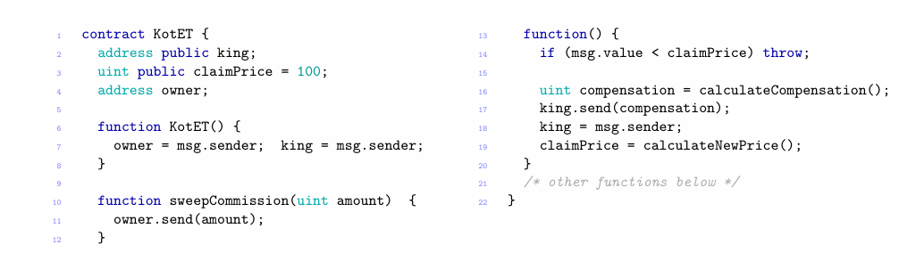
Attack on King of the Ether Throne Contract
The King of the Ether Throne is a game where players compete for acquiring the title of King of the Ether.
If someone wishes to be the king, he must pay some ether to the current king, plus a small fee to the contract.

Slide 67
The crown
Whenever a player sends msg.value ether to the contract, he also triggers the execution of KotET s fallback.
The fallback first checks that the sent ether is enough to buy the title: if not, it throws an exception.
At this point, a compensation is sent to the dismissing king, and the player is crowned

Slide 68
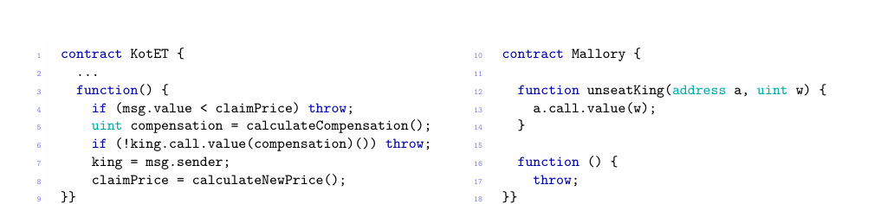
Attack
#1 :send is equipped with a few gas (see gasless send vulnerability), the send at line 17 will fail if the kings address is that of a contract with an expensive fallback. In this case, since send does not propagate exceptions.
#2: lets say we use in call as in the photo lets think on attacker Mallory whose fallback just throwsan exception anybody can be the king this
is denial of service to the game.

Slide 69
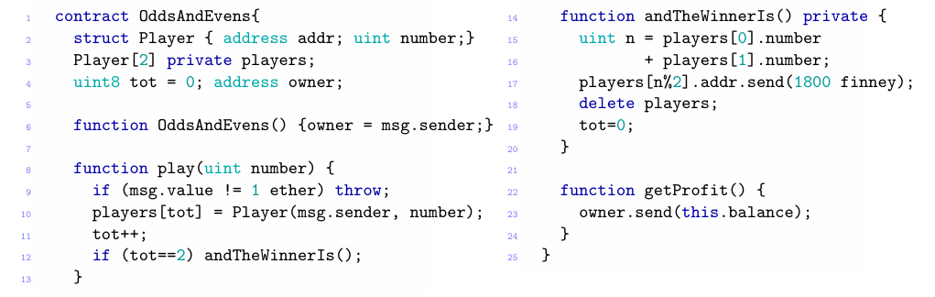
Multi-player games
Consider a contract which implements a simple odds and evens game between two players. Each player chooses a number: if the sum is even, the first player wins, other the second one wins.

Slide 70
Attacks
The adversary impersonates the second player,and waits that the first player makes his bet.
Now, although the field players is private, the adversary can infer the first player bet, by inspecting the blockchain transaction where he joined the game.
Then, the adversary can win the game by invoking play with a suitable bet.
This attack exploits the keeping secrets vulnerability.

Slide 71
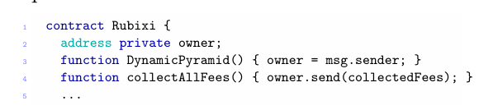
Rubixi
Rubixi is a contract which implements a Ponzi scheme, a fraudulent high yield investment program where participants gain money from the investments made by newcomers

Slide 72
Attack and solution
At some point during the development of the contract, its name was changed from DynamicPyramid into Rubixi.
However, programmers forgot to accordingly change the name of the constructor, which then became a function invokable by anyone!!
The DynamicPyramid function sets the owner address, the owner can withdraw his profit via collectAllFees func.
The solution was to change the name of function but the point is to pay attention to changes in the contract

Slide 73
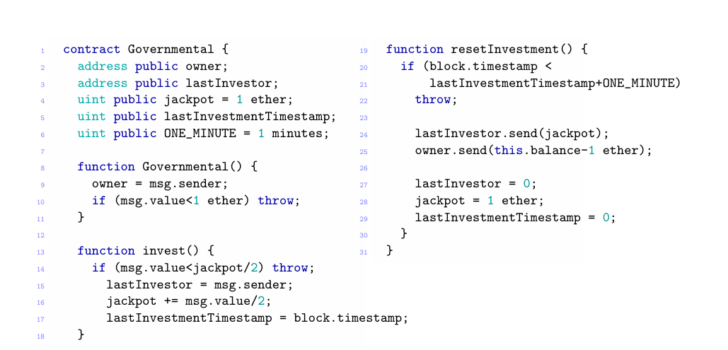
GovernMental
GovernMental is another flawed Ponzi scheme.
To join the scheme, a participant must send a helf of jackpot
For simple we will talk the simple game If no one joins the scheme for 1 minute, the last participant that denoate gets all the ether in the contract (except for a fee kept by the owner)

Slide 74
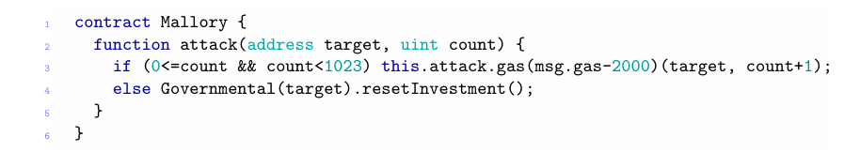
Attack #1
This attack exploits the vulnerabilities exception disorder and stack size limit that was disccused.
The attack is performed by the contract owner his goal not to pay the winner, so that the ether is kept by the contract, and redeemable by the owner at a later time,
The attacker call this contract : the call stack reaches the depth of 1022, which is then executed at stack size 1023. At this point, the send at line 24 fails Since GovernMental does not check the return code of send, the execution proceeds
The balance of the contract increases every time this attack is run, because the legit winner is not paid

Slide 75
Attack #2
the attacker is a miner, who also impersonates a player.
he can choose not to include in blocks the transactions directed to GovernMental,except for her own, in order to be the last player in the round.
Furthermore,the attacker can reorder the transactions, such that her one will appear first: indeed,by playing first and by choosing a suitable amount of ether to invest,she can prevent others players to join the scheme.
This attack exploits the unpredictable state vulnerability, since players cannot be sure that,when they publish a transaction to join the scheme.

Slide 76
Attack #3
Also the attacker is a miner impersonating a player.
Assume that the attacker manages to join the scheme she be the last player in around for a minute,by play with the block timestamp.
More specifically, the attacker sets the timestamp of the new block so that it is at least one minute later than the timestamp of the current block.
The attacker choose if use time constraints vulnerability that we saw early for publish the new block with the delayed timestamp, she will be the last player in the round, and will win the jackpot.

Slide 77
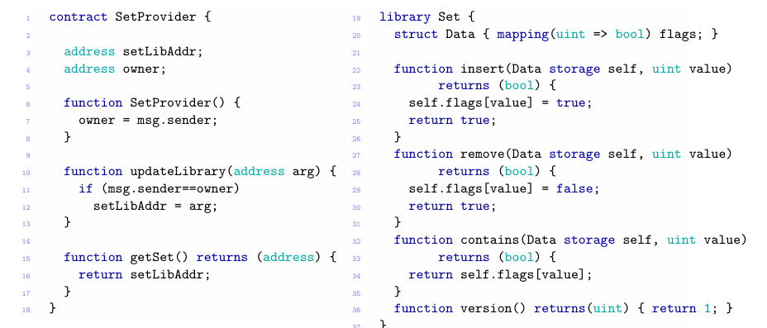
Dynamic libraries
We now consider a contract which can dynamically update one of its components, which is a library of operation on sets.
Lets look on setProvider :

Slide 78
Set provider use the set contract for operation on sets.
The owner of contract SetProvider can use function updateLibrary to replace the library address with a new one. Any user can obtain the address of the library via getSet.
Import point :When a user declares that an interface is a library, direct calls to any of its functions are done via delegatecall that we talked before.
Arguments tagged as storage are passed by reference.

Slide 79
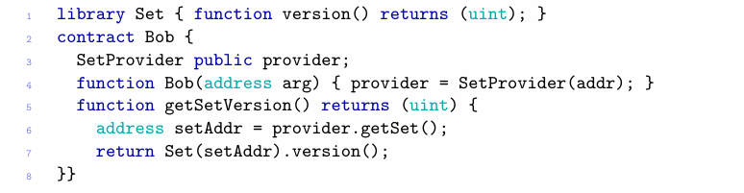
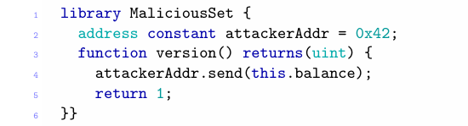
Attack on user use on Providerset
Assume that Bob is the contract of an honest user of SetProvider
The attack by the owner of setProvider :the adversary publishes a new library MaliciousSet, and then it invokes the function updateLibrary of SetProvider to make it point to MaliciousSet.

Slide 80
Since Bob has declared the interface Set as a library, any direct call to version is implemented as a delegatecall, and thus executed in Bob s environment because of the delegate call.
Any use of version from bob will causing the send to transfer all his ether to the adversary.
Another way to craft a malicious library is to use the function selfdestruct. This is a special function, which disables the contract which executes it and send all its balance to a target address. For example:selfdestruct(attackerAddr);
This will disable Bob s contract forever, and send his balance to the adversary.
The attack outlined above exploits the unpredictable state vulnerability, because Bob cannot know which version of the library will be executed when it used SetProvider.

Slide 81
Analysis of Ethereum Smart Contract Security
The article Based on academic literature, blogs, forums, and practical experience in programming smart contracts.
Covers all major vulnerabilities and attacks reported so far.
Taxonomy extends to smart contracts and builds on existing software security vulnerability classifications.
Expected to evolve as new vulnerabilities and attacks are discovered.

Slide 82
Common Causes of Insecurity
Main Cause: Difficulty in detecting mismatches between intended and actual contract behavior.
Turing-complete Languages: Limits on verification due to complex execution possibilities.
Emerging Solutions: Non-Turing complete languages might offer solutions, especially in specific application domains.

Slide 83
Attacks on Smart Contracts
Delegatecall Attacks: Attack possible even after Solidity v0.4.2.
Common Vulnerabilities:
Exception Disorder: Not checking return codes of call, send, and delegatecall.
Time Constraints: Using block timestamps in conditional expressions.
Unpredictable State: Unforeseen changes in contract state.
Reentrancy: Malicious contracts repeatedly invoking functions.

Slide 84
Taxonomy of Vulnerabilities
Extension to existing classifications: Based on software security vulnerabilities.
Emerging research direction: Non-Turing complete languages for specific applications may mitigate these issues.

Slide 85
Verification Tools
Oyente (Static Analysis Tool):
Extracts control flow graph from EVM bytecode.
Symbolic execution to detect vulnerability patterns like exception disorder, time constraints, unpredictable state, and reentrancy.
Other Verification Tools:
Translating Solidity/EVM bytecode into F language for functional analysis.
Verification of code equivalence and low-level analysis (e.g., gas consumption).

Slide 86
Verification Results
Oyente Results: 28% of analyzed contracts potentially contain exception disorder vulnerabilities.
Isabelle/HOL Proof Assistant:
  Used for verifying specific contracts (e.g., Deed contract of Ethereum Name Service).
  Verifies contract behavior, ensuring only the owner can decrease balance.

Slide 87
Conclusion & Future Directions
Main message of the paper:
Widespread security vulnerabilities found in Ethereum contracts.
These vulnerabilities were exploit to execute attacks.
We need to know them and avoid them to prevent attacks.
What was done in the paper? The paper exhibit these vulnerabilities and how to handle with them.
What left us to do? Know these vulnerabilities and handle them carefully.
Research into new tools and languages is vital to improve security.
Non-Turing complete languages might provide solutions in specific domains.

Slide 88
Attack on low level for end
Besides the attacks involving contracts, also the Ethereum network has been targeted by adversaries
Their attacks exploit vulnerabilities at EVM specifcation level, combined with security flaws in the Ethereum client.

Slide 89
Example 1: denial of service based computational effort .
Attack Type: denial-of-service attack exploits an EVM instruction whose cost in units of gas was too low, compared to the computational effort required for its execution
. The attacker floods the network with that instruction, causing a substantial decrease of its computational power, and a slowdown to the blockchain synchronization process.
this problem has been addressed by forking the blockchain.

Slide 90
Example 2: Vulnerabilities in Client Implementations - Block Propagation Attack
Attack Type: Exploiting the Ethereum official client’s block propagation algorithm.
The Ethereum network can be partitioned into small groups of nodes by the attacker(not described how)
Attacker forces nodes to accept sequences of blocks created by him.
Allows the attacker to manipulate the block sequence accepted by nodes in a partitioned network.

Slide 91
The End!

