Slide 1
Formal Verification Techniques for Software
Based on Chapters 12.1–12.3 from "Decision Procedures: An Algorithmic Point of View“
Roee Moscovici & sapir alon

Slide 2
Agenda
Introduction
Bounded program analysis:
Checking feasibility of a single path
Checking feasibility of a all paths
Unbounded Program Analysis:
Overapproximation
Loop Variants

Slide 3
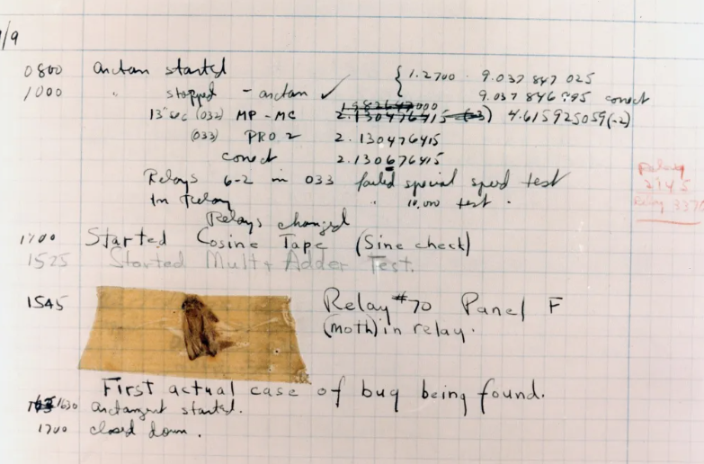
The first “real” bug
In 1947, engineers found a real moth trapped in a computer relay.
This caused a malfunction, and they taped it into their logbook, calling it a "bug.“
Since then, the term bug has been used to describe errors in software and hardware.
The logbook found in 1988

Slide 4
Introduction
* A bug is a flaw or an error in a computer program’s design or code that cause it to produce incorrect or unexpected results.
* The traditional method to find and diagnose software defects is to test the program
* Some types of testing : unit testing, fuzzing, formal verification

Slide 5
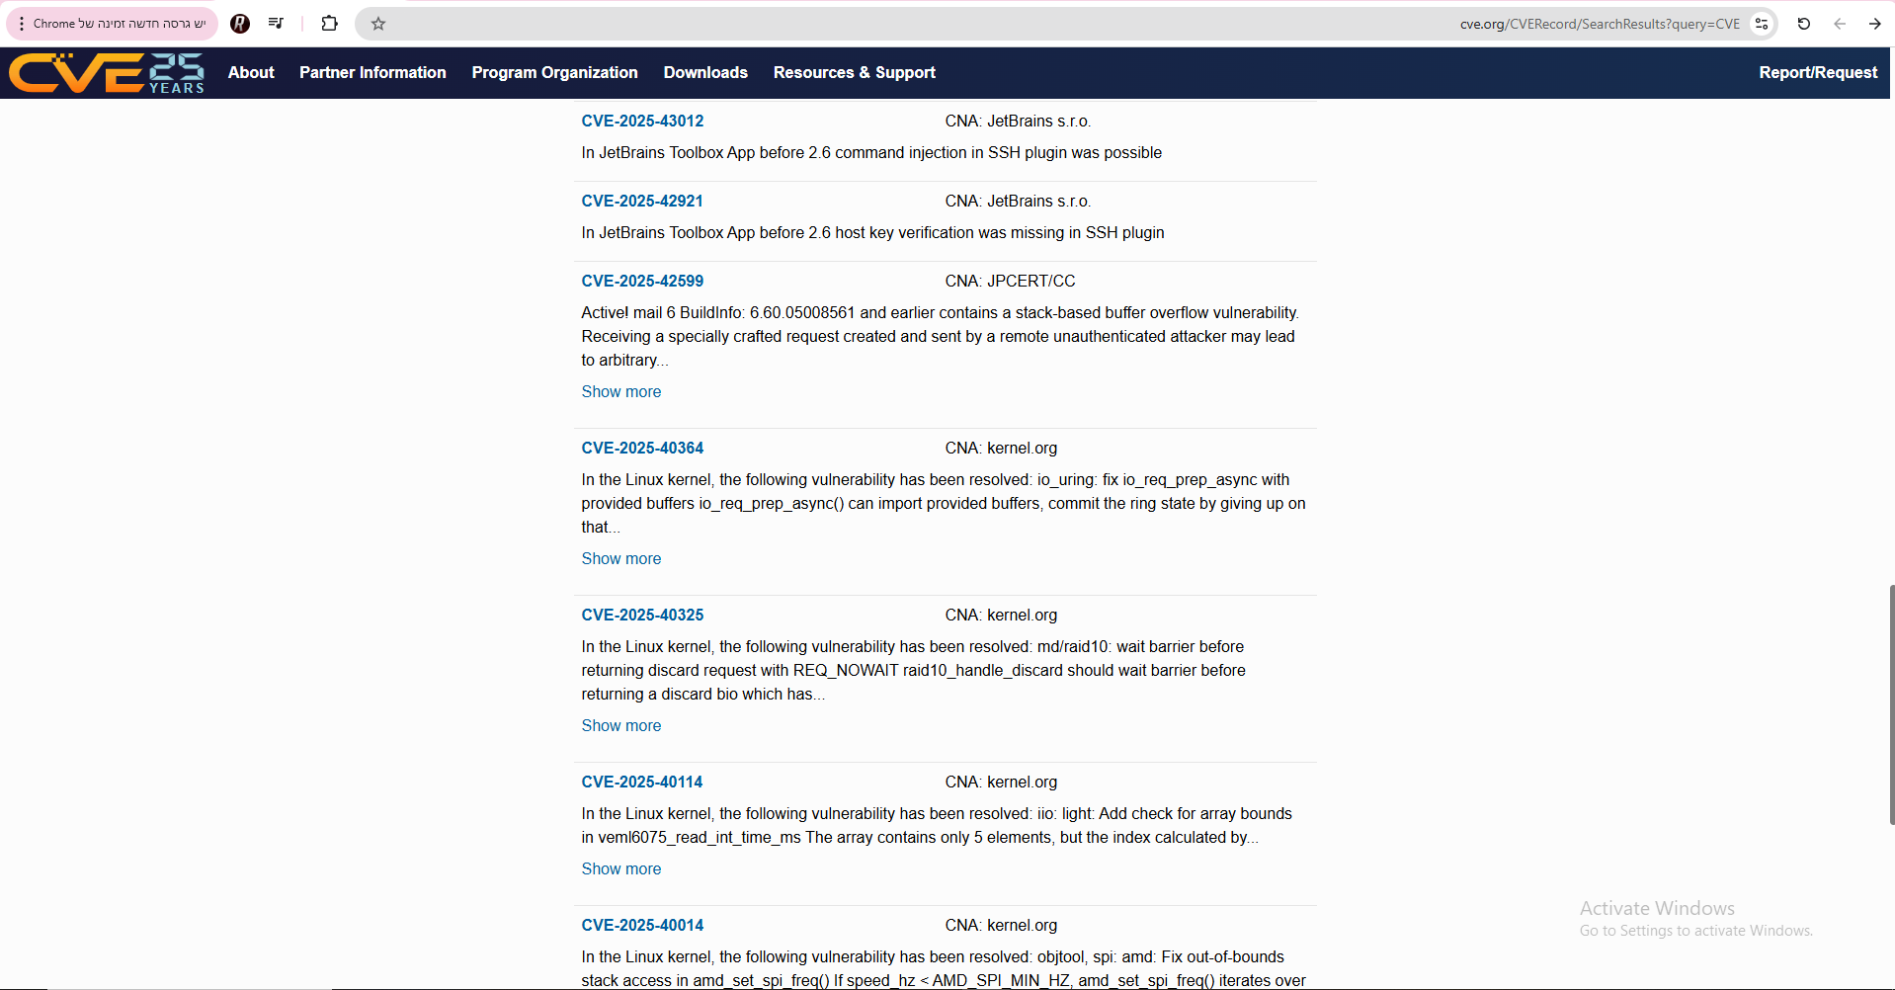

CVE stands for Common Vulnerabilities and Exposures.

Slide 6
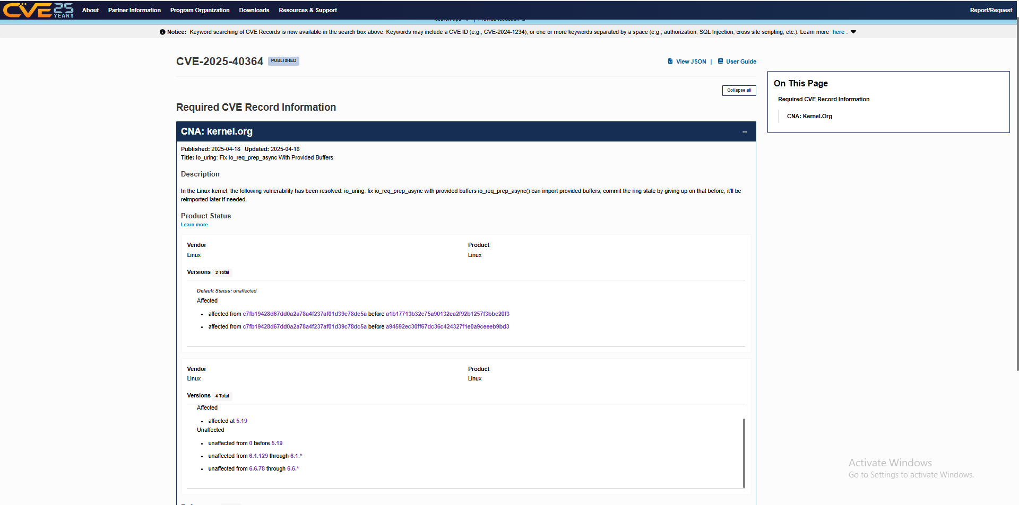

Slide 7
Type | What it is | Goal | Example | Tools
Unit Testing- bare minimum | Testing individual parts of code (functions/methods) in isolation | Ensure each unit works as expected | add(2, 3) should return 5 | JUnit, PyTest
Fuzzing- getting there | Feeding random or malformed inputs to a program | Discover hidden bugs, especially edge cases | Send random strings to a parser and see if it crashes | AFL, LibFuzzer, Peach
Formal Verification- jackpot | Using mathematical logic to prove a program satisfies its specification | Prove correctness for all possible inputs | Prove that a sorting function always returns sorted list | Z3, Dafny, Coq, SMT solvers

Slide 8
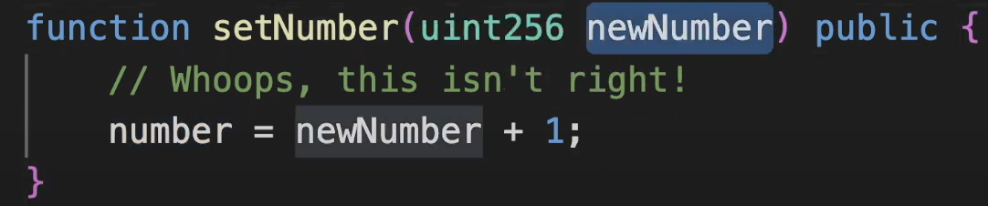
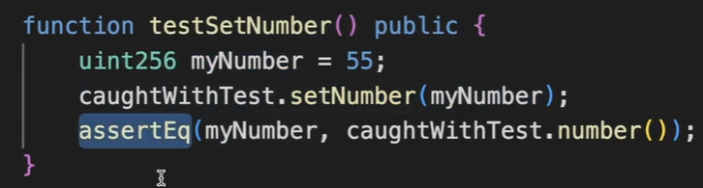
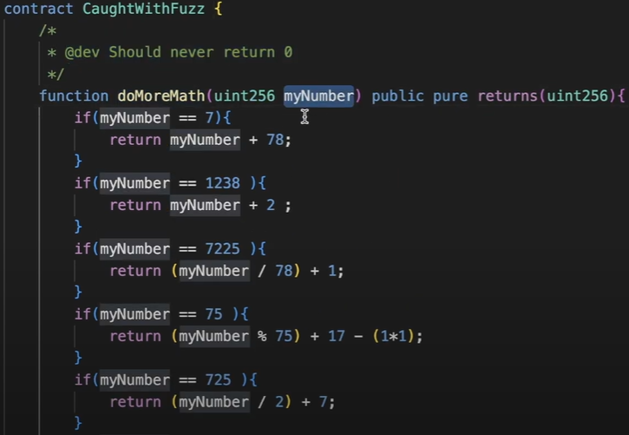
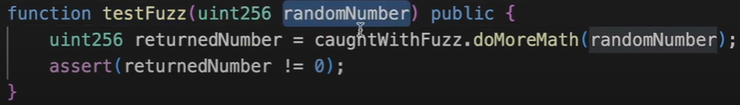

Slide 9

THE GOAL OF FORMAL VERIFICATION
decide whether for all possible inputs a given specification is satisfied by the program
- X< y always holds
- No division by 0 and more…

Slide 10

The Reachability Problem and Undecidability
The reachability problem- the problem of checking whether a given program state occurs in any execution of the program (in the example x == 1? )
what is undecidable and what makes a problem undecidable?
The reachability problem is undecidable, and software verification is as well.
Many partial solutions were invented throughout the years, some say testing can be seen as a partial solution

Slide 11
Bounded Program Analysis
- Checking Feasibility of a Single Path
-Checking Feasibility of All Paths in a Bounded Program

Slide 12
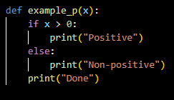
Checking Feasibility of a Single Path
* An execution path is a sequence of program instructions executed during a run of a program.
* An execution trace is a sequence of states that are observed along an execution path.
* An assertion is a program instruction that takes a condition as an argument, and if the condition evaluates to false, it reports an error and aborts
Instruction or Condition | Kind | Line
x > 0 → True | Branch | 1
print("Positive") | Function | 2
print("Done") | Function | 5

Slide 13

Symbolic simulation
Simulates program behavior using symbols instead of specific values to represent inputs- allowing analysis of many paths at once
Popular uses:
- automatic test generation
- detection of dead code
- verification of properties in the form of assertions

Slide 14
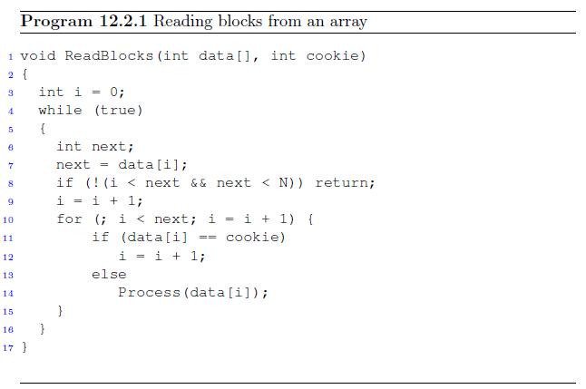
A running example of verifying assertions
The program exemplifies low level code like typically used when processing file formats such as media formats JPEG, AVI or MPEG
Does anyone see the two array bound errors here?

Slide 15

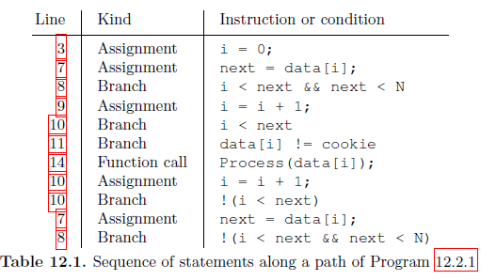
A chosen path

Slide 16
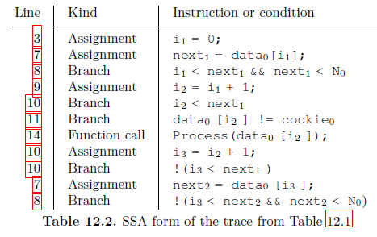
SSA – static single assignment

Slide 17
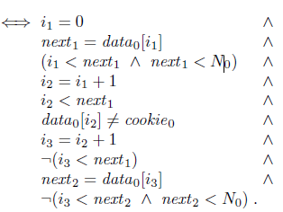
SSA to logical formula
All valuations of the inputs data0 and cookie0 that satisfy the formula
SSA above correspond to a trace for the path we saw in 12.1

Slide 18


Assertion checking
Now let's consider a path that executes the assignment in Line 3 and then checks that the variable i is within the required range for the array access in Line 8.
The constraint:
Satisfied by:

Slide 19

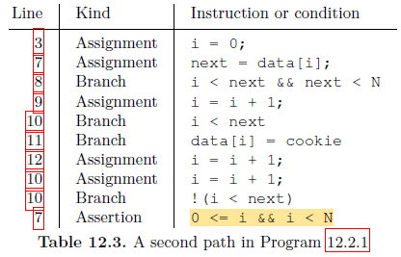
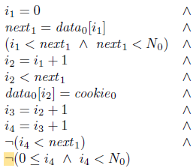
Another error

Slide 20
Checking Feasibility of all paths in a bounded program
The number of paths through a program can grow exponentially in the number of branches
An efficient solution is generating SSA for bounded programs that contain branches

Slide 21
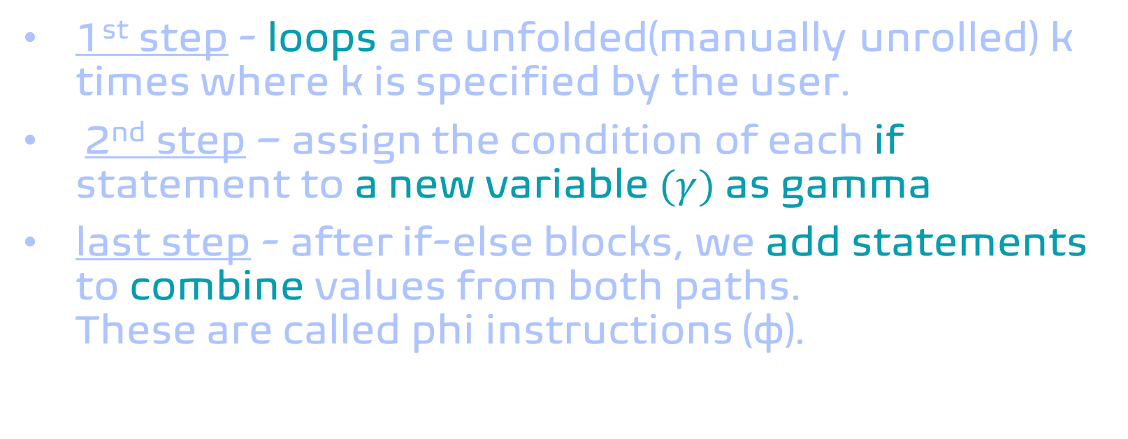
Steps to encode all paths
1st step - loops are unfolded(manually unrolled) k times where k is specified by the user.
2nd step – assign the condition of each if statement to a new variable $(γ)$ as gamma
last step - after if-else blocks, we add statements to combine values from both paths.
These are called phi instructions (φ).

Slide 22
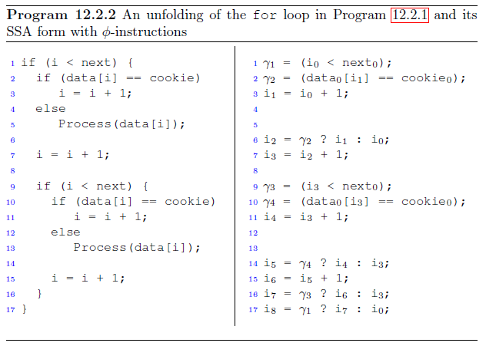
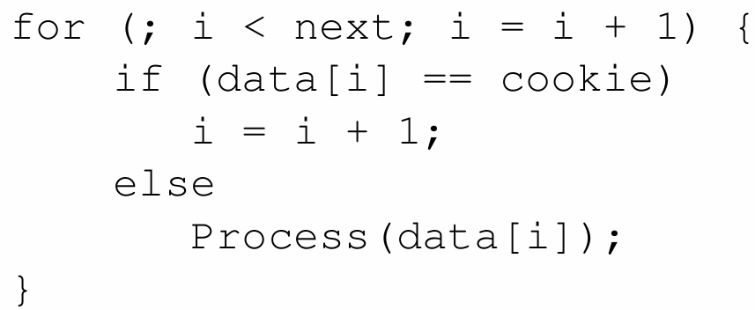
An example (k=2) and program seen before

Slide 23
Unbounded Program Analysis
- overapproximation
- loop invariants

Slide 24

Unbounded Program Analysis
Unbounded programs are ones where loops or recursion can run an unknown number of times, depending on the input. For example:
This makes it difficult to fully analyze their behavior, especially when aiming for general correctness and not just testing specific inputs.

Slide 25
Why is Unbounded Program Analysis Hard?
Testing only checks specific cases, but we want to prove correctness in general.
We can’t predict how many times the code will run.
We can’t just “unroll” loops like in bounded analysis.
We need to reason about all possible executions, even infinite ones.

Slide 26
How Do We Handle Undecidability?
Verifying such programs becomes an undecidable problem.
There is no algorithm that can determine the correctness of all unbounded programs.
So instead, we settle for an approach that might not be perfect- but helps us find bugs and prove properties in many cases.

Slide 27
Overapproximation
To analyze unbounded programs, we use overapproximation.
The main idea: rewrite the unbounded program as a loop-free program that might include behaviors the original program would never actually take.
Why? To make sure we don’t miss any potential bugs.

Slide 28
Overapproximation
Transformation Steps
The loop transformation involves three steps:
At the start of the loop, assign a nondeterministic value to every variable modified in the loop.
After the loop, add assume(¬condition) to indicate that the loop ends.
Replace the loop with an if statement using the same condition- this allows most one iteration.

Slide 29
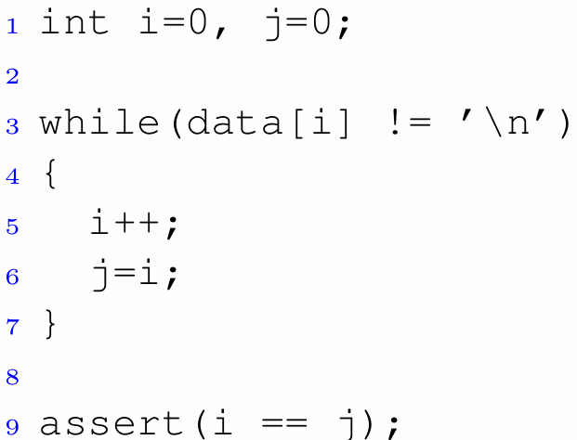
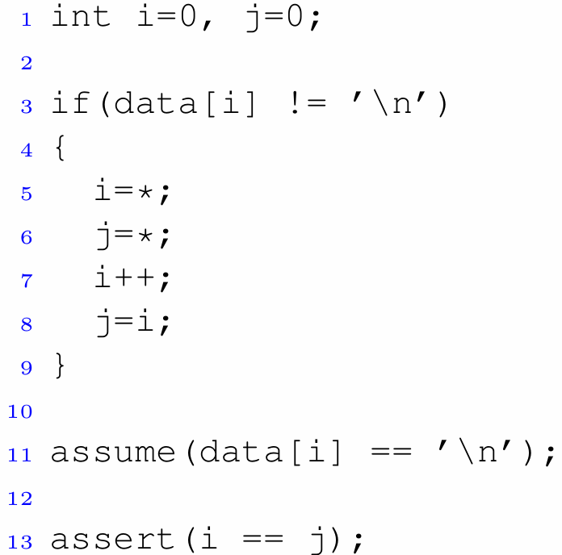
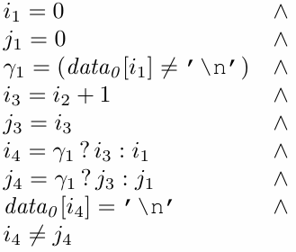
Overapproximation
Example
We can now convert to SSA form like Roee showed us and use a SMT solver to check the assertion.
Unknown number of loop iterations.
* means any possible value.

Slide 30
Overapproximation Can Be Too Coarse
While overapproximation helped in the example, it doesn’t work for all programs. It was successful because the assertion didn’t depend on previous loop iterations.
But in other cases, this method can be too coarse. Allowing any initial state can introduce impossible behaviors and cause false positives- errors that can't happen in reality.

Slide 31
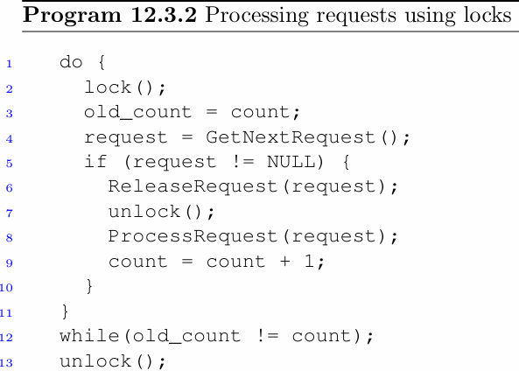
Overapproximation Can Be Too Coarse
Example 1
This is a piece of code from a Windows device driver that processes requests.
The code uses lock() and unlock() to protect a shared data structure.
For each request: lock → perform an action → release → continue.

Slide 32
Overapproximation Can Be Too Coarse
Example 1
Key behavior:
It is important to release the lock before processing the request, because processing can take a long time or acquire other locks.
It should never be possible to exit the loop without holding the lock, otherwise, the unlock() after the loop would release a lock twice, and calling unlock() without owning the lock is a violation of the locking policy.

Slide 33
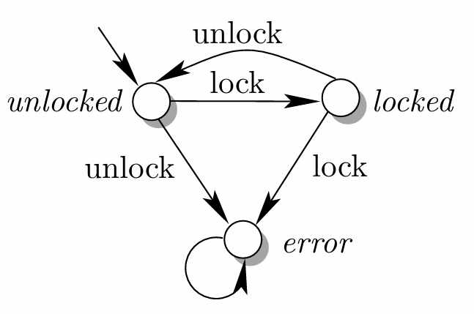
Overapproximation Can Be Too Coarse
Example 1
To clarify the expected behavior, we will define the locking state with a state machine:
The goal is to never reach the error state. Thus, the program should alternate strictly between locking and unlocking.

Slide 34
Why Does Overapproximation Fail Here?
When we apply overapproximation, we allow the loop to start in any arbitrary state- including the lock state = locked.
But in the real program, it always starts with lock state = unlocked.
So SMT solver might find a bug: Double locking, or unlocking without owning the lock
This is a false alarm – a situation allowed by the approximation, but not actually reachable in the program.

Slide 35
Overapproximation Can Be Too Coarse
Another attempt
In multithreaded programs, locking is used to prevent race conditions. But for formal analysis, it's enough to model a single thread- to verify that no illegal lock/unlock sequences can occur.
We rewrite the program to model the lock state:
  Introduce a variable state_of_lock to track whether the lock is held
  Update state_of_lock whenever lock() or unlock() is called
  Add assertions to verify that the locking protocol is respected
Goal: Verify the program respects the locking state diagram.

Slide 36
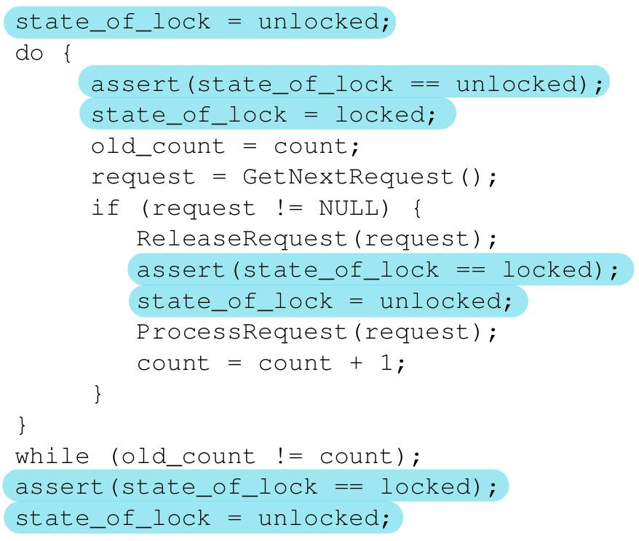
Overapproximation Can Be Too Coarse
Example 2- Original
We simulate the lock state using state_of_lock.
At key points in the program, we assert that the state is legal:
→ lock() is only called when the lock is currently unlocked
→ unlock() is only called when the lock is currently locked
→ The final unlock() is only reached when we still hold the lock

Slide 37
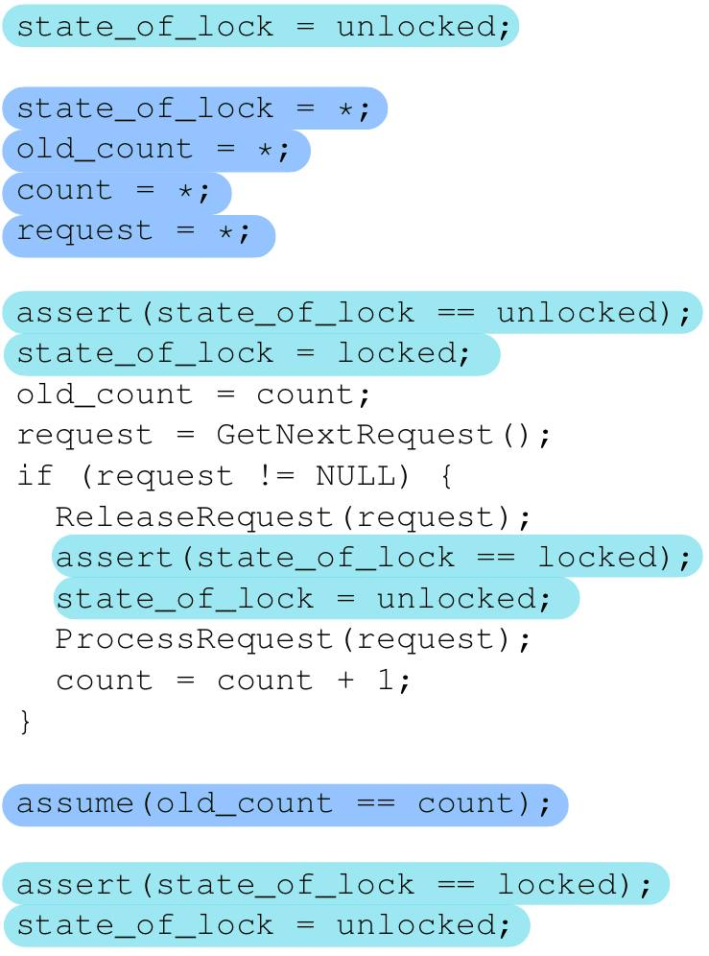
Overapproximation Can Be Too Coarse
Example 2- Transformed
We now apply overapproximation:
→ We assign nondeterministic values (using *) to all variables modified in the loop
→ We replace the loop with a single iteration
→ We use assume(old_count == count) to restrict to paths where the loop terminates
→ All asserts are preserved to check the correctness of the transformation

Slide 38
Overapproximation Can Be Too Coarse
Example 2- False Alarm
After rewriting the code, the SMT solver finds that the formula is satisfiable- meaning, it found a path where an assert fails.
But why?
Because we allowed: state_of_lock = *
which includes the case: state_of_lock == locked
This is a false alarm because this state can't really happen in the actual program.

Slide 39
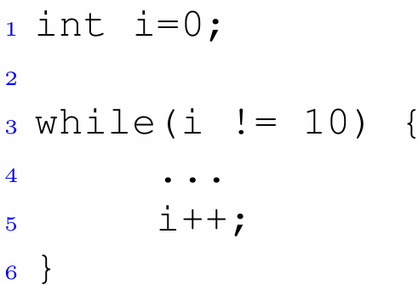
Solution – Loop Invariants
A loop invariant is a predicate that always holds at the start of the loop body, regardless of how many iterations have occurred.
For example:
The predicate 0 ≤ i < 10 is a loop invariant- it holds at the beginning of every iteration.

Slide 40
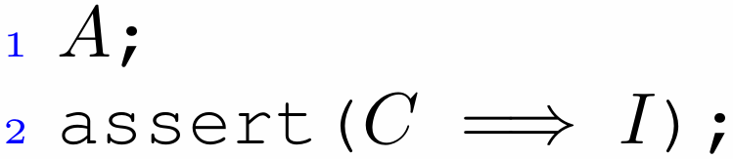
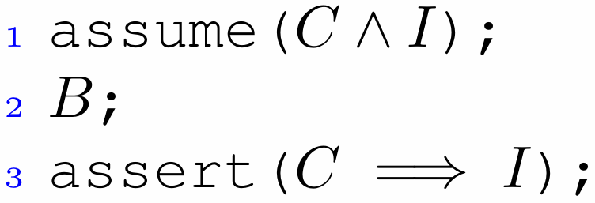
Proving a Loop Invariant
To prove that a loop invariant holds, we use induction:
  Base case: Check the invariant before the first loop iteration.
  Induction step: Assume the invariant holds at the start of an iteration, and prove it still holds after one loop iteration.
A = Code before the loop (no loops) | B = Loop body (no loops) | C = Loop conditions | I = Suggested invariant

Slide 41
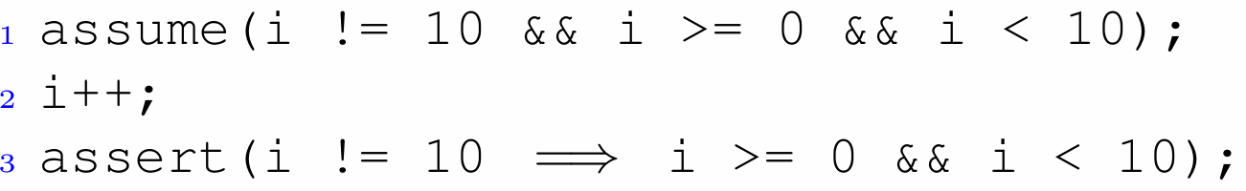
Proving a Loop Invariant example
  Base case:
  i = 0 → the
  invariant 0 ≤ i < 10 holds
  Induction step:
  if 0 ≤ i < 10 holds before
  i++, then it still holds after
  Invariant is proven- we can now use it to refine our analysis.

Slide 42
Loop Invariants in Overapproximation
To avoid false alarms, we add a loop invariant for each loop.
We do this in 3 steps inside the transformed program:
  base case- Assert the invariant before the nondeterministic assignments
  induction hypothesis- Assume the invariant holds before the loop body
  induction step- Assert the invariant holds after the loop body

Slide 43
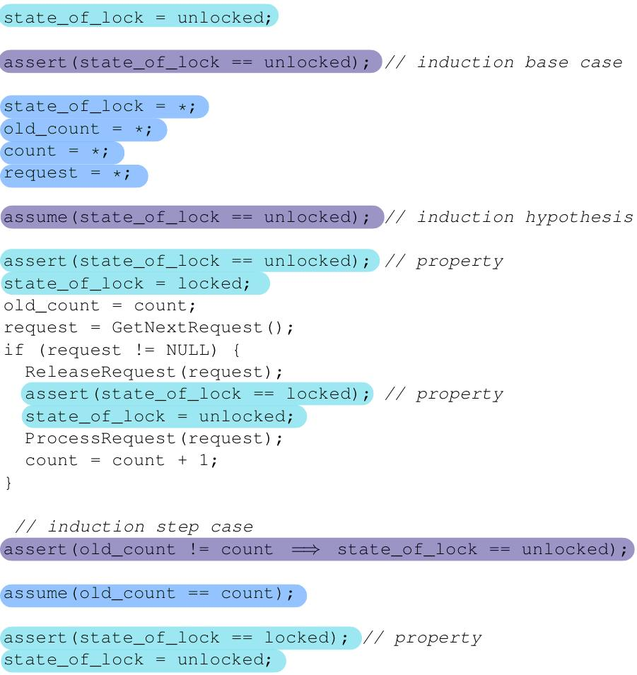
Loop Invariants in Overapproximation
Example
3
12
18
25
29
Analysis of the success of the proof:
Lines 3, 12, 18 pass easily: they match the obvious behavior of the code.
Why do lines 25, 29 also pass?
If request ≠ NULL:
  state becomes unlocked → line 25 is true
  count ≠ old_count → line 29 is not executed at all (due to assume)
If request == NULL:
  state remains locked, count == old_count → both tests are true

Slide 44
Loop Invariants – Choosing the Right One
A good loop invariant helps eliminate false alarms and improves analysis accuracy, but finding such invariants isn’t easy- there's no general algorithm for it, and it's still an active research area.
Not every invariant is helpful. for example: true is valid, but proves nothing.
Common strategies include reusing conditions from the code or combining program variables with logical relations.
Tools often guess and check candidate invariants.

Slide 45
THANK YOU
Roee Moscovici
Sapir Alon
Blockchain and software verification seminar 2025

