Slide 1


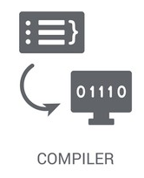

SolCMC: Solidity Compiler's Model Checker
Formal Verification of Smart Contracts
Or Haibi
Orel Shai

Slide 2
What Are Smart Contracts?
Solidity language
enforce contractual conditions
Written on the blockchain
Public code
Immutable
Notes:
In previous lectures, we learned that smart contracts are essentially code written in the Solidity language, designed to automatically enforce contractual conditions.
Smart contracts are powerful but unforgiving. Once deployed to the blockchain, they become immutable — meaning no one, not even the developers, can change or fix them.

Slide 3
Motivation — Why Verify Smart Contracts?
Immutable
Financially impactful
Dangerous
Bugs
(overflows, reentrancy..)
Manual testing is insufficient !
Notes:
This immutability, while useful for trust and transparency, makes bugs especially dangerous, so these contracts are immutable, which makes their correctness critically important.
Given that these contracts often control millions or even billions of dollars in assets, the stakes are incredibly high. A single overlooked vulnerability can be exploited and cause huge damage.

Slide 4
Famous Smart Contract Failures
The DAO Hack (2016)
Parity Wallet Bug (2017)
BZX Exploits (2020 - 2021)
$60M loss
$150M frozen
$64M loss
Notes:
example of harmful bugs:
In previous lecture we saw The Dao attack which cause 60 million dollar loos
Another attack back in 2017 - although no ETH was stolen, a huge amount of ETH was permanently frozen and became inaccessible. Now this amount of ETH is worth over 1 billion dollars!
And another series of attacks causes accumulation of a loss of 60 million dollars during 2020-2021

Slide 5
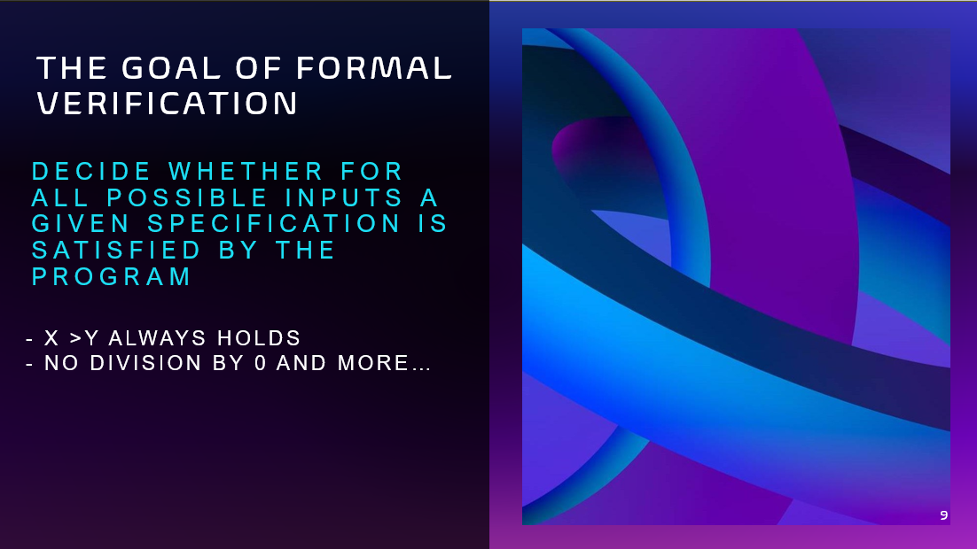
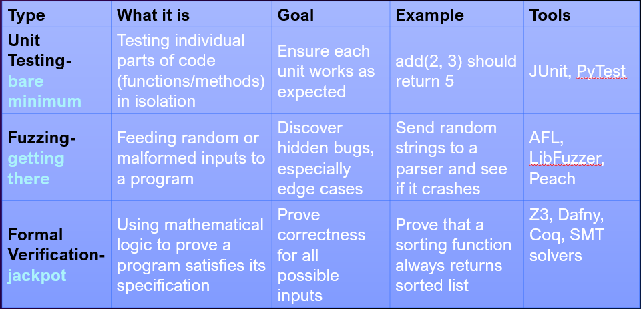
credit: sapir & roee
Formal Verification
Notes:
Unfortunately, manual testing is simply not enough. You can’t test every possible input or execution path, especially in complex contracts. This leaves room for undetected bugs.
Some of the most common bugs include arithmetic overflows, reentrancy vulnerabilities, and unexpected state changes — all of which have caused major losses in the past.
This is why formal verification and model checking are becoming increasingly important — to mathematically prove the correctness of the contract logic before it’s ever deployed.

Slide 6
Our focus
Smart contracts & Formal verification
Model checker
  solCMC – the Solidity compiler’s model checker
  User interface
  Counterexamples & invariants
  Verified Contracts: Deposit contract & ERC777
Solvers comparison
summary
Notes:
User interface – how users can use the compiler
Counterexamples & invariants – the compiler outcome when a bug was found or when correctness has proved
Verified Contracts – complex real world contracts used solcmc
Solvers comparison – we will explain later

Slide 7
What is a model checker?
An automated tool that explores all possible execution paths
Checks whether a program satisfies formal properties (safety, correctness)
Reports counterexamples when properties fail
Often used in hardware, concurrent systems, and now smart contracts
Notes:
A model checker is a formal verification tool that exhaustively explores all possible paths a program can take.
There are many tools designed to formally verify smart contracts.
To ensure that a verification tool always stays synchronized with the evolving language features, the best solution is to embed the tool within the compiler itself.
This integration offers two main benefits

Slide 8
What is SolCMC?
Solidity Constrained Horn Clause Model Checker
model checker for Solidity
Integrated into Solidity compiler
Detects bugs, generates counterexamples and invariants
Notes:
SolCMC is a model checker specifically designed for Solidity
What makes SolCMC stand out is its ability to:
Detect critical bugs, such as overflows, assertion violations, and reentrancy vulnerabilities.
Automatically generate counterexamples
Compute inductive invariants, which are logical properties that hold across all execution paths. These help prove correctness of loops, recursive calls, and safety properties in complex contracts.
.

Slide 9
SolCMC usage
checks errors and vulnerabilities like:
Arithmetic errors: overflow, underflow, division by zero
Structural errors: out-of-bounds access, empty array pops
Reentrancy, assertion violations
If the contract calls external functions unsafely, SolCMC synthesizes malicious reentrant behaviors to test vulnerability.
Notes:
SolCMC is designed to detect some issues and problems in Solidity smart contracts.
First, it checks for arithmetic errors, like overflow, underflow, or division by zero — these are common in low-level programming and can lead to major bugs.
It also looks for structural errors, such as accessing elements out of bounds or trying to pop from an empty array — typical mistakes in Solidity.
One of the most important checks is for reentrancy and assertion violations. Reentrancy is especially dangerous and has been used in real-world attacks like the DAO hack.

Slide 10
SolCMC Automated Smart Contract Verification
Goal: Verify Solidity program properties with minimal user input
Three Ways to Use SolCMC:
1. * require statements (assumptions/ precondition)
* assert statements (verification - must always hold)
2. Structural Property Checks (Automatic)
3. Test Harnesses (for Complex Properties)

Slide 11
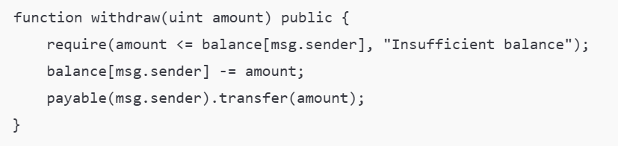
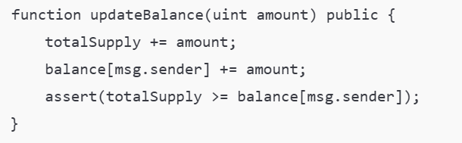
Require- Assert
This assert checks a property that should always be true — the total supply of tokens should never be less than the balance of a single user.
If this condition fails, it indicates a logical bug in the contract, not a user error.
Here, we check that the precondition for executing the function holds — the user must have enough coins.
If this is not true, the function stops with an error message.
This is an external input from the user, so it’s an assumption.

Slide 12
SolCMC Automated Smart Contract Verification
Goal: Verify Solidity program properties with minimal user input
Three Ways to Use SolCMC:
1. * require statements (assumptions/ precondition)
* assert statements (verification - must always hold)
2. Structural Property Checks (Automatic)
3. Test Harnesses (for Complex Properties)

Slide 13
SolCMC engines
SolCMC Based on two egines
CHC
Constrained Horn Clauses
BMC
Bounded Model Checking
Notes:
So how SolCMC actually worls?
SolCMC supports both CHC-based reasoning and Bounded Model Checking (BMC). CHC is used for proving general properties, while BMC is more suitable for detecting bugs within a limited number of execution steps.
SolCMC is based on Constrained Horn Clauses (CHCs). These are logical formulas used to express the semantics of smart contracts. The CHCs are processed by back-end solvers like Spacer and Eldarica, which are capable of proving whether a property always holds or finding counterexamples if it doesn't.
BMC is a more pragmatic approach: It checks properties only up to a fixed bound — for example, a certain number of function calls or loop iterations. It is unsound in the sense that it cannot prove a property universally true, but it is great at finding bugs quickly. (behaves like a test for a specific scenario with specific inputs).
SolCMC allows developers to select the appropriate engine depending on their goal:
Use BMC to uncover bugs quickly during development or fuzz-style testing (software testing technique where a program is bombarded with random, unexpected, or invalid inputs to uncover bugs, crashes, or unexpected behavior).
Use CHC for deep correctness proofs before deploying high-value contracts.

Slide 14
What Are CHCs?
SolCMC encodes Solidity smart contracts into a system of Constrained Horn Clauses (CHCs).
Describes a state transition in a program
A₁ ∧ A₂ ∧ ... ∧ Aₙ ∧ C ⇒ B
Aᵢ: Predicates (conditions)
C: Constraints (e.g., arithmetic conditions)
B: Conclusion (predicate)
Notes:
🔹 Describes a state transition in a program:
“If all conditions and constraints hold — then the conclusion must hold too.”
🔹 Why it's useful:
Models how a program moves from one state to another
Enables automatic reasoning: find bugs or prove properties
🔹 Used in SolCMC:
Solidity contracts are translated into CHCs
Makes it possible to verify correctness and find counterexamples
Equivalent form of Horn clause = at most one positive literal

Slide 15
CHC engine flow
counter example
code
AST
(Abstract Syntax Tree)
CFG
(control flow graph)
CHC to
Horn Solver
invariants
Regular compiler
solCMC Model checker
Notes:
This diagram illustrates the end-to-end flow of how SolCMC's CHC engine analyzes a smart contract.
We start with the source code — a Solidity smart contract. SolCMC begins by parsing this code into an Abstract Syntax Tree (AST), which captures the program's structure in a tree format.
From there, the compiler transforms the AST into a Control Flow Graph (CFG). This graph models all the possible execution paths of the contract — including function calls, loops, conditionals, and transitions.
The CFG is then converted into a set of Constrained Horn Clauses (CHCs), which are logic rules representing each program state and its transitions.
These CHCs are passed to a Horn solver, such as Spacer or Eldarica. The solver attempts to either:
Find a counterexample, showing a specific set of inputs and actions that violate a property (e.g., cause an overflow or reentrancy), or
Prove that a certain property always holds by generating inductive invariants — logical conditions that remain true throughout the contract’s execution.
This entire process allows SolCMC to symbolically verify smart contracts for both bugs and correctness — even across loops and recursive function calls.

Slide 16
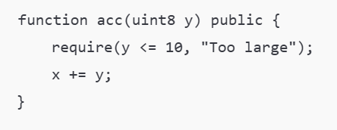
similar to automaton
(computational models course)
Code to Graph - Example
No
Check:
y<=10
Exit
Entry
Yes
Add:
x+=y
Notes:
Each vertex represents a state or section of the code, which can be reached by satisfying the conditions represented by the edges.
Each node in the graph corresponds to a program location, and its transitions are encoded into Horn rules using the Single Static Assignment (SSA) form.
This structure makes the logic easier to analyze and ensures that variable updates are clearly traceable.
This diagram shows how a simple Solidity function is transformed into a Control Flow Graph (CFG) — a visual representation of all possible execution paths in the function.
Let’s start with the Solidity code shown on the right. The function acc(uint8 y) performs two operations:
It first checks that the input y is less than or equal to 10 using a require statement.
If the check passes, it adds y to the contract’s state variable x.
Now, let’s walk through the CFG on the left:
Entry Node: This represents the start of the function. Control flows immediately to the next node.
Check Node (y <= 10): This is where the require condition is evaluated.
Add Node (x += y): This node performs the addition only if the check passed. It's the safe execution path.
Exit Node: Both successful and reverted paths eventually lead to the exit. Even though the revert undoes state changes, it still ends function execution — which is why we connect it to Exit too.
This graph is an essential part of how SolCMC generates CHC predicates. Each node becomes a logical clause, and the flow between them becomes formal rules. By encoding this graph into logic, SolCMC can verify whether paths are reachable, and under what conditions.

Slide 17
Predicate types & State Variables
Bf – Function Body Predicate
CHC form
A₁ ∧ A₂ ∧ ... ∧ Aₙ ∧ C ⇒ B
Represents the start of a function call.
Captures the initial state before execution.
Ensures inputs are valid and sets up execution context.
Variables
e - error flag
a - the contract address
st - the Blockchain state
tx - the transaction data
Balances - connect addresses to balances
every contract have it’s own state variables
Example:
  Bf(e=0, a, abi, tx, st, x, y, ...)
Notes:
On this slide, we introduce one of the core predicate types used in SolCMC: the function body predicate, denoted as Bf.
This predicate represents the very beginning of a function execution. It's responsible for capturing the initial state — before any line of code has been executed.
It sets up the context: making sure inputs are valid and preparing the system to track what will happen next.
In the example below, you can see Bf taking in multiple parameters like e for error flag, a for the contract address, tx for the transaction data, and st which holds the current state of the blockchain, including balances and storage.
On the right side of the slide, we’ve listed a few important variables you'll see frequently. Each contract will also have its own specific state variables — such as x, y, and others — which appear toward the end of the predicate.
So to summarize: the Bf predicate defines the starting conditions for any function, and it plays a crucial role in modeling how the contract behaves under verification.

Slide 18
Predicate types & State Variables
Sf – Function Summary Predicate
CHC form
A₁ ∧ A₂ ∧ ... ∧ Aₙ ∧ C ⇒ B
Represents the outcome of a function call.
Describes how the function changes state.
Used to verify correctness or detect errors.
Can encode error conditions or normal return.
Variables
e - error flag
a - the contract address
st - the Blockchain state
tx - the transaction data
Balances - connect addresses to balances
every contract have it’s own state variables
Examples:
Success: Bf (e = 0,...) ∧ T ⇒ Sf (e = 0, ...)
Error: Bf (e = 0, ...) ∧ T ⇒ Sf (e = 1, ...)
Notes:
Now let’s look at the Sf predicate, which stands for the function summary.
While the Bf predicate captures the beginning of a function call, Sf represents its end — specifically the result of execution.
This predicate is used to describe how the function changes the program state, and whether it finished normally or ended with an error.
It plays a central role in verifying correctness or detecting bugs.
In the example here, we see two possibilities:
On the first line, the predicate shows a successful outcome, with e = 0.
On the second line, it shows an error occurred, indicated by e = 1.
T here stands for the transition logic — it could include things like variable updates or conditions.
So in short:
Sf captures what happens at the end of a function, and it's essential for proving whether the code behaves safely across all possible executions.

Slide 19
Predicate types & State Variables
IC – Interface Predicate
CHC form
A₁ ∧ A₂ ∧ ... ∧ Aₙ ∧ C ⇒ B
Represents a contract's stable state between transactions.
Used at the start and end of each transaction.
Central for expressing invariants and tracking transitions.
Variables
e - error flag
a - the contract address
st - the Blockchain state
tx - the transaction data
Balances - connect addresses to balances
every contract have it’s own state variables
Example:
  Safe update: IC(...) ∧ Sf(...) ∧ e = 0 ⇒ IC(...)
  Error detected: IC(...) ∧ Sf(...) ∧ e > 0 ⇒ Err(e)
Notes:
In this slide, we introduce the IC predicate, which stands for Interface Clause.
This predicate represents the stable state of the contract — in other words, the points between transactions where the contract isn’t actively running a function.
IC is used at both the start and end of every transaction. It acts as a checkpoint before and after something happens.
The reason it’s so important is that it allows us to express invariants — properties that should always hold true for the contract — and it helps us track transitions from one state to the next.
If we look at the examples:
The first rule shows a safe update: we started in a stable state, executed a function (Sf) with no error (e = 0), and then returned to a new stable state — another IC.
The second rule shows an error case: the transaction ended with e > 0, so instead of going back to IC, we trigger an error predicate Err(e).
So in short, IC tells us what the contract looks like when it’s not in motion, and how to detect whether the most recent action was safe or not.

Slide 20
Predicate types & State Variables
NC – Nondeterministic Interface Predicate
CHC form
A₁ ∧ A₂ ∧ ... ∧ Aₙ ∧ C ⇒ B
Represents all possible external behaviors (adversaries, reentrancy).
Models how the environment may interact with the contract.
Enables unbounded external calls (e.g. reentrant attacks).
Crucial for security analysis.
Variables
e - error flag
a - the contract address
st - the Blockchain state
tx - the transaction data
Balances - connect addresses to balances
every contract have it’s own state variables
Example:
  External call sequence: NC(...) ∧ Sf(...) ⇒ NC(...)
Notes:
This final predicate, NC, stands for nondeterministic interface.
Unlike the others, it’s not about internal logic or stable states — instead, it models everything the outside world might do to the contract.
That includes things like arbitrary external calls, interactions from other contracts, or even malicious behavior such as reentrancy attacks.
The purpose of this predicate is to simulate unbounded external behavior. So it doesn’t just run a function once — it models what happens if external actors call the contract again and again, in any order.
This is especially important in security analysis, where we want to make sure that no matter what the environment does, the contract still behaves safely.
In the example at the bottom, you can see how it allows chaining calls:
If a call described by Sf(...) happens during an external state represented by NC(...), the system transitions to another external state — a new NC(...).
So in short: NC lets the verification engine explore all possible sequences of external actions, including worst-case adversarial scenarios.

Slide 21
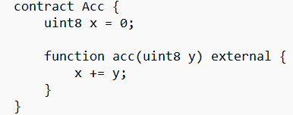
Example — Simple Accumulator Contract
Notes:
CHC encodes all paths through acc()
Detects overflow on x + y

Slide 22
Example — Simple Accumulator Contract
1. Initial state setup
e = 0 ∧ st = st′ ∧ x = x′ ∧ y = y′ ∧ 0 ≤ x′, y′ ≤ 255
⇒ Bacc(e, a, abi, cr, tx, st, x, y, st′, x′, y′)
Inputs are valid, no error, variables are initialized.
2. Overflow Detected
3. Normal Execution
Bacc(...) ∧ (x′ + y′ > 255)
⇒ Sacc(1, a, abi, cr, tx, st, x, y, st′, x′, y′)
Bacc(...) ∧ (x″ = x′ + y′) ∧ (x″ ≤ 255)
⇒ Sacc(0, a, abi, cr, tx, st, x, y, st′, x″, y′)
Addition would overflow → raise error e = 1
Update the contract state, no error raised.
Notes:
This slide demonstrates how a very simple Solidity function — in this case, an acc(uint8 y) function that just adds a value to a state variable — gets translated into Horn clauses used for verification.
Let’s walk through each of the three parts shown here:
1. Initial State Setup:
This line encodes the starting point of the function.
It says: there is no error (e = 0), the blockchain state (st) is unchanged, and the variables x and y are initialized properly.
The predicate Bacc is used to mark that we're inside the body of the acc function.
2. Overflow Detected:
This rule checks for overflow.
If the sum of x′ + y′ is larger than 255, it would overflow the uint8 type.
That’s considered an error, so Sacc returns with an error code: e = 1.
3. Normal Execution:
If there’s no overflow, the function continues normally.
Here we compute x″ = x′ + y′, and as long as the result is still within range, the function exits safely with e = 0.
So even this tiny function becomes three Horn rules — one for setup, one for the error case, and one for the successful case.
This kind of encoding lets the model checker reason precisely about what can go wrong and when.

Slide 23
CHC solvers requirements
CHC-based verification requires advanced Horn solvers
with built-in support for SMT theories
LIA
Linear Integer Arithmetic
UF
Uninterpreted Functions
Arrays
BV
  require(x + 2 * y <= 100);
  x + 2*y ≤ 100
  f(x) = f(y) → x = y
  arr[index] = value
  arr2 = w(arr1, i, v)
  x = a & 0xff
  bvand(a, 0xff)
Only Spacer and Eldarica currently support these requirements.
Notes:
The verification process relies on Horn solvers, which are advanced tools that can handle various mathematical theories. For example, LIA supports arithmetic operations on integers, Arrays model blockchain storage, and ADTs represent complex contract states. When contracts use nonlinear arithmetic or bitwise logic, SolCMC falls back on the NIA or BV theories.

Slide 24
SolCMC in the Compilation Pipeline
After type checking
Converts to CHCs logic
Insertion for solvers (Spacer or Eldarica)
Reports results directly in compiler output

Slide 25
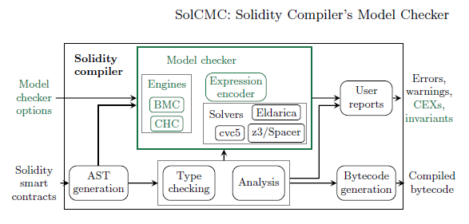
SolCMC in the Compilation Pipeline
Notes:
the Solidity Compiler’s Model Checker, integrates into the overall compilation pipeline.
The process begins with a Solidity smart contract. Like any compiler, the Solidity compiler parses the code into an AST (Abstract Syntax Tree), performs type checking, and runs semantic analysis.
But when model checking is enabled, an additional component — the Model Checker — is triggered.
Inside this box, SolCMC uses engines like BMC (Bounded Model Checking) and CHC (Constrained Horn Clauses), depending on the verification strategy.
These engines use an expression encoder to transform the logic into a format solvable by logical solvers. Solvers like Eldarica, Spacer, z3, and cvc5 are then used to check properties about the contract.
The output goes to the user as reports that may include:
errors,
warnings,
counterexamples (CEXs),
or proven invariants.
Meanwhile, the regular compilation process continues, and bytecode is generated as usual.

Slide 26
How Users Access SolCMC
SolCMC is built into the Solidity compiler
It can be accessed through:
WebAssembly via JavaScript bindings
Command-line interface
Web IDEs like Remix
Remix is the easiest to use but offers limited configuration
Notes:
SolCMC is available by default in the Solidity compiler. Developers can access it through different environments. Remix is the most accessible platform for beginners, though it provides limited control over configuration- we will expand about it in next slides.
For more advanced setups, the WebAssembly and command-line interfaces offer full customization.

Slide 27
Configuration Options
SolCMC supports changing and configuring the settings via command line or WebAssembly.
Key options include:
Selecting engine - CHC, BMC or both
Specifying which contracts and targets to verify
Setting a timeout per verification target
Notes:
When working with the command line or the JavaScript wrapper (option 1 or 2 from the previous slide), users can control nearly every aspect of SolCMC’s behavior. For example, they can choose the underlying verification engine (CHC or BMC), filter which functions and contracts to check:
Typically the user specifies only the contract they wish to deploy. Inherited and library contracts are included automatically, avoiding verifying every contract as the main one.
and adjust performance-related settings like timeouts. Encoding methods for division/modulo can also be changed for better solver compatibility.
more configurations:
show-unproved: watch unproved targets, beside those who failed.

Slide 28
Counterexamples
If verification fails, SolCMC provides detailed counterexamples
Includes:
Failing code line
Execution trace (functions and transactions)
Input arguments and state variable values
Reentrancy traces when relevant
Notes:
One of the powerful features of SolCMC is that it doesn’t just say “verification failed” — it actually shows why it failed.
When a property can’t be proven, SolCMC provides a detailed counterexample, which helps us understand exactly what went wrong and where.
The counterexample includes:
The exact line of code that failed the assertion or condition
A full execution trace — showing which functions and transactions were called leading up to the failure
The actual input arguments and state variable values that caused the error
And if the issue involves reentrancy, it will even include the reentrant call trace that triggered the bug
This level of detail makes debugging much easier — you’re not guessing what caused the failure. You get a concrete scenario, like a real attack path or logic flaw, that you can immediately investigate or reproduce.

Slide 29
Inductive Invariants
If verification succeeds, SolCMC can generate invariants
These describe what always holds true in the program
Invariants are displayed in Solidity-like syntax
Can include reentrancy safety guarantees
Notes:
So now we’ve seen what happens when verification fails — but what about when it succeeds?
In that case, SolCMC is able to generate something called an inductive invariant.
These are logical statements that describe what always remains true in the contract — across any number of transactions, inputs, or states.
These invariants are extremely useful because they can give us formal assurance about things like balance preservation, access control, or absence of reentrancy.
One of the nice features of SolCMC is that it presents these invariants in Solidity-like syntax, so they’re readable even to developers who aren't formal methods experts.
And as the last bullet notes, the invariants can even capture reentrancy safety guarantees, like ensuring that no reentrant call will change the contract’s critical state unexpectedly.
So in summary: invariants are like mathematical safety proofs that SolCMC produces automatically — when everything checks out.

Slide 30
Counterexamples and Inductive Invariants Example
https://docs.soliditylang.org/en/latest/smtchecker.html
Solidity documentations in github
Notes:
This contract, VulnerableBank, appears simple: users deposit Ether (=native cryptocurrency of the Ethereum blockchain), and can later withdraw it.
However, there's a serious flaw in the withdraw function. The key issue is the order of operations.
It first checks if the sender has enough balance (require). Then it sends Ether to msg.sender using a low-level .call, but only after that does it subtract the amount from the internal balance.
The problem is that .call transfers control to the receiving address — which could be a malicious smart contract. That contract could immediately call withdraw again before its balance has been updated, allowing it to withdraw multiple times.
This is a classic reentrancy vulnerability, the same type that caused the DAO hack in 2016. SolCMC is designed to detect this kind of bug by synthesizing such an attacker contract and checking if it can reach an invalid state or assertion failure.
Overflow example:
This slide shows a practical example of how the Solidity SMTChecker can detect overflows during verification.
At the top, we have a very simple smart contract with two immutable variables, x and y, and a function that returns x + y.
The key point here is that we’re using the SMTChecker to formally verify that overflow can’t occur — but by default, Solidity versions from 0.8.7 and up no longer check overflow automatically in this analysis.
So we have to manually enable it using a flag:
--model-checker-targets "underflow,overflow"
Once this flag is added, the SMTChecker performs symbolic execution and finds a counterexample where overflow happens.
In this case, it shows a warning saying that the value of x + y is larger than 2**256 - 1.
It also gives a detailed counterexample showing specific values for x and y, the exact line in the code that fails (return x_ + y_), and a full transaction trace.
This demonstrates how SMTChecker can help catch serious arithmetic bugs — not by running the code, but by analyzing it mathematically.
At the bottom, we also see how to fix the issue: by adding require statements that limit the values of x and y, we avoid the overflow.
Once these guards are added, the warning disappears, and the SMTChecker proves that the function is now safe.

Slide 31
Real World Experiment
Real smart contracts analysis
Notes:
Now we will present two important contracts - to demonstrates SolCMC's power in handling complex verification tasks.
The contracts are: the Ethereum 2.0 Deposit Contract and the ERC777 token.
These are sophisticated, widely used contracts with constructs that are traditionally hard to verify automatically. The experiments demonstrate how SolCMC, powered by CHC encoding and Horn solvers, successfully verified or found issues in both cases.

Slide 32
Etherum 2.0 Deposit Contract
Predicates & State Variables

Slide 33
Deposit Contract - Role & Purpose
The Deposit Contract is the official gateway for becoming a validator in Ethereum 2.0.
Connects Ethereum 1.0 (Proof of Work) with Ethereum 2.0 (Proof of Stake)
Validators are the new miners
Allows users to deposit 32 ETH and join the network as validators
Notes:
In previous lectures, we saw that the entities responsible for securing the Ethereum 1.0 network were called miners.
In Ethereum 2.0, this role is performed by validators, who help secure the network using a mechanism called Proof of Stake instead of computational power.
To become a validator, a user must deposit 32 ETH into the Deposit Contract — the smart contract shown here.
The contract is deployed on Ethereum 1.0, but its data is read by the Ethereum 2.0.
This makes the Deposit Contract a kind of bridge between the two versions of the network — it enables the new Ethereum to register validators based on deposits made in the old Ethereum.

Slide 34
Deposit Contract - Importance & complexity
The Deposit Contract is a small but critical component powering Ethereum 2.0
significant financial importance - holds over 9M ETH
Compact - only 200 code lines
critical to Ethereum's transition
Includes many complex features — such as loops, dynamic types, hash functions
Notes:
The Deposit Contract is critical in the Ethereum ecosystem.
It has significant financial importance, holding over 9 million deposits with a total value of tens of billions of dollars.
Moreover, it plays a foundational role in the progression of the Ethereum protocol itself, as it performs the essential function of transferring coins to the new proof-of-stake chain.
Its complexity arises from the combination of several advanced features used in parallel, such as loops, cryptographic hashing (Merkle trees), and low-level data manipulations.
Initially the contract was manually proven. Manual verification was enough for correctness, but not ideal because:
it’s time-consuming – requires experts writing and checking proofs line by line.
and It’s hard to repeat or reuse – each code change might require redoing large parts of the manual proof.

Slide 35
SolCMC vs Deposit Contract |Automatic Verification in Action
What SolCMC did ?
Translated contract into 127 CHC rules
Sent rules to backend solvers: Spacer & Eldarica
Optimization that made the difference:
Replaced size & 1 ➜ size % 2
Made constraints easier for solvers to handle
Outcome & Insight
Spacer
Timed out after 1 hour
Struggled with bitwise complexity
Eldarica
Solved in 22.4 seconds
Successfully proved the property
💡 Takeaway: Even a small syntactic change can dramatically improve verification performance.
Notes:
SolCMC turned the Deposit Contract into 127 CHC rules and passed them to backend solvers. Spacer failed due to complexity, but Eldarica succeeded — largely due to a small but important rewrite: replacing size & 1 (a bitwise operation) with size % 2 (a modulo operation). This simplification avoided the need for bit-vector theory and made the problem solvable faster. This shows how even subtle syntax can greatly influence automatic verifiability.

Slide 36
ERC777 Token Contract

Slide 37
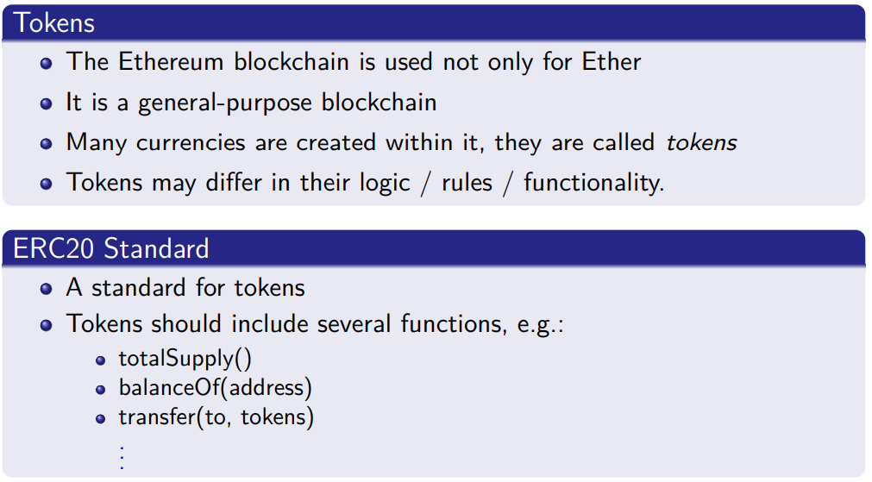
credit: Yoni
Tokens - Overview
So, if we have ERC20 why we need ERC777?
Notes:
This slide is from Yoni’s first lecture. We see that the Ethereum blockchain doesn’t just use Ether – it can build many other types of digital currencies, called tokens.
Each token can have its own rules and logic – but so that everyone knows how to communicate with certain tokens, standards have been created.

Slide 38
ERC777 Token Contract - Overview
ERC777 is a modern token standard on Ethereum
Adds new features to former token standard ERC20
1200 lines, 8 files, inheritance, hooks
Hooks enable External calls during transfer - allow dynamic behaviors, including reentrancy
ERC777 vulnerability: No basic property that total token supply stays constant during transfer
Notes:
ERC777 is an advanced token standard offering more flexibility than ERC20.
This flexibility comes at the cost of complexity—1200 lines of code, assembly usage, inheritance, and reentrant function calls.
Hooks are predefined function calls that a contract can trigger in another contract during a transaction.These allow external contracts to respond
For example, in ERC777:
tokensToSend: called before tokens are sent
tokensReceived: called after tokens are received
One major disadvantage : it doesn't ensure that the total supply remains constant during token transfers, opening the door to subtle bugs.

Slide 39
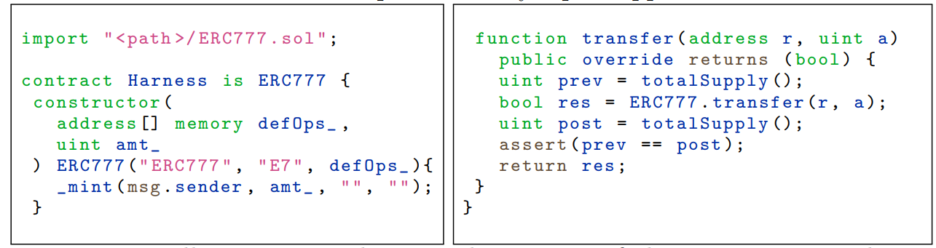
ERC777 with SolCMC

Slide 40
ERC777 Counterexample Found by SolCMC
SolCMC found a trace where totalSupply changes mid-transfer
tokensReceived in Recipient contract
Call operatorBurn inside Recipient contract
Reduce the tokens while the transfer is not yet complete
(prev ≠ post) SolCMC shows mismatch in the tokens
Notes:
SolCMC detected a bug in the ERC777 transfer process.
During a transfer, the token contract notifies the recipient contract once tokens are moved.
At that point, the recipient can run its own code — for example, it might call operatorBurn to burn some of its tokens.
If this happens before the original transfer call finishes, the total supply gets reduced in the middle of the transfer.
SolCMC was able to detect this and report a counterexample where the assertion prev == post fails, exposing a safety violation.

Slide 41
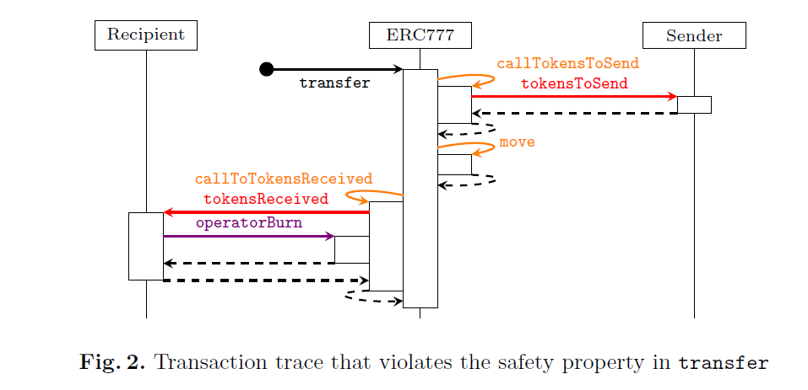
Transaction Trace That Violates Token Supply Safety
Notes:
This diagram shows the transaction trace of a call to the transfer function in the ERC777 token contract.
We can see the process step-by-step:
The transfer function first triggers an external call to tokensToSend on the sender’s side, notifying them of the transfer.
Then, the move operation performs the actual transfer of tokens from sender to recipient.
Finally, tokensReceived is called on the recipient, allowing them to react to receiving tokens.
Here lies the problem: inside tokensReceived, the recipient makes a reentrant call to operatorBurn, which burns tokens.
This changes the total supply during the transfer, violating the safety property we enforced via assert(prev == post).
This diagram clearly illustrates the reentrancy vulnerability, highlighting the need for protection mechanisms like mutex locks to maintain system integrity.

Slide 42
Fixing ERC777
So, what could be a solution to the problem?
Add mutex to prevent reentrancy
Re-run SolCMC: property now safe
Eldarica returns inductive invariants

Slide 43
So what is the difference between the solvers?

Slide 44
Eldarica vs Spacer
Conducted an experiment with 1,098 Solidity files and 3,688 Horn logical queries
Spacer and Eldarica run on all of them.
Eldarica was better on structures, tuples, nested types, loops etc .
Spacer was better on simple code with regular variables, direct conditions.

Slide 45
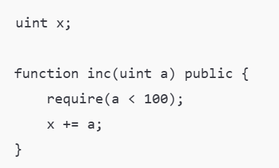
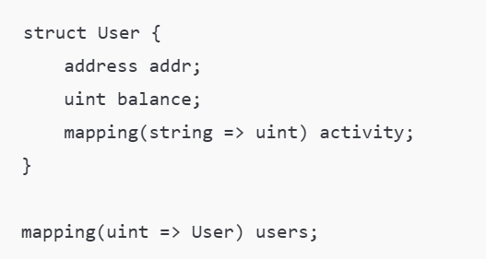
Eldarica vs Spacer
Which solver for each code?
Spacer
Eldarica
Notes:
On the left, we have a very simple function using a regular variable and a straightforward condition.
This is ideal for Spacer, which works well with basic logic, simple state, and minimal abstraction.
On the right, we have a much more complex structure: a struct that includes a nested mapping, and a global mapping to access these structs.
This level of data nesting and abstraction is hard for Spacer to handle efficiently, but Eldarica is designed to support abstract and complex data types like these.
It can encode and reason about nested mappings, tuples, and complex data relations — which makes it the better solver for the right-hand example.

Slide 46
To Sum Up…
SolCMC is integrated with the Solidity compiler and tracks language evolution
Enables formal verification directly within developer workflows
Uses direct encoding of Solidity AST into CHC format for SMT solvers
Practical tool for proving or disproving real-world smart contracts
Notes:
To conclude, SolCMC is a powerful, stable, and accessible model checker embedded into the Solidity compiler.
By supporting direct encoding of smart contracts into CHC, it makes verifying real-world Solidity code feasible.
The tool has already uncovered and verified complex behaviors and provides developers with readable counterexamples and inductive invariants. Its integration with compiler infrastructure ensures it evolves with the language and stays useful long-term.
Future work may further improve encoding efficiency and solver performance, especially in handling ADTs and complex data types (like algebraic data) ,tuple-heavy structures.

Slide 47
Questions?

