Slide 1
SMT-Friendly Formalization of the Solidity Memory Model
Akos Hajdu, Dejan Jovanovi´c
Avichai Iny
Evyatar Kersh

Slide 2
Agenda
Motivation
Background
  Ethereum
  Solidity
  SMT based program
Formalization
  Types
  Local storage pointers
  Contracts, state variables and functions
  Statements
  Assignments
  Expressions
Evaluation
Summary

Slide 3
Motivation

Slide 4
Motivation
Formalization of language: take the behavior of the language and turn it into clear rules that a machine can understand and verify
Bugs in smart contracts can lead to serious financial damage.
Goal: Ensure smart contracts are correct and error-free.
Use automated tools to verify contracts.
These tools work with SMT (Satisfiability Modulo Theories) languages.
Therefore, we want to formalize Solidity into SMT-compatible form.
This enables precise verification and helps prevent critical bugs.
Smart Contract Code
Formalization
SMT Solver Analysis
Bug Detection
Property Verification
Verified Smart Contract
Notes:
Convert from Solidity syntax to SMT syntax.
Verfication by automatic tools.
Betterr verification.
Good verification prevent economic damage.

Slide 5
Motivation – cont.
Previous formalizations focused on low-level EVM byte code, not Solidity.
Solidity's memory model was not fully formalized.
This formalization includes the Solidity memory model.
Most parts are kept quantifier-free for simplicity.
Solidity
Formalization
Low-Level EVM
Formalization
Provides accurate
and efficient results
Less accurate and
efficient
Notes:
1. So far the formalization

Slide 6
Background - Ethereum

Slide 7
Background - Ethereum
Ethereum's Core Components
2 kinds of memory of contract
Contract Interaction
Accounts
The process of calling public
functions of contracts
Digital entities with Ether
balances and contract
associations
Persistent
Memory
Temporary
Memory
Contract variables,
complex data types
Function
parameters, return
values, temporary data
Blockchain Deployment
Smart Contracts
Self-executing agreements
written in Solidity
Stored in 256-bit
slots, hashtables
Erased after
transaction
The process of deploying
contracts as bytecode

Slide 8
Background - Solidity

Slide 9
Background – Solidity
Solidity Data Types
OOP language.
Two types of data:
  Values - int, bool, addresses.
  References – structs, arrays and mapping.
Value Types
Reference
Types
Basic data types
passed by value, like
integers and
booleans.
Complex data
structures like
structs and arrays.

Slide 10
Background - Solidity
There are 2 storage data types, “Storage” and “Memory”.
In the storage all the variables store as values.
In the memory the data can be saved by reference.
storage and memory are separate from each other and cannot be mixed by pointers.
Functions define local variables and pointers that can point to both storage and memory.
Data stored
permanently on the
blockchain.
Storage
Temporary data, not
persistent across
transactions.
Memory
Variables exist
during function
execution.
Function
Variables
stack

Slide 11
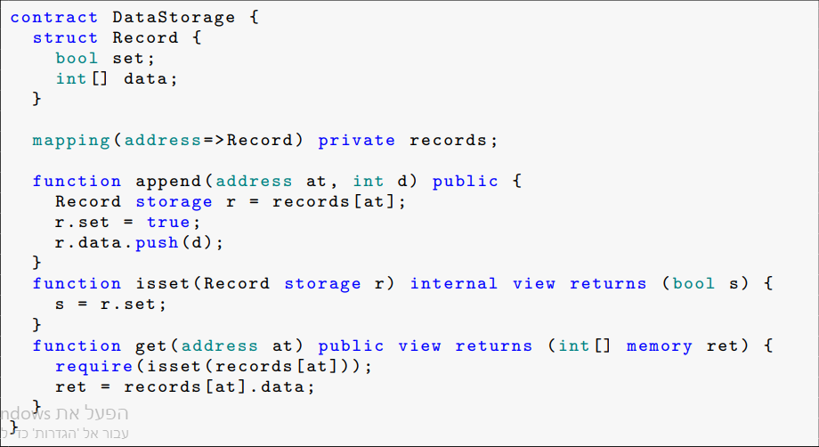
Example – Solidity contract

Slide 12
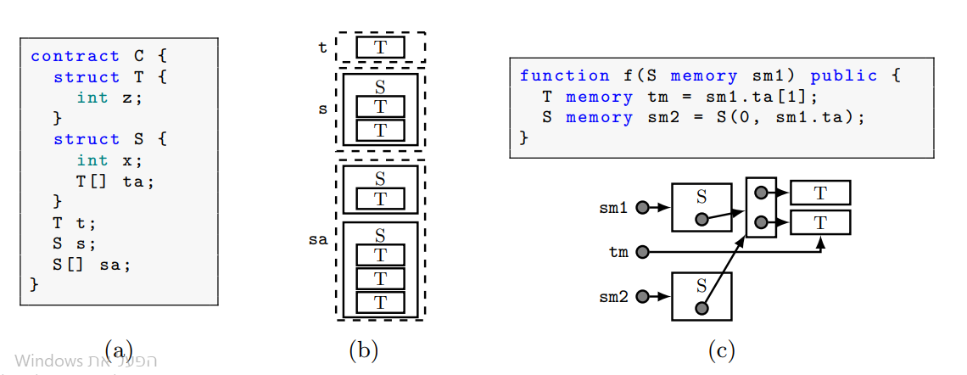
Storage VS Memory

Slide 13
Background - SMT

Slide 14
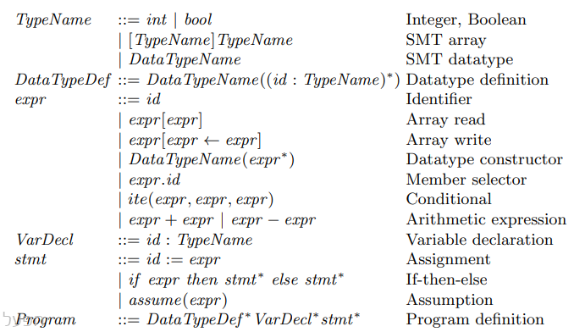
Background SMT based program

Slide 15
Formalization

Slide 16
Formalization
Types
Assignments
Expressions
Local storage pointers
Contracts, Functions and state variables
Statements

Slide 17
Formalization
Types

Slide 18

Formalization - Types
We define T(.) function to convert Solidity type into an SMT type.
First, we'll show the value type conversion and then the reference type conversion.
The value types converted to int / Boolean.
The reference type divided into three parts: mapping, arrays and structs.
Each reference type is classified according to where it is stored in memory: Storage, StoragePtr and Memory.
Convert value type

Slide 19

Formalization - Types
Mapping in storage convert to SMT array.
We convert recursively the data types of the key and value.
Mapping of StoragePtr convert to int array to point to the mapping in the storage.
Convert mapping

Slide 20
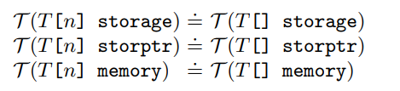
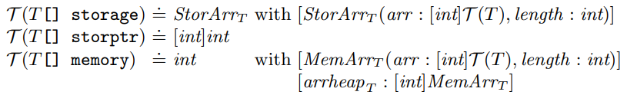
Formalization - Types
Both arrays of known size and dynamic arrays will be converted by T(.) in a similar manner.
Arrays in storage will be converted to a new data type defined in SMT called StoreArrT, which consists of an array of T that will be converted recursively, as well as the length of the array (int).
Pointers to arrays in storage will be converted to pointers in SMT using an array of ints.
Arrays in memory will be converted to int index so that a new data type called MemArrT is defined which also consists of an array of T which is recursively converted to SMT data type and length, and these arrays are stored in another array called arrheapT. The index to which the array is converted is the corresponding index in arrheapT.
Convert arrays

Slide 21
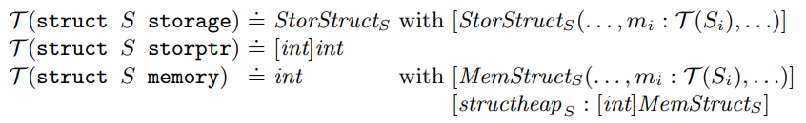
Formalization - Types
Structs in storage will be converted to a new data type defined in SMT called StorStructsS, which consists of members Mi that will be converted recursively.
Pointers to structs in storage will be converted to pointers in SMT using an array of ints.
Structs in memory will be converted to int index so that a new data type called MemStructS is defined which also consists of members Mi that will be converted recursively, and these structss are stored in another array called structheapS. The index to which the array is converted is the corresponding index in structheapS.
Convert structs

Slide 22
Formalization
Local storage pointers

Slide 23
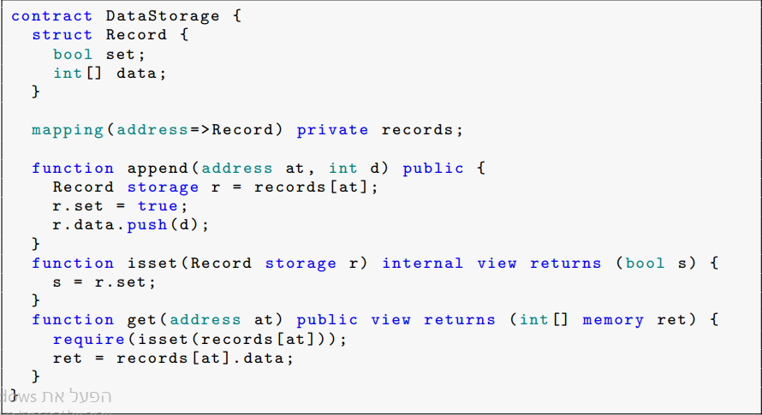
Formalization – Local storage pointers
As we defined in the background, there are storage pointers that are defined as local variables in functions and are stored on the function's stack.
The problem is that when we want to frame them in SMT, we can't encode them directly.
A bad solution to the problem would be to simply define a pointer as the data type it points to. But this solution is not good because during the program it can point to a different data type, and it is not always possible to know at compile time which data type it points to.

Slide 24
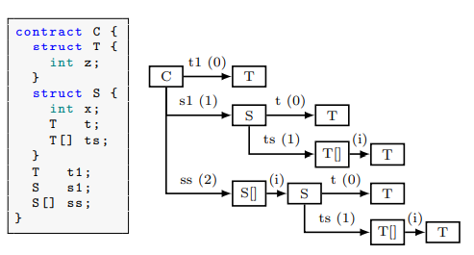
Formalization – Local storage pointers
The proposed solution to the problem is a special encoding for these pointers by constructing an indexed tree.
The tree is defined by state variables, each of which has its own index.
This way, it is possible to encode the path of a pointer to a specific object in storage.
For example, the state variable t1 can be represented as [0], the member s1.t as [1, 0], and ss[8].ts[5] as [2, 8, 1, 5]

Slide 25
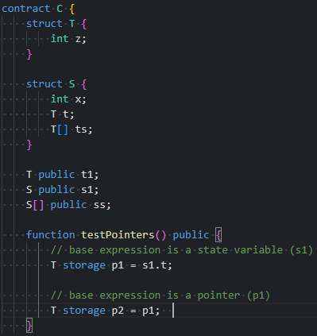
Formalization – Local storage pointers
When the pointer is set to point to a state variable, the encoding of the pointer can be precisely defined by the tree and the expression.
But when the base expression is a pointer itself, we don't know exactly where it points to, so we will need to define a conditional path for the new pointer.
Base is a Pointer
Define conditional paths
to cover all possibilities.
Base is a State
Variable
Use the tree structure to
define the path.

Slide 26
Formalization – Local storage pointers
We will define two functions: one, pack(), which encodes a pointer expression into an SMT pointer encoding. The other, unpack(), does the opposite, converting an SMT pointer encoding into a Solidity pointer expression.
1
2
Converts a pointer
expression to SMT
syntax using arrays.
Converts an SMT
pointer expression
back to a Solidity
pointer.
Packpath
Unpack

Slide 27
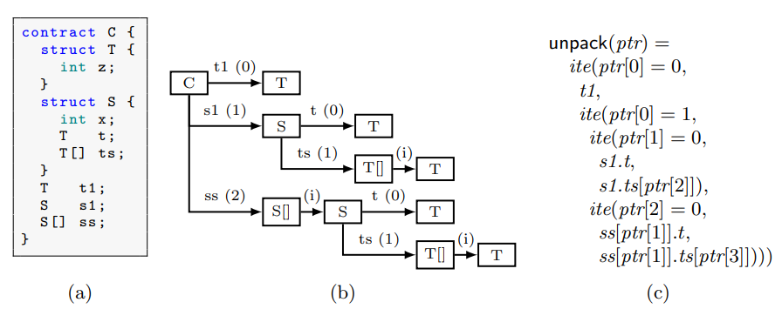
Formalization – Local storage pointers
In the unpack() function we need to trace the indices of the SMT representation to determine exactly where the index points. This will be in the form of if then else.

Slide 28
Formalization -
Contracts, state variables and functions

Slide 29
Formalization – Contracts, state variables and functions
In contract there are two types of variables.
State Variables: These variables are stored in storage, and their data types are translated into SMT data types: T (type(si))
Function Calls variables: Each parameter and return value of a function is assigned an SMT data type. For reference types such as arrays and structs, it is defined whether they point to storage or to memory.
Contract variables
State Variables
Function variables
Storage location
Storage
Storage or memory
Data types
SMT data types
SMT data types

Slide 30
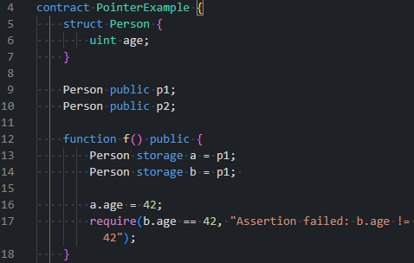
Formalization – Contracts, state variables and functions
In SMT we need to keep the storage “non-aliasing”.
It means that two pointers can not point to the same location at the storage.
How can we do it?

Slide 31
Formalization – Contracts, state variables and functions
We will define reference counter - refcnt: int.
Track the reference variables and is defined as the address of the pointer.
Each allocation of rerference variable we incrememnt the value of refcnt.
We assume each parameter of a function ≤ refcnt in order that the pointer not point to a memory allocation that will be in the function.
If the parameter is a struct or array, we need to assume that all the members/indices are <= refcnt recursively.
Memory Allocation Strategy
Recursive Check
Non-Aliasing
Verifies complex arguments to
maintain address integrity.
Ensures unique memory
addresses to prevent conflicts.
Function Parameter
Limit
Reference Counter
Restricts function parameters
to avoid address overlap.
Tracks memory allocations and
acts as an address.

Slide 32


Formalization – Contracts, state variables and functions
We need to define the default values in the SMT for translating the constructor function.
The default of value variables is 0 or false.
Mapping is converted to array like we saw, and we give the default value to the Val.
Arrays without fix size we initialize them to zero size.
For storage array we define const array with default value of T and length N.
For storage structs we define StorStruct and default value for each member Si.
Default value in SMT

Slide 33
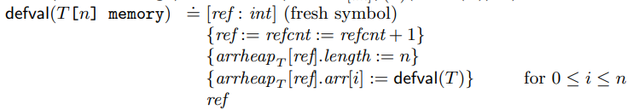
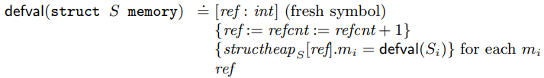
Formalization – Contracts, state variables and functions
In memory arrays and structs we define fresh symbol ref to the new allocation address.
We initialize every member in struct to is default value.
In array we initialize the length to N and assign each index to it’s default value.

Slide 34
Formalization -
Assignments

Slide 35
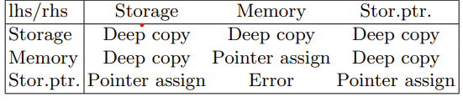
Formalization – Assignments
LHS – Left Hand Side – the variable in the left side of the equal sign.
RHS - Right Hand Side – the variable in the right side side of the equal sign.
For example: in x =5, X is LHS and 5 is RHS.
Deep copy - creates a new instance of an object and all the data it references, so there is no shared memory between the original and the copy.
Pointer assignment, just copy the address.

Slide 36

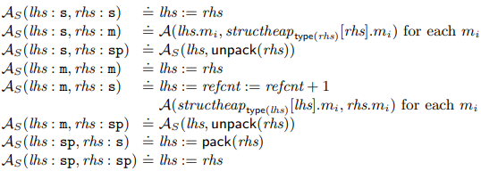
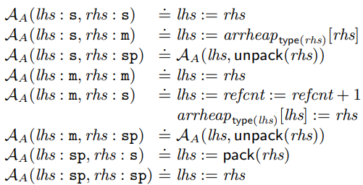
Formalization – Assignments
We define the function A(lhs, rhs) for assignments, and Am, Aa, As for mapping, arrays and structs respectively.
LHS and RHS in this case are SMT expressions.
For value types we do regular assignment.
In mappings we can declare storage pointer to mapping or assigning two storage pointers.
In structs if LHS is storage we will do deep copy. I d LHS is memory we do or deep copy to new address or pointer assignment depend on RHS. If LHS is storage pointer we will do pointer assignment.
In arrays very similar to structs.

Slide 37
Formalization -
Expressions

Slide 38
Formalization – Expressions
We have four types of expressions in Solidity.
Field Access
Arrays indices accessing
Conditional
Expressions
Allocating New
Arrays/Structs

Slide 39
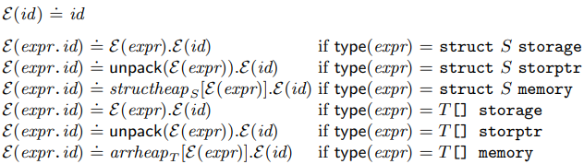
Formalization – Expressions
We define the function Epsilon(.) to translate Solidity expression to SMT expression.
Each identifier translate to the identifier itself.
Access member is defined corresponded to the expression type.
If its Storage Object – direct accessing.
If its storage pointer we need to unpack the pointer.
If its memory object, we need first access the object via the arrHeap.

Slide 40
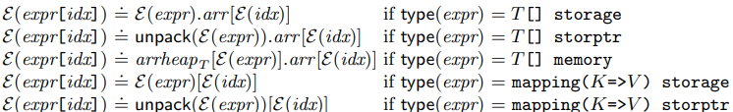
Formalization – Expressions
In the same way for array indexing access.
If the expression type is array, we need to access the array and from there to arr.
In mapping accessing to the right index.

Slide 41
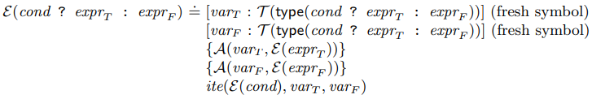
Formalization – Expressions
In conditional expressions the true expression and the false expression may refer to different memory locations.
we define two temporary variables at the same memory location.
If either original expression is in memory, both temporaries will also be in memory. Otherwise, will be storage pointers.
then make assignments using A(., .) and finally use the new variables in the conditional.

Slide 42
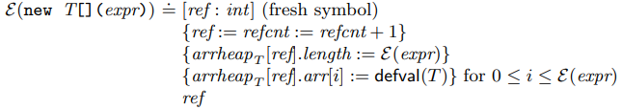
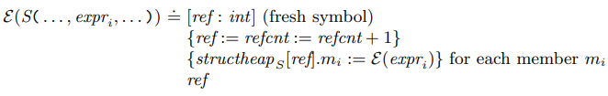
Formalization – Expressions
In new array allocation in memory, we create new array in arrHeap.
Increment refcnt.
Define the length of the array.
Set each index to its default value.
In structs is same, just we apply the epsilon function to each member recursively.

Slide 43
Formalization -
Statements

Slide 44
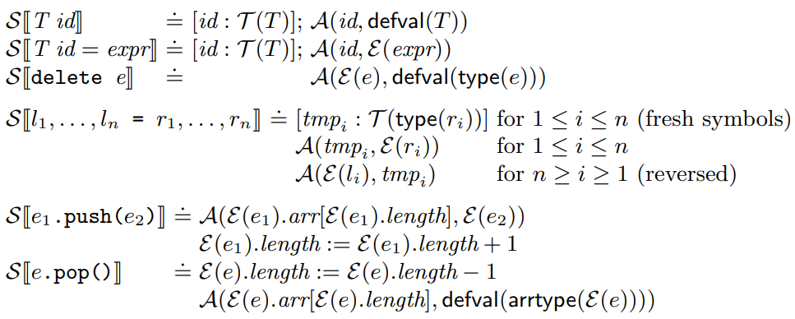
Formalization – Statements
we define the S[.] function that Translates Solidity statements to a list of statements in the SMT program.
Uninitialized variable – declare with SMT type and assign default value with epsilon function.
initialized variable – declare with SMT type and assign expression value with epsilon function.
Delete – assign default value.

Slide 45
Formalization – Statements
Declaration and assignment of multiple variables – define TMPi of type Ri. Assign TMPi = Ri with A(.) function. Assign Li = TMPi with A(.) function.
Push – increment array length, and Add the new variable to the end of the array.
Pop – assign to the popped variable default value, and decrement array length.

Slide 46
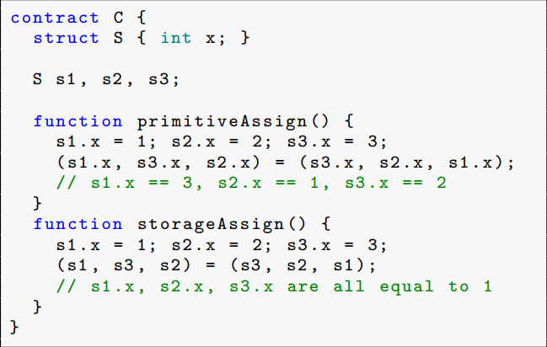
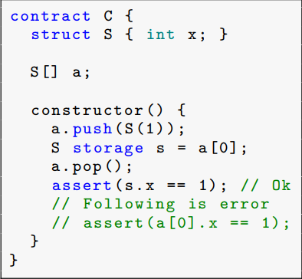
Formalization – Statements
Assignments of values vs pointers
Access by pointer vs index in pop

Slide 47
Evaluation

Slide 48
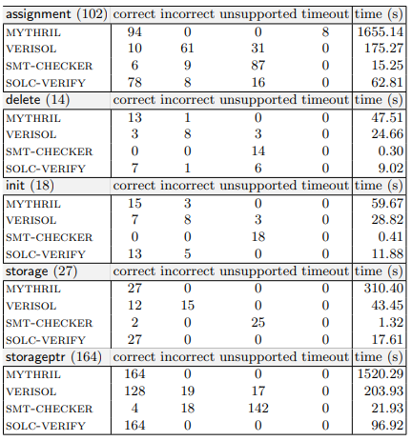
Evaluation
Researchers evaluated their formalization using the SOLC-VERIFY tool.
Used representative contracts with heavy use of Solidity's memory features.
Compared their tool's verification against existing tools
Results showed their formalization achieved the best balance of accuracy and computational cost.

Slide 49
Conclusion

Slide 50
Conclusion
Presented a high-level SMT-based formalization of Solidity's memory model.
The formalization covers both persistent storage and transient local memory.
Introduced a novel encoding of storage pointers as arrays, enabling precise modeling without quantifiers.
Serves as the foundation for the modular verification tool solc-verify.
Results show improved soundness and precision over existing Solidity-level tools.

Slide 51
Thank You

