Slide 1
Learning to Play Belote with Reinforcement Learning
MID-TERM REVIEW · TECHNION · 2026
♠
♥
♦
♣
PPO self-play on a two-player Belote environment
Noa Curiel & Yoni Benabou
Notes:
Introduce the project: an RL agent that learns two-player Belote from scratch with PPO self-play.

Slide 2



Why Belote?
01 / MOTIVATION
A popular strategic game
One of the most played card games in France, with a Belote tournament held every year at the Technion.
A real AI challenge
Imperfect information: the opponent's hand is hidden, so every decision is a bet on what they hold and on how the trick will unfold.
Our motivation
As long-time players, we wanted to see whether an RL agent can rediscover human conventions — or beat them — purely through self-play.

Slide 3
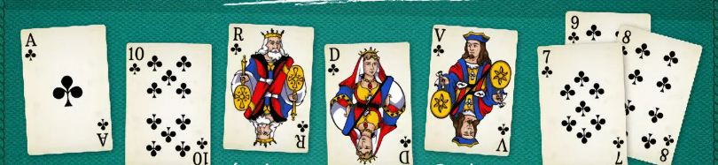
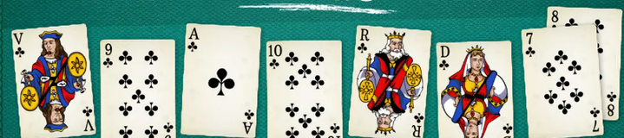
Our two-player Belote variant
02 / THE GAME
RULES
NON-TRUMP
32-card deck, 8 cards per player — 16 stay hidden all round
Trump suit drawn at random each round
Must follow suit; otherwise must trump; must over-trump when trump is led
Highest card wins the trick (trump beats every other suit)
+10 for the last trick (dix de der), +20 for King + Queen of trump (belote-rebelote)
11 pts
10 pts
4 pts
3 pts
2 pts
0 pts
TRUMP
20 pts
14 pts
11 pts
10 pts
4 pts
3 pts
0 pts
In trump, the Jack and the Nine jump to the top.

Slide 4
From four-player Coinche to two-player Belote
03 / SCOPE
INITIAL IDEA
THE PROBLEM
OUR CHOICE
Four-player Coinche
Too noisy for PPO
Two-player Belote
Two teams of two
Bidding & contracts
Full original rules
3 hidden hands + a partner
Reward shared by the team
Bidding adds huge variance
One opponent, zero-sum
Keeps trumps, cutting, hidden info
Single shared network in self-play
→
→

Slide 5
Development pipeline
04 / PIPELINE
01
02
03
04
05
06
07
Rule engine
Gym env
Baselines
Actor-critic
Self-play + GAE
PPO update
Evaluation
Legal moves, scoring
598-dim obs, action mask
4 reference agents
Shared policy + value
Experience & advantages
Clipped objective
Duplicate deals
KEY DESIGN PRINCIPLE
Every stage is validated by its own test suite (7 in total) before the next one is built on it. Two silent bugs still slipped through — found by code review and by analysing why the agent did not learn, then locked in by new tests.

Slide 6
The Belote environment
05 / ENVIRONMENT
OBSERVATION
ACTION
REWARD
598-dim vector
1 of 32 cards
Points actually won
My hand (32) + cards played (32)
Trump suit (4), both scores (2)
Who won each trick: me / opponent
Per-trick detail: my card, theirs, leader
Illegal cards masked to −∞ before the softmax
The agent only ever samples a legal move
Trick points, normalized
+ dix de der, + belote-rebelote
No ±1 win bonus (removed — see results)
BUG FIXED
Trick winners were stored as an absolute seat (0/1) while everything else was relative to the active player — breaking the perspective a shared self-play network relies on. Re-encoded as me / opponent / not played.

Slide 7
Hand-crafted reference opponents
06 / BASELINES
Strength = average point margin per game against the Random agent (duplicate deals, 10 000 games each)
Random
Plays a uniformly random legal card. Sanity floor.
+0.4
Heuristic
Leads its strongest trump, wins tricks as cheaply as possible, discards low.
+3.9
VoidExploit
Tracks suits the opponent can't follow and leads them to drain its trumps.
+7.3
TrumpCount
Counts remaining trumps and leads trump only when holding the majority.
+7.9

Slide 8
One shared network, trained by PPO self-play
07 / AGENT
ACTOR-CRITIC NETWORK
TRAINING LOOP
Observation
598
1
Rollout
128 self-play rounds, alternating who leads
Dense + ReLU
128
2
Credit
Trick reward sent back to the move that earned it
Dense + ReLU
128
3
GAE
Advantages computed per seat (γ = λ = 1)
Policy
Value
4
PPO update
32 logits
1 scalar
Clip ε 0.2 · 4 epochs · batch 256 · Adam 3e-4
Same weights play both seats — observations are always seen from the active player.
Repeat → evaluation every 50 000 games

Slide 9
Measuring skill in a game of luck
08 / EVALUATION
56%
DUPLICATE DEALS — AS IN BRIDGE
→
Game 1
Agent: A Opp: B
Same cards, seats swapped: the luck of the deal cancels out.
1 deal
Win rate of our best hand-crafted agent against a random player.
hands A, B
+ trump
→
Game 2
Agent: B Opp: A
The deal decides most games. A plain evaluation's error bar (±3–7 pp) was larger than the progress we wanted to detect.
PRECISION, SAME 4 000 GAMES
Heuristic vs Random
±1.44 → ±0.74 pts
4–9× fewer games
for the same precision
TrumpCount vs Heuristic
±1.22 → ±0.52 pts
VoidExploit vs Heuristic
±1.20 → ±0.41 pts

Slide 10
What unlocked learning
09 / ABLATIONS
THREE CHANGES
POINT MARGIN VS TRUMPCOUNT · 200K GAMES
01
GAE per seat
Returns mixed both players' points — the signal "who wins the points" vanished. Bug fixed.
02
No ±1 win bonus
Winning a round mostly depends on the deal: the bonus was noise.
03
Learning rate 3e-4
1e-3 made updates too abrupt (KL ≈ 0.04).

Slide 11
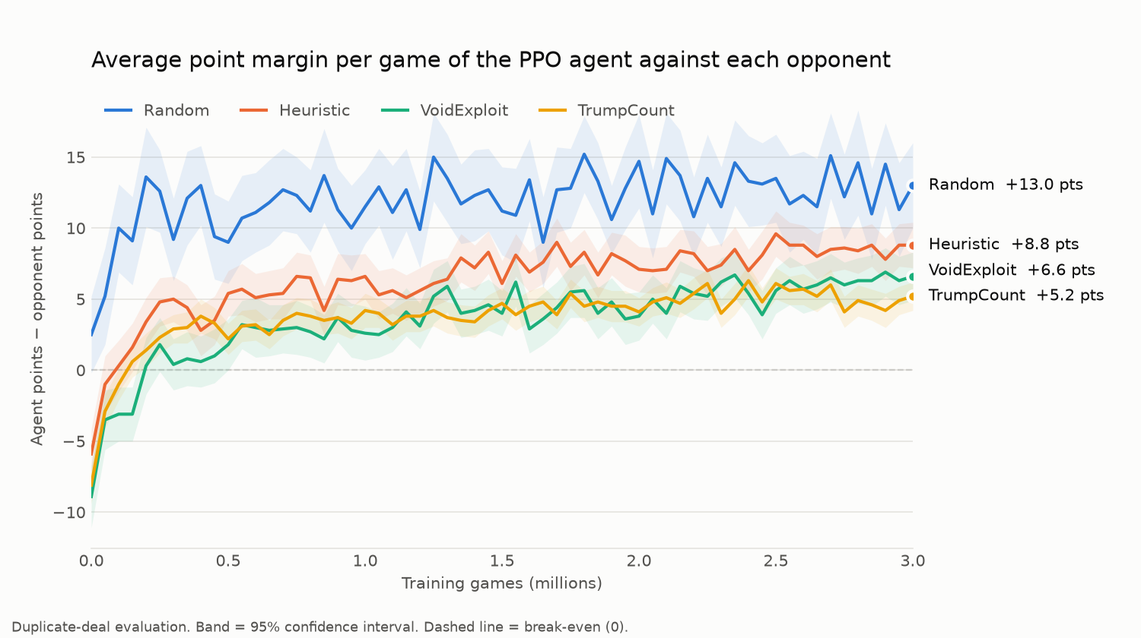
3 million games: the agent beats every baseline
10 / RESULTS
+5.0
vs TrumpCount
±0.4 · 56.0% wins
+5.7
vs VoidExploit
±0.5 · 56.2% wins
+8.3
vs Heuristic
±0.5 · 59.2% wins
+12.5
vs Random
±0.6 · 63.1% wins
Notes:
Final numbers: final agent re-evaluated on 3 000 duplicate deals (6 000 games) per opponent.

Slide 12
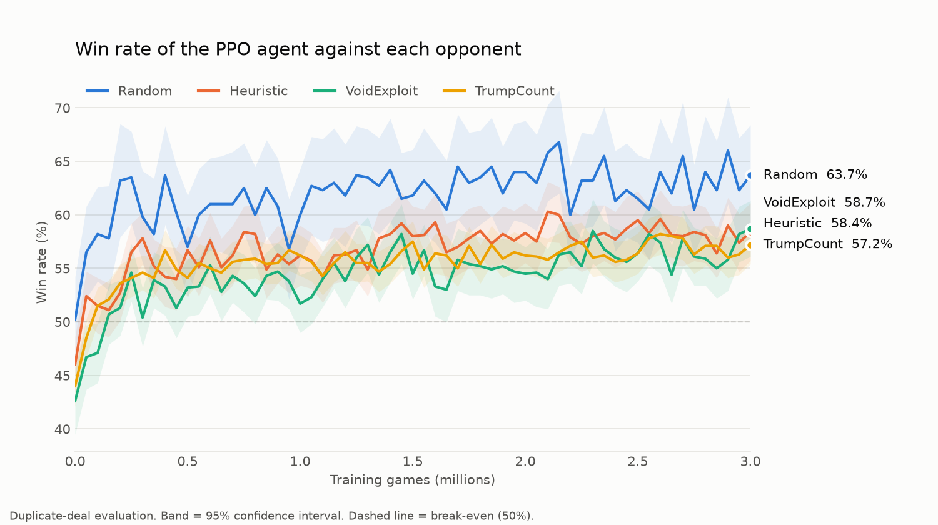
Above 56% against every baseline
11 / WIN RATE
56.0%
wins vs TrumpCount, our strongest heuristic (±0.7 pp, final agent re-tested on 6 000 games)
WHY NOT 80%?
The deal decides most games: even TrumpCount only wins 56% against a random player.

Slide 13
Putting 56% in context
12 / IN CONTEXT
MATCH-UP | WIN RATE | POINTS / GAME
HAND-CRAFTED AGENTS
Random vs Random | 50.1% | +0.4
Heuristic vs Random | 52.1% | +3.9
VoidExploit vs Random | 56.0% | +7.3
TrumpCount vs Random | 56.0% | +7.9
TrumpCount vs Heuristic | 54.6% | +3.8
OUR PPO AGENT (3M GAMES)
PPO vs Random | 63.1% | +12.5
PPO vs Heuristic | 59.2% | +8.3
PPO vs VoidExploit | 56.2% | +5.7
PPO vs TrumpCount | 56.0% | +5.0
READING THE TABLE
Random vs Random = 50%: the evaluation is fair.
Our best heuristic beats a random player by only 56%: the deal decides most games.
PPO wins 56% against TrumpCount — as often as TrumpCount wins against a random player.
Duplicate deals · ≥ 6 000 games per match-up · win rate ±0.6–0.9 pp

Slide 14
Real progress in self-play — until ~2M games
13 / SELF-PLAY
FINAL AGENT VS ITS OWN EARLIER VERSIONS
TAKEAWAYS
It improves against itself, not only against our heuristics.
Gains shrink, then stop near 1.5–2M games: the last million added nothing.
Going further needs a better agent (memory, bigger net, league self-play), not longer training.
Opponent checkpoint (training games) · 1 000 duplicate deals each · ±0.5–0.9 pts

Slide 15
What the agent learned on its own
14 / BEHAVIOUR
SAME HAND, TWO PLAYERS · TRUMP ♦
LEARNED ALONE
8
♦
Q
♦
10
♦
A
♦
7
♠
10
♥
K
♣
10
♣
Wait for the opponent's top trumps to fall
Profitable ruffs
Cash master cards at the end
Big trumps — but not the Jack or the Nine, the opponent holds both.
TrumpCount
Leads the Ace of trump at once → captured by the Jack (−31 pts).
7 pts
STILL WRONG
Leads a Ten while the Ace is still out (−21 pts), with 100% confidence.
→ weak memory of which high cards remain.
PPO agent
Ducks under the Jack with the 8, flushes out the Nine with the Queen, then cashes 10 + Ace as masters.
58 pts

Slide 16
Where we stand — and what comes next
15 / NEXT STEPS
DONE
NEXT
Tested Belote environment, 4 baselines, PPO from scratch
Duplicate-deal evaluation: 2–3× tighter error bars
Fixed 2 silent bugs (perspective leak, GAE across seats)
Ablations: removing the win bonus is the key change
3M games: +5.0 pts / 56% wins vs our best heuristic
01
Reproducibility
Re-run the best setup with 2 more seeds
02
Memory
LSTM or a belief table of the opponent's cards
03
League self-play
Train against a pool of past versions
04
Trump choice
Let the agent bid the trump suit (Phase 4)

Slide 17
Thank you
QUESTIONS
♠
♥
♦
♣
Noa Curiel & Yoni Benabou

