Slide 1
Electric Car Acceleration Sub-System
ECE 303 - 061: ECE Laboratory – Fall 2018
Written By: Yonatan Carver
Farhan Muhammad
Date: 12/03/2018

Slide 2
objective
Test-bed for the pedal-to-wheel system of an electric car
Component calibration and analysis
Measurement equipment procedures and automation
Integration of several sub-systems

Slide 3
Main Functionality
Use of (2) Arduino Mega microcontroller boards
main controller
data acquisition system
Load cell and signal amplifier to emulate acceleration pedal
Main controller to read in data and output PWM signal to wheel
H-bridge to drive wheel motor and optical counter to measure RPM
Serial communication between main controller and DAQ for sharing data
Storing load cell calibration factor and maximum RPM in Arduino EEPROM

Slide 4
Main Functionality (Continued)
Data acquisition system to read RPM and send to GUI for display
Maintain various sensors for maintaining normal operation of the system
Initiate emergency shutdown protocols to turn off motor using a relay
Send all sensor data to GUI to control visual indicators
Transfer start-stop instructions from GUI to main controller

Slide 5
User interface
Design GUI using MATLAB App Designer
Maintain serial communication with data acquisition system
Dynamic display of motor RPM, battery percentage, and distance travelled
System start-stop and additional functionality

Slide 6
Additional Components
4-digit 7-segment display for dynamic display of motor RPM
Secondary data display integrated with data acquisition system
GY-521 accelerometer for detecting excessive vibration and tilt
Additional emergency shutdown system integrated with main controller

Slide 7
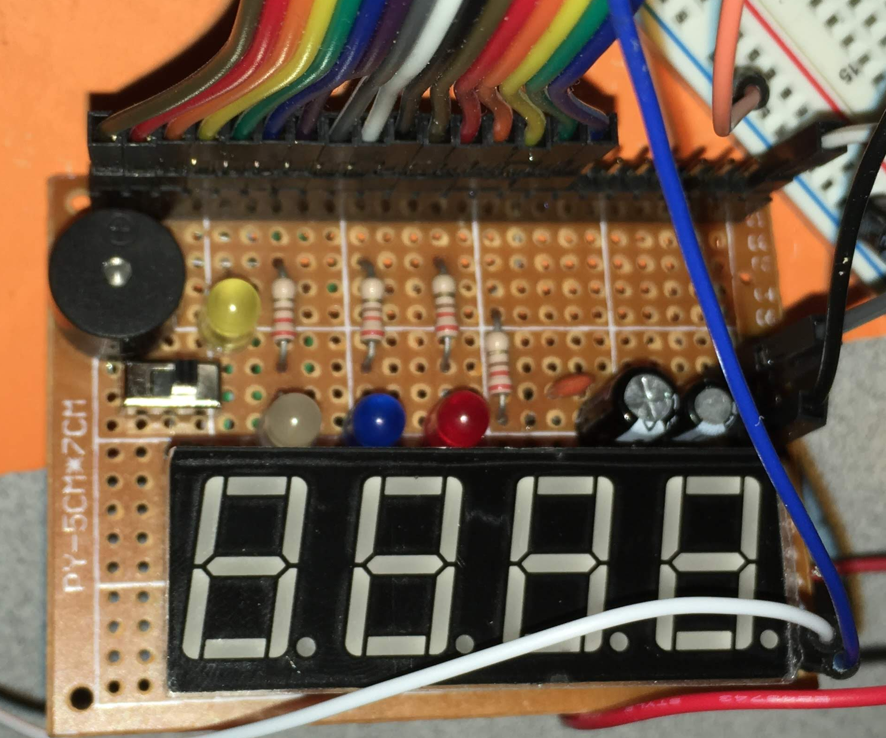
Custom DAQ Circuit board

Slide 8
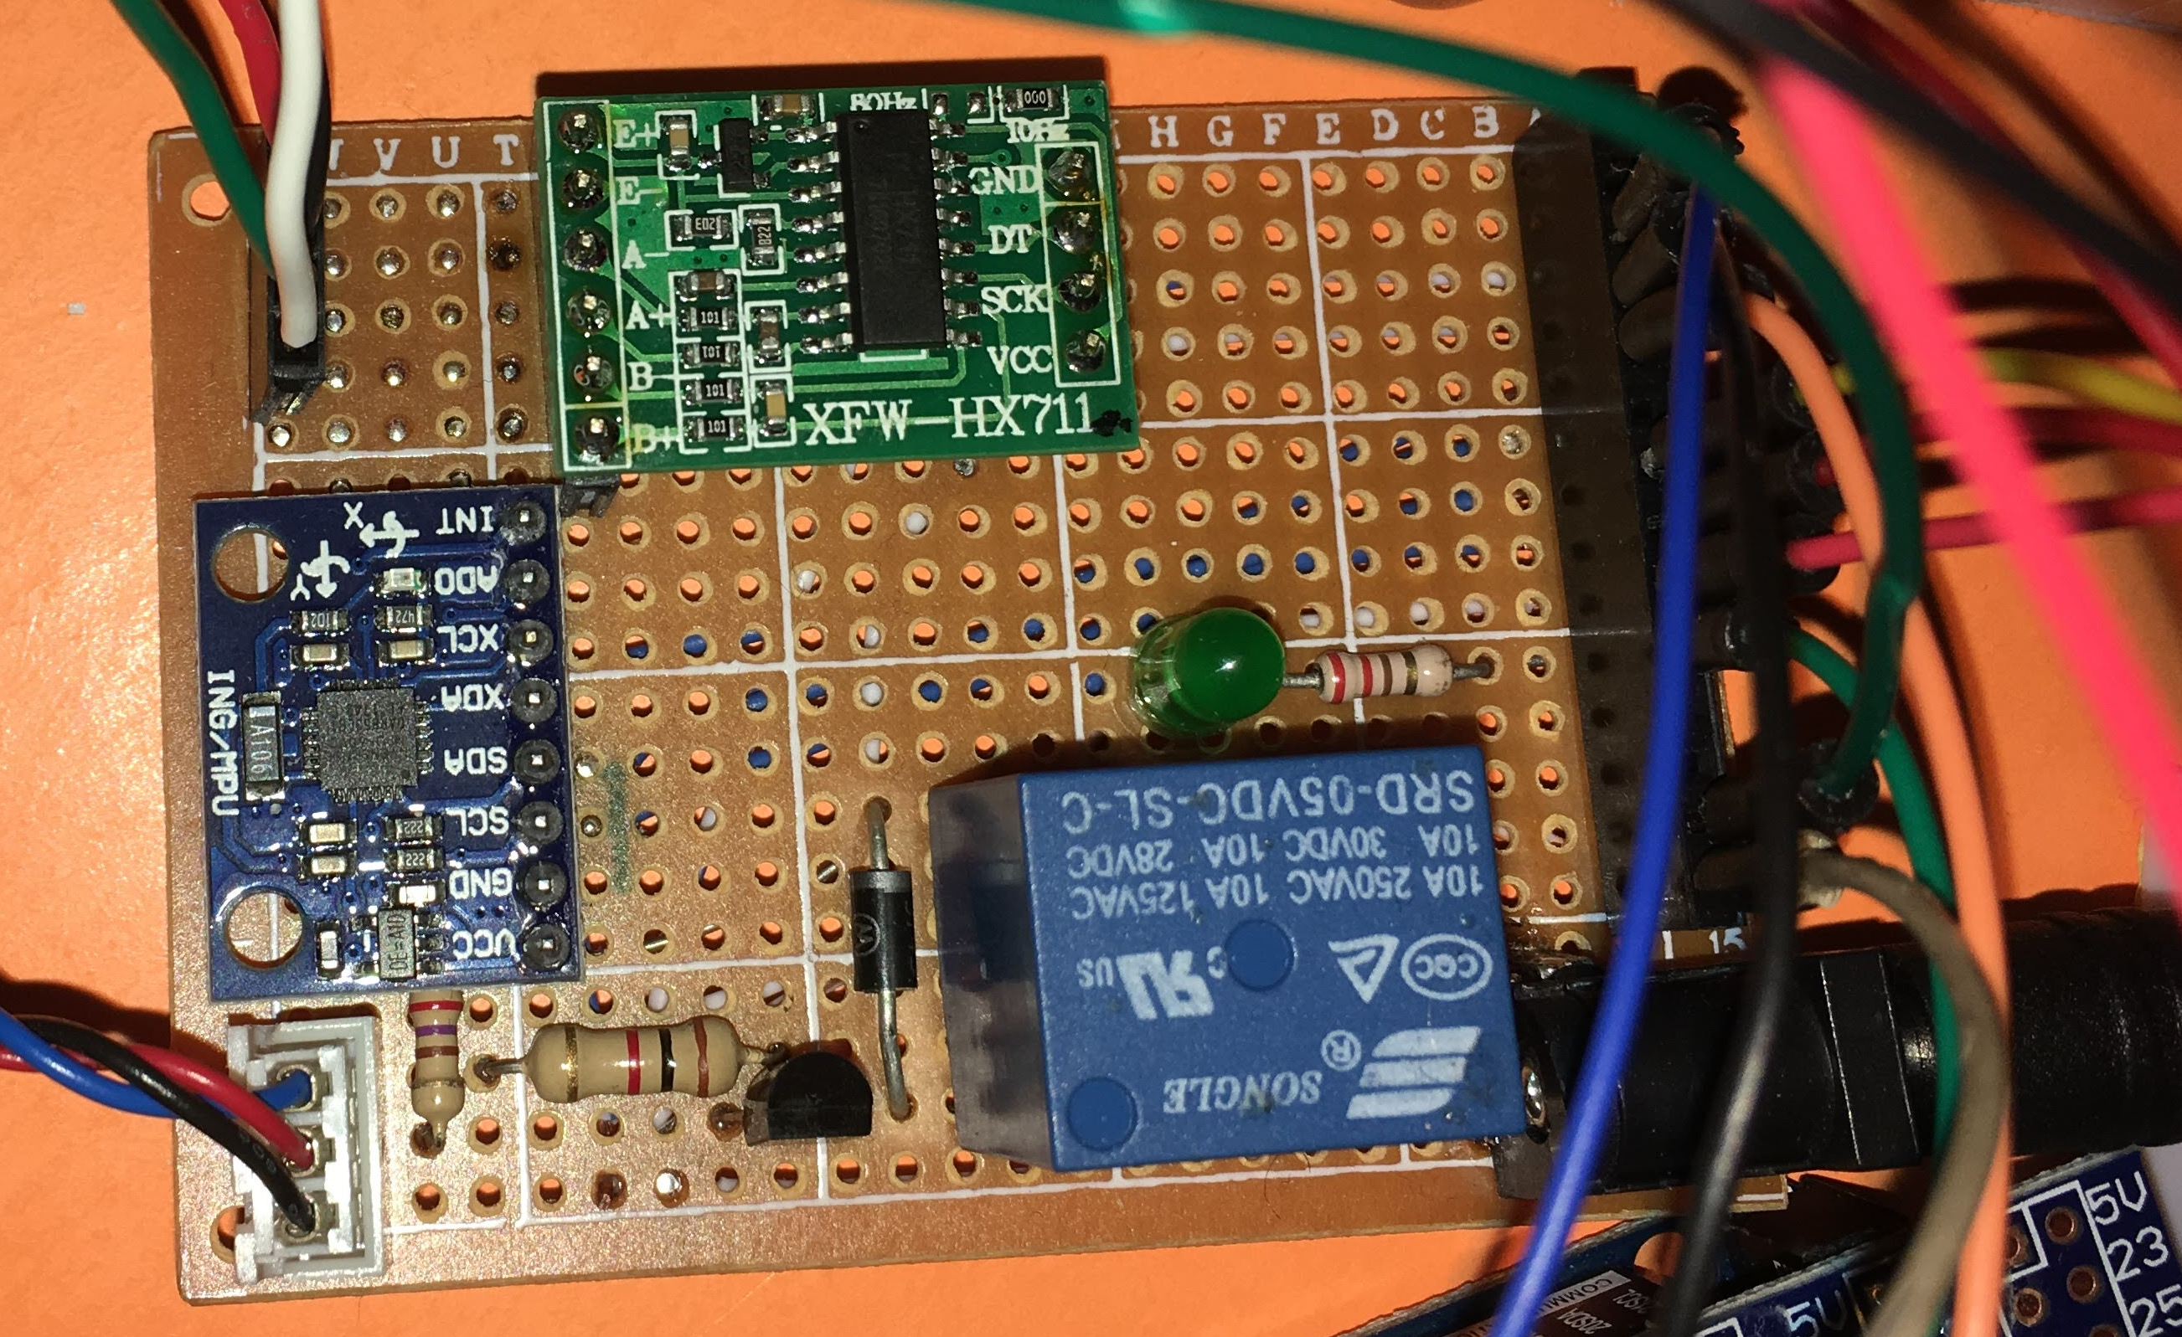
Custom Main controller circuit board

Slide 9
Demo
Part 1: https://youtu.be/XoUiI-7gRtg
Part 2: https://youtu.be/6TS6ROIBclw

