Slide 1

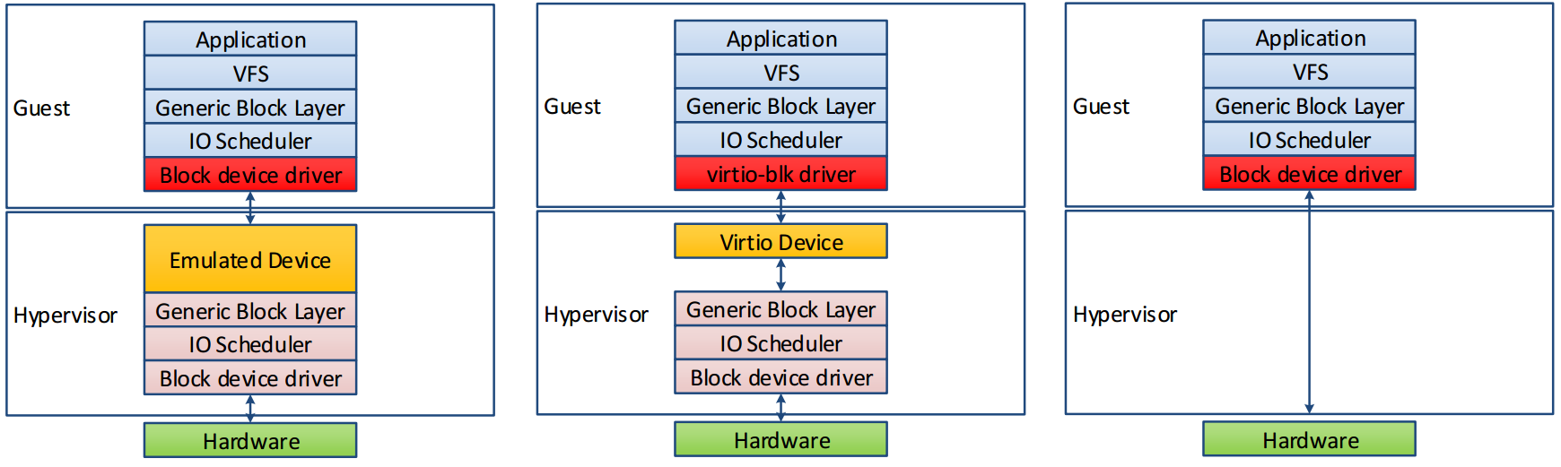
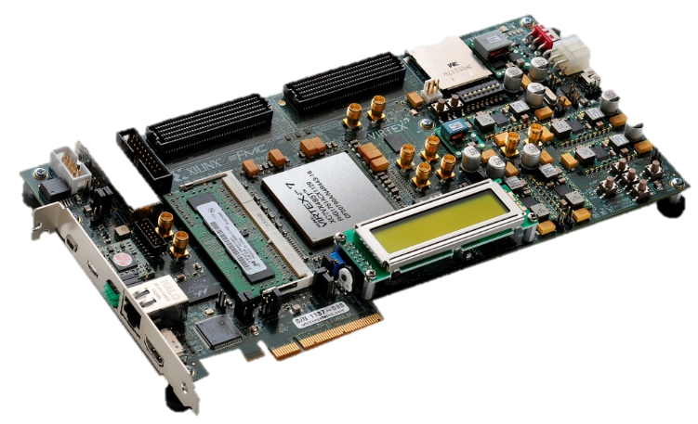
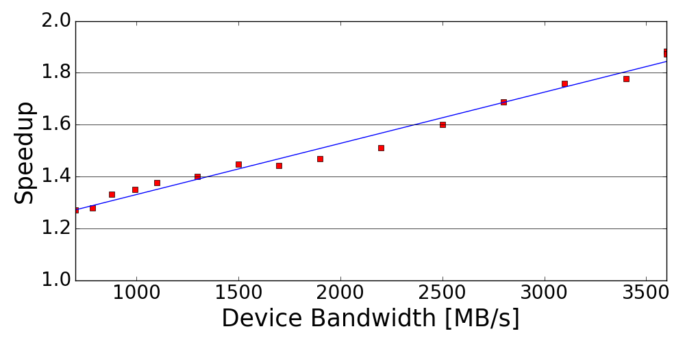
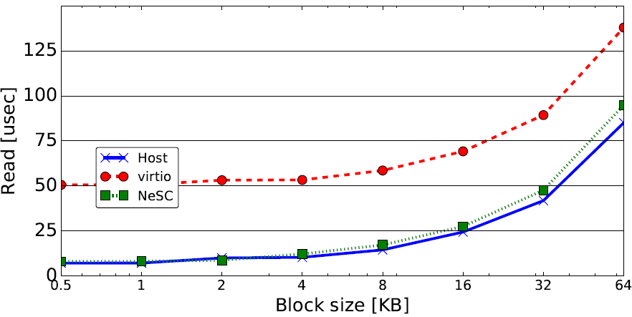
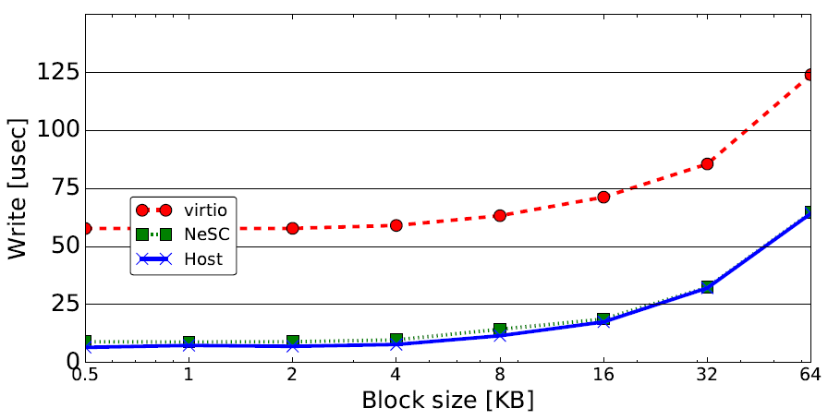
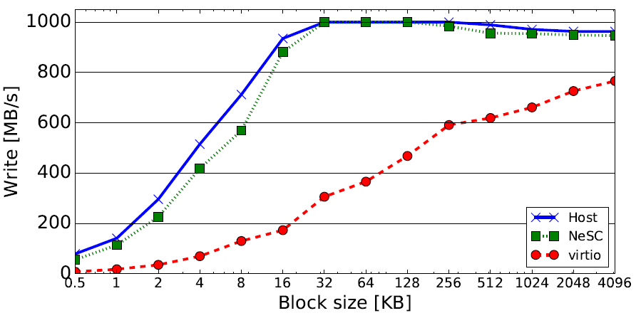
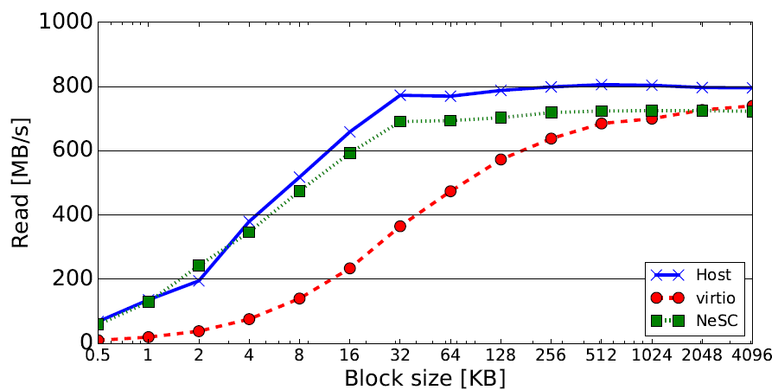


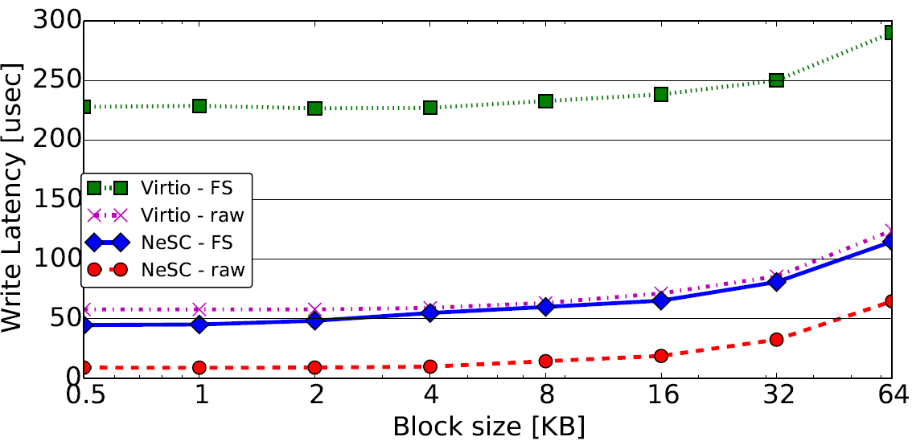
NeSC: Self-Virtualizing Nested Storage Controller
Yonatan Gottesman • Yoav Etsion
Technion – Israel Institute of Technology
Introduction
Design
Conclusion
IO-Virtualization
Idea: the performance of Direct-IO with the isolation of Emulation
Multiple VMs, single device? SR-IOV
PCIe interface specification
Multiple clients share the device VIA direct-IO
Hardware-level Isolation: extent trees
Virtio uses host filesystem to enforce isolation
Each VM attached to a file
Each file maintains logical to physical mapping with extent trees
Prototype
We implemented NeSC storage controller on Xilinx FPGA
KVM/QEMU hypervisor
Hypervisor driver and management code
EXT4 extent based filesystem
File Offset
Inode
Extent-Header
LBA
Storage Blocks
Extent-Header
Extent-Index
Extent-Index
Extent-Index
Extent-Index
Extent-Index
Virtualization Overheads
As devices get faster, software overheads get more significant
We must rethink the division of labor between hardware and software
Extent-Header
Extent-Index
Extent-Index
Extent-Header
Extent-Index
Results
Latency
Throughput
Filesystem overheads
Extent-Index
Extent-Index
NeSC
Combine SR-IOV with file isolation
Device enforces isolation
VM
VM
Hypervisor
VLBA
Virtual Function
Virtual Function
Physical Function
NeSC Objectives
Enable multiple VMs to directly access the storage device (Direct-IO)
Enforce file-level isolation at the hardware level
Separate control and data path to be filesystem agnostic
Hypervisor creates isolation policy
Hardware enforces policy on every access
BAR
DMA
BAR
DMA
BAR
DMA
Translation Unit
PLBA
MUX
storage
VM 1
VM 2
NeSC
Storage Blocks

