Slide 1

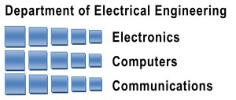
NeSC Self-Virtualizing Nested Storage Controller
Yonatan Gottesman Yoav Etsion
Technion – Israel Institute of Technology
Electrical Engineering and Computer Science Departments
Notes:
<add CS logo?>
<make slide numbers bigger>

Slide 2


NeSC: A Self-Virtualizing Nested Storage Controller
Yonatan Gottesman and Yoav Etsion
Electrical Engineering and Computer Science
Technion – Israel Institute of Technology
Notes:
<add CS logo?>
<make slide numbers bigger>

Slide 3
Emergence of High Speed Storage Systems
New fast storage technologies
Hardware is no longer the bottleneck
Software overheads become more significant in virtualized environments
Rethink interfaces between storage and software
Notes:
Explain that the bottlencks where once in the hardware level so we didn’t need to optimize software.
<get numbers of best throughput devices in the market today>
Rethink the interfaces -> we introduce NeSC
<Picture of storage technologies and throughput over the years>

Slide 4
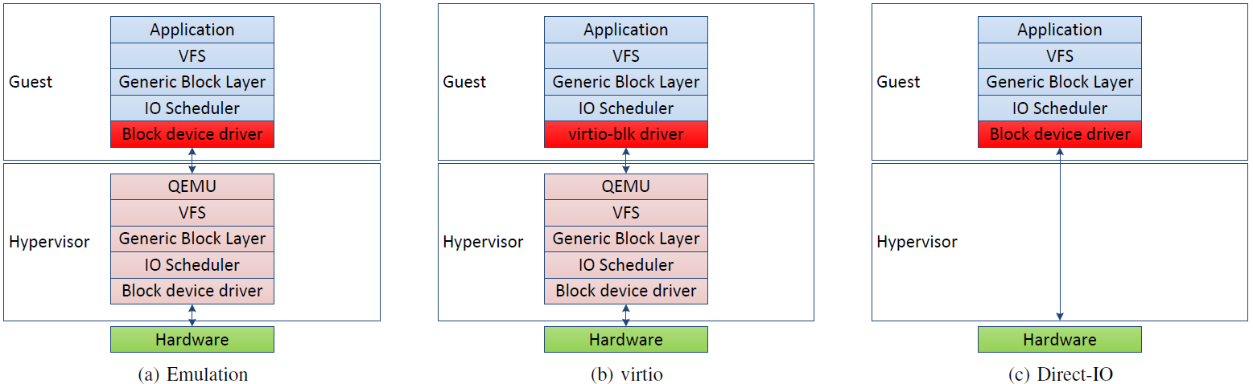
Hypervisor Overheads
IO virtualization techniques
We want to achieve performance of Direct-IO with flexibility and isolation of Emulation
Notes:
Full emulation is not relavent
Explain the 2 kinds of IO virtualization.:
Virtio: every access passes through the hypervisor and it multiplexes the requests to the hardware, isolation is guaranteed by the FS
Direct –io: VM is attached to hardware address space, no hypervisor mediation. faster, but standard devices allow only 1 VM to access.
Up until now virtio was good enough because devices were slow, now faster devices the software overhead becomes more noticeable.
See next slide
We want the performance of Direct-IO, with the flexibility of emulation

Slide 5
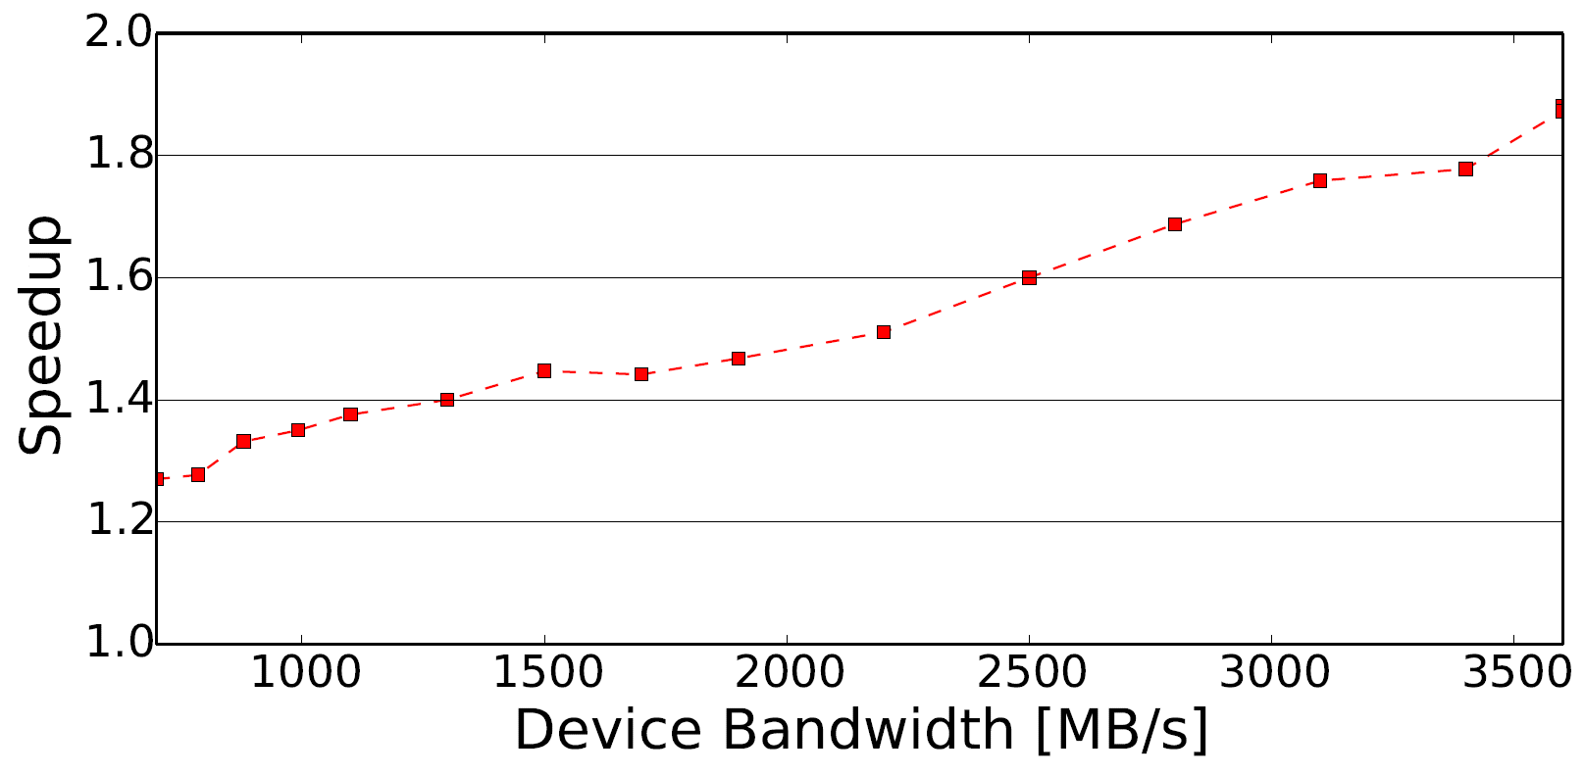
Hypervisor Overheads
Direct-IO speedup for fast storage devices
As devices get faster, software overheads get more significant
Notes:
We simulated the speedup achived by direct-io over virtio in a virtualized env,
We see that when device performance is low, it ok to use virtio because the bottleneck is the device.
For faster and faster devices, it becomes mutch better to use direct-io
<http://www.storagereview.com/fusionio_ion_data_accelerator_review>
<add arrow with current best throughput device on sale>

Slide 6
NeSC Objectives
Provide Direct-IO access to multiple VMs
Provide block level isolation enforced by the hardware
Separate control and data path
Hypervisor creates isolation policy
Hardware enforces policy on every access
VM 1
VM 2
NeSC
Storage Blocks
Notes:
We want to provide multiple VMs access to storage, while maintaining direction performacen, with flexibility and isolation of virtio

Slide 7
NeSC Solutions
Multiple VM direct-IO
SR-IOV
Block isolation
Use filesystem
Notes:
We use a PCIe interface called sriov
We use the same technique used in modern filesystems to device blocks to different files

Slide 8
SR-IOV
PCIe interface specification
Multiple clients share the device
VIA direct-IO
SR-IOV does not specify how the device enforces isolation of the block device
VM
VM
Hypervisor
Virtual Function
Virtual Function
Physical Function
BAR
DMA
BAR
DMA
BAR
DMA
?
MUX
storage
Notes:
SR-IOV, allows multiple VMs to access the device via direct io
VF – lightweight pci function attached to VM address space
PF – full pcie function attached to hypervisor, through it it can create more VF, manage the device, and create isolation of the storage

Slide 9
File Isolation
Virtio uses the filesystem to enforce isolation between VMs
Each VM is attached to a file on the filesystem
Each file maps logical to physical storage blocks with an extent Tree
Inode
Extent-Header
Storage Blocks
Extent-Index
Extent-Header
Extent-Index
Extent-Index
Extent-Index
Extent-Index
Extent-Header
Extent-Index
Extent-Index
Extent-Header
Extent-Index
Extent-Index
Extent-Index
Notes:
When using virtio, the isolation of the storage is done by the FS,
Each VM can access whatever virtual offsets of storage,
The FS will translate the virtual offset to a physical LBA on the device

Slide 10
NeSC Design
VM
VM
VLBA
Hypervisor
Combine SR-IOV with file isolation
Enforces filesystem isolation at the device level
Hypervisor sets the logical to physical mapping using extent trees
Hardware queries per VM extent tree on each block access via DMA
VM storage access is called VLBA
After translation PLBA
Virtual Function
Virtual Function
Physical Function
BAR
DMA
BAR
DMA
BAR
DMA
Translation Unit
PLBA
MUX
storage
Notes:
Now we need to combine, sriov with file isolation
NeSC implements the SR-IOV interface standard
Uses the filesystem isolation mechanism to enforce isolation
Only VF calls go through Translation unit
PF calls go raw to the device as is
Translation unit uses in memory extent trees
When a VM accesses the storage the address is called VLBA
After the translation its called PLBA
The trees are in main memory!

Slide 11
Access Flow
VLBA
VM
VM
Hypervisor
Main Memory
VM 1 issues VLBA access
Translation Unit DMA tree
Send request with PLBA to storage
Just like MMU and page tables!
Virtual Function
Virtual Function
Physical Function
BAR
DMA
BAR
DMA
BAR
DMA
Translation Unit
PLBA
MUX
storage
Notes:
Explain on the go

Slide 12

Access Issues
Delayed allocation
Blocks are allocated for each VM only when needed
Extent tree may be missing a translation
If while the translation a VLBA couldn’t be translated
Trigger an interrupt to hypervisor
Hypervisor allocates blocks and adds translations to the tree
Device traverses the tree, guaranteed not to fail
Notes:
This is for write
Explain one by one

Slide 13
Access Flow 2
VLBA
VM
VM
Hypervisor
Main Memory
VM 1 issues VLBA access
Translation not found
Trigger an interrupt
Allocate blocks
Translate VLBA
Virtual Function
Virtual Function
Physical Function
BAR
DMA
BAR
DMA
BAR
DMA
Translation Unit
PLBA
MUX
storage
Notes:
Explain on the go

Slide 14
Design Issues
Small bTLB cache of latest translations
Support swap out of extent tree nodes
Read from unallocated blocks returns zero
Notes:
<change word “issues” with something else
Small TLB like cache to keep latest tranlsations
Support swapping tree nodes, each node has a bit at its parent if its unallocated or unswapped
When a read command accesses an unallocated block, return zero blocks

Slide 15
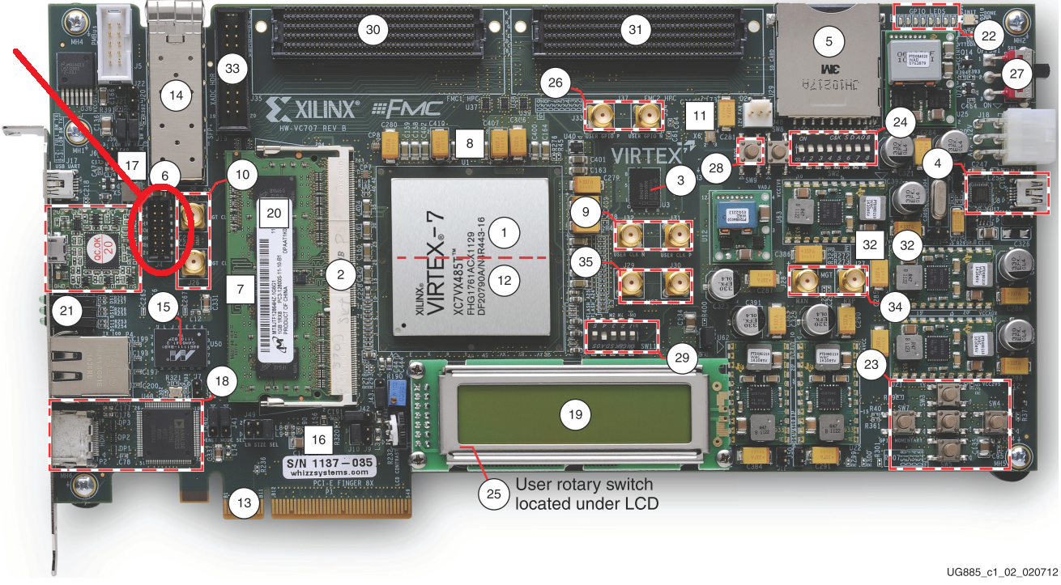
NeSC Prototype
Implemented NeSC storage controller on Xilinx FPGA
KVM hypervisor
Hypervisor driver and management code
EXT4 extent based filesystem
Notes:
Fpga – so real hardware driver interfaces

Slide 16
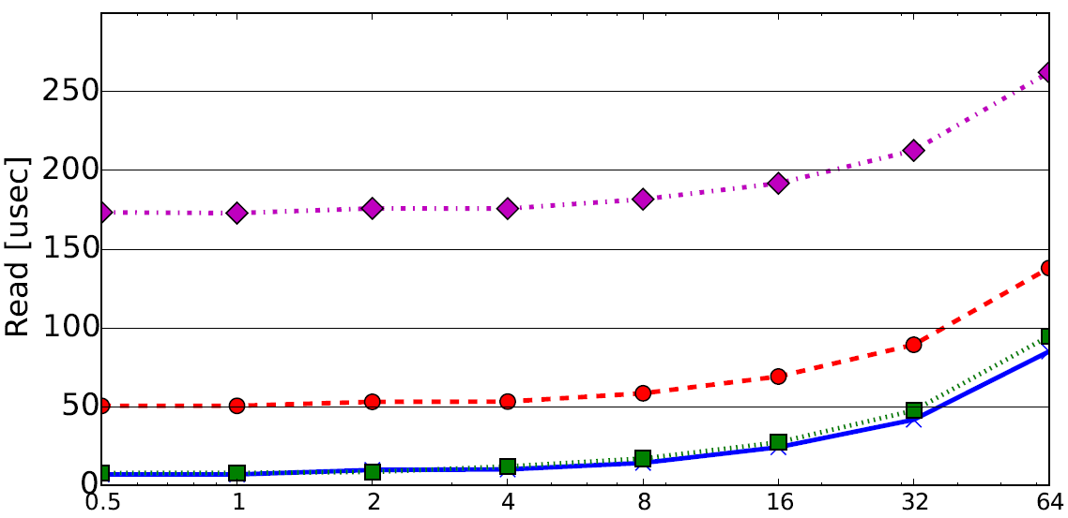
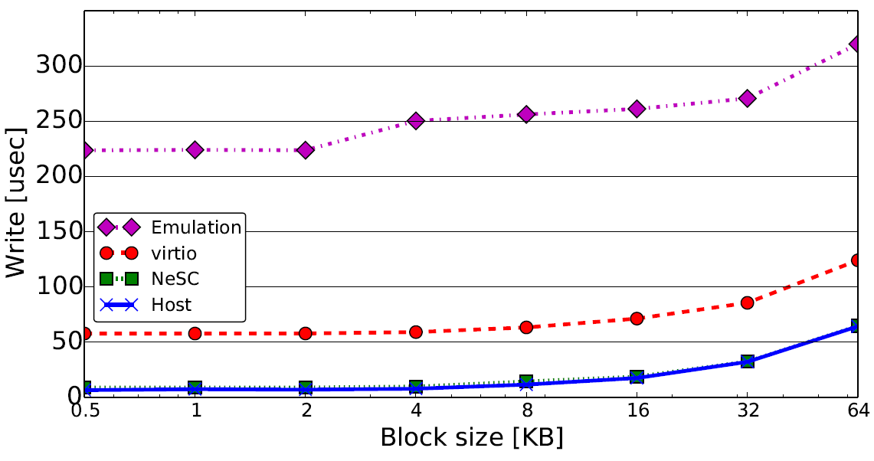
Latency
Notes:
Explain exes and go over results
Explain we used virtio on our device – just all accesses go through qemu

Slide 17
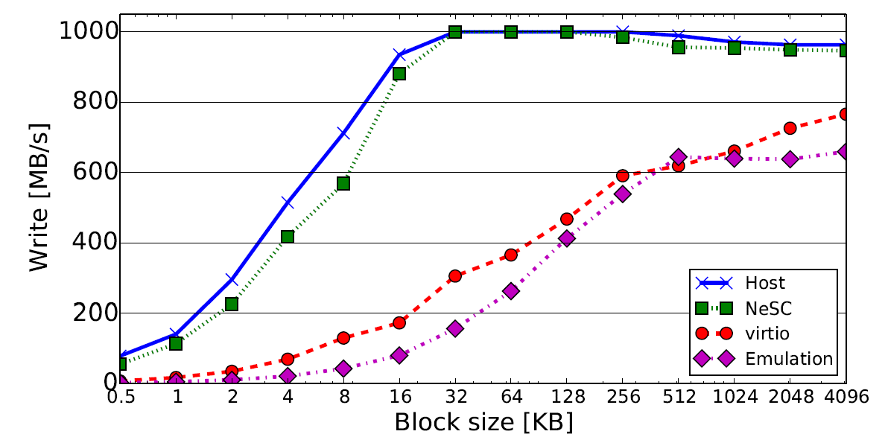
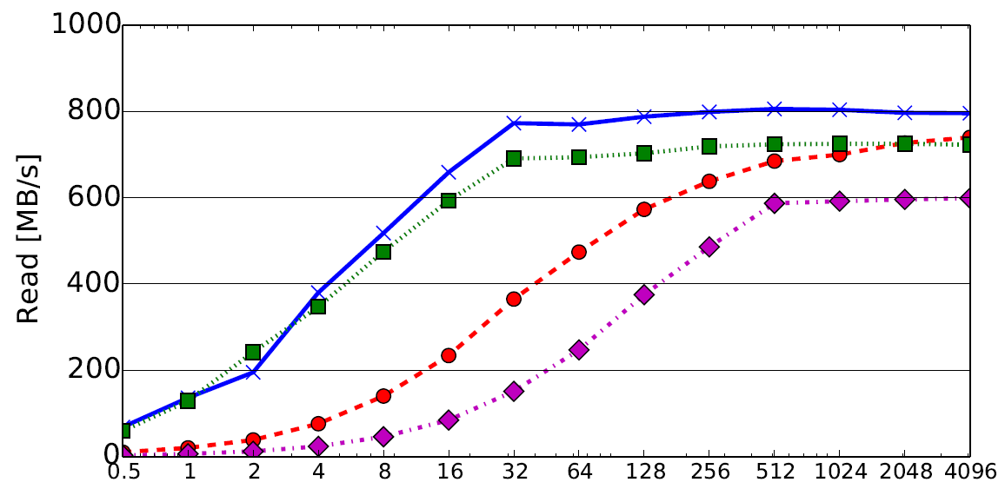
Throughput
Notes:
Explain why when block sizes get bigger, performance gets closer to virtio

Slide 18
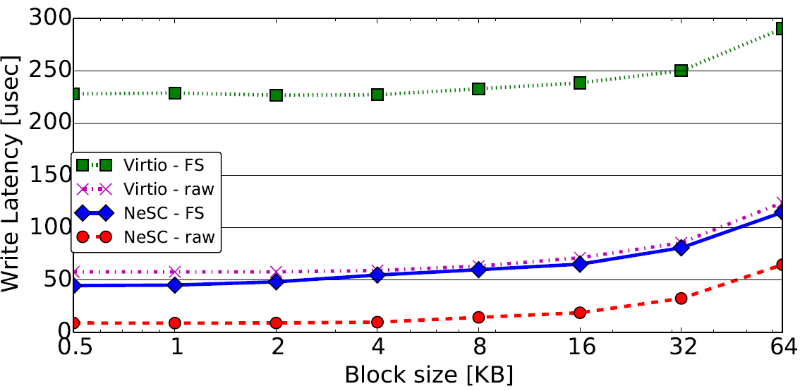
File System Overheads
Notes:
Explain:
Tested acceses to storage with and without a filesystem. Once with direct IO once with virtio.
Results show that nesc eliminates host fs overheads: blue line is VM fs and nesc translation == purple line is only host fs translation

Slide 19
Conclusions
High speed devices shifted bottlenecks to software
Rethink hardware/software interfaces
Presented NeSC
Hypervisor-managed filesystem
File translation done by hardware
Implemented NeSC prototype on FPGA
Results show NeSC removes host overheads

Slide 20
Thank you!
Questions…?

Slide 21
NeSC Translation
Extent trees map logical offsets to blocks
Blocks accessed by a VM are called VLBA
NeSC scans the tree VIA DMA to translate VM block access
Blocks after translation are called PLBA
Extent trees are in memory and accessible by NeSC
VM 1 Extent Tree
VM 2 Extent Tree
Storage Blocks

Slide 22
Initializtion Flow
Hypervisor installs extent based FS on storage
New VM attachment
Create a file on the FS – creates an empty extent tree mapping
Create new VM, attach VF to address space
Accept read/write from VM
Allocate new blocks when needed
VM 1
Hypervisor
Vdisk1.img
NeSC
Storage Blocks
Notes:
When a read is not translated, return 0

Slide 23
Isolation and Security
VMs can only access their own PCIe VF
MMU
VM cannot access storage blocks of other VMs
Each VM has its unique extent tree managed by the hypervisor
Extent tree traversal is done by the hardware
<maybe add a figure?>

Slide 24
Access Flow
Write VLBA 1234
Main Memory
VM 1 issues write VLBA
Translation Unit DMA tree
Send write request with PLBA to storage
Just like MMU and page tables!
VM 1
VM 2
VMM
Virtual Function
Virtual Function
Physical Function
BAR
DMA
BAR
DMA
BAR
DMA
Translation Unit
Write PLBA ABCD
MUX
storage

