Slide 1


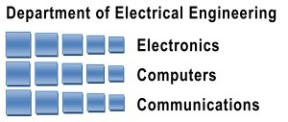
NeSC: A Self-Virtualizing Nested Storage Controller
Yonatan Gottesman and Yoav Etsion
Electrical Engineering and Computer Science
Technion – Israel Institute of Technology
Notes:
<add CS logo?>
<make slide numbers bigger>

Slide 2
Emergence of High Speed Storage Systems
New fast storage technologies
Shifts the overhead focal point from the hardware to the software layers
Software overheads become more significant in virtualized environments
We must rethink the division of labor between hardware and software
Notes:
Explain that the bottlencks where once in the hardware level so we didn’t need to optimize software.
<get numbers of best throughput devices in the market today>
Rethink the interfaces -> we introduce NeSC
<Picture of storage technologies and throughput over the years>

Slide 3
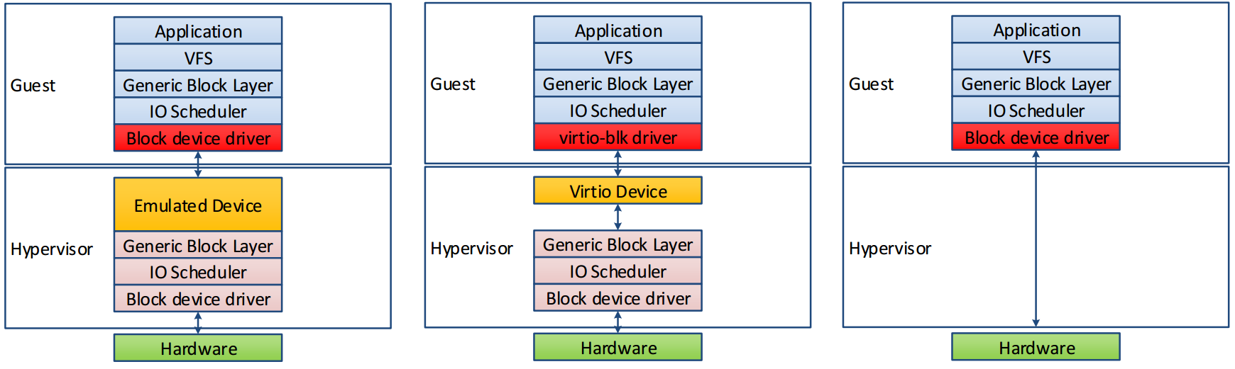
Hypervisor Overheads
Emulation
virtio
Direct-IO
Idea: the performance of Direct-IO with the isolation of Emulation
Notes:
Full emulation is not relavent, too many overheads
Explain the 2 kinds of IO virtualization.:
Virtio: every access passes through the hypervisor and it multiplexes the requests to the hardware, isolation is guaranteed by the FS
Direct –io: VM is attached to hardware address space, no hypervisor mediation. faster, but standard devices allow only 1 VM to access.
Up until now virtio was good enough because devices were slow, now faster devices the software overhead becomes more noticeable.
See next slide
We want the performance of Direct-IO, with the flexibility of emulation

Slide 4
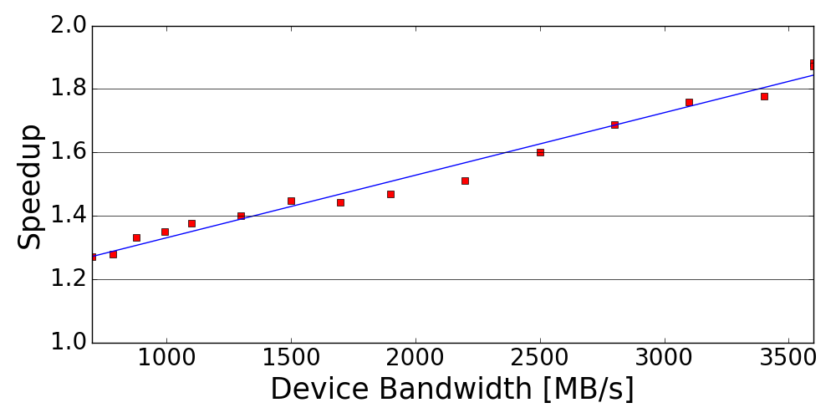
Hypervisor Overheads
Direct-IO speedup for fast storage devices
As devices get faster, software overheads get more significant
Notes:
We simulated the speedup achived by direct-io over virtio in a virtualized env,
We see that when device performance is low, it ok to use virtio because the bottleneck is the device.
For faster and faster devices, it becomes mutch better to use direct-io
<http://www.storagereview.com/fusionio_ion_data_accelerator_review>
<add arrow with current best throughput device on sale>

Slide 5
NeSC Objectives
Enable multiple VMs to directly access the storage device (Direct-IO)
Enforce file-level isolation at the hardware level
Separate control and data path to be filesystem agnostic
Hypervisor creates isolation policy
Hardware enforces policy on every access
VM 1
VM 2
NeSC
Storage Blocks
Notes:
We want to provide multiple VMs access to storage, while maintaining direction performacen, with flexibility and isolation of virtio

Slide 6
Multiple VMs, single device? Use SR-IOV
PCIe interface specification
Multiple clients share the device
VIA direct-IO
SR-IOV does not specify how the device enforces isolation of the block device
VM
VM
Hypervisor
Virtual Function
Virtual Function
Physical Function
BAR
DMA
BAR
DMA
BAR
DMA
?
MUX
storage
Notes:
SR-IOV, allows multiple VMs to access the device via direct io
VF – lightweight pci function attached to VM address space
PF – full pcie function attached to hypervisor, through it it can create more VF, manage the device, and create isolation of the storage

Slide 7
Hardware-level file Isolation: Use extent trees
Virtio uses the filesystem to enforce isolation between VMs
Each VM is attached to a file on the filesystem
Each file maps logical to physical storage blocks with an extent Tree
File Offset
Inode
Extent-Header
Storage Blocks
Extent-Index
LBA
Extent-Header
Extent-Index
Extent-Index
Extent-Index
Extent-Index
Extent-Header
Extent-Index
Extent-Index
Extent-Header
Extent-Index
Extent-Index
Extent-Index
Notes:
When using virtio, the isolation of the storage is done by the FS,
Each VM can access whatever virtual offsets of storage,
The FS will translate the virtual offset to a physical LBA on the device
Storage blockas are accessed in LBA resolution
When an application wants to access storage, it accesses an offset In the file, and after the translation the kernel has an LBA – logical block Address
FS sends the request with LBA to block device driver
B+ tree

Slide 8
NeSC Design
VM
VM
VLBA
Hypervisor
Combine SR-IOV with file isolation
Device enforces file isolation
Hypervisor sets the logical to physical mapping using extent trees
Hardware queries per VM extent tree on each block access via DMA
VM storage access -> vLBA
NeSC storage access -> pLBA (translated)
Virtual Function
Virtual Function
Physical Function
BAR
DMA
BAR
DMA
BAR
DMA
Translation Unit
PLBA
MUX
storage
Notes:
Now we need to combine, sriov with file isolation
NeSC implements the SR-IOV interface standard
Uses the filesystem isolation mechanism to enforce isolation
Only VF calls go through Translation unit
PF calls go raw to the device as is
Translation unit uses in memory extent trees
When a VM accesses the storage the address is called VLBA
After the translation its called PLBA
The trees are in main memory!

Slide 9
Access Flow
vLBA
VM
VM
Hypervisor
Main Memory
VM 1 issues vLBA access
Translation Unit DMA tree
Send request with pLBA to storage
Similar to MMU and page tables!
Virtual Function
Virtual Function
Physical Function
BAR
DMA
BAR
DMA
BAR
DMA
Translation Unit
pLBA
MUX
storage
Notes:
Explain on the go

Slide 10

Access Issues
Delayed allocation
Blocks are allocated for each VM only when needed
Extent tree may be missing a translation
If a vLBA cannot be translated
Trigger an interrupt to hypervisor
Hypervisor allocates blocks and adds translations to the tree
Device traverses the tree, guaranteed not to fail
Notes:
This is for write
Explain one by one

Slide 11
Block Allocation
vLBA
VM
VM
Hypervisor
Main Memory
VM 1 issues vLBA access
Translation not found
Trigger an interrupt
Allocate blocks, update tree
Signal NeSC to continue
Translate vLBA
Access storage
Virtual Function
Virtual Function
Physical Function
BAR
DMA
BAR
DMA
BAR
DMA
Translation Unit
pLBA
MUX
storage
Notes:
Explain on the go

Slide 12
Design Issues
NeSC uses a small cache for least recently used extents – bTLB
Support swap out of extent tree nodes
Read from unallocated blocks returns zero
More Issues in the paper
Notes:
<change word “issues” with something else
Small TLB like cache to keep latest tranlsations
Support swapping tree nodes, each node has a bit at its parent if its unallocated or unswapped
When a read command accesses an unallocated block, return zero blocks

Slide 13
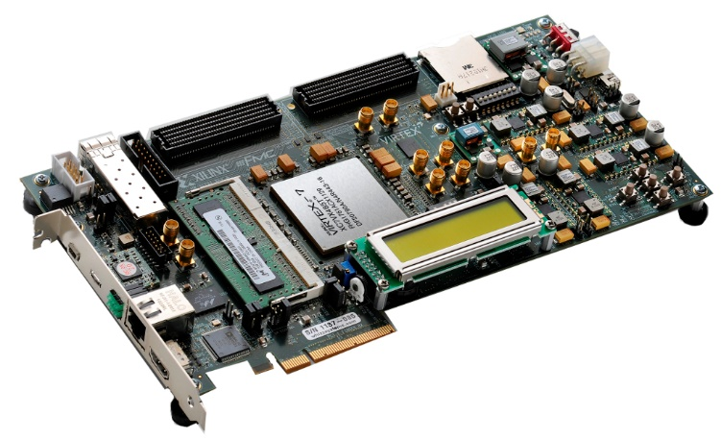
NeSC Prototype
We implemented NeSC storage controller on Xilinx FPGA
KVM/QEMU hypervisor
Hypervisor driver and management code
EXT4 extent based filesystem
Notes:
Fpga – so real hardware driver interfaces

Slide 14
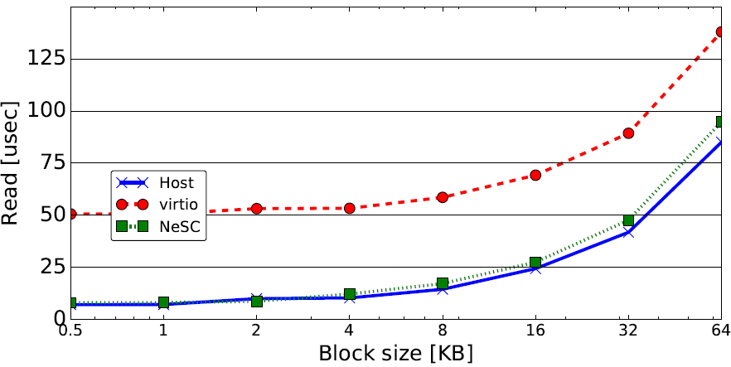
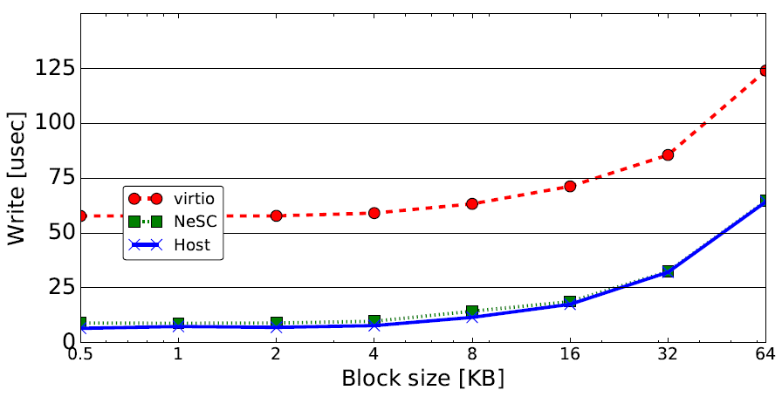
Latency
NeSC latency x5 lower then virtio
Near bare metal performance
Notes:
Explain exes and go over results
Explain we used virtio on our device – just all accesses go through qemu

Slide 15
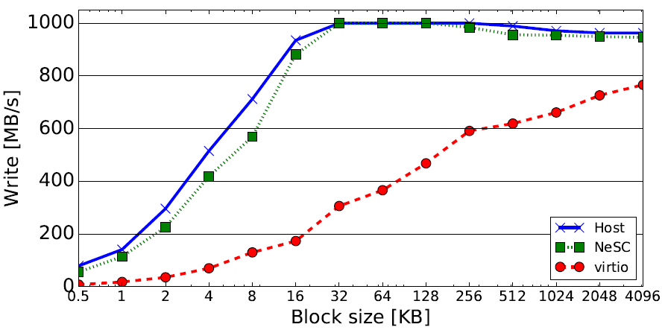
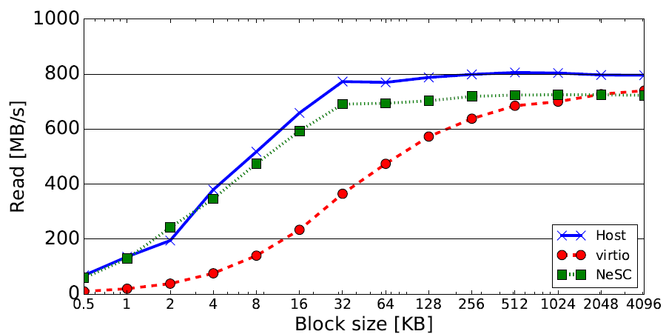
Throughput
On average NeSC is x3 faster then virtio
Notes:
Explain why when block sizes get bigger, performance gets closer to virtio
Bigge block size, less access to hypervisor, less overheads

Slide 16
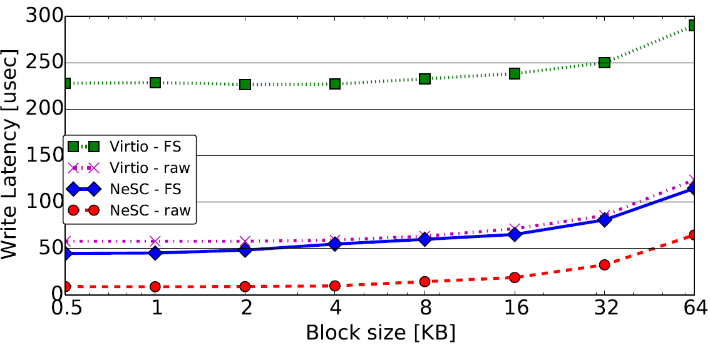
File System Overheads
NeSC eliminates hypervisor filesystem overhead
Virtio with no filesystem has same performance as NeSC with one
Notes:
Explain:
Tested acceses to storage with and without a filesystem. Once with direct IO once with virtio.
Results show that nesc eliminates host fs overheads: blue line is VM fs and nesc translation == purple line is only host fs translation
Talk about double FS overheads – green line

Slide 17
Conclusions
High speed devices shifted bottlenecks to software
Rethink hardware/software interfaces
Presented NeSC
Hypervisor-managed filesystem
File translation done by hardware
Implemented NeSC prototype on FPGA
Results show NeSC removes host overheads

Slide 18
Thank you!
Questions…?

Slide 19
NeSC Translation
Extent trees map logical offsets to blocks
Blocks accessed by a VM are called VLBA
NeSC scans the tree VIA DMA to translate VM block access
Blocks after translation are called PLBA
Extent trees are in memory and accessible by NeSC
VM 1 Extent Tree
VM 2 Extent Tree
Storage Blocks

Slide 20
Initializtion Flow
Hypervisor installs extent based FS on storage
New VM attachment
Create a file on the FS – creates an empty extent tree mapping
Create new VM, attach VF to address space
Accept read/write from VM
Allocate new blocks when needed
VM 1
Hypervisor
Vdisk1.img
NeSC
Storage Blocks
Notes:
When a read is not translated, return 0

Slide 21
Isolation and Security
VMs can only access their own PCIe VF
MMU
VM cannot access storage blocks of other VMs
Each VM has its unique extent tree managed by the hypervisor
Extent tree traversal is done by the hardware
<maybe add a figure?>

Slide 22
Access Flow
Write VLBA 1234
Main Memory
VM 1 issues write VLBA
Translation Unit DMA tree
Send write request with PLBA to storage
Just like MMU and page tables!
VM 1
VM 2
VMM
Virtual Function
Virtual Function
Physical Function
BAR
DMA
BAR
DMA
BAR
DMA
Translation Unit
Write PLBA ABCD
MUX
storage

