Slide 1

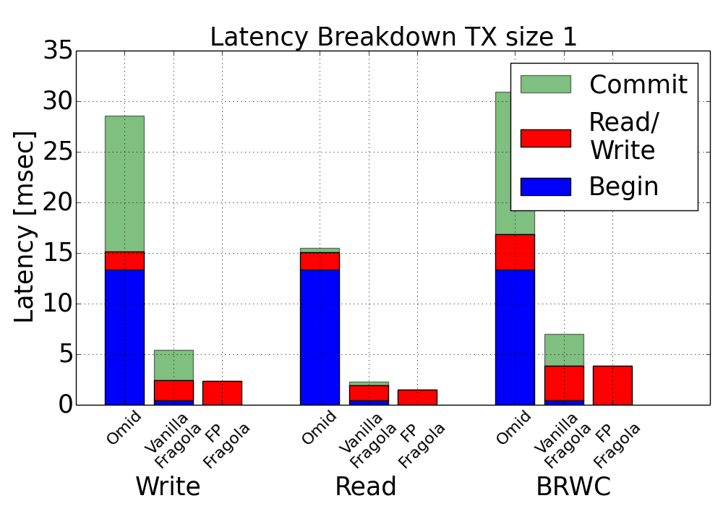
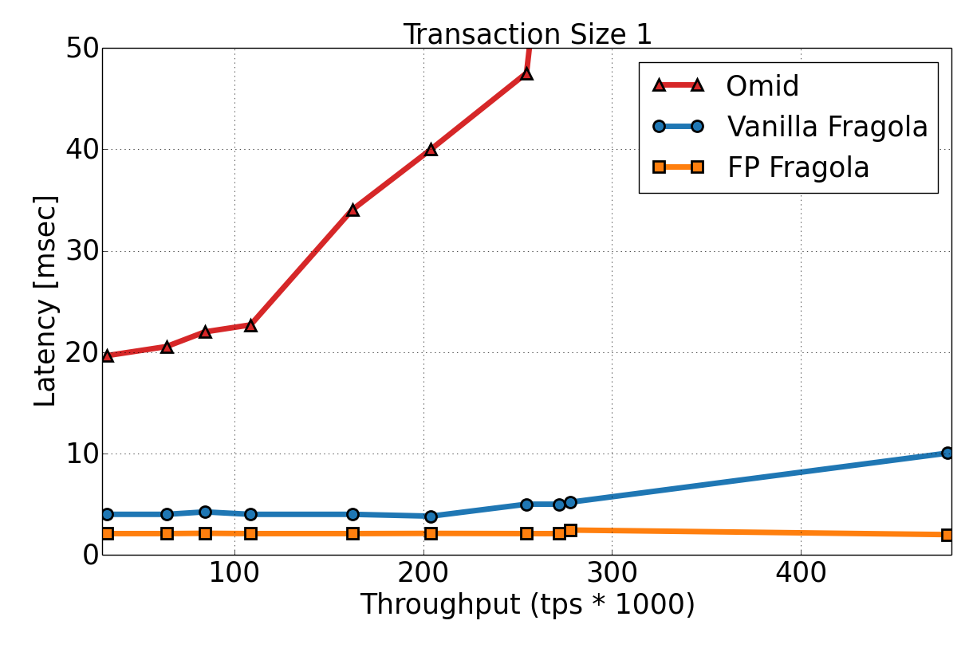
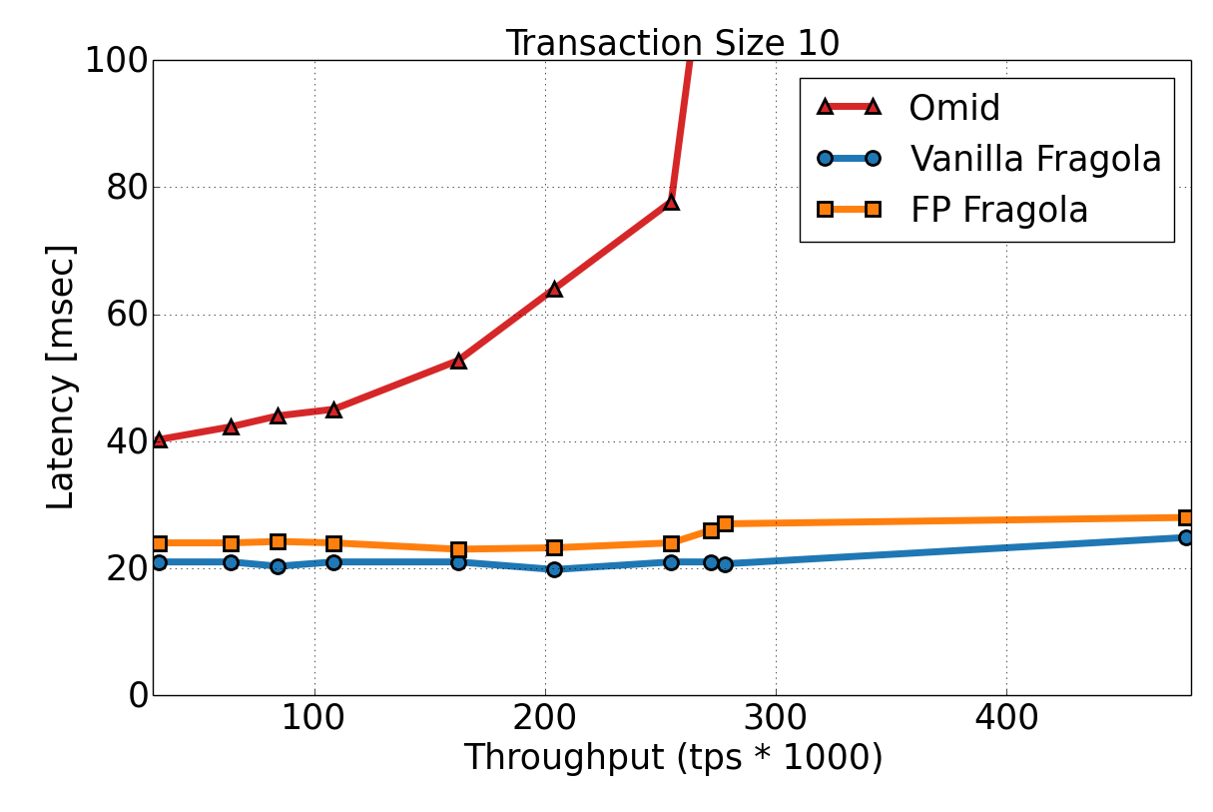


Fragola: Low-Latency Transactions in Distributed Data Stores
Y. Gottesman • O. Shacham • E. Bortnikov • E. Hillel • I.Keidar • A. Bergman
Yahoo! Research
Successor of Omid (FAST 2017)
Transaction API over HBase
Snapshot Isolation Consistency
Scalable, Highly Available
Novel Fast Path algorithm for short transactions
PUT - Metadata Evolution
Performance
Fragola: Transactions for Key-Value Store
Begin
PUT
Commit
Post Commit termination
key | version | value | commit ts | leader
k1 | 3 | a | nil | <k1,3>
k2 | 3 | b | nil | <k1,3>
key | version | value | commit ts | leader
k1 | 3 | a | 7 | <k1,3>
k2 | 3 | b | nil | <k1,3>
Low Latency API
Distributed Commit Table
﻿Store each transaction’s commit entry along-side its first written key, which we call the leader
Other keys in the transaction store a pointer to the leader
Eliminates Omid’s TM access to commit table bottleneck
Fast Path Transactions
Novel algorithm for short single-key transactions
Execute short transactions without TM access
Performance near native HBase native operations
Added local clocks to HBase regions for local conflict detection
key | version | value | commit ts | leader
k1 | 3 | a | 7 | <k1,3>
k2 | 3 | b | 7 | <k1,3>
t
BEGIN ← tsr
GET(k2) For rec ← ds.get(k2, versions down from tsr) do If (rec.commited && rec.commitTS < tsr) return rec.value else if (rec.commit = nil) tsc = ds.check&mutate(rec.leader) if (tsc != abort && tsc < tsr) return rec.value
GET operations invalidate leaders while reading them
Not doing so could lead to violation of snapshot isolation
GET Algorithm
t
HBase API
FPWrite(key, value) – Get new version number from local clock. Detect conflicts with regular transactions. Write value with version.
write(key, value, tsr) – Detect conflicts with FP transactions by checking if tsr < version.
Read(key, tsr) – Bump local clock to tsr. Read value.
Write Conflict Example
Fast Path Transactions
Results
Under low load, even without the fast path, Fragola transactions are 4x to 5x faster than Omid’s, and the fast path further reduces the latency of short trans- actions by another 55% on average
Under high load Omid’s latency surges and Fragola remains stable
Fast Path transactions have no scalability bottlenecks but come in the cost on minor negative impact on longer transactions
Architecture
Client
Transaction Manager (TM)
begin/commit
Global Clock
Put/ Get/ Commit
FP Transactions
Data store
Data store
Commit Table
Bump clock
Conflict!
Local Clock
Local Clock
T1
read(x) → 0
write(x,2)
FP1
write(x,1)
Write version + 1

