Slide 1


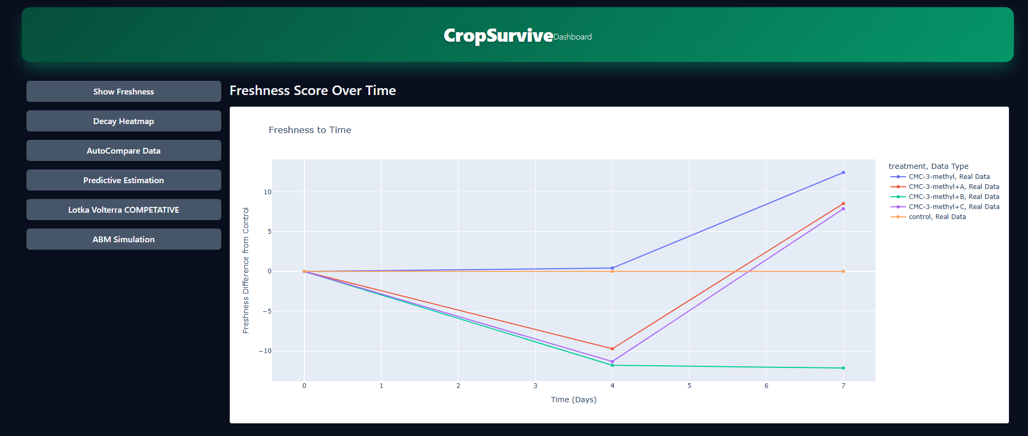
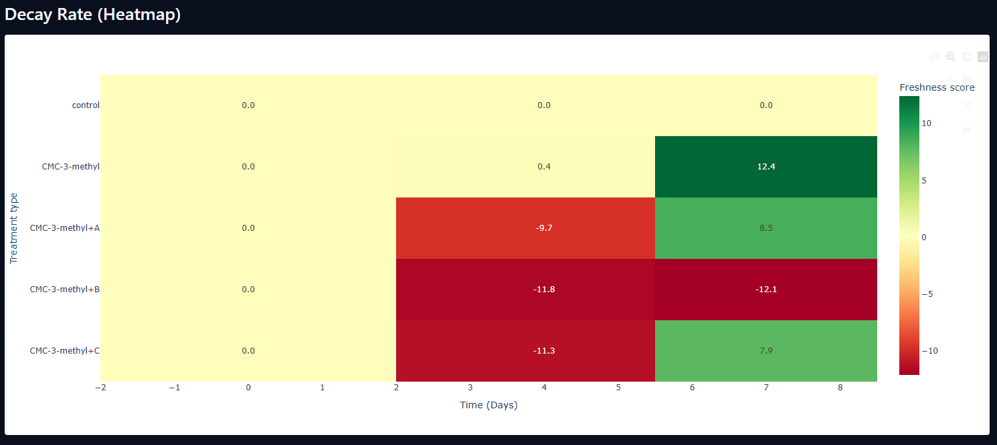
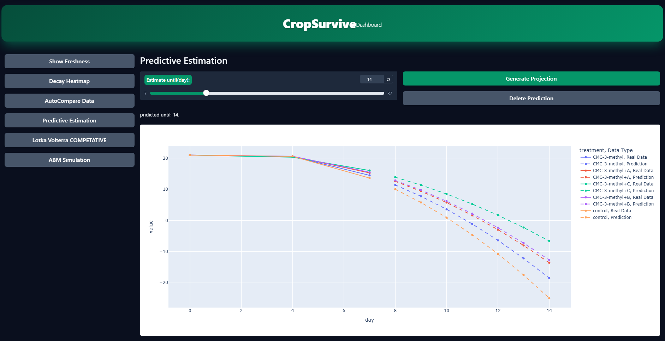
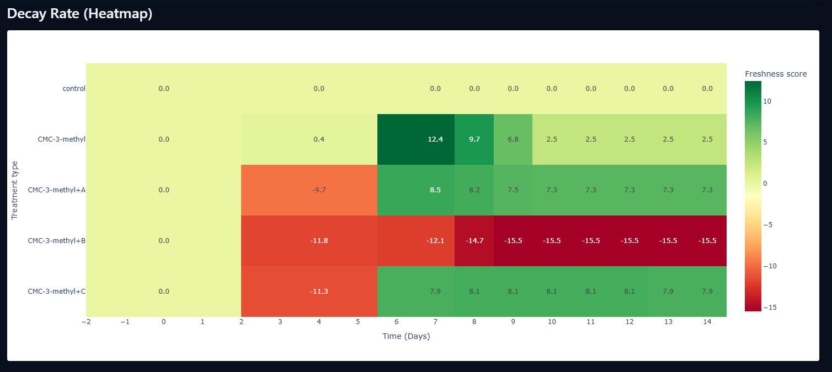
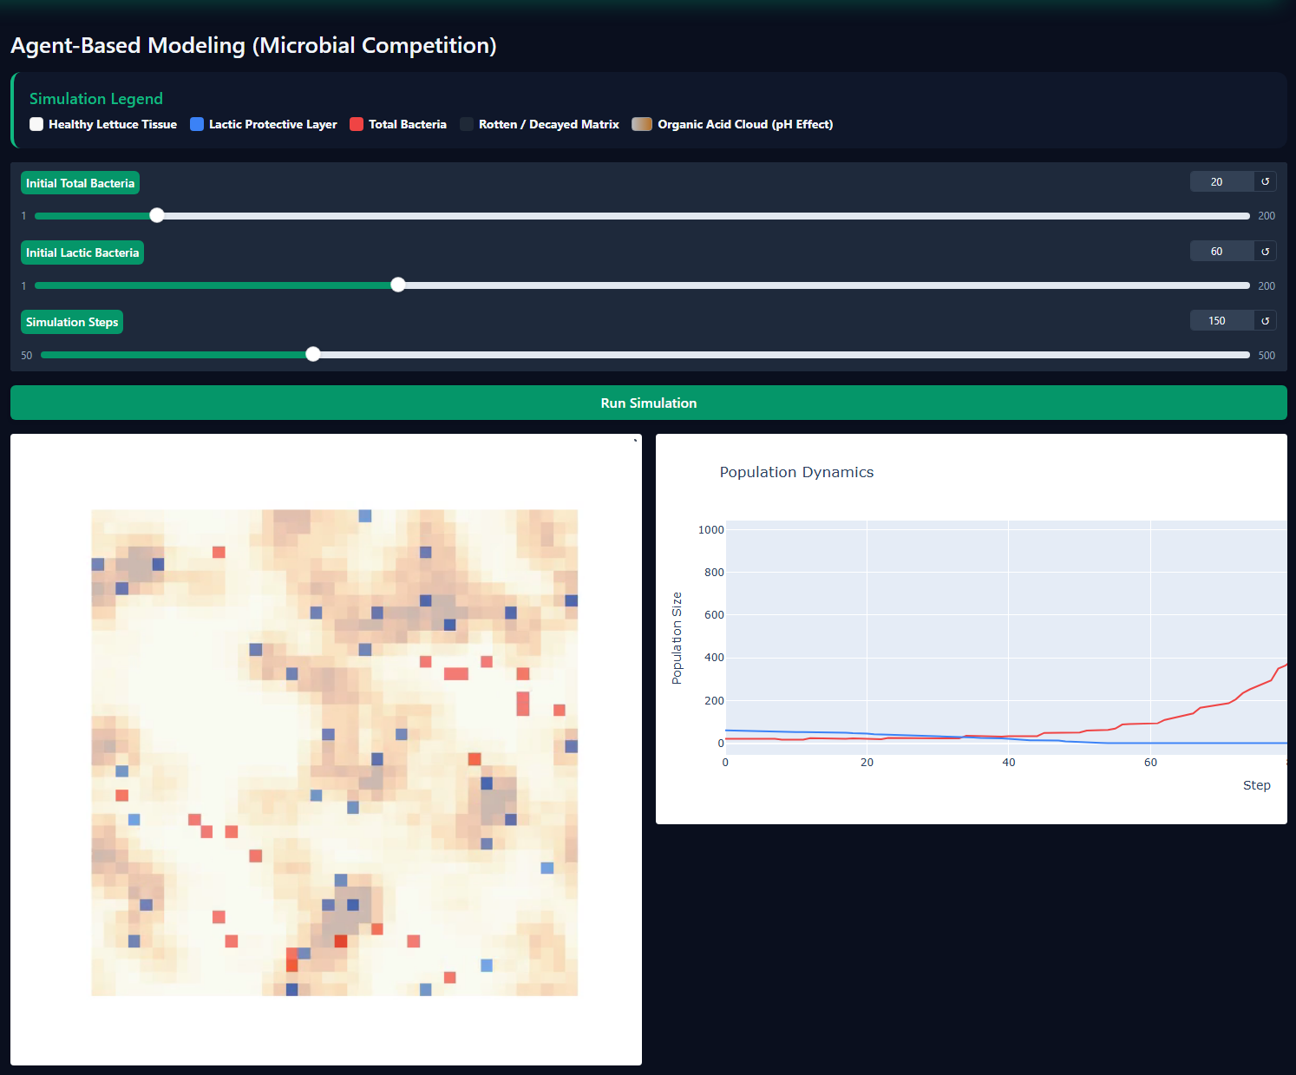
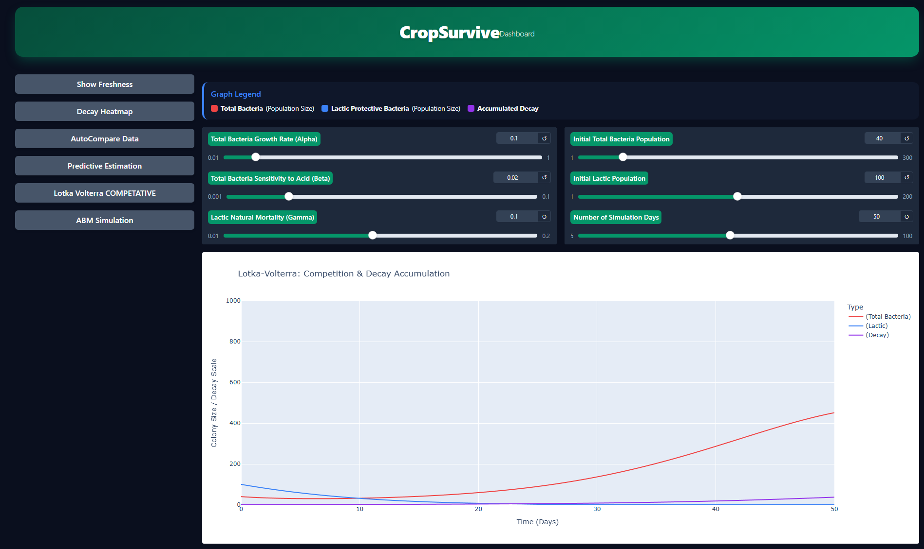
CROP SURVIVE
Project Name: Crop Survive: Engineering Platform for Shelf-Life Prediction
Developed & Presented by: Yoni Grinberg
Supervisor: Dr. Unkelos Shpigel Naome
Project Description (Copy directly to PowerPoint)
Post-harvest decay: causes substantial food waste and quality loss of fresh agricultural produce throughout the supply chain.
Biological degradation: directly impacts cellular tissue, causing rapid deterioration of firmness, respiration kinetics, and weight.
Sparse laboratory data: measurements are collected only at sparse intervals (Days 0, 4, 7), creating high overfitting risks for standard predictive models.
Inefficient manual analysis: evaluating the shelf-life efficacy of different active bio-coating formulations lacks unified, automated comparison tools.
Lack of dynamic prediction: producers lack accessible digital pipelines to forecast decay timelines or simulate competitive microflora dynamics in real time.
Functional Requirements
Automated Data Integration
The system shall merge 8 distinct CSV files (weight loss, gas composition, texture, microbial load, etc.) into a single, consolidated dataset aligned by sampling days.
Freshness Score Computation
The system shall calculate a weighted system health score (scaled ) for each sampling day based on the imported scientific metrics.
Auto-Compare Dashboard
The system shall provide a graphical interface allowing the user to select and compare the experimental treatment groups directly against the control group over the timeline.
Predictive Estimation (Trend Forecasting)
The system shall perform mathematical extrapolation to project trends for missing experimental days (beyond Day 14), using clear visual indicators to distinguish projected estimates from empirical measurements.
Decay Slider Simulation
The system shall feature an interactive timeline slider that dynamically adjusts the visual hue of the produce illustration from green to black based on the calculated Freshness Score
Non-Functional Requirements
Usability
The user interface workflow shall emulate a spreadsheet environment (similar to Microsoft Excel) to ensure a comfortable learning curve for researchers (e.g., Dr. Lilach) without requiring advanced technical training.
Reliability (Data Integrity)
The system shall perform input validation on uploaded variables and trigger warning alerts for physical anomalies (e.g., unrealistic weight metrics) to preserve research accuracy.
Performance (Efficiency)
The system shall process slider movements and render integrated analytical charts in under 2 seconds, even when handling complete experimental datasets.
Maintainability
The codebase shall be designed with a modular architecture, enabling easy integration of new biological variables (e.g., additional bacterial strains or new gas parameters) without refactoring the core score-computation logic.
Interoperability (Compatibility)
The system shall support direct ingestion of raw CSV and Excel file formats generated directly by laboratory instruments, eliminating the need for manual user pre-processing.

