Slide 1
Ecological Modeling Lab
Lec3 — Foundations of Ecological Modeling
Population dynamics · Species interactions · Mathematical modeling

Slide 2
1
Modeling
Foundations

Slide 3
Diversity Types
Biodiversity is measured at multiple scales: alpha (local), beta (between habitats), and gamma (regional) diversity. Various indices like Shannon-Wiener and Simpson's quantify diversity for comparison.
Research increasingly shows that biodiversity enhances ecosystem function, stability, and resilience, though the exact relationships remain an active area of study.
Genetic
Variation in genes within species, providing adaptive potential and resilience to environmental changes.
Species
Variety of species within an ecosystem, measured by richness (number of species) and evenness (relative abundance).
Ecosystem
Variety of habitats, communities, and ecological processes within a region or landscape.
Functional
Range of ecological roles and processes performed by organisms in an ecosystem

Slide 4
Population Growth Models
Exponential Growth
Logistic Growth
Multi-Species Models
Assumes unlimited resources. Population increases continuously.
dN/dt = rN where r = intrinsic growth rate. Valid only short-term or in resource-rich conditions.
Incorporates carrying capacity K. Growth decelerates as N approaches K.
dN/dt = rN(1−N/K) — creates the characteristic S-shaped sigmoidal curve.
Extends single-species models to include interactions between species.
Lotka-Volterra: predator-prey cycles and competitive interactions between species.
⚠ Real populations rarely follow simple models — always validate against field data and check assumptions.

Slide 5
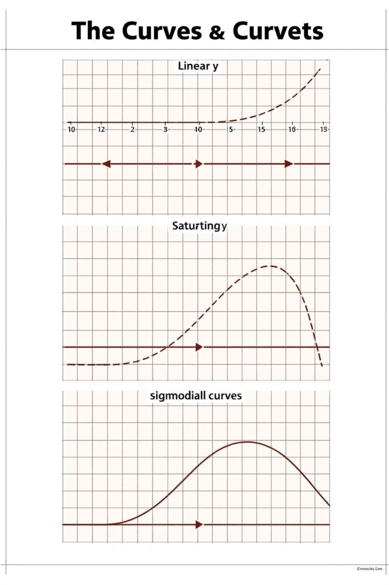
Functional Response Types
Functional responses describe how a predator's consumption rate changes with prey density.
f(ALG) = ALG
Consumption proportional to food availability
No saturation — rare in nature
Common in filter feeders
f(ALG) = ALG / (K + ALG)
Plateaus at high food availability
Holling Type II — most common
Invertebrate predators
f(ALG) = ALG² / (K² + ALG²)
S-shaped curve — slow start, rapid middle
Vertebrate predators — learning behavior
Prey switching at high densities

Slide 6
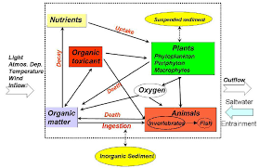
Understanding Population Dynamics - Conceptual vs Mechanistic Models
Two complementary approaches to understanding population dynamics and ecological systems.
Conceptual Models
Mechanistic Models
Identify relationships
Develop research questions
Communicate understanding
Guide model development
Make quantitative predictions
Test hypotheses
Evaluate scenarios
Forecast conditions
Mechanistic Model: The mathematical representation
Conceptual Model: The "big picture" understanding
⚠ Both approaches are essential: conceptual models clarify thinking; mechanistic models enable prediction and testing.

Slide 7
Conceptual Model
A mechanistic model uses mathematical equations with defined parameters to make quantitative, testable predictions about ecological systems.
Mathematical Equations
Key Components
Driving Processes
Influence Direction
System elements and their relationships
Factors causing changes in population
Positive/negative effects between components
Enables simulation, scenario testing, and forecasting.

Slide 8
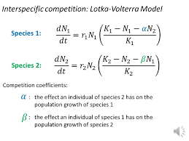
Mechanistic Model Equation
A mechanistic model uses mathematical equations with defined parameters to make quantitative, testable predictions about ecological systems.
Mathematical Equations
Key Components
Quantitative Predictions
Parameters must be measurable and biologically meaningful.
Enables simulation, scenario testing, and forecasting.

Slide 9
Types of Equations in Ecological Modeling
Three equation types underpin most ecological models, each suited to different timescales and data.
 | Recursion Equation | Difference Equation
Definition | n(t+1) = R × n(t) — value at next step | Δn = n(t+1) − n(t) — change between steps
Best for | Discrete generations (insects, annual plants) | Organisms with distinct breeding seasons
Time scale | Discrete time steps (days, years) | Continuous time (ODEs)
Example | Insect generations, fish year-classes | Differential equation: dn/dt = r×n (exponential)
ODE type | ODE: one independent variable (time) | PDE: multiple independent variables (time + space)

Slide 10
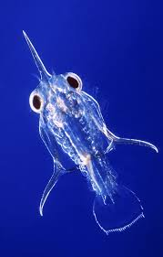
Example - Zooplankton Biomass Dynamics
Light & Nutrients — primary inputs to the system
Algae (ALG) Biomass — food source for zooplankton
Zooplankton (ZOO) — affected by grazing, predation, respiration
Decomposition — returns nutrients back to system
dZOO/dt = g × e × ZOO × f(ALG) − m × ZOO − p(ZOO)
g = grazing rate, e = assimilation efficiency
m = mortality, p(ZOO) = predation term
The zooplankton biomass equation tracks net growth as the balance between food-driven growth and losses from mortality and predation.

Slide 11
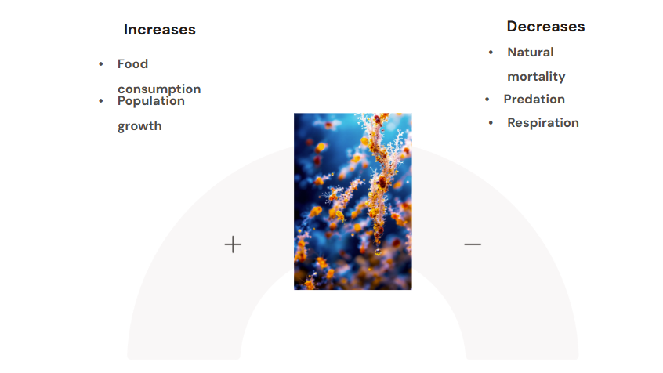
Understanding Zooplankton Biomass Dynamics
The zooplankton biomass equation tracks net growth as the balance between food-driven growth and losses from mortality and predation.

Slide 12
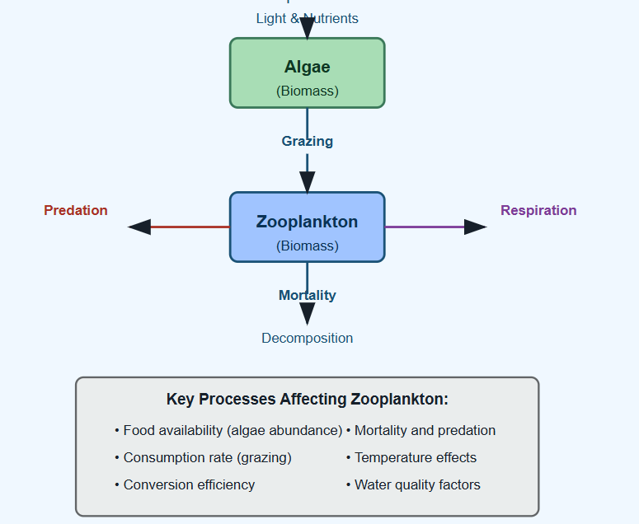
Zooplankton conceptual model
Qualitative understanding
"What affects what"
General relationships

Slide 13
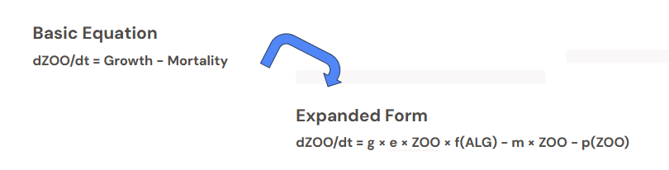
Zooplankton mechanistic model
Quantitative representation
g = grazing rate, e = efficiency, m = mortality rate
Specific parameters
Testable predictions
Basic Equation
dZOO/dt = Growth - Mortality
Expanded Form
dZOO/dt = g × e × ZOO × f(ALG) - m × ZOO - p(ZOO)

Slide 14
2
Population Growth
Models

Slide 15
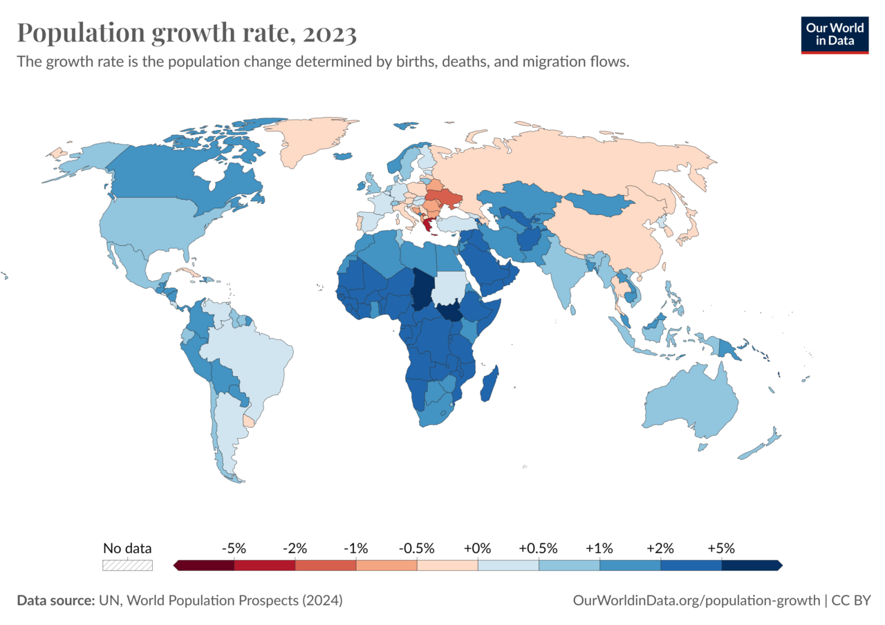
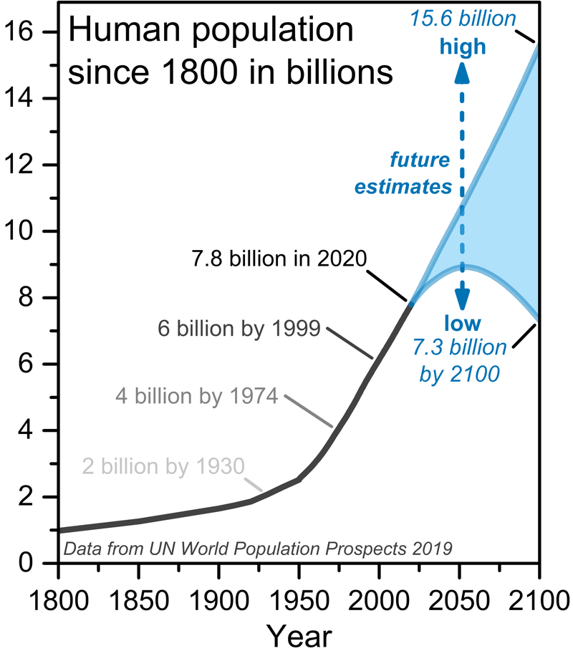
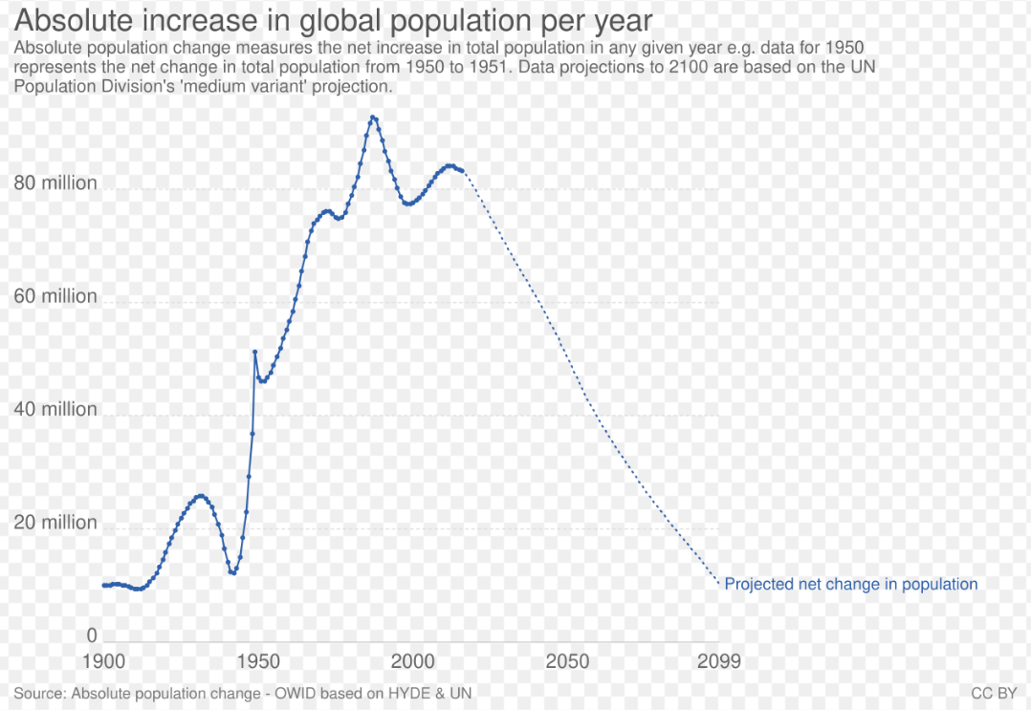
Population trajectory
Population growth is the increase in the number of people in a population or dispersed group.
Population has grown from 1 billion in 1800 to 8.2 billion in 2025.
Actual human population growth amounts to around 70 million annually, or 0.85% per year.
As of 2024, The United Nations projects that global population will peak in the mid-2080s at around 10.3 billion.

Slide 16
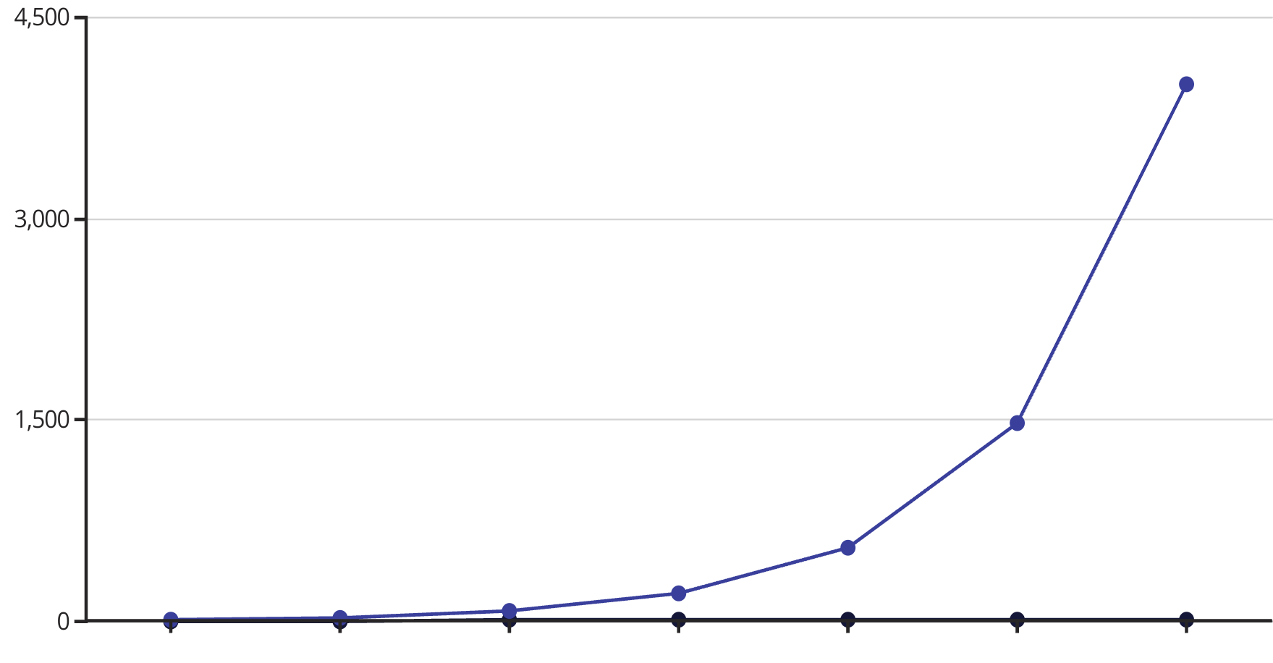
The Exponential Growth Model
The simplest population model: assumes unlimited resources and constant per-capita growth rate.
Key Equation
Key Characteristics
dN/dt = rN (continuous time)
Unlimited growth — no ceiling
Growth proportional to population size
N(t+1) = R × N(t) (discrete time)
N = population size
r = intrinsic growth rate
R = finite rate of increase; r = intrinsic growth rate (R = eʳ)
No environmental constraints
Valid only short-term in nature
When R > 1: population grows
When R = 1: population stable
When R < 1: population declines toward extinction
Analytical solution: N(t) = N₀ × eʳᵗ
Discrete solution: N(t) = N₀ × Rᵗ
Population doubles every ln(2)/r time units
Examples: invasive species with no predators, bacteria in fresh media, human population in 1800s.

Slide 17

General solution to the exponential growth model
Population doubles every ln(2)/r time units
The general solution allows us to determine exactly when the population will grow
or shrink without having to explore all possible values of R numerically. Rt n(0) always
equals n(0) when R equals one, it declines as time passes whenever R is less than one,
and it increases as time passes whenever R is greater than one.
Does modeling population growth in continuous-time generate different
predictions? To address this question graphically requires that we predict future
population sizes using the differential equation dn/dt = r n(t).
That is, we must “solve”the differential equation so that we know n(t) itself at time t,
and not just the rate at which n(t) changes over time.
Just as with discrete-time recursion equations,
differential equations can be solved analytically or numerically

Slide 18
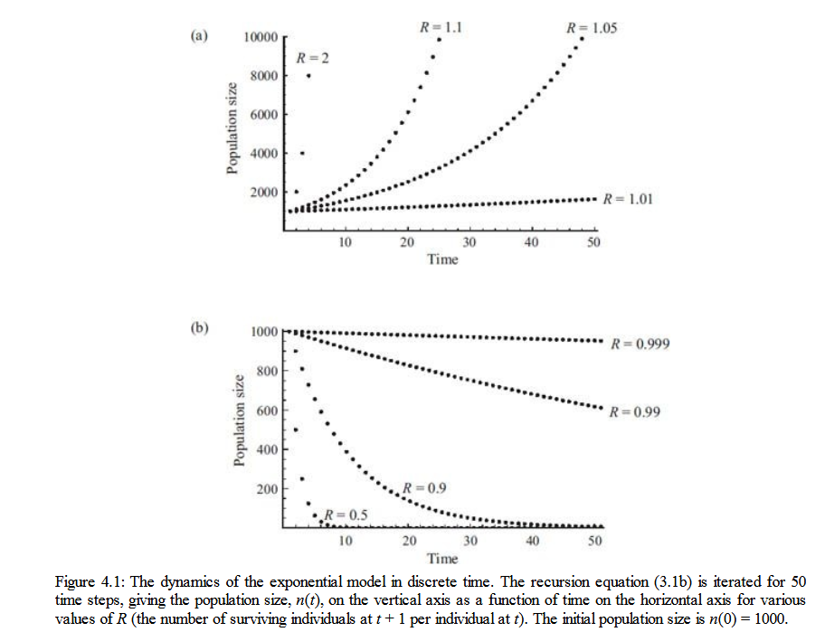
Dynamics of the Exponential Model
The value of R determines whether a population grows, stays stable, or declines over time.
When R > 1
When R = 1
Population grows without bound
Population is exactly stable
Births precisely offset deaths
Each individual leaves more than one descendant
Seen in early-stage invasions and lab cultures
Rarely observed long-term in nature
When R < 1
Population declines toward extinction
Each individual leaves fewer than one descendant
Critical threshold for conservation management
General solution: N(t) = Rᵗ × N(0)
Allows exact prediction without simulation
Population at time t = N₀ × eʳᵗ
Continuous-time equivalent of discrete recursion
Both predict same long-run behavior
Limitation: exponential growth is unsustainable — real populations face resource limits, disease, and predation.

Slide 19
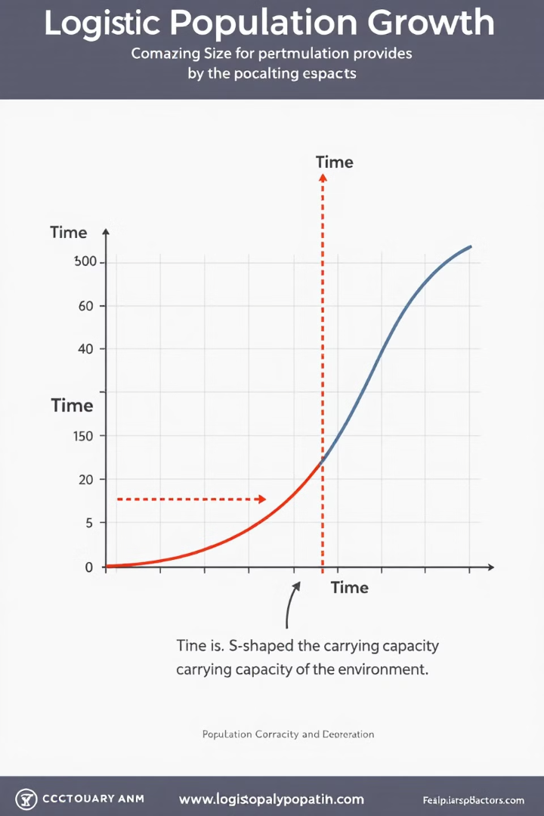
The Logistic Growth Model
Extends exponential growth by introducing carrying capacity K — the maximum population size the environment can sustain.
Key Equation
dN/dt = rN(1−N/K)
As N → K, the term (1−N/K) → 0, slowing growth
When N << K: growth is nearly exponential
At N = K/2: growth rate is maximized (inflection point)
Key Parameters
Population Size (N):
Current population size being tracked
Growth Rate (r):
Intrinsic per-capita rate of increase
Carrying Capacity (K):
Maximum sustainable population given environmental constraints
Equilibrium:
Population stabilizes at N = K. Perturbed populations return to K.
Discrete version: N(t+1) = N(t) + rN(t)(1−N(t)/K) — can exhibit chaos for large r.
Analytical Solution:
N(t) = K / (1 + ((K−N₀)/N₀) × e^−ʳᵗ)

Slide 20
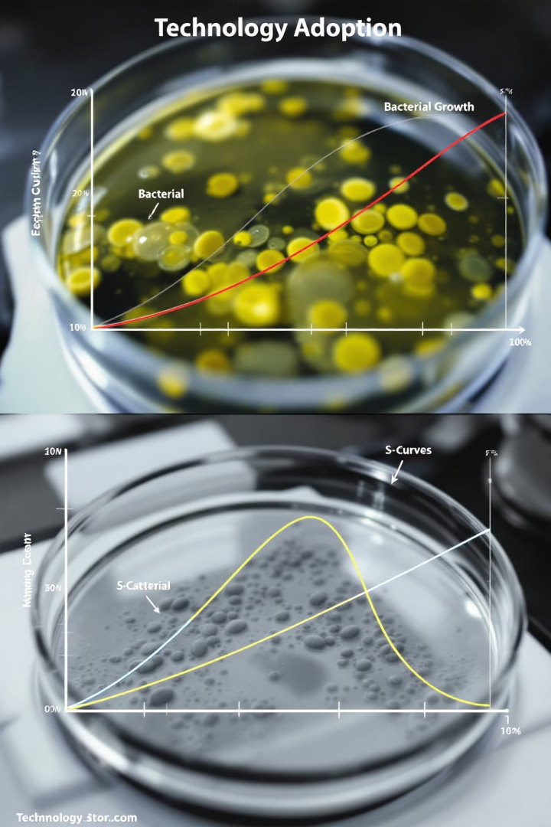
Insights from the Logistic Growth Model
⚠ Logistic growth is a foundational model - Population never exactly reaches K —
it asymptotically approaches it.
# Logistic growth function
def logistic_growth(N0, K, r, t):
return K / (1 + ((K - N0) / N0) * np.exp(-r * t))

Slide 21
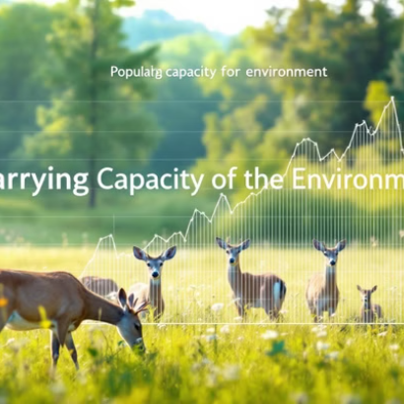
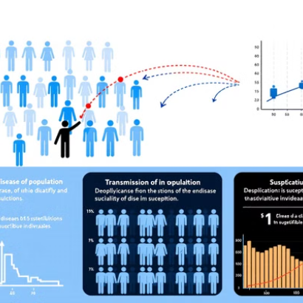
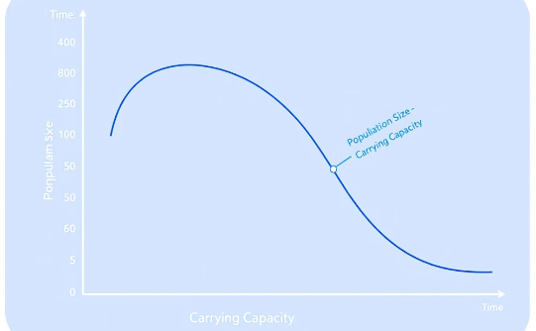
Logistic Model Applications
Wildlife Management
Disease & Epidemiology
Technology & Innovation
Fisheries: Maximum Sustainable Yield = rK/4 at N = K/2.
Wildlife reserves: K set by habitat carrying capacity.
Recovery modeling: how fast will depleted stocks rebound?
Epidemic modeling: logistic spread with susceptible limit.
Herd immunity threshold mirrors population K.
Antibiotic resistance spread in host populations.
Technology adoption follows S-curves (Rogers 1962).
Market saturation mirrors ecological carrying capacity.
Software user growth, social network adoption.

Slide 22
Importance & Best Practices
Small Population (N << K)
Mid-Range (N = K/2)
Growth is nearly exponential. (1−N/K) ≈ 1. Maximum per-capita growth rate.
Inflection point. Absolute growth rate is maximized. Rate = rK/4 at this point.
Approaching Capacity (N → K)
Exceeding Capacity (N > K)
Growth rate slows dramatically. (1−N/K) → 0. Population asymptotically approaches K.
Negative growth. Population declines back toward K. Can occur after overshot disturbances.
Population growth rate dN/dt is always highest at N = K/2 — the basis for Maximum Sustainable Yield (MSY) in fisheries management.

Slide 23
Exercise
Small Population (N << K)
Mid-Range (N = K/2)
Choose a case from:
https://drive.google.com/drive/folders/1zUWTSnFrmb9mbxTZde5GKqkxxTAUIq2a
Identify and document:
How population growth and succession are modeled mathematically
Where growth patterns might be implemented
How carrying capacity concepts are represented
Is there ant missing data? explain
.

Slide 24
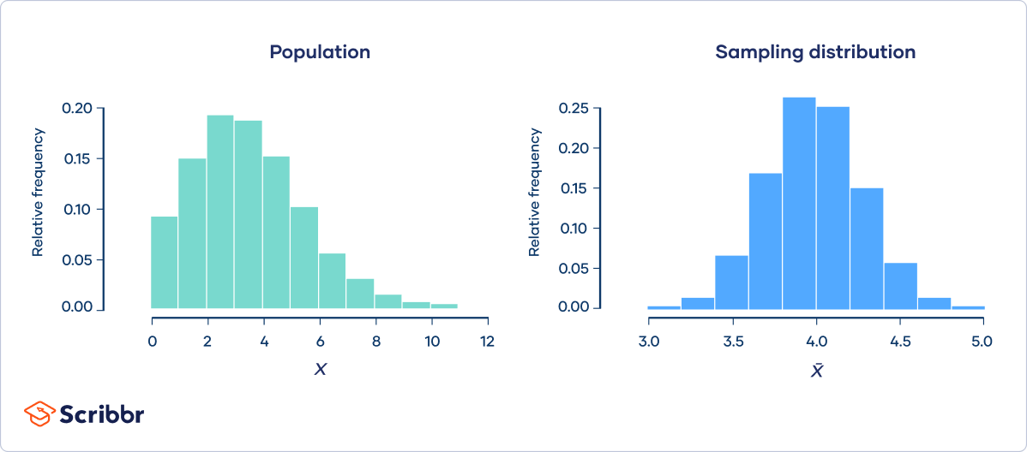
The Discrete Logistic Model
The discrete version of the logistic model can exhibit rich dynamics including chaos — a landmark result in theoretical ecology (May, 1976).
May's Logistic Map
Ecological Significance
· Equation: N(t+1) = N(t) + rN(t)(1−N(t)/K)
· For small r: stable equilibrium at K
· For moderate r: population oscillates (period-2 cycles)
· For large r (> 2.57): chaotic, unpredictable fluctuations
· Chaos from simple deterministic rule — no randomness needed
· Population fluctuations may be chaotic, not just noisy
· Long-term prediction impossible in chaotic regime
· Chaos is sensitive to initial conditions (butterfly effect)
r Value Guidelines
n < 15 — Small sample
r = 1–2 — Oscillations
r > 2.57 — Chaos
Population reaches K smoothly
Period-2 or period-4 cycles
Sensitive dependence on initial conditions

Slide 25
3
Species Interactions

Slide 26
Beyond Single-Species Models
Species do not exist in isolation. Single-species models (exponential/logistic) fail to capture how species affect each other.
Interaction Types
A complete model
Competition (+/-): species compete for limited resources
H₁: Mean diversity in fragmented forest < Mean diversity in continuous forest
Describing every species interaction would be prohibitively complex except in the simplest of biological communities. Yet some insight can be obtained by focusing on specific types of interactions and how these interactions affect population growth.
Do the species compete with or aid each other in obtaining resources?
Does a species consume or provide fodder for another species?
Do they fight for territories or provide a habitat for one another?

Slide 27










Interaction types
Competition
Predation
Species compete for limited resources
One species consumes another
Mutualism
‹#›
Both species benefit
Parasitism
One benefits, other harmed
Commensalism
One benefits, other unaffected

Slide 28
Multi Species Interaction research
Interaction Types
Model Approach
Competition (+/-): species compete for limited resources
H₁: Mean diversity in fragmented forest < Mean diversity in continuous forest
p < 0.05 → Reject H₀ (fragmentation has an effect)
Interaction coefficients (α) quantify the effect of one species on the other.
1
Identify Interactions
Document which species co-occur and how they affect each other
2
Formulate Equations
Add inter-species terms to single-species logistic equations
3
Simulate Dynamics
Run ODE solver to predict population trajectories over time
4
Validate & Apply
Compare to field data; use for management and conservation decisions

Slide 29
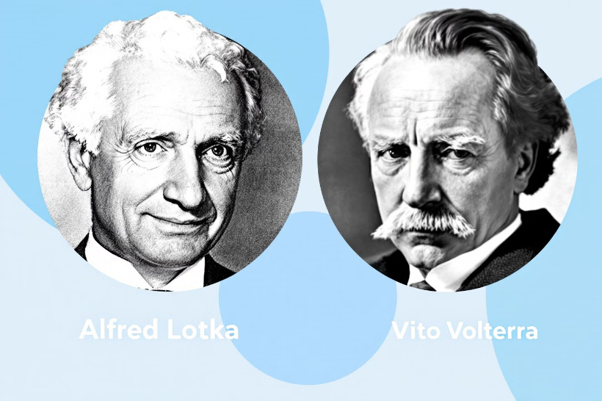
4
Two Main Types
Predator-Prey Model
Lotka-Volterra Models
Competition Model
Fundamental to theoretical ecology and population dynamics
Developed by Alfred Lotka (1925) and Vito Volterra (1926)

Slide 30
Gotelli, N. J. (2008). A Primer of Ecology.
Lotka-Volterra Predator-Prey Model
Prey Equation
Predator Equation
d = predator death rate
dH/dt = rH − aPH
H = prey population (herbivores)
r = prey intrinsic growth rate
a = predation rate coefficient
dP/dt = baPH − dP
P = predator population
b = predator conversion efficiency
Key Dynamics
Prey grows exponentially without predators.
Predator declines without prey.
Cyclical oscillations
Equilibrium Points
Prey peak precedes predator peak by ~quarter cycle
Populations oscillate indefinitely (no damping)
Neutral stability — sensitive to initial conditions
Trivial: H=0, P=0 (extinction)
Limited to one or two groups
Assumes independence of observations

Slide 31
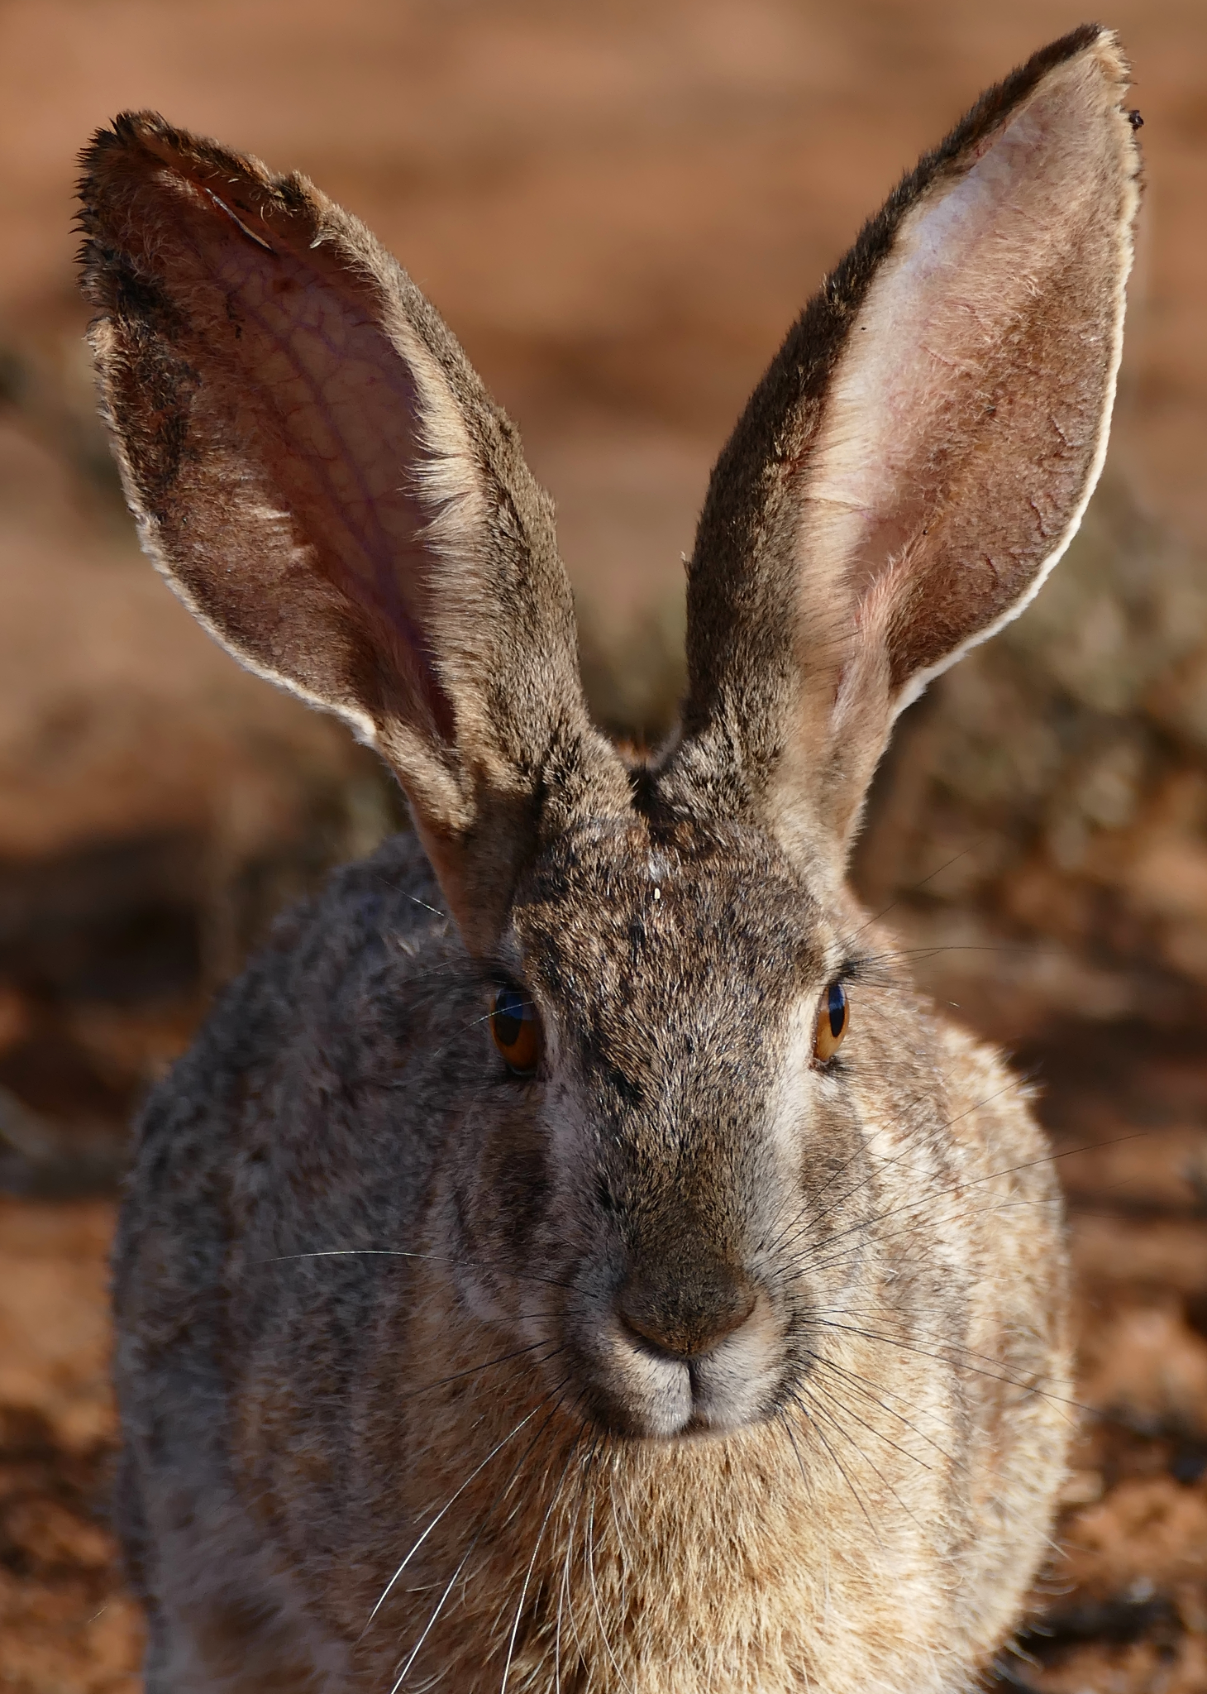
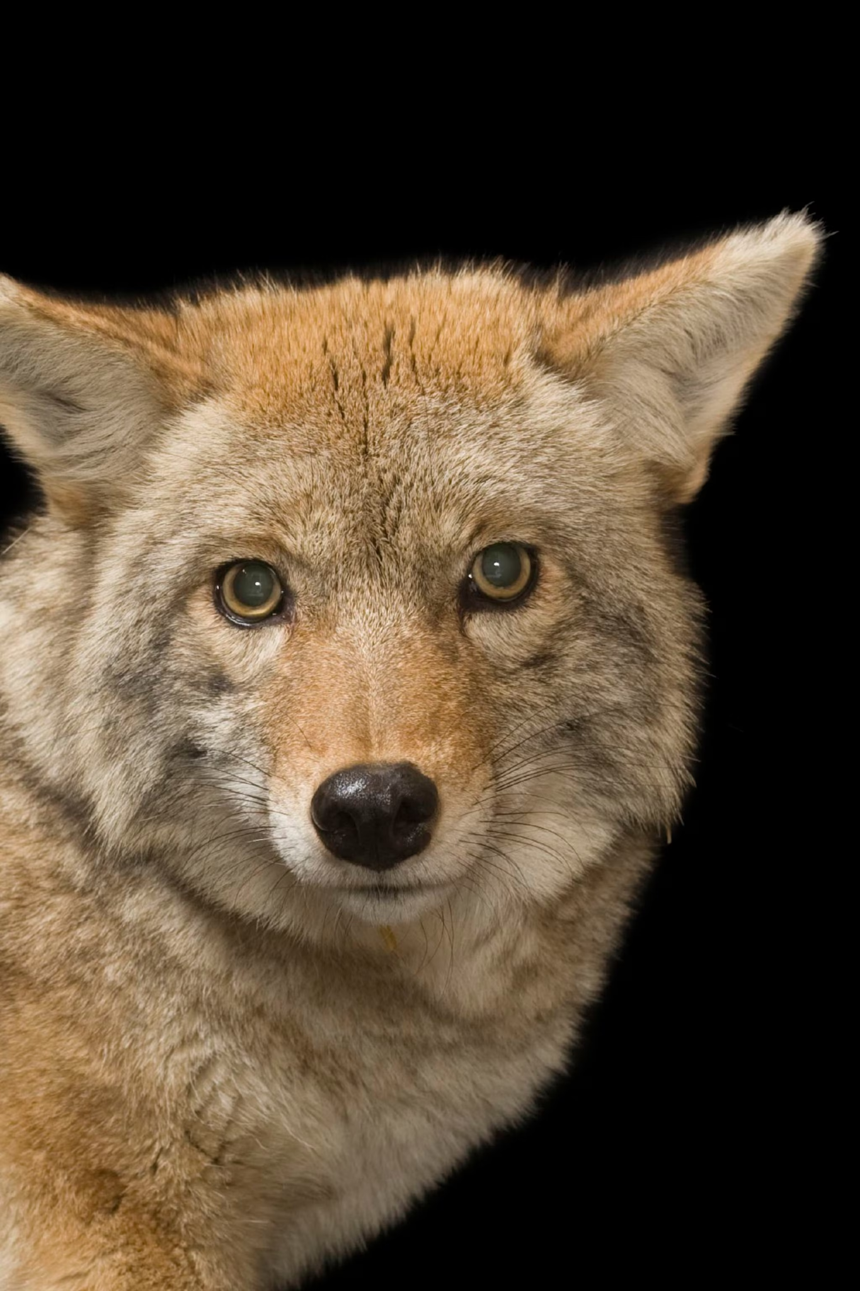
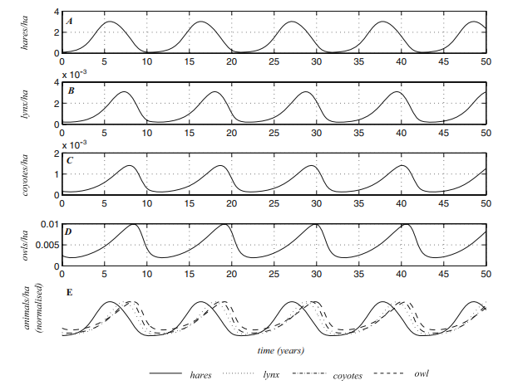
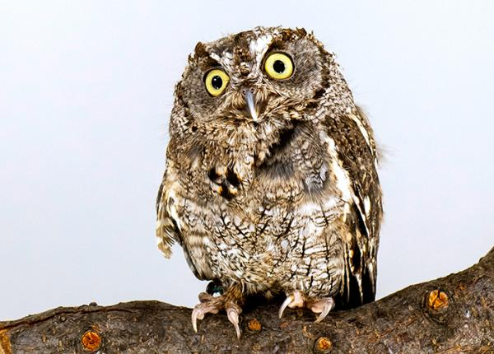
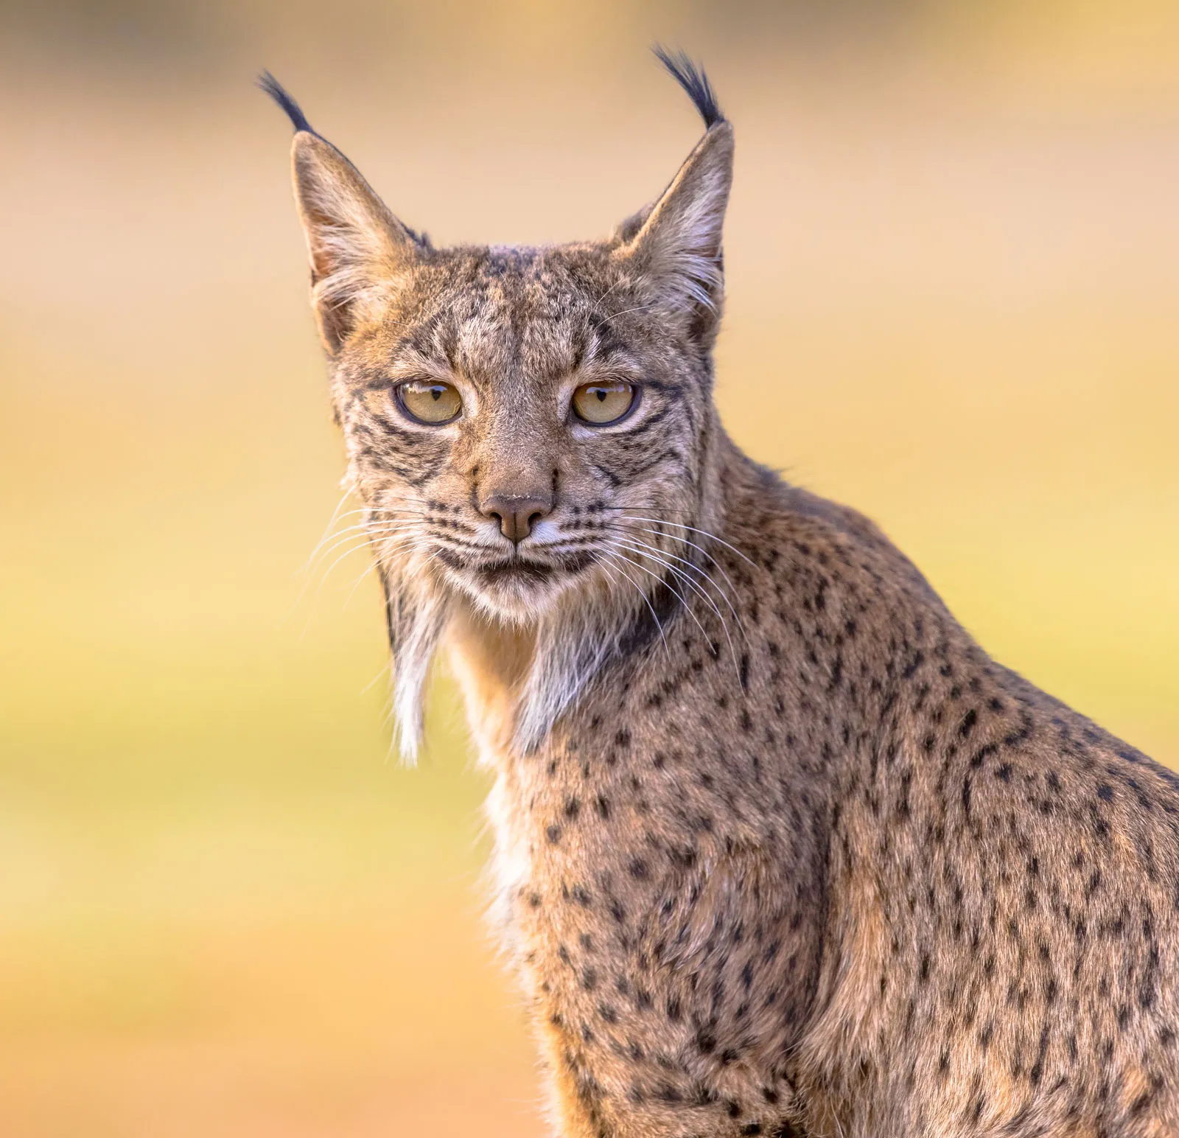
Lotka-Volterra Predator-Prey example (based on logistic model)
Hare
Coyote
Owl
Lynx
Tyson, R., Haines, S., & Hodges, K. E. (2010). Modelling the Canada lynx and snowshoe hare population cycle: the role of specialist predators. Theoretical Ecology, 3, 97-111.‏
‹#›

Slide 32
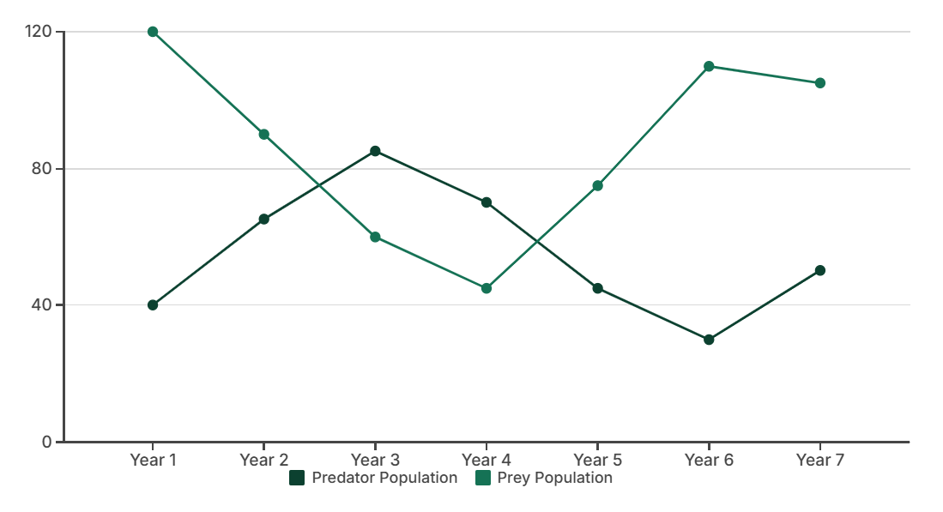
Understanding Predator-Prey Dynamics
Prey Growth
Proportional to predator-prey interactions.
Predator Population
dP/dt = -dP + cPH
Prey Population
dH/dt = rH - aPH
Rate: −aPH (predation loss)
More predators → faster prey decline Predator Growth
Proportional to successful predation.
P
Predator population
Prey growth
H
Prey (herbivore) population
‹#›
Exponential in absence of predators.
Rate: dH/dt = rH (no predator)
Positive feedback: more prey → more growth
Prey Decrease
r
Prey growth rate
a
Predation rate
c
Predator conversion efficiency
d
Predator death rate
Cyclical Dynamics: Predator peak follows prey peak with a time lag. Populations oscillate indefinitely without damping.

Slide 33
Lotka-Volterra Competition Model
Extends logistic growth to two competing species. Both intraspecific and interspecific competition reduce growth.
Species 1
Species 2
dN₁/dt = r₁N₁(1−(N₁+α₁₂N₂)/K₁)
dN₂/dt = r₂N₂(1−(N₂+α₂₁N₁)/K₂)
N₁ = population of species 1
K₁ = carrying capacity of species 1
α₁₂ = effect of species 2 on species 1
α₁₂ > 1 means species 2 competes more strongly than species 1 itself
N₂ = population of species 2
K₂ = carrying capacity of species 2
α₂₁ = effect of species 1 on species 2
Competition coefficients are asymmetric in general
Outcome depends on α₁₂, α₂₁, K₁, K₂
Competition Outcomes
Outcome determined by competition coefficients relative to K ratios:
Coexistence
Bonferroni Correction
Dunnett's Test
Both species persist when intraspecific > interspecific competition
Adjust α for multiple comparisons
Compare treatments to a control
α' = α/n (where n is number of comparisons)
More powerful than Tukey when only comparing to control
K₁/α₁₂ > K₂ and K₂/α₂₁ > K₁
Best for all pairwise comparisons
Conservative approach
Common in experimental ecology

Slide 34
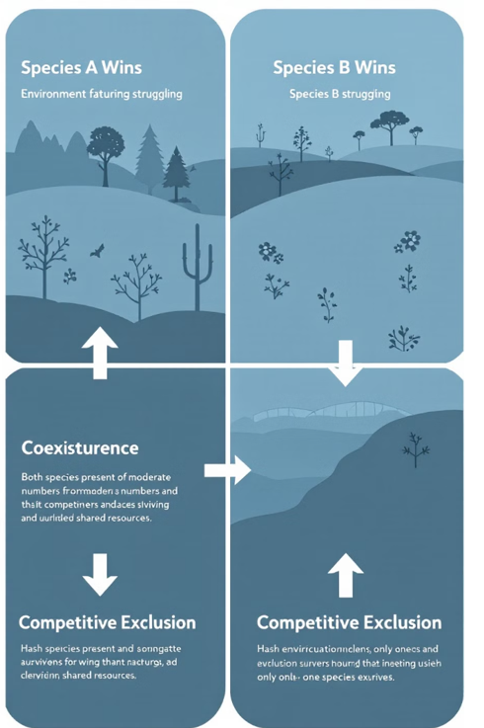
https://www.wolframcloud.com/obj/bd5f7de5-6b85-4fd3-805b-8be50285f8db?src=CloudBasicCopiedContent#sidebar=basic-notebook-links
Competition Outcomes: 4 Cases
Coexistence
Both species survive at equilibrium
Species 1 Excluded
‹#›
Only species 2 survives
Species 2 Excluded
Only species 1 survives
Bistability
Outcome depends on initial conditions
K₁/α₁₂ > K₂ and K₂/α₂₁ > K₁
A correlation coefficient is a value between -1 and +1 that indicates the strength and direction of the linear relationship between two variables.
A value close to +1 indicates a strong positive linear relationship (as one variable increases, the other tends to increase).
A value close to -1 indicates a strong negative linear relationship (as one variable increases, the other tends to decrease).
A value close to 0 indicates a weak or no linear relationship.
⚠ Which species wins depends on starting population sizes (bistability)

Slide 35
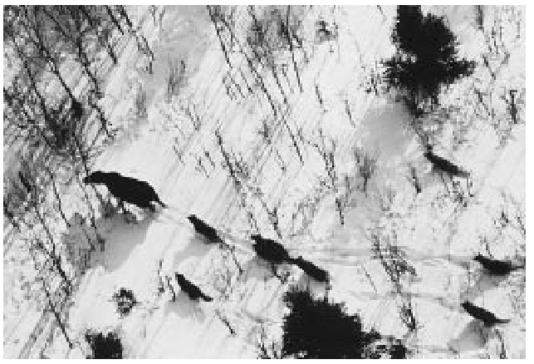
Peterson, R. O. (1999). Wolf–moose interaction on Isle Royale: the end of natural regulation?. Ecological Applications, 9(1), 10-16.
Case Study: Wolf-Moose Dynamics
Research Question:
How do wolf and moose populations interact on Isle Royale?
Model Setup
dH/dt =
rH − aPH (moose growth minus predation)
dP/dt =
Mean diversity in fragmented forest < Mean diversity in continuous forest
Fitted to 60+ years of annual census data
Key Findings
p < 0.05
Wolf numbers track moose with a time lag
Inbreeding depression weakened wolf population
Wolf immigration needed for long-term stability
Conservation Implications
Isle Royale is the world's longest-running predator-prey study (1958–present). Results inform wolf reintroduction policy and show that isolated predator populations face genetic bottlenecks. Model limitations: LV assumes constant parameters, but r, a, b, d all vary with climate.

Slide 36
Exercise — Classify Each Scenario
For each ecological scenario, identify the appropriate model: Exponential / Logistic / Lotka-Volterra Predator-Prey / Lotka-Volterra Competition
Exercise
Scenario | Key Clue | Model Type
Invasive species just introduced to new habitat | No predators, unlimited food initially
Deer population in fenced national park | Bounded by available vegetation (K)
Lynx and snowshoe hare populations oscillate in cycles | Predator numbers track prey with a time lag
Two grass species competing for the same soil nutrients | Both affect each other's carrying capacity
Bacterial growth in unlimited nutrient broth | Exponential phase before nutrient depletion
Wolves reintroduced to an elk-populated valley | Elk decline as wolf numbers rise
Yeast population in a wine fermentation vessel | Growth slows as ethanol accumulates (toxic limit)

Slide 37
5
Advanced
Models

Slide 38
Core Mathematical Approaches
Differential Equations
Difference Equations
Stochastic & Matrix Models
Represent continuous change over time.
Logistic growth: dN/dt = rN(1−N/K)
Lotka-Volterra: system of coupled ODEs
scikit-bio: bioinformatics & ecology
Yellowstone wolf reintroduction, coral reef dynamics
Represent discrete time steps (generations).
Ricker model: N(t+1) = N(t)e^(r(1−N(t)/K))
May's logistic map: chaos at high r
Best for: annual species, fish year-classes
Pacific salmon spawning, insect generations
Incorporate randomness and population structure.
Stochastic: birth-death processes, environmental noise
Matrix: Leslie matrix for age-structured populations
Eigenvalue λ = population growth rate
Grizzly bear management, condor recovery
Python: scipy.integrate · R: deSolve · NetLogo: agent-based · MATLAB: numerical

Slide 39
Summary
Variables & Data Types
Species Interactions
Exponential: dN/dt = rN (unlimited growth)
Logistic: dN/dt = rN(1−N/K) (resource-limited)
Discrete logistic: can exhibit chaos (May 1976)
Analytical solutions + numerical simulation
Predator-Prey: dH/dt = rH−aPH; dP/dt = baPH−dP
Competition: dN₁/dt = r₁N₁(1−(N₁+α₁₂N₂)/K₁)
Outcomes: coexistence, exclusion, oscillations
Advanced Models
Implementation
Differential equations (continuous), Difference equations (discrete)
Type I & II errors
Matrix models: age/stage-structured populations (Leslie)
Validation: AIC, cross-validation, sensitivity analysis
Python: scipy.integrate.solve_ivp, numpy, matplotlib
R: deSolve, vegan, ggplot2
NetLogo for agent-based, MATLAB for numerical
Always validate against field data · check assumptions · report uncertainty

Slide 40
Questions and Discussion
Common questions in ecological modeling:
Q
When is a model "good enough" to use?
Q
How do I choose between ODE and stochastic models?
A: When it captures the essential dynamics, fits available data reasonably, and its assumptions match the system. All models are wrong — some are useful.
A: Consider zero-inflated Poisson models or negative binomial distributions.
Q
How do I estimate parameters I can't measure directly?
Q
Can simple models really explain complex ecosystems?
A: Fit model to time-series data using maximum likelihood or Bayesian inference. Use sensitivity analysis to identify which parameters matter most.
A: Yes — often surprisingly well for key dynamics. Start simple, add complexity only where data support it and where it changes predictions.

Slide 41
References
Key Texts
Online Resources
Gotelli, N.J. & Ellison, A.M. (2004). A Primer of Ecological Statistics. Sinauer.
Edelstein-Keshet, L. (2005). Mathematical Models in Biology. SIAM.
Quinn, G.P. & Keough, M.J. (2002). Experimental Design and Data Analysis for Biologists. Cambridge.
https://esajournals.onlinelibrary.wiley.com/doi/pdf/10.1890/1051-0761%281999%29009%5B0010%3AWMIOIR%5D2.0.CO%3B2?casa_token=c5ZheG3hKeMAAAAA%3AS3SrjbVNYFJ0JGV5oK1EKcAw7gLCxhUynS800vIVW8saPQLxA8hJ04vNpJb5Zr9W9rgNHIUyolWAgWM
Wolfram Demonstrations — ecological model simulations
NetLogo Models Library — biology section
PyScience — Lotka-Volterra tutorial
deSolve (R): ODE solver documentation
SciPy docs: scipy.integrate.solve_ivp
https://wolframcloud.com
https://ccl.northwestern.edu/netlogo/

