Slide 1
Introduction to
Ecological Modeling
Lecture 1 · Naomi Unkelos-Shpigel

Slide 2
Course Overview
Credits
Schedule
2.5 credit points
2h lecture + 1h practice per week
Grading
Project
Homework 30% · Project 60% · Participation 10%
Presentation 20% + Research 20% + Submission 20%
Prerequisites: Algorithms (61753) · Introduction to Cloud Computing (61773)

Slide 3
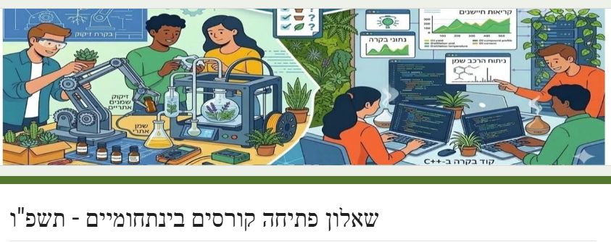
Opening survey
Google form
Padlet
https://docs.google.com/forms/d/e/1FAIpQLSdMH8j2gEeSR9r-av2IW4CSRrRiz1fgkDE3_imhZX5LIgCZJg/viewform
https://padlet.com/naomius/my-supercalifragilisticexpialidocious-padlet-e7e3pwdhmtaakmb9

Slide 4
1
What Is
Ecological Modeling?

Slide 5
What Is Ecological Modeling?
A scientific approach to understanding and predicting ecosystem behaviour —
bridging ecological theory and real-world observations.
Translates ecological processes and relationships into mathematical language
Manages complexity by breaking intricate biological systems into manageable components
Enables quantitative predictions about ecological dynamics across time and space
Ranges from simple equations to sophisticated computer simulations
Provides a shared framework for communicating ecological knowledge across disciplines

Slide 6
Why Model Ecological Systems?
Test Hypotheses
Predict Future States
Models let us test ideas about ecological processes (climate change, pollution, species interactions) without costly or impossible field experiments.
By simulating different scenarios, we forecast future ecosystem states and identify threats to biodiversity before they occur.
Bridge Theory & Data
Guide Decisions
Models connect theoretical concepts to real-world observations — incorporating temperature, rainfall, nutrients, competition, and predation.
Models translate science into policy — providing actionable information for resource management and conservation planning.

Slide 7
History of Ecological Modeling
From pencil-and-paper equations to machine learning — the field has evolved dramatically.
1920s
Lotka-Volterra
Mathematical foundations of predator-prey dynamics and competition — still central today.
1960s
Systems Ecology
Engineering principles applied to ecosystems; energy flow and nutrient cycling formalised.
1970s
Computer Simulations
Increased computing power enabled dynamic simulations; IBP drove large-scale modelling.
2000s
Agent-based & SDMs
Species distribution models and agent-based models transformed spatial ecology.
2010s+
ML & Big Data
AI, citizen science platforms (iNaturalist, GBIF), and satellites enable global-scale inference.

Slide 8
2
Core Ecological
Concepts

Slide 9
Ecological Organization
Each level exhibits emergent properties — behaviours unpredictable from lower levels alone.
Individual
Single organism
Population
Same species group
Community
Multiple interacting species
Ecosystem
Community + environment
Biosphere
All ecosystems on Earth

Slide 10
Population Dynamics
Concept | Formula / Details | Ecological Significance
Key parameters | Birth rate (b), death rate (d), immigration (i), emigration (e) | Foundation of all population models
Exponential growth | Nₜ = N₀eʳᵗ (r = intrinsic rate of increase) | Describes unlimited growth — rare in nature
Logistic growth | dN/dt = rN(1 − N/K) | Incorporates resource limits via carrying capacity K
Carrying capacity (K) | Max sustainable population size for a given environment | Balance between resources and population demand
Applications | Wildlife management, invasive species control, conservation | Guides real-world management decisions

Slide 11
Species Interactions
Interactions shape population dynamics, drive evolution, and determine community structure.
+/− Predation
−/− Competition
+/+ Mutualism
Predator-prey cycles, functional responses, trophic cascades
Competitive exclusion principle, resource limitation, niche differentiation
Pollination, mycorrhizae, nitrogen-fixing bacteria in legumes
+/0 Commensalism
−/0 Amensalism
+/− Parasitism
Epiphytes on trees, remoras on sharks, cattle egrets following cattle
Allelopathy in plants, physical shading, antibiotic production
Internal and external parasites; often drives host evolution

Slide 12
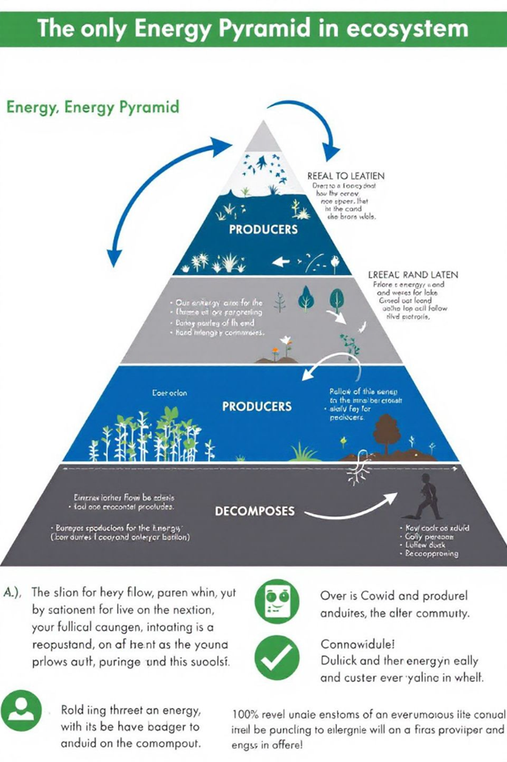
Energy Flow & Nutrient Cycling
Energy Flow (one-way →)
Biogeochemical Cycling (cyclic ↻)
1. Producers
Atmospheric Pool
Convert solar energy via photosynthesis
Gases and particles in atmosphere
2. Primary Consumers
Biotic Pool
Herbivores that eat producers
Nutrients locked in living organisms
3. Secondary Consumers
Hydrologic Pool
Carnivores eating primary consumers
Dissolved nutrients in water bodies
4. Decomposers
Geologic Pool
Break down dead organisms and waste
Nutrients stored in soil and rock
~10% energy transfer efficiency → food chains rarely exceed 4–5 levels.
Key elements: C, N, P, H₂O. Human activity disrupts natural cycles.

Slide 13
Succession, Disturbance & Spatial Ecology
Ecological Succession
Pioneer
Early
Mid
Climax
First colonizers; extreme-tolerant.
→
Fast-growing, light-demanding.
→
Mix of early and late species.
→
Stable, self-perpetuating community.
Intermediate Disturbance Hypothesis: moderate disturbance maximises biodiversity.
Spatial Ecology
Landscape Structure
Metapopulation Dynamics
Patches (habitat areas), corridors (connecting features), and matrices (surrounding environment) influence species movement and population dynamics.
Networks of subpopulations connected by dispersal. Local extinctions offset by recolonisation — provides landscape-scale resilience.

Slide 14
3
Model Types, Principles
& Development

Slide 15
Core Principles of Ecological Models
1
Abstraction
All models simplify reality — focusing on essential elements while deliberately omitting unnecessary detail. The art is choosing what to include.
2
Balance
Navigate trade-offs between realism, precision, and generality (Levins' trilemma). No model can maximise all three simultaneously.
3
Purpose-Driven
Model structure must match the specific research question. A nutrient-cycling question demands a different model than a range-shift question.
4
Uncertainty
All models contain uncertainty from parameter estimation, structural choices, and initial conditions. Acknowledging this is crucial.
5
Validation
Models must be tested against independent data. A model is assumed correct until proven wrong — and it is our job to try to prove it wrong.

Slide 16
Types of Ecological Models
Analytical
Simulation
Agent-based
Equations solved directly (closed-form). Fast and elegant, limited to simple systems.
Example: Lotka-Volterra, logistic growth.
Computer implementations that mimic system behaviour over time.
Example: dynamic systems models, compartment models.
Individual organisms as autonomous agents following local rules; emergent community behaviour arises.
Example: NetLogo predator-prey simulations.
Statistical / Empirical
Stochastic
Mechanistic
Fit patterns to observed data using regression, GLMs, or ML.
Example: Species Distribution Models (MaxEnt, BRT).
Include random processes to capture natural variability. Contrasted with deterministic models.
Example: demographic stochasticity in small populations.
Explicitly represent underlying biological, chemical, and physical processes. Interpretable and extrapolatable.
Example: biogeochemical cycling models.

Slide 17
Why Not Just Use Statistics?
"Black-box routines consider ecosystems as something to be measured, not to be understood."
Statistical (Black-Box) Models
Mechanistic Models
Assume similar areas behave identically
Discrepancies corrected with adjustment factors
High R² possible without mechanistic understanding
Cannot safely extrapolate outside data range
Limited transferability across sites and conditions
Examples: regression, GLMs, MaxEnt, Random Forest
Explicitly model biological, chemical, physical interactions
Parameters are measurable quantities (rates, concentrations)
Can extrapolate to novel conditions and scenarios
Increased knowledge as a byproduct of model building
More robust for climate change and scenario analysis
Examples: Lotka-Volterra, biogeochemical models, IBMs

Slide 18
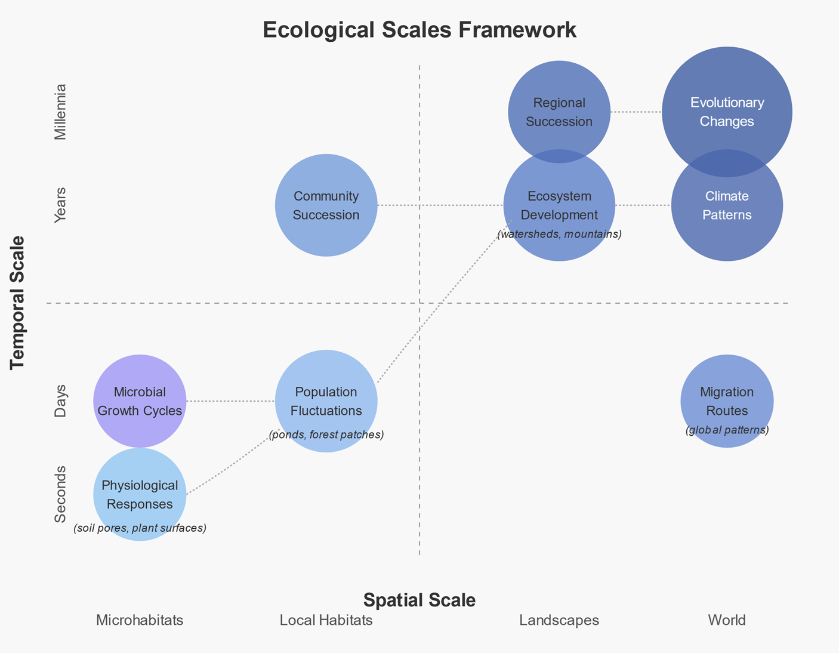
Scales in ecological moeling
It is not possible to describe everything in a single model. Modellers must deliberately choose temporal and spatial scales.
Every ecological model operates within two dimensions simultaneously: time and space. The temporal scale defines how long the modeled process unfolds and at what resolution — from hourly wildfire spread to decadal climate-driven range shifts. The spatial scale defines the study extent and the minimum resolvable unit, from a single field plot to an entire continent.
The two are linked: large-scale processes tend to be slow, so choosing a scale in one dimension often constrains the other. The persistent practical challenge is scale mismatch — field data collected at one resolution must inform a model running at another, while managers need answers at a third.

Slide 19
What to Model? — Choosing Scale
It is not possible to describe everything in a single model. Modellers must deliberately choose temporal and spatial scales.
Modellers select temporal and spatial scales (seconds to centuries; millimetres to kilometres) based on the phenomenon.
Sub-scale processes (much smaller than the chosen scale) are simplified — not explicitly modelled.
Supra-scale processes (much larger) are imposed on the model as boundary conditions.
Example — Lake eutrophication model: temporal scale = one year; spatial scale = whole lake. Resolves processes between daily and annual rates. Faster processes are simplified; multi-year fluctuations are imposed as external forcing.
The model focuses specifically on nutrients and processes that consume or produce them, aligned with its purpose.
Rule of thumb: model complexity should match the complexity of your question — not the system.

Slide 20
Model Development Process
"A model is assumed to be right until proven wrong."
1. Conceptualization
2. Formalization
3. Implementation
Define purpose; identify key variables, relationships, and assumptions. Draw flow diagrams.
Express relationships mathematically — typically as differential or difference equations.
Convert mathematical formulation into code (R, Python, MATLAB, NetLogo).
4. Parameterization
5. Verification
6. Validation & Application
Estimate parameters from empirical data, literature, or expert knowledge. Run sensitivity analysis.
Ensure code correctly implements the mathematical model — debugging and unit testing.
Compare outputs with independent data. Apply to answer the original question. Iterate.

Slide 21
Seven Steps to Modeling a Biological Problem
1
1. Formulate the question
State clearly what you want to know. Boil it down to the simplest biologically reasonable description.
2
2. Determine basic ingredients
Define variables, constraints, interactions. Choose discrete vs. continuous time and appropriate time scale.
3
3. Qualitative description
Draw life-cycle or flow diagrams. For complex systems, construct an event table.
4
4. Quantitative description
Write equations from diagrams. Check units and constraints on both sides of every equation.
5
5. Analyze the equations
Simulate and graph changes over time. Choose and perform appropriate analyses to address the question.
6
6. Checks and balances
Check results against data. Extend or simplify and repeat steps 2–5.
7
7. Relate back to the question
Do results answer the question? Are they counterintuitive? Describe new insights and potential experiments.

Slide 22
Discrete vs. Continuous Time Models
Choosing the right time framework is a fundamental modelling decision.
Discrete-Time Models
Continuous-Time Models
Variables change at fixed time steps
Variables change at any point in time
Changes tracked at distinct intervals (e.g. annually)
Described by difference equations: Nₜ₊₁ = f(Nₜ)
Natural for organisms with synchronised life cycles (annual plants, insects)
Easier to parameterise from census data
Example: Leslie matrix, Beverton-Holt model
Changes described by differential equations: dN/dt = f(N)
Natural for organisms with overlapping generations
Analytically tractable for simple systems
More realistic for physiological processes
Example: Logistic growth, Lotka-Volterra, compartment models
Key question: Does the biology suggest distinct pulses (discrete) or constant flow (continuous)?

Slide 23
4
Key Concepts
for Modellers

Slide 24
Carrying Capacity
Carrying Capacity (K)
The maximum population an environment can sustain indefinitely.
Resource Availability: food, water, shelter, nutrients
Habitat Area: physical space for living, breeding, foraging
Environmental Conditions: temperature, precipitation, seasonality
Interspecies Interactions: competition, predation, mutualism
Waste Accumulation: environment's capacity to process waste
When N > K: competition, stress, population decline, ecosystem damage

Slide 25
Critical Population Size
Critical Population Size (MVP)
The minimum population needed for a species to persist.
Below MVP: population may be unable to recover
Genetic effects: inbreeding depression, loss of adaptive variation
Demographic stochasticity: chance fluctuations can cause extinction
Allee effects: reduced reproduction at low density
Environmental stochasticity: random events can wipe small populations
Conservation implication: reserves must maintain populations above MVP

Slide 26
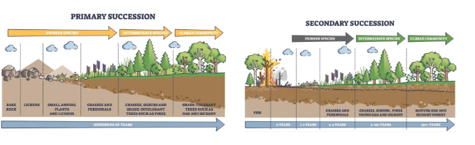
Ecological Succession
Ecological succession is the process by which natural communities replace (or “succeed”) one another over time.

Slide 27
Feedback Loops & Equilibrium States
Feedback loops — where a change in one part of a system loops back — are fundamental to ecological dynamics.
Negative Feedback
(stabilizing)
Positive Feedback
(amplifying)
Counteracts change — pushes system back toward equilibrium.
Example: more herbivores → less plant biomass → fewer herbivores.
Amplifies change — system moves further from original state.
Example: permafrost melts → CO₂ released → warming → more melt.
Disturbance & Recovery
Natural disturbances (fires, floods, storms) maintain biodiversity and reset succession
Resilience: ability to absorb disturbance and reorganise — determined by diversity, connectivity, redundancy
Adaptive capacity: species and ecosystems can shift traits and ranges in response to sustained change
Regime shifts: disturbance + feedback can push the system past a tipping point (e.g. clear lake → turbid)

Slide 28
Equilibrium States
Equilibrium States
Ecosystems fluctuate around stable points. Multiple stable states are possible — tipping points lead to regime shifts.
Disturbance & Recovery
Natural disturbances (fires, floods, storms) maintain biodiversity and reset succession
Resilience: ability to absorb disturbance and reorganise — determined by diversity, connectivity, redundancy
Adaptive capacity: species and ecosystems can shift traits and ranges in response to sustained change
Regime shifts: disturbance + feedback can push the system past a tipping point (e.g. clear lake → turbid)

Slide 29
5
Applications
& Challenges

Slide 30
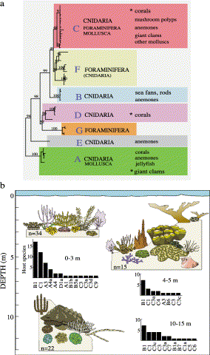
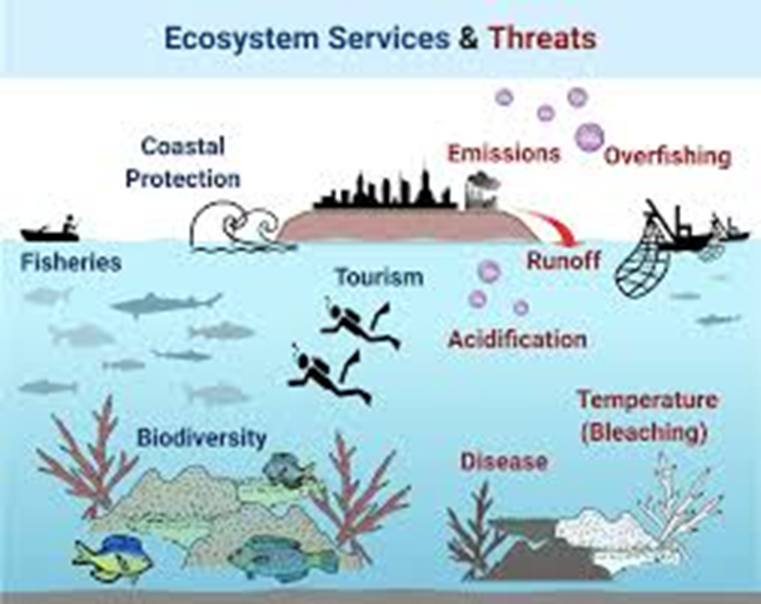
Application to Real Ecosystems
Marine / Coral Reefs
Runoff raises nutrients → algal growth exceeds fish grazing capacity → algal dominance smothers coral. Great Barrier Reef is a documented case.
In coral reef ecosystems, carrying capacity manifests through complex relationships between coral species, fish populations, and nutrient levels. When nutrient levels increase due to agricultural runoff or sewage discharge, algae growth can exceed the grazing capacity of herbivorous fish, leading to algal dominance that smothers coral.
The Great Barrier Reef demonstrates this dynamic, where areas affected by runoff from the Queensland coast show reduced biodiversity and ecosystem function compared to more pristine areas.
Lesser, M. P. (2004). Experimental biology of coral reef ecosystems. Journal of Experimental Marine Biology and Ecology, 300(1-2), 217-252.

Slide 31
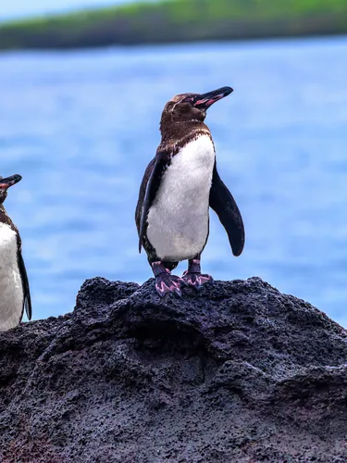
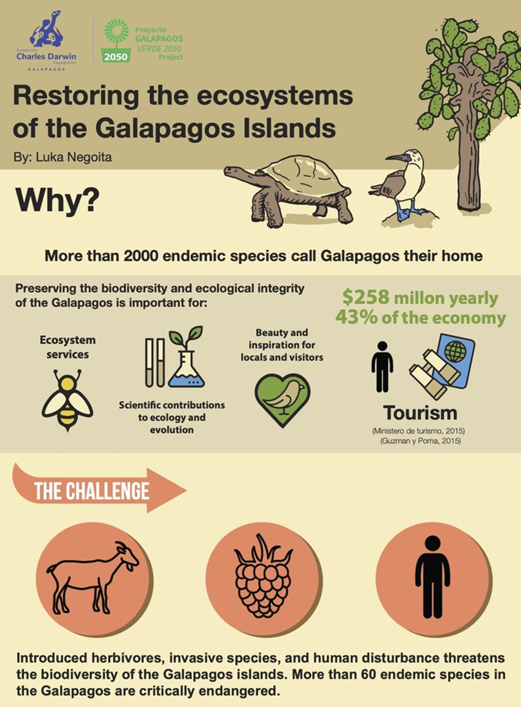
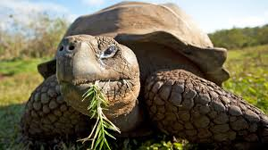
Application to Real Ecosystems
Island Ecosystems
Galápagos: introduced pigs, goats, and deer exceeded carrying capacity → erosion and native plant destruction. Active management required to restore balance.
Snell, H. M., Stone, P. A., & Snell, H. L. (1996). A summary of geographical characteristics of the Galapagos Islands. Journal of Biogeography, 23(5), 619-624.

Slide 32
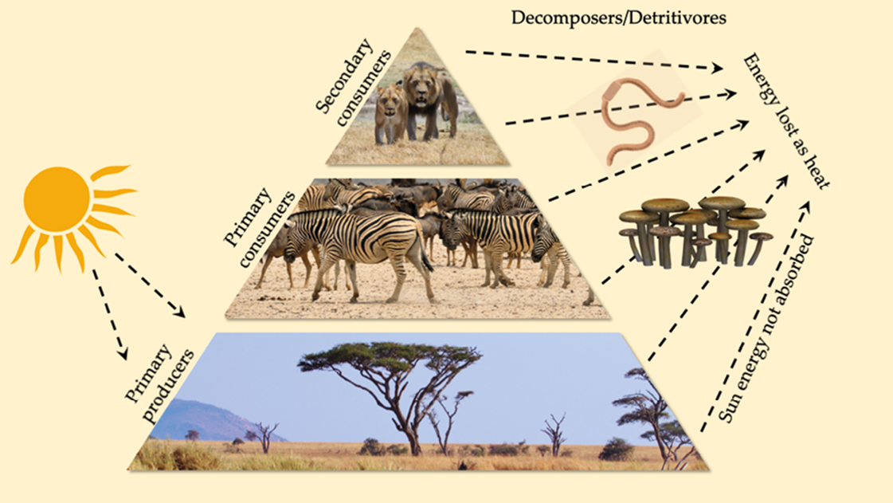
Application to Real Ecosystems
African Savanna
Grassland Ecosystems
The African savanna illustrates carrying capacity through the relationship between grazing animals and vegetation. During the rainy season, plant growth increases carrying capacity, supporting larger herbivore populations. In the dry season, reduced vegetation forces migration or population reduction.
The Serengeti ecosystem maintains balance through seasonal migrations of wildebeest and zebra that follow rainfall patterns, preventing overgrazing in any single location.
Rainy season raises carrying capacity; dry season forces migration. Serengeti wildebeest follow rainfall — preventing overgrazing in any single location.

Slide 33
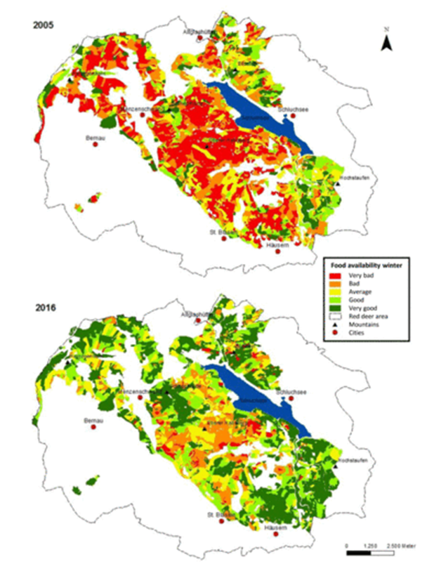
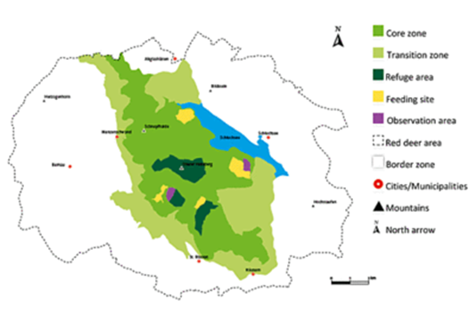
Application to Real Ecosystems
IIn temperate forests like Germany's Black Forest, carrying capacity for deer is actively managed through hunting quotas.
Without natural predators, deer populations can exceed carrying capacity, resulting in overgrazing of seedlings that prevents forest regeneration. Forestry management considers both timber production and wildlife populations to maintain ecosystem health.
Temperate Forests
Germany's Black Forest: deer exceed K without predators → seedling overgrazing prevents regeneration. Hunting quotas set using carrying-capacity models.

Slide 34
Challenges in Ecological Modeling
1
Data Limitations
Field data are often sparse, incomplete, or biased. Long time series are rare. Missing data must be handled carefully.
2
Scale Mismatches
Data collected at one scale must inform models at another. Mismatch between data resolution, model resolution, and management needs is pervasive.
3
Emergent Properties
Complex behaviours arise from simple rules in ways that are difficult to anticipate. Agent-based models can capture emergence at high computational cost.
4
Computational Constraints
High-dimensional parameter spaces, long simulation times, and stochastic models requiring many replicates create practical limits on model complexity.
5
Parameter Uncertainty
Ecological parameters vary in space, time, and across individuals. Sensitivity analysis and Bayesian approaches can quantify and propagate uncertainty.

Slide 35
Future Directions in Ecological Modeling
Data Science & ML
Citizen Science
iNaturalist, eBird, GBIF — crowdsourced observations expand data globally. Real-time biodiversity monitoring at unprecedented scale.
Big data and ML identify patterns traditional approaches miss. Deep learning for species ID. Hybrid mechanistic–ML models emerging.
Integration
Visualisation & Tools
Combining population, community, and ecosystem processes into unified frameworks. Coupled social-ecological models for the Anthropocene.
Interactive tools for stakeholders to explore model behaviour. Open-source platforms, real-time dashboards for conservation decision support.

Slide 36
Resources & Career Paths
Software Tools
Learning Resources
Career Paths
R: vegan, unmarked, raster, lme4, MuMIn
Python: scipy, statsmodels, scikit-bio
NetLogo: agent-based modelling (free)
MATLAB / Simulink: system dynamics
QGIS + R: spatial ecological analysis
ESA (Ecological Society of America)
Software Carpentry workshops
edX / Coursera ecology courses
GitHub: open-source model repositories
A Practical Guide to Ecological Modeling
Academic research — universities, institutes
Conservation organisations (WWF, TNC, WCS)
Environmental consulting firms
Government agencies (EPA, national parks)
Conservation technology start-ups

Slide 37
Exercise - Ecological research
Work in teams of 2–3 students · Select an ecological environment that interests you.
GBIF
Global species occurrence data — millions of observations, open access. Essential for distribution models.
gbif.org
European Environment Agency
Comprehensive ecological data for Europe, relevant to Israel and Mediterranean contexts.
eea.europa.eu
Israel Open Data
Israeli government data: air quality, water quality, biodiversity indices. Also: המשרד להגנת הסביבה.
data.gov.il
https://docs.google.com/document/d/1U7Gd7F5geYKFgq7EoOx9pk9AXeZpqNZ9/edit?usp=drive_link&ouid=118157260584278498099&rtpof=true&sd=true

Slide 38
References & Further Reading
Key Texts
Online Resources
Soetaert, K. & Herman, P.M.J. (2009). A Practical Guide to Ecological Modelling. Springer.
Otto, S.P. & Day, T. (2007). A Biologist's Guide to Mathematical Modeling. Princeton UP.
Gotelli, N.J. & Ellison, A.M. (2004). A Primer of Ecological Statistics. Sinauer.
Grimm, V. & Railsback, S.F. (2005). Individual-based Modeling and Ecology. Princeton UP.
Levins, R. (1966). The strategy of model building in population biology. American Scientist 54.
GBIF — gbif.org (global biodiversity data)
EEA — eea.europa.eu (European environmental data)
Israel open data — data.gov.il
NetLogo models library — ccl.northwestern.edu
Software Carpentry — software-carpentry.org
Chapter ref: Jørgensen (2018) History of ecological modelling, in Ecological Model Types, Springer. · Futurecasting ecological research — rise of technoecology. ResearchGate #325027525.

Slide 39
Next Lecture:
Population Models
& Lotka-Volterra
Prepare: review differential equations and exponential vs. logistic growth before Lecture 2.

